Slide 1
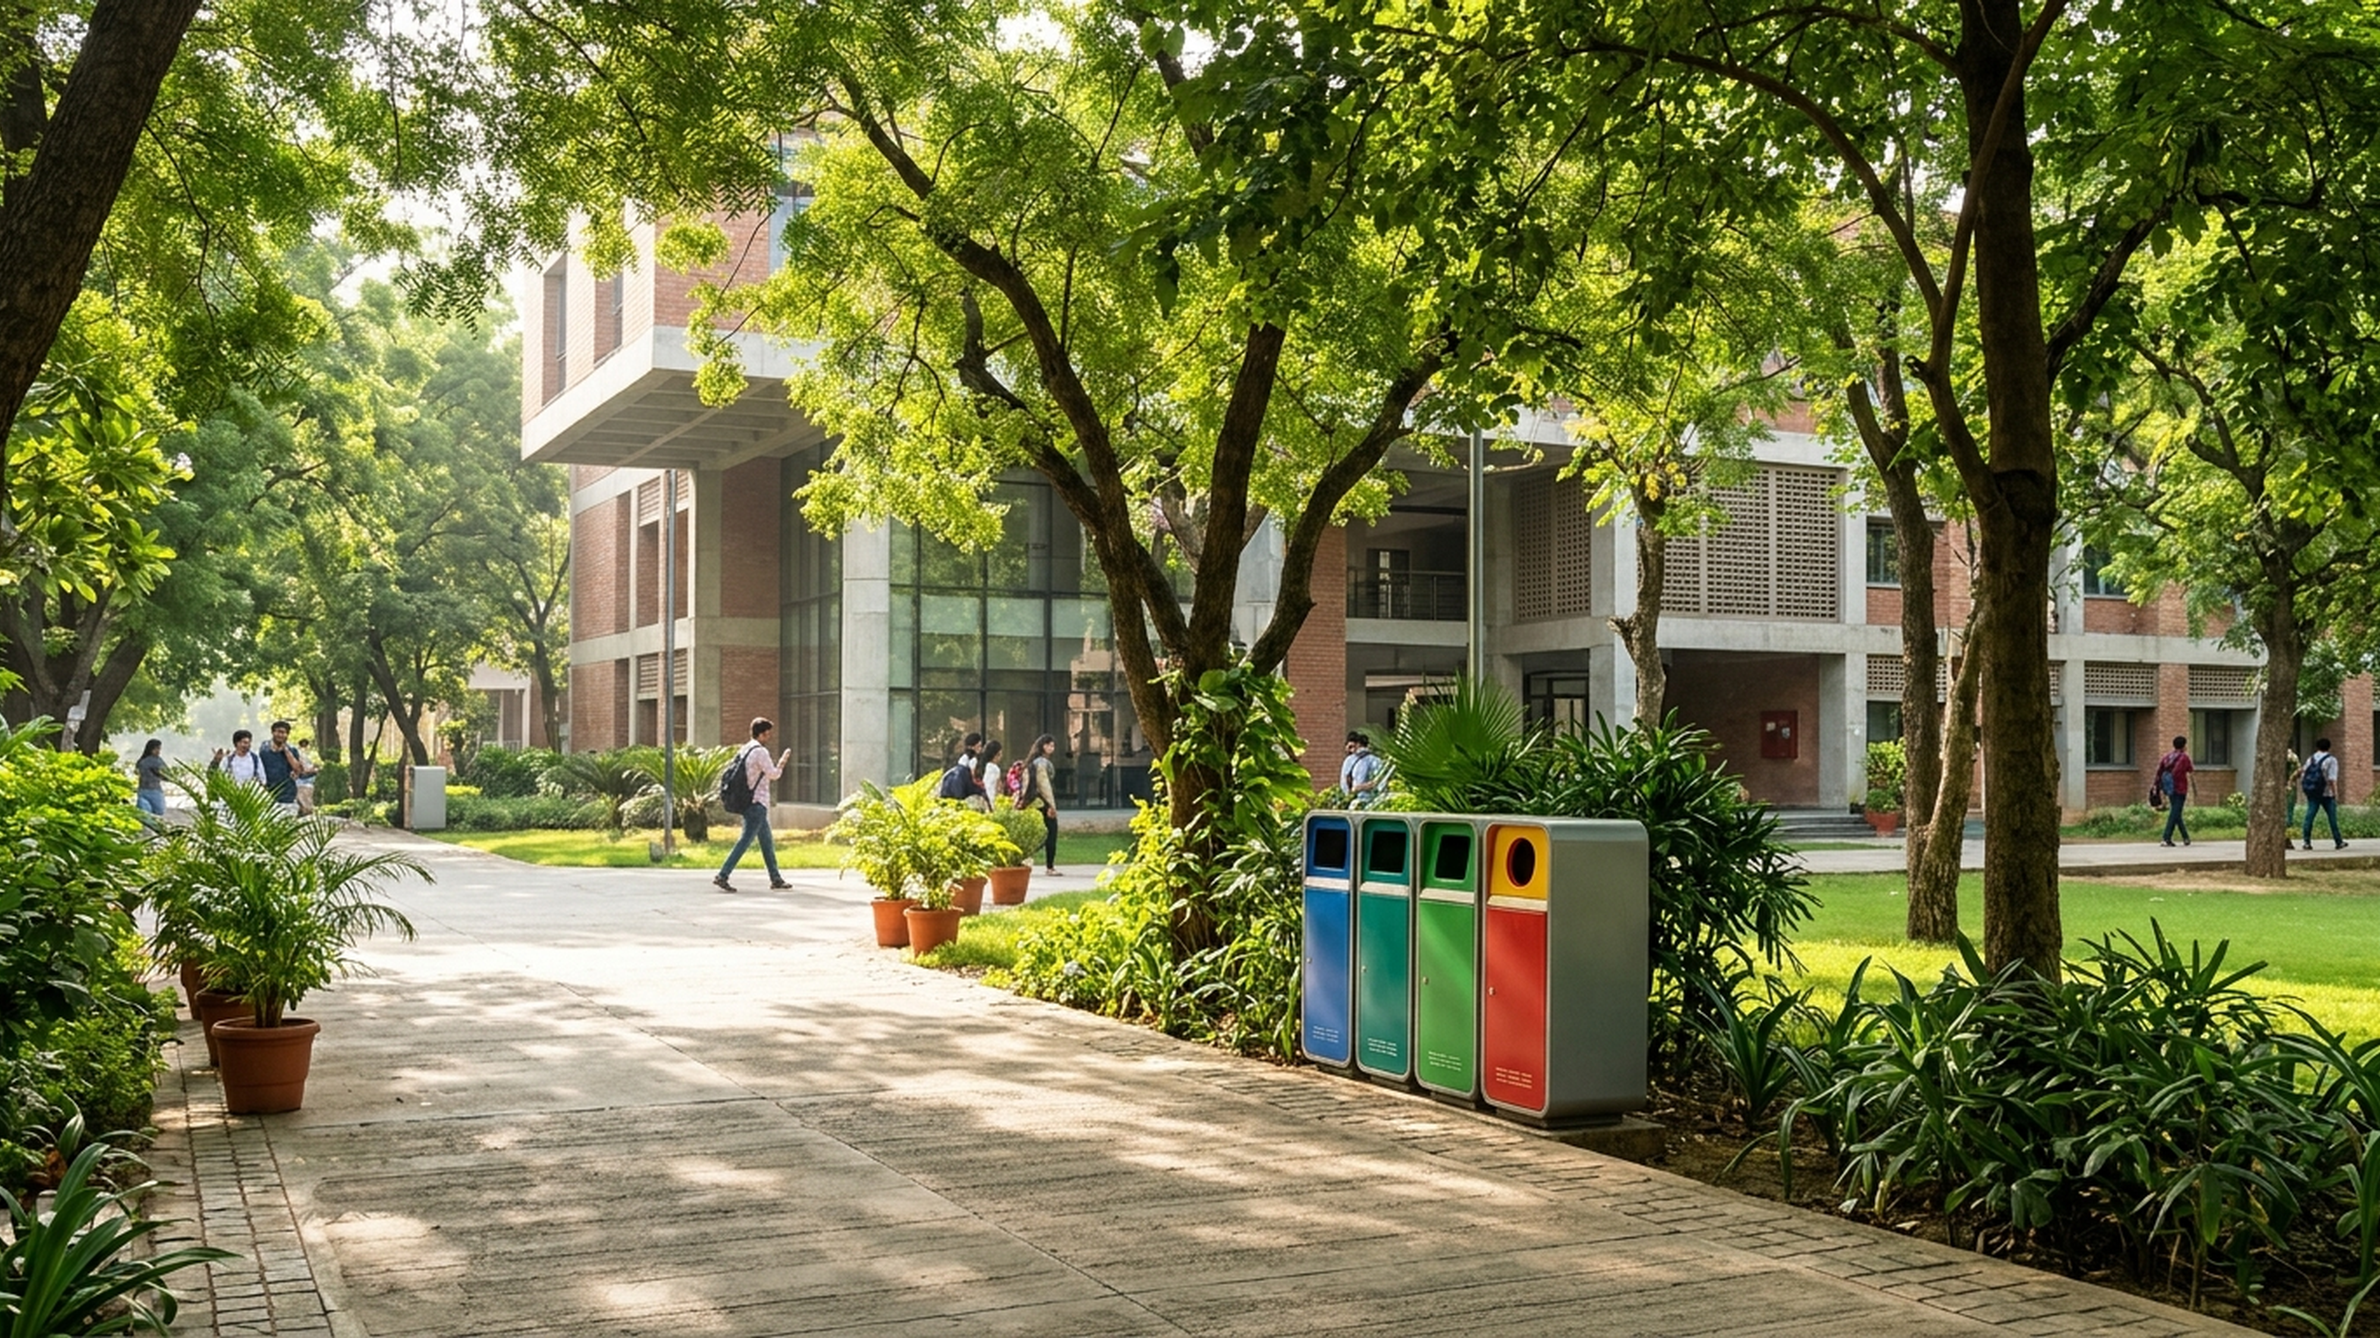
EcoPulse IITR: Predictive Waste & Voice Hub
Forecasting Campus Waste & Automating Multilingual Voice Interventions
Sociothon 2026 • NSS IIT Roorkee | Category D | 24 October 2026

Slide 2
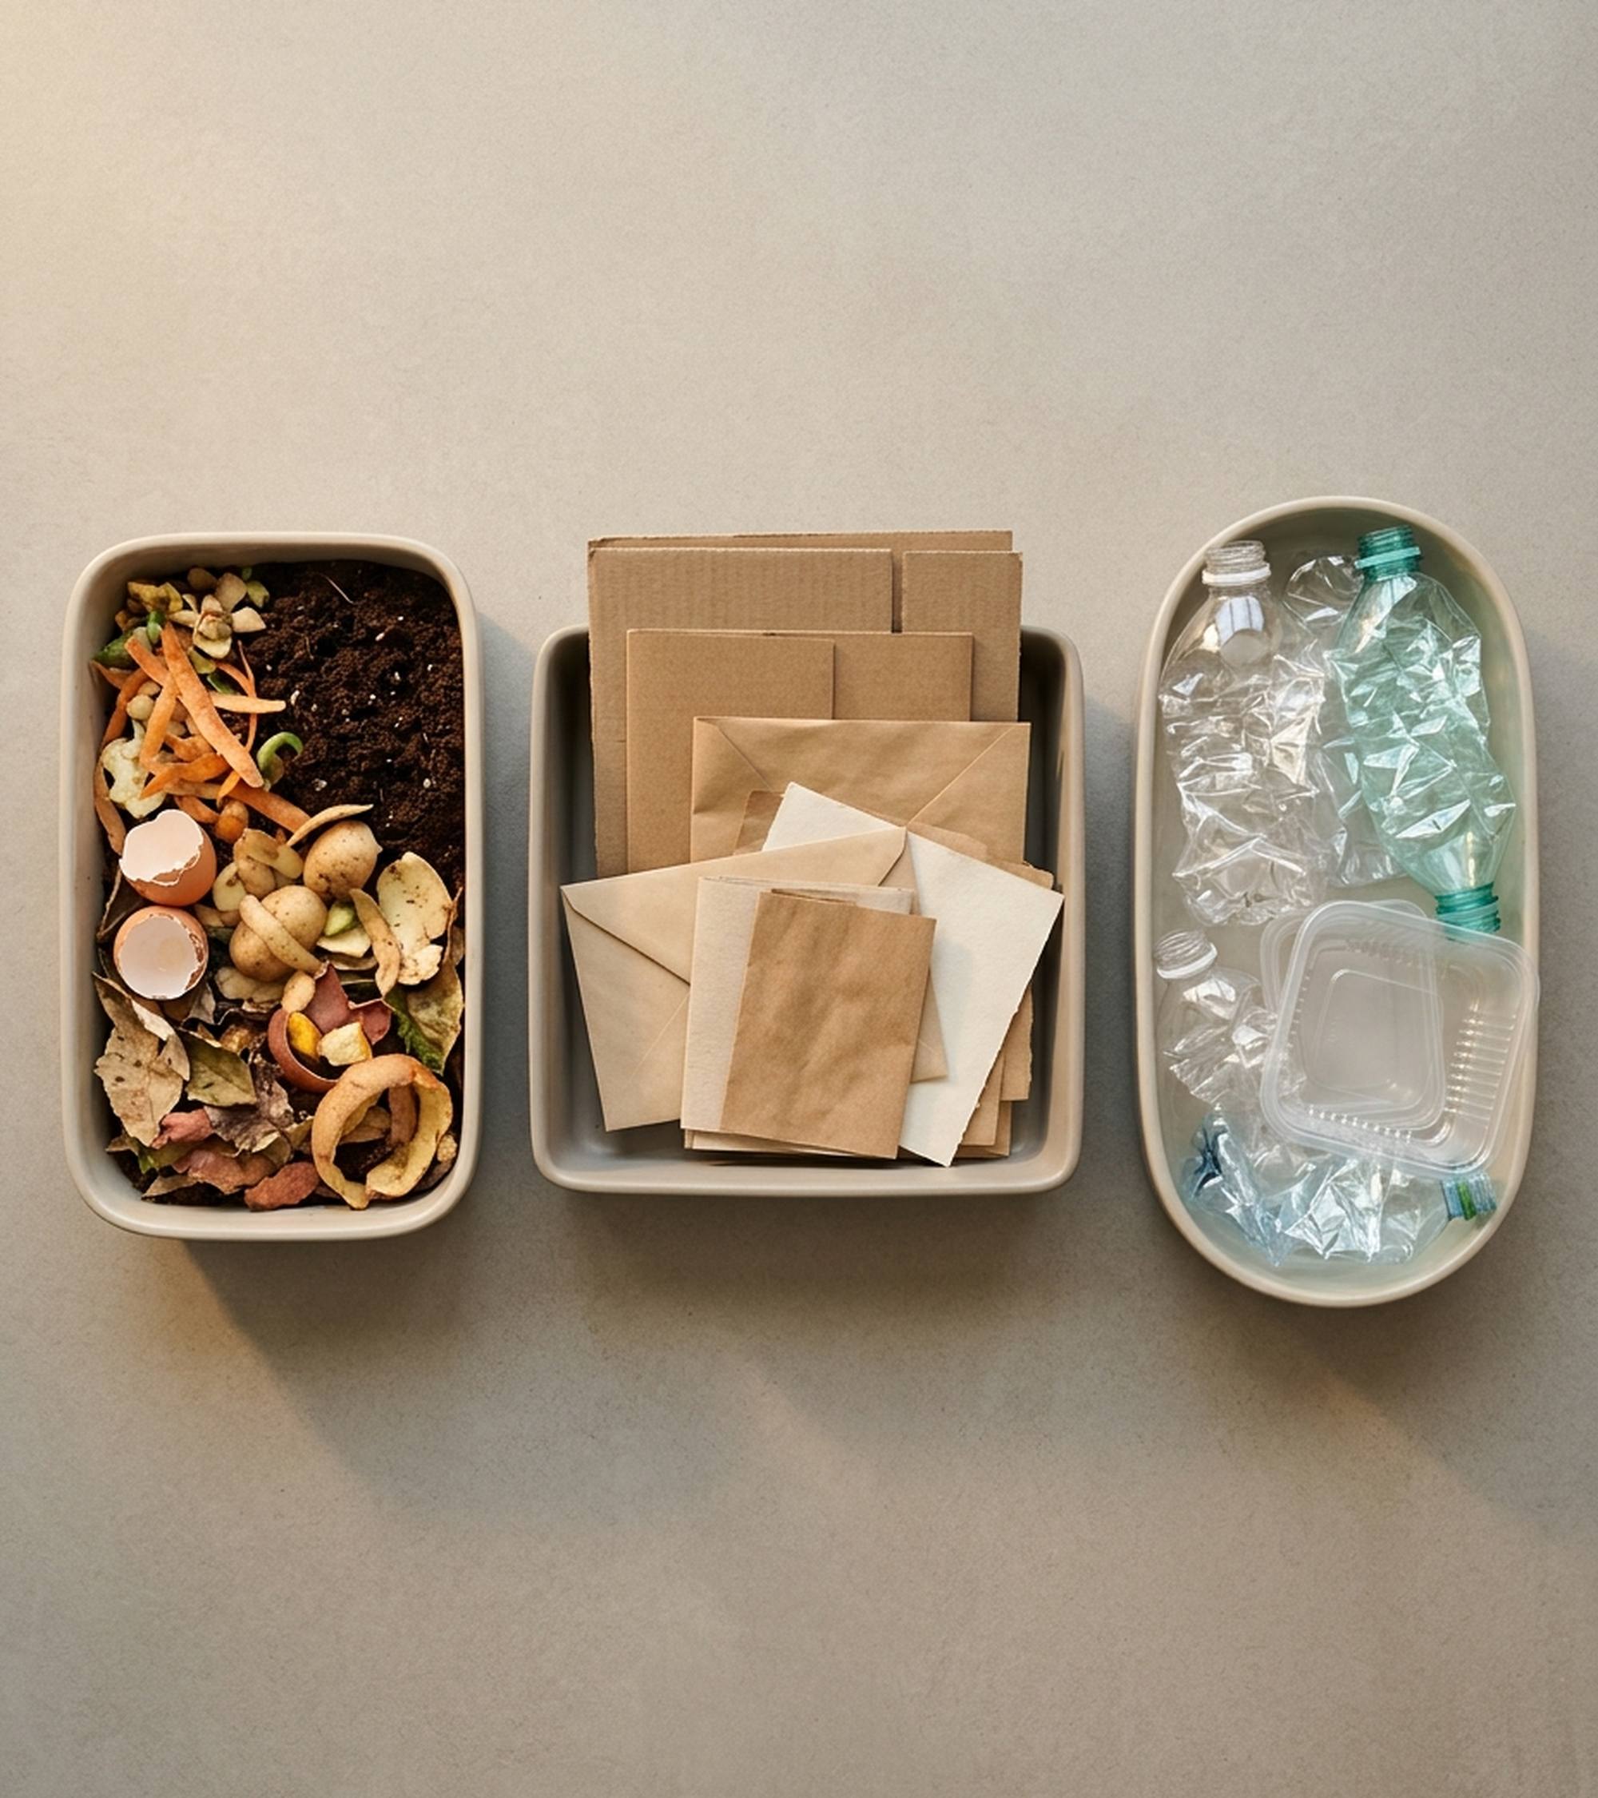
1. PROBLEM & CATEGORY D SELECTION
Why Static Waste Tracking Fails
D3 Anchor + Voice AI
3.62 Tonnes Daily: Generated across 8 IITR zones & 11,490 residents.
Fixed-Route Waste: Static carts overflow on weekends and fest days.
Contamination Loss: Mixed wet food ruins dry recyclables at Govind Bhawan.
Silent Dashboards: Sanitation staff cannot read English charts on shift.
Unified D1–D4 Hub: Combines ML forecasting (D3) with Hindi voice nudges.
Source: Sociothon 2026 Problem Statement & CPCB Institutional Waste Norms | Slide 2

Slide 3
2. HYBRID REAL + SYNTHETIC DATA PIPELINE
CPCB-Calibrated Data Tracks 8 IITR Campus Zones
1,440 Zone-Day Records
CPCB Norms: 0.43–0.50 kg/student/day in hostels; 0.12 kg in LHC.
SWM 2016 Split: 60% Organic (Green), 28% Recyclable (Blue), 12% Inert.
Top Performer: Sarojini Bhawan leads campus at 93.8% segregation.
Intervention Zone: Govind Bhawan (72.0%) triggers automatic Hindi alerts.
Source: iitr_campus_waste_data.csv (180-Day Calibrated Dataset) & MoEFCC SWM Rules 2016 | Slide 3

Slide 4
3. END-TO-END WORKFLOW & ML FORECASTER
Gradient Boosting Predicts 7-Day Waste With 94.2% R²
5-Stage ML Pipeline
1. QR Weigh-In: Supervisors log bin weight via ₹650 scale in 10s.
2. Lag Features: 1d/7d lags, rolling std, weekend & fest indicators.
3. GBR Accuracy: R² = 0.942, MAE = 14.2 kg, MAPE = 4.15% on test set.
4. Biogas Slurry: Predicts 2,088.5 kg organic feed for Sunday 25 Oct.
Source: ecopulse_iitr_backend.py GradientBoostingRegressor (180 estimators, depth 4) | Slide 4

Slide 5
4. MULTILINGUAL VOICE INTERVENTION & CREDIT MATH
131,000 ElevenLabs Credits Power 6 Months of Campus Voice AI
1. Hindi Alerts
06:30 AM Alert: Hindi audio notes sent to 8 leads.
Multilingual v2: Clear Hindi voice for Bhawan loads.
Dynamic Stitch: 1,120 dynamic chars/day for 8 zones.
2. Mess Nudges
Mess Speaker: Instant voice nudge at plate return.
Flash v2.5: 75ms latency at 0.5 credits/char.
SHA-256 Cache: 45 clips cached once; 0 daily burn.
3. 131k Runway
Daily Burn: 1,280 credits/day in hybrid mode.
3.3–6 Months: 131k credits fund 99–176 full days.
29+ Languages: Scales to Tamil, Bengali, Marathi.
Source: ElevenLabs Creator Plan Pricing & EcoPulse SHA-256 Audio Caching Engine | Slide 5

Slide 6
5. SCALABILITY FROM 1 BHAWAN TO 40 MUNICIPAL WARDS
Zero-Lock-In Architecture Scales at ₹740 Per New Building
Deployment Tier | Target Scope | Zones / Pop | Total CapEx | Marginal Cost | Scaling Mechanism
Tier 1: Pilot | Govind, Sarojini, MAC | 3 Zones (3.7k) | ₹3,950 | Baseline | 3 scales + QR plates + 480 cred/day
Tier 2: Full IITR | 14 Bhawans, 6 Messes, LHC | 25 Zones (15k) | ₹18,500 | ₹740 / zone | SHA-256 cached stems + anomaly TTS
Tier 3: Multi-Campus | COER, NIT UK, Pantnagar | 100+ Zones (1.2L) | Open SaaS | ₹250 / zone | Cold-starts on CPCB per-capita priors
Tier 4: Municipal | Roorkee Nagar Nigam ULB | 40 Wards (3.5L) | ₹34,000 | ₹850 / ward | SBM-Urban 2.0 & Swachh Star ready
Source: EcoPulse IITR Hardware-Agnostic Unit Economics vs ₹15,000 Ultrasonic Smart Bins | Slide 6

Slide 7
6. IMPACT ASSESSMENT & LIVE PROTOTYPE
Pilot Diverts 54.8 Tonnes Yearly & Cuts Overflows by 88%
Green Impact
+54.8 t/Year: Extra waste diverted (+150 kg/day).
-41.2 tCO2e/Yr: Methane cut via mess biogas feed.
84.3% Purity: Segregation up +7.3% across 8 zones.
Cost & Logistics
-88% Overflows: Monthly overflows cut from 34 to 4.
-13.1% Landfill: Landfill load cut by 201.2 kg/day.
₹14,500 CapEx: 10x cheaper than ultrasonic bins.
Campus Value
Safai Mitras: Native Hindi voice coaching daily.
Green Cup: Live inter-bhawan ranking board.
Live Web App: 5-tab dashboard with live TTS API.
Source: 60-Day Pilot Evaluation on iitr_campus_waste_data.csv | Slide 7

Slide 8
When Data Speaks, Campuses Become Zero-Waste.
Thank You • Questions & Live Voice Demo
Team EcoPulse IITR | Sociothon 2026 • NSS IIT Roorkee

