Slide 1

Retail sales & promotions
Group 10:
SACCHIT SHAH
ANUJ GOPANWAR
SIDDHANT DHATRAK
YASH DESHPANDE
1

Slide 2
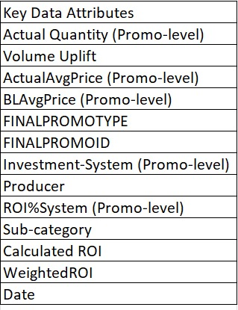
DATASET
The dataset titled "Retail Sales and Promotion ROI" is a comprehensive collection of retail performance metrics such as sales quantities, average prices, and return on investment for promotional activities.
The dataset comprises data spanning four years, ranging from 2012 to 2015.
Dataset: 135k rows

Slide 3
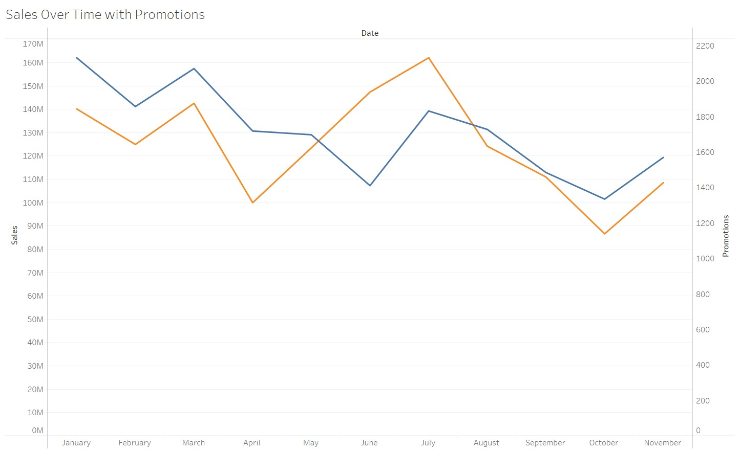

Sales over time with promotions
There's an inverse relationship between sales and promotions.
This suggests a strategy of using promotions to boost lower sales periods.

Slide 4
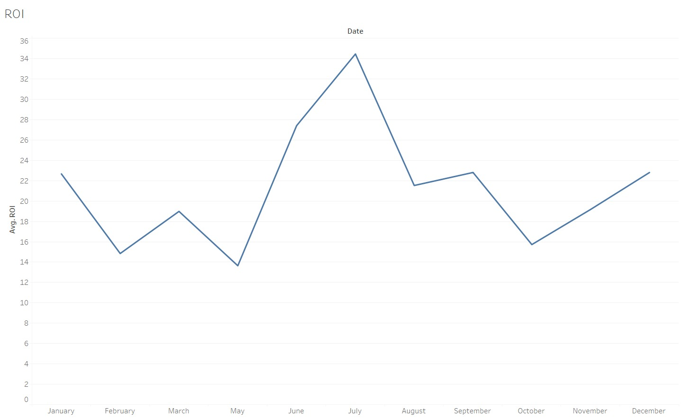
ROI
A prominent peak around June suggests a highly successful period for investments, likely due to seasonal campaigns or effective marketing strategies.
Lowest points in February and August indicate periods of diminished returns on investments, possibly attributed to off-peak sales or less effective promotions.

Slide 5
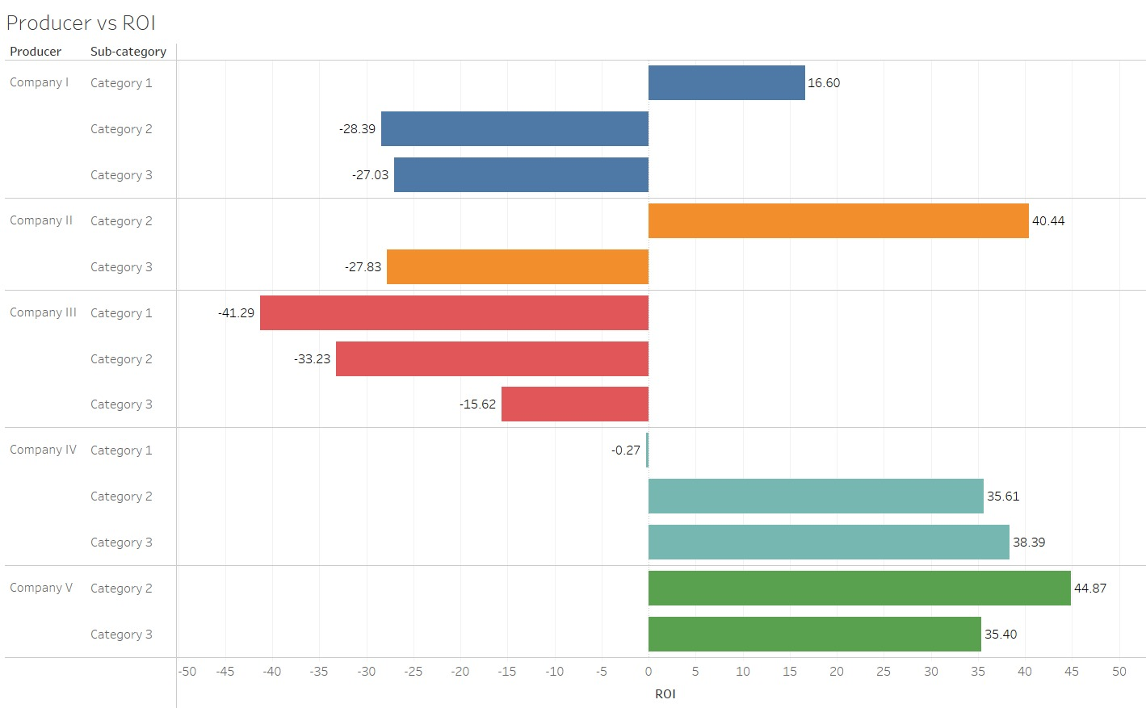
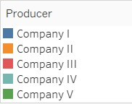
Producer v/s ROI
Companies IV and V display consistently positive ROIs across all categories, with Company V leading in Category 3 at 44.87%.
Conversely, Companies I, II, and III show negative ROIs in multiple categories.
Companies IV and V likely employ more effective strategies or hold stronger market positions in these product categories compared to others.

Slide 6
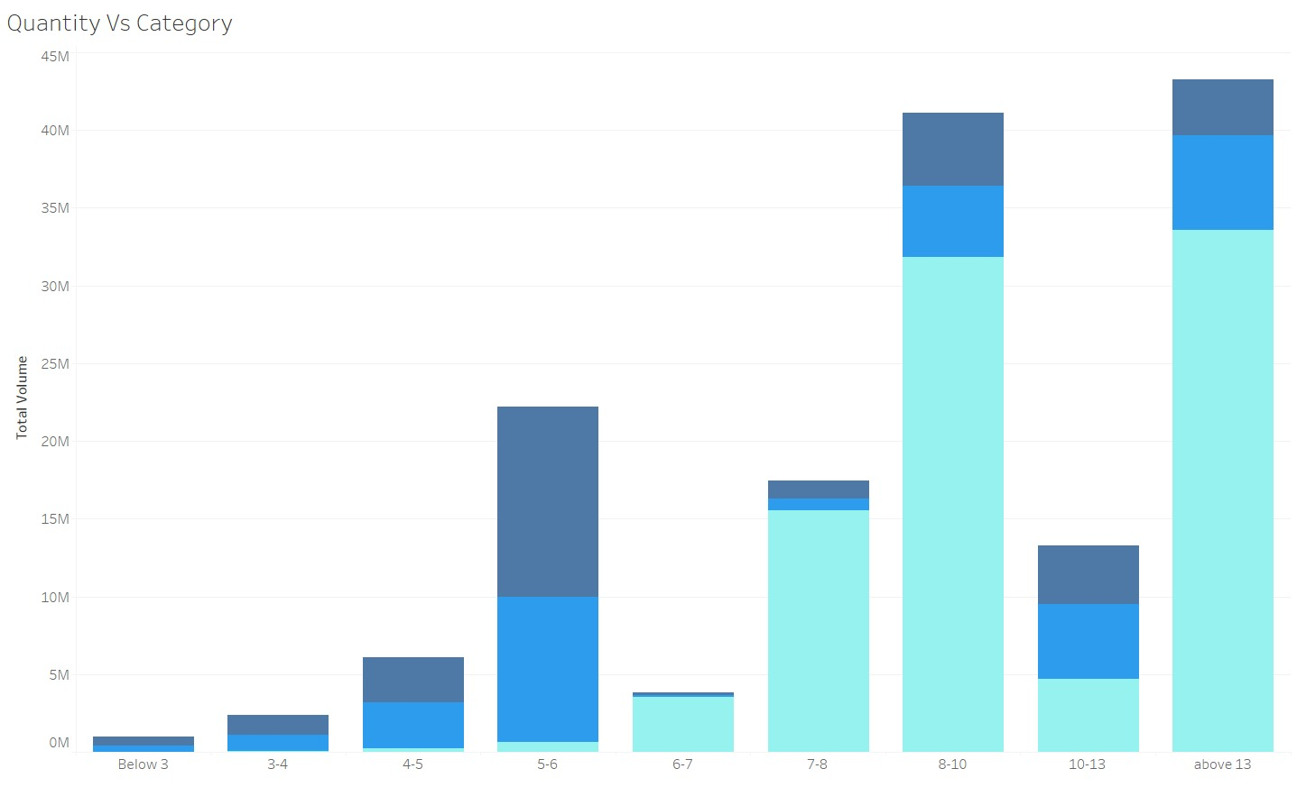

Quantity v/s PRICE
The chart represents total sales volume distributed across different product categories, categorized by ranges (price brackets).
"8-10" and "above 13" categories demonstrate the highest total volumes, with "above 13" being the most significant, suggesting these ranges contain the best-selling or most popular products.
The considerable variance between categories emphasizes the importance of focusing on high-volume ranges for sales strategies and possibly reassessing approaches for categories with lower volumes.
Average Price

Slide 7
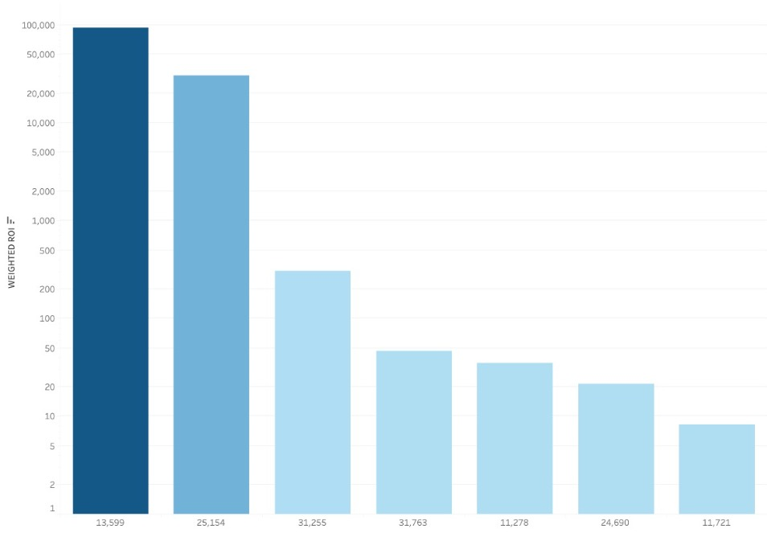
TOP 7 PROMOTIONS
Promotion "13,599" stands out with the highest ROI, significantly surpassing others, showcasing a highly successful campaign compared to the rest.
The remaining promotions show a gradual decline in ROI, with "11,721" ranking lowest among the selected top 7.
Promotion ID

Slide 8
Insights
July has the highest ROI in the year.
There is variability in the ROI over the year emphasizing the necessity for tailored approaches throughout the year to optimize ROI.
Average price range from 8-10 and above has the maximum sales.
Companies IV and V are the most profitable.

Slide 9
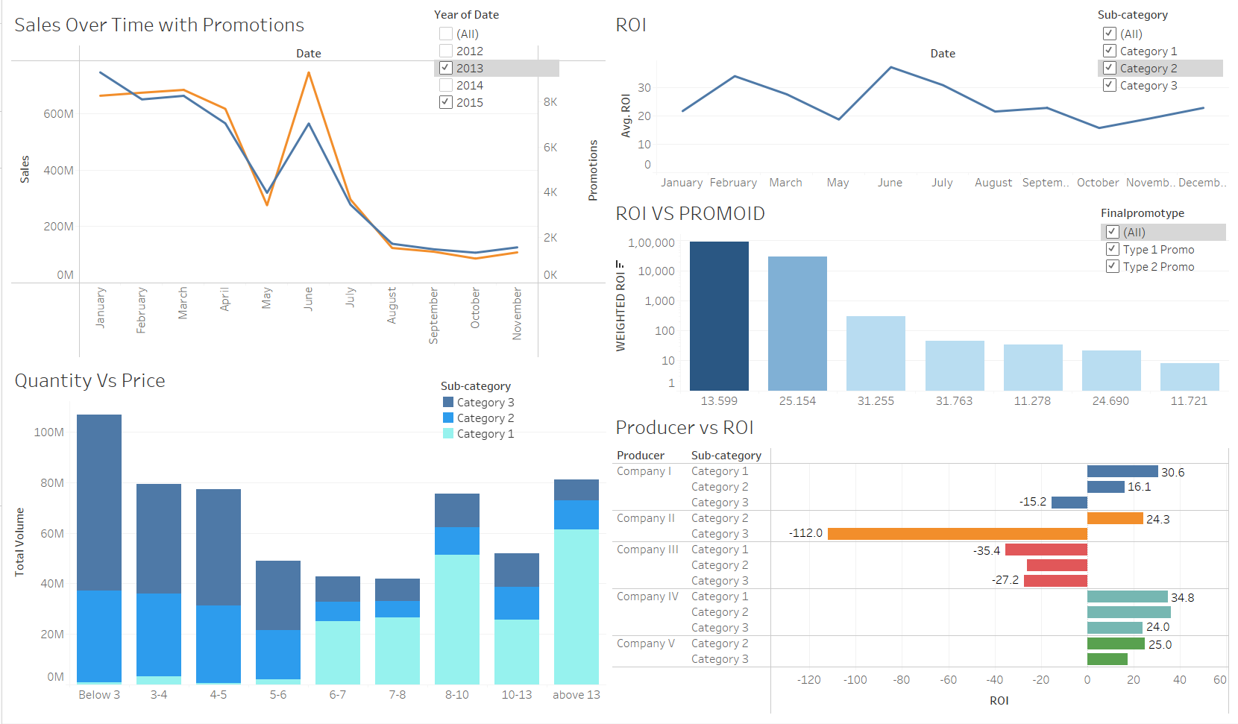

Slide 10
DASHBOARD

Slide 11

Thank You

