Slide 1
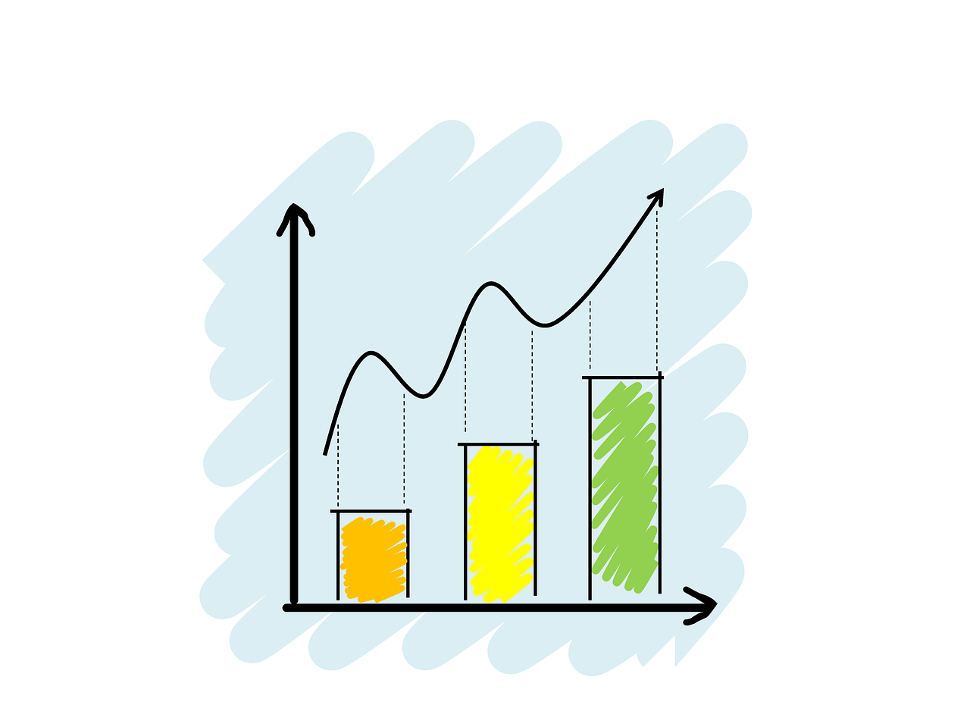
HEART DISEASE AND RISK PREDICTION USING MACHINE LEARNING ALGORITHMS
Submitted by
ANUJ ANANDAKUMAR
1001746608 Project Advisor
(12/15/2020) Dr Shoyui Wang

Slide 2
INTRODUCTION
Heart disease, also known as cardiovascular disease, encases various conditions that impact the heart and is the primary basis of death worldwide over the past few decades.
This research presents various factors related to cardiovascular disease, and the model on basis of supervised learning algorithms as Logistic regression, decision tree, K-nearest neighbor, and random forest algorithm.
The accuracy proposed by different techniques varies with list of attributes.
This research provides diagnostic accuracy score for improvement of better health results.

Slide 3
Attributes
sex: male or female (Nominal)
age: age of the patient (Continuous )
currentSmoker: patient is a current smoker in that zone (Nominal)
cigsPerDay: the number of cigarettes that the person smokes on average in one day.(continious)
BPMeds: whether patient was on blood pressure medication (Nominal)
prevalentStroke: whether patient had previously had a stroke (Nominal)
prevalentHyp: whether patient was hypertensive (Nominal)
diabetes: whether patient had diabetes (Nominal)

Slide 4
Attributes(contd)
totChol: total cholesterol level (Continuous)
sysBP: systolic blood pressure (Continuous)
diaBP: diastolic blood pressure (Continuous)
BMI: Body Mass Index (Continuous)
heartRate: heart rate (Continuous )
glucose: glucose level (Continuous)
10-year risk of coronary heart disease CHD (binary: “1” means “Yes”, “0” means “No”) - Target Variable

Slide 5
Objective
Predict the probability of a patient suffering a coronary heart disease in the next 10 years
Identify the most important factors that influence for this cardiovascular disease
Come up with recommendations for
a. Preventing / reducing chances of getting the disease
b. Extrapolated applications of the model we build and its results.

Slide 6
Pre-Processing
Cleaning of Data:
We create box plot to find the percentage of outliers
We here understand the frequency distribution for various attributes using Histogram
Exploratory Data Analysis Findings
Data Insights:
1. Data is unbalanced overall.
2. Education level does not seem to be related to the heart disease risk.
3. Systolic BP & Diastolic BP are highly correlated to each other.

Slide 7
Feature Selection
There are three benefits of performing feature selection before modeling your data are:
It reduces Overfitting.
It improves the Accuracy.
It reduces the training time.

Slide 8
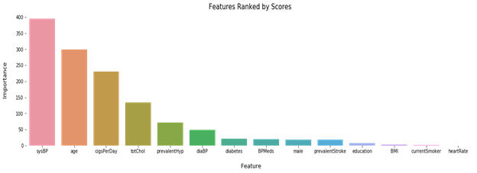

Slide 9
Model BUILDING
Logistic Regression
Support Vector Machines
Decision Tree
K-Nearest Neighbour
Random Forests
Gradient Boosting

Slide 10
64%
65.4%
72.2%
Logistic regression
Support Vector Machines
Decesion Tree
.
A 64% accuracy, 31% F1 Score and AUC of 62% are observed which are not up to the mark
A 65.4% accuracy, 32.5% F1 Score and AUC of 67% are observed which are not up to the mark
A 72.2% accuracy, 24.4% F1 Score and AUC of 55.7% are observed which are really appreciated.

Slide 11
66.3%
75.1%
73.6%
K-nearest Neighbour
Random Forests
Gradient Boosting
.
A 66.3% accuracy, 27.3% F1 Score and AUC of 57.9% are observed which are much better than LR and SVM
A 75.1% accuracy, 30% F1 Score and AUC of 60% are observed which are much better than LR and SVM and is the current best
A 73.6% accuracy, 32.7% F1 Score and AUC of 62.5% are observed which can said as 2nd best,

Slide 12
Hyperparameter tuning for best classifier
Choosing appropriate hyperparameters plays a crucial role in the success of our neural network architecture.
Since it makes a huge impact on the learned model. For example, if the learning rate is too low, the model will miss the important patterns in the data. If it is high, it may have collisions.
Efficiently search the space of possible hyperparameters
Easy to manage a large set of experiments for hyperparameter tuning

Slide 13
Random Forests
78.9%
Hyper Parameter Tuning
Gradient Boosting
75.1%

Slide 14
Conclusion
The 2 factors that we can control in our lifestyle are:
Systolic Blood Pressure is one of the most important factor to determine risk of cardiovascular disease. So keeping BP in control is essential.
The number of cigarettes we smoke also have a massive Impact with the Heart disease which ultimately proves smoking kills.
The factor which is not in control with human hands is Age, so exercise regularly, do Yoga and Practice a healthy lifestyle.

Slide 15
Conclusion(contd)
Findings from the Data:
The data is highly unbalanced
The gradient boosting showed the highest accuracy of almost 82%. We can use this model many health organization such as hospitals.
The support vector machine had a high accuracy in terms of F1 score, precision and Recall scores. So if any information needed to be predicted based on population, age, demographic SVM can be used.

Slide 16
Acknowledgement
A special gratitude I give to(IE 6318) Professor Dr Shoyui Wang, whose contribution in stimulating suggestions and encouragement, helped me to coordinate my project especially in doing my analysis work.
I would also like to thank my Teaching Assistant Bahareh Nasirian for wonderful guidance throughout my course work

Slide 17
Reference
Alberto, Túlio C, Johannes V Lochter, and Tiago A Almeida. "Tubespam: comment spam filtering on YouTube." In Machine Learning and Applications (Icmla), Ieee 14th International Conference on, 138–43. IEEE. (2015).
"Definition of Algorithm." https://www.merriam-webster.com/dictionary/algorithm. (2017).
https://towardsdatascience.com/all-machine-learning-models-explained-in-6-minutes-9fe30ff6776a
https://www.geeksforgeeks.org/machine-learning/
https://www.kaggle.com/datasets?utm_medium=paid&utm_source=google.com+search&utm_campaign=datasets&gclid=CjwKCAiAq8f-BRBtEiwAGr3DgQpfwSuALLK4C6bRPCtbzrdridTANu5AtgdmVqf4FBijHLSyj11NeRoC2_8QAvD_BwE

