Slide 1

Depression Detection from Social Media
with Sarcasm Awareness
Advanced NLP Final Project
by
Anuj Prakash

Slide 2
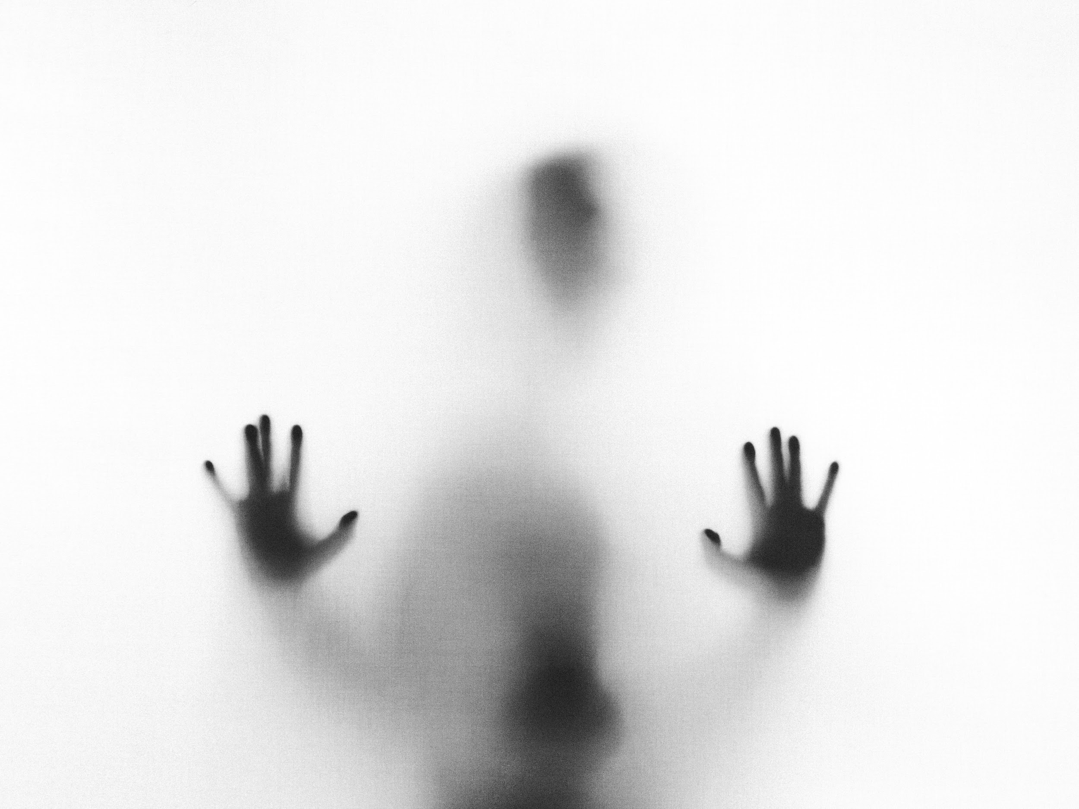
Project Introduction & Goal
Social media platforms like Reddit often contain early linguistic signals of depression.
Sarcasm and irony can confuse standard depression detection models.
Goal: Build an NLP system that detects depressive language and accounts for sarcasm to make predictions more reliable and interpretable.

Slide 3
Motivation & Real-World Impact
Supports large-scale mental health research by analyzing linguistic patterns in social media text.
Improves reliability of depression detection models by explicitly handling sarcasm which is a known NLP challenge.
Useful for research teams and platform analysts studying emotional trends, not for clinical diagnosis.

Slide 4
Model Architecture & Error-Aware Design
Text Preprocessing
Depression Classifier (DistilBERT)
Error Analysis
Sarcasm Classifier (DistilBERT)
Interpretation Layer (Logic on Top of Both Models)
- High depression, low sarcasm → likely genuine distress
- High depression, high sarcasm → “depressed but sarcastic” → treat with caution
- Non-depressed, high sarcasm → likely joking/ironic

Slide 5
Model Performance & Key Insights
Depression Model (DistilBERT)
    Accuracy ≈ 98%
    Macro F1 ≈ 0.98
Key Insight from Error Analysis
    Only ~29 misclassified samples
    Many errors involved sarcastic or ironic language
Sarcasm Model (DistilBERT)
    Accuracy ≈ 78%
    Macro F1 ≈ 0.78
Design Outcome
    Added sarcasm detection to flag unreliable predictions instead of hiding them

Slide 6
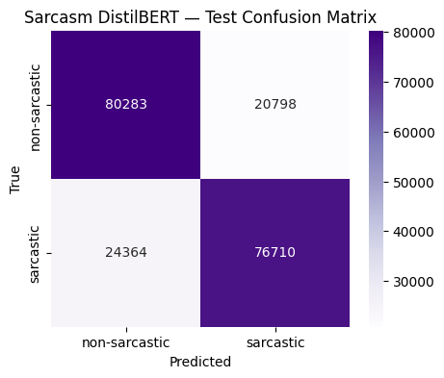
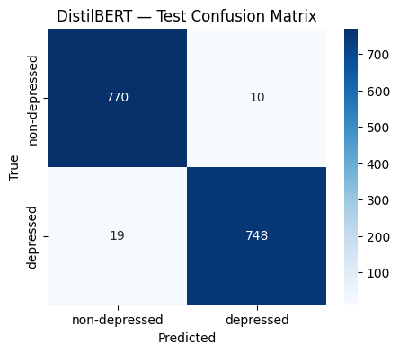
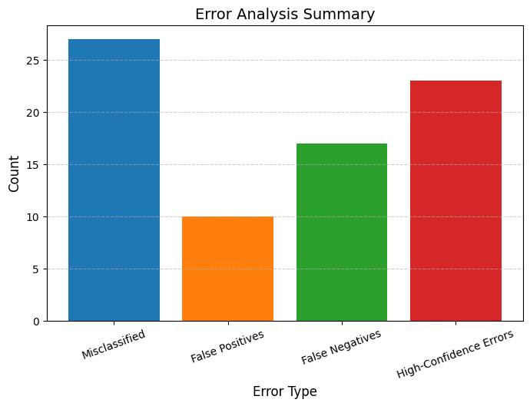
Model Performance & Key Insights
Depression Confusion Matrix
Sarcasm Confusion Matrix
Bar Graph for error analysis

Slide 7
Demo & Output
Gradio-based interactive demo
Shows predictions + confidence scores
Flags unreliable predictions due to sarcasm

Slide 8
Future Work & Improvements
Model-Level:
Multi-task learning for joint depression + sarcasm detection
Use RoBERTa/BERT-large for better sarcasm representation
Application-Level:
Add emotion and stress-level detection
Track user sentiment change over time
Research-Level:
Explore explainability (SHAP, attention heatmaps)

Slide 9
Thank you!
Any questions?

