Slide 1
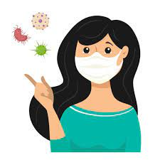
Face Mask Detection & Alert System
Group-11

Slide 2
Team Members
M.Joshasree (19BCS069) P.Lalithaanjale(19BCS087) S.Pranay Sai Teja(19BCS102) M.Anupama(19BCS123)

Slide 3
Table of Contents
Motivation
Introduction
Objective
Requirements
Flow chart
Procedure
Simulation
Results
Scalability & Future scope
Conclusion

Slide 4
Motivation
Covid-19 pandemic is having devastating effects on societies and economies around the world. The increase in the number of COVID-19 tests gives more information about the epidemic spread, which may lead to the possibility of further infections. However, wearing a face mask that prevents the transmission of droplets in the air and maintaining an appropriate physical distance between people, and reducing close contact with each other can still be beneficial in combating this pandemic.

Slide 5
Introduction
According to the WHO’s official Situation Report – 205, coronavirus disease has started in 2019 and has globally infected over 20 million people causing over 0.7 million deaths.Our proposed solution verifies if the people wearing a mask or not. If there is any violation, then a message will be sent to concerned authorities. Also it detects the temperature after detecting the mask and opens the gate if temperature lies in the threshold limit.

Slide 6
Objective
The main objective of our project is to make people to wear mask when they are going to public areas by detecting the mask and the temperature of a person when he is entering into the shopping mall or college or any public areas and sending the information to the respective authority.So that, the spread of covid-19 will be controlled to maximum extent.

Slide 7
Requirements
Software requirements
Hardware requirements
Compim module

Slide 8

Software Requirements
Proteus 8 simulator
VSPE
Virtual serial port emulator
It help developers to create/debug/test applications that use serial ports.
The Proteus Design Suite is a proprietary software tool suite used primarily for electronic design automation

Slide 9
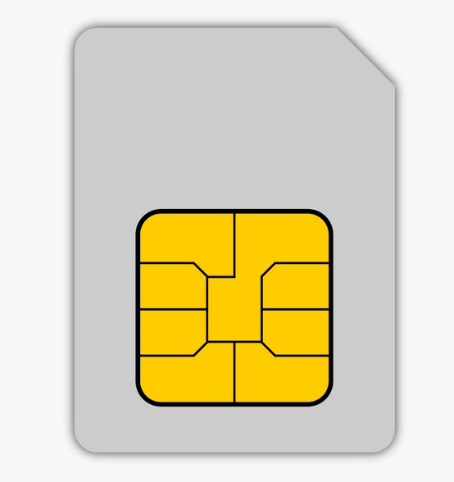
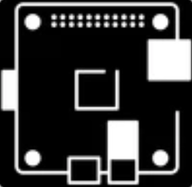
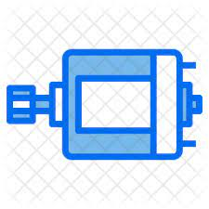
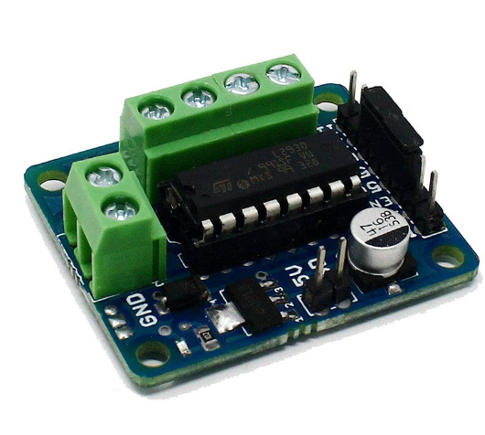
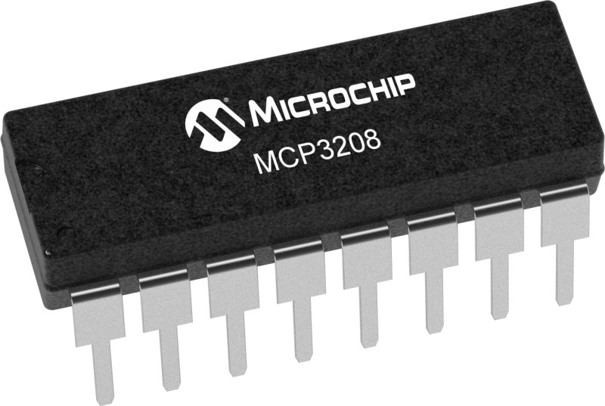
Hardware Requirements
Raspberry pi
Gsm sim900d
LCD
Raspberry pi is a tiny computer
Gsm sim is to send the message
Lcd is a flat panel display
MCP3208
Motor
L293D
It is a sensor to collect the temperature
Motor is to open the gate
It is a motor driver module

Slide 10
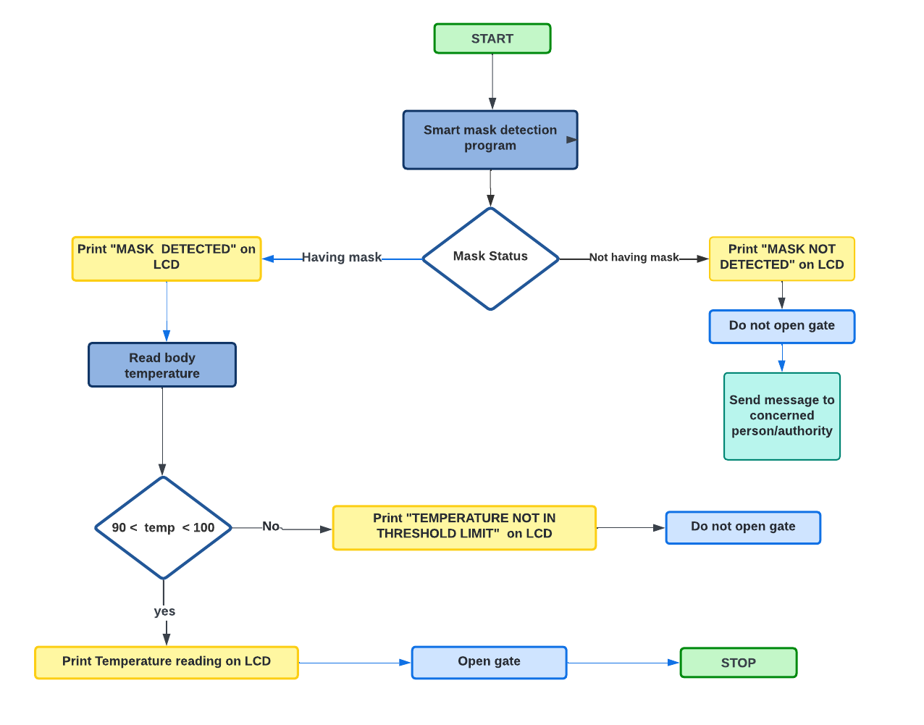
Flow chart

Slide 11
ML Model
Tensorflow : TensorFlow is a free and open-source software library for ML.In our ML model, the whole process uses TensorFlow at backend. It is also used to reshape the data (image) in the data processing.
Keras : Keras is an open-source software library that provides a Python interface for the TensorFlow library.It takes full advantage of the scalability and cross-platform capabilities of TensorFlow. It helps in the conversion of the class vector to the binary class matrix in data processing, and to compile the overall model.
Open CV : OpenCV is a cross-platform library using which we can develop real-time computer vision applications. It mainly focuses on image processing, video capture and analysis including features like face detection.
MobileNet : MobileNet is a type of convolutional neural network designed for mobile and embedded vision applications.They are based on a streamlined architecture that uses depth wise separable convolutions to build lightweight deep neural networks that can have low latency for mobile and embedded devices.

Slide 12
Data Description
Data collection : We have collected 2 datasets with mask and without mask from kaggle and few online resources .
Data Preprocessing : Data preprocessing involves conversion of data from a given format to much more user friendly, desired and meaningful format. The proposed method deals with image and video data using Numpy and OpenCV.
This involves
Data Visualization
Conversion of RGB image to Gray image
Image Reshaping

Slide 13
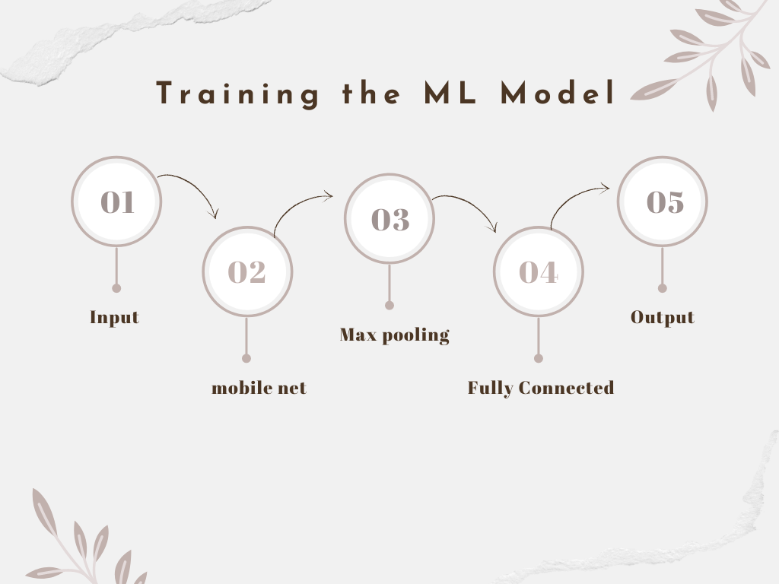
Load the face mask data set
a pooling operation that calculates the maximum, or largest, value in each patch of each feature map
Testing of mask detection
Convolution converts all the pixels in its receptive field into a single value
layers where all the inputs from one layer are connected to every activation unit of the next layer.

Slide 14
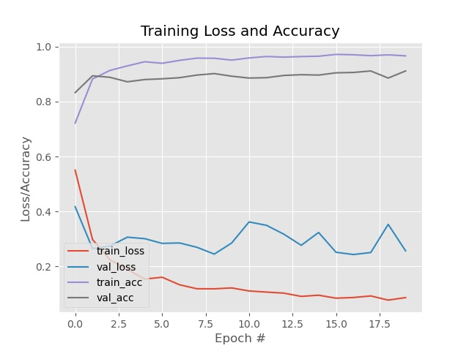
Accuracy Test
The accuracy of our training model is increasing gradually.
The loss is decreasing eventually .
So we get the good model

Slide 15
Working of GSM Module
A GSM 900D is a device or chip that is actually responsible for the wireless communication with the GSM Network. A GSM MODEM is device that modulates and demodulates the signals from the Wireless Network and allows internet connectivity.
Commands :
AT : for testing our GSM module
AT+CMGF=1 : converting our GSM module to text messages
AT+CMGS=”**********″ : Connecting to respective mobile number
Ctrl+Z : if the reply is +CMGS: 01 it means its the first SMS sent from this GSM module

Slide 16
Simulation

Slide 17
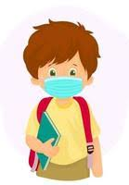
Scalability
This system can therefore be used in real-time applications which require face-mask detection for safety purposes due to the outbreak of Covid-19.
This project can be integrated with embedded systems for application in airports, railway stations, offices, schools, and public places to ensure that public safety guidelines are followed.
By changing ml algorithm we can detect the people who are not wearing mask properly in a crowd and if the percentage of people not wearing mask is greater than the given threshold value then we can alert the authorities.
The model can be further improved to detect if the mask is virus prone or not i.e. the type of the mask is surgical, N95 or not.

Slide 18
Conclusion
The deployed model will contribute immensely to the public health care system. Using basic ML tools and simplified techniques the method has achieved reasonably high accuracy. It can be used for a variety of applications.Wearing a mask may be obligatory in the near future, considering the Covid-19 crisis. Many public service providers will ask the customers to wear masks correctly to avail of their services.

Slide 19
Thank you!!

