Slide 1
Updates on Modeling Bus-based Fabric
Anuparna and Rahul
19th Jan 2026

Slide 2
Agenda
Modeling bus-based fabric in DSL
Status of simulator for bus-based fabric

Slide 3
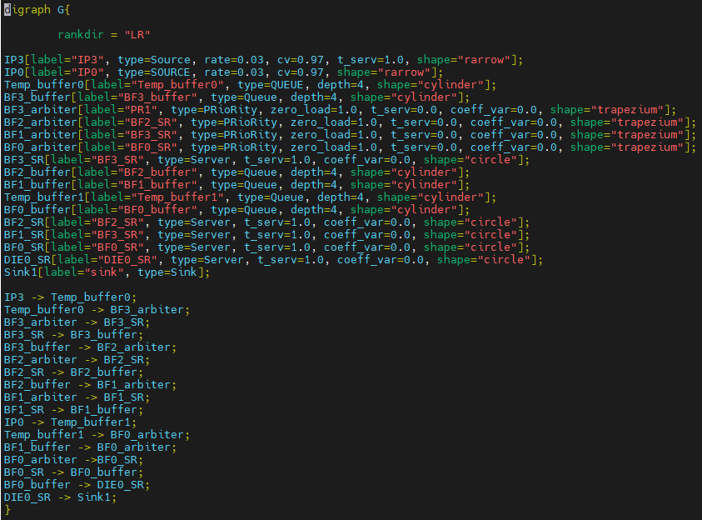
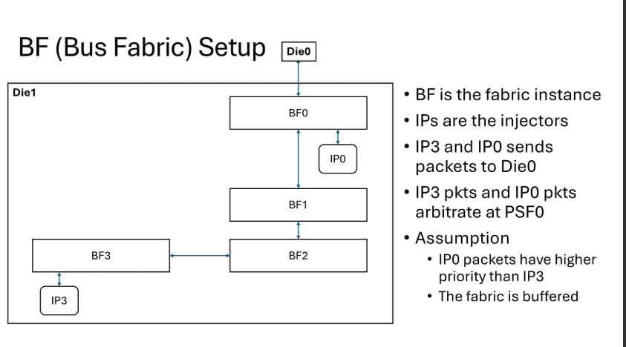
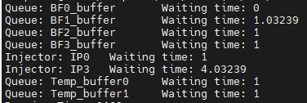
Input from Intel
Converted to .dot file
Every BF has arbitration
Each BFs(BF0, BF1, BF2, BF3) causes 1 cycle delay (from input port to output) in addition to the arbitration. If no arbitration at a said BF, then assume delay = 1 cycle
Zero_load = 1.0
Output verified on pen and paper

Slide 4
Status of Simulator
No existing bus-based simulator for our use case
The closest we could find is PCISIM [1], which is very outdated
Short term: Make a cycle accurate simulator for the configuration shown in the previous slide and verify
Long term: Modifying BookSim
Combining anynet with hybrid arbitration
[1] Sharp, Robin. "PCISIM-A Simulation Tool for PCI Bus Based Systems." (1999).

