Slide 1

Deep Neural Network
MODULE # 7: RNN
DNN Team
BITS Pilani WILP

Slide 2
The instructor is gratefully acknowledging the authors who made their course materials freely available online.
This deck is prepared by Seetha Parameswaran.
Deep Neural Network

Slide 3










Table of Contents
Introduction to Sequence Modeling
Sequence Models Theory Basic RNN Architecture RNN Training & BPTT Bidirectional RNNs
Deep (Stacked) RNNs
Gated Recurrent Units (GRU)
Long Short-Term Memory (LSTM)
Time Series Forecasting Applications Comparison & Summary
1
2
3
4
5
6
7
8
9
10
Deep Neural Network

Slide 4


Motivation: Why Sequence Models?
Many real-world problems involve sequential data:
⁾ Natural Language: ”The cat sat on the ”
⁾ Time Series Forecasting: Stock prices, temperature prediction, sensor data
⁾ Speech: Audio signals over time
⁾ Video: Frame sequences
⁾ Genomics: DNA/protein sequences
Key characteristic: Order matters
Dependencies exist across time steps
The
cat
the
?
sa
t
Dependencies
o
n
Deep Neural Network

Slide 5
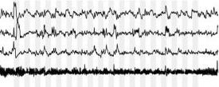
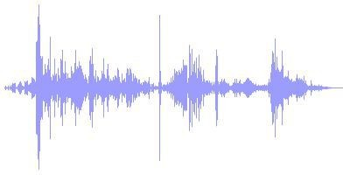
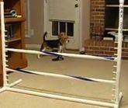
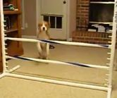

Sequential data
“I took the dog for a walk this morning.”
sentence
medical signals
speech waveform
video frames
5

Slide 6
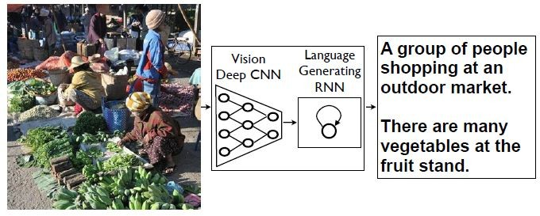



Modeling sequential data
Sample data sequences from a certain distribution
Generate natural sentences to describe an image
P (x₁,. .., x_{N} )
P (y₁,. .., y_{M} |I)
Activity recognition from a video sequence
P (y|x₁,. .., x_{N} )
Running Jumping Dancing Fighting Eating
Adapted from Xiaogang Wang
6

Slide 7
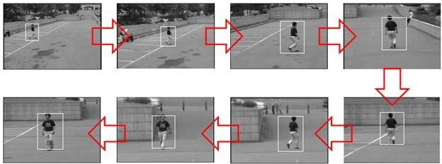
Modeling sequential data
Speech recognition
P (y₁,. .., y_{N} |x₁,. .., x_{N} )
→ Hey Siri
Object tracking
P (y₁,. .., y_{N} |x₁,. .., x_{N} )
Adapted from Xiaogang Wang
7

Slide 8

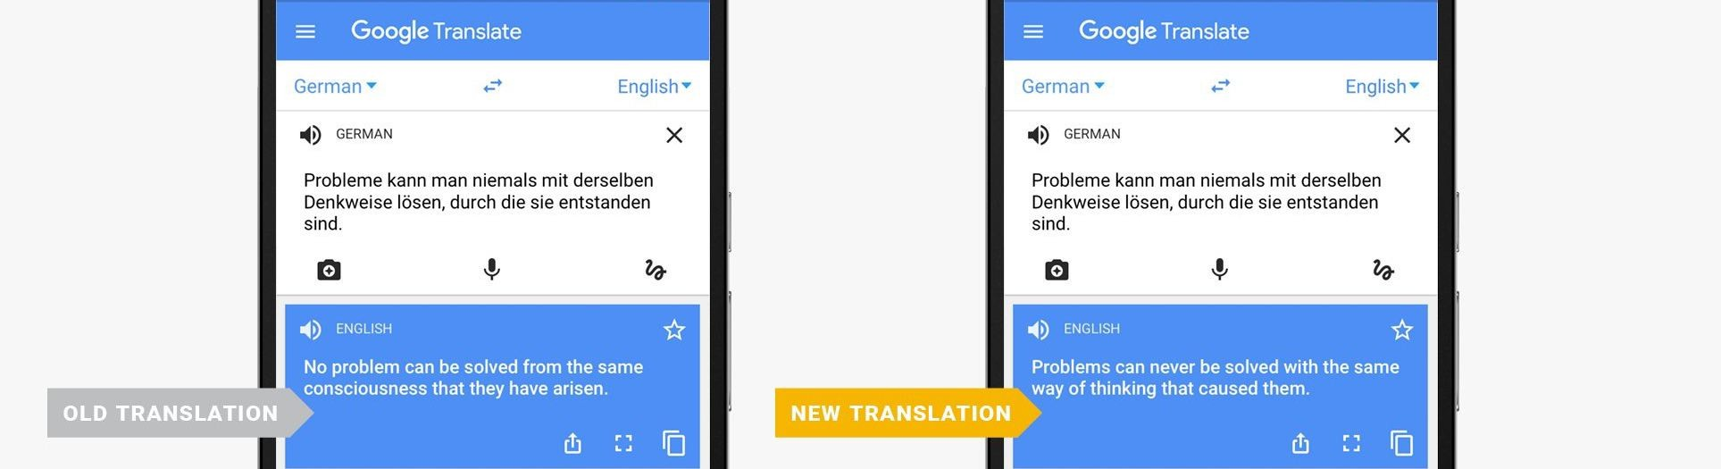
Modeling sequential data
Generate natural sentences to describe a video
P (y₁,. .., y_{M} |x₁,. .., x_{N} )
…
→ A man is riding a bike
Machine translation
P (y₁,. .., y_{M} |x₁,. .., x_{N} )
Adapted from Xiaogang Wang
8

Slide 9
Why Feedforward Networks Fail?
Key issues:
⁾ Fixed input size: Cannot handle variable-length sequences
⁾ No memory: Each input processed independently
⁾ No parameter sharing: Different weights for each position
Example Problem: Predict next word in a sentence
⁾ Input: ”I grew up in France, …..so I speak fluent ”
⁾ Need context from 7 words back (”France”) to predict ”French”
⁾ Feedforward network treats each position independently
We need: A model that can remember past information
Deep Neural Network

Slide 10
Temporal Dependencies
Short-term dependencies: Information needed is recent
⁾ ”The clouds are in the ” → ”sky”
Long-term dependencies: Information needed is far back
⁾ ”I grew up in France... I speak fluent ” → ”French”
Challenge: Model must learn to remember relevant information and forget irrelevant information.
Different sequence lengths require flexible architectures
Deep Neural Network

Slide 11


Table of Contents
Introduction to Sequence Modeling
Sequence Models Theory Basic RNN Architecture RNN Training & BPTT Bidirectional RNNs
Deep (Stacked) RNNs
Gated Recurrent Units (GRU)
Long Short-Term Memory (LSTM)
Time Series Forecasting Applications Comparison & Summary
1
2
3
4
5
6
7
8
9
10
Deep Neural Network

Slide 12
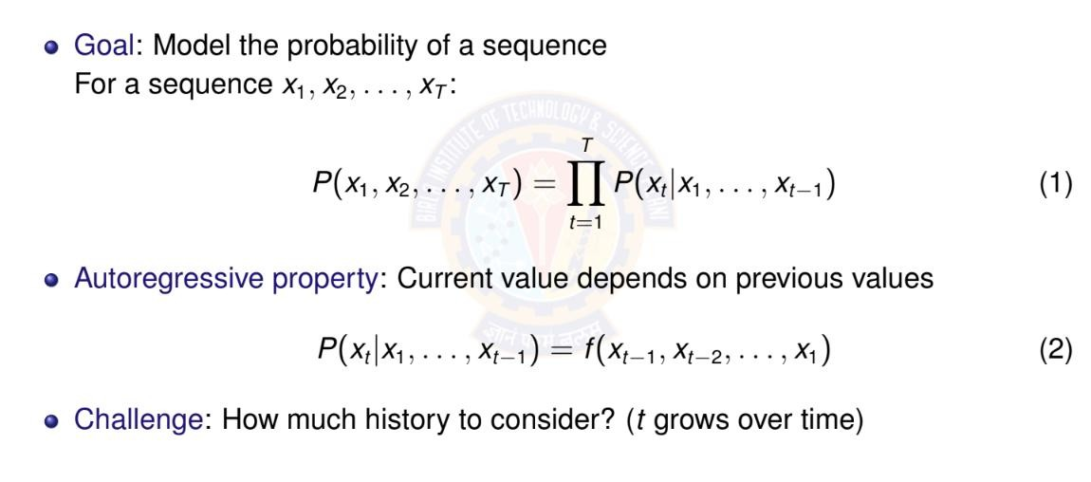
Autoregressive Models
Deep Neural Network

Slide 13
Autoregressive Models: Example
Sequence: ”The cat sat on the” Predict: Next word (e.g., ”mat”) Autoregressive decomposition:
P (The, cat, sat, on, the, mat) = P(The)
× P(cat|The)
× P(sat|The, cat)
× P(on|The, cat, sat)
× P(the|The, cat, sat, on)
× P(mat|The, cat, sat, on, the)
⁾ Each word depends on ALL previous words
⁾ History grows with sequence length
Deep Neural Network

Slide 14
Markov Assumption
Simplification: Limit the context window
First-order Markov: Only immediate past matters
P(x_{t} |x₁, . . . , x_{t —1}) ≈ P(x_{t} |x_{t —}
₁)
k -th order Markov: Last k steps matter
(3)
P(x_{t} |x₁, . . . , x_{t —1}) ≈ P(x_{t} |x_{t —k} , . . . , x_{t —}
₁)
(4)
Advantage: Fixed-size context, tractable computation Disadvantage: May lose important long-term dependencies
Deep Neural Network

Slide 15
Markov Assumption: Example
Sequence: ”The cat sat on the” Predict: Next word (e.g., ”mat”) First-order Markov (bigram):
P(mat|The, cat, sat, on, the) ≈ P(mat|the)
Second-order Markov (trigram):
P(mat|The, cat, sat, on, the) ≈ P(mat|on, the)
Key insight:
⁾ Fixed context window (1 or 2 words)
⁾ Ignores earlier words like ”cat” and ”sat”
⁾ Computationally efficient but limited expressiveness
Deep Neural Network
11 / 96

Slide 16
Latent Variable Models
Alternative approach: Summarize past with a hidden state
h_{t} = f (x_{t} , h_{t —1})
P(x_{t} |x₁, . . . , x_{t —1}) = P(x_{t} |h_{t} )
(5)
(6)
Key insight:
⁾ h_{t} is a latent (hidden) variable
⁾ Contains compressed summary of history
⁾ Fixed-size representation regardless of sequence length
⁾ Updated recursively at each time step
This is the foundation of RNNs!
Deep Neural Network

Slide 17
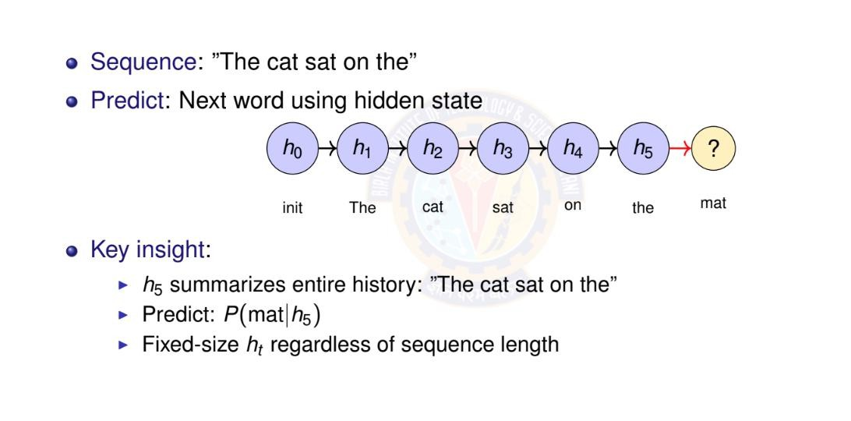
Latent Variable Models: Example
Deep Neural Network

Slide 18
Numerical Example: Temperature Forecasting - Setup
Task: Predict tomorrow’s temperature (regression) Observed sequence: 20◦C, 22◦C, 25◦C, 24◦C, 21◦C Approach 1: Autoregressive (First-order)
⁾ Linear relationship learned from data:
T_{t +1} = α · T_{t} + β
⁾ From historical data, we learned:
α = 0.8,
β = 4.0
⁾ Example: If today is 25◦C:
T_{tomorrow} = 0.8 × 25 + 4.0 = 24.0◦C
Deep Neural Network

Slide 19
Temperature Forecasting - Autoregressive Prediction
Sequence: 20◦C, 22◦C, 25◦C, 24◦C, 21◦C
Model: T_{t +1} = 0.8 · T_{t} + 4.0
Predict next day (day 6):
⁾ Last observation: T₅ = 21◦C
⁾ Prediction: T₆ = 0.8 × 21 + 4.0 = 20.8◦C
Multi-step ahead (day 7, using predicted T₆):
⁾ T₇ = 0.8 × 20.8 + 4.0 = 20.64◦C
Limitation: Only uses immediate past
⁾ Cannot capture weekly/seasonal patterns
⁾ Error accumulates in multi-step predictions
Deep Neural Network

Slide 20
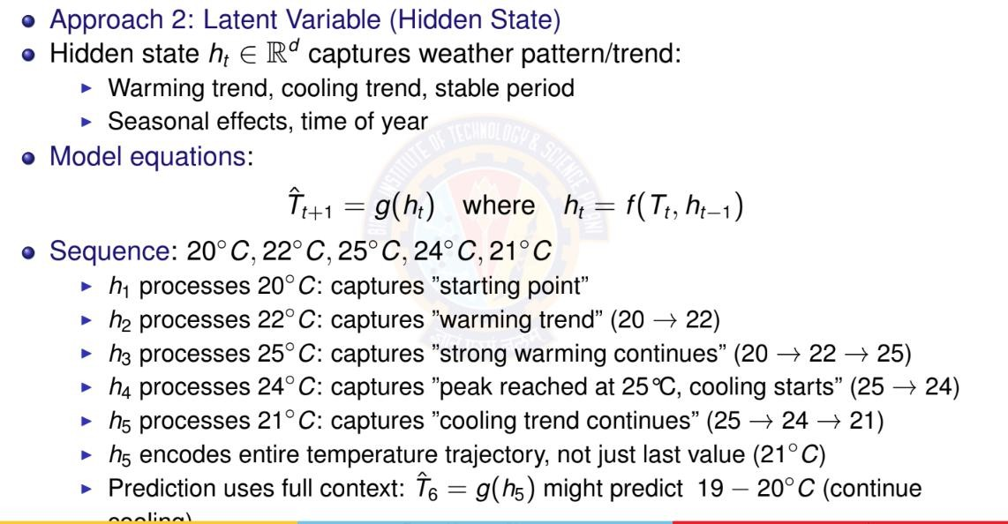
Temperature Forecasting - Latent Variable Model
Deep Neural Network

Slide 21

Table of Contents
Introduction to Sequence Modeling
Sequence Models Theory Basic RNN Architecture RNN Training & BPTT Bidirectional RNNs
Deep (Stacked) RNNs
Gated Recurrent Units (GRU)
Long Short-Term Memory (LSTM)
Time Series Forecasting Applications Comparison & Summary
1
2
3
4
5
6
7
8
9
10
Deep Neural Network

Slide 22
Recurrent Neural Network (RNN)
Definition
Neural network with loops, allowing information to persist
Key idea:
⁾ Process sequential data one step at a time
⁾ Maintain hidden state that summarizes past information
⁾ Same parameters shared across all
time steps
The loop: Hidden state h_{t} feeds
back into itself at next time step
o_{t}
h_{t}
RNN
Recurrent connection
x_{t}
Deep Neural Network
18 / 96

Slide 23
RNN: Unrolled Computation Graph
Unrolling: Visualize RNN across time steps
W_{hx}: The weight matrix between the input, x(t), and the hidden layer, h
W_{hh}: The weight matrix associated with the recurrent edge
W_{ho}: The weight matrix between the hidden layer and output layer
Sometimes, W_{xh} and W_{hh}, are concatenated
to W_{h} = [W_{xh}; W_{hh}]
Where the parameters are:
bias vectors b_{h} and b_{o}
weight matrices
Shared across timestamps
o₁
o₂
o₄
o₃
same W_{ho}
same W_{ho}
same W_{ho}
same W_{ho}
h₄
· · ·
h
h
h
1
2
3
same W_{hh}
same W_{hh}
same W_{hh}
same W_{hx}
same W_{hx}
same W_{hx}
same W_{hx}
x₁
t = 1
x₂
t = 2
x₃
t = 3
x₄
t = 4
Key insight: Same parameters (W_{hx} , W_{hh}, W_{ho} ) applied at each time step
Deep Neural Network

Slide 24
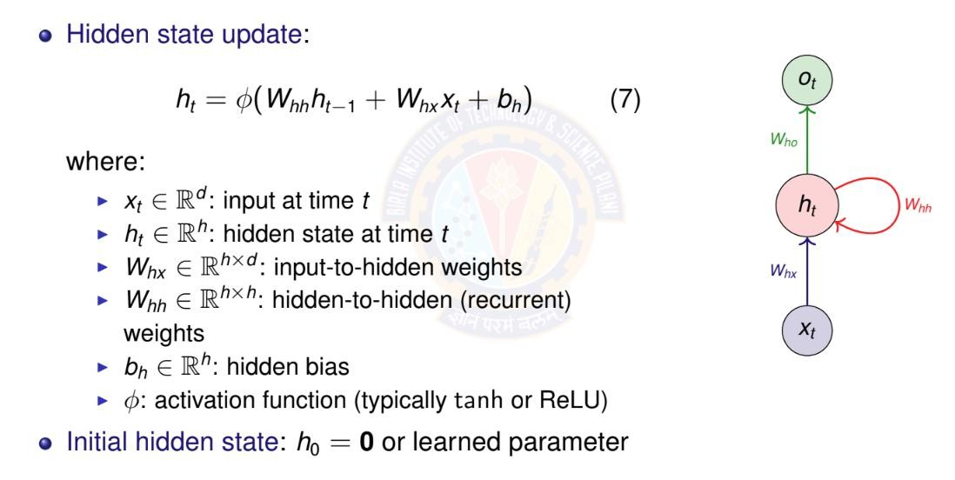
RNN Mathematical Formulation I
Deep Neural Network

Slide 25
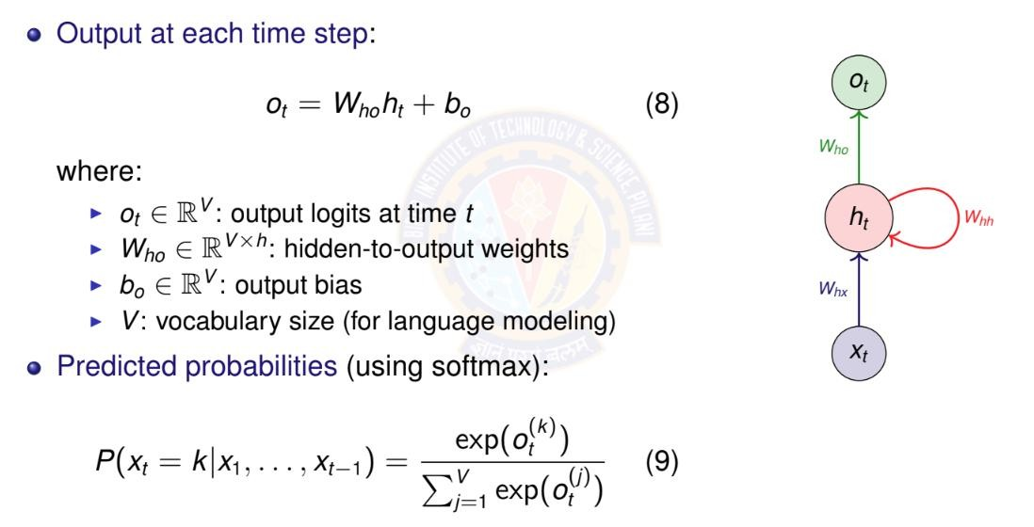
RNN Mathematical Formulation II
Deep Neural Network

Slide 26
Parameter Sharing Across Time
Key insight: Same parameters used at every time step
W_{hx} , W_{hh} , b_{h} : Shared across all time steps
W_{ho} , b_{o} : Shared across all time steps
Advantages:
Fixed number of parameters regardless of sequence length
2 Can process sequences of any length
Generalization: patterns learned at one position transfer to others
1
3
Contrast with feedforward: Different weights for each position
Deep Neural Network

Slide 27
RNN Parameter Counting
Given:
Input dimension: d
Hidden dimension: h
Output/vocabulary size: V
Parameter count:
W_{hx} : h × d W_{hh} : h × h
b_{h} : h W_{ho} : V × h
b_{o} : V
Total : hd + h² + h + Vh + V = h(d + h + V + 1) + V
Deep Neural Network

Slide 28
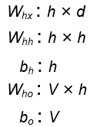
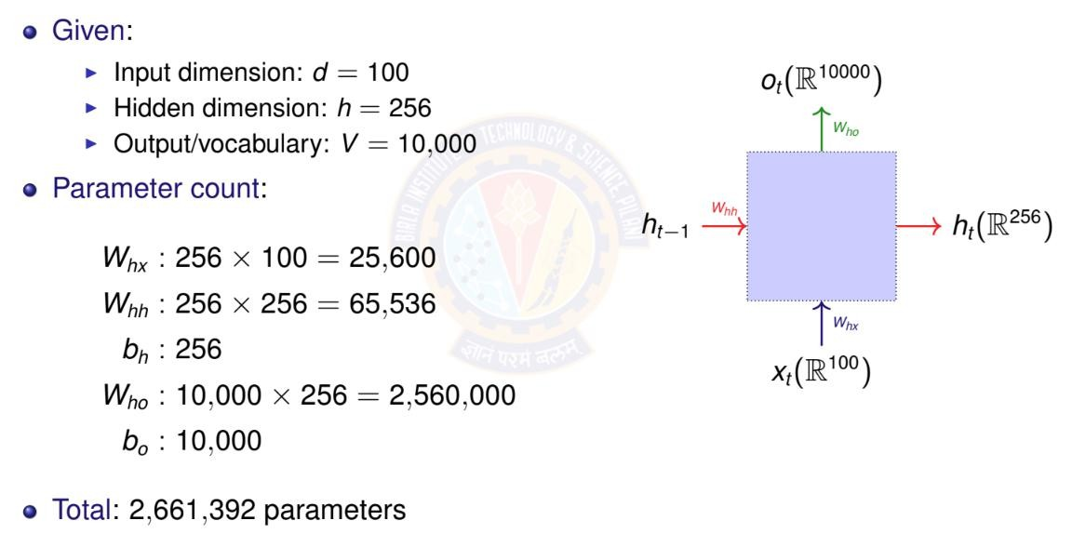
RNN Parameter Counting Example
Deep Neural Network

Slide 29
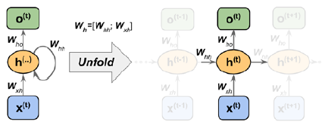



Computing activations in an RNN

Slide 30

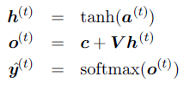
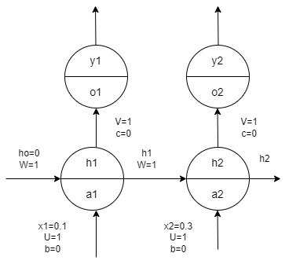
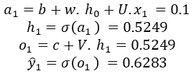
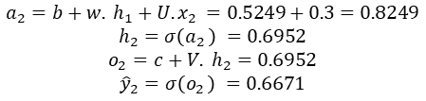
RNN Forward propagation example
calculate the output and total parameters in the network assuming all Sigmoid neurons.
$$a_{1}=b+w. h_{0}+U. x_{1 }=0.1$$
$$h_{1}=σ\left(a_{1 }\right) =0.5249$$
$$o_{1}=c+V. h_{1}=0.5249$$
$${\hat{y}}_{1}=σ\left(o_{1 }\right) =0.6283$$
$$a_{2}=b+w. h_{1}+U. x_{2 }=0.5249+0.3=0.8249$$
$$h_{2}=σ\left(a_{2 }\right) =0.6952$$
$$o_{2}=c+V. h_{2}=0.6952$$
$${\hat{y}}_{2}=σ\left(o_{2 }\right) =0.6671$$
U → 1
W →1
V→ 1
Biases →2
Total 5 parameters

Slide 31
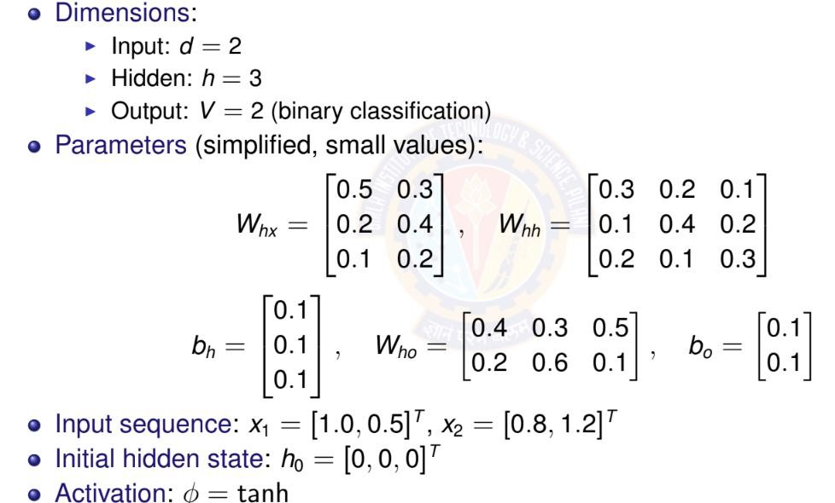
RNN Forward Pass: Simple Example
Deep Neural Network

Slide 32
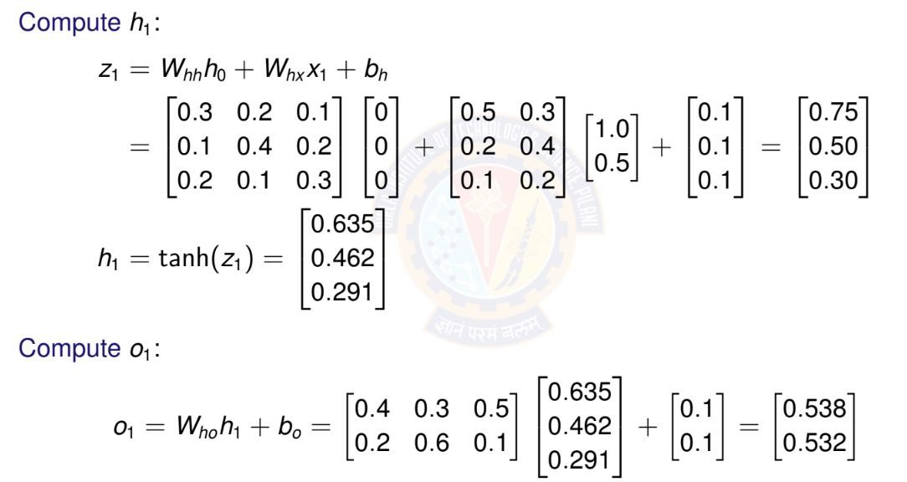
RNN Forward Pass: Time Step t = 1
Deep Neural Network

Slide 33
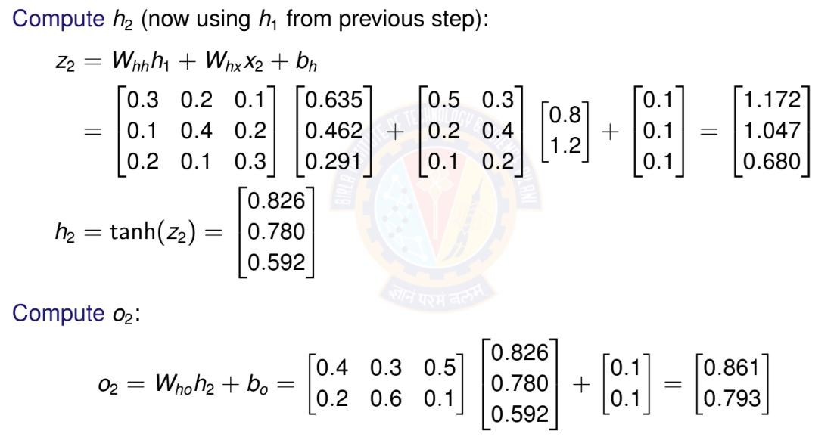
RNN Forward Pass: Time Step t = 2
Deep Neural Network

Slide 34
Activation Functions in RNNs
Common choices for φ:
Hyperbolic tangent (tanh):
⁾ Range: [−1, 1]
⁾ Centered at zero (helps with gradient flow)
⁾ Most common for vanilla RNNs
ReLU:
⁾ Range: [0, ∞)
⁾ Can help with vanishing gradient
⁾ May cause exploding activations
Deep Neural Network

Slide 35

Table of Contents
Introduction to Sequence Modeling
Sequence Models Theory Basic RNN Architecture RNN Training & BPTT Bidirectional RNNs
Deep (Stacked) RNNs
Gated Recurrent Units (GRU)
Long Short-Term Memory (LSTM)
Time Series Forecasting Applications Comparison & Summary
1
2
3
4
5
6
7
8
9
10
Deep Neural Network

Slide 36
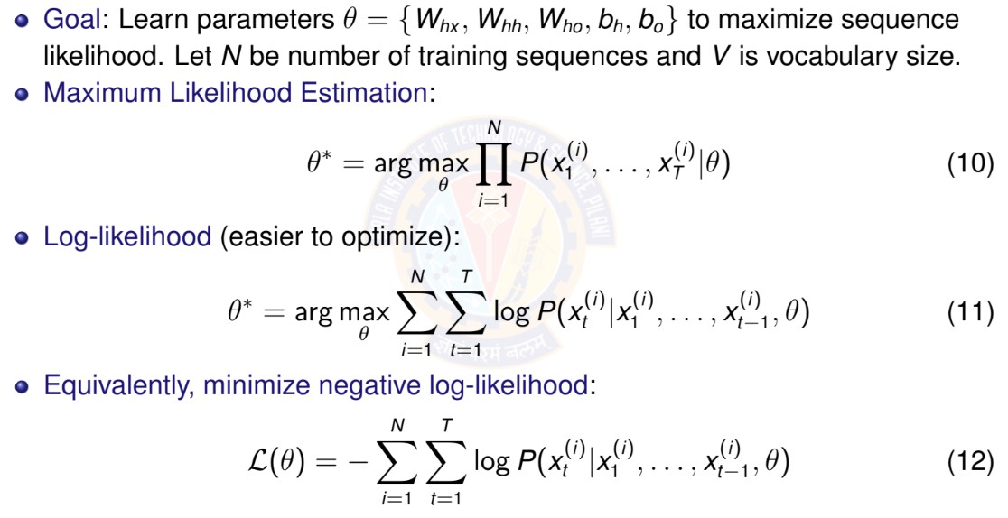
Training Objective for RNNs
Deep Neural Network

Slide 37
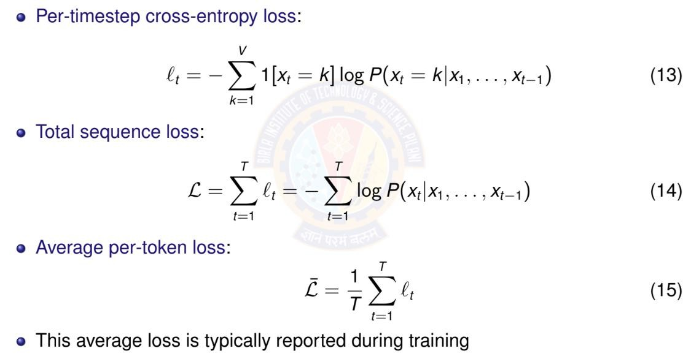
Loss Function for Sequences
Deep Neural Network

Slide 38
Backpropagation Through Time (BPTT)
Challenge: How to compute gradients in RNNs?
⁾ Parameters shared across all time steps
⁾ Hidden state depends on entire history
⁾ Need to backpropagate through time
Key insight: Unroll RNN into feedforward network
⁾ Apply standard backpropagation
⁾ Sum gradients from all time steps (parameter sharing)
BPTT: Backpropagation Through Time
⁾ Forward pass: compute outputs for all time steps
⁾ Backward pass: compute gradients from t = T to t = 1
⁾ Gradients flow backward through time
Deep Neural Network

Slide 39
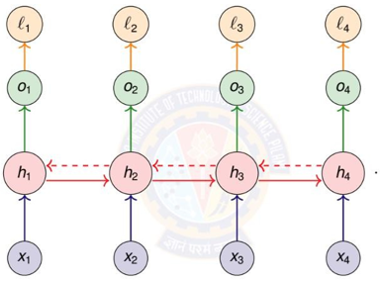

BPTT: Computational Graph
h_{t} depends on h_{t-1}, and h_{t-1} depends on h_{t-2}, any loss at the end of a sequence is function of every previous state
h₃ = f(h₂)
h₂ = f(h₁)
h₃ = f(f(h₁))

Slide 40






Generalizing →
If t=100 and k=1, expand the chain rule 99 times
Generalizing →
derivative of the tanh activation function used inside RNN
Diag : It's a mathematical trick that turns a list of individual neuron derivatives into a square matrix so we can use standard matrix multiplication to pass the error back correctly

Slide 41







Gradient at the hidden state (in recursive form)
E.g. →
Last time step →
T-1 step →
T-2 step →
Expanded →
Generalized →

Slide 42
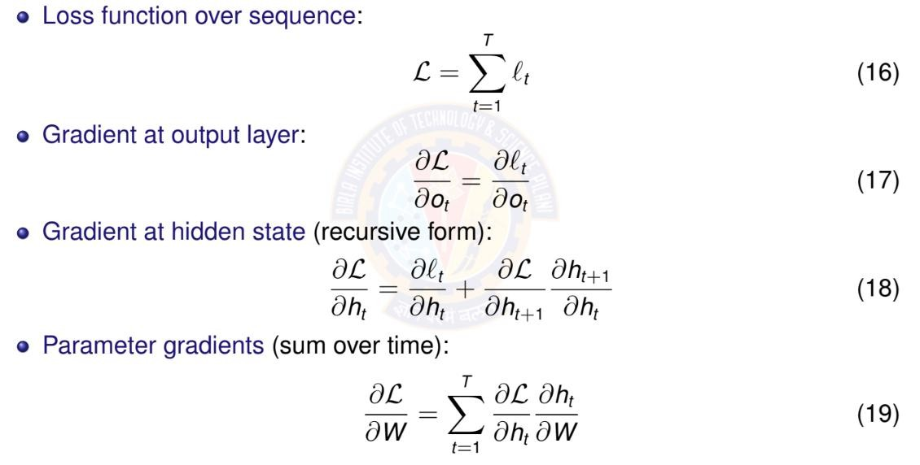

BPTT: Key Gradient Equations
Deep Neural Network

Slide 43
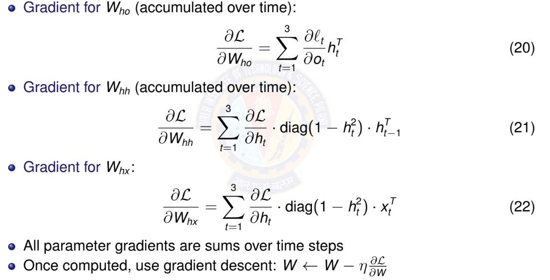
BPTT: Parameter Gradients
Deep Neural Network

Slide 44
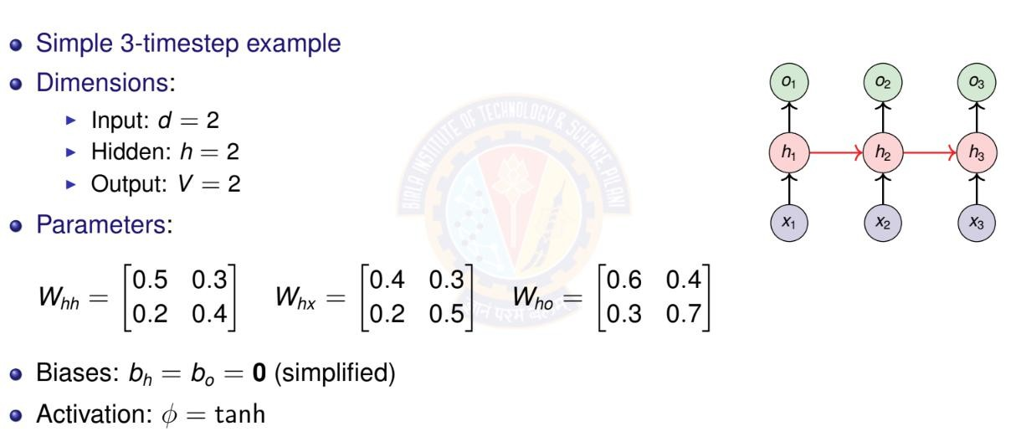
BPTT: Numerical Example Setup
Deep Neural Network

Slide 45
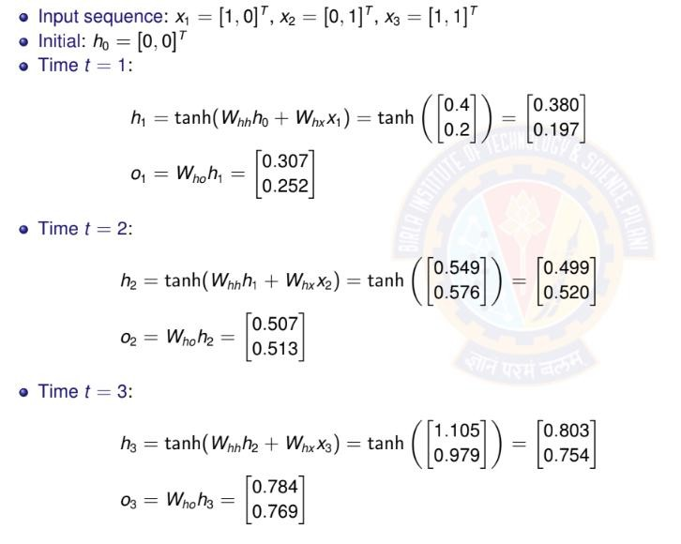
BPTT: Forward Pass
Deep Neural Network

Slide 46
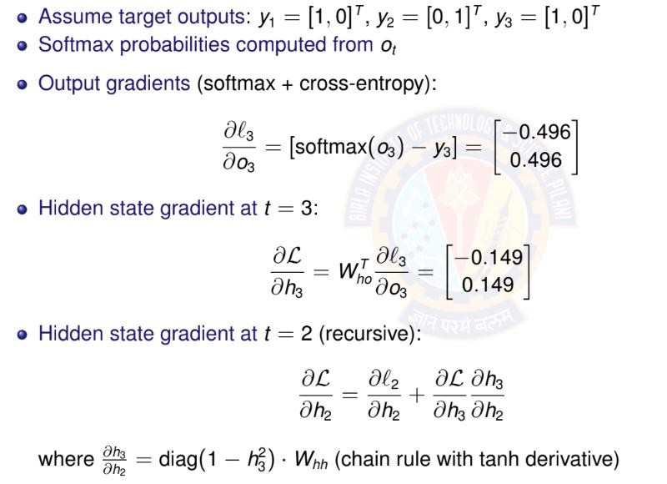
BPTT: Backward Pass
move error from output layer (o3) back into hidden state (h3), we multiply by the weights connecting them (W_{ho}^{T})
Deep Neural Network

Slide 47
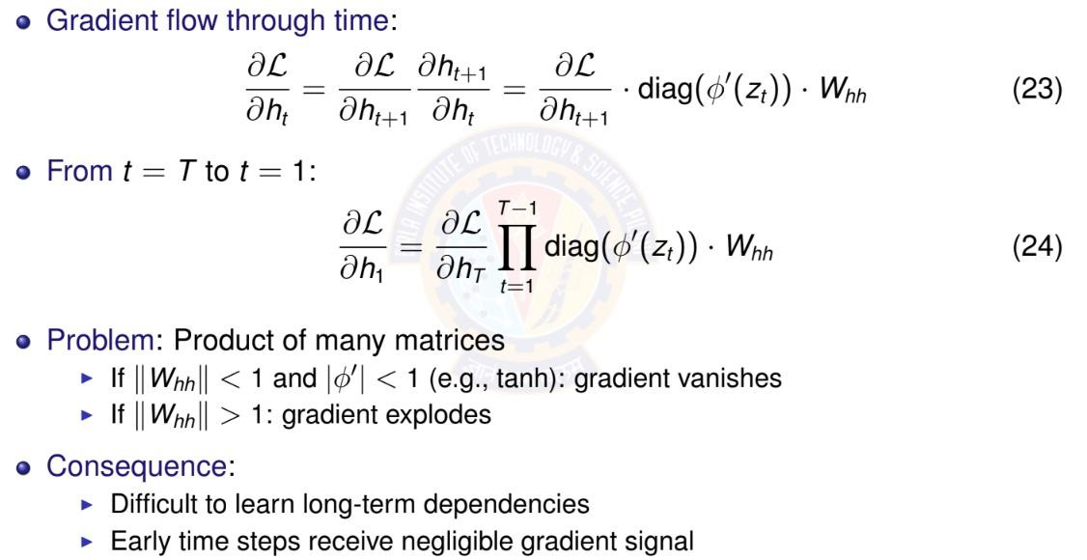
Vanishing Gradients: The Problem
Deep Neural Network

Slide 48
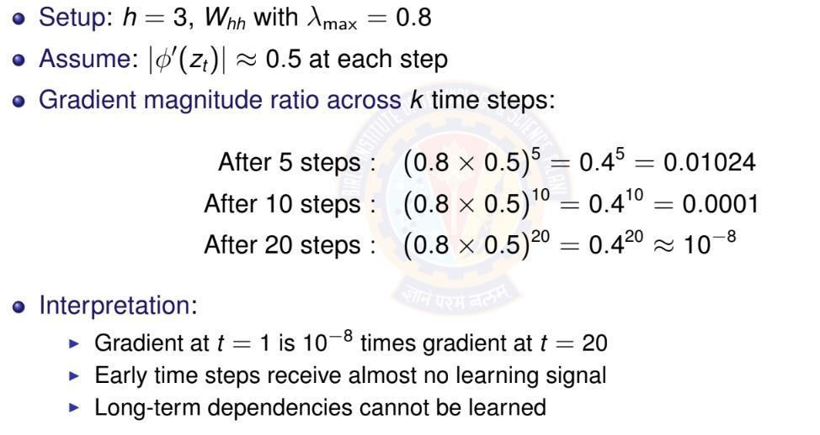
Vanishing Gradients: Numerical Example
Deep Neural Network

Slide 49
Why Vanishing Gradients are Problematic?
Learning difficulty:
⁾ Parameters affecting early time steps barely update
⁾ Model cannot learn long-term patterns
⁾ Training becomes ineffective for long sequences
Example scenarios where this fails:
⁾ ”I grew up in France... [50 words]... I speak fluent ”
⁾ Long-range syntactic dependencies in language
⁾ Time series with seasonal patterns (yearly cycles)
Solutions:
⁾ Better architectures: LSTM, GRU
⁾ Careful initialization
⁾ Skip connections
Deep Neural Network

Slide 50

Table of Contents
Introduction to Sequence Modeling
Sequence Models Theory Basic RNN Architecture RNN Training & BPTT Bidirectional RNNs
Deep (Stacked) RNNs
Gated Recurrent Units (GRU)
Long Short-Term Memory (LSTM)
Time Series Forecasting Applications Comparison & Summary
1
2
3
4
5
6
7
8
9
10
Deep Neural Network

Slide 51
Bidirectional RNNs: Motivation
Limitation of standard RNN: Only uses past context
⁾ Predicts based on x₁, . . . , x_{t —1}
⁾ Cannot use future information
Many tasks benefit from full context:
⁾ Sentiment analysis: ”The movie was not ” (need to see ”good” or ”bad”)
⁾ Named entity recognition: ”I met Paris in Paris” (person vs city - need full context)
⁾ Speech recognition: Future phonemes help disambiguate current sound
⁾ Machine translation: Full sentence context improves translation
Key idea: Process sequence in both directions
⁾ Forward RNN: left-to-right
⁾ Backward RNN: right-to-left
⁾ Combine information from both
Deep Neural Network

Slide 52
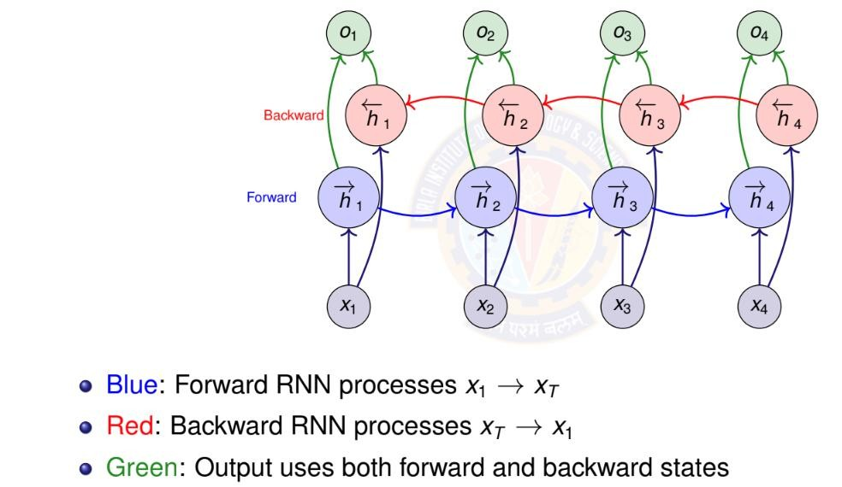
Bidirectional RNN Architecture
Deep Neural Network

Slide 53
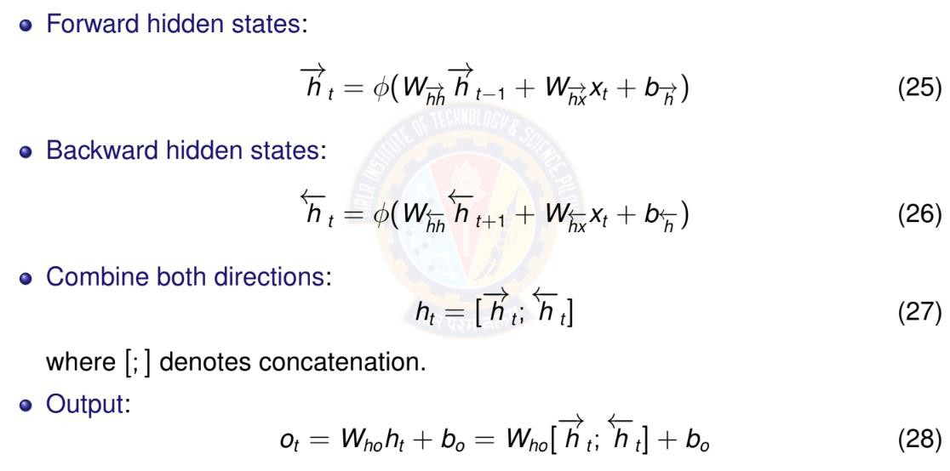
Bidirectional RNN: Mathematical Formula
Deep Neural Network

Slide 54
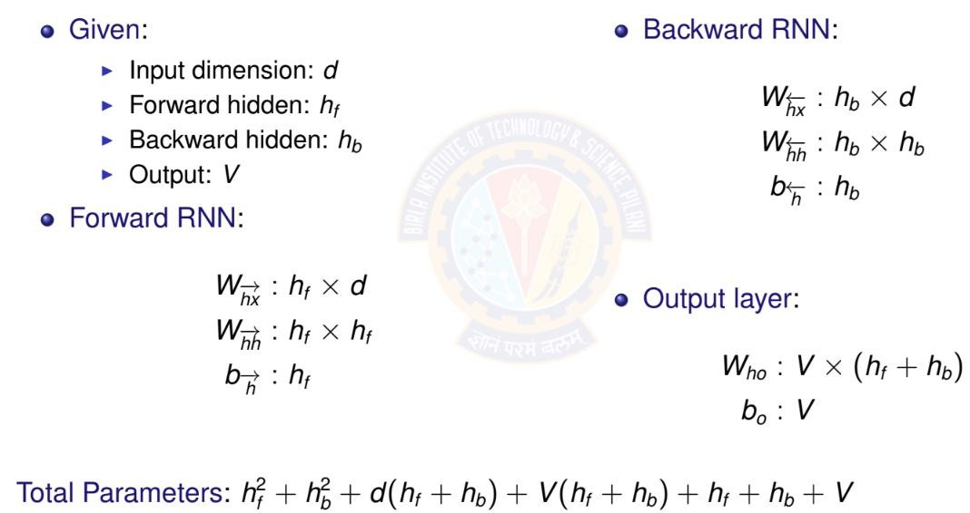
Bidirectional RNN: Parameter Counting
Deep Neural Network

Slide 55
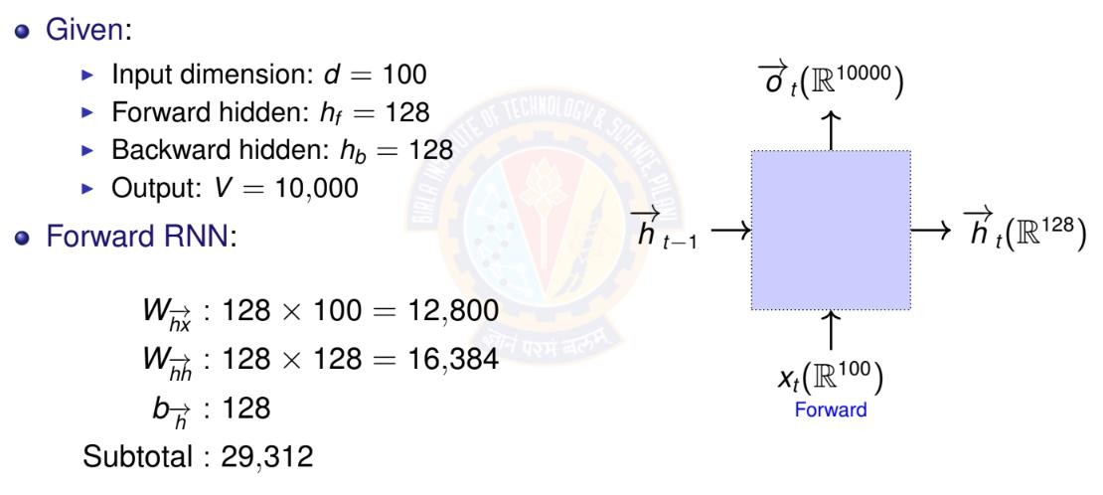
Example Bidirectional RNN: Parameter Counting
Deep Neural Network

Slide 56
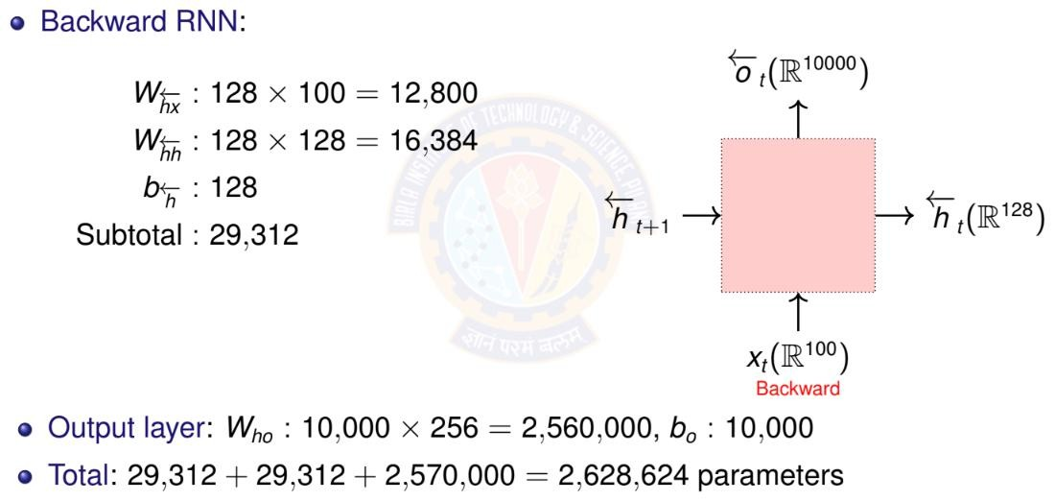
Example Bidirectional RNN: Parameter Counting
Deep Neural Network

Slide 57
When to Use Bidirectional RNNs
Use bidirectional RNNs when:
⁾ Entire sequence available before prediction
⁾ Task benefits from future context
⁾ Examples: text classification, named entity recognition, machine translation
(encoder)
Do NOT use when:
⁾ Real-time/online prediction required
⁾ Causal modeling (future cannot influence past)
⁾ Examples: language modeling, real-time speech recognition, time series
forecasting
Key limitation: Must process entire sequence
⁾ Cannot make predictions until sequence complete
⁾ Higher computational cost (two RNNs)
⁾ Not suitable for streaming applications
Deep Neural Network

Slide 58

Table of Contents
Introduction to Sequence Modeling
Sequence Models Theory Basic RNN Architecture RNN Training & BPTT Bidirectional RNNs
Deep (Stacked) RNNs
Gated Recurrent Units (GRU)
Long Short-Term Memory (LSTM)
Time Series Forecasting Applications Comparison & Summary
1
2
3
4
5
6
7
8
9
10
Deep Neural Network

Slide 59
Deep (Stacked) RNNs: Motivation
Why stack RNN layers?
⁾ Single RNN layer: limited representational capacity
⁾ Deep networks learn hierarchical features
⁾ Lower layers: simple patterns
⁾ Higher layers: complex, abstract patterns
Examples of hierarchical features:
⁾ Text: characters → words → phrases → sentences
⁾ Speech: phonemes → syllables → words
⁾ Time series: short-term → medium-term → long-term trends
Empirical observation:
⁾ Deeper RNNs often outperform wider single-layer RNNs
⁾ Typical depth: 2-4 layers (diminishing returns beyond this)
Deep Neural Network

Slide 60
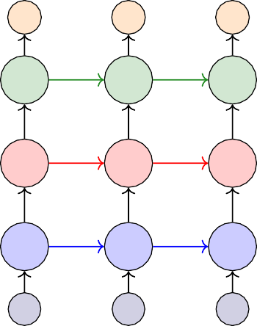
Deep RNN Architecture
Each layer processes output of previous layer
Horizontal arrows: recurrent
connections within layer
Vertical arrows:
feed-forward connections
between layers
 | o₁ | o₂ | o₃
Layer 3 | _{h}(3) 1 | _{h}(3) 2 | _{h}(3) 3
Layer 2 | _{h}(2) 1 | _{h}(2) 2 | _{h}(2) 3
Layer 1 | _{h}(1) 1 | _{h}(1) 2 | _{h} (1) 3
x₁
x₂
x₃
Deep Neural Network

Slide 61

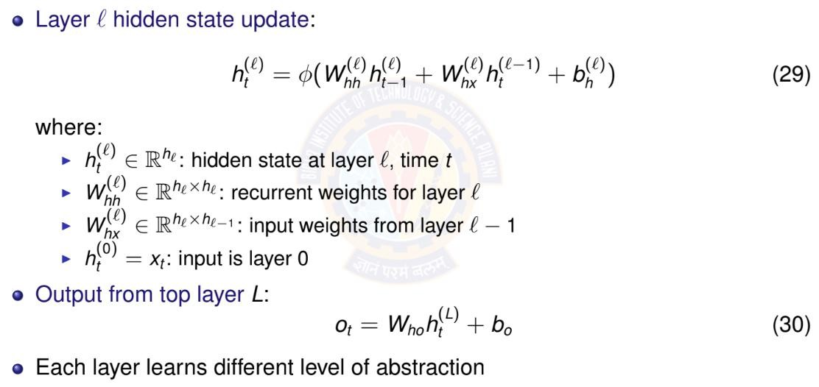
Deep RNN: Mathematical Formulation
Deep Neural Network

Slide 62
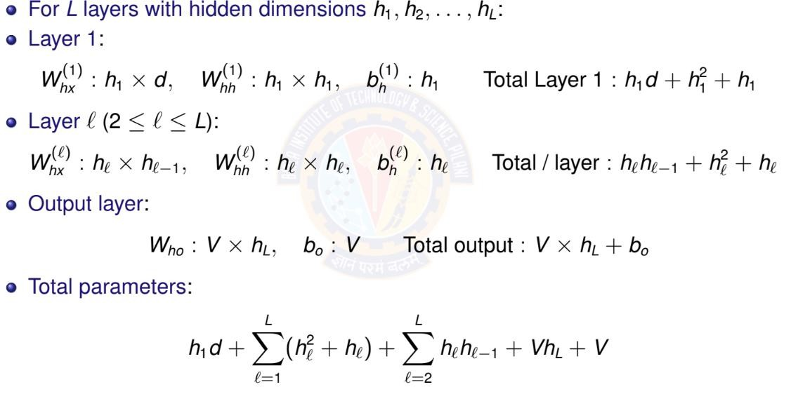
Deep RNN: Parameter Counting
Deep Neural Network

Slide 63
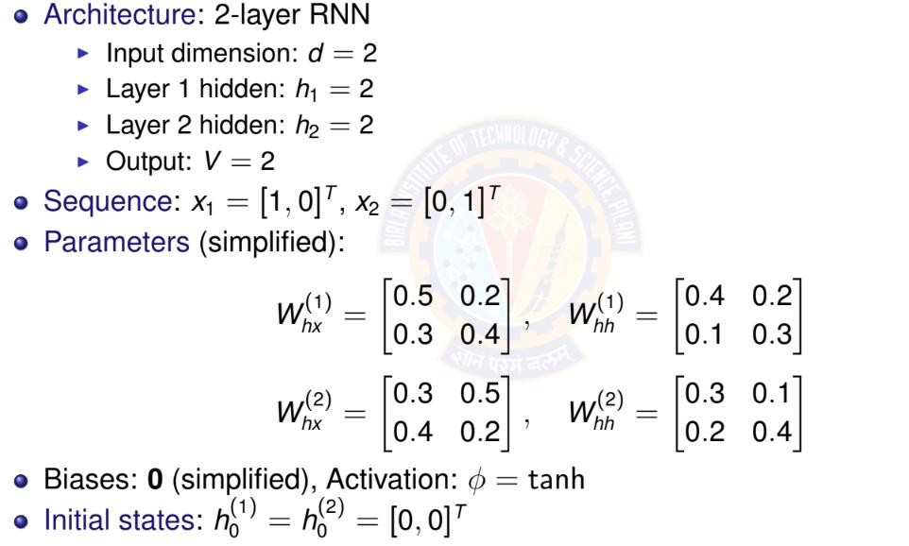
Deep RNN: Numerical Example Setup
Deep Neural Network

Slide 64
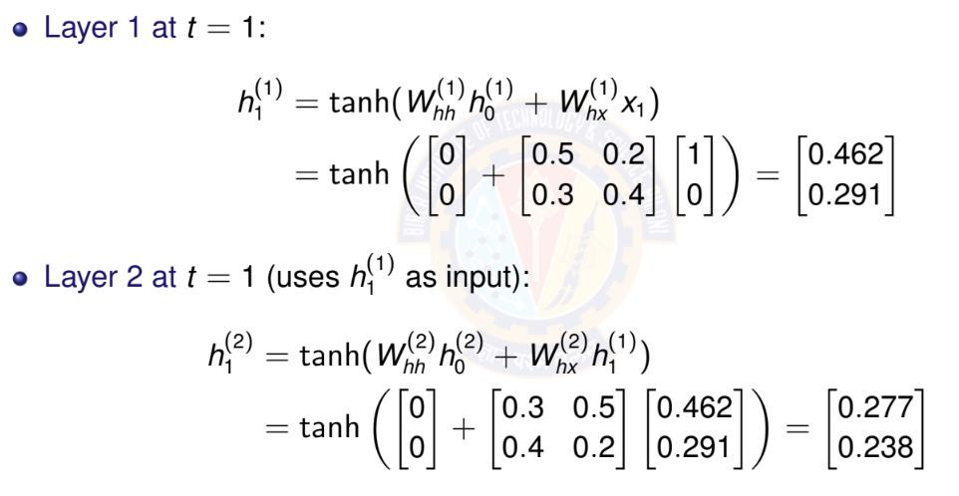
Deep RNN: Forward Pass at t = 1
Deep Neural Network

Slide 65
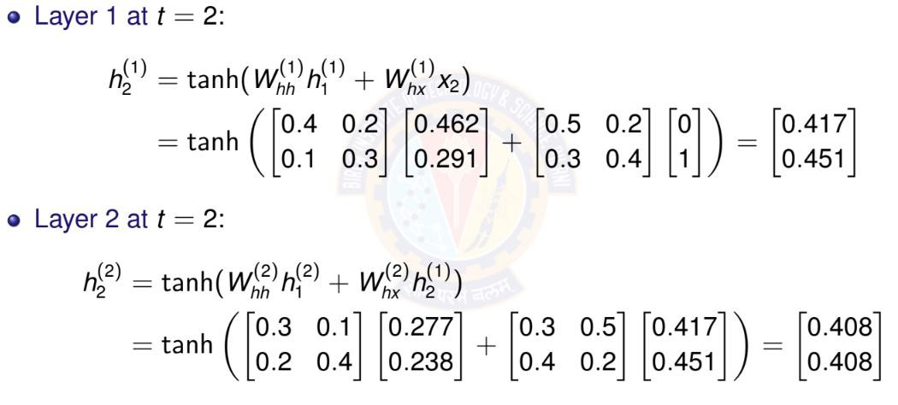
Deep RNN: Forward Pass at t = 2
Deep Neural Network

Slide 66
Deep RNN: Gradient Flow Considerations
Gradient must flow through:
⁾ Time (horizontal connections within each layer)
⁾ Depth (vertical connections between layers)
Compound vanishing gradient problem:
⁾ Gradients vanish in time dimension (as in single-layer RNN)
⁾ Additional vanishing through depth
⁾ Problem is more severe than single-layer RNN
Mitigation strategies:
⁾ Use LSTM/GRU cells instead of vanilla RNN (upcoming)
⁾ Skip connections between layers (residual connections)
⁾ Careful initialization
⁾ Layer normalization
Practical limit: Typically 2-4 layers
⁾ Deeper networks harder to train
⁾ Diminishing returns beyond 4 layers
Deep Neural Network

Slide 67

Table of Contents
Introduction to Sequence Modeling
Sequence Models Theory Basic RNN Architecture RNN Training & BPTT Bidirectional RNNs
Deep (Stacked) RNNs
Gated Recurrent Units (GRU)
Long Short-Term Memory (LSTM)
Time Series Forecasting Applications Comparison & Summary
1
2
3
4
5
6
7
8
9
10
Deep Neural Network

Slide 68
GRU: Motivation
Vanilla RNN problems:
⁾ Vanishing gradients prevent learning long-term dependencies
⁾ All information in hidden state weighted equally
⁾ No mechanism to selectively remember or forget
Key insight: Use gates to control information flow
⁾ Gates: Neural network layers with sigmoid activation σ ∈ [0, 1]
⁾ σ = 0: Block information completely
⁾ σ = 1: Let all information pass through
⁾ σ ∈ (0, 1): Partially allow information
GRU advantages:
⁾ Learn what to remember and what to forget
⁾ Better gradient flow through time
⁾ Can capture long-term dependencies
⁾ Fewer parameters than LSTM
Deep Neural Network

Slide 69
GRU: Architecture Overview
Two gates:
⁾ Reset gate r_{t} : Controls how much past information to forget
⁾ Update gate z_{t} : Controls how much to
update hidden state
o
t
z_{t}
GRU
r_{t}
Candidate hidden state h˜ : Proposed
h
h_{t}
t
t —1
new content
Final hidden state h_{t} : Interpolation
between old and new
All gates learned from data
x_{t}
Deep Neural Network

Slide 70
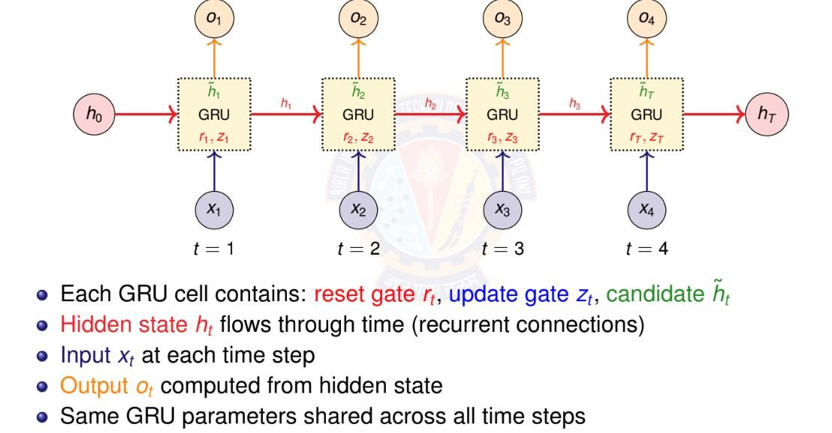
GRU: Unrolled Architecture Across Time
h_{T}
Deep Neural Network

Slide 71
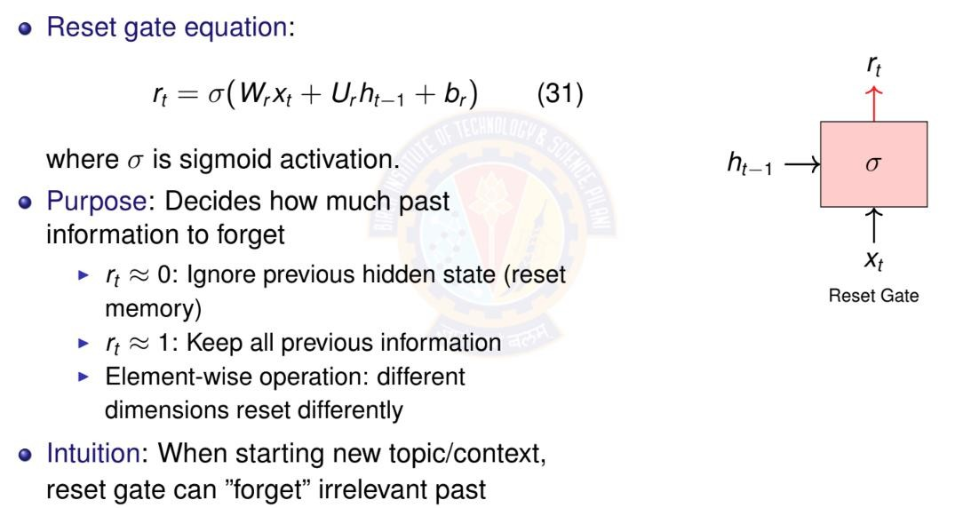
GRU: Reset Gate
Deep Neural Network

Slide 72
GRU: Update Gate
Update gate equation:
z_{t}
z_{t} = σ(W_{z}x_{t} + U_{z}h_{t —1} + b_{z} )
Purpose: Decides how much to update hidden state
⁾ z_{t} ≈ 0: Keep old hidden state h_{t —1} (don’t
(32)
h
t —1
σ
update)
x_{t}
Update Gate
˜
⁾ z_{t} ≈ 1: Replace with new candidate h _{t} (full
update)
⁾ Acts like a ”memory gate”
Intuition: For long-term dependencies, keep
z_{t} small to preserve information
Deep Neural Network

Slide 73
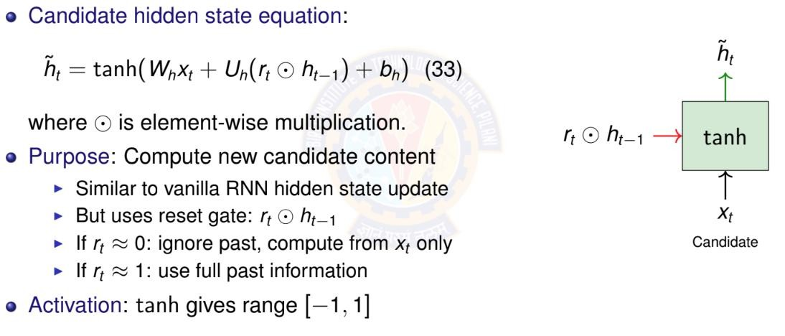
GRU: Candidate Hidden State
Deep Neural Network

Slide 74
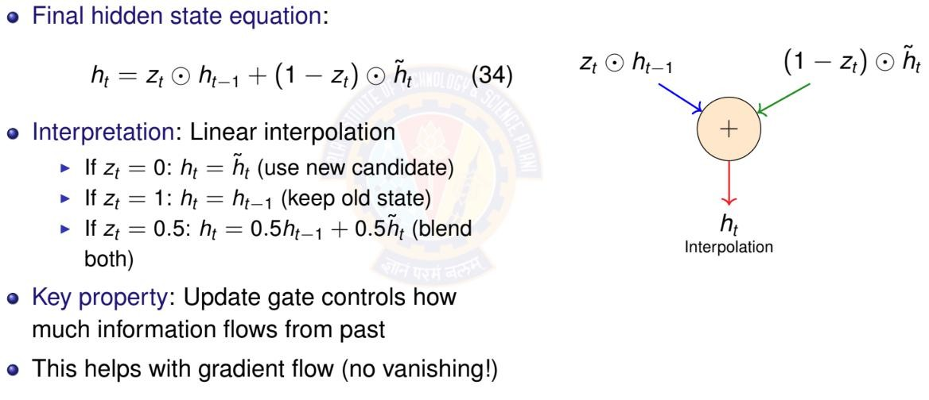
GRU: Final Hidden State Update
Deep Neural Network

Slide 75
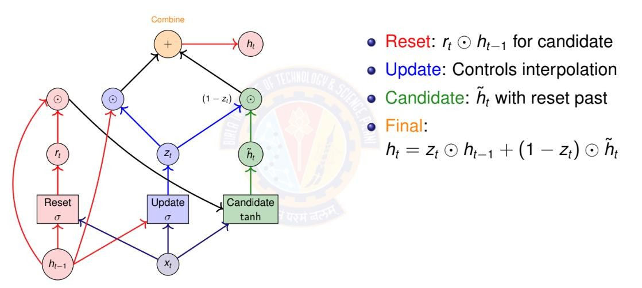
GRU: Computational Graph
Deep Neural Network

Slide 76
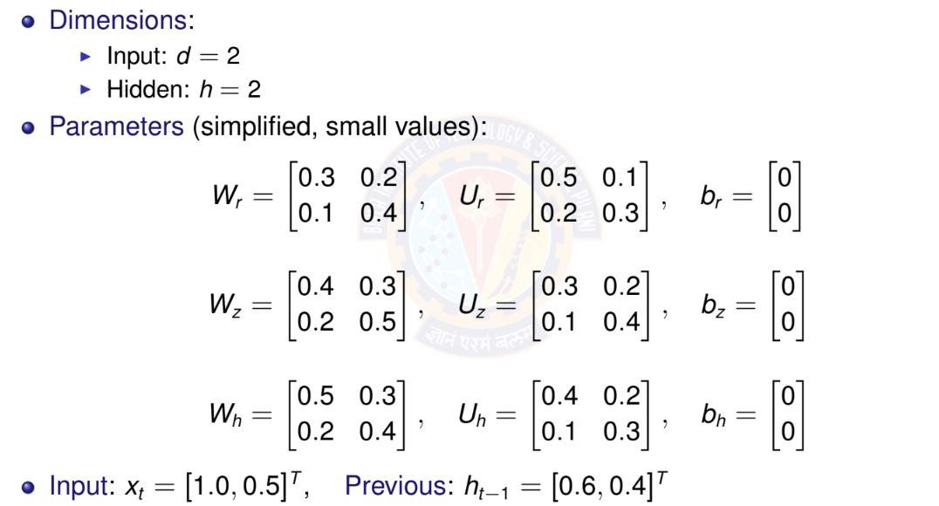
GRU: Numerical Example - Setup
Deep Neural Network

Slide 77
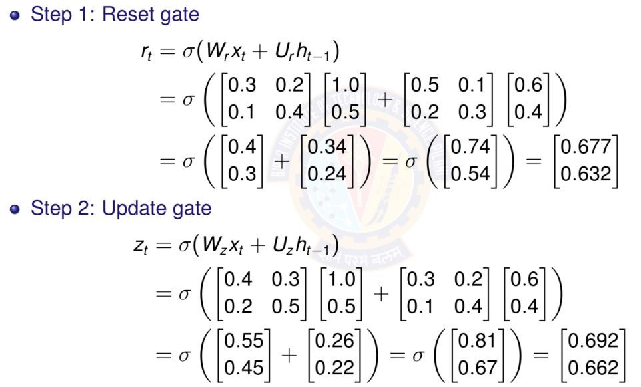
GRU: Numerical Example - Gates Computation
Deep Neural Network

Slide 78

GRU: Numerical Example - Hidden State Update
Deep Neural Network

Slide 79

GRU: Numerical Example - Final Hidden State
Deep Neural Network

Slide 80

GRU: Parameter Counting
Deep Neural Network

Slide 81

GRU: Why It Helps with Vanishing Gradients
Deep Neural Network

Slide 82

Table of Contents
Introduction to Sequence Modeling
Sequence Models Theory Basic RNN Architecture RNN Training & BPTT Bidirectional RNNs
Deep (Stacked) RNNs
Gated Recurrent Units (GRU)
Long Short-Term Memory (LSTM)
Time Series Forecasting Applications Comparison & Summary
1
2
3
4
5
6
7
8
9
10
Deep Neural Network

Slide 83
LSTM: Motivation
GRU limitations:
⁾ Single hidden state combines both long-term and short-term information
⁾ Update gate controls both memory and output together
⁾ Less explicit control over information flow
LSTM innovation: Separate memory from hidden state
⁾ Cell state c_{t} : Long-term memory (information highway)
⁾ Hidden state h_{t} : Short-term memory (working memory)
⁾ More fine-grained control with 3 gates instead of 2
Key advantages:
⁾ Cell state provides uninterrupted gradient flow
⁾ Forget gate can selectively remove information
⁾ Output gate separates what to remember from what to output
⁾ Better for very long sequences (100+ time steps)
Most widely used RNN variant in practice
Deep Neural Network

Slide 84

LSTM: Architecture Overview
Deep Neural Network

Slide 85

LSTM: Unrolled Architecture Across Time
Deep Neural Network

Slide 86

LSTM: Forget Gate
Deep Neural Network

Slide 87

LSTM: Input Gate and Candidate
Deep Neural Network

Slide 88

LSTM: Cell State Update
Deep Neural Network

Slide 89

LSTM: Output Gate and Hidden State
outputting
Deep Neural Network

Slide 90

LSTM: Computational Graph
Deep Neural Network

Slide 91

LSTM: Parameter Counting
Deep Neural Network

Slide 92

LSTM: Why It Solves Vanishing Gradients
Deep Neural Network

Slide 93
LSTM vs GRU: Comparison
Property | GRU | LSTM
Number of gates | 2 (reset, update) | 3 (forget, input, output)
Memory types | 1 (hidden state) | 2 (cell + hidden)
Parameters | 3(hd + h² + h) | 4(hd + h² + h)
Relative params | Fewer (∼ 25% less) | More
Training speed | Faster | Slower
Memory usage | Lower | Higher
Gradient flow | Good | Excellent
Long sequences | Good (50-100 steps) | Better (100+ steps)
Popularity | Increasing | Most widely used
When to use GRU: Smaller datasets, shorter sequences, faster training When to use LSTM: Longer sequences, more data available, maximum performance needed
Deep Neural Network

Slide 94

Table of Contents
Introduction to Sequence Modeling
Sequence Models Theory Basic RNN Architecture RNN Training & BPTT Bidirectional RNNs
Deep (Stacked) RNNs
Gated Recurrent Units (GRU)
Long Short-Term Memory (LSTM)
Time Series Forecasting Applications Comparison & Summary
1
2
3
4
5
6
7
8
9
10
Deep Neural Network

Slide 95

Time Series Forecasting with RNNs
Deep Neural Network

Slide 96

Univariate vs Multivariate Time Series
Multivariate advantage: Captures cross-variable dependencies
Example: Humidity affects temperature Prediction.
88 / 96

Slide 97


Forecasting Architectures: Output Types
Single-Step (Univariate Output) Predict only next time step
Multi-Step (Multivariate Output) Predict multiple future steps
Output: x^{ˆ} ∈ R
Output: [x^{ˆ} , x^{ˆ} , . . . ,
t +1
Most common approach
xˆ
t
+1
t +1 t +2
_{x}ˆ
t +k ]
Direct prediction
xˆ
xˆ
t +1
xˆ
t +2
t +3
x₁
x₂
x₃
Many-to-One
x₄
x₁
x₂
x
x
3
4
Deep Neural Network
Many-to-Many
89 / 96

Slide 98

Time Series Forecasting: Complete Example
Deep Neural Network

Slide 99

Evaluation Metrics for Time Series
Deep Neural Network

Slide 100

Table of Contents
Introduction to Sequence Modeling
Sequence Models Theory Basic RNN Architecture RNN Training & BPTT Bidirectional RNNs
Deep (Stacked) RNNs
Gated Recurrent Units (GRU)
Long Short-Term Memory (LSTM)
Time Series Forecasting Applications Comparison & Summary
1
2
3
4
5
6
7
8
9
10
Deep Neural Network

Slide 101

RNN Architectures: Comparison

Slide 102
Summary: Key Takeaways
RNN fundamentals:
⁾ Recurrent connections enable processing sequences of arbitrary length
⁾ Parameter sharing across time steps
⁾ Hidden state summarizes past information
Challenges and solutions:
⁾ Problem: Vanilla RNN suffers from vanishing/exploding gradients
⁾ Solution: Gating mechanisms (GRU, LSTM) provide controlled information flow
⁾ Gates learn what to remember, forget, and output
Architecture variants:
⁾ Bidirectional RNN: Use both past and future context
⁾ Deep/Stacked RNN: Multiple layers for hierarchical features
⁾ Encoder-Decoder: Variable-length input to variable-length output
Applications:
⁾ Time series forecasting: Stock prices, weather, energy demand
⁾ Natural language: Translation, text generation
Deep Neural Network

Slide 103

References
Zhang, A., Lipton, Z. C., Li, M., & Smola, A. J. (2023). Dive into deep learning.
Cambridge University Press. Chapters 6 and 7.
Goodfellow, I., Bengio, Y., Courville, A. (2016). Deep Learning. MIT Press.
Deep Neural Network

