Slide 1

Deep Neural Network Module # 8: Attention Mechanism

Slide 2

The instructor is gratefully acknowledging the authors who made their course materials freely available online.
This deck is prepared by Seetha Parameswaran.
Deep Neural Network

Slide 3









Table of Contents
Encoder-Decoder Foundation Introduction to Attention Mechanisms Core Attention Concepts
Query-Key-Value Framework Attention Scoring Functions Bahdanau Attention for Seq2Seq Types of Attention
Self-Attention & Positional Encoding Summary & Key Takeaways
1
2
3
4
5
6
7
8
9
Deep Neural Network

Slide 4
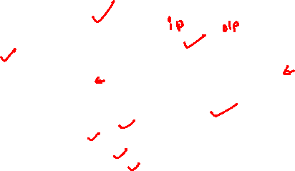
Why Study Encoder-Decoder?
Many NLP tasks require variable-length sequence-to-sequence mapping: Sentiment Analysis:
⁾ Input: ”The phone battery lasts only 2 hours. Very disappointed.”
⁾ Output: ”Negative”
Question Answering:
⁾ Input: Context + ”What is the capital of India?”
⁾ Output: ”New Delhi”
Text Summarization:
⁾ Input: 500-word article
⁾ Output: 50-word summary
Key observation: Input length T /= Output length T ^{r} in general.
Deep Neural Network

Slide 5
The Challenge: Standard RNN Limitations
Example: Question Answering fails with standard RNN
Standard RNN: Produces one output per input step (requires T = T ^{r})
Input: ”India gained independence from Britain. What year was independence?” (10 words)
Desired Output: ”1947” (1 word)
Problem: Standard RNN produces 10 outputs, not 1!
Output length T ^{r} = 4
y₂ y₃ y₄
h₂ h₃ h₄
y₁
h₁
x₁
x₂ x₃ x₄
Input length T = 4
Solution needed: Separate reading phase from generation phase.
Deep Neural Network

Slide 6



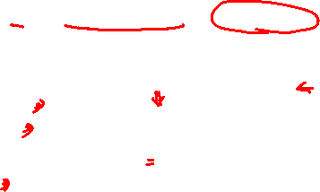
Solution: Encoder-Decoder Architecture
Key Idea: Two-stage process
1
Encoder: Read and compress entire input into context vector c
Decoder: Generate output sequence from context, one token at a time
Output: y₁, . . . , y_{T} ′
New Delhi
y₁ y₂ y₃
2
Read input
Context
Encoder
Decoder
c
(Fixed size)
Generate output
x₁
What
x₂
is
x₃
capital
Input: x₁, . . . , x_{T}
Flexibility: T (input length) can differ from T ^{r} (output length).
Deep Neural Network
6 / 70

Slide 7
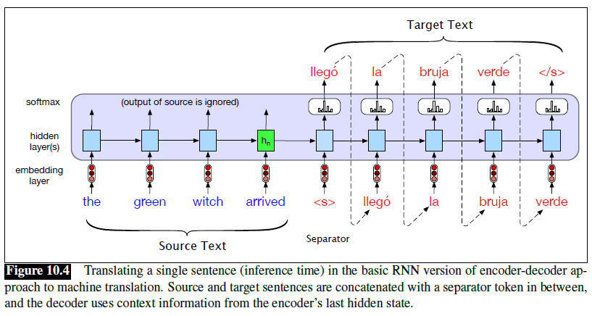
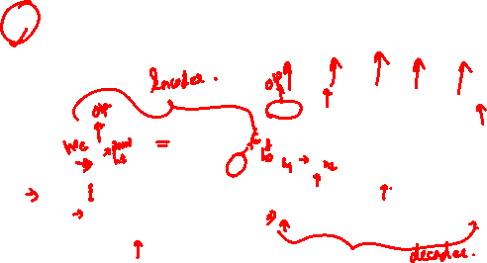
MT with RNN based encoder-decoder

Slide 8
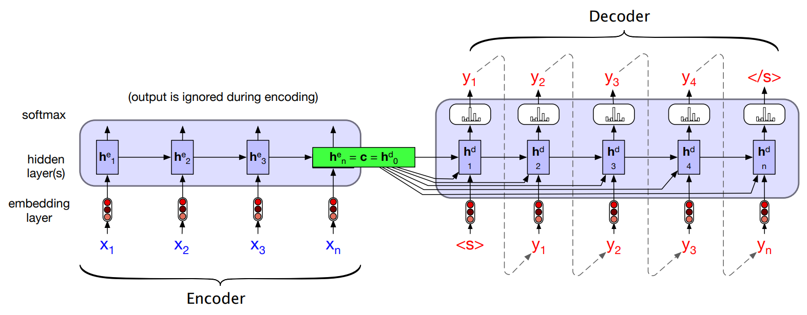
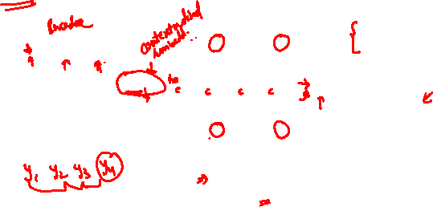
Encoder - Decoder using RNN
Encoder - Decoder for Language Translation
Encoder generates a contextualized representation of the input (last state)
Decoder takes that state and autoregressively generates a sequence of outputs
word generated at each time step is conditioned on word from previous step.

Slide 9
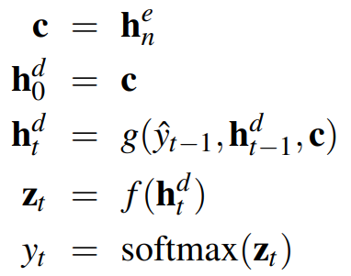
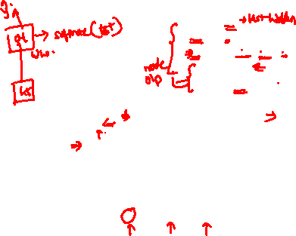
Encoder - Decoder
Encoder - Decoder for Language Translation

Slide 10
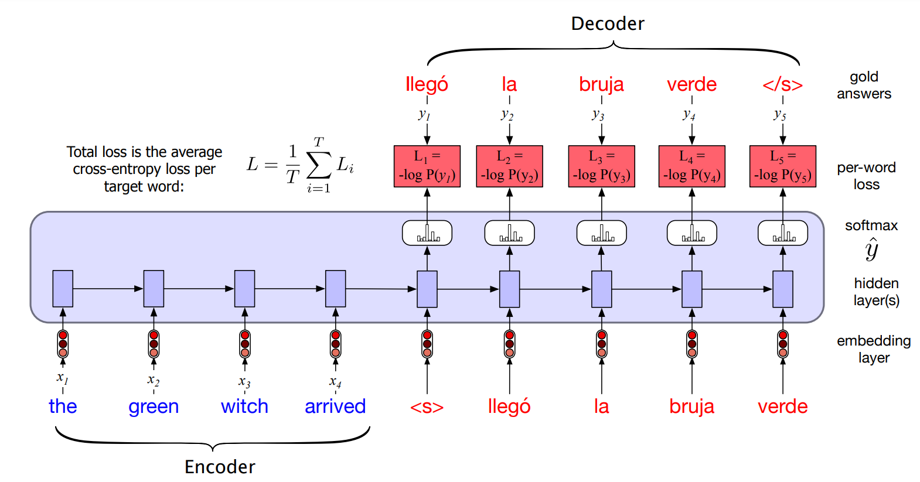
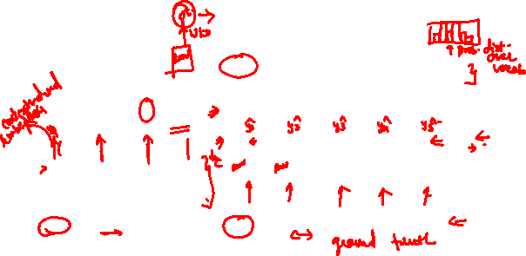
Encoder - Decoder
Training

Slide 11
How Encoder-Decoder Works
Phase 1: Encoding
⁾ Process input sequence with RNN:
_{h}enc _{= φ(W} enc_{h}enc _{+ W} enc_{xt + b}enc₎
t hh t —1 hx h
⁾ Extract context from final hidden state:
_{c = h}enc
T
Phase 2: Decoding
⁾ Initialize decoder with context:
_{h}dec _{= c}
0
⁾ Generate output sequence autoregressively:
_{h}dec _{= φ(W} dec_{h}dec _{+ W} dec_{yt —1 + b}dec₎
t hh t —1 hy h
⁾ Output probability distribution:
P(y |y , c) = softmax
dec
t <t
(W h + b )
o o
t
Deep Neural Network

Slide 12
Example: Question Answering with Encoder-Decoder
Task: Answer question from context
Context: ”India gained independence in 1947. Gandhi led the movement.” Question: ”What year was independence?”
Answer: ”1947”
⟨END⟩
1947 —
· · ·
c
What ^{year}
was indep. · · ·
move
Encoder: Process question + context
Decoder: Generate answer
Process:
⁾ Encoder reads entire input (T ≈ 15 tokens)
⁾ Context c encodes: ”answer is about year and independence”
⁾ Decoder generates: ”1947” then ⟨END⟩ (T ^{r} = 1 meaningful token)
Deep Neural Network

Slide 13
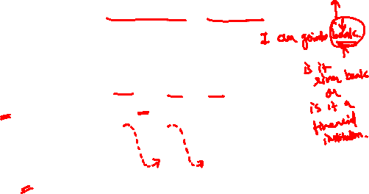
Training vs Inference
Training (Teacher Forcing): Use ground truth as decoder input
yˆ₁ yˆ₂ yˆ₃
c
y₀ (truth) y₁ (truth) y₂ (truth)
Inference (Free Running): Use model’s own predictions
yˆ₁ yˆ₂ yˆ₃
c
feedback
y₀ (START)
Exposure Bias: Decoder trained on ground truth but tested on own predictions!
Deep Neural Network

Slide 14
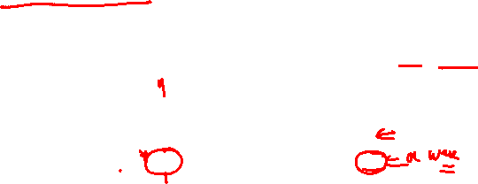
Issues with recurrent models
O(sequence length) steps for distant word pairs to interact means:
Forward and backward passes have O(sequence length) unparallelizable operations
RNNs are unrolled “left-to-right”.
This encodes linear locality: a useful heuristic!
Nearby words often affect each other’s meanings
Hard to learn long-distance dependencies (because gradient problems!)
tasty
pizza
The chef who …
was

Slide 15
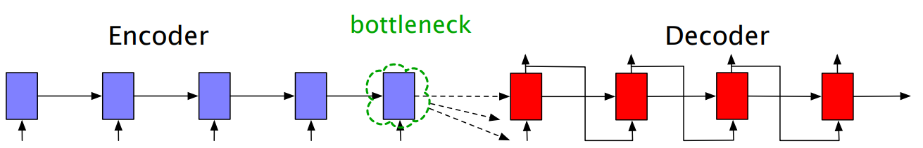
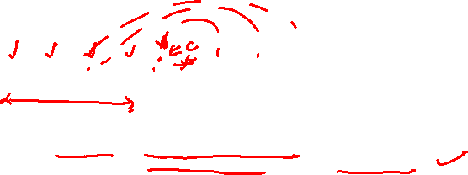
Encoder-decoder bottleneck
Final state of the E is the only context available to D
It must represent absolutely everything about the meaning of the source text
The only thing the decoder knows about the source text is what’s in this context vector

Slide 16
The Critical Problem: Context Bottleneck
All input information must pass through fixed-size vector c.
Input:
^{x}7 ^{x}10 · · ·
x₁ x₂ x₃ x₄ x₅ x₆
x₈ x₉
c
BOTTLENECK
Output:
y₁ y₂ y₃ y₄
y5
Problems:
1
Information loss: Long sequences → early tokens forgotten
2
Fixed capacity: Vector size (e.g., 512-dim) limits information storage Uniform encoding: All input parts weighted equally, no selectivity
3
Example: 50-word review compressed to 512 numbers, then generate sentiment!
Deep Neural Network

Slide 17
Bottleneck Impact: Concrete Example
Task: Sentiment analysis of product review Input (30 words):
”Ordered this laptop for work. Initial impressions were good. Fast delivery. However, after 2 weeks, battery drains in 2 hours. Screen flickers constantly. Very disappointed. Would not recommend.”
Initial good
Fast delivery
However | battery drains | screen flickers
Very disappointed
Not recommend
c (512-dim)
Early positive sentiment lost?
Key phrases ”very disappointed” weakened?
Issue: When generating ”Negative”, decoder needs to emphasize later parts, but c treats all parts equally!
Deep Neural Network

Slide 18
Why Fixed Context Fails for Long Sequences
Visualization of information loss:
Information in c
Early tokens
Later tokens dominate
Forgotten
Input position
Observations from research (Sutskever et al., 2014):
Performance degrades significantly for sequences > 30 tokens First few words often lost by the time decoder generates output Model struggles with long-range dependencies
Question: How can we avoid this bottleneck?
Deep Neural Network

Slide 19
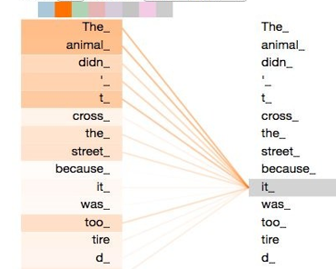
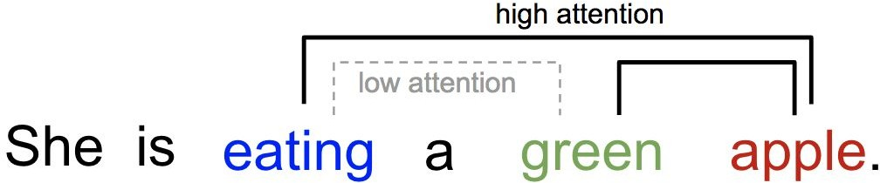
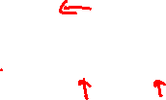
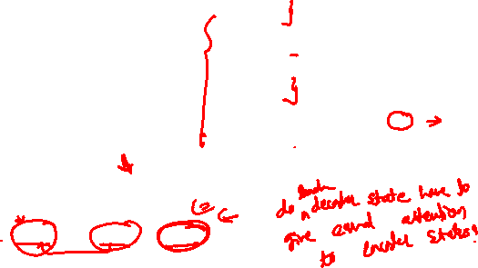
Context
“The animal didn't cross the street because it was too tired”
What is “it”?

Slide 20


Table of Contents
Encoder-Decoder Foundation Introduction to Attention Mechanisms Core Attention Concepts
Query-Key-Value Framework Attention Scoring Functions Bahdanau Attention for Seq2Seq Types of Attention
Self-Attention & Positional Encoding Summary & Key Takeaways
1
2
3
4
5
6
7
8
9
Deep Neural Network

Slide 21
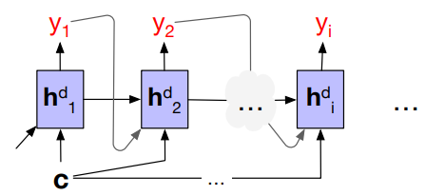
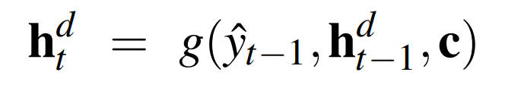
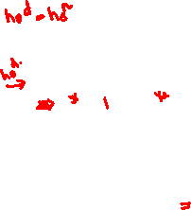
Attention ! (in RNN based encoder-decoder)
Without attention, a decoder sees the same context vector , which is a static function of all the encoder hidden states

Slide 22
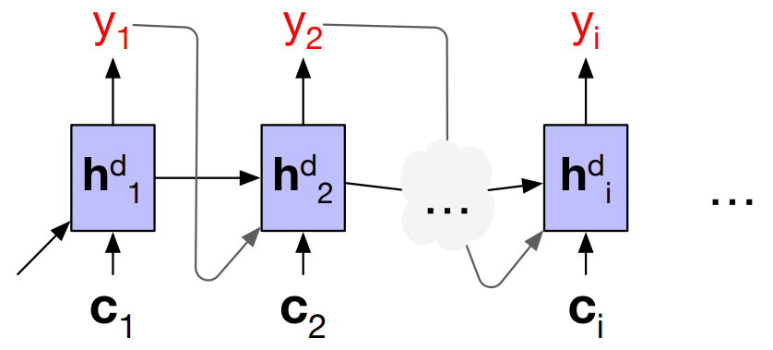
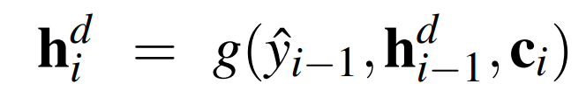
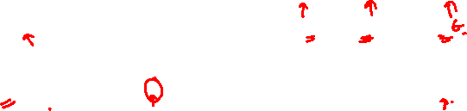
Attention ! (in RNN based encoder-decoder)
Without attention, a decoder sees the same context vector , which is a static function of all the encoder hidden states
With attention, decoder to sees a different, dynamic, context, which is a function of all the encoder hidden states

Slide 23
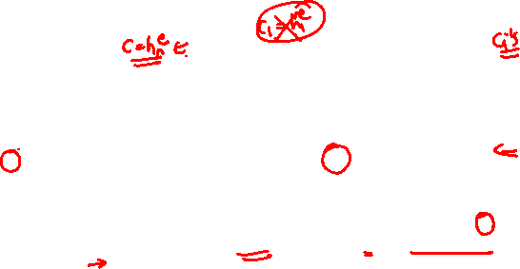
Attention !
Without attention, a decoder sees the same context vector , which is a static function of all the encoder hidden states
With attention, decoder to sees a different, dynamic, context, which is a function of all the encoder hidden states
With attention, decoder gets information from all the hidden states of the encoder, not just the last hidden state of the encoder
Each context vector is obtained by taking a weighted sum of all the encoder hidden states.
The weights focus on (‘attend to’) a particular part of the source text that is relevant for the token the decoder is currently producing

Slide 24
The Solution: Attention Mechanisms
Core Insight: Instead of single fixed context, let decoder selectively attend to relevant input parts at each step.
α₂=0.50_{α3=0.30}
α₁ =0.05 α₄ =0.10 α₅ =0.05
Encoder:
h₁ h₂ h₃ h₄ h₅
c_{t}
Dynamic!
Decoder:
s_{t}
Key Differences from Encoder-Decoder:
⁾ Before: Single context c for entire decoding
⁾ After: Different context c_{t} at each decoder step t
⁾ Weights α_{i} learned automatically from data
⁾ Focuses on relevant input positions dynamically
Deep Neural Network

Slide 25
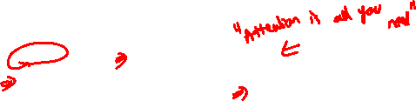
Historical Context: The Breakthrough
Timeline:
Seq2Seq
(Sutskever)
2014
Attention
(Bahdanau)
2014
Transformer
(Vaswani)
2017
Fixed context bottleneck
Dynamic attention
Pure attention
Impact of Bahdanau et al. (2014):
Introduced attention for neural machine translation Improved BLEU scores significantly on long sentences Decoder could ”align” to relevant source words
Laid foundation for Transformer architecture (2017)
Deep Neural Network

Slide 26
Modern Landscape: Attention Everywhere
Attention has become the dominant mechanism across AI domains.
NLP
BERT, GPT, T5
Vision
ViT, DEIT, Swin
Attention
Speech
Conformer, Whisper
Multimodal
CLIP, Flamingo
Understanding attention is essential for modern deep learning.
Deep Neural Network

Slide 27

Table of Contents
Encoder-Decoder Foundation Introduction to Attention Mechanisms Core Attention Concepts
Query-Key-Value Framework Attention Scoring Functions Bahdanau Attention for Seq2Seq Types of Attention
Self-Attention & Positional Encoding Summary & Key Takeaways
1
2
3
4
5
6
7
8
9
Deep Neural Network

Slide 28


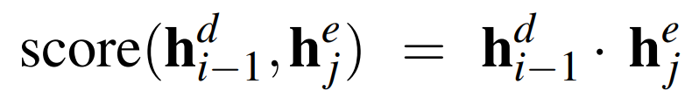
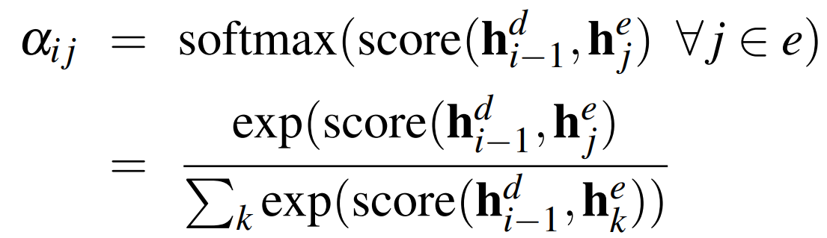
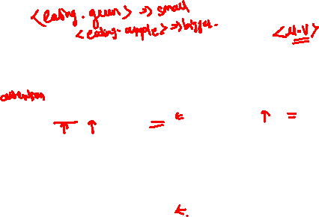



Attention !
Step -1 :
Find out how relevant each encoder state is to the present decoder state
Compute a score of similarity between and all the encoder states :
Dot Product Attention :
Step -2 :
Normalize all the scores with softmax to create a vector of weights, α_{i,j}
α_{i,j} indicates the proportional relevance of each encoder hidden state j to the prior hidden decoder state,

Slide 29
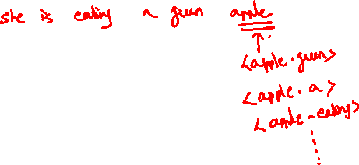

Slide 30
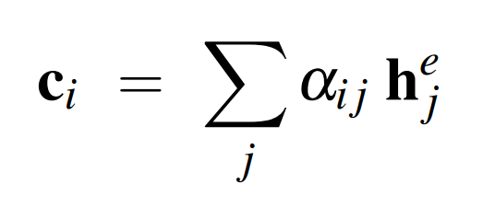
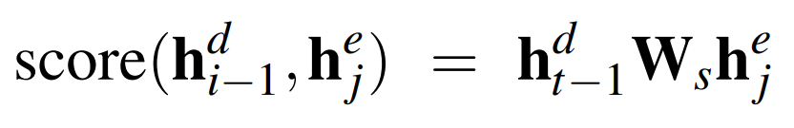

Attention !
Step -3 :
Given the distribution in α, compute a fixed-length context vector for the current decoder state by taking a weighted average over all the encoder hidden states
Plus :
In step-1, we can get a more powerful scoring function by parameterizing the score with its own set of weights, W_{s}:
W_{s} , is trained during normal end-to-end training,
W_{s} , gives the network the ability to learn which aspects of similarity between the decoder and encoder states are important to the current application.

Slide 31
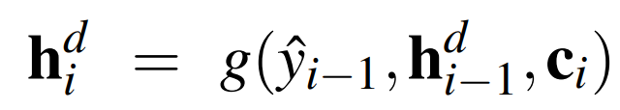
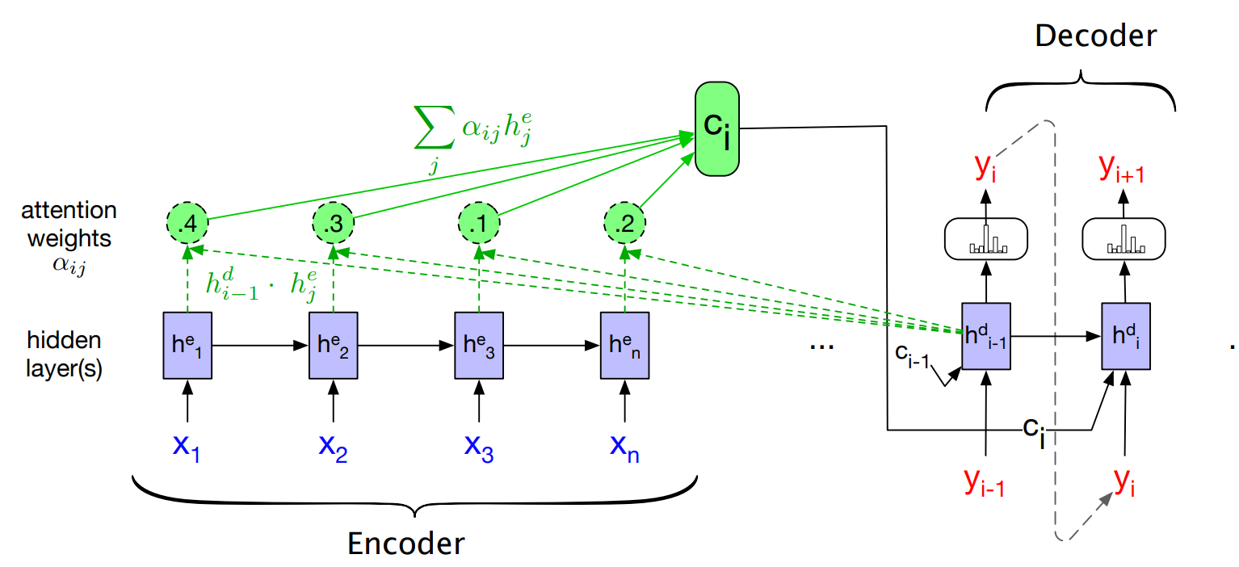
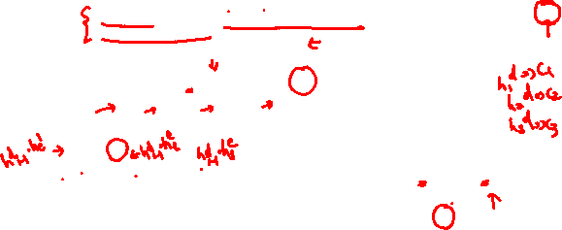
Attention !
compute a fixed-length context vector for the current decoder state by taking a weighted average over all the encoder hidden states.

Slide 32
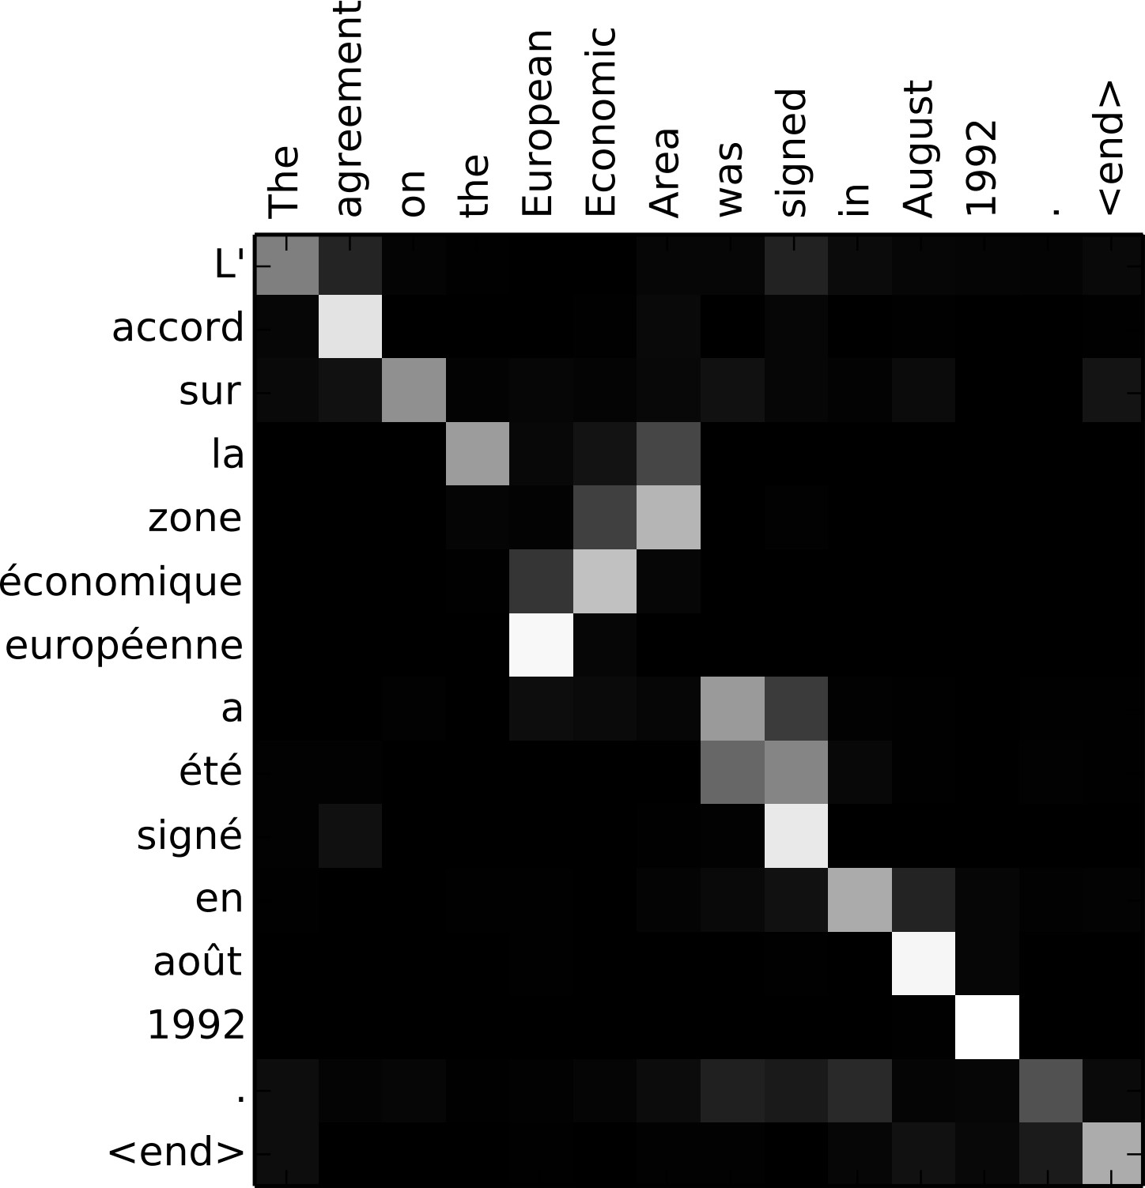
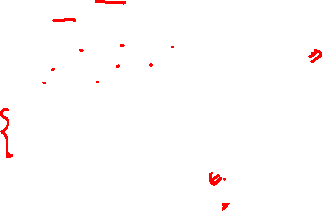
Sequence-to-Sequence with RNNs and Attention
Visualize attention weights a_{t,i}
Example: English to French translation
Input: “The agreement on the European Economic Area was signed in August 1992.”
Output: “L’accord sur la zone économique européenne a été signé en août 1992.”
Bahdanau et al, “Neural machine translation by jointly learning to align and translate”, ICLR 2015

Slide 33
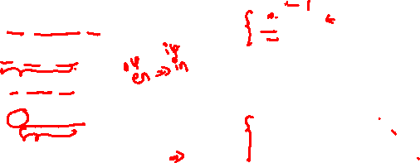
Sequence-to-Sequence with RNNs and Attention
Visualize attention weights a_{t,i}
Example: English to French translation
Input: “The agreement on the European Economic Area was signed in August 1992.”
Diagonal attention means words correspond in order
Output: “L’accord sur la zone économique européenne a été signé en août 1992.”
Diagonal attention means words correspond in order
Bahdanau et al, “Neural machine translation by jointly learning to align and translate”, ICLR 2015

Slide 34
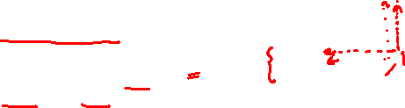
Sequence-to-Sequence with RNNs and Attention
Visualize attention weights a_{t,i}
Example: English to French translation
Input: “The agreement on the European Economic Area was signed in August 1992.”
Diagonal attention means words correspond in order
Attention ﬁgures out diﬀerent word orders
Output: “L’accord sur la zone économique européenne a été signé en août 1992.”
Diagonal attention means words correspond in order
Bahdanau et al, “Neural machine translation by jointly learning to align and translate”, ICLR 2015

Slide 35
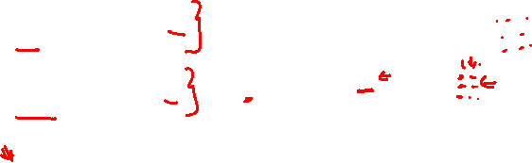
Sequence-to-Sequence with RNNs and Attention
Visualize attention weights a_{t,i}
Example: English to French translation
Input: “The agreement on the European Economic Area was signed in August 1992.”
Diagonal attention means words correspond in order
Attention ﬁgures out diﬀerent word orders
Output: “L’accord sur la zone économique européenne a été signé en août 1992.”
Verb conjugation
Diagonal attention means words correspond in order
Bahdanau et al, “Neural machine translation by jointly learning to align and translate”, ICLR 2015

Slide 36
Attention
Definition
Attention is a mechanism that computes a weighted sum of values based on the similarity between a query and keys.
Components:
Query (q): What we’re looking for (decoder state)
Keys ({k_{i} }): What’s available to match (encoder states) Values ({v_{i} }): Actual content to retrieve (encoder states)
Mathematical Form:
Σ
n
n
Attention
(q, {k , v } ) = α v
i i
i=1
i i
i=1
where attention weights:
exp(score
(q, k ))
α =
i
(softmax normalization)
i
n
exp(score(q, k_{j} ))
Deep Neural Network

Slide 37


Core Concept: Weighted Combinations
Key Principle: Not all inputs contribute equally – attention learns relevance.
Without Attention: With Attention:
!
!
Σ Σ
n n
output = f x_{i} output = f α_{i} x_{i}
i=1 i=1
Uniform weighting
Σ
Learned weights α_{i}
Σ
α₂ x₂
x₁ x₂ x₃ x₄
α₃ x_{3 α4 x4}
Σ
α₁ x₁
Constraint: Weights sum to 1:
n i=1
α_{i} = 1 (probability distribution)
Deep Neural Network

Slide 38
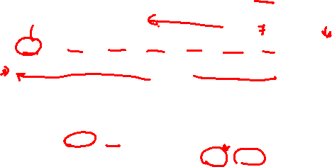
Example 1: Stock Price Prediction
Task: Predict tomorrow’s gold price (|/gram) using past 7 days.
Input: Gold prices = [|6,200, |6,180, |6,150, |6,250, |6,280, |6,270, |6,300]
|6200
|6180
|6150
|6250
|6280
|6270
|6300
Query: Tomorrow?
α₁ = 0.03 α₂ = 0.05 α₃ = 0.07
α₄ = 0.15
α5 = 0.25
α₆ = 0.23
α7 = 0.22
Context c = Weighted avg
|6,261
Observation: Recent days (5-7) receive higher attention weights α_{i} .
c ≈ 0.03 × 6200 + 0.05 × 6180 + 0.07 × 6150 + 0.15 × 6250+
0.25 × 6280 + 0.23 × 6270 + 0.22 × 6300
≈ 6261
Deep Neural Network

Slide 39

Example 2: Sentiment Analysis
Task: Classify review sentiment while identifying key phrases. Input: ”The product quality is excellent but delivery was very slow”
is
The
0.02
product |  |  |  | quality
 | 0.15 |  |  |  | 0.2
excellent
 | 0.35
but
0.08
delivery
 | 0.1
slow
0.08
0.02
Weighted context
emphasizes ”excellent”
Classify sentiment
Positive
Key Insight: Model learns ”excellent” (α₅ = 0.35) is most important for sentiment, despite negative word ”slow” present.
Deep Neural Network

Slide 40
Example 3: Q& A with Attention
Context: ”Mumbai is the financial capital. Delhi is the national capital.” Question: ”What is the national capital?”
Mumbai
is
financial
capital
Delhi
is
national
capital
0.05
0.02
0.08
0.03
0.45
0.02
0.2
0.15
Answer ”national capital”
Delhi
Attention weights show:
Highest attention on ”Delhi” (α₅ = 0.45)
Secondary attention on ”national” (α₇ = 0.20) and ”capital” (α₄ = 0.15) Model correctly ignores ”financial capital”
Deep Neural Network

Slide 41




Without vs With Attention: Side-by-Side
Without Attention: With Attention:
h₁ h₂ h₃ h₄
h₁ h₂ h₃ h₄
c
c₁
s₁
Output
s₁
Output
Issues:
Benefits:
Fixed bottleneck c Information loss Poor long sequences
Dynamic context c_{t}
Selective focus
Handles long sequences
Key Difference: Context adapts to what decoder needs at each step!
Deep Neural Network

Slide 42

Table of Contents
Encoder-Decoder Foundation Introduction to Attention Mechanisms Core Attention Concepts
Query-Key-Value Framework Attention Scoring Functions Bahdanau Attention for Seq2Seq Types of Attention
Self-Attention & Positional Encoding Summary & Key Takeaways
1
2
3
4
5
6
7
8
9
Deep Neural Network

Slide 43
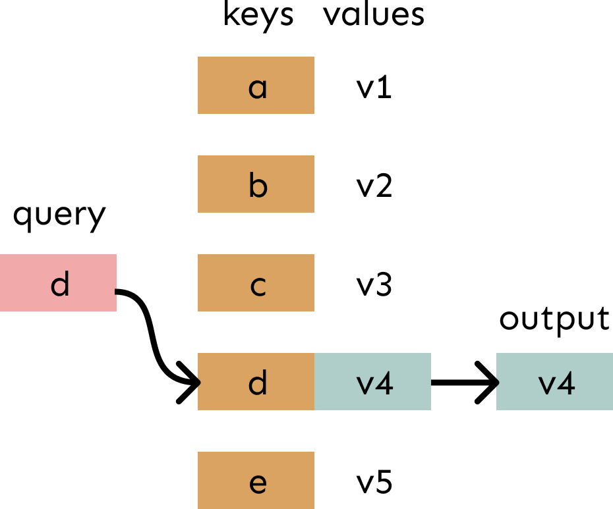
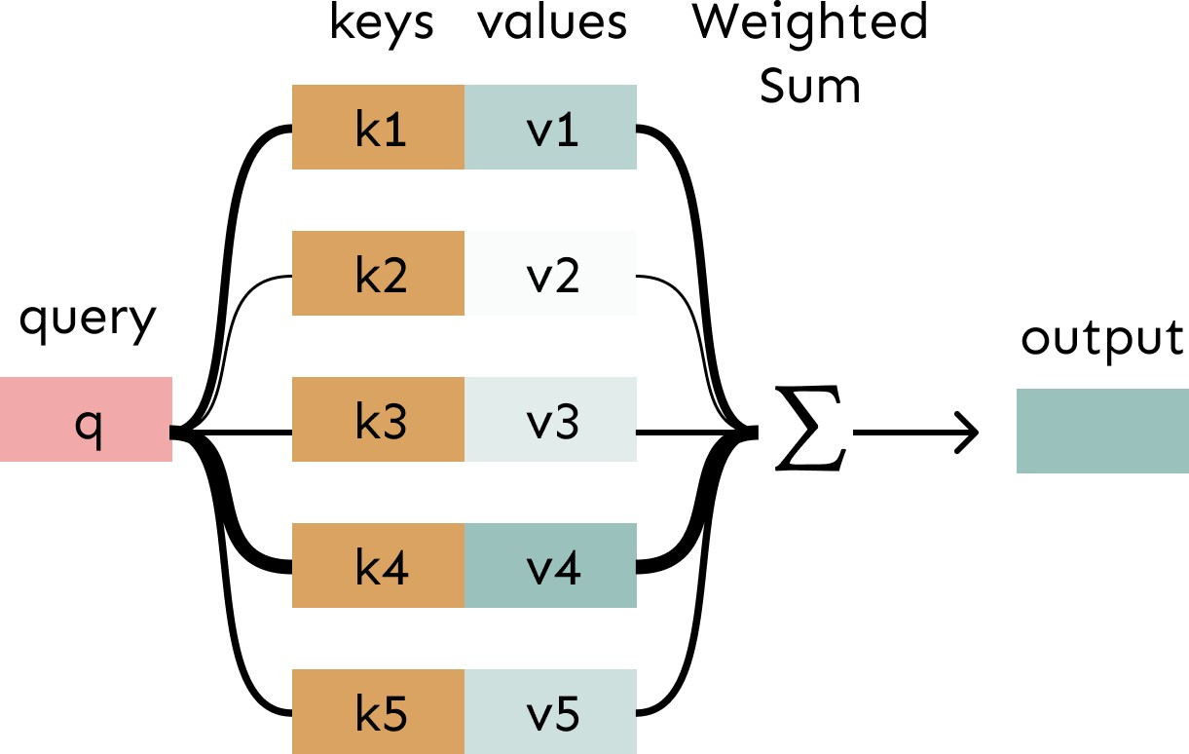
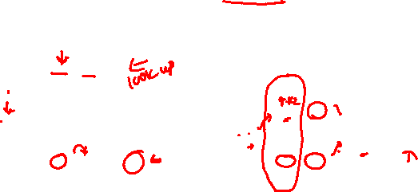
Attention as a soft, averaging lookup table
We can think of attention as performing fuzzy lookup in a key-value store.
In a lookup table, we have a table of keys that map to values. The query matches one of the keys, returning its value.
In attention, the query matches all keys softly, to a weight between 0 and 1. The keys’ values are multiplied by the weights and summed.
Credits: Stanford CS224N

Slide 44
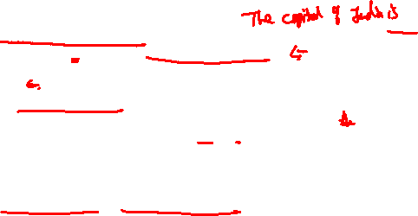
Query-Key-Value (QKV): Components
Three distinct roles in attention mechanism: Query (q):
⁾ What information are we seeking?
⁾ Comes from decoder state: ”I need to generate next word”
⁾ Example: Decoder state when generating ”Delhi”
Keys ({k_{i} }):
⁾ What’s available to match against?
⁾ Comes from encoder states: representations of input tokens
⁾ Example: Encoded representations of [Mumbai, is, financial, capital, Delhi, ...]
Values ({v_{i} }):
⁾ What actual content do we retrieve?
⁾ Also from encoder states (often same as keys)
⁾ Example: Contextual embeddings of input words
Intuition: Query searches Keys, retrieves matching Values.
Deep Neural Network

Slide 45






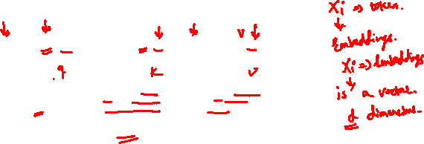
Scaled – Dot product Attention
1. Transform each word embedding with weight matrices W^{Q}, W^{K}, W^{V} , each in ℝ^{𝑑×𝑑}
In Vaswani et al., 2017, d was 1024.
Query, Q
Key, K
Value, V
As the current focus of attention when being compared to all of the other preceding inputs.
In its role as a preceding input being compared to the current focus of attention.
As a value used to compute the output for the current focus of attention
Three different roles each x_{i} (input embedding) , in the computation of self attention

Slide 46
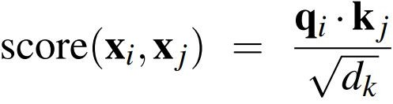
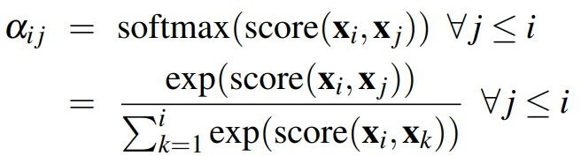


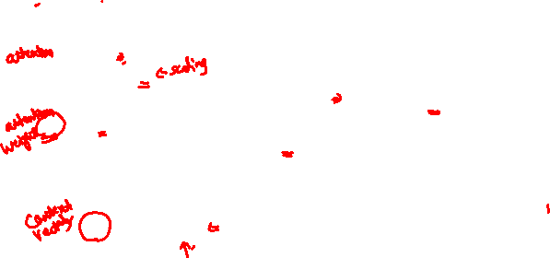
Scaled – Dot product Attention
2. Compute pairwise similarities between keys and queries (alignment score)
The simple dot product can be an arbitrarily large; scaled dot-product is used in transformers
3. Normalize with softmax
d_{k} =dimensionality of the query and key vectors acts as regularization and improve performance of larger models
Alignment scores measures of how well
the query and keys match
4. Compute output for each word as weighted sum of values

Slide 47
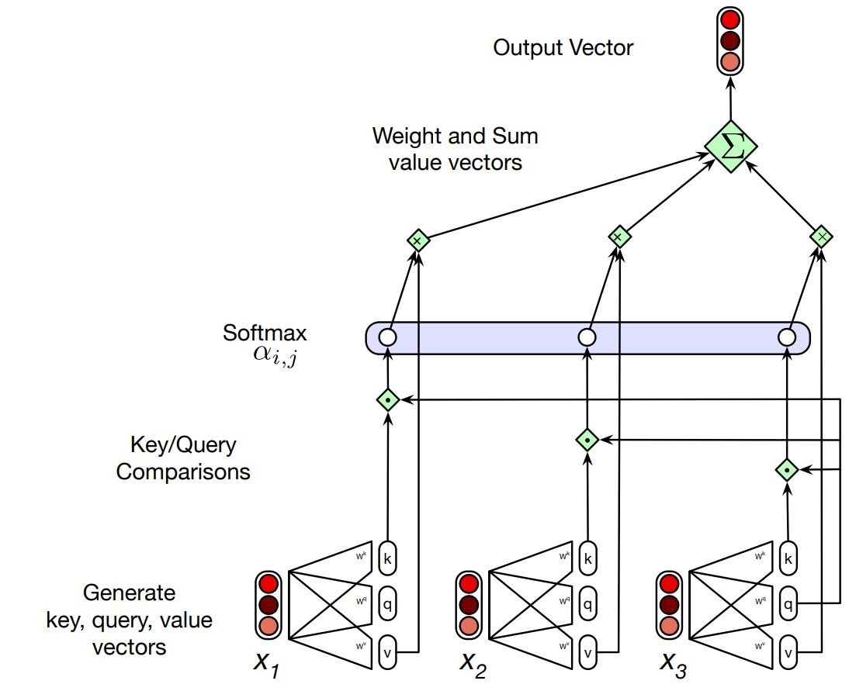


Self-Attention | Transformers
Each output, y , is
computed independently
Entire process can be parallelized
Calculating the value of y3, the third element of a sequence
using causal (left-to-right) self-attention
28

Slide 48



Parallelized using efficient matrix multiplication
Create three vectors from each of the encoder’s input values (query, key, value)
We sometimes say that the query attends to the values. E.g. in the seq2seq + attention model, each decoder hidden state (query) attends to all the encoder hidden states (values).

Slide 49



Scaled – Dot product Attention
For N tokens
Pack the input embeddings of the N input tokens into a single matrix
Each row of X is the embedding of one token of the input
Multiply X by the key, query, and value (dxd) matrices

Slide 50

Attention as Information Retrieval
Analogy: Attention works like a database lookup system.
Memory (Key-Value Store)
Key: Mumbai → Value: Info1
Weighted Context
Query
Key: Delhi → Value: Info2
Key: Bangalore → Value: Info3
”What is national capital?”
Similarity Matching |  | Softmax (weights)
Process:
Query searches memory via key similarity
Compute attention weights based on query-key match Retrieve values weighted by attention
1
2
3
Deep Neural Network

Slide 51
QKV Paradigm: Detailed Mechanics
Step-by-step attention computation:
1
Compute compatibility scores between query and all keys:
e_{i} = score(q, k_{i} ) for i = 1, . . . , n
2
Normalize with softmax to get attention weights:
exp(e )
Σ
α = Σ
i
(ensures α = 1)
i
n
exp(e_{j} )
i
j=1
i
3
Compute weighted sum of values:
Σ
n
c = α v
i i
i=1
Deep Neural Network

Slide 52
QKV Paradigm: Visual
Query q : What information are we seeking? Decoder state Key k_{ı} : What’s available to match against? Encoder state Value v_{ı} : What actual content do we retrieve? Encoder state
α₁ =0.1 α₂ =0.5 α₃ =0.3 α₄ =0.1
k₁ k₂ k₃ k₄
v₁ v₂ v₃ v₄
q
c
α_{i} = softmax (score(q, k_{i} )) for i = 1, . . . , n
n
Σ
c = α v
i i
i=1
Deep Neural Network

Slide 53

Attention as Weighted Pooling
Pooling Perspective: Attention is soft, adaptive pooling over sequence.
Max Pooling Avg Pooling Attention Pooling
0.1
0.5
0.2 0.2
3 7 2 5
3 7 2
5
3
7 2
5
Σ
max = 7
avg = 4.25
α v
i i
Hard selection Uniform weights Learned weights
Key Difference:
Max/Avg pooling: Fixed, uniform aggregation
Attention: Data-dependent, learned aggregation based on query
Deep Neural Network

Slide 54

Table of Contents
Encoder-Decoder Foundation Introduction to Attention Mechanisms Core Attention Concepts
Query-Key-Value Framework Attention Scoring Functions Bahdanau Attention for Seq2Seq Types of Attention
Self-Attention & Positional Encoding Summary & Key Takeaways
1
2
3
4
5
6
7
8
9
Deep Neural Network

Slide 55


Dot-Product Attention

Slide 56

Example: Dot-Product Attention
Example: Stock price prediction
Query: q = [0.8, 0.6]^{T} (tomorrow’s expected trend features) Keys: k₁ = [0.5, 0.3]^{T}, k₂ = [0.9, 0.7]^{T}, k₃ = [0.4, 0.2]^{T}
Scores:
e₁ = 0.8(0.5) + 0.6(0.3) = 0.58
e₂ = 0.8(0.9) + 0.6(0.7) = 1.14 (highest!)
e₃ = 0.8(0.4) + 0.6(0.2) = 0.44
Weights: α₁ = 0.21, α₂ = 0.62, α₃ = 0.17 (after softmax) Interpretation: Day 2 most aligned with query → highest attention.
Deep Neural Network

Slide 57


Scaled Dot-Product Attention
Problem: For large dimension d , dot products grow large → softmax saturates. Solution (Vaswani et al., 2017): Scale by √d_{k} to normalize variance.
Benefits:
Keeps scores in reasonable range regardless of dimension Prevents vanishing gradients in softmax
Standard in all Transformer models
Deep Neural Network

Slide 58
Why Scaling Matters: Gradient Flow
Effect of scaling on softmax gradients:
Without scaling (d = 512)
With scaling
1
softmax(x/√d )
1
softmax(x )
0.5
0.5
Good gradients
∇ healthy
Saturated
∇ ≈ 0
0
0
−10 0 10
−10 0
10
√
Score x
Score x/ d
Impact:
Left: Large scores push softmax to extremes (0 or 1) Right: Scaled scores maintain gradient flow
Critical for training deep networks (6-24+ layers)
Deep Neural Network

Slide 59

Additive Attention (Bahdanau, 2014)
Original attention mechanism for neural machine translation.
score(q, k_{i} ) = v^{T} tanh(W_{q} q + W_{k} k_{i} )
where:
W_{q} ∈ R^{h×dq} : Query projection matrix
W_{k} ∈ R^{h×dk} : Key projection matrix
v ∈ R^{h} : Learnable weight vector
h: Hidden dimension (hyperparameter, e.g., 256) Computation flow:
q
W_{q}
+
tanh
_{v}T
e_{i}
k_{i}
W_{k}
nsions).
35 / 70

Slide 60
Comparison: Dot-Product vs Additive
Aspect Dot-Product (Scaled) Additive (Bahdanau)
q^{T}k
√_{dk}
T
Formula
v tanh(W_{q} q + W_{k} k)
Parameters | None | W_{q}, W_{k} , v
Complexity | O(d ) per pair | O(d · h + h) per pair
Expressiveness | Limited to linear | Nonlinear (tanh)
Parallelization | Excellent (matrix mult) | Moderate
Dimension req. | Requires d_{q} = d_{k} | Works with d_{q} /= d_{k}
Modern usage | Transformers | Early seq2seq
Historical note: Additive was better for RNN-based models (2014-2016), but scaled dot-product dominates in Transformer era (2017+).
Deep Neural Network

Slide 61
Computational Complexity Analysis
For sequence length n, dimension d , and m queries:
Operation | Scaled Dot-Product | Additive
Score computation | O(mnd ) | O(mndh + mnh)
Softmax | O(mn) | O(mn)
Weighted sum | O(mnd ) | O(mnd )
Total | O(mnd) | O(mndh)
Matrix formulation (batch processing):
Scaled dot-product: QK^{T} ∈ R^{m×n} computed in one GPU operation Highly parallelizable on modern hardware (GPUs/TPUs)
Memory efficient: O(mn) for attention matrix
Practical impact: Dot-product is 3-5× faster in practice due to better hardware utiliza-tion.
Deep Neural Network

Slide 62


Scoring Functions: Overview
The scoring function score(q, k) measures query-key compatibility.
Design Trade-offs:
Dot product: Fast (matrix ops), no parameters, requires d_{q} = d_{k}
Scaled Dot Product : Prevents saturation for large dimensions (Transformer default)
Additive: More expressive, flexible dimensions, more parameters
Deep Neural Network

Slide 63

Table of Contents
Encoder-Decoder Foundation Introduction to Attention Mechanisms Core Attention Concepts
Query-Key-Value Framework Attention Scoring Functions Bahdanau Attention for Seq2Seq Types of Attention
Self-Attention & Positional Encoding Summary & Key Takeaways
1
2
3
4
5
6
7
8
9
Deep Neural Network

Slide 64



Bahdanau Attention: The Breakthrough
Key Innovation (Bahdanau et al., 2014): Replace fixed context with dynamic atten-tion.
Context at time t :
where α_{t,i} depends on current decoder state s_{t —1} and encoder state h_{i} .
Deep Neural Network

Slide 65


Bahdanau Attention: Math
At each decoder time step t :
Step 1: Compute alignment scores
Step 2: Normalize to attention weights
Step 3: Compute context vector
Step 4: Update decoder state
Step 5: Generate output distribution
Deep Neural Network

Slide 66
Encoder with Attention: Bidirectional RNN
Bahdanau used bidirectional RNN encoder to capture context from both directions.
^{→−}h _{i} = RNN_{fwd}(x_{i} , ^{→−}h _{i—1})
^{←−}h _{i} = RNN_{bwd}(x_{i} , ^{←−}h _{i+1})
h₁
h₂
h₃
h₄
h_{i} = [^{→−}h _{i} ; ^{←−}h _{i} ]
Backward:
←−
←−
←−
←−
h ₁
h ₂
h ₃
h ₄
Forward:
→−
→−
→−
→−
h ₁
h ₂
h ₃
h ₄
x₁
Benefit: h_{i} encodes both past and future context for position i .
x₂
x₃
x₄
Deep Neural Network

Slide 67
Attention Alignment: Visualization
Example: Hindi to English translation Source (Hindi): yah kitaab bahut achchhi hai Target (English): This book is very good
Hindi:
This book
is very
good
yah kitaab bahut achchhi hai
English:
High
Low
Observations:
Strong diagonal pattern: word-level alignment ”yah” ↔ ”This”: α = 0.85
”kitaab” ↔ ”book”: α = 0.82
Deep Neural Network

Slide 68

Example: Q& A with Attention
Context: ”Mumbai is the financial capital. The Reserve Bank is located there.” Question: ”Where is Reserve Bank?”
Answer: ”Mumbai”
0.15
0.2
· · ·
· · ·
0.55
Mumbai
Where
is Reserve Bank
Mumbai
Encoder: Process context + question Decoder: Attends to ”Mumbai”
Attention interpretation:
Decoder focuses on context mentioning ”Reserve Bank” and ”Mumbai” Highest weight (α = 0.55) on ”Mumbai” in context
Successfully extracts answer from relevant part of input
Deep Neural Network

Slide 69
Implementation Considerations
Training with Attention:
⁾ Teacher forcing: Use ground-truth y_{t —1} as decoder input
⁾ Loss function: Cross-entropy over target vocabulary
_{T} ′
Σ
∗ ∗
L = − log P(y |y , x)
t <t
t =1
⁾ Optimizer: Adam with learning rate warmup and decay
⁾ Regularization: Dropout on encoder/decoder states and attention weights
Inference with Attention:
⁾ Greedy decoding: Select arg max_{y} P(y_{t} |y_{<t} , x) at each step
⁾ Beam search: Maintain top-k hypotheses (typical k = 5)
⁾ Attention recomputed: Fresh context c_{t} at each decoder step
⁾ Stopping: Generate until ⟨END⟩ token or max length
Computational cost:
⁾ Attention: O(T × T ^{r}) for input length T , output length T ^{r}
⁾ Manageable for t
y
pical sequence lengths (T , T ^{r} < 1
00 in 2014)
Deep Neural Network
45 / 70

Slide 70

Table of Contents
Encoder-Decoder Foundation Introduction to Attention Mechanisms Core Attention Concepts
Query-Key-Value Framework Attention Scoring Functions Bahdanau Attention for Seq2Seq Types of Attention
Self-Attention & Positional Encoding Summary & Key Takeaways
1
2
3
4
5
6
7
8
9
Deep Neural Network

Slide 71
Attention is a general Deep Learning technique
Attention significantly improves performance
It’s very useful to allow decoder to focus on certain parts of the source
Attention solves the bottleneck problem
Attention allows decoder to look directly at source; bypass bottleneck
Attention helps with the vanishing gradient problem
Provides shortcut to faraway states
By inspecting attention distribution, we see what the decoder was focusing on
Attention ⇒ Ability to compare an item of interest to a collection of other items in a way that reveals their relevance in the current context.
Self-attention ⇒
> Set of comparisons are to other elements within a given sequence
> Use these comparisons to compute an output for the current input

Slide 72
Self-Attention | Transformers
Each output, y , is
computed independently
Entire process can be parallelized
Calculating the value of y3, the third element of a sequence
using causal (left-to-right) self-attention
28

Slide 73


Self-Attention Hypothetical Example
Image credit: https://towardsdatascience.com/attention-please-85bd0abac41#:~:text=If%20keys%2C%20values%20and%20queries,things%20at%20the%20same%20time.

Slide 74
Attention Types: Taxonomy
Type | Q Source | K,V Source | Use Case
Self-Attention | Same sequence | Same sequence | Intra-sequence rela-
 |  |  | tionships
Cross-Attention | Sequence A | Sequence B | Inter-sequence align-
 |  |  | ment (seq2seq)
Masked Attention | Same sequence | Same (causal mask) | Autoregressive gener-
 |  |  | ation
Multi-Head | Same (parallel) | Same (parallel) | Multiple relationship
 |  |  | types
Key Distinctions:
Source of Q, K, V: Where do query, key, value vectors come from? Masking: What positions can attend to what?
Purpose: What relationships are being modeled?
Deep Neural Network

Slide 75
Self-Attention: Definition and Purpose
Self-attention: Query, key, and value all come from the same sequence.
Q = XW_{Q}, K = XW_{K} , V = XW_{V}
where X = [x₁, . . . , x_{n} ]^{T} is the input sequence. Purpose: Model relationships within a sequence.
Time Series Example: Stock price prediction using past 24 hours
⁾ Input: Gold prices over 24 hours: [|6,180, |6,200, . . ., |6,280]
⁾ Self-attention allows each hour to attend to all other hours
⁾ Example: Hour 24 might attend strongly to hours 17, 10, 3 (7-hour periodicity)
⁾ Captures temporal patterns automatically
Text Example: ”The student didn’t pass the exam because he was unprepared”
⁾ Self-attention helps ”he” attend to ”student”
⁾ Resolves coreference within the sentence
⁾ Captures long-range dependencies (”he” → ”student”)
Deep Neural Network

Slide 76
Self-Attention: Visualization
Text Example: Pronoun resolution with self-attention
Sentence: ”The customer complained because he received wrong order”
The customer complained because he
Self-attention learns: ”he” → ”customer” (high weight)
received
wrong
order
Deep Neural Network

Slide 77
Self-Attention: Visualization
Time Series: Each time step attends to relevant past time steps
Price (|)
Weekly pattern
Attends to 3h ago
Hour
Deep Neural Network

Slide 78



Self Attention Vs Cross Attention

Slide 79
Cross-Attention: Inter-Sequence Alignment
Cross-attention: Query from one sequence, keys and values from another.
Q = X_{A}W_{Q}, K = X_{B} W_{K} , V = X_{B} W_{V}
Time Series Example: Multivariate forecasting
⁾ Sequence A: Stock prices (query current state)
⁾ Sequence B: Economic indicators (keys/values: inflation, GDP, interest rates)
⁾ Cross-attention: Stock prices attend to relevant economic indicators
⁾ Example: Gold price queries inflation rate and USD exchange rate
Text Example: Hindi → English translation
⁾ Sequence A (Decoder): English words being generated
⁾ Sequence B (Encoder): Hindi source sentence
⁾ When generating ”book”, decoder attends to Hindi ”kitaab”
⁾ Example: Generating ”yah kitaab achchhi hai” → ”This book is good”
² ”book” (EN) attends to ”kitaab” (HI) with α ≈ 0.85
² ”good” (EN) attends to ”achchhi” (HI) with α ≈ 0.78
Deep Neural Network

Slide 80
Cross-Attention: Visualization
Machine Translation Example: Hindi to English
Hindi:
yah
kitaab
achchhi
hai
α = 0.85
α = 0.82
α = 0.78
English: good
This book is
Key: Decoder (English) dynamically attends to relevant parts of encoder (Hindi).
This is exactly Bahdanau attention – the original cross-attention mechanism!
Deep Neural Network

Slide 81

Masked Attention: Causal/Autoregressive
Masked attention: Self-attention with causal constraint – can only attend to past.
Time Series Example: Stock price prediction (prevent future leakage)
⁾ Predicting price at time t using only times 1, . . . , t − 1
⁾ Mask prevents attending to future times t + 1, t + 2, . . .
⁾ Ensures no ”cheating” during training
⁾ Example: Predict tomorrow’s gold price without seeing tomorrow’s actual price
Text Example: GPT-style language modeling
⁾ Task: Predict next word given previous words. ”The customer was very ”
⁾ Token at position 5 (”very”) can only attend to positions 1-4
⁾ Cannot see future tokens during training or inference
⁾ Autoregressive: generate one token at a time, left-to-right
Deep Neural Network

Slide 82

Masked Attention: Causal/Autoregressive
Masking the future in self-attention
Calculation of the comparisons in QK results in a score for each query value to every key value, including those that follow the query
Inappropriate in the setting of language modeling
To use self-attention in decoders, we need to ensure we can’t peek at the future.
To enable parallelization, we mask out attention to future words by setting attention scores to −∞

Slide 83

Masked Attention: Causal Mask Visualization
Attention mask pattern: Query (row) attends to Key (column)
Interpretation: Lower triangular pattern ensures token i only sees tokens ≤ i . Implementation: Add −∞ to masked positions before softmax → weight = 0.
Deep Neural Network
54 / 70

Slide 84
Multi-Head Attention: Concept
Motivation: Single attention may miss different types of relationships. Solution: Use multiple attention ”heads” in parallel, each learning different patterns.
Time Series Example: Gold price with 3 heads
⁾ Head 1: Attends to short-term trends (last 2-3 days)
⁾ Head 2: Attends to weekly patterns (7-day cycles)
⁾ Head 3: Attends to monthly patterns (30-day trends)
⁾ Combined: Richer representation than single attention
Text Example: Sentence with 3 heads
⁾ Syntax head: Subject-verb-object relationships
² ”The customer complained” – verb attends to subject
⁾ Semantic head: Meaning and coreference
² ”he” attends to ”customer” (resolves pronoun)
⁾ Positional head: Adjacent word dependencies
² ”very happy” – modifier-adjective pair
Deep Neural Network

Slide 85
Multi-Head Attention: Architecture
Formula (Vaswani et al., 2017):
Q, K, V
MultiHead(Q, K, V) = Concat(head₁, . . . , head_{h} )W_{O}
where each head i computes:
W^{Q}, W^{K} ,
W^{Q}, W^{K} ,
W^{Q}, W^{K} ,
1 1
2 2
3 3
_{W}V
_{W}V
_{W}V
1
2
3
head_{i} = Attention(QW^{Q}, KW^{K} , VW^{V} )
i i i
Typical hyperparameters:
⁾ h = 8 heads
⁾ d_{model} = 512
⁾ d_{k} = d_{v} = 64 per head
head₁
head₂
head₃
Concat
W_{O}
Multi-head output
Deep Neural Network

Slide 86
When to Use Which Attention Type?
Attention Type
Use When...
Self-Attention
Modeling relationships within a single sequence
Building contextual representations (e.g., BERT encoder) Capturing long-range dependencies in text or time series
Cross-Attention
Aligning two different sequences (seq2seq) Translation, summarization, question answering Transformer decoder attending to encoder outputs
Masked
Autoregressive generation (language modeling) Preventing information leakage from future GPT-style models, time series forecasting
Multi-Head
Capturing diverse relationship types simultaneously All modern Transformers (BERT, GPT, T5, ViT) When you need multiple attention patterns
Deep Neural Network

Slide 87

Table of Contents
Encoder-Decoder Foundation Introduction to Attention Mechanisms Core Attention Concepts
Query-Key-Value Framework Attention Scoring Functions Bahdanau Attention for Seq2Seq Types of Attention
Self-Attention & Positional Encoding Summary & Key Takeaways
1
2
3
4
5
6
7
8
9
Deep Neural Network

Slide 88
Self-Attention: Formal Definition
Self-attention allows each position to attend to all positions in the same
sequence.
Given input X = [x₁, . . . , x_{n} ] ∈ R^{n×d} :
1
Linear projections:
Q = XW_{Q}, K = XW_{K} , V = XW_{V}
Scaled dot-product attention:
2
QK
T
Attention(Q, K, V) = softmax √_{dk} V
3
Output:
Z = Attention(Q, K, V) ∈ R^{n×dv}
Key property: Every output z is a weighted combination of all inputs {x } .
n
i j
j=1
Difference from RNN: Direct connections between all positions (no sequential bottleneck).
Deep Neural Network

Slide 89
CNNs vs RNNs vs Self-Attention: Comparison
Aspect Receptive field
CNN
Local (kernel k )
RNN
Sequential
Self-Attn Global (all)
(his-
tory)
O(n)
Sequential
Path length Parallelization Complexity Long-range Position info
O(log n)
High
O(1)
High
O(k · n · d ²)
O(n · d ²)
O(n² · d )
Many layers Vanishing grad
Implicit Built-in
Direct
Need encoding
Key insight: Self-attention provides O(1) path between any two positions! Trade-off: Better long-range modeling but O(n²) memory and computation.
Deep Neural Network

Slide 90
Parallelization: RNN vs Self-Attention
RNN (Sequential): Self-Attention (Parallel):
h₁ h₂ h₃
Must compute sequentially
h₄
x₁ x₂ x₃ x₄
Self-Attention (parallel)
z₁ z₂ z₃ z₄
All positions in parallel
Bottleneck: h₄ depends on h₃ depends on h₂ depends on h₁
Benefit: All outputs computed simultaneously on GPU!
Result: Transformers train 10-100× faster than RNNs for long sequences.
Deep Neural Network
61 / 70

Slide 91
Position-Invariance Problem
Critical issue: Self-attention is permutation-invariant !
Attention(X) = Attention(PX) for any permutation matrix P.
Example: These sentences are treated identically:
⁾ Original: ”The customer was happy with service”
⁾ Shuffled: ”service with happy was customer The”
Why? Attention weights depend only on content, not position. Problem for NLP: Word order matters!
⁾ ”Dog bites man” /= ”Man bites dog”
⁾ Need position information to distinguish
Solution: Inject positional information into input embeddings.
Deep Neural Network

Slide 92
Positional Encoding: The Solution
Add position information to input embeddings:
x_{i} (content)
+
x˜_{i} = x_{i} + p_{i}
Input to Transformer
p_{i} (position)
Two approaches:
Learned positional embeddings (BERT, GPT-2):
⁾ p_{i} is a learned parameter for each position i
⁾ Simple, but doesn’t generalize beyond training length
Fixed sinusoidal encoding (Original Transformer):
⁾ p_{i} computed using sine/cosine functions
⁾ Deterministic, generalizes to any sequence length
1
2
Deep Neural Network

Slide 93
Absolute Positional Encoding: Sinusoidal
Why Sinusoids?
Unique Signatures: Every position gets a unique vector.
Relative Positioning: Because of trigonometric identities, the model can learn to attend to relative positions
Extrapolation: Since these are continuous functions, the model can potentially handle sequences longer than those it saw during training.
pos: index of the word in the sequence (e.g., in "I am a robot," "I" is at pos=0, "am" is at pos=1)
d_{model}: total dimension of the embedding vector
i: index of the dimension within that vector. It ranges from 0 to d_{model}/2
10000^{2i}/d_{model} : Twavelength factor. As i increases, twavelength gets longer, meaning the values change more slowly across positions.

Slide 94
Absolute Positional Encoding: Sinusoidal
Vaswani et al. (2017): Use fixed sinusoidal functions.
pos
PE(pos, 2i ) = sin
₁₀₀₀₀2i/dmodel
pos ₁₀₀₀₀2i/dmodel
PE(pos, 2i + 1) = cos
pos: Position in sequence (0, 1, 2, . . .)
i : Dimension index (0, 1, . . . , d_{model}/2)
d_{model}: Model dimension (e.g., 512)
Intuition:
Different dimensions use different frequencies
Lower dimensions = lower frequency (long-range patterns) Higher dimensions = higher frequency (fine-grained positions) Each position gets unique encoding vector
Deep Neural Network
64 / 70

Slide 95
Why Sinusoidal Encoding Works
Key mathematical property: For any fixed offset k , PE(pos + k ) is a linear function of PE(pos).
PE(pos + k, 2i ) = M_{k} · PE(pos, 2i ) for some transformation matrix M_{k} Trigonometric identity:
sin(α + β) = sin α cos β + cos α sin β
cos(α + β) = cos α cos β − sin α sin β
Example: For dimension i , let ω_{i} = 1/10000^{2i/d}
PE(pos + k, 2i ) = sin((pos + k )ω_{i} ) = sin(posω_{i} ) cos(kω_{i} ) + cos(posω_{i} ) sin(kω_{i} )
This is a linear combination of PE(pos, 2i ) and PE(pos, 2i + 1).
Benefit: Model can learn to attend by relative position (e.g., ”3 positions back”).
Deep Neural Network

Slide 96

Table of Contents
Encoder-Decoder Foundation Introduction to Attention Mechanisms Core Attention Concepts
Query-Key-Value Framework Attention Scoring Functions Bahdanau Attention for Seq2Seq Types of Attention
Self-Attention & Positional Encoding Summary & Key Takeaways
1
2
3
4
5
6
7
8
9
Deep Neural Network

Slide 97
Summary: Attention Mechanisms
Attention Mechanism
⁾ Dynamic, weighted aggregation based on relevance
⁾ Query-Key-Value framework for information retrieval
⁾ Solves bottleneck by attending selectively
Scoring Functions
⁾ Dot-product: simple, fast
⁾ Scaled dot-product: prevents saturation (Transformer default)
⁾ Additive: more expressive, slower
Attention Types
⁾ Self: intra-sequence, Cross: inter-sequence
⁾ Masked: causal, Multi-head: diverse patterns
Positional Encoding
⁾ Required for position-aware self-attention
⁾ Sinusoidal: fixed, generalizable
1
2
3
4
Deep Neural Network

Slide 98
Key Formulas to Remember
1. Attention (general):
n
Σ
Attention
(q, {k , v }) = α v
where
α_{i} = softmax (score(q, k_{i} ))
i i i i
i=1
2. Scaled Dot-Product Attention:
QK
T
Attention(Q, K, V) = softmax √_{d} V
k
Multi-Head Attention:
MultiHead(Q, K, V) = Concat(head₁, . . . , head_{h} )W_{O}
Positional Encoding:
pos 10000^{2i/d}
pos 10000^{2i/d}
PE(pos, 2i ) = sin
, PE(pos, 2i + 1) = cos
Deep Neural Network

Slide 99
Key References
1
Bahdanau, D., Cho, K., & Bengio, Y. (2014). Neural Machine Translation by Jointly Learning to Align and Translate. ICLR 2015.
Luong, M.-T., Pham, H., & Manning, C. D. (2015). Effective Approaches to Attention-based Neural Machine Translation. EMNLP 2015.
Vaswani, A., et al. (2017). Attention Is All You Need. NeurIPS 2017.
Sutskever, I., Vinyals, O., & Le, Q. V. (2014). Sequence to Sequence Learning with Neural Networks. NeurIPS 2014.
The Illustrated Transformer (Jay Alammar) Visual guide to Transformer architecture https://jalammar.github.io/illustrated-transformer/
Attention? Attention! (Lilian Weng) Comprehensive blog post on attention mechanisms
https://lilianweng.github.io/posts/2018-06-24-attention/
2
3
4
5
6
Deep Neural Network

Slide 100

References
Zhang, A., Lipton, Z. C., Li, M., & Smola, A. J. (2023). Dive into deep learning. Cambridge University Press. Chapter 11.
Goodfellow, I., Bengio, Y., Courville, A. (2016). Deep Learning. MIT Press. Chapter 10.12
Deep Neural Network

