Slide 1


MICROSOFT
STOCK
PREDICTION
ANURAAG.R
20691A2805
DEVI CHANDU.K
199691A2811

Slide 2
INDEX
TOPIC | SLIDE .NO
PROJECT INTRODUCTION | 3
PURPOSE | 4
DATASET AND IMPLEMENTATION | 5
ALLGORITHMS | 6 - 10
CONCLUSION | 11

Slide 3

PROJECT INTODUCTION
“MICROSOFT STOCK” prediction using “Machine Learning”.
Now-a-Days “stock market” is quick and easiest income source.
Investing in stocks isn’t easy ,as all outsiders think.
As it was so risky ,by watching the past data predicting the fluctuations in stock prices can reduce the risk of loss .
So prediction is more important before investing in “stock market”.

Slide 4
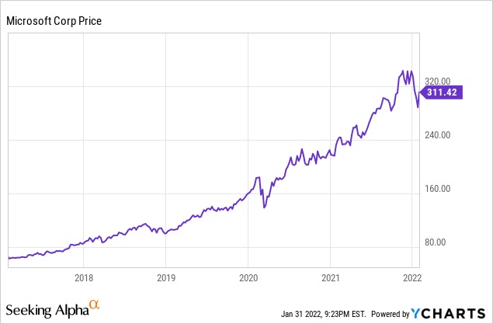
PURPOSE
By the help of this we can predict the stock price of “Microsoft” company for further dates.
We can help people who are investing in Microsoft stocks to get some notable profits instead of some losses.
Every predicted output with this model will be more accurate to current stock price.

Slide 5
DATASET
The dataset is taken from a website named “ Kaggle.com”
From this previous 1 years data of “MICROSOFT STOCK” has take dated (1-APR-2015 to 31-MAR-2021).
https://query1.finance.yahoo.com/v7/finance/download/MSFT?period1=1639340934&period2=1670876934&interval=1d&events=history&includeAdjustedClose=true
IMPLEMENTATION OF THE PROJECT: https://colab.research.google.com/drive/1tc22IYvTRiS-D44Sxr23rUqI9yQBruVs?usp=sharing

Slide 6
Algorithms
Three Machine Learning algorithms are used in this project. Based on the accuracy user can use the particular algorithm.
Algorithms :
Linear Regression
K-Nearest Neighbours
Auto ARIMA
Long Short Term Memory (LSTM)

Slide 7
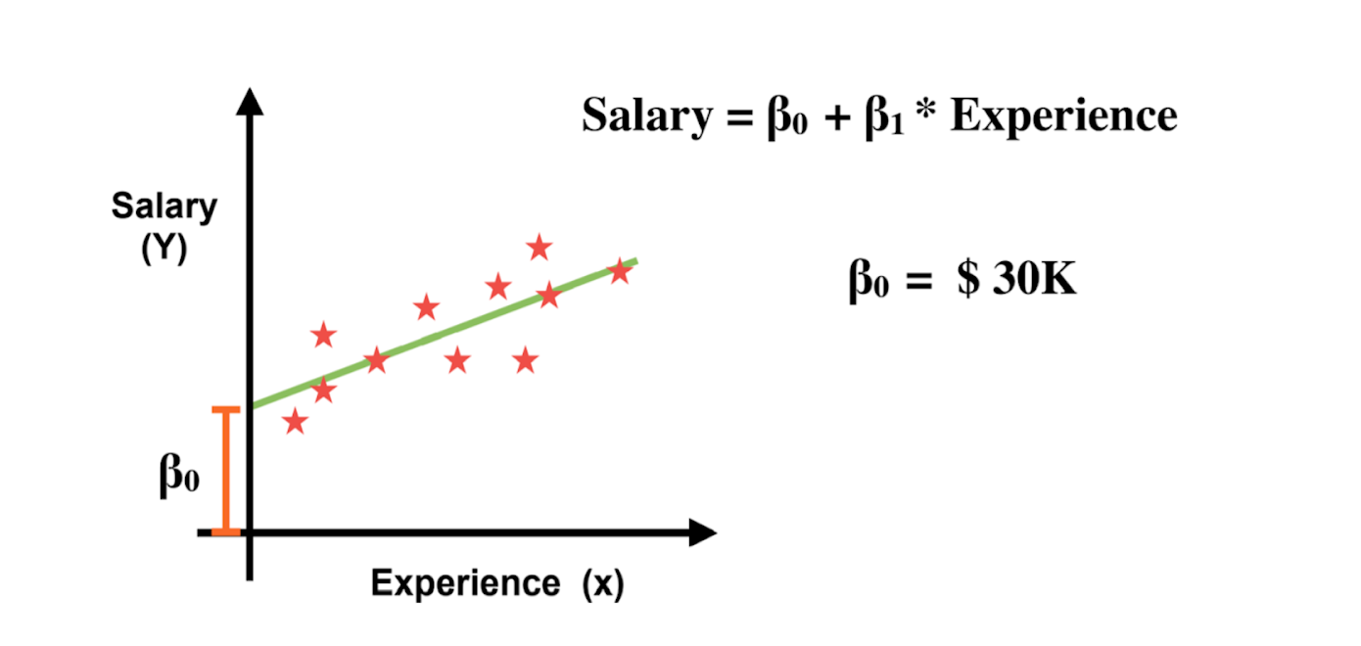
LINEAR REGRESSION
The most basic machine learning algorithm that can be implemented on this data is linear regression.
Linear regression is one of the easiest and most popular Machine Learning algorithm. It is a statistical method that is used for predictive analysis
The MATHEMATICAL representation linear regression is : “y=mx+c”

Slide 8
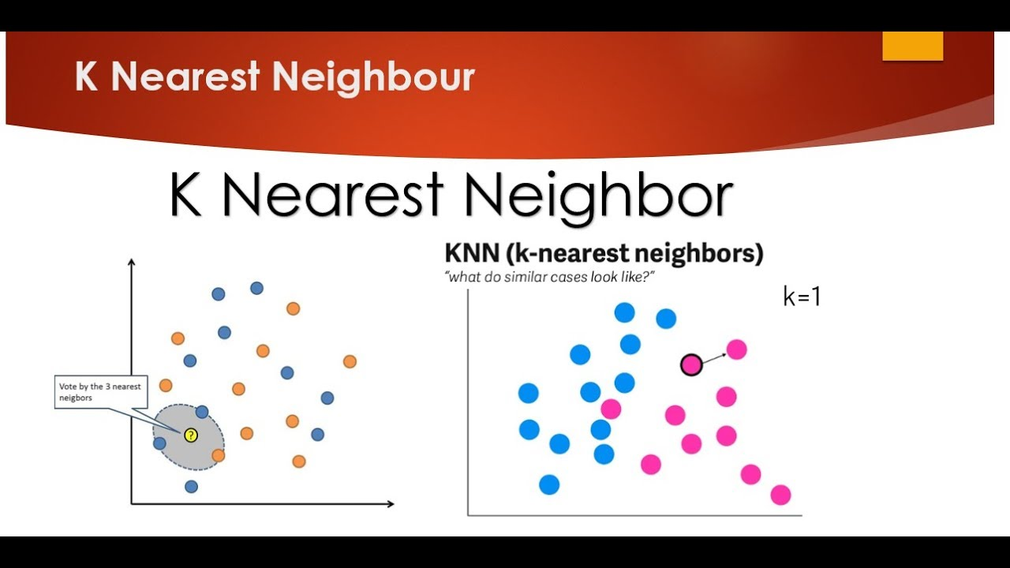
K-NEAREST NEIGHBOURS
K-Nearest Neighbour is based on Supervised Learning technique.
It stores all the available data and classifies a new data point based on the similarity.

Slide 9
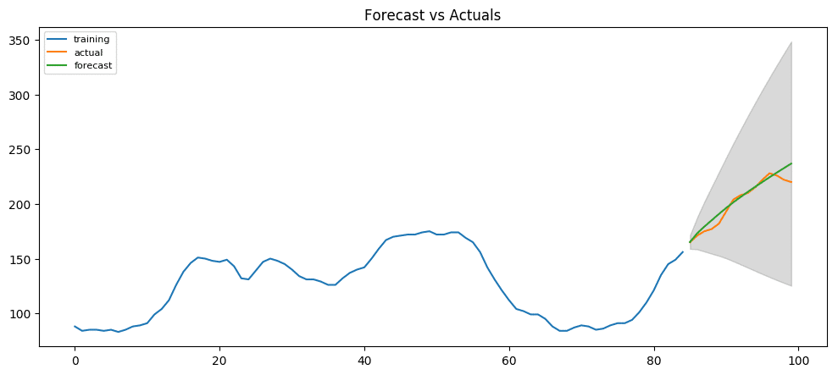
Auto ARIMA
Autoregressive integrated moving average (ARIMA) models predict future values based on past values.
ARIMA makes use of lagged moving averages to smooth time series data.
They are widely used in technical analysis to forecast future security prices.

Slide 10
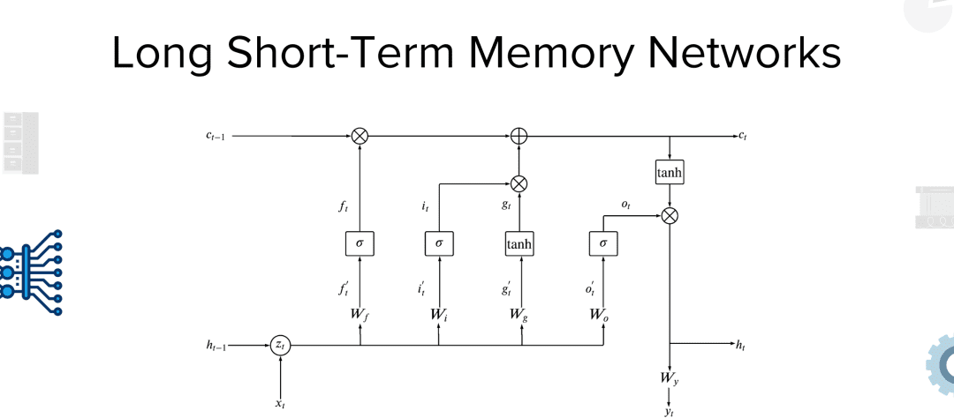
Long Short Term Memory (LSTM)
Long short-term memory (LSTM) is an artificial neural network used in the fields of artificial intelligence and deep learning.
It is the most complicated and often used algorithm for stock prediction.
LSTM is a special kind of RNN.it is capable of processing the entire sequence of data, apart from single data points.

Slide 11
Conclusion:
According to the forecast, Microsoft (MSFT) is predicted to increase over the coming eight years.
The data forecast expected that Microsoft share price is predicted to rise to $302 by the end of 2022, $350 in 2023, $420 in 2024, $505 in 2025, $600 in 2026, $690 in 2027, $740 in 2028 and $770 in 2029.

Slide 12
THANK YOU

