Slide 1
PSCS_4_Use of Digital Technology to calculate water footprints for different daily use items.
CSE7101- Capstone Project
Review-3
Batch Number: 20221CSE13(CSE_66)
Under the Supervision of,Ms.Swetha K H
Ms.Swetha K H
Assistant Professor
School of Computer Science and Engineering
Presidency University
Roll Number | Student Name
20221CSE0607 | P V NavyaShree
20221CSE0577 | Anusha G
20221CSE0538 | Mythri D C
Name of the Program: B.Tech
Name of the HoD: Dr. Asif Mohammed , Dr. Blessed Prince
Name of the Program Project Coordinator: Dr. Jayavadivel Ravi , Mr.Muthuraju V
Name of the School Project Coordinators: Dr. Sampath A K , Dr. Geetha A

Slide 2
Problem Statement Number: PSCS_4
Organization::Ministry of Jal Shakti
Category (Hardware / Software / Both) :SOFTWARE
Problem Description: This project aims to develop a comprehensive digital platform that calculates and visualizes the water footprints of common daily use items,Agriculture, helping users understand the hidden water consumption embedded in their everyday products and lifestyle choices

Slide 3
Content
Problem Statement
_{Literature Survey}
_{Objectives}
_{Existing Methods and Drawbacks}
Proposed method and Feasibility Study
_{Architecture Diagram}
_{Modules}
_{Hardware and software Details}
_{Timeline}
_{References}

Slide 4
Content (continuation)..
Problem Statement : Water scarcity is one of the most pressing global challenges, with households and agriculture consuming over 70% of available freshwater.However, lack of real-time monitoring prevents timely detection of wastage, inefficient irrigation, and unsustainable usage patterns.
A solution is needed to:
Continuously track water usage of a user how much he is using for a day,week ormonth.
Visualize the data from the dasboard and by using
Calculate direct water footprints for households and farms.

Slide 5
Literature Survey — Use of Websites to Calculate Water Footprints
Daily-Use Items
1.Website platforms provide low-cost and accessible alternatives to manual water accounting .
2.Water Footprint Network offers an online calculator to estimate personal footprints of food, clothing, and household items
3.Dataset-driven websites use product-specific coefficients (e.g., liters of water per kg of rice or cotton shirt) to calculate footprints
4.Visualization tools (Chart.js, D3.js) make footprint results interactive and easy to understand .
5.Research confirms these platforms are effective for awareness and behavior change in sustainable consumption
Agriculture
1.web-based tool calculates irrigation requirements and crop-specific water footprints.
2.Agricultural dataset provide standardized values for crop and livestock water footprints
3.Research confirms that web-based platforms are accurate, farmer-friendly, and scalable for water resource planning

Slide 6
Objectives
Project Goals
Specific:
Develop a website-based digital platform to calculate water footprints for both daily-use items (food, clothing, energy) and agricultural products (crops, livestock).
Integrate reliable datasets (e.g., Water Footprint Network, FAO AQUASTAT, CropWat) for accurate footprint estimation.
Provide interactive visualizations (charts/graphs) to display water footprints.
Outcome-Focused:
Provide a scalable and user-friendly platform for consumers, farmers, and policymakers to assess water footprints.
Enhance awareness of hidden water use in daily products, promoting sustainable consumption.
Support agricultural planning by providing region- and crop-specific water footprint insights.
Contribute to sustainable water management by making water footprints visible, measurable, and actionable.

Slide 7
Existing Methods and Drawbacks
Manual Calculations & Surveys
Traditionally, water footprints are estimated using manual questionnaires, surveys, and paper-based reports.
Drawbacks:
1.Time-consuming
2.Limited accuracy
Mobile Apps
A few mobile applications exist for water footprint estimation (mainly personal lifestyle calculators).
Drawbacks:
1.Focused mainly on daily-use items, with little or no support for agriculture.
2.Limited scalability for research or policy-making.

Slide 8
Proposed method and feasibility study
Proposed Method
1.Website-based platform for calculating water footprints.
2.Users can see daily-use items (food, clothing) or agricultural crops/livestock.
3.Generates results with interactive charts/graphs for better understanding.
Feasibility Study
1.Technical: Runs on standard web technologies (HTML, CSS, JS, Python/Flask), accessible via any browser, no special hardware required.
2.Operational: Easy-to-use interface for students, farmers, researchers, and policymakers; calculations completed within seconds.
3.Economic: Low-cost since it uses open-source tools and freely available datasets
4.Social & Environmental: Raises awareness of hidden water in daily life, supports sustainable agriculture, and promotes responsible water management at community and policy levels.

Slide 9
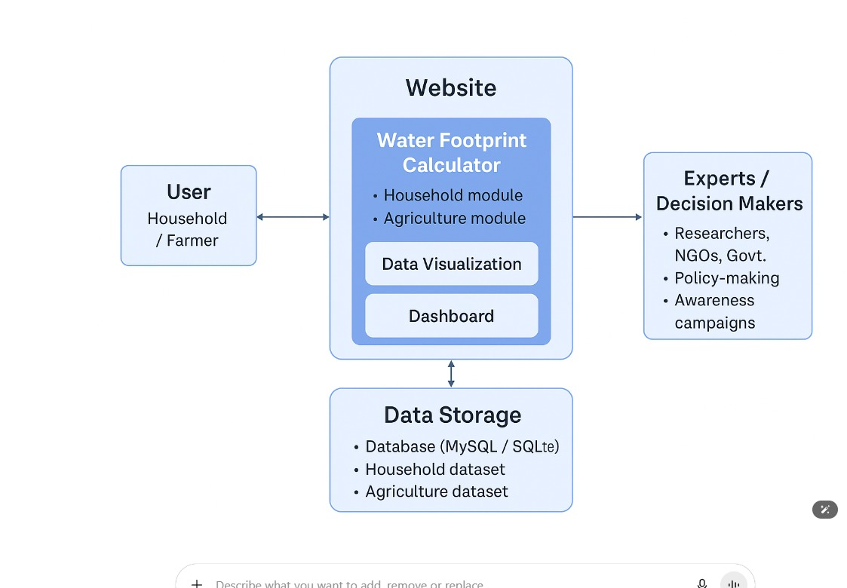
Architecture Diagram

Slide 10
Modules of Water Footprint Website
1.User Management Module - Handles registration, login, and authentication for household users and farmers.
2.Household Water Footprint Module - Allows households to select daily usage data.Calculates water footprint for different daily use items.Provides graphical reports and comparisons.
3.Agriculture Water Footprint Module - Enables farmers to select crop, irrigation, and livestock data.Calculates water footprints.
4.Data Visualization & Dashboard Module - Generates charts, graphs, and summaries of water usage.Displays personalized dashboards for households and farmers.

Slide 11
Software Details
Technology Stack Components:
1. Frontend (User Interface)
HTML5, CSS3, JavaScript – Core web technologies.
Angular – Interactive, responsive dashboards.
2. Backend (Server-Side Processing)
Python (Flask ) – Application logic
REST / GraphQL APIs – Communication between frontend & backend.

Slide 12
software Details
3. DataSet
4. Data Processing & Analytics
Pandas, NumPy – Data analysis & transformation.
Scikit-learn – Predictive analytics & recommendations.
Matplotlib / Seaborn – Data plotting & statistical visuals.

Slide 13
Github Link
The Github link provided should have public access permission.
Github Link
https://github.com/Shree336/CAPSTONE_PSCS_4_waterfootprint-calculator-for-daily-usage-products

Slide 14
Analysis of Problem Statement (contd...)
Software Requirements:
Functional Requirements (What the software must do)
Water Usage Tracking – water usage data.
Water Footprint Calculation – Compute direct water usage for households and agriculture.
Data Visualization – Interactive dashboards with charts
Report Generation – Export usage reports in PDF/CSV formats.
User Management – Role-based access ( household user, farmer).
Historical Data Analysis – Compare usage over days, weeks, and months

Slide 15
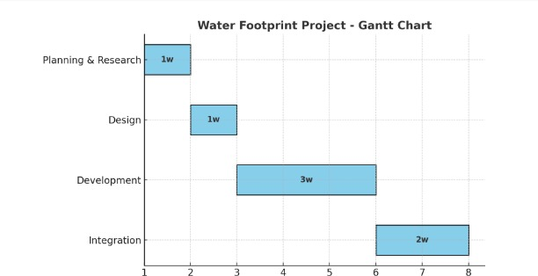
Timeline of the Project

Slide 16
References (IEEE Paper format)
1.Kowsalya M., Barsha M., Charukesi S., and Jeevadharsini G. K., “AgriDropIQ: A Digital Innovation for Crop-wise Water Footprint Intelligence and Sustainable Farming,” Erode Sengunthar Engineering College, Tamil Nadu, India, 2024. [Online]. Available: https://www.researchgate.net/publication/393073181_AgriDropIQ_A_Digital_Innovation_for_Cropwise_Water_Footprint_Intelligence_and_Sustainable_Farming
2.Carlos Parra-López a, Saker Ben Abdallah b, Guillermo Garcia-Garcia c, Abdo Hassoun d e, Hana Trollman f Sandeep Jagtap g h
, Sumit Gupta i, Abderrahmane Aït-Kaddour j k, Sureerat Makmuang j, Carmen Carmona-Torres a l
https://www.sciencedirect.com/science/article/pii/S0378377425000617
3.2.Dr G Prabhakar Raju1, Sama Vikyath Reddy2, Shubhranshu Ranjan Dash3,Bijnapally Megnadh41Associate Professor, Department of Computer Science and Engineering, Anurag University, Telangana, India2,3,4Student, Department of Computer Science and Engineering, Anurag University, Telangana, India
http://journaleims.com/wp-content/uploads/2025/01/2024010304.pdf
4.Priyansh Singh*1, Utkarsh Shukla*2, Yogesh Sharma*3*1,2,3Department Of Information Technology, Bbd Northern IndiaInstitute Of TechnologyLucknow, India.
https://www.irjmets.com/uploadedfiles/paper/issue_3_march_2025/69109/final/fin_irjmets1741787053.pdf

Slide 17


