Slide 1

New word

Slide 2
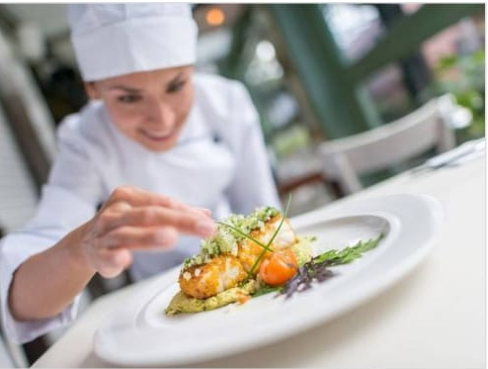

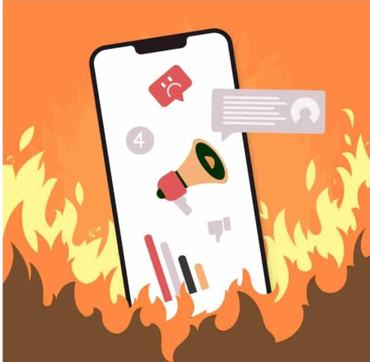
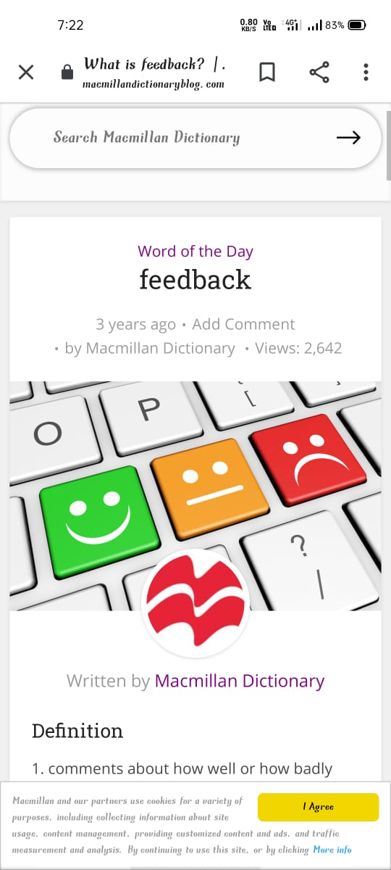


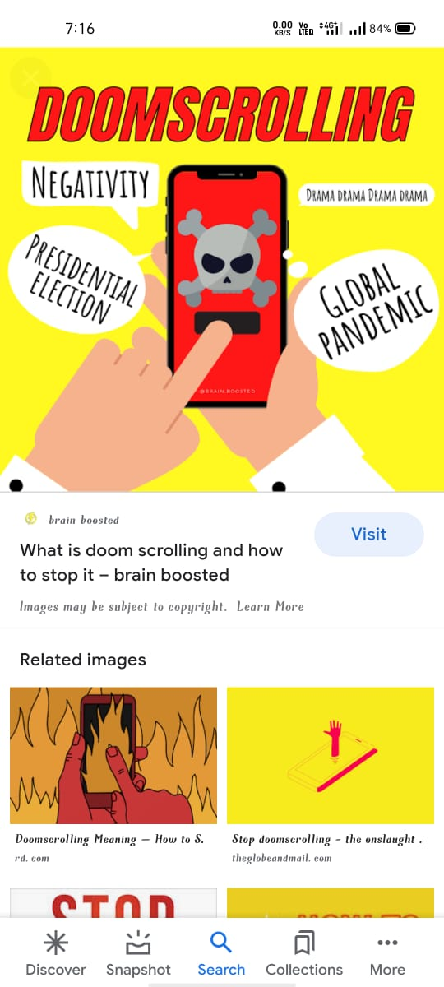













D O CR LL N LC O E I U

Slide 3
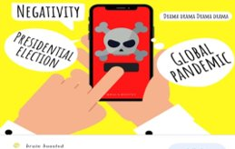
Doomscrolling
Doomscrooling is the tendency to continuously scroll through social media looking at bad news in attempt to gather information.

Slide 4

Examples
I was doomscrolling on Twitter today while reading about covid 19 cases.
Experts warn that doomscrolling can be harmful to your mental health.
This Photo by Unknown author is licensed under CC BY-SA.

Slide 5
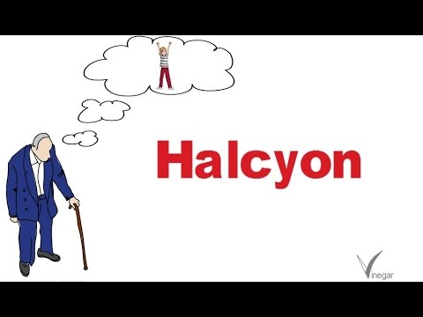
Halcyon
Free from storms or physical disturbance. Relating to a time in the past marked by peace and happiness.

Slide 6

Examples
I miss the halcyon days of my childhood when I didn't have to worry about the pressures of adult life.
Her halcyon lifestyle may seem wonderful, but it was earned by decades of hard work and determination.

Slide 7

Epicure
A person who takes particular pleasure in fine food and drink.

Slide 8


Examples
He researches diets carefully, and is a true epicure.
This cookery book has been written by a real epicure.

Slide 9

Thank you

