Slide 1

TITLE OF THE PROJECT PROPOSAL
Detection and Classification of IoT Malware based
on
Image Texture Analysis
Presented by:
Dr. G. Madasamy Raja,
Department of CSE,
VELTECH MULTITECH Dr. RANGARAJAN Dr. SAKUNTHALA ENGINEERING COLLEGE,
AVADI, CHENNAI
1

Slide 2
IoT Malware
IoT suffers form Malware
Distributed Denial of Service attacks(DDoS)
IoT malware mainly attacks IT Companies
Mirai- IoT malware that focuses on line consumers
It is a botnet kind of malware-that is available in a computer but sharing the details to a large network
Mirai malware particularly attacks router through twitter, netflix websites.

Slide 3
RANSOMWARE
It is a growing threat for the internet users
A new malware that intrudes into user device and encrypts the data with a very strong key
Malware developer must be paid very high amount to get the key (ransom to release the captive)
‘Wannacry’- May_2017 and ‘Petya’- June_2017 are some examples.
Some Police stations in Gujarat were affected by ‘Wannacry’
India's largest container port -- Jawaharlal Nehru Port Trust (JNPT), Mumbai were partially affected by Petya.

Slide 4
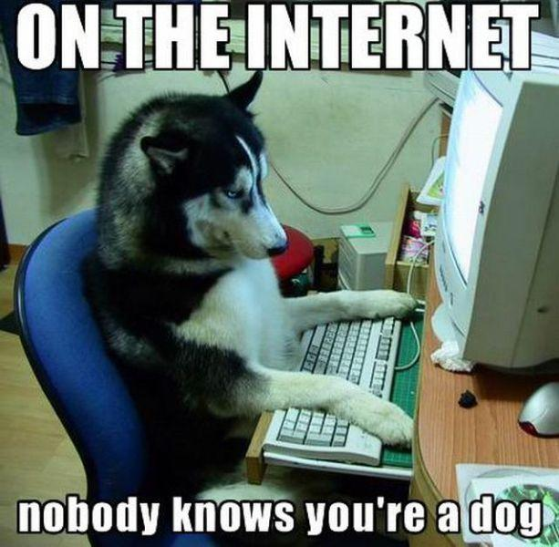
FINGERPRINT & FOOTPRINT
Fingerprint & Footprint are digital evidences for the Digital Forensic Investigation
Fingerprint are the Coded string of binary digits (generated by a mathematical algorithm) that uniquely identifies a data file
Footprint are the information about a particular person that exists on the Internet as a result of his/her online activity
Everything we do online leaves a footprint

Slide 5
OBJECTIVE OF THE PROJECT
We live and eat digital almost 24 hours 7 days a week
Growing ransomware attacks all over the world
By 2021, digital forensics is estimated to be a $4.9 billion industry
Academic, professionals and the industry shifted focus to web and mobile cybercrime, hacking, and cyber-defense
This proposal deals with the investigation of How to stop/avoid the ransomware attacks in our physical media

Slide 6
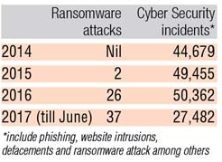
OBJECTIVE OF THE PROJECT (Contd…)
Yesterday (03/09/2017) Indian Government warns about a new ransomware called ‘Locky’
Aims to attack the outdated copy of Microsoft Windows OS

Slide 7
NOVELTY OF THE PROJECT
Third party software are only applicable for Virus and Trojans (malware)
No third party software available for ransomware
Very useful and applicable in growing IoT technology
In the literature only detection and recovery is very much available and not successful ideas in avoiding techniques

Slide 8
RELEVANT RESEARCH PAPERS

Slide 9
Thank u

