Slide 1

Crop recommender
Presentation by-Anusika Rani

Slide 2
Introduction/approach
As provided with 5 datasets, first data cleaning, and exploration was required to understand the nature of the dataset to develop the required recommendation model.
After EDA several states came up with their crop growing pattern, and after analyzing them, we can tell that which state is suitable for which kind of crop.
For the prediction part a dataset with labeled data was used and found that after putting those features we can tell which region is suitable for growing which crop.
Also, different ML algorithms were applied for prediction to see if the accuracy is achieved.
As for the interface using statements in the notebook, we can simply put the required data in the form of an array, and the model will return the suitable crop.

Slide 3
Findings
After exploring the datasets these were the findings-
The dataset contains several repeated columns that needed to be dropped.
After cleaning, realized a Ph-dataset containing only 2 columns that had repeated data ad of other datasets, so dropped the whole dataset.
After analyzing the datasets, finalized 2 datasets to be used for state-wise crop analysis, and another dataset to analyze the yield as per state.
As for prediction another dataset containing the features like rainfall, temperature etc, was used. It was a labeled dataset.
To analyze further EDA was needed.

Slide 4
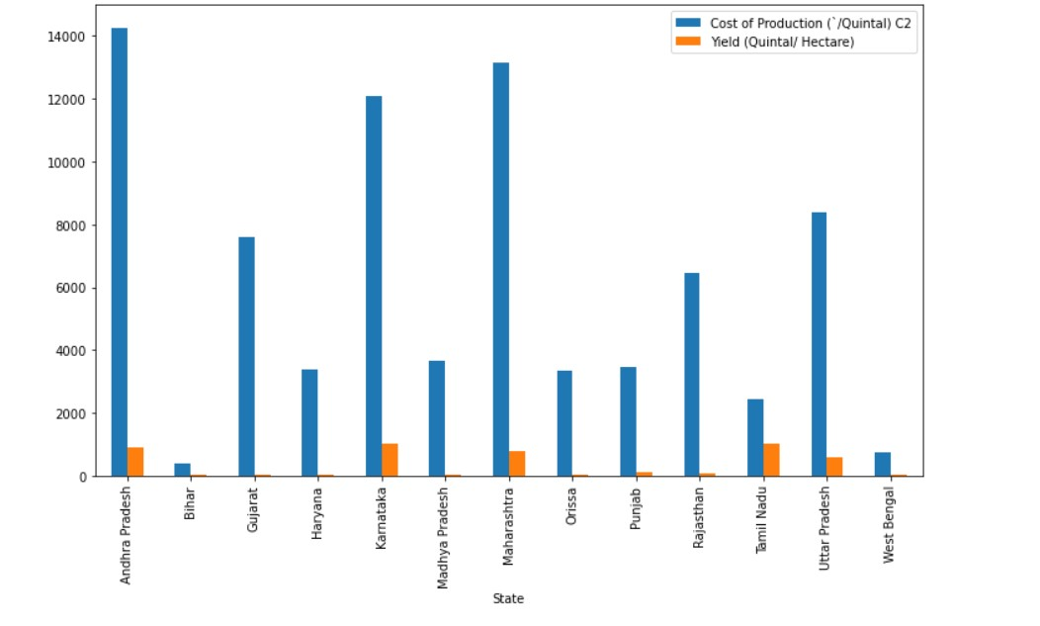
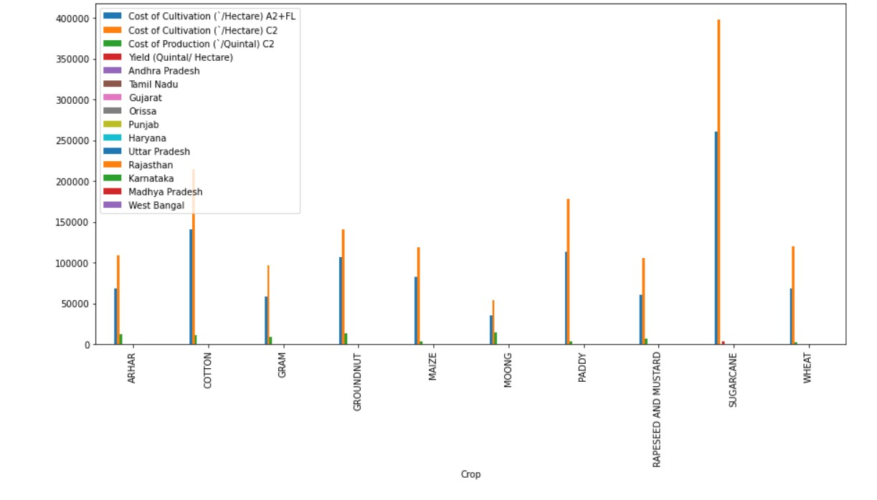
EDA

Slide 5
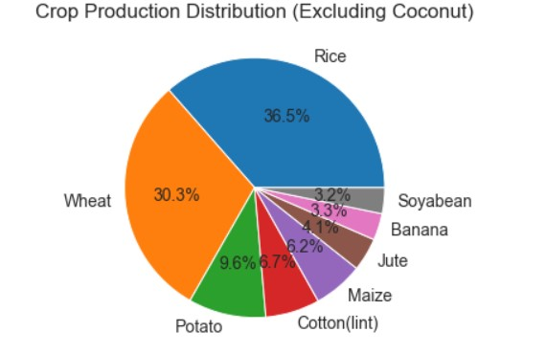
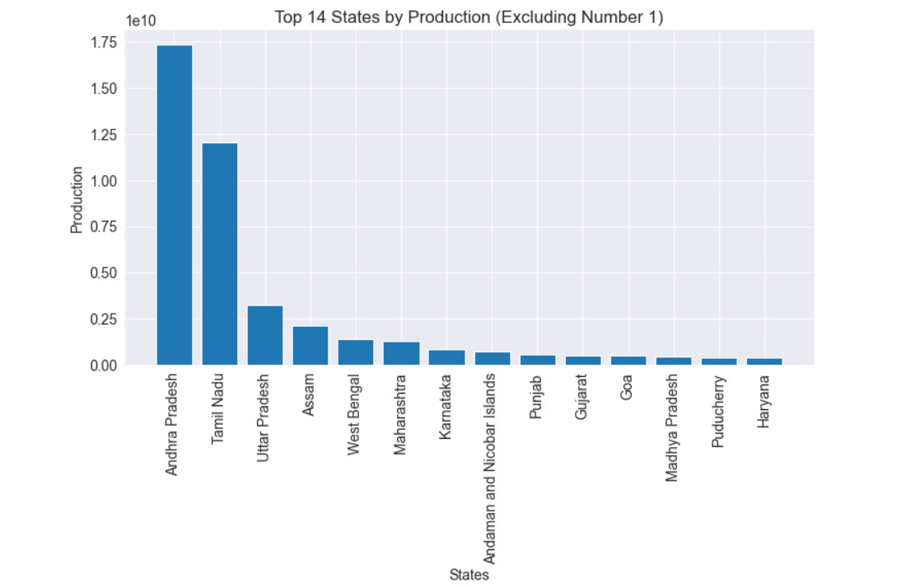

Slide 6
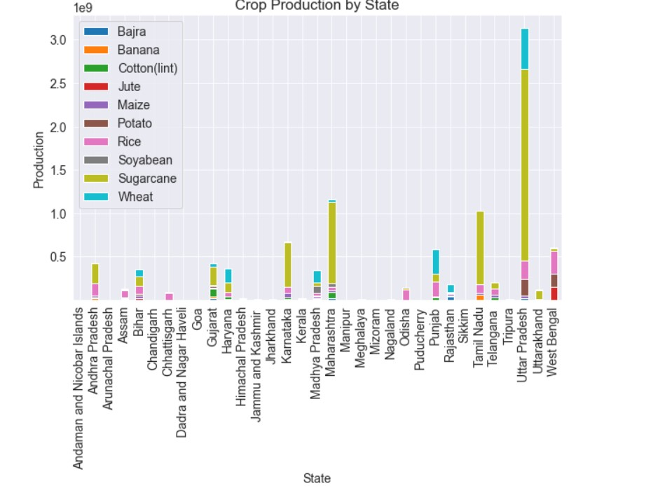

Slide 7
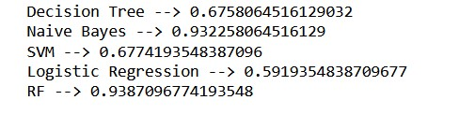
Models
Different models were used as follows:-

Slide 8
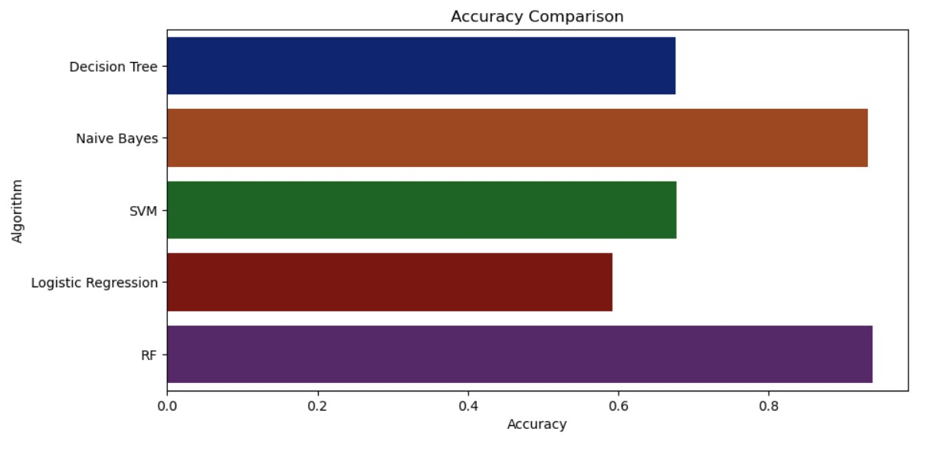
Accuracy comparison of models-

Slide 9
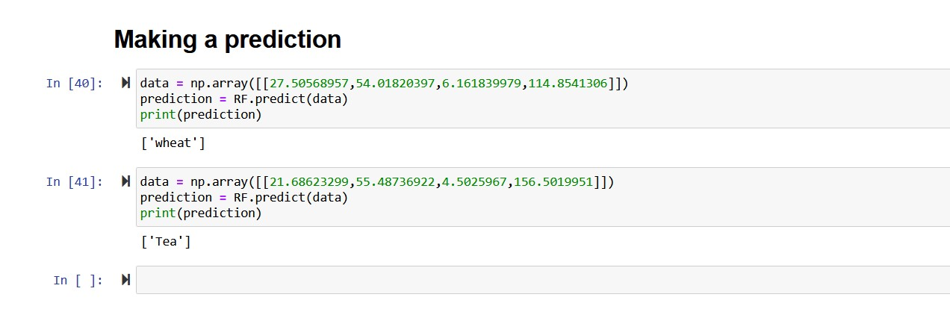
Prediction

Slide 10
Conclusion
After comparing the accuracy, the RF (Random Forest) algorithm with an accuracy of about 94% was found most accurate.
Therefore, was used while predicting the suitable crop.
Also made the pickle files to save the model, and can be further deployed.
Few limitations to the projects were, limited datasets available, as for further development data of different traits are required.
Also for user convenience the model can be deployed and hosted over a cloud-based website.
THANK YOU!!!

