Slide 1

SCHOOL OF ENGINEERING AND IT
MAJOR PROJECT
on
‘STUDENT ATTENDANCE SYSTEM’
TEAM MEMBERS:-
Uplow kumar Pandey(AJU/200274)
Anusika Rani (AJU/201336)
Riya kumari (AJU/200597)
GUIDE NAME:-
Dr. Nidhi Dua
(Assistant Professor)

Slide 2
INTRODUCTION
Our Attendance System, powered by Python, is a solution designed to streamline the attendance tracking process.
Utilizing the camera of a device, our system offers smooth and accurate monitoring of individuals in various settings.
We prioritize automation, ensuring that organizations can effortlessly manage attendance records.
Our user-friendly interface and strong backend algorithms guarantee real-time data collection, minimizing administrative workload.
With a focus on security and reliability, our system promotes a hassle-free experience for both users and administrators.
Embracing innovation, we are dedicated to revolutionizing traditional attendance management methods, making attendance tracking smarter and more convenient than ever before.

Slide 3
SYSTEM REQUIREMENT
RAM:- 16.0 GB,
PROCESSOR:- 12th Gen Intel® Core™ i5-1235U 1.30GHz
SYSTEM TYPE:- 64-bit Operating System,
EDITION:- Windows 11
PLATFORM:- Python 3.8v , Xampp , Visual Studio code

Slide 4
ROLE OF technologies INVOLVED :-
Frontend
To design the interface HTML is used. Giving static websites a design to obtain a list of students present date-wise.
Algorithm
Face recognition algorithm based on a deep learning CNN module(convolutional neural network), is used for face recognition, verification, and clustering.
Backend
At the backend, to store entered data, a database is created locally using SQL queries.

Slide 5
Python libraries used
NumPy: Numerical computing library.
Pandas: Data manipulation and analysis.
Dlib: Toolkit for machine learning and computer vision.
os: Operating system interface.
cv2 (OpenCV): Computer vision library.
time: Time-related functions.
logging: Logging messages from applications.
sqlite3: SQLite database interface.
datetime: Date and time manipulation.
shutil: File operations.
tkinter: GUI (Graphical User Interface) toolkit.

Slide 6
WORKFLOW
START
FACE REGISTRATION
Data gets stored in a file named (data_faces_from_camera)
FEATURE EXTRACTION AND MODEL TRAINING
Data gets stored in a file named(feature_all.csv)
FACE RECOGNITION
Data stored at the database
ATTENDANCE LIST
STOP

Slide 7
WORKFLOW
For the registration of an individual in the system we have two modes, i.e., we can collect and pre-train the system, or collect it at the site by capturing the image and entering the respective name.
The data gets collected and stored in a folder named after the individual’s name.
After that feature extraction is done, where the model gets trained by recognizing features in the frames of pictures captured, and the features are collected in CSV files.
After that when we start the facial recognition window, it detects if the person in front of the camera matches the pre-trained features, if any, then the result gets stored in the database.
Which a list can be further obtained and checked date-wise, from the webpage hosted on the local server.

Slide 8
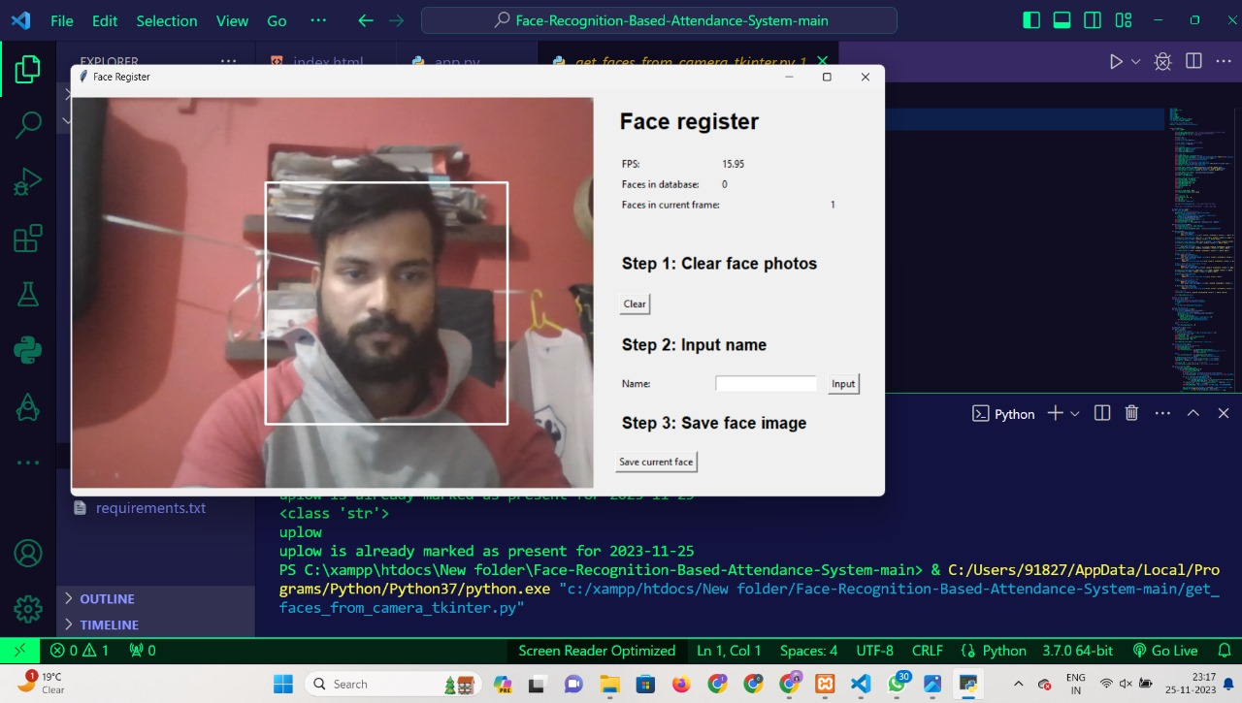
FACE REGISTRATION WINDOW

Slide 9
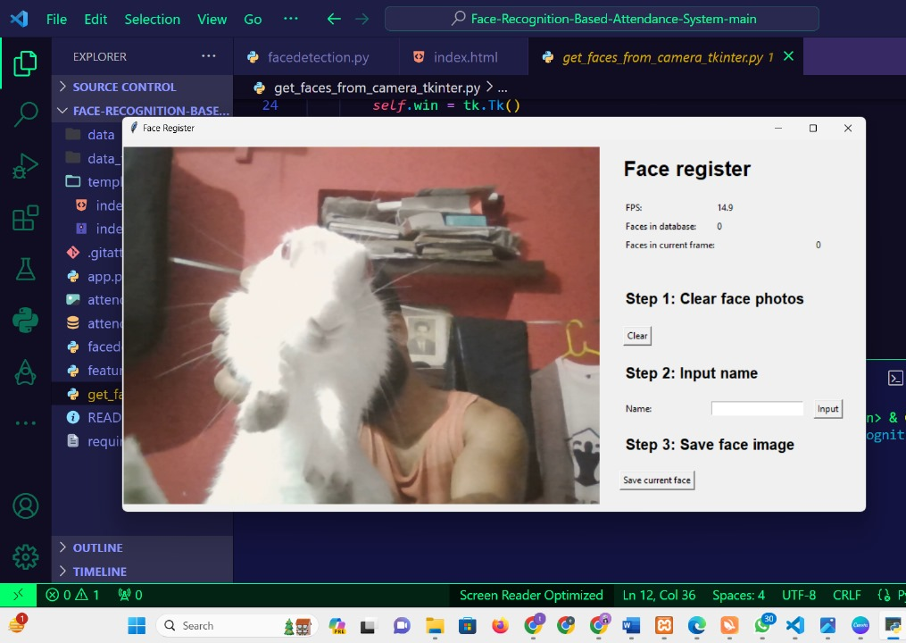
FACE REGISTRATION WINDOW
Model does not recognise any other objects(animal, things etc) except for human face.

Slide 10
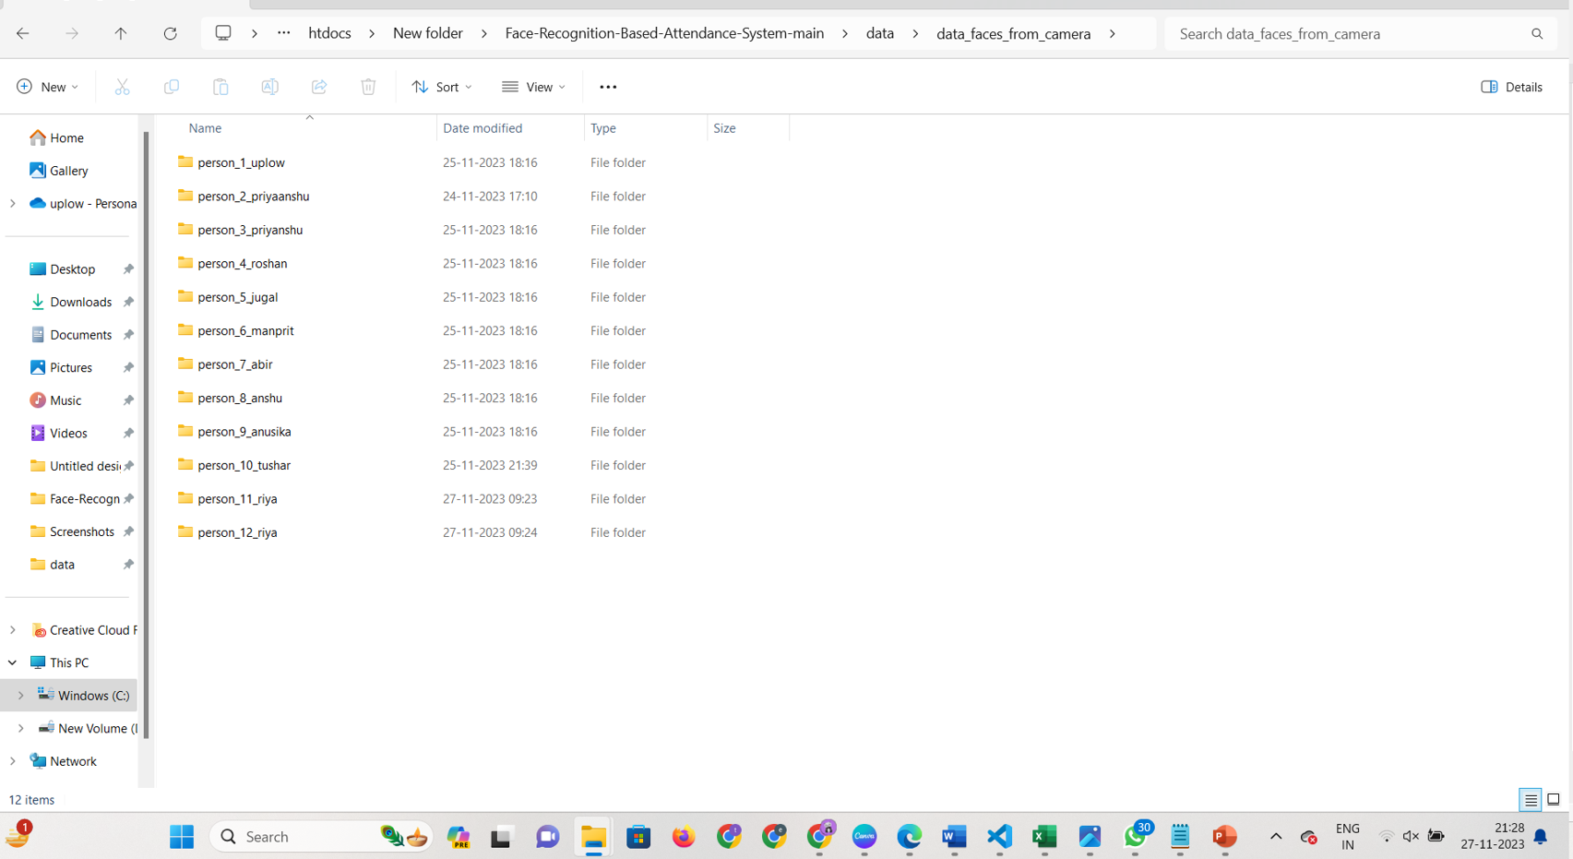
AFTER REGISTERATION

Slide 11
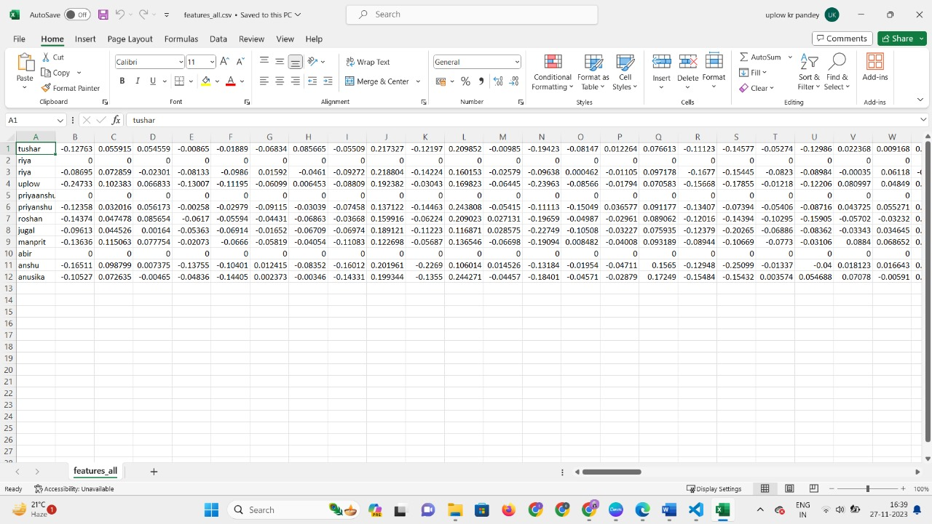
DATA GETTING COLLECTED FROM FRAMES (feature extraction)

Slide 12
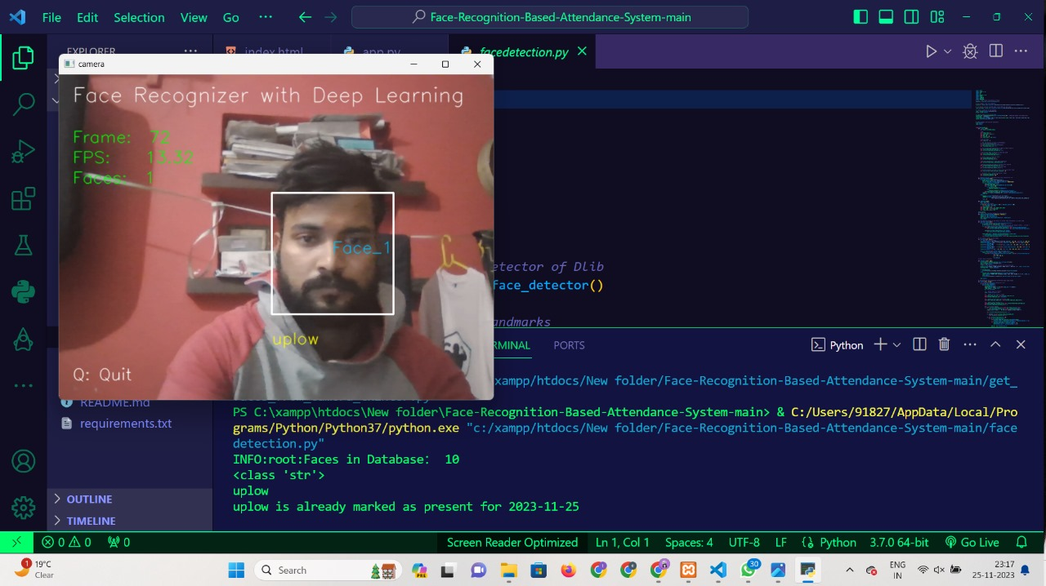
FACE RECOGNITION SYSTEM WORKING

Slide 13
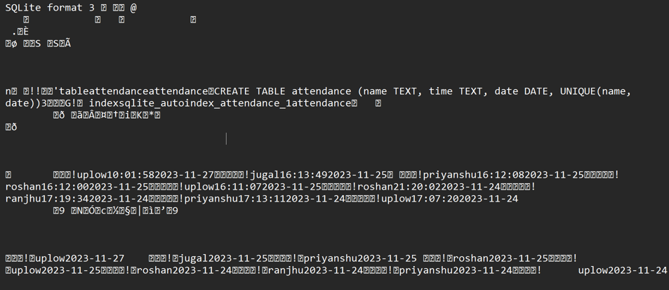
DATABASE

Slide 14
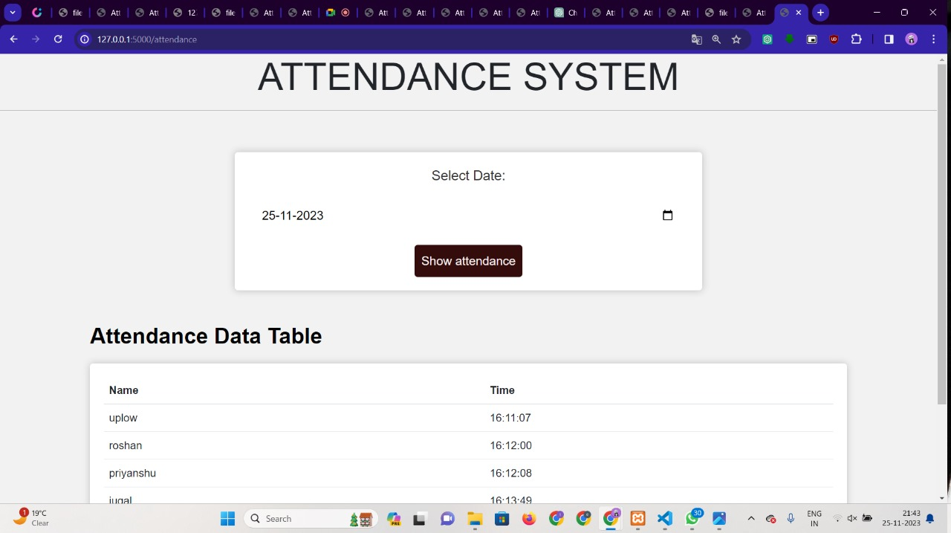
USER INTERFACE

Slide 15
NEW CHANGES INTRODUCED ARE:-
We have covered a corner case by reflecting multiple changes on the database side by adding needed SQL queries.
We realized that there could be a scenario where a faculty member might be taking two subjects of the same class. A student will be required to mark attendance in each class separately.
So we have considered the subject as the main parameter depending upon the class scheduled rather than the student and generated a list of attendance likewise.
The design of the login page for our web deployment is in progress too. We have made almost the front end, connecting it to the backend is our next task.

Slide 16
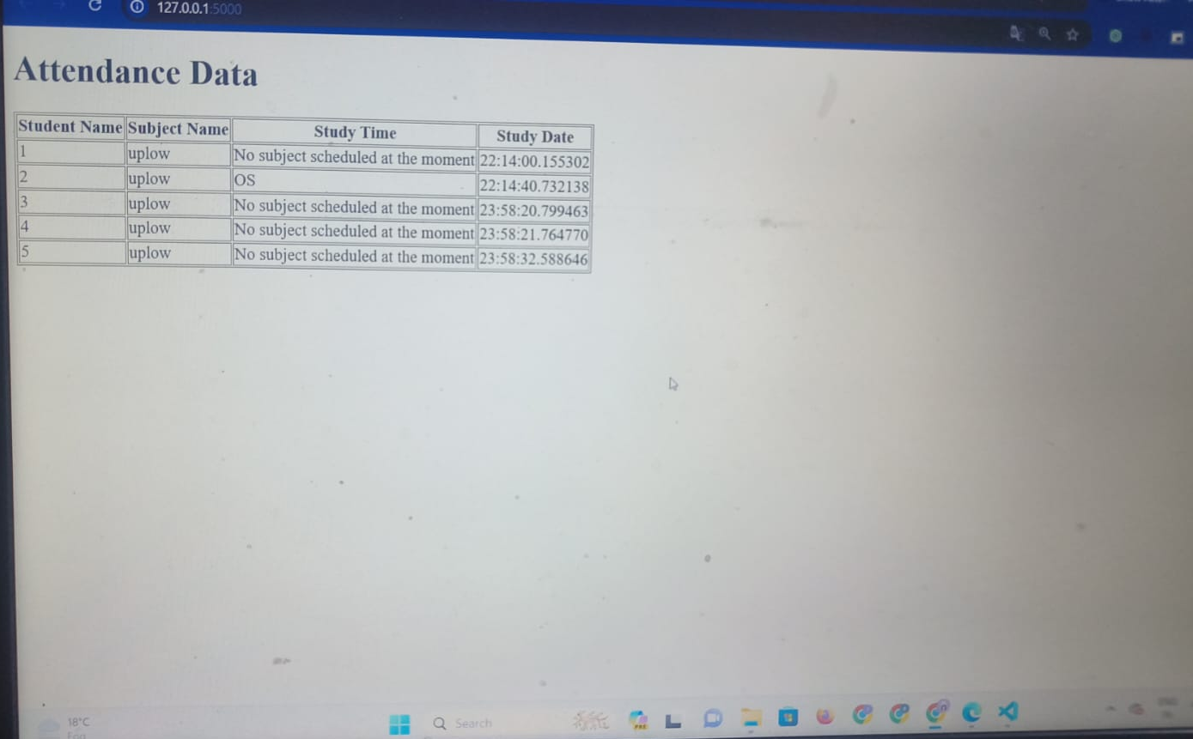
DATABASE TABLE.

Slide 17
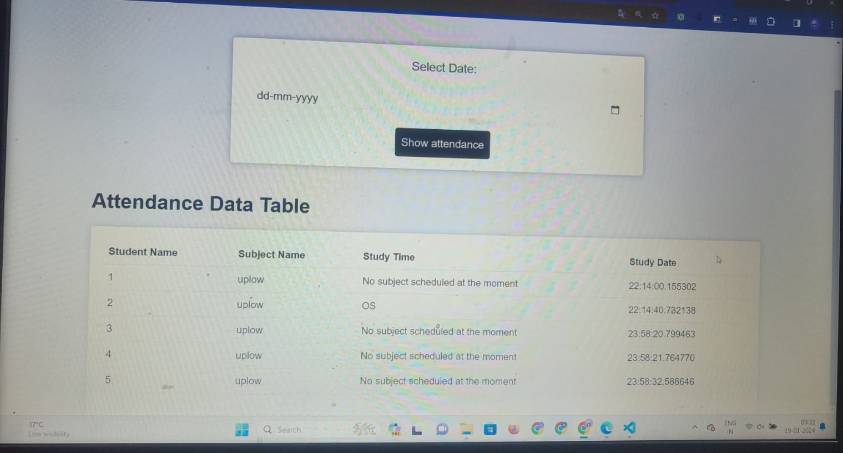
CHANGES REFLECTED ON INTERFACE-

Slide 18
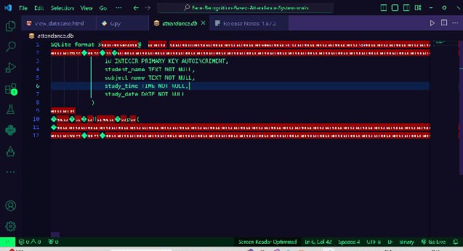
CODE IN DATABASE.

Slide 19
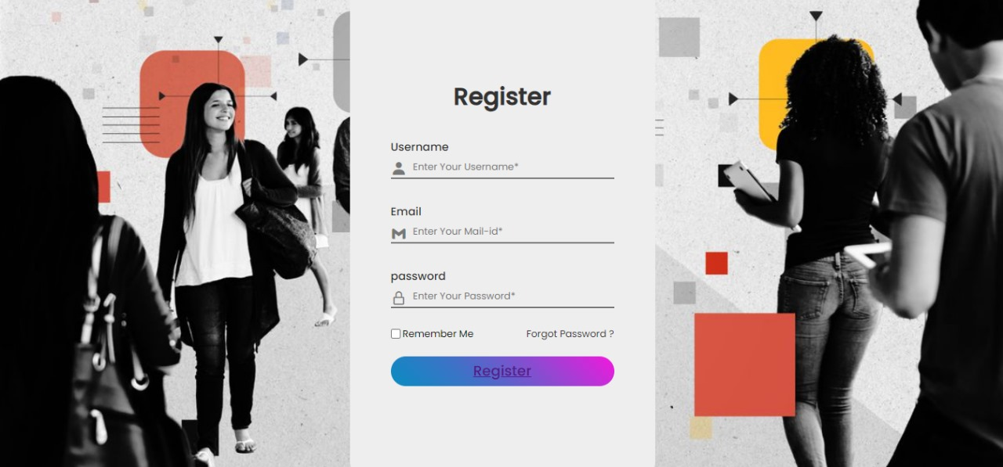
LOGIN PAGE DESIGN

Slide 20
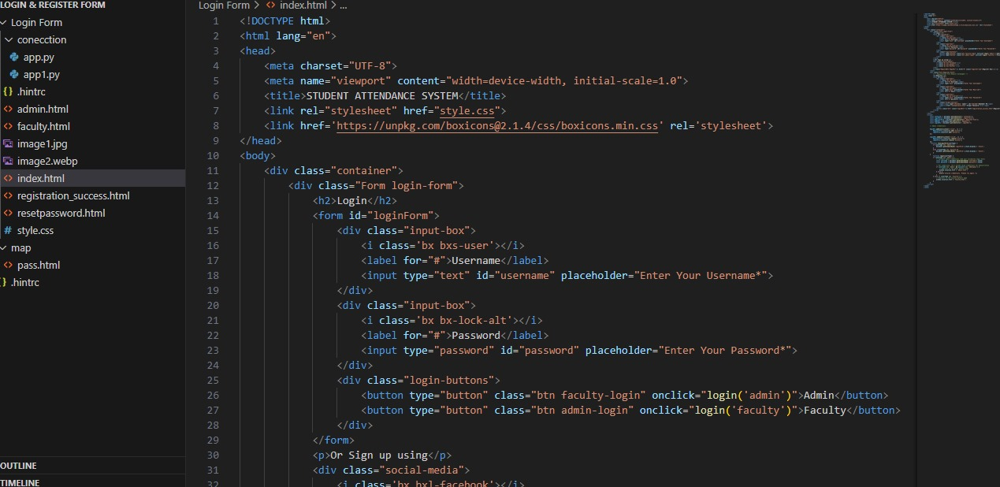
LOGIN PAGE CODING

Slide 21
CONCLUSION
ADVANTAGES
Using the face characteristics as biometric, the face recognition system can be implemented as a touchless technology.
The training database is created by training the system with the faces of the authorized students. The cropped images are then stored as a database with respective labels.
The small institutions as well as organizations will be able to use this system as we have reduced costs as to other software comparatively.
With this automation, the time initially used for the attendance will instead be used on work, increasing efficiency.
If the work becomes efficient then it will bring more of an economical and monetary value to the organizations.
After training the model with around 50+ students’ data, and then testing the results, the model recognizes each individual uniquely with their respective label names. And offers particularly accurate results, with the least amount of errors as of now.

Slide 22
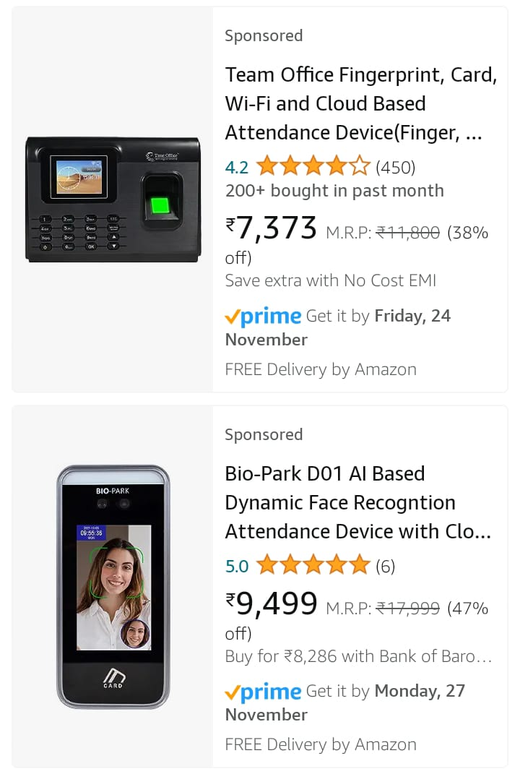
FUTURE SCOPE/MODIFICATIONS
For future evaluations, we will be able to recognize the attendance pattern and implement a better working environment both for the clients and consumers.
Getting an updated list of attendees, and managing notifications may also become easier, as that of a manual process of maintaining contact lists.
Furthermore, by increasing system specification, features, and training data, our model does have an influential future scope, as our motive is to reduce the software development cost for future accessibility.

Slide 23
THANK YOU!!!

