Slide 1
CS 573 Advanced Software Engineering
Introduction to Petri Nets

Slide 2
Reference
Tadao Murata. “Petri nets: Properties, Analysis and Applications.” Proc. of the IEEE, 77(4), 1989.

Slide 3
Agenda
What Is Petri Net?
Dynamic Behaviors
Introductory Modeling Examples
Behavioral Properties
Analysis Methods

Slide 4
Formal Methods
Mathematically based techniques for the specification and verification of software and hardware systems
Application of a variety of theoretical CS to specification and verification
Logic calculi,
Formal languages, automata theory
Program semantics
Algebraic data types

Slide 5
Petri Nets: History
1962: C.A. Petri’s dissertation (U. Darmstadt, W. Germany)
1970: Project MAC Conf. on Concurrent Systems and Parallel Computation (MIT, USA)
1975: Conf. on Petri Nets and related Methods (MIT, USA)
1979: Course on General Net Theory of Processes and Systems (Hamburg, W. Germany)
1980: First European Workshop on Applications and Theory of Petri Nets (Strasbourg, France)
1985: First International Workshop on Timed Petri Nets (Torino, Italy)

Slide 6
Petri Nets as a Formal Method
Concurrent, asynchronous, distributed, parallel,
Nondeterministic and/or stochastic systems
Graphical tool
Visual communication aid
Mathematical tool
State equations, algebraic equations,
Communication between theoreticians and practitioners

Slide 7
Petri Nets: Applications
Communication protocols
Distributed, concurrent and parallel programs
Performance evaluation
Industrial control systems
Discrete events systems
Multiprocessor memory systems
Dataflow computing systems
Fault-tolerant systems
Model-based testing
Threat modeling
…

Slide 8
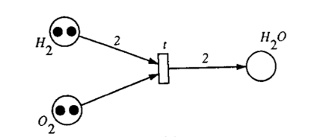

Informal Definition
Directed, weighted, bipartite graph
Places
Transitions
Arcs (places to transitions or transitions to places)
Weights associated with all arcs (default is 1)
Initial marking
Assigns a non-negative integer to each place

Slide 9
Formal Definition
A Petri net is a 5-tuple, PN= (P, T, F, W, M₀)
P = {p₁, p₂, …, p_{m}} is a finite set of places
T = {t₁, t₂, …, t_{n}} is a finite set of transitions
F ⊆ (P×T) ∪ (T×P) is a finite set of arcs, F≠∅
(t, p): arc from t to p; (p, t): arc from p to t
W: F→ {1, 2, 3, …} is a weight function
W(p, t): weight of the arc from t to p
M₀: P → {1, 2, 3, …} is the initial marking
M₀(p): number of tokens in each place p
A Petri net structure N=(P, T, F, W) without any specific initial marking is denoted by N
(N, M₀): A Petri net with the given initial marking M₀

Slide 10

Exercise
Specify the following Petri net:
P=?, T=?,
F=?, W=?
M₀=?
M₀ (H₂)? M₀ (O₂)?, M₀ (H₂O)?

Slide 11
Dynamic Behavior
A transition t is enabled or firable if each input place p has at least w(p, t) tokens
An enabled transition may or may not fire
A firing on an enabled transition t removes w(p, t) from each input place p, and adds w(t, p’) to each output place p’
A sequence of firings (firing sequence) will result in a sequence of markings
σ=M₀ t₁M₁ t₂M₂…t_{n}M_{n} or simply t₁t₂…t_{n}

Slide 12
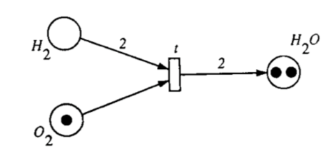
Firing Example
Chemical reaction: 2H₂ + O₂ → 2H₂O
t is enabled
New marking after t is fired.
t is no longer enabled.

Slide 13
Simulation
Token game of transition firings
MISTA

Slide 14
Some Definitions
Source transition: no inputs
Sink transition: no outputs
Self-loop: a pair of place p and transition t is a self-loop if p is both an input and an output of t.
Pure PN: no self-loops
Ordinary PN: all arc weights are 1’s
Infinite capacity net: places can accommodate an unlimited number of tokens
Finite capacity net: each place p has a maximum capacity K(p)

Slide 15
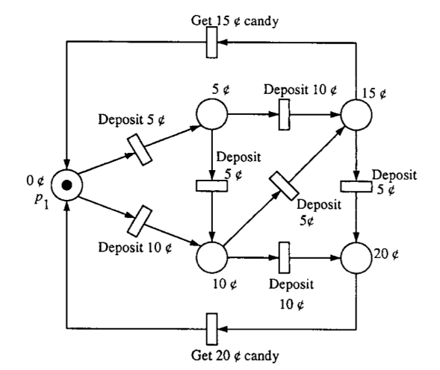
Modeling Finite State Machine
Vending machine (coin return not considered)

Slide 16
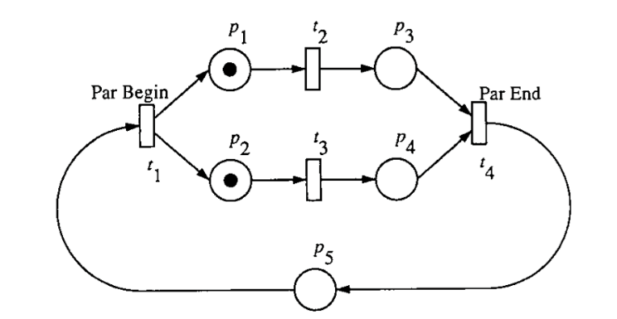
Modeling Parallel Activities

Slide 17
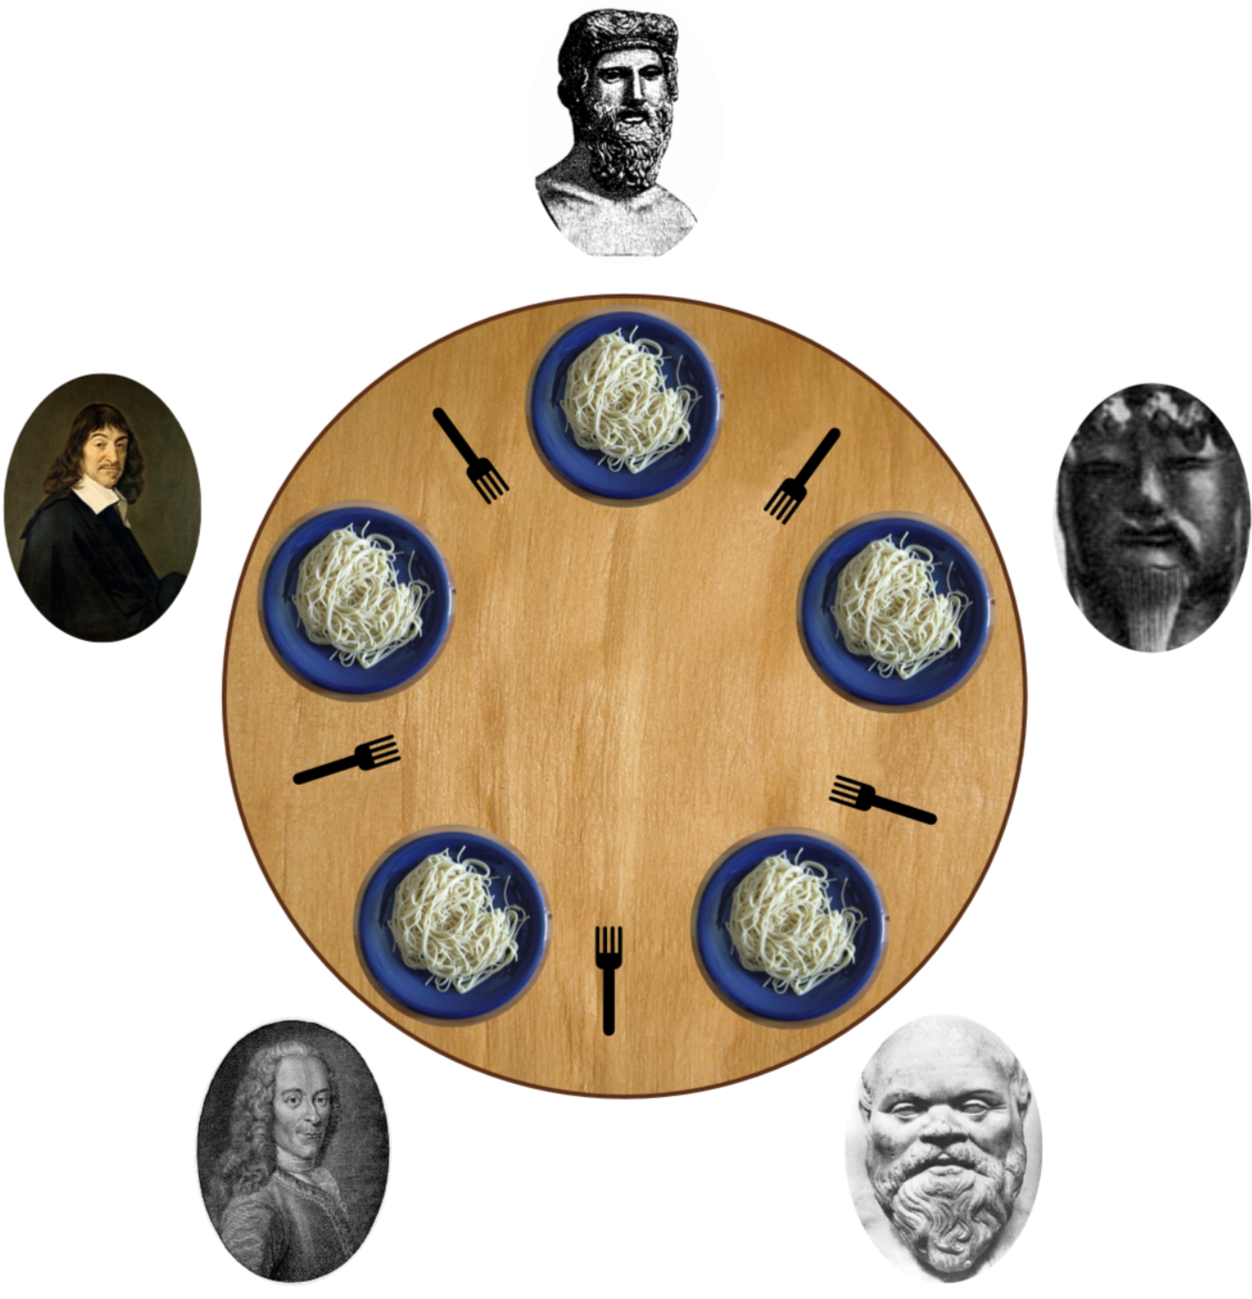
Dining Philosophers
Five philosophers sit at a table with bowls of spaghetti.
Forks are placed between each pair
Each philosopher must alternately think and eat.
A philosopher can only eat spaghetti when they have both left and right forks.
illustrate the challenges of avoiding deadlock

Slide 18
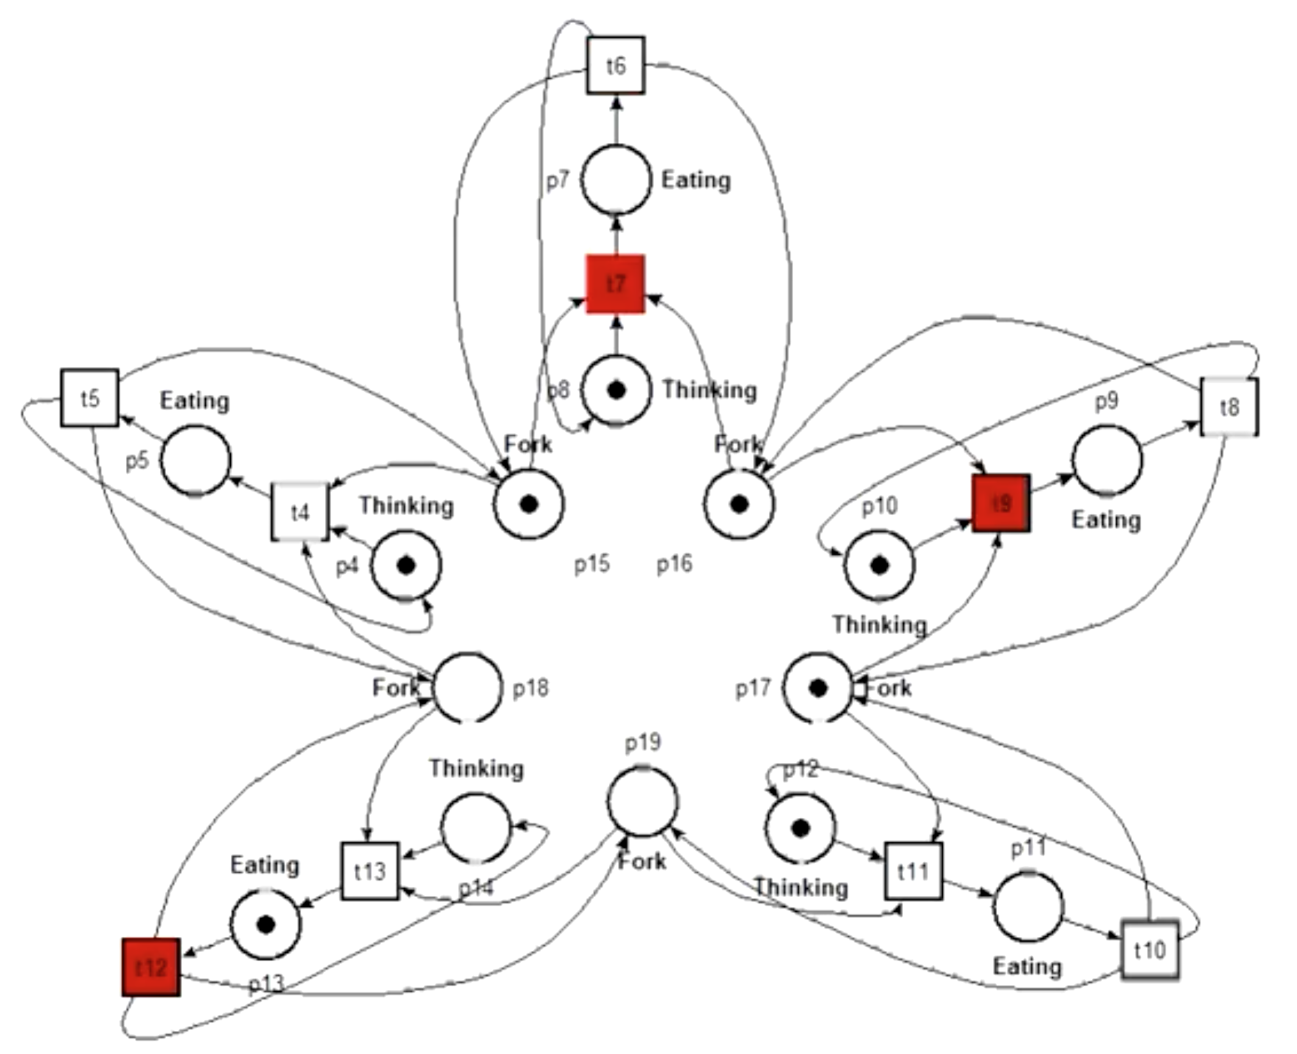
Modeling Dining Philosophers

Slide 19
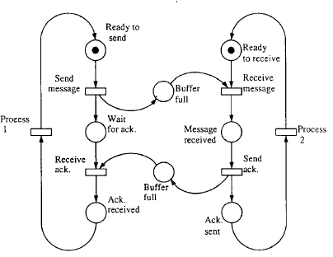
Modeling Communication Protocol

Slide 20
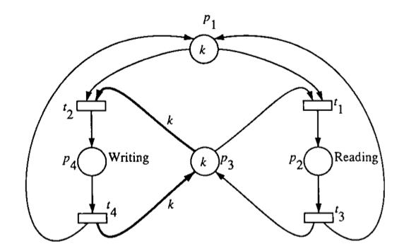
Modeling Synchronization Control
Readers-writers system
k processes can read, but only one can write
k tokens in p1 represents p processes that may read and write a shared memory represented by p3

Slide 21
Behavioral Properties
Reachability
Boundedness
Liveness
Coverability
…

Slide 22
Reachability
Recall transition firing
Remove tokens from each input place
Add tokens to each output place
Recall firing sequence: σ=M₀ t₁M₁ t₂M₂…t_{n}M_{n}
A marking M_{n} is reachable from M₀ if there exists a sequence of firings that transform M₀ into M_{n}: M₀[ σ >Mn
σ=M₀ t₁M₁ t₂M₂…t_{n}M_{n}
R(N, M₀): the set of all possible markings reachable from M₀ in a net (N, M₀)
Notes:
σ: sigma

Slide 23
Reachability – cont’d
Reachability problem of M_{n}
Find if M_{n}∈R(N, M₀)
Submarking reachability problem of M_{n}:
Not interested in all places
Find if M_{n}’∈R(N, M₀) where M_{n}’ is any marking whose restriction to a given subset of places agrees with that of a given marking M_{n}
The reachability problem is decidable, but it takes at least exponential space and time to verify in general case.

Slide 24
Exercise: Is {p₅(1)} Reachable?

Slide 25
(k-)Boundedness
A PN is bounded if the number of tokens in each place doesn’t exceed a finite number k for any marking M reachable from M₀
M(p) <= k for every place p and every M∈R(N, M₀)
No overflow when places represent buffers and registers
A PN is safe if it is 1(one)-bounded.

Slide 26
Exercise: Bounded?

Slide 27
Exercise: Bounded?

Slide 28
Liveness
A PN is live if, no matter what marking has been reached, it is possible to fire any transition by progressing through some further firing sequence
Guarantee deadlock-free operation, no matter what firing sequence is chosen
Liveness is a strong property
Can be relaxed with different levels of liveness

Slide 29
Liveness – cont’d
Transition t in Petri net (N, M₀) is:
L₀-live (dead) if t can never be fired in any firing sequence
L₁-live (potentially firable) if t can be fired at least once in some firing sequence
…
L₄-live (i.e., live) if t is L₁-live for every marking M∈R(N, M₀)

Slide 30
Exercise: Live?
Notes:
Yes.

Slide 31
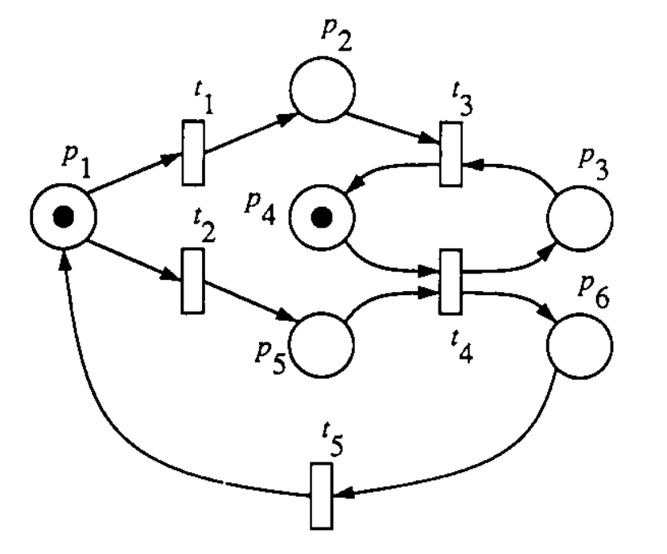
Exercise: Live?
Notes:
The net is not live because no transition is enabled after either t1 fires.
The net is strictly L1-live because each transition can be fired exactly once: t2, t4, t5, t1, t3

Slide 32
Coverability
A marking M is coverable if exists M’ reachable from M₀ such that M’(p)>=M(p) for all places p
Let M be the minimum marking needed to enable transition t.
t is dead (not L₁-live) if and only if M is not coverable
t is L₁-live if and only if M is coverable
Notes:
Coverability is closely related to L₁-liveness (potentially firability)

Slide 33
Exercise: Modeling Weekly Schedule
Modeling your weekly activities
breakfast, lunch, dinner, classes, research tasks, meetings, …
Analysis
Are all activities reachable?
Is it bounded?
Is it live?

Slide 34
Analysis Methods
Coverability Tree
Incidence Matrix and State Equation
Reduction Rules for Analysis
Model Checking
Many other analysis methods for specific problems such as deadlock

Slide 35
Coverability Tree
Represent all possible reachable markings
Root = M₀
Nodes = markings reachable from M₀
Arcs = transition firings
If net is unbounded, then tree is kept finite by introducing ω (infinity)
ω> n (any integer)
ω + n = ω
ω- n = ω
ω≥ω
Notes:
Ω/ω: omega

Slide 36
Constructing Coverability Tree
S1. Label M0 as the root and tag it “new”
S2. While new markings exist, do:
S2.1 Select a new marking M
S2.2 If M is identical to a marking on the path from M0 to M, then tag it “old” and go to another new marking
S2.3 If no transition is enabled at M, tag it “dead-end”
S2.4 For each transition t enabled at M, do
S2.4.1 Obtain the marking M’ that results from firing t at M
S2.4.2 On the path from the root to M if there exists a marking M’’ such that M’(p)>=M’’(p) for each place p and M’ <>M’’, i.e., M’’ is coverable, then replace M’(p) by ω for each p such that M’(p)>M’’(p)
S2.4.3 Introduce M’ as a node, draw an arc with label t from M to M’, and tag M’ “new”
Notes:
Problem with S2.2 identical to a dead-end or old marking anywhere in the tree, not just in the path. This problem will be shown in the coverability tree exercise.

Slide 37
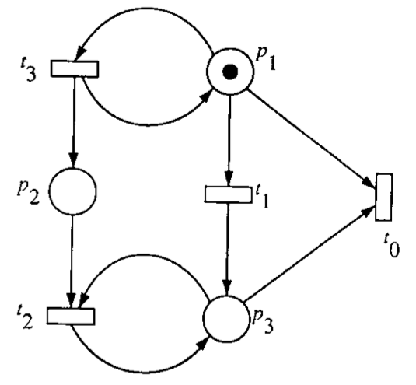
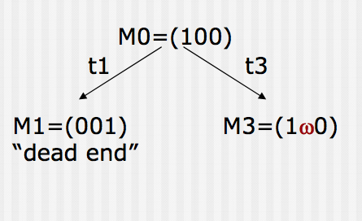
Coverability Tree: Example -1
M’=(110), which covers M’’=M0=(100)
Notes:
Firing t3 at M0 leads to marking M’ = (110), which covers M’’=(100). Therefore M’ is changed to (1ω0), i.e., M3

Slide 38
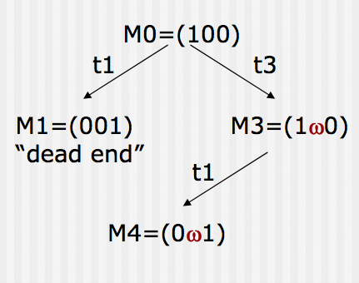
Coverability Tree: Example -2

Slide 39
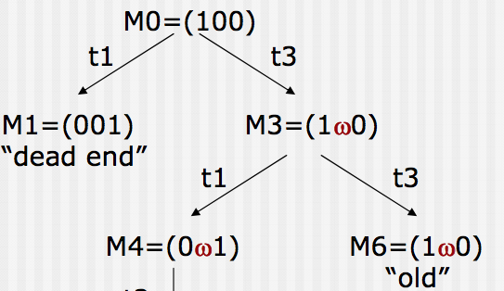
Coverability Tree: Example -3

Slide 40
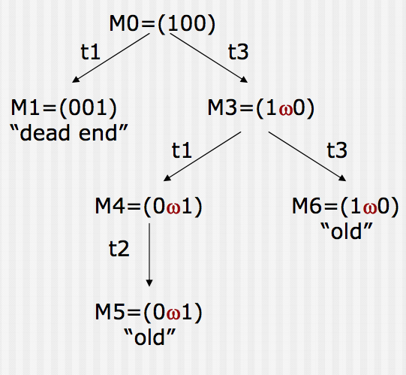
Coverability Tree: Example -4

Slide 41
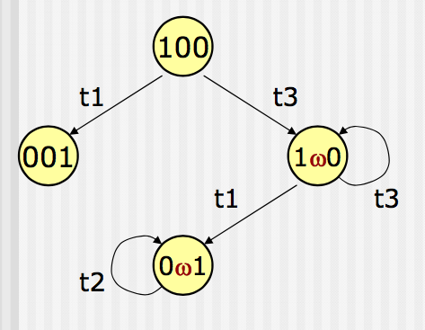
Coverability Tree: Example -5
Coverability tree
Coverability graph

Slide 42
Coverability Tree Exercise

Slide 43
Properties of Coverability Tree
A PN is bounded if and only if (iff) ω doesn’t appear in any node
Coverability tree is called reachability tree, containing all possible reachable markings
Can solve all reachability, boundedness, and liveness problems.
A PN is safe iff only 0’s and1’s appear in nodes
A transition is dead iff it doesn’t appear in any arc.
If M is reachable form M₀, then exists a node M’ that covers M.

Slide 44
Exercise: Using Coverability Tree
Is this net bounded?
It this net safe?
It this net live?

Slide 45
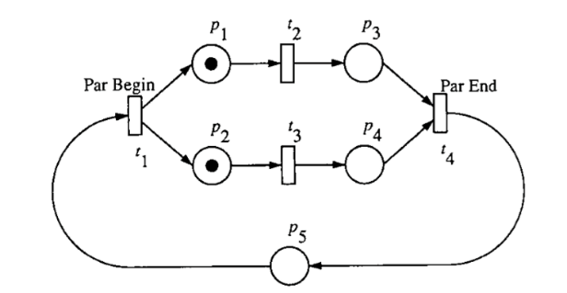
Group Exercise: Coverability Tree
Is this net bounded?
It this net safe?
It this net live?

