Slide 1
Visualizing differential gene expression and interpreting cell-types
Prof. Jean Fan

Slide 2
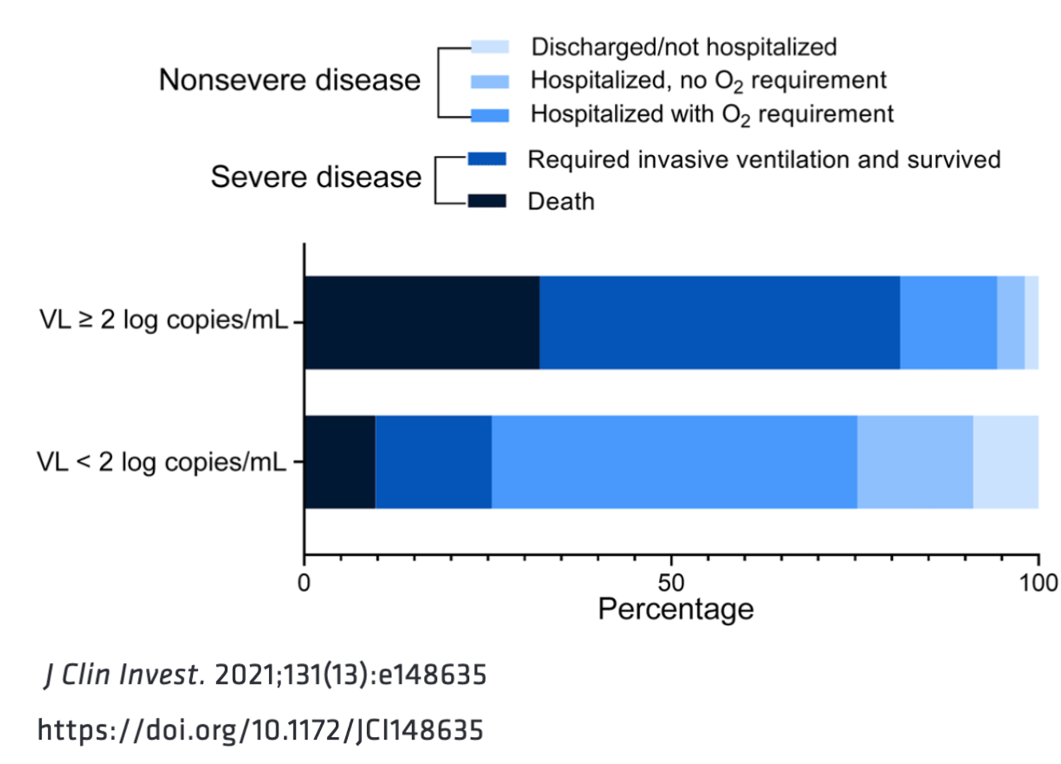
Quiz review: Part I

Slide 3
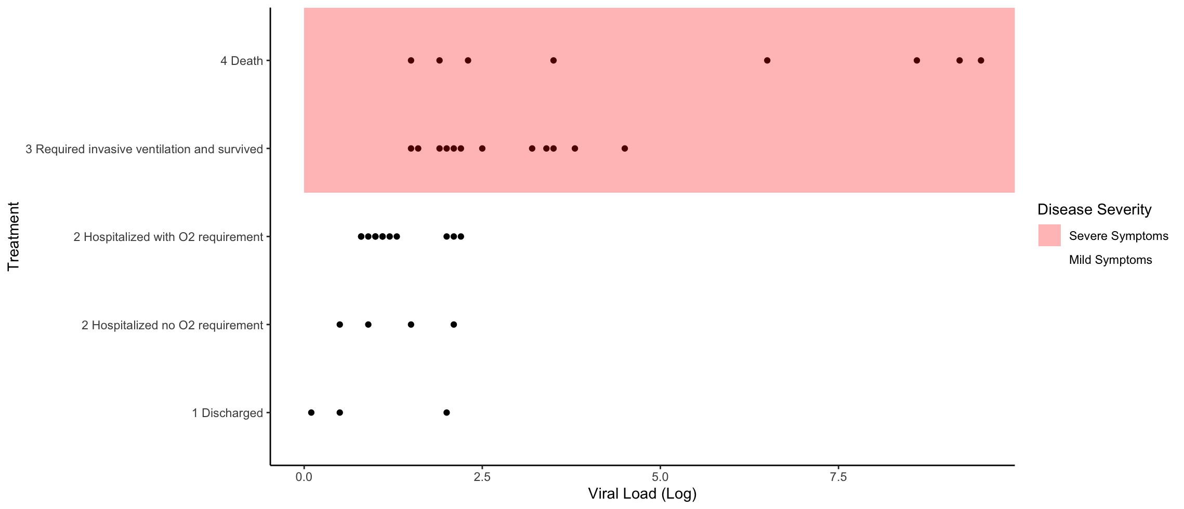
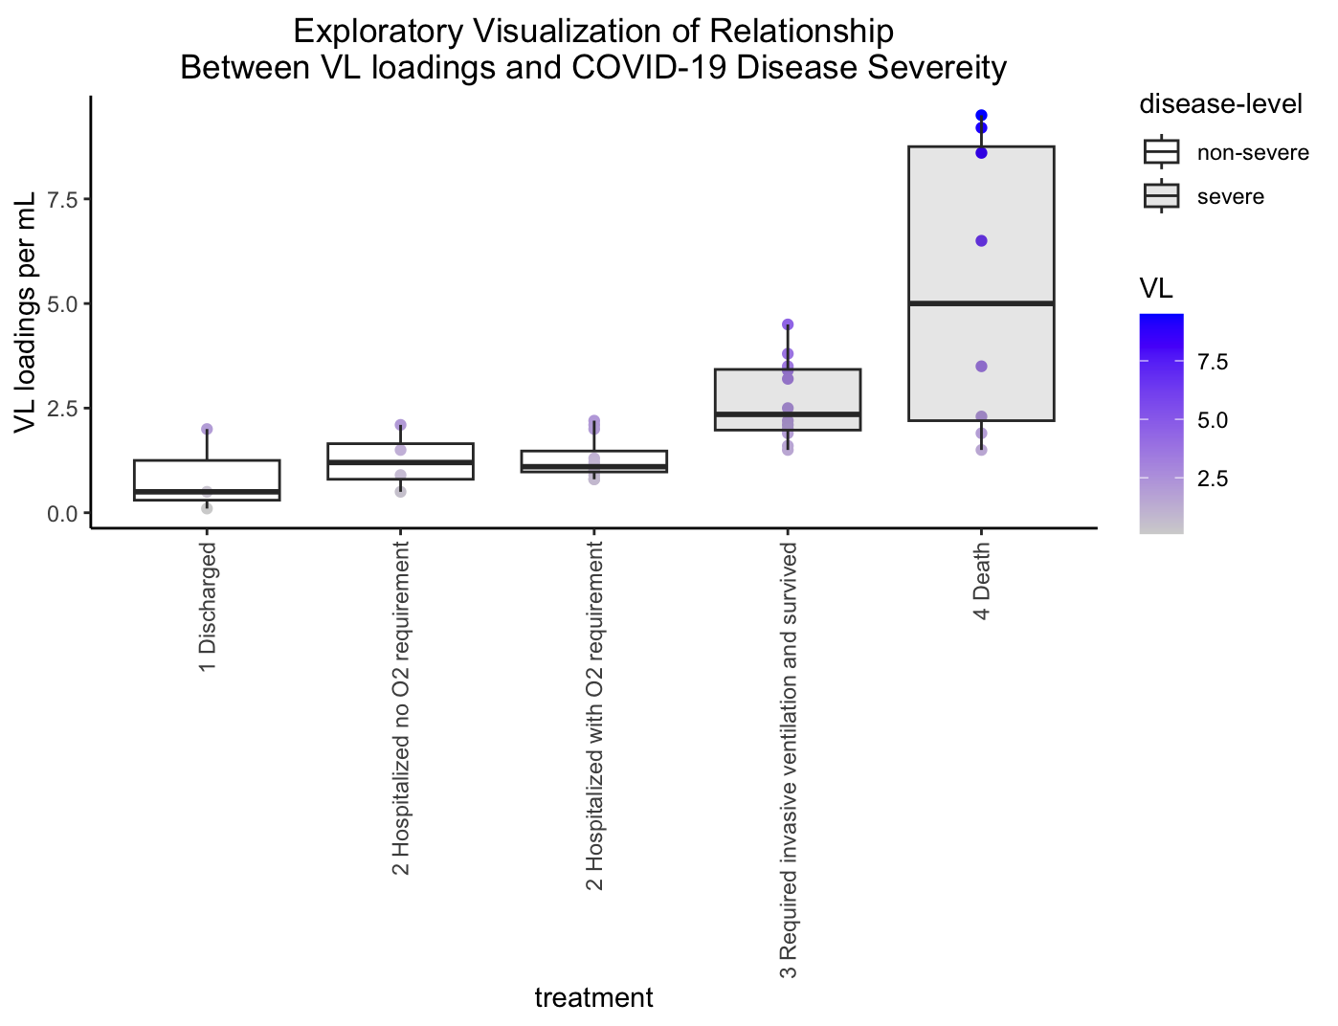
Diversity of data visualization redesigns

Slide 4
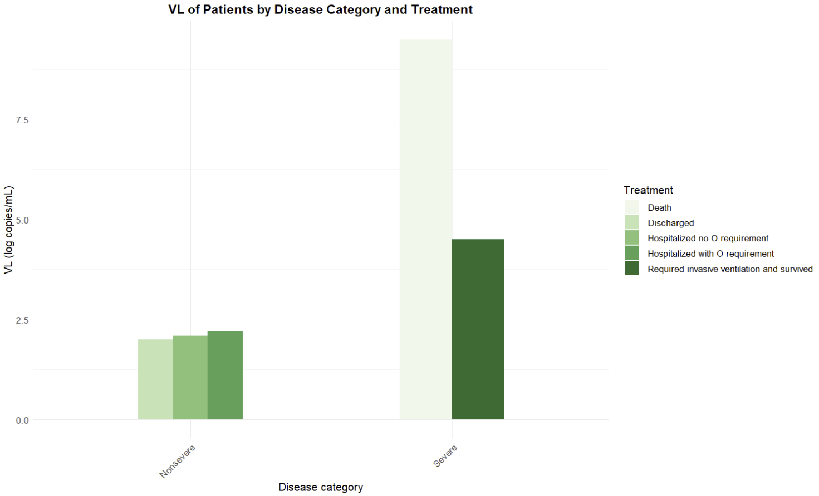
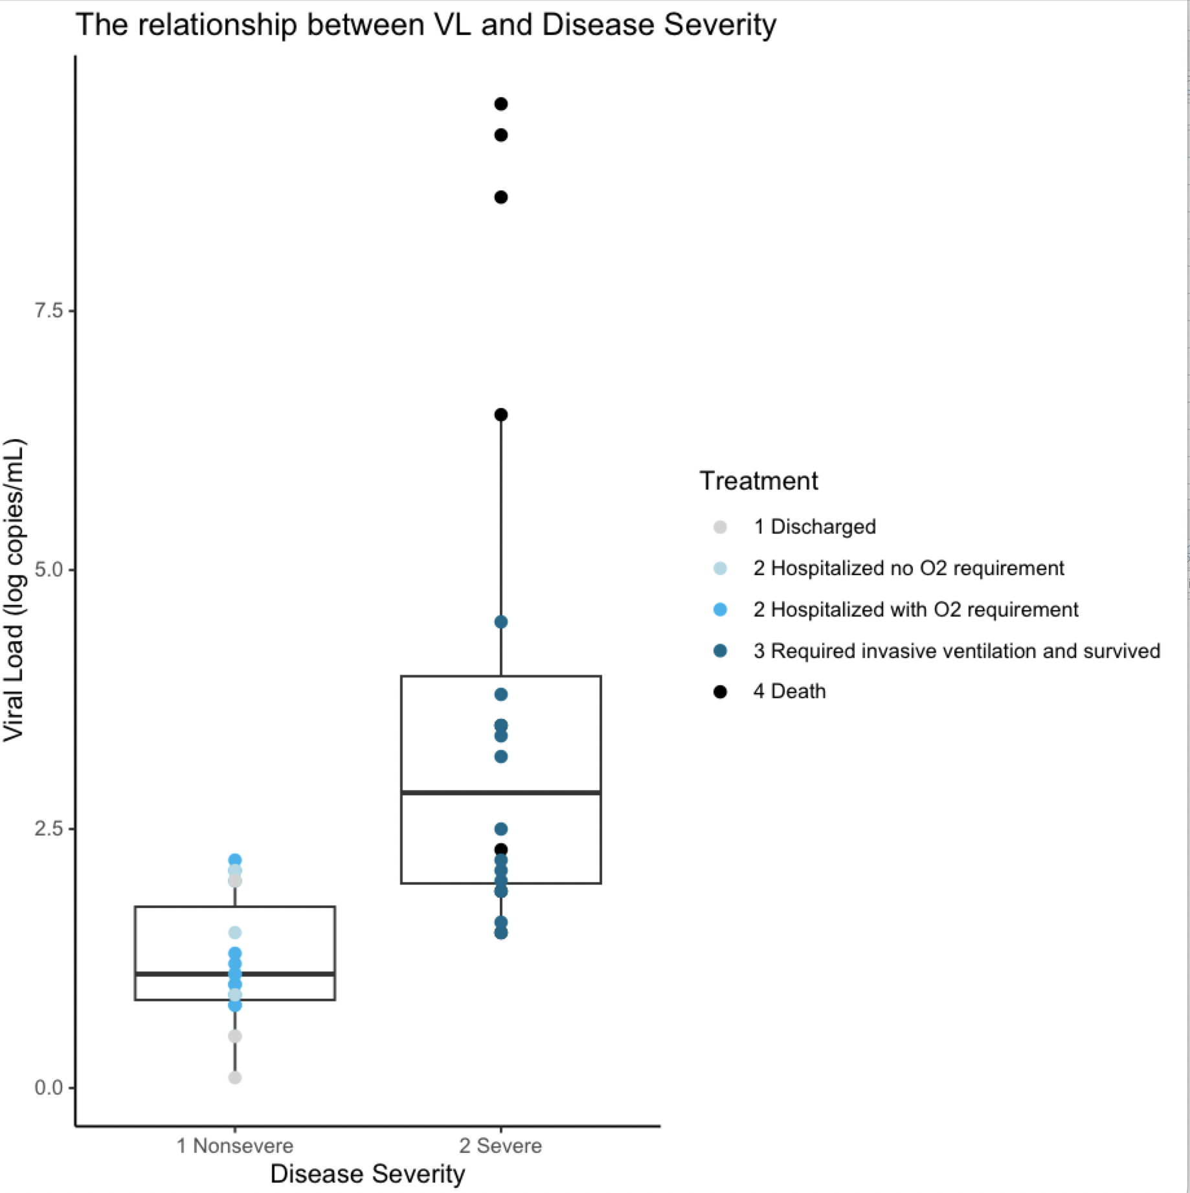
Diversity of data visualization redesigns

Slide 5
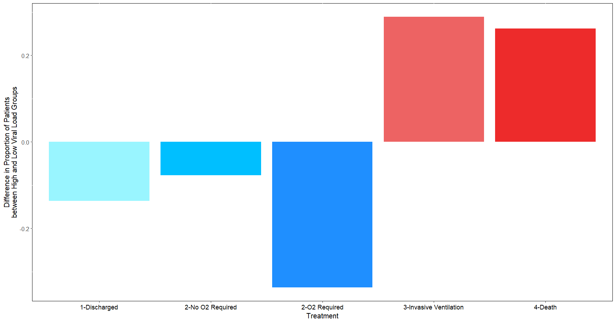
Diversity of data visualization redesigns

Slide 6
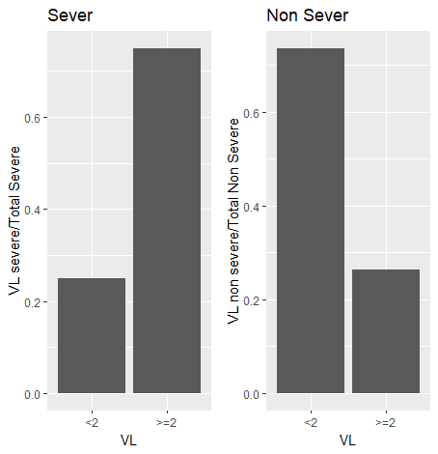
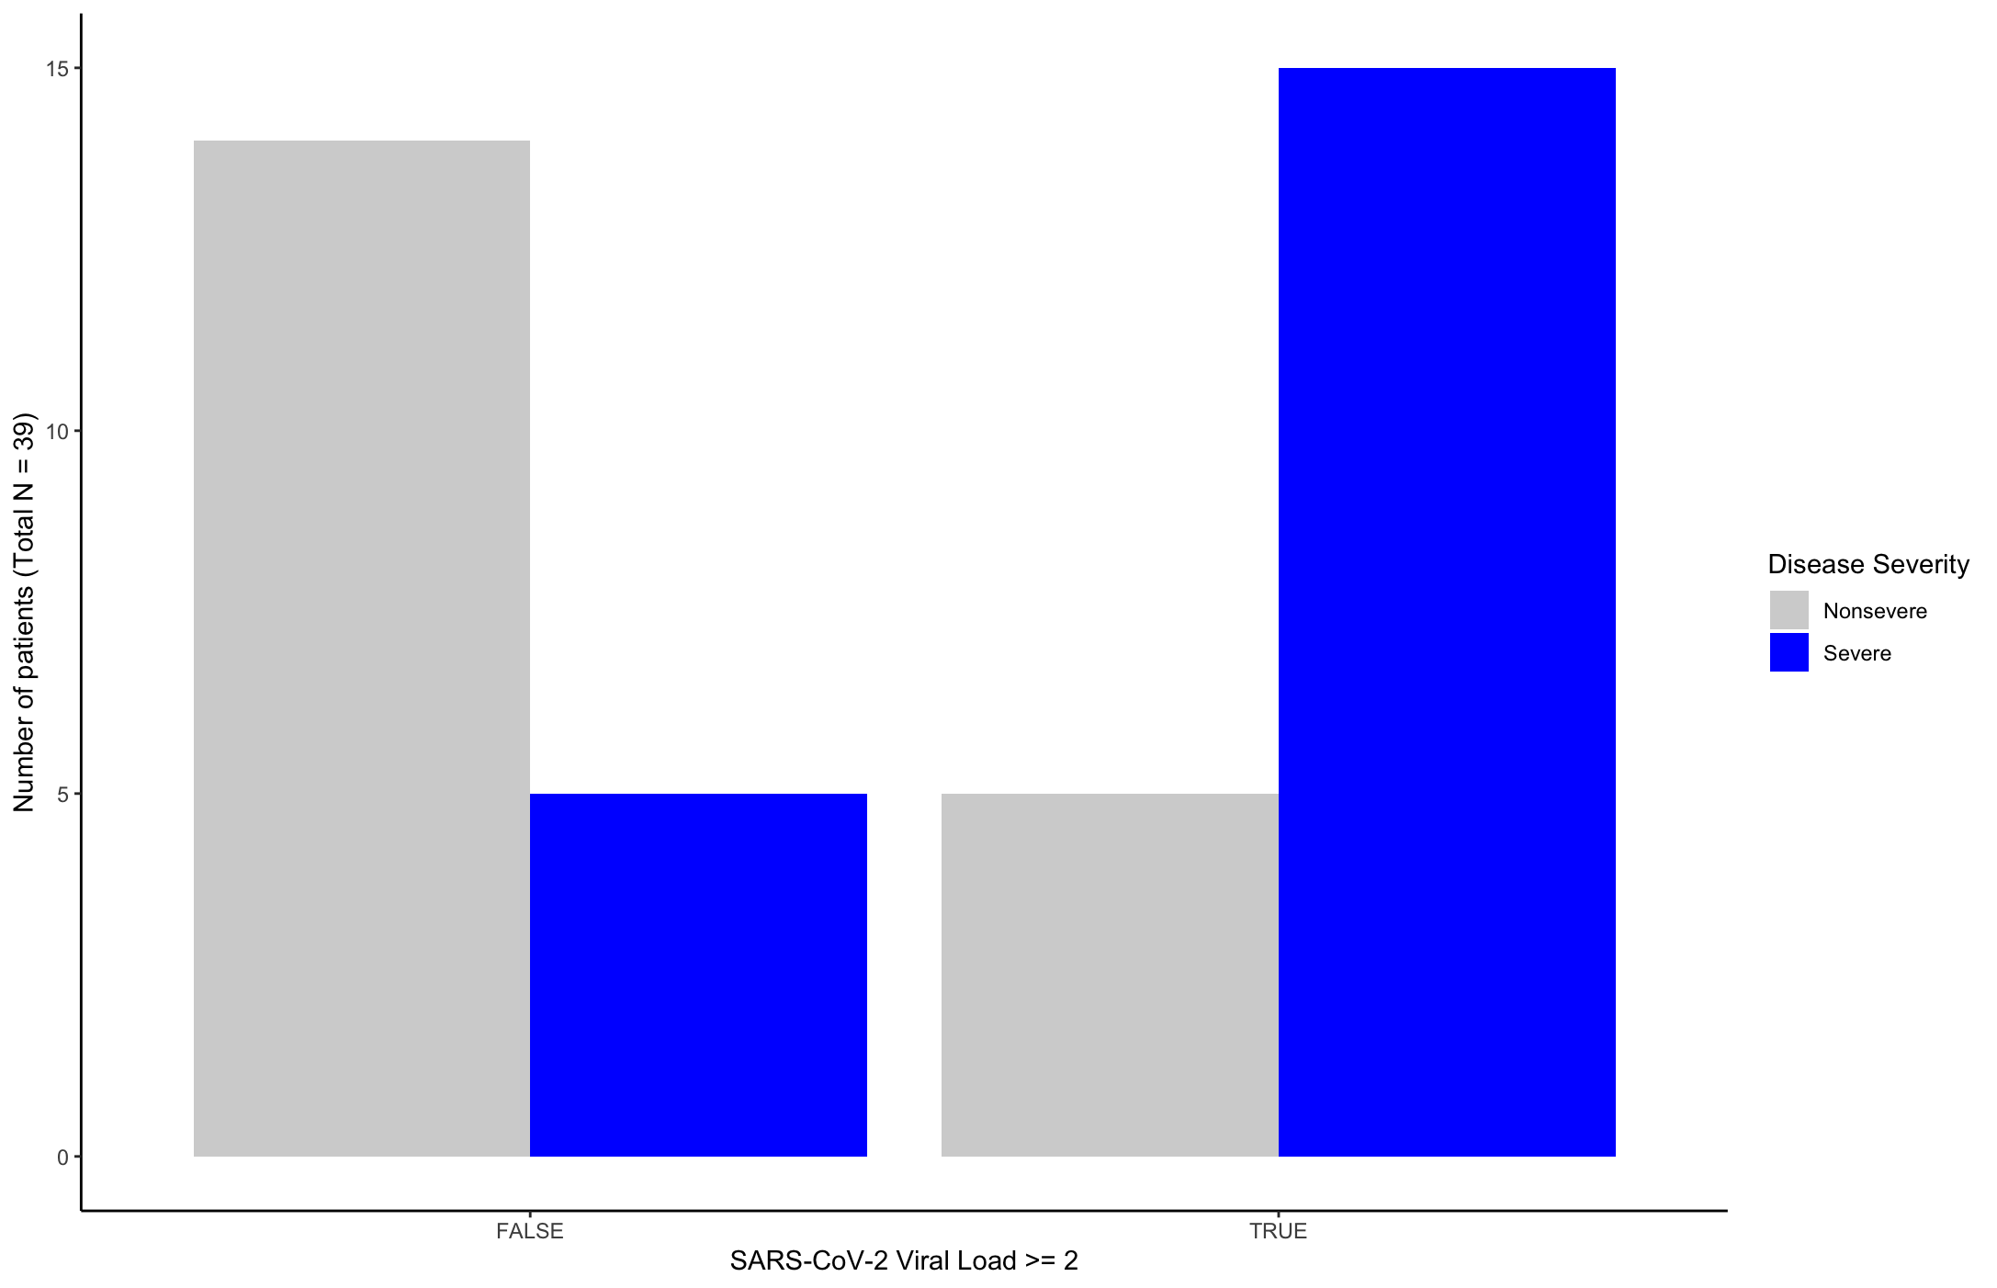
Diversity of data visualization redesigns

Slide 7
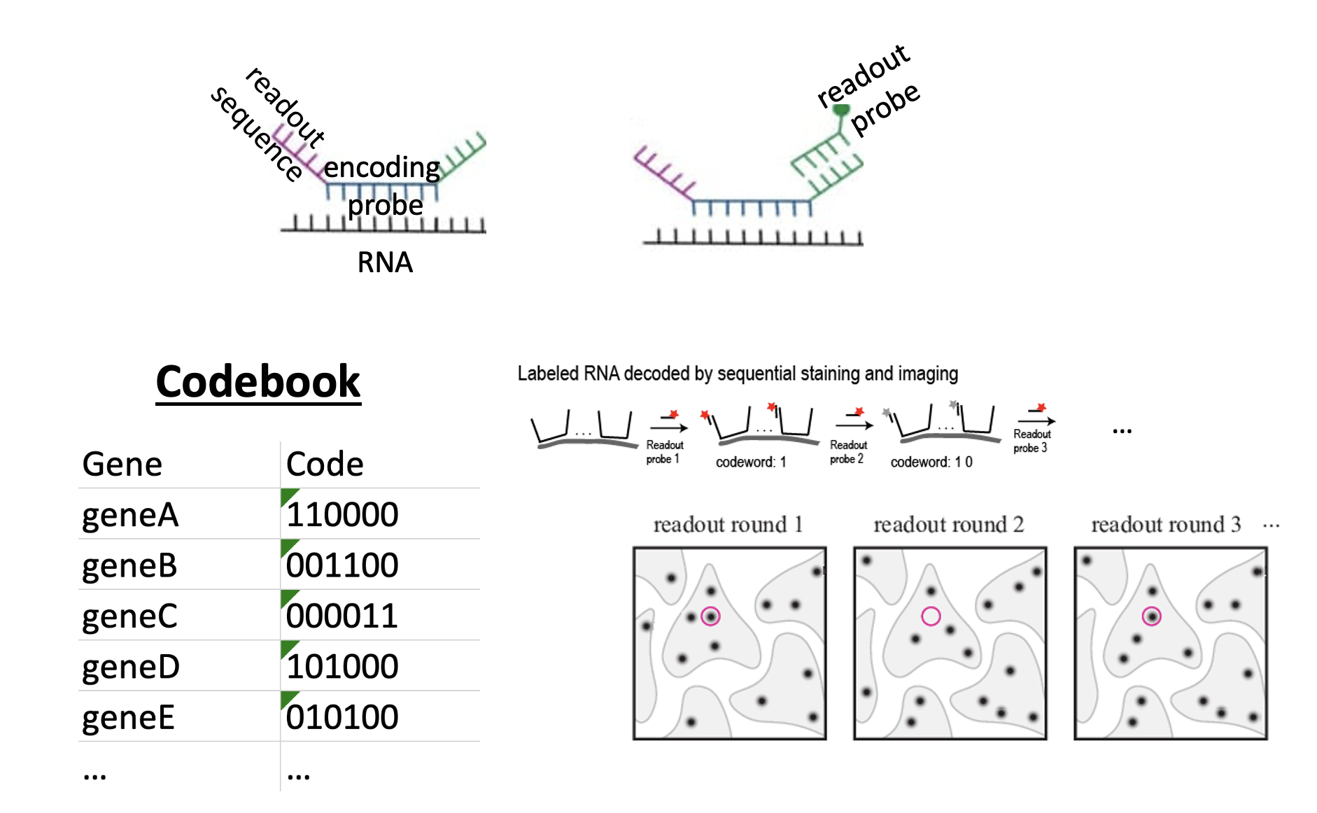
Quiz review: Part II
Q.2.1. Prof. Fan designs her probes such that each encoding probe (complementary to RNA of interest) is 16 base pairs, and each encoding probe has 1 round-specific read-out sequence (complementary to a read-out probe with a fluorescent tag). At least 20 fluorescent tags are needed to create a spot that is bright enough to be imaged. Assume encoding probes cannot overlap but can be placed perfectly side by side. What is theoretically the shortest gene in terms of number of base pairs that Prof. Fan can target based on this design? (2 pts)

Slide 8
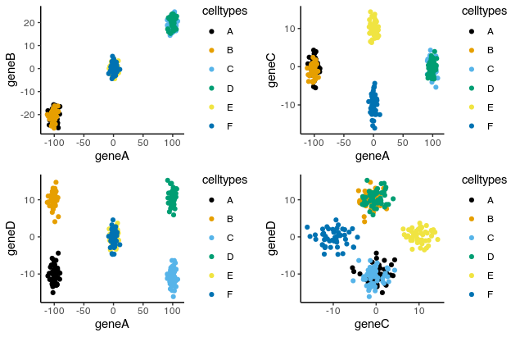
Quiz review: Part III
Gene A has largest variance and highest absolute loading on PC1
Make a data visualization of the relationship between magnitude versus variance in your data
Interpret similarity and differences between cell-types based on genes not 2D tSNE embedding distances

Slide 9
Additional notes

Slide 10
From last class

Slide 11
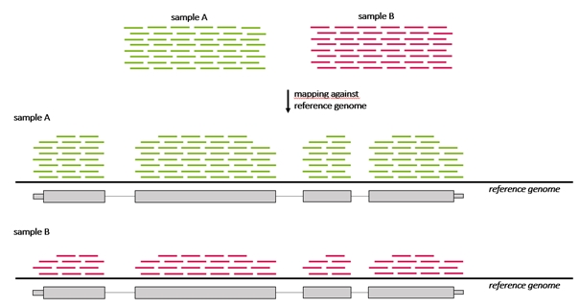
Visualizing differential expression results

Slide 12
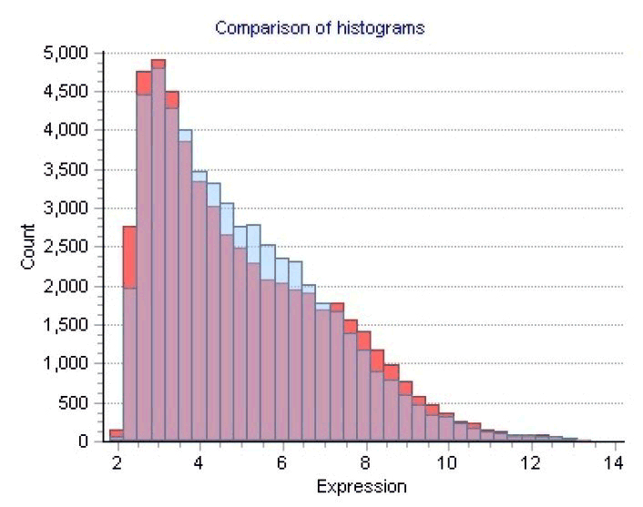
Visualizing differential expression results

Slide 13
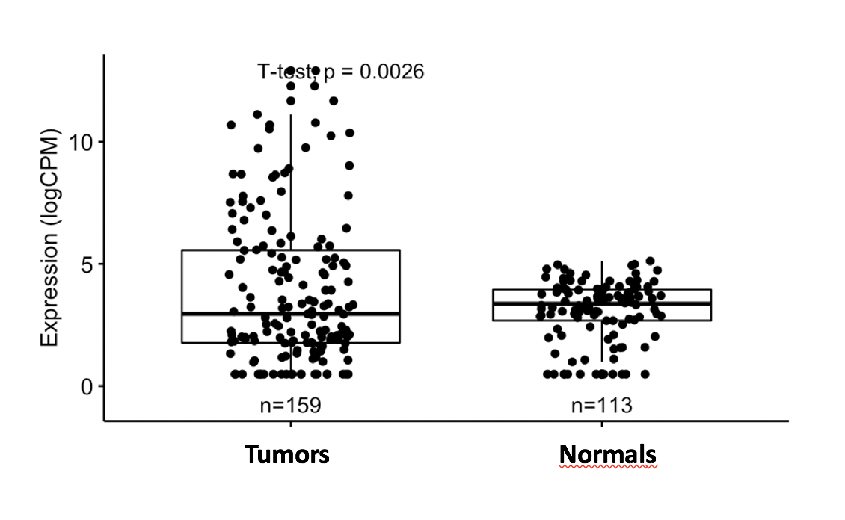
Visualizing differential expression results

Slide 14
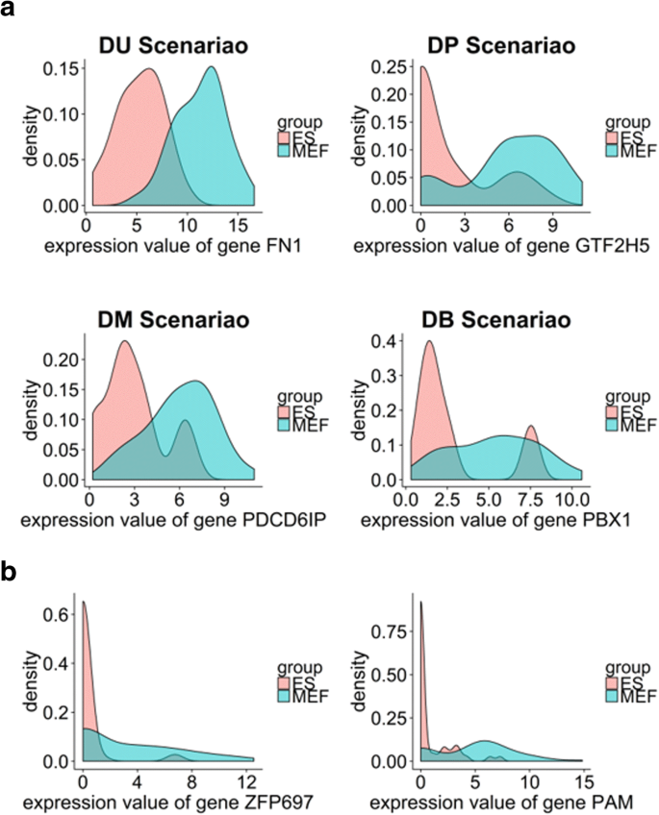
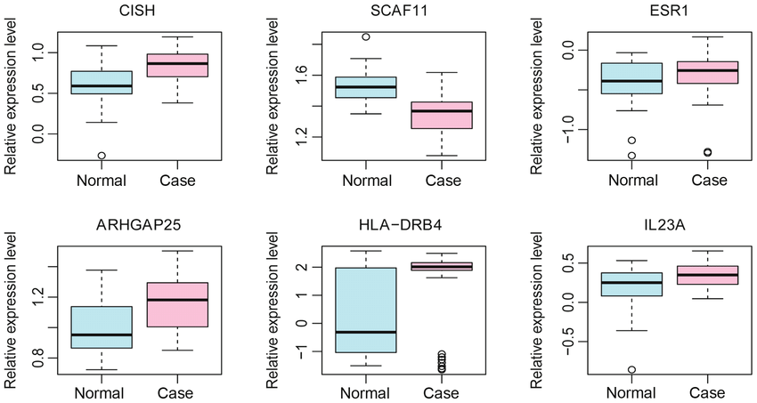
Visualizing differential expression results

Slide 15
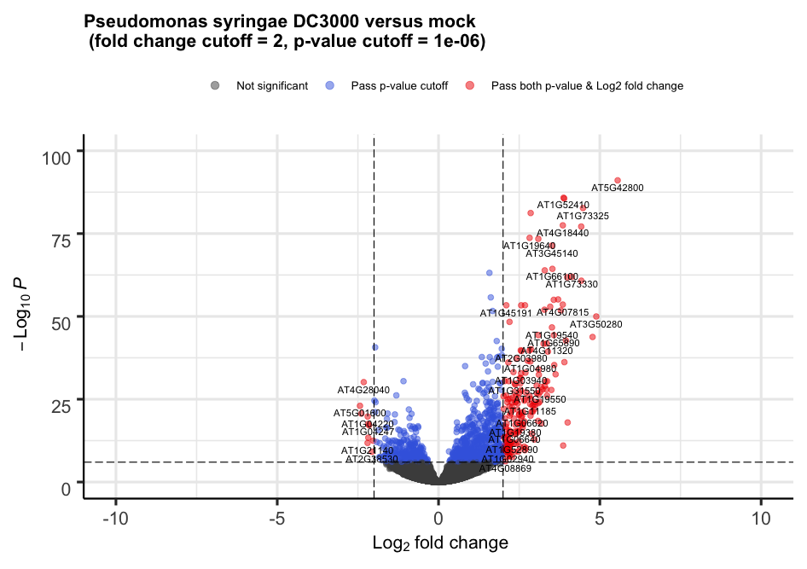
Visualizing differential expression results

Slide 16
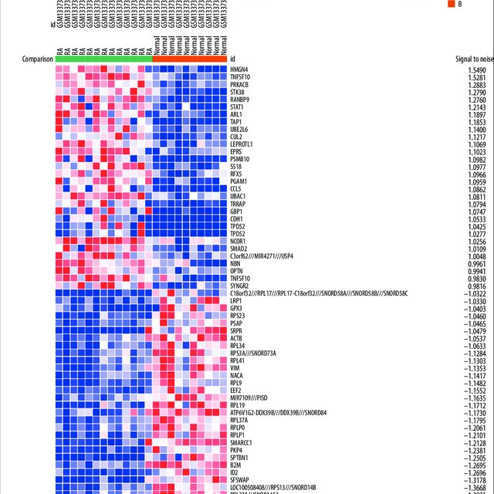
Visualizing differential expression results

Slide 17
Interpreting cell-types

Slide 18
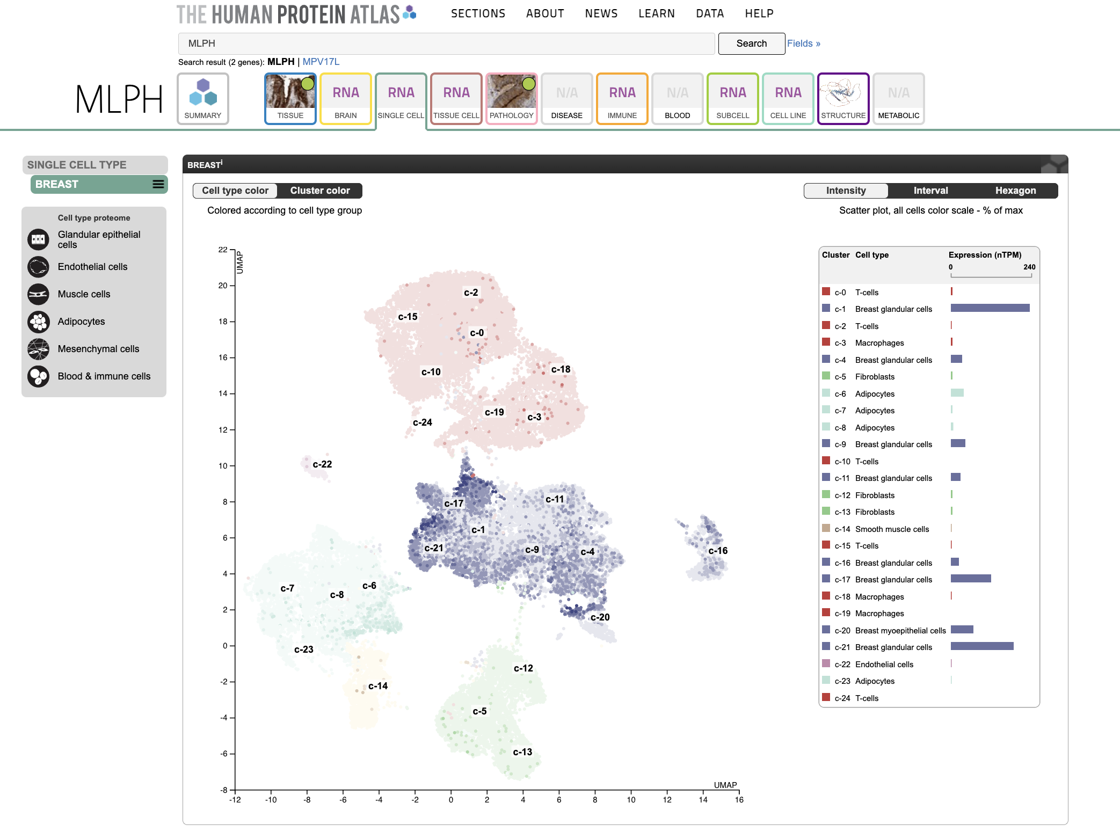
Human Protein Atlas: https://www.proteinatlas.org/

Slide 19
HW5 (due Friday midnight): Create a multi-panel data visualization to interpret a cell cluster in your data
Perform kmeans clustering on your data. Pick ONE cluster and figure out what cell-type it corresponds to. Create a data visualization and write a description to convince me that your cell-type interpretation is correct.
Your multi-panel data visualization should include at minimum the following components:
A panel visualizing your one cluster of interest in reduced dimensional space (PCA, tSNE, etc)
A panel visualizing your one cluster of interest in space
A panel visualizing multiple differentially expressed genes for your cluster of interest
A panel visualizing one of these genes in reduced dimensional space (PCA, tSNE, etc)
A panel visualizing one of these genes in space
Your description should reference papers and content that allowed you to interpret your cell cluster as a particular cell-type. You must provide attribution to external resources referenced. Links are fine; formatted references are not required. (You do not need to describe the data visualization as you have been doing)
You must include the entire code you used to generate the figure so that it can be reproduced.

