Slide 1
Homework Assignment 1
Due Monday (Midnight Baltimore Time)

Slide 2
Create and describe a Data Visualization using YOUR DATA
Your description of your data visualization must address the following questions:
What data types are you visualizing?
What data encodings (geometric primitives and visual channels) are you using to visualize these data types?
What type of data visualization is this? What about the data are you trying to make salient through this data visualization?
What Gestalt principles or knowledge about perceptiveness of visual encodings are you using to accomplish this?
You must include the entire code you used to generate the figure so that it can be reproduced.
You must provide attribution to external resources referenced (if any) in writing your code.

Slide 3
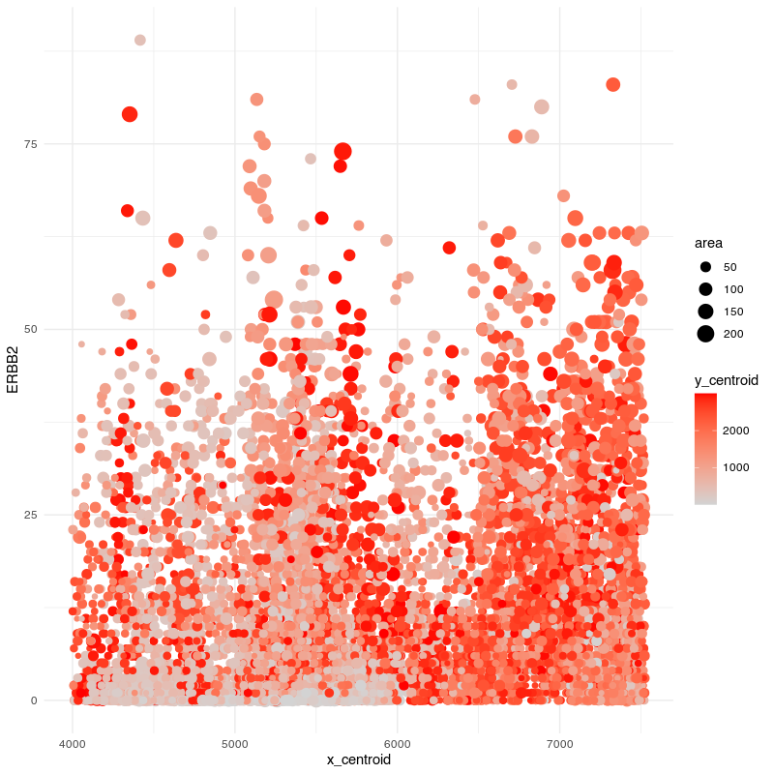
Example
What data types are you visualizing?
I am visualizing quantitative data of the expression count of the ERBB2 gene for each cell, quantitative data of the area for each cell, and spatial data regarding the x,y centroid positions for each cell.
What data encodings are you using to visualize these data types?
I am using the geometric primitive of points to represent each cell. To encode expression count of the ERBB2 gene, I am using the visual channel of position along the y axis. To encode the area for each cell, I am using the visual channel of size. To encode the spatial x position, I am using the visual channel of position along the x axis. To encode the spatial y position, I am using the visual channel of saturation going from an unsaturated lightgrey to a saturated red.
What type of data visualization is this? What about the data are you trying to make salient through this data visualization?
My explanatory data visualization seeks to make more salient the relationship between ERBB2 expression and the cell area.
What Gestalt principles or knowledge about perceptiveness of visual encodings are you using to accomplish this?
I am using the Gestalt principle of proximity to put my legends on one side.

Slide 4
Code used
file <- '~/Desktop/genomic-data-visualization-2023/data/charmander.csv.gz'
data <- read.csv(file, row.names=1)
library(ggplot2)
ggplot(data, aes(x=x_centroid, y=ERBB2, col=y_centroid, size=area)) +
scale_colour_gradient(low = 'lightgrey', high='red') +
geom_point() +
theme_minimal()

Slide 5
Submitting your HW

Slide 6
To submit your homework, follow the steps from HW0, summarized here
0. Update your personal fork by fetching upstream
1. Save your data visualization to the homework/hw[N]/ folder using hw[N]_[jhed].png
2. Create a .md file in main/_posts/ following the 2023-01-21-jfan9.md file
3. Double check your post and make a pull request as you learned from HW0

Slide 7
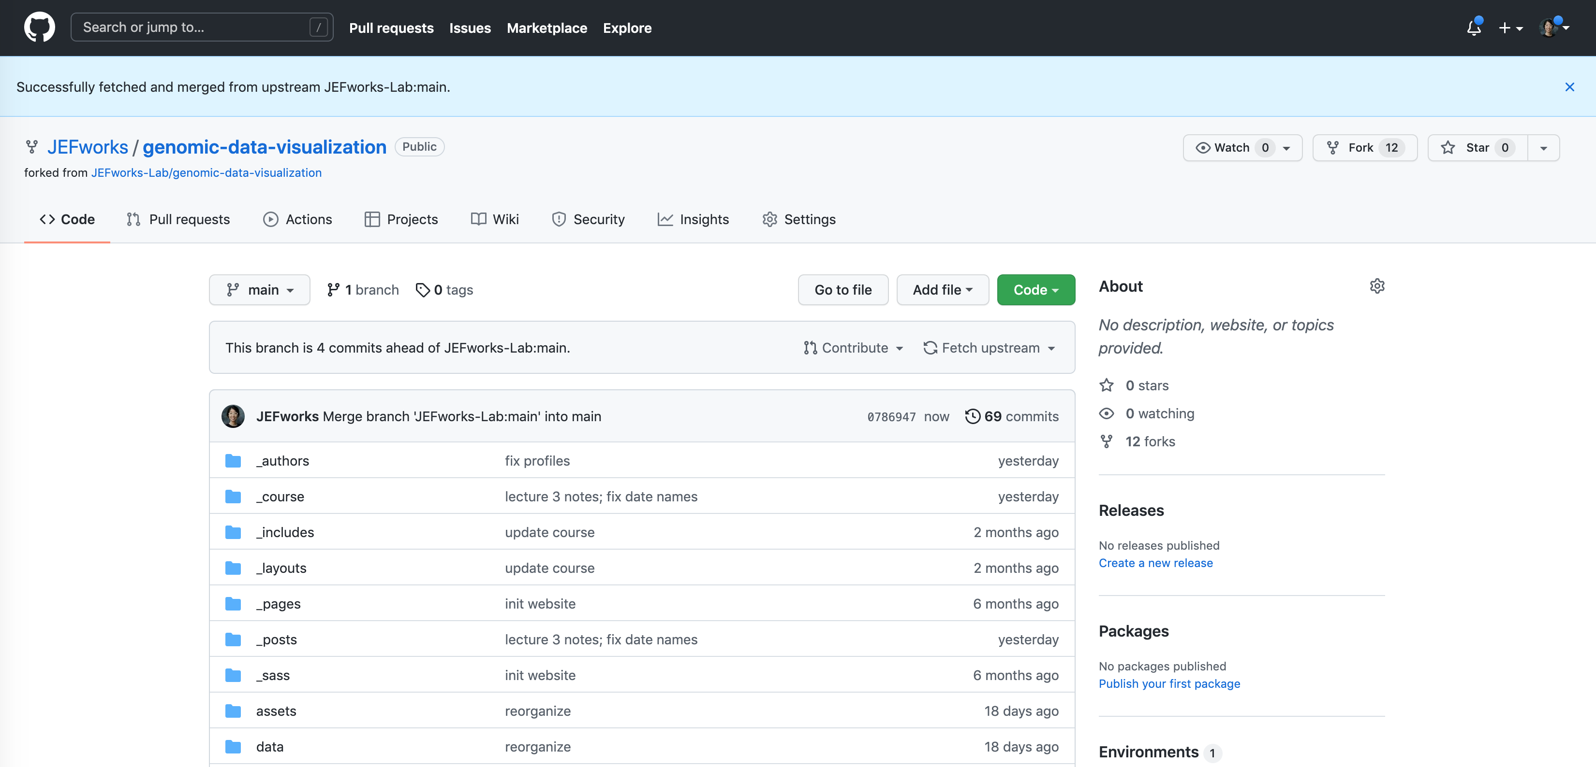
0. Update your personal fork by fetching upstream

Slide 8
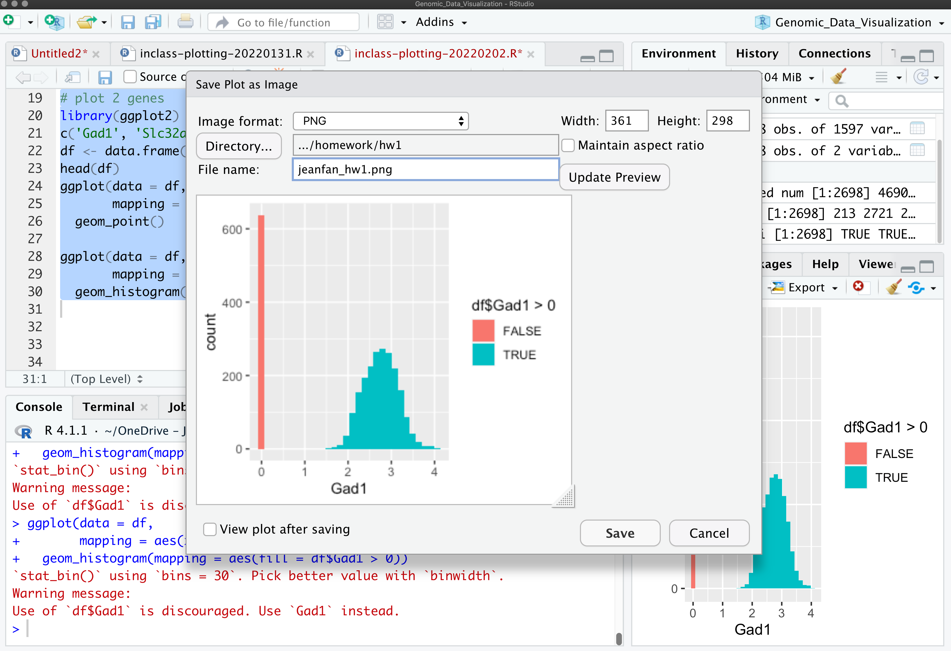
1. Save your data visualization to the homework/hw[N]/ folder using /hw[N]/ folder using hw[N]_[jhed].png

Slide 9
2. Create a .md file in main/_posts/ following the 2023-01-21-jfan9.md file
Update the date on the file name to [the date the homework was assigned]-[your jhed].md
Note that the format of the date is [year]-[month]-[day]
Your file will likely look something like this to the right but with the highlighted components changed
Note that the ”image:” should point to the image you just uploaded to the homework/ folder so please update the file names accordingly
---
layout: post
title: "Sample Homework Submission"
author: Prof. Jean Fan
jhed: jfan9
categories: [ HW1 ]
image: homework/hw1/jeanfan_hw1.png
featured: false
---
[description]
```{r}
[code]
```

Slide 10
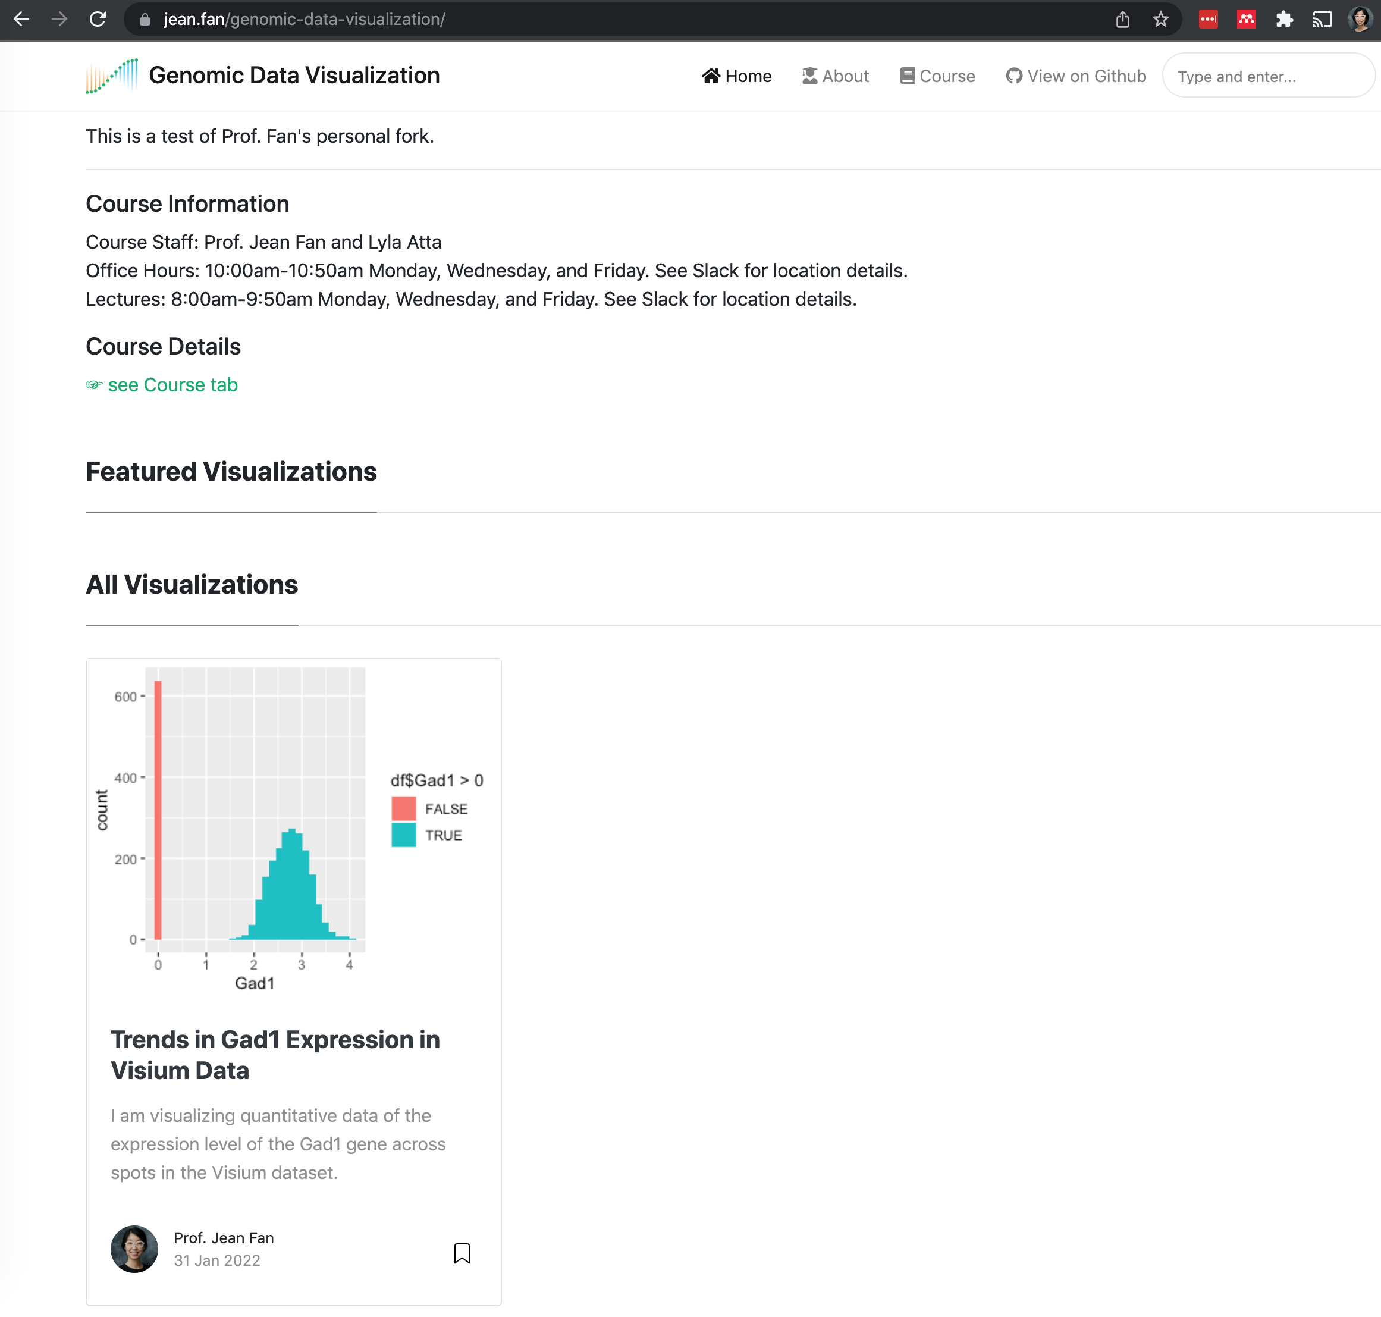
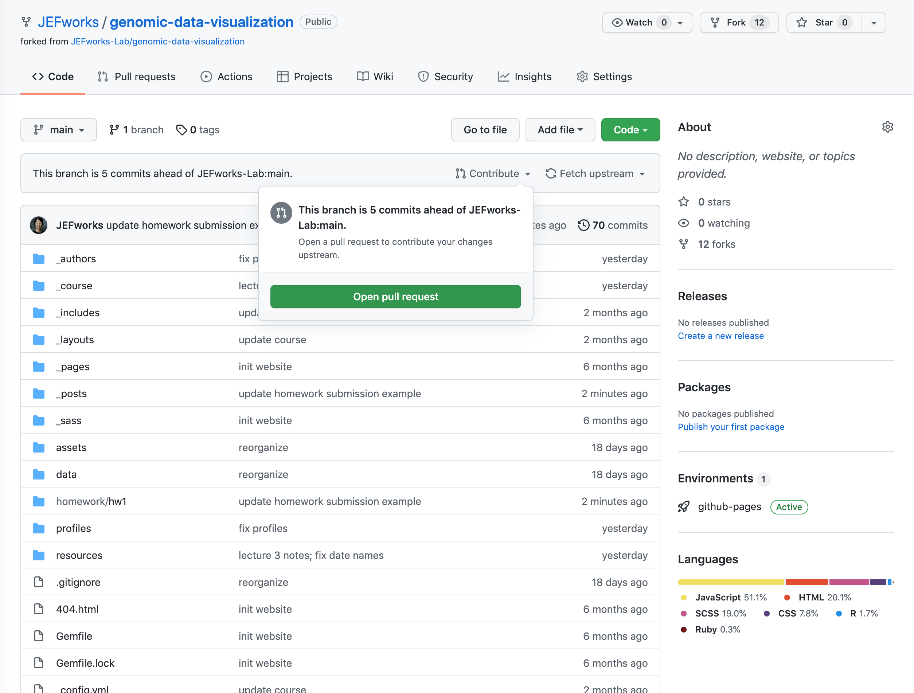
3. Double check your post and make a pull request as you learned from HW0

