Slide 1
Data Types Review
Feb 10, 2023

Slide 2
Lesson Objectives
By the end of this lesson students should be able to:​
classify data into data types
evaluate how appropriate a visual channel is given data of a specified type
This lesson is heavily built on https://jef.works/genomic-data-visualization-2022/course/1-data-visualization-theory/

Slide 3
Categorical Data
represent qualitative characteristics. Categorical data can take on numerical values, but those numbers don’t have mathematical meaning and the order isn't meaningful.

Slide 4
Categorical Data
represent qualitative characteristics. Categorical data can take on numerical values, but those numbers don’t have mathematical meaning and the order isn't meaningful.
Examples:
shapes (circle, square, triangle, etc.)
majors at a university (Public Health, Applied Math, Neuroscience, etc.)
BINGO spaces called (B7, I25, B2, G50, N38, O70, G46, I30)
favorite menu items at a restaurant (#7, #3, #12)

Slide 5
Ordinal Data
represent qualitative characteristics that have meaningful ordering. Ordinal data fall into categories, but when numbers are placed on the categories they have meaning regarding directionality but not distance between categories.

Slide 6
Ordinal Data
represent qualitative characteristics that have meaningful ordering. Ordinal data fall into categories, but when numbers are placed on the categories they have meaning regarding directionality but not distance between categories.
Examples:
year in college (freshman, sophomore, junior, senior)
levels of spice (mild, medium, hot, extra hot)
description of height (short, tall)
income brackets ($0–$19,999, $20,000–$39,999, $40,000–$59,999)

Slide 7
Quantitative Data
represent numerical values. Values can be interpreted mathematically, i.e. between two values you can observe meaningful direction and distance.

Slide 8
Quantitative Data
represent numerical values. Values can be interpreted mathematically, i.e. between two values you can observe meaningful direction and distance.
Examples:
heart rates (60 bpm, 118bpm, 95bpm)
cloud coverage (75%, 0%, 100%)
trip length (0.48 km, 3725 km, 12,880 km)

Slide 9
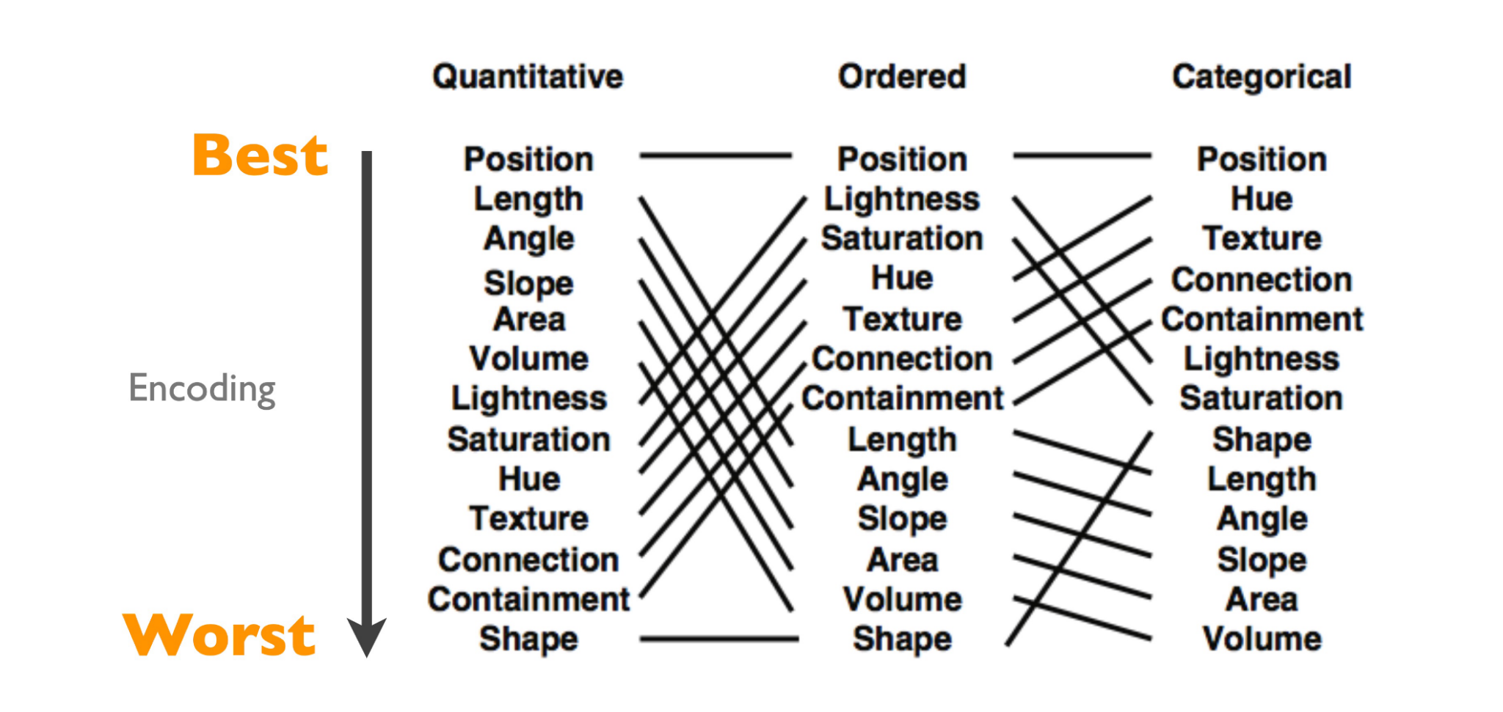
Ranking Of Encodings For Different Data Types
(Image credit: Munzner, Visualization Analysis and Design, 2014; adapted from Mackinlay, Automating the Design of Graphical Presentations of Relational Information, 1986)

Slide 10
Ranking Of Encodings For Different Data Types
favorite menu items at a restaurant (#7, #3, #12)
(Image credit: Munzner, Visualization Analysis and Design, 2014; adapted from Mackinlay, Automating the Design of Graphical Presentations of Relational Information, 1986)

Slide 11
Ranking Of Encodings For Different Data Types
levels of spice (mild, medium, hot, extra hot)
(Image credit: Munzner, Visualization Analysis and Design, 2014; adapted from Mackinlay, Automating the Design of Graphical Presentations of Relational Information, 1986)

Slide 12
Ranking Of Encodings For Different Data Types
cloud coverage (75%, 0%, 100%)
(Image credit: Munzner, Visualization Analysis and Design, 2014; adapted from Mackinlay, Automating the Design of Graphical Presentations of Relational Information, 1986)

