Slide 1
Genomic Data Visualization (slides on class website)
Prof. Jean Fan

Slide 2
Announcements
COVID exposure
If I do test positive or become symptomatic, we will move to virtual
HW1 and HW2 are now graded
Drop date for this class in Feb 12
Quiz this Friday Feb 10
Lesson objectives:
Quick review of tSNE
Kmeans
Coding loops

Slide 3
t-SNE review
Prof. Jean Fan

Slide 4
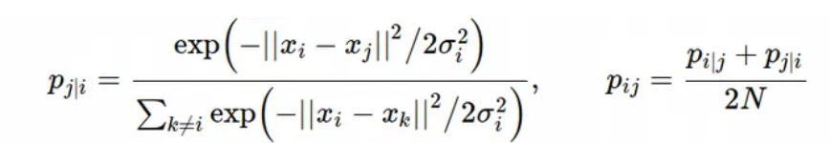
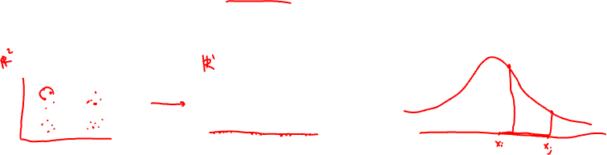
tSNE review
Step 1: Compute a scaled similarity p_{ij} between every pair of points i and j in high dimensional space

Slide 5

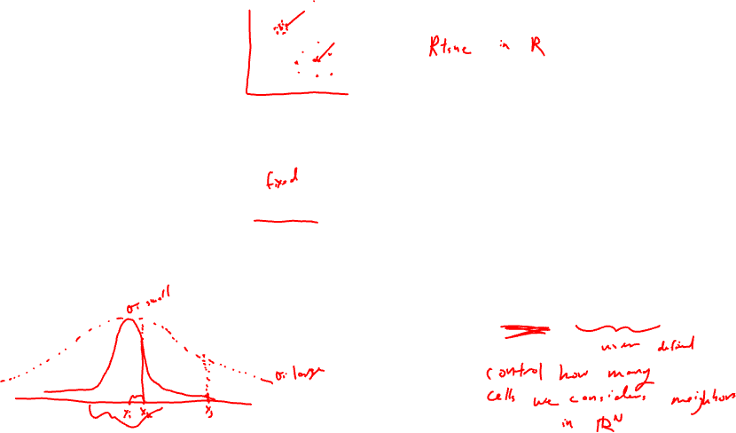
tSNE review
Step 1: Compute a scaled similarity p_{ij} between every pair of points i and j in high dimensional space
σ_{i} is a choice we make
Related to “perplexity” parameter
in your R code

Slide 6
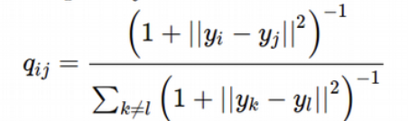
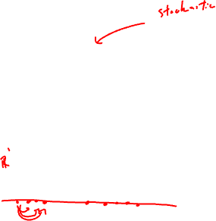
tSNE review
Step 2: randomly squish all our points into a low dimensional space and compute another scaled similarity q_{ij} between every pair of points i and j in low dimensional space

Slide 7
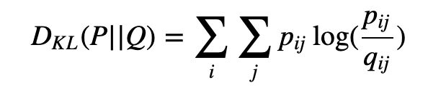

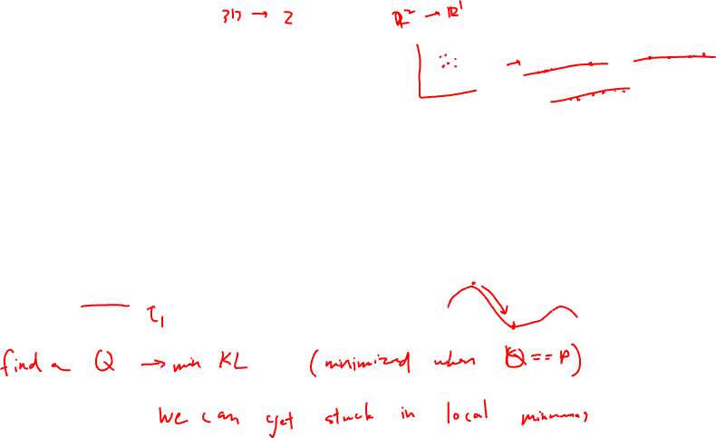
tSNE review
Step 3: quantify the KL divergence between these two scaled similarities
Step 4: iterate step 2 and step 3 N steps to minimize KL divergence
(can be set with “max_iter = 1000” parameter in your R code)

Slide 8
K-means clustering
Prof. Jean Fan

Slide 9
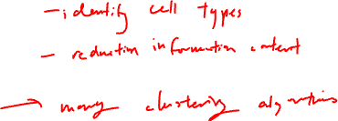
Why cluster?
Gene B
Gene B
Gene A
Gene A

Slide 10

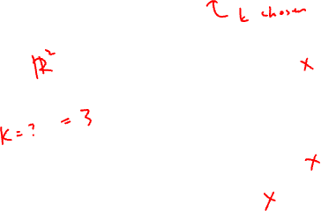
K-means clustering algorithm
Step 1: randomly place k centroids
Gene B
Gene A

Slide 11
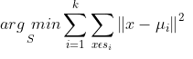
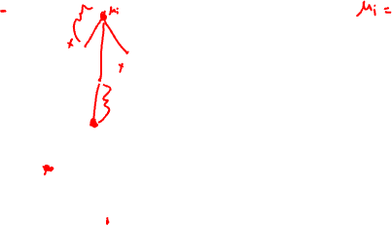
K-means clustering algorithm
Step 2: for each observation (x), find the nearest centroid
Gene B
Gene A

Slide 12

K-means clustering algorithm
Step 3: assign the observation (x) to that cluster
1
Gene B
2
3
Gene A

Slide 13

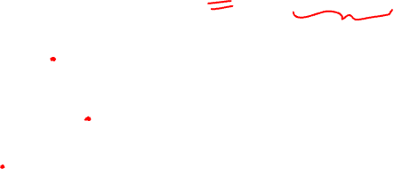
K-means clustering algorithm
Step 4: for each centroid, recompute to find a new centroid based on the observations in that cluster
Gene B
Gene A

Slide 14

K-means clustering algorithm
Step 5: repeat steps 2 through 4 until cluster assignments no longer change
1
Gene B
2
3
Gene A

Slide 15
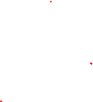
K-means clustering algorithm
Step 5: repeat steps 2 through 4 until cluster assignments no longer change
1
Gene B
2
3
Gene A

Slide 16
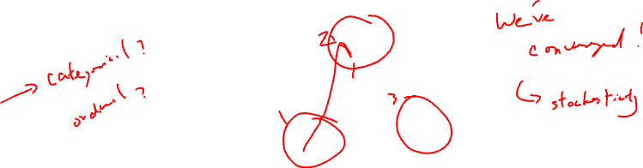
K-means clustering algorithm
Step 5: repeat steps 2 through 4 until cluster assignments no longer change
1
Gene B
2
3
Gene A

Slide 17
How to pick an appropriate k?
What if I had picked k = 2?
Gene B
Gene A

Slide 18

How to pick an appropriate k?
What if I had picked k = 2?
1
Gene B
2
Gene A

Slide 19
How to pick an appropriate k?
What if I had picked k = 2?
1
Gene B
2
Gene A

Slide 20
How to pick an appropriate k?
What if I had picked k = 2?
1
Gene B
2
Gene A

Slide 21
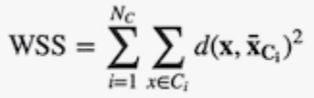
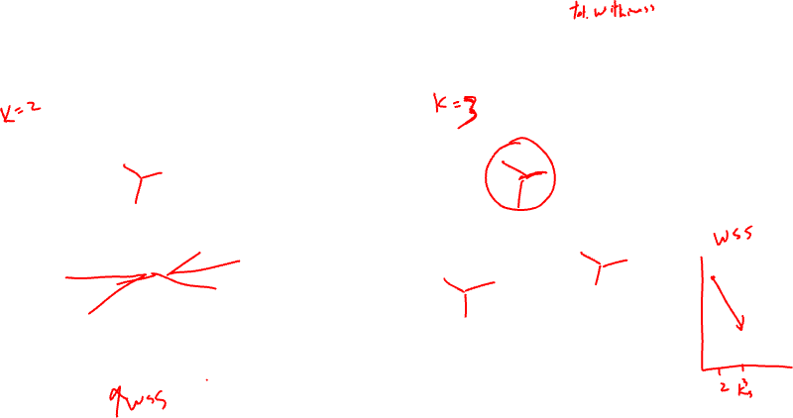
How to pick an appropriate k?
How does the within cluster sum of squares compare?
1
1
Gene B
Gene B
2
2
3
Gene A
Gene A

Slide 22
How to pick an appropriate k?
What if I had picked k = 4?
Gene B
Gene A

Slide 23
How to pick an appropriate k?
What if I had picked k = 4?
1
Gene B
3
2
4
Gene A

Slide 24
How to pick an appropriate k?
What if I had picked k = 4?
1
Gene B
3
2
4
Gene A

Slide 25
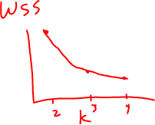
How to pick an appropriate k?
What if I had picked k = 4?
1
Gene B
3
4
2
Gene A

Slide 26


How to pick an appropriate k?
How does the between cluster sum of squares compare?
1
1
Gene B
3
Gene B
2
4
3
2
Gene A
Gene A

Slide 27
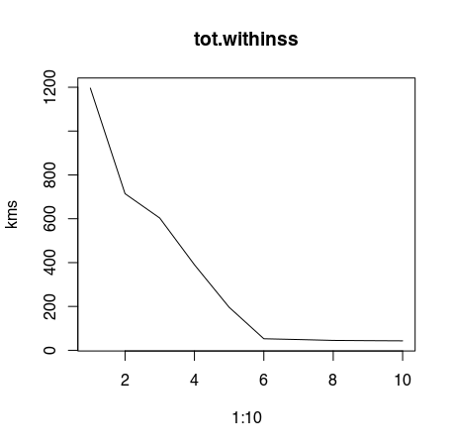
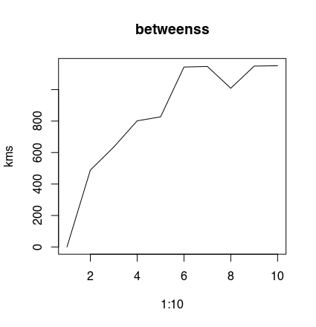
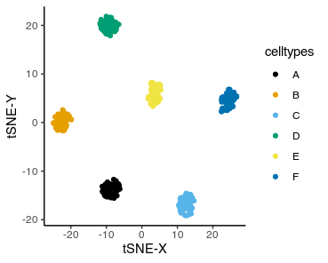
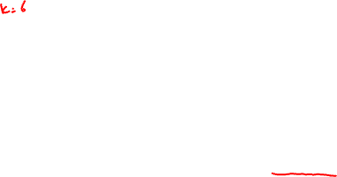
How to pick an appropriate k?

Slide 28
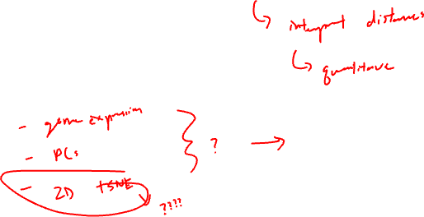
What can we compute k-means on?
Can we do k-means on categorical data?

