Slide 1
t-SNE review
Prof. Jean Fan

Slide 2
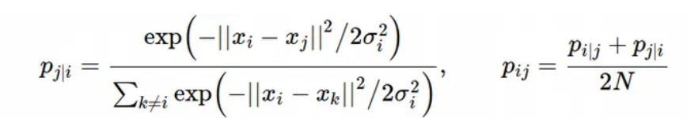
tSNE review
Step 1: Compute a scaled similarity p_{ij} between every pair of points i and j in high dimensional space

Slide 3

tSNE review
Step 1: Compute a scaled similarity p_{ij} between every pair of points i and j in high dimensional space
σ_{i} is a choice we make
Related to “perplexity” parameter
in your R code

Slide 4
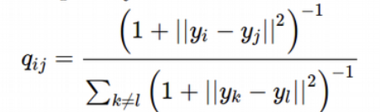
tSNE review
Step 2: randomly squish all our points into a low dimensional space and compute another scaled similarity q_{ij} between every pair of points i and j in low dimensional space

Slide 5
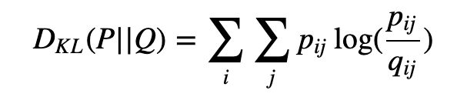

tSNE review
Step 3: quantify the KL divergence between these two scaled similarities
Step 4: iterate step 2 and step 3 N steps to minimize KL divergence
(can be set with “max_iter = 1000” parameter in your R code)

Slide 6
K-means clustering
Prof. Jean Fan

Slide 7
Why cluster?
Gene B
Gene B
Gene A
Gene A

Slide 8

K-means clustering algorithm
Step 1: randomly place k centroids
Gene B
Gene A

Slide 9
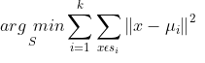
K-means clustering algorithm
Step 2: for each observation (x), find the nearest centroid
Gene B
Gene A

Slide 10
K-means clustering algorithm
Step 3: assign the observation (x) to that cluster
1
Gene B
2
3
Gene A

Slide 11

K-means clustering algorithm
Step 4: for each centroid, recompute to find a new centroid based on the observations in that cluster
Gene B
Gene A

Slide 12
K-means clustering algorithm
Step 5: repeat steps 2 through 4 until cluster assignments no longer change
1
Gene B
2
3
Gene A

Slide 13
K-means clustering algorithm
Step 5: repeat steps 2 through 4 until cluster assignments no longer change
1
Gene B
2
3
Gene A

Slide 14
K-means clustering algorithm
Step 5: repeat steps 2 through 4 until cluster assignments no longer change
1
Gene B
2
3
Gene A

Slide 15
How to pick an appropriate k?
What if I had picked k = 2?
Gene B
Gene A

Slide 16
How to pick an appropriate k?
What if I had picked k = 2?
1
Gene B
2
Gene A

Slide 17
How to pick an appropriate k?
What if I had picked k = 2?
1
Gene B
2
Gene A

Slide 18
How to pick an appropriate k?
What if I had picked k = 2?
1
Gene B
2
Gene A

Slide 19
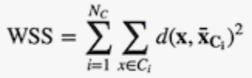
How to pick an appropriate k?
How does the within cluster sum of squares compare?
1
1
Gene B
Gene B
2
2
3
Gene A
Gene A

Slide 20
How to pick an appropriate k?
What if I had picked k = 4?
Gene B
Gene A

Slide 21
How to pick an appropriate k?
What if I had picked k = 4?
1
Gene B
3
2
4
Gene A

Slide 22
How to pick an appropriate k?
What if I had picked k = 4?
1
Gene B
3
2
4
Gene A

Slide 23
How to pick an appropriate k?
What if I had picked k = 4?
1
Gene B
3
4
2
Gene A

Slide 24

How to pick an appropriate k?
How does the between cluster sum of squares compare?
1
1
Gene B
3
Gene B
2
4
3
2
Gene A
Gene A

Slide 25
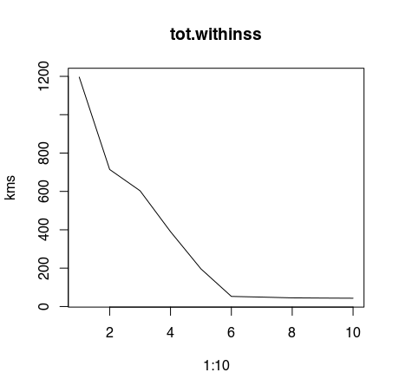
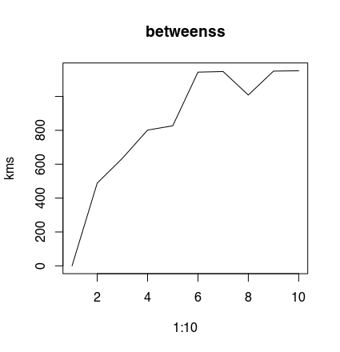
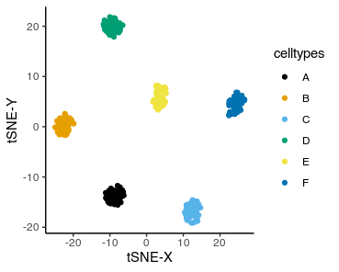
How to pick an appropriate k?

Slide 26
What can we compute k-means on?
Can we do k-means on categorical data?

