Slide 1

Terpresso: 0502_05
Terpresso
DATABASE
By Group 0502-05
Anwesha Gupta (0502)
Janhavi Namjoshi (0502)
Madhulika Nambi (0502)
Udit Singh (0501)

Slide 2
Terpresso: 0502_05
Terpresso
WELCOME TO
We are a rising chain of coffee houses, trying to build data management processes that would hold true as we expand
We want to monitor our product inventory, customer database, transactions, and supplier database and use it to improve our menu and profits.
We want to know how our products perform and improve our relationship with our suppliers.
Data Source: Circulated google form link among peers and collected data for the database
Specialisation:
Coffee beans and Tea leaves
Primary Products:
Beverages
Users:
Analysts
Store Managers
Marketing Team
Page 02 of 11

Slide 3
Terpresso
MISSION STATEMENTS
RANKED
TOP 3
CUSTOMER LOYALTY
TOP STORE
Most and least Selling Products
Most and Least profitable products
Identify returning customers and push promotional material
Identify best performing store to reduce overhead, INVEST better to expand more
Terpresso: 0502_05
Page 03 of 11

Slide 4
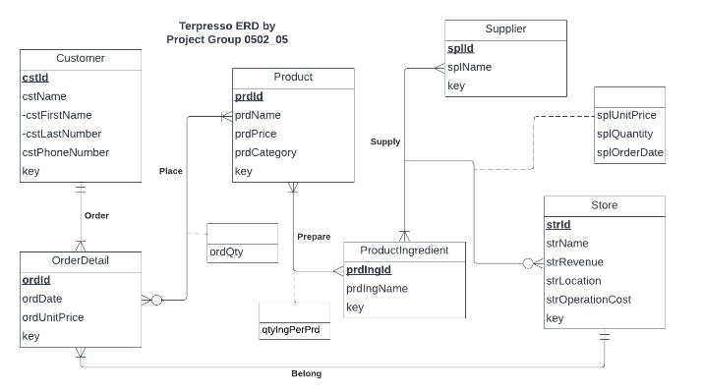
Page 04 of 11
Terpresso: 0502_05
ER DIAGRAM

Slide 5
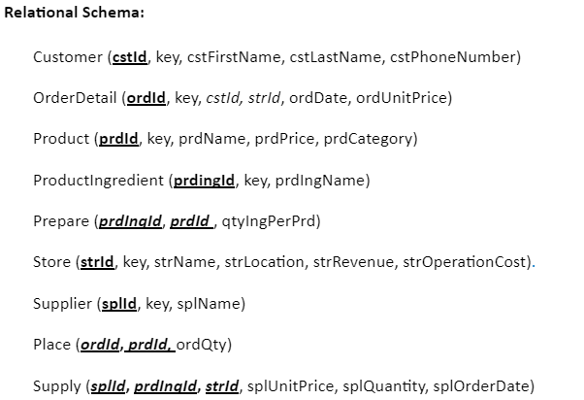
Page 05 of 11
Terpresso: 0502_05
RELATIONAL SCHEMA

Slide 6
Page 06 of 11
CREATE TABLE Customer(
cstKey INT IDENTITY(10,1),
cstId AS 'CST' + RIGHT('00' + CAST(cstKey AS VARCHAR(10)),7)PERSISTED NOT NULL,
cstFirstName VARCHAR(20),
cstLastName VARCHAR(20),
cstPhoneNumber CHAR(10),
CONSTRAINT pk_Customer_cstId PRIMARY KEY (cstId))
PHYSICAL
DATABASE
DESIGN
Terpresso: 0502_05

Slide 7
Page 06 of 11
CREATE TABLE Store(
strKey INT IDENTITY(10,1),
strId AS 'STR' + RIGHT('00' + CAST(strKey AS VARCHAR(10)),7)PERSISTED NOT NULL,
strName VARCHAR(50),
strLocation VARCHAR(50),
strRevenue DECIMAL(7,2),
strOperationCost DECIMAL(7,2),
CONSTRAINT pk_Store_strId PRIMARY KEY (strId))
PHYSICAL
DATABASE
DESIGN
Terpresso: 0502_05

Slide 8
Page 06 of 11
CREATE TABLE OrderDetail(
ordKey INT IDENTITY(10,1),
ordId AS 'ORD' + RIGHT('00' + CAST(ordKey AS VARCHAR(10)),7)PERSISTED NOT NULL,
cstId VARCHAR(10) NOT NULL,
strId VARCHAR(10) NOT NULL,
ordDate DATE,
ordUnitPrice DECIMAL(5,2),
CONSTRAINT pk_OrderDetail_ordId PRIMARY KEY (ordId),
CONSTRAINT fk_OrderDetail_cstId FOREIGN KEY (cstId)
REFERENCES Customer(cstId)
ON DELETE NO ACTION ON UPDATE CASCADE,
CONSTRAINT fk_OrderDetail_strId FOREIGN KEY (strId)
REFERENCES Store (strId)
ON DELETE CASCADE ON UPDATE CASCADE)
PHYSICAL
DATABASE
DESIGN
Terpresso: 0502_05

Slide 9
Page 06 of 11
CREATE TABLE Product (
prdKey INT IDENTITY(10,1),
prdId AS 'PRD' + RIGHT('00' + CAST(prdKey AS VARCHAR(10)),7)PERSISTED NOT NULL,
prdName VARCHAR(50),
prdPrice DECIMAL(5,2),
prdCategory VARCHAR(20),
CONSTRAINT pk_Product_prdId PRIMARY KEY (prdId))
PHYSICAL
DATABASE
DESIGN
Terpresso: 0502_05

Slide 10
Page 06 of 11
CREATE TABLE Supplier(
splKey INT IDENTITY(10,1),
splId AS 'SPL' + RIGHT('00' + CAST(splKey AS VARCHAR(10)),7)PERSISTED NOT NULL,
splName VARCHAR(50),
CONSTRAINT pk_Supplier_splId PRIMARY KEY (splId))
PHYSICAL
DATABASE
DESIGN
Terpresso: 0502_05

Slide 11
Page 06 of 11
CREATE TABLE Place (
ordId VARCHAR (10) NOT NULL,
prdId VARCHAR (10) NOT NULL,
ordQty INT,
CONSTRAINT pk_Place_ordId_prdId
PRIMARY KEY (ordId ,prdId),
CONSTRAINT fk_Place_ordId FOREIGN KEY (ordId)
REFERENCES OrderDetail(ordId)
ON DELETE CASCADE ON UPDATE CASCADE,
CONSTRAINT fk_Place_prdId FOREIGN KEY (prdId )
REFERENCES Product(prdId )
ON DELETE CASCADE ON UPDATE CASCADE )
PHYSICAL
DATABASE
DESIGN
Terpresso: 0502_05

Slide 12
Page 06 of 11
CREATE TABLE ProductIngredient(
prdIngKey INT IDENTITY(10,1),
prdIngId AS 'PIN' + RIGHT('00' + CAST(prdIngKey AS VARCHAR(10)),7)PERSISTED NOT NULL,
prdIngName VARCHAR(50),
CONSTRAINT pk_ProductIngredient_prdIngId PRIMARY KEY (prdIngId))
CREATE TABLE Prepare (
prdIngId VARCHAR(10) NOT NULL,
prdId VARCHAR(10) NOT NULL,
qtyIngPerPrd DECIMAL(5,2),
CONSTRAINT pk_Prepare_prdIngId_prdId
PRIMARY KEY (prdIngId ,prdId),
CONSTRAINT fk_Prepare_prdIngId FOREIGN KEY (prdIngId )
REFERENCES ProductIngredient(prdIngId)
ON DELETE CASCADE ON UPDATE CASCADE,
CONSTRAINT fk_Prepare_prdId FOREIGN KEY (prdId )
REFERENCES Product(prdId )
ON DELETE CASCADE ON UPDATE CASCADE )
PHYSICAL
DATABASE
DESIGN
Terpresso: 0502_05

Slide 13
Page 06 of 11
CREATE TABLE Supply (
splId VARCHAR (10) NOT NULL,
prdIngId VARCHAR (10) NOT NULL,
strId VARCHAR (10) NOT NULL,
splUnitPrice DECIMAL(6,2),
splQuantity INT,
splOrderDate DATE,
CONSTRAINT pk_Supply__splId_prdId_strId
PRIMARY KEY (splId , prdIngId, strId),
CONSTRAINT fk_Supply_splId FOREIGN KEY (splId)
REFERENCES Supplier(splId )
ON DELETE CASCADE ON UPDATE CASCADE,
CONSTRAINT fk_Supply_prdIngId FOREIGN KEY (prdIngId)
REFERENCES ProductIngredient(prdIngId )
ON DELETE CASCADE ON UPDATE CASCADE,
CONSTRAINT fk_Supply_strId FOREIGN KEY (strId)
REFERENCES Store(strId)
ON DELETE CASCADE ON UPDATE CASCADE)
PHYSICAL
DATABASE
DESIGN
Terpresso: 0502_05

Slide 14
Terpresso
Terpresso: 0502_05
DATABASE
By Group 0502-05
WHAT ARE THE RANKED MOST AND LEAST SELLING PRODUCTS?
Terpresso: 0502_05
Page 07 of 11

Slide 15
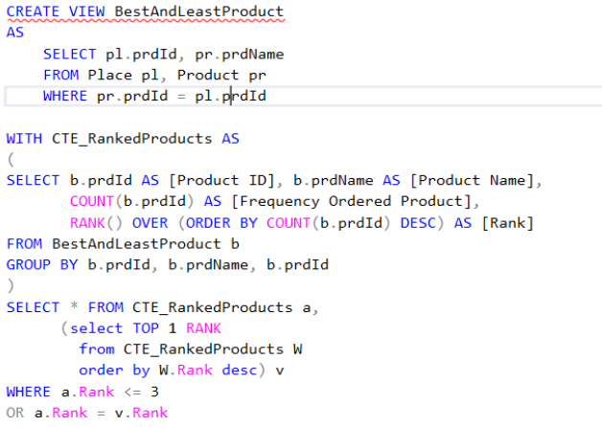
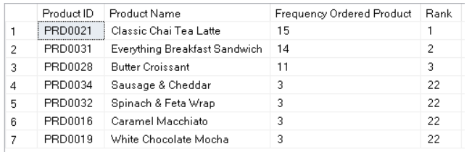
Page 08 of 11
Terpresso: 0502_05

Slide 16
Terpresso
Terpresso: 0502_05
DATABASE
By Group 0502-05
WHAT ARE THE TOP 3 MOST AND LEAST PROFITABLE PRODUCTS?
Terpresso: 0502_05
Page 07 of 11

Slide 17
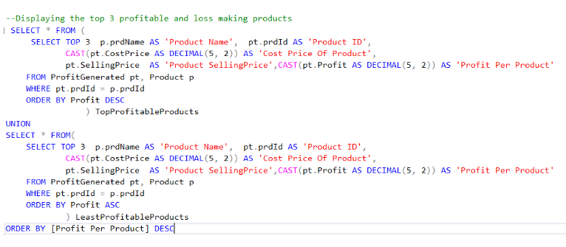
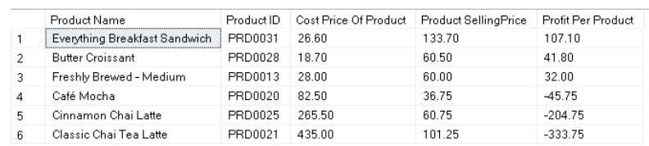
Page 08 of 11
Terpresso: 0502_05

Slide 18
Terpresso
Terpresso: 0502_05
DATABASE
By Group 0502-05
WHO ARE TERPRESSO’S MOST FREQUENTLY RETURNING CUSTOMERS AND THEIR CONTACT DETAILS?
Terpresso: 0502_05
Page 07 of 11

Slide 19
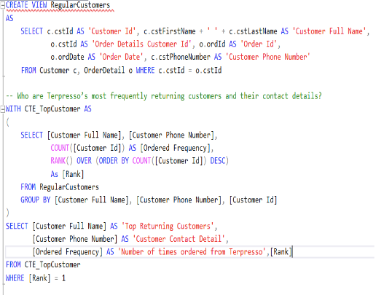

Page 08 of 11
Terpresso: 0502_05

Slide 20
Terpresso
Terpresso: 0502_05
DATABASE
By Group 0502-05
WHAT IS THE STORE INFORMATION AND THE TOTAL SALES PROFIT PER STORE?
Terpresso: 0502_05
Page 09 of 11

Slide 21
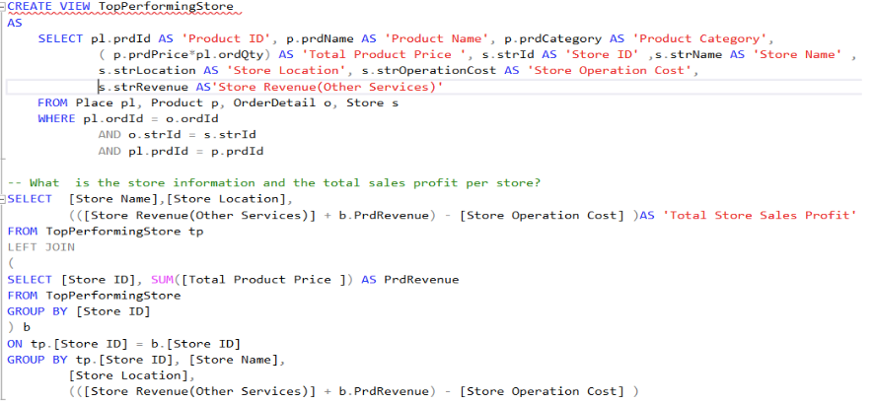
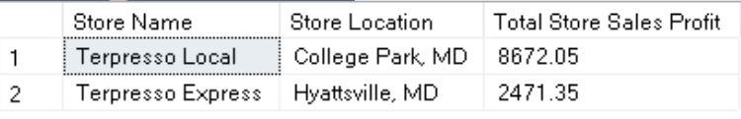
Page 10 of 11
Terpresso: 0502_05

Slide 22
Terpresso: 0502_05
Anwesha Gupta (0502)
Janhavi Namjoshi (0502)
Madhulika Nambi (0502)
Udit Singh (0501)
Terpresso
THANK YOU

