Slide 1
Making Blockchain Real for Business

Slide 2
BLOCKCHAIN ESSENTIALS

Slide 3
Why blockchain?
Blockchains are an emerging technology pattern that can radically improve banking, supply-chain and other transaction networks, giving them new opportunities for innovation and growth while reducing cost and risk.

Slide 4





Problem: Electronic networks that transfer the ownership of assets between parties according to business rules are inefficient, expensive and vulnerable.
Party A’s Records
Hack
Counter-party
records
Bank records
API-integrations
Party C’s Records
Auditor records
Party B Records
System integrations grow x(x-1)
with each additional party x

Slide 5

Solution: Blockchain networks — simpler; no centralized control points; spread risk = lowered costs; hardened inside (not just at perimeter).
Party A
Counter-parties
All Parties have
Replicated Ledger
Banks
Can still have private – permissioned network
Party C
Auditors
Consensus Algorithm
Prevents Double-spend
Digitally Signed / Encrypted
Transactions & Ledger
Party B

Slide 6
Blockchain in a Nutshell: Our Perspective
Blockchain = Replicated ledger + Crypto + Concensus + Logic
Shared replicated ledger: a peer-to-peer append-only transaction database that is replicated and shared across organizational boundaries/legal entities
Embedded crypto layer: supporting secure authenticated verifiable multi-party transactions via tokenization, digital identity, digital signatures, and other
Business rules (evolving to Smart Contracts): ability to specify business logic, embed it in the transaction database, and couple execution of the logic with transaction processing
Business rules derived from contracts trigger actions & workflows
Multi-party contracts defined around shared state & state changes
Org A
Org C
Secure authenticated updates to shared state
Org B
Org D
Replicated shared state

Slide 7
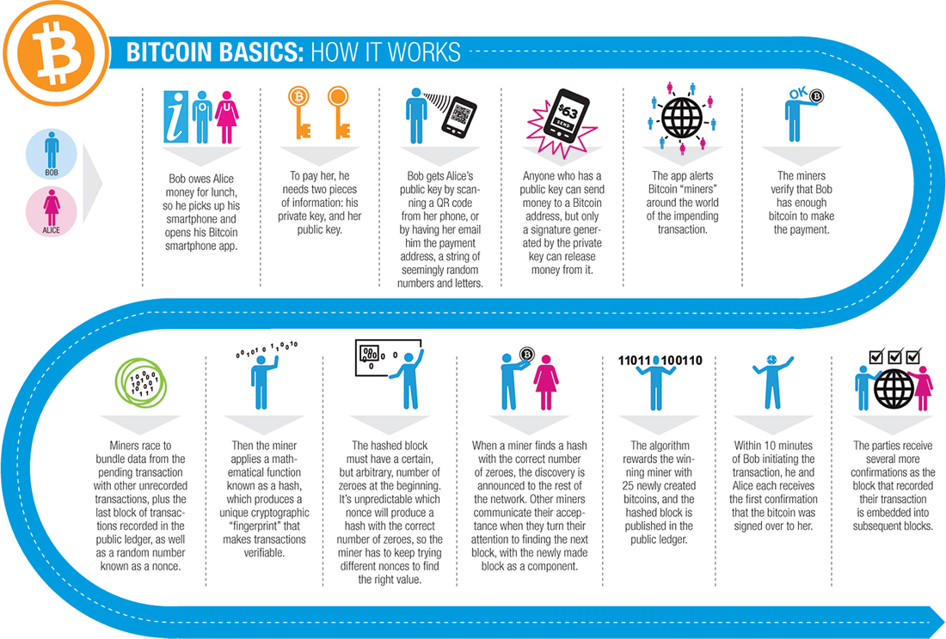

Blockchain is not cryptocurrency:
Blockchain makes the popular cryptocurrency, Bitcoin possible, ensuring that ‘coins’ passed between parties are cash-like: unique, immutable and final.
But the way Bitcoin implements blockchain makes bitcoins an unregulated, censorship-resistant shadow currency. IBM does not support this use.
Many aspects of Bitcoin, such as miners solving cryptographic puzzles, are unnecessary for industrial uses of blockchain, while many industrial requirements, like private transactions, are missing from Bitcoin and other current fabrics.
http://cdn.americanbanker.com/media/ui/how-bit-works-big.jpg

Slide 8
Benefits of Blockchain
Reduce costs and complexity
With a distributed ledger, information can be shared between any participant on the network, eliminating the cost and complexity of involving intermediary layers to interconnect participants. When such a market-level approach can be achieved, we eliminate the need to implement bilateral API-to-API transactions with each party we want to trade with.
Improve discoverability
When everyone on an exchange can view the same ledger, it is easy to broadcast an intention (or offer) by appending it. For example, in a trading network, all asks and bids would be visible to every network participant.
Automate trusted processes
Unlike a centralized system where only the network operator can create a generalized solution that fits every user’s needs, Blockchain networks allow each participant to create customized solutions using their own proprietary business logic while running on the same common ledger.
Ensure trusted record-keeping
By design, no one party can modify, delete, or even append any record to the ledger without the consensus from others on the network, making the system useful for ensuring the immutability of contracts and other legal documents.

Slide 9




How to decide when to use blockchain
High Performance,
Millisecond Transactions?
Are You Managing
Contractual Relationships?
Does Identity
Matter?
Does This Require
a Market Approach?
No
Yes
1
Yes
Yes
Yes
Are you working with Complex Business Logic?
Do You Need to Keep Your Transactions Private?
Does it Require Greater
Than Two Parties?
No
Yes
4
Yes
2
Yes
Yes
Are You Looking
to Reduce Costs?
Consider Alternative Approaches
Let’s Talk
No
Yes
Are You Looking to
Improve Discoverability?
3
1
By design, no one party can modify, delete, or even append any record without consensus, making the system useful for ensuring the immutability of contracts and other legal documents.
Smart contracts aim to provide security superior to traditional contract law and to reduce other transaction costs associated with contracting.
When everyone on an exchange can view the same ledger, it is easy to broadcast an intention (or offer) by appending it. For example, in a trading network, all ask and bids would be visible to every network participant.
Blockchain networks allow each participant to create customized solutions using their own proprietary business logic while running on the same common ledger.
2
3
4

Slide 10
Compelling topics for blockchain
Securities
Post-trade settlement
Derivative contracts
Trade Finance
Letters of credit
Cross-currency payment
Supply Chain
Ariba 2.0: trade and logistics without the central authority
IOT
Manufacturing provenance
Device-to-device transactions
Public Records
Real estate records as a Service
Vehicle registration as a Service
Running list of blockchain use cases:
http://ledracapital.com/blog/2014/3/11/bitcoin-series-24-the-mega-master-blockchain-list

Slide 11
Blockchain use cases
Letters of Credit
As a bank handling letters of credit (LOC) for my clients, I need a common ledger that allows me and all counter-parties to have the same validated record of transaction and fulfillment of conditions, so that we can increase trust and speed of execution from 4 days to <1 day. If we can drive out 99% of the time and cost, we can offer innovative LOC solutions for a wider range of clients, including startups that are “born global.”
Corporate Debt
As a bank handler of corporate debt, I need a Blockchain based system so that I can pay vendor invoices for my corporate client immediately and win the highest NET discount while immediately letting my client validate that the invoice was executed and the money paid, and also so that I don't need to build another system for innovative factoring use cases and government oversight measures — one API for all. I want to do this at a market-level, so that I don’t have to build one for each of my client relationships, and so that I can spread the cost of building and maintaining the system.
Repurchase Agreements
As a repurchase agreement trader, I need a transparent marketplace of bids and asks, so that I can discover, trade, and execute agreements with relative assurance that there will be no repudiation or other issues. I don’t want to have to be subject to the string of counterparties exerting control over the market; rather, I want to be an equal partner in the network, trade directly, and spread the costs/risks.
Supply Chain and Self-Executing B2B Contracts
As a corporate buyer, I want to be able to submit my purchase contract to a network I share with the supplier, which will convert the agreement into a validated, trusted, self-executing process, so that when the PO is appended to the ledger, supply has been received, and other events occur, the terms of the contract are automatically executed, and both the suppler, me (the buyer), our banks, logistics partners and other stakeholders all can have visibility and be assured of proper completion of the transaction.

Slide 12
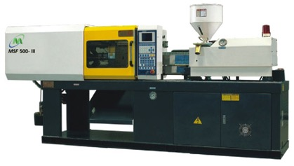
Blockchain use cases
IOT and Manufacturing
A refrigerator equipped with sensors and connected to the Internet could use blockchain to manage automated interactions with the external world--anything from ordering and paying for food to arranging for its own software upgrades and tracking its warranty.
When something goes wrong with a complex piece of machinery, like a car, knowing the exact telemetry of every machine that produced every part as it made it — and knowing with certainty that no party could tamper with the data once recorded — would give investigators and manufacturers key insights and allow batch-level recalls.
(Manufacturing cont): For example, if a part that went into three different makes & models of car were found to have been made by a machine that was slightly out of tolerance during a short period on a particular day, only the cars with parts from that batch would have to be recalled, saving billions. (Blockchain is also key here, because it is unlikely that the suppliers and manufacturers in a complex value web will submit to a central authority (or say one single manufacturer) collecting and controlling real-time telemetry of their equipment.
Gaming and Loyalty Point Syndicates
As a game player, I want to be able to trade the “gold” I have earned in my current game for the currency or assets of another game, so that I can use my experience with the current game to put me ahead and not have to start cold in the new game.

Slide 13
Blockchain for Banking Consortia | Security Services | Security Settlement: Once financial assets are dematerialized on a shared ledger, all stakeholders will have direct access to the asset depository and the power to settle trades, without always going through intermediaries needlessly. Post Trade Operation: Post trade processes such as trade capture, enrichment, confirmation/affirmation, clearing, and settlement can be automated on shared ledger, potentially reducing post trade operation time from days to seconds. Trade Repository: By design, blockchain is a secure record repository of ordered collection of financial transactions. It records the history of asset control and state changes, reducing the need of maintaining a separate trade repository for record keeping.
 | Capital Market | Derivative Trading: Connect potential buyers and sellers on a decentralized network. Offers placed on blockchain network can be automatically seen by all participants, the network will be cheaper and potentially bigger than ECNs today because the risk and cost of maintaining the network is spread across all participants (there will not be a single owner charging premium for maintaining the service. Derivative Post-Trade Management: Derivatives contracts can be managed and automated through smart contracts on shared ledger, significantly cutting down the management cost and time while reducing the intra-day risk. Syndicated Loan: Help borrowers and arrangers to broadcast their offers to all potential investors on a blockchain network, and to automate the syndication process.
 | Trade Finance | Cross-Currency Payment: Automatically connecting market makers and bypassing intermediaries to significantly reduces time taken for cross currency payment from days to seconds.
 | Card Operation | KYC: Creditor card issuers can record customer credit histories on a shared ledger so that customer information can be easily shared (or sold) between companies.

Slide 14
BLOCKCHAIN OPEN SOURCE

Slide 15
Industrial use cases clarify need for an industrial fabric
By working with clients and observing hackathon participants, we have identified important features that are missing, and non-functional requirements that are deficient, in the existing open source blockchain fabrics for many industrial use cases.
Some of these can be remedied by fixing the existing fabrics (if their communities prioritized them, which often they don’t). Other issues are more fundamental and beg for new approaches.
Examples of use cases and requirements:
B2B agreements:
Private transactions
Private on-chain self-executing logic
Internal time management
Asset depository — post-trade settlement:
Access control
Lower latency (higher capacity) than current public fabrics
Content state management (balance obfuscation + auditability)

Slide 16

What can we do about it?
As has been done with Java, Linux, Open Stack, Node and Spark, industry can advance open blockchain technology and focus it on the requirements of industrial use cases by working together through an open source foundation.

Slide 17
Objectives of an industrial open source community
Define an enterprise grade blockchain specification
Throw the full support of IBM and a growing team of industry leaders behind a blockchain standard that we can make real for business
Ensure that the blockchain that industry supports is:
open source (Apache license preferred)
focuses on the needs of industry
easy to embrace, support and use

Slide 18






Essential properties of an industrial blockchain
Shared single source of truth (ledger)
Secure tamper proof
Private un-linkable identity
Scalable 100+ year architecture
Confidential permission control
Audit-able prove identity & ownership

Slide 19
Additional priorities and attributes
Asset definition
Operators must be able to define complex asset types on their network, and their execution logic and governing rules. (e.g An convertible bond asset can be automatically converted to equity if its stock drops below a certain amount)
The Fabric
The fabric must include 4 major components: a P2P protocol that interconnect nodes, an embedded VM that runs contracts, a PBFT consensus algorithm, and a data structure that stores code, transactions, and block states efficiently.
Smart Contract
Smart contract to allow developers to write and automate business contracts with Turing complete code. Codified contracts can either be deployed on-chain or off-chain based on specific business requirements
Consensus Algorithm
The fabric must be packaged with a consensus algorithm. However, the architecture must be flexible enough to allow network operators to switch to other consensus algorithms before deployment

Slide 20
Even more priorities and attributes
Off-chain data store
The fabric must define a facility to bridge the on-chain ledger with off chain data stores, so that large files can be secured without overloading the ledger
Inter-ledger integration
To prepare for a future where multiple chain networks would run in parallel, specification defines a common protocol to allow standalone networks to interconnect in a standardized way.
Identity Manager
An identity manager module is defined as part of a specification to allow a standardized way to issue and manage enrollment certificates and keys.
Access control
System allows participants to secure their transactions and contracts so that only pre-identified stakeholders are allowed to access them.
Integration event bus
Understanding the need to connect blockchain with today’s systems of record, the fabric must have an Event Bus component that makes calls to outside system when records on ledger changes.

Slide 21
Key non-functional requirements
Performance NFR | Speed | Response time: Average response time per transaction must be under 1 second when executing under closed lab environment and under 5 seconds under normal production environment Lookup time: Average lookup time of past records must be under 5 seconds under all conditions including mid-life condition, and must perform significantly better for recently appended records
 | Capacity | Processed transaction per second: must be able to achieve at least 1,000 transactions per-second in the lab environment, and 10,000-100,000 transactions per second under normal production environment
 | Scalability | Ability to scale: Total transaction load, network size (# of validating nodes), and blockchain size are all expected to increase overtime. The fabric must allow users to maintain performance level by adding additional resources (hardware) to validating nodes.
Closed Lab Environment
Consensus Algorithm: PBFT
Validating Nodes: 5
Network delay: Negligible
Memory Footprint: 50 mb**
Normal Production Environment
Consensus Algorithm: PBFT
Validating Nodes: 20
Network delay: Noticeable
Memory Footprint: 200 mb**
Fully Private Environment
Consensus Algorithm: None
Validating Nodes: 1
Network delay: Negligible
Data Size: 50 mb**

Slide 22
More non-functional requirements
Non-Performance NFR | Usability | Time taken to install: users must be able to follow well- structured user instruction to install, configure, and deploy a network on their workstation or a lab environment in under one hour Time taken to learn: users must be able to learn and write simple contract code and defining their asset type within two working days
 | Reliability | Fault tolerance: PBFT consensus algorithm implemented as part of the standard distribution must can handle up to 1/3 node failures.
 | Supportability | Maintainability: System updates and bug fixes can be pushed to the network relatively easily after deployment Portability: The fabric must support different operating environments
Bottom line: The fabric must be easy to learn and use, reliable enough for large businesses, and easy to support and maintain

Slide 23
Join the movement
Help build the open source fabric
Be on the advisory board
Be a committer
Responsibilities
Benefits
Apache License
OSS Foundation

