Slide 1
Chapter 5 Transform and conquer
University of Bahrain

Slide 2
Plan
Introduction
Heaps
Constructing A Heap
Heap Operations: Insertion And Deletion
Heapsort.

Slide 3
1. Introduction
This chapter deals with a design method that is based on the idea of transformation.
This method works as two-stage procedure
Transformation stage: modifies the problem to a simpler one.
Conquering stage solves the problem
Three variations of this idea:
Simpler instance
Or
Problem’s instance
Another representation
Solution
Or
Another Problem’s instance

Slide 4
2. Heaps
Definition: A heap is a binary tree with keys assigned to its nodes under these conditions:
The tree’s shape requirement: the tree is complete (all its levels are full except possibly the last level, where only some rightmost leaves may be missing)
The parental dominance requirement: the key of each node is ≥ the keys of its children.
10

10

10

5
7
5
7
5
7
4
2
1
2
1
6
2
1

Slide 5
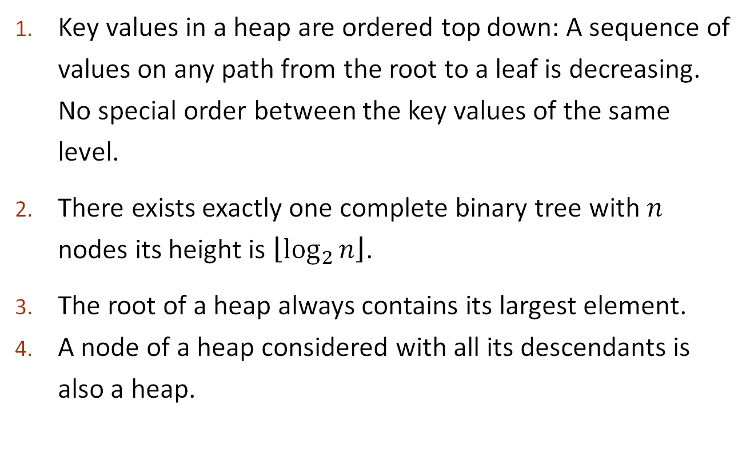
2. Heaps - properties
Key values in a heap are ordered top down: A sequence of values on any path from the root to a leaf is decreasing. No special order between the key values of the same level.
There exists exactly one complete binary tree with $n$ nodes its height is $\left\lfloor \log_{2}{n}\right\rfloor$.
The root of a heap always contains its largest element.
A node of a heap considered with all its descendants is also a heap.
root
10
keys
5
7
height
4
2
1
children

Slide 6
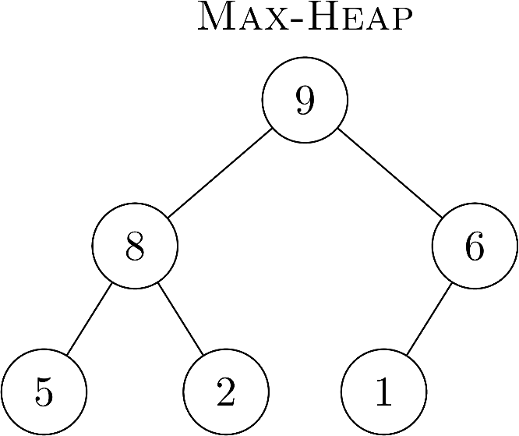
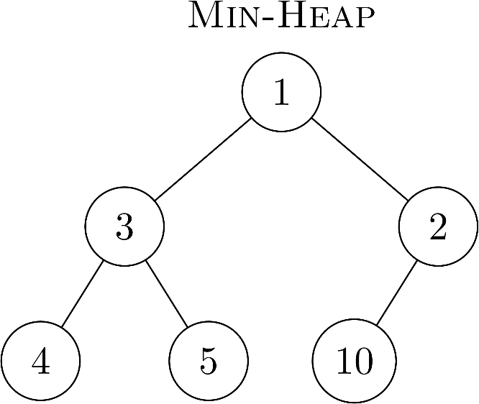
2. Heaps - properties
Based on the property of a heap we can classify heaps into two types:
Max-Heap: The value of a node must be greater than or equal to the values of its children.
Min-Heap: The value of a node must be less than or equal to the values of its children.
We will focus on Max-Heap (parental dominance).

Slide 7
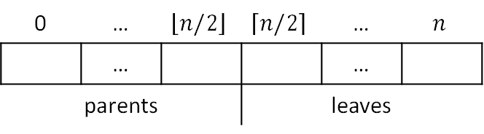
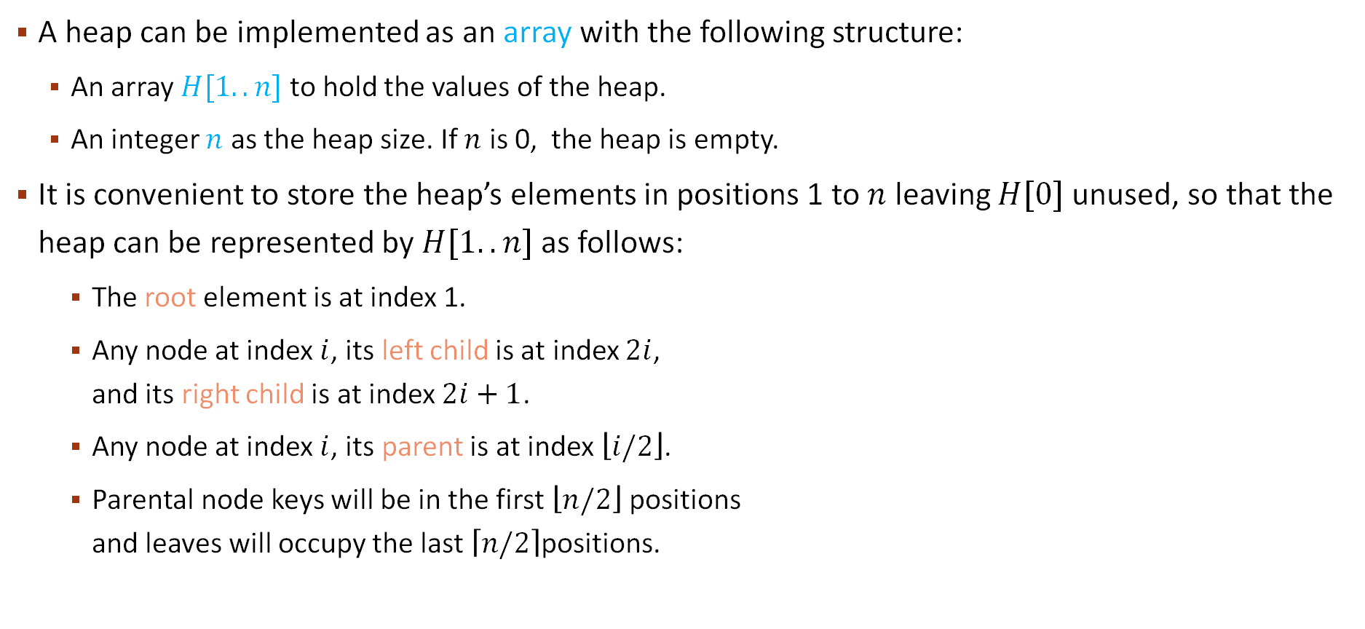
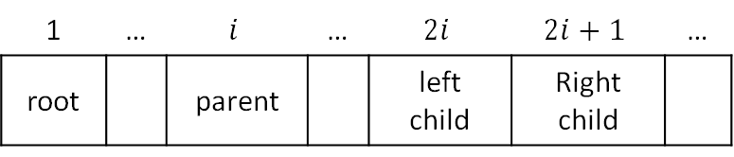
2. Heaps - Representation
A heap can be implemented as an array with the following structure:
An array $H[1..n]$ to hold the values of the heap.
An integer $n$ as the heap size. If $n$ is 0, the heap is empty.
It is convenient to store the heap’s elements in positions 1 to $n$ leaving $H[0]$ unused, so that the heap can be represented by $H[1..n]$ as follows:
The root element is at index 1.
Any node at index $i$, its left child is at index $2i$, and its right child is at index $2i+1$.
Any node at index $i$, its parent is at index $\left\lfloor i/2\right\rfloor$.
Parental node keys will be in the first $\left\lfloor n/2\right\rfloor$ positions and leaves will occupy the last $\left\lceil n/2\right\rceil$positions.
1 | … | $$i$$ | … | $$2i$$ | $$2i+1$$ | …
root |  | parent |  | left child | Right child
0 | … | $$\left\lfloor n/2\right\rfloor$$ | $$\left\lceil n/2\right\rceil$$ | … | $$n$$
 | … |  |  | …
parents |  |  | leaves

Slide 8
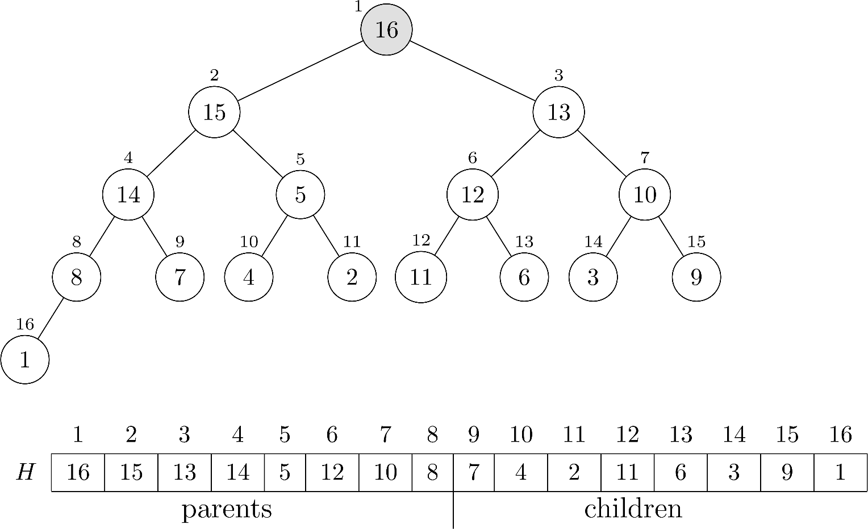
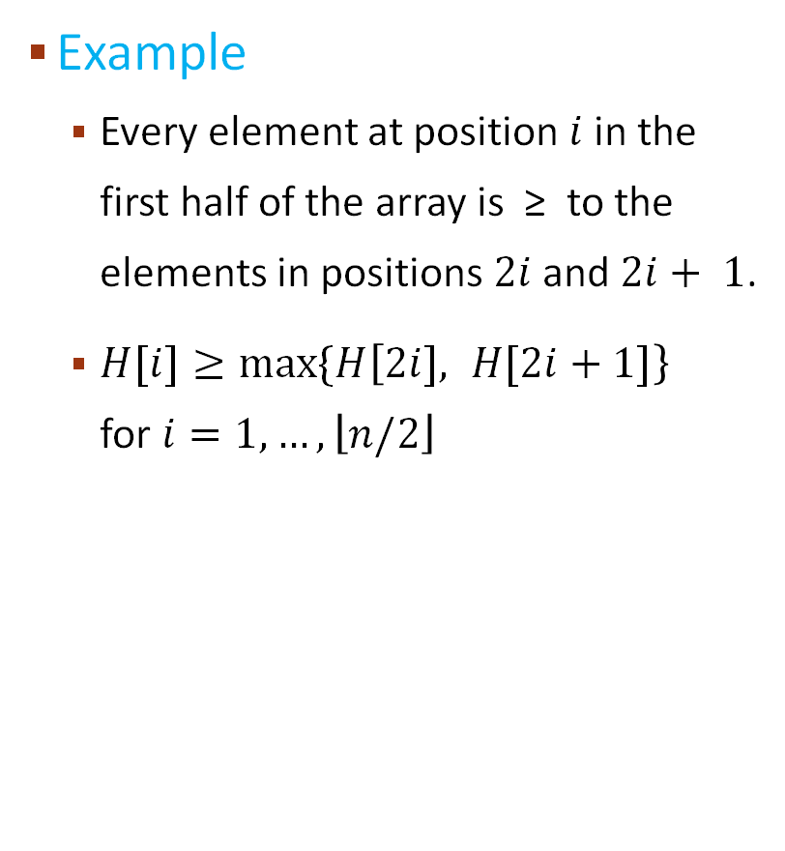
2. Heaps - Representation
Example
Every element at position $i$ in the first half of the array is ≥ to the elements in positions $2i$ and $2i+ 1$.
$H[i]≥max⁡\{H\left[2i], H[2i+1]\right\}$ for $i=1,…,\left\lfloor n/2\right\rfloor$

Slide 9
2. Heaps – Heapify a Heap
If a tree is a heap but its root is not satisfying the heap property, then we need to heapify (fix) this tree.
To heapify a heap:
Start from the root. If the root is larger than its children, the heap property is satisfied, stop the algorithm.
Otherwise, swap it with the larger of its children (left or right).
Continue the process on the subtree of the larger child until the heap property is satisfied.
root
1
9
10
3
2
7

Slide 10
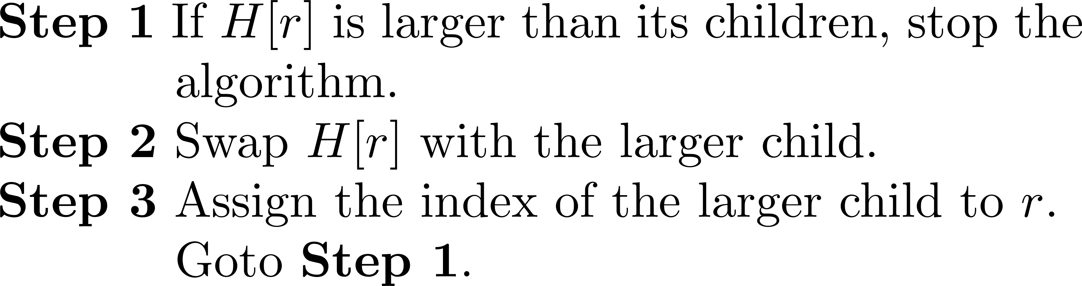

2. Heaps – Heapify a Heap
$$r$$
1
10
10
9
10
9
1
9
7
3
2
7
3
2
7
3
2
1

Slide 11
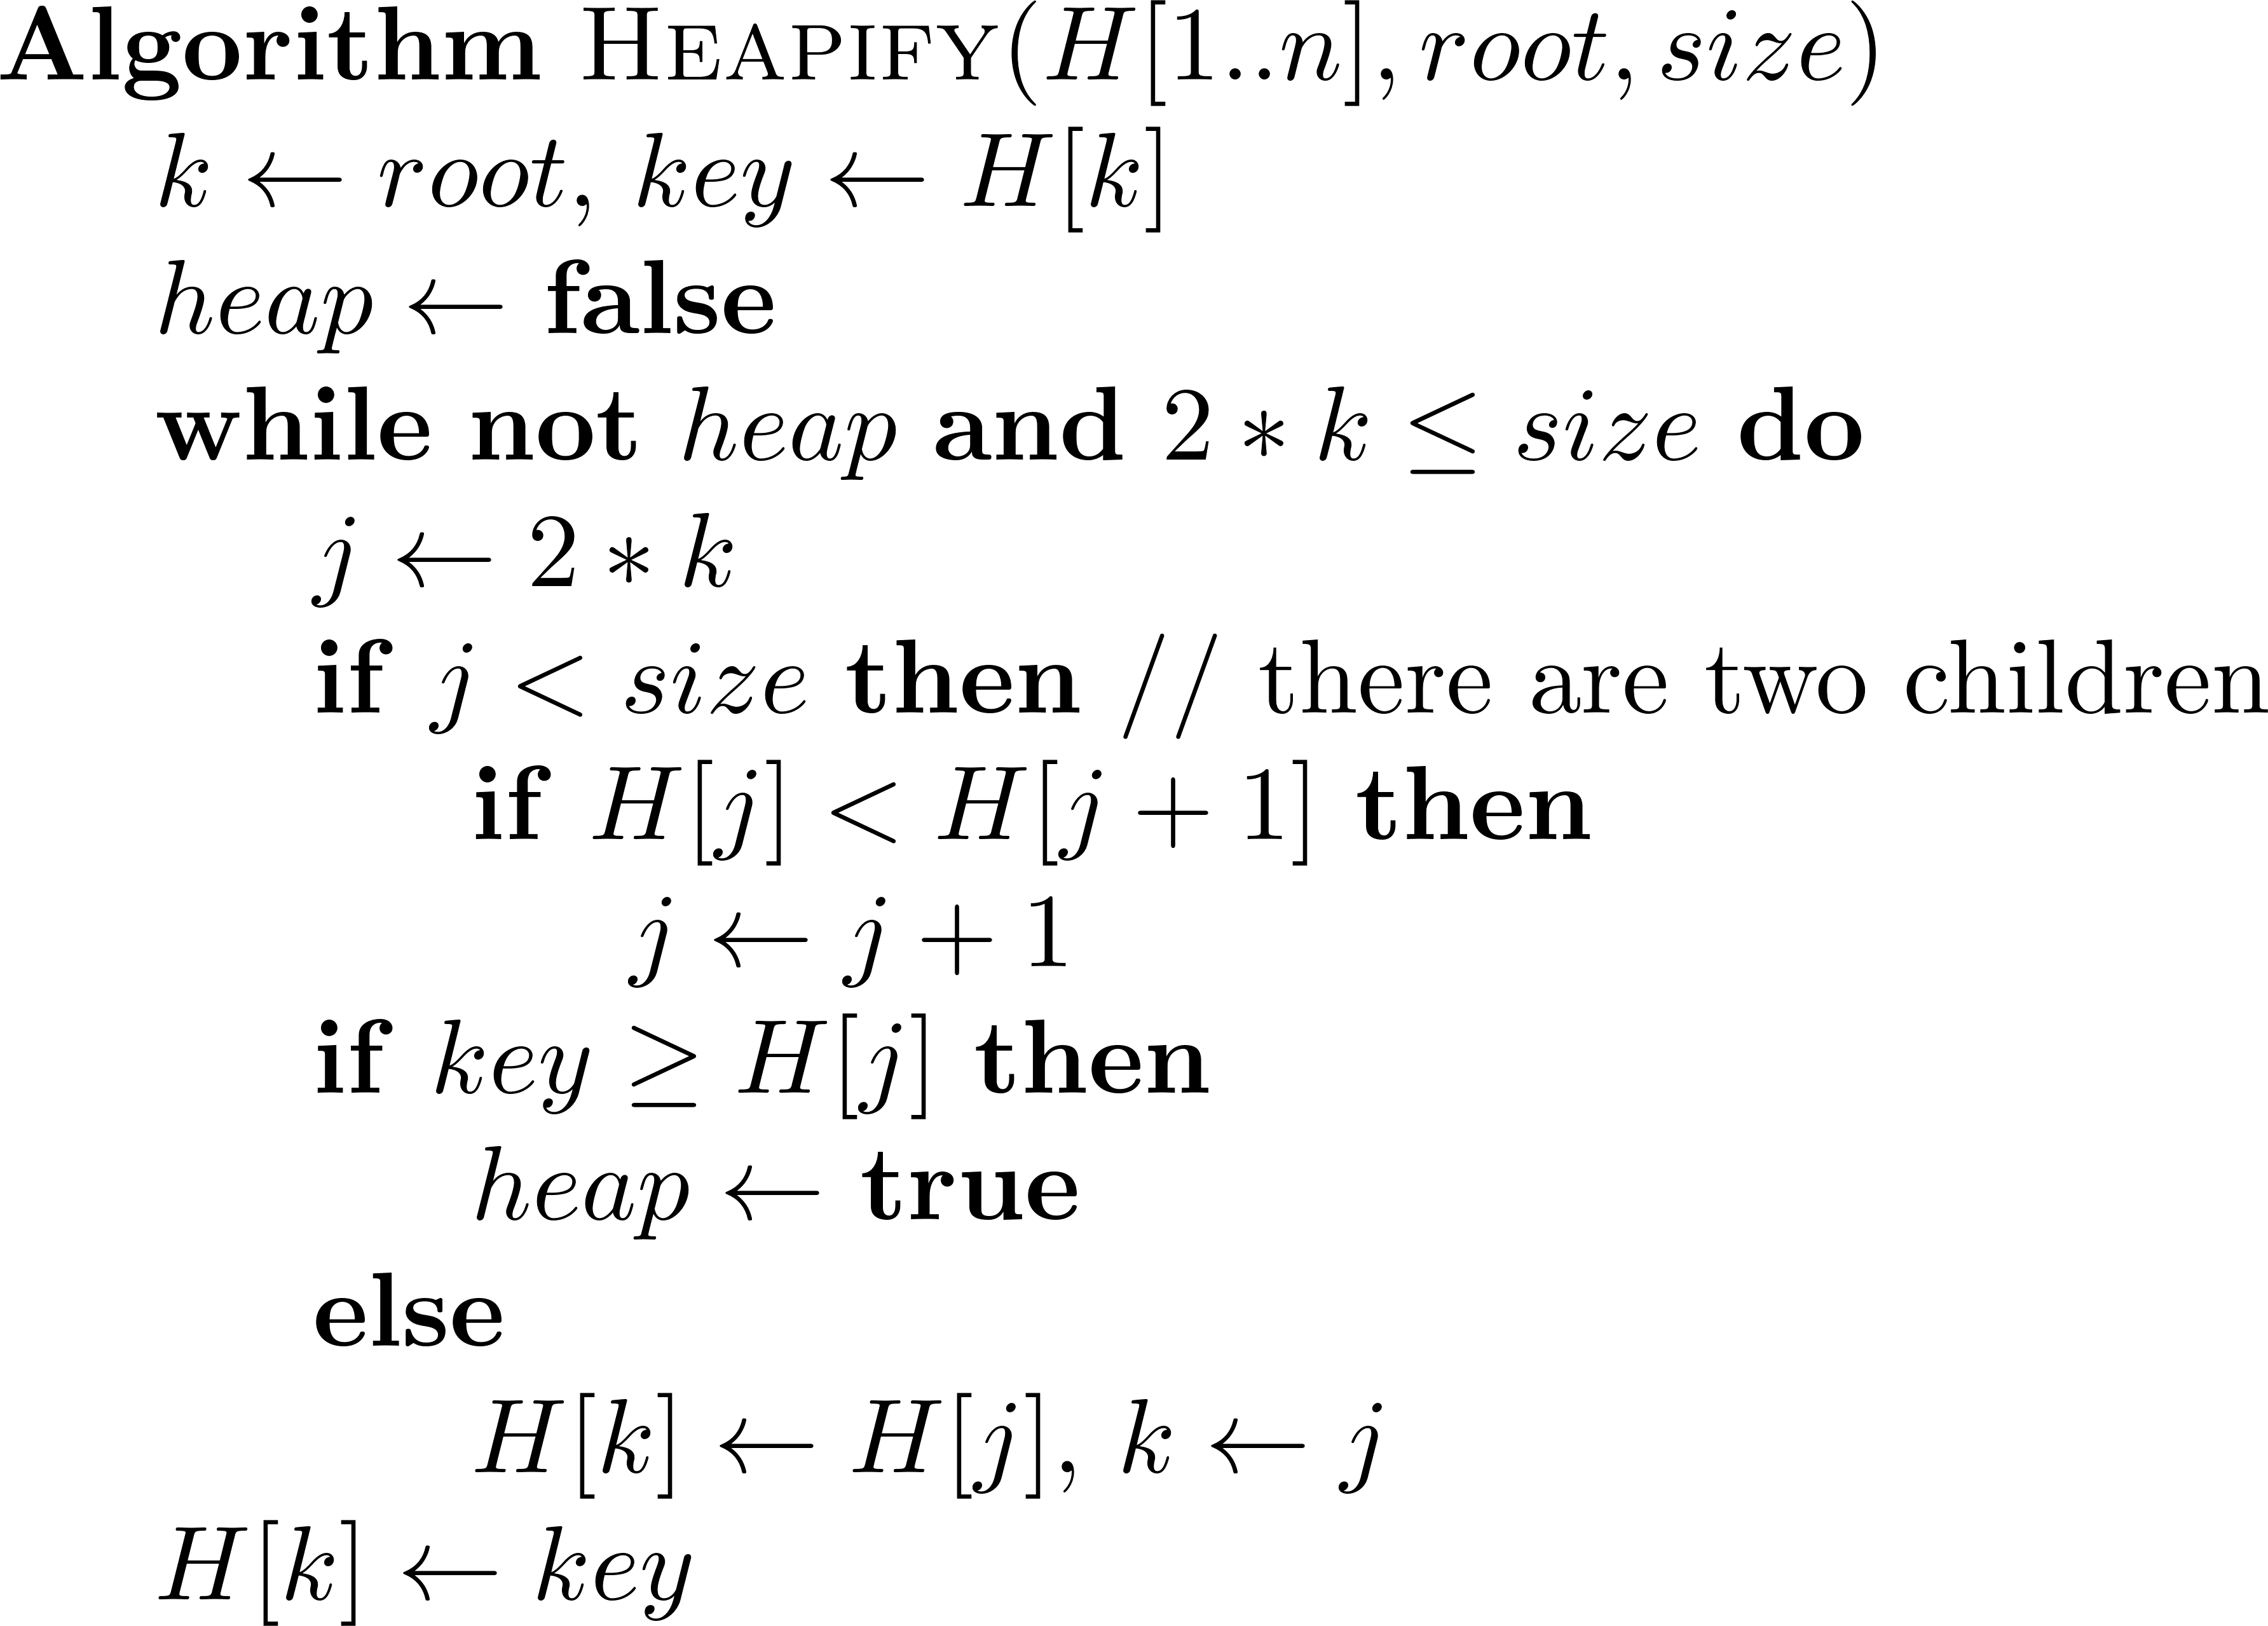

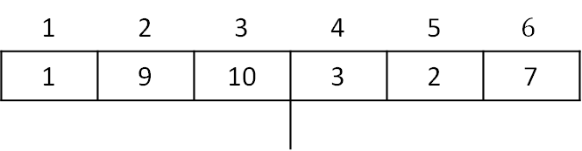


2. Heaps – Heapify a Heap
The Heapify Algorithm
$key =$ 1
$size$ = 6
$$k$$
1
1
1
$$j$$
2
3
9
10
10
4
5
6
3
2
7
7
1 | 2 | 3 | 4 | 5 | $$6$$
1 | 9 | 10 | 3 | 2 | 7

Slide 12
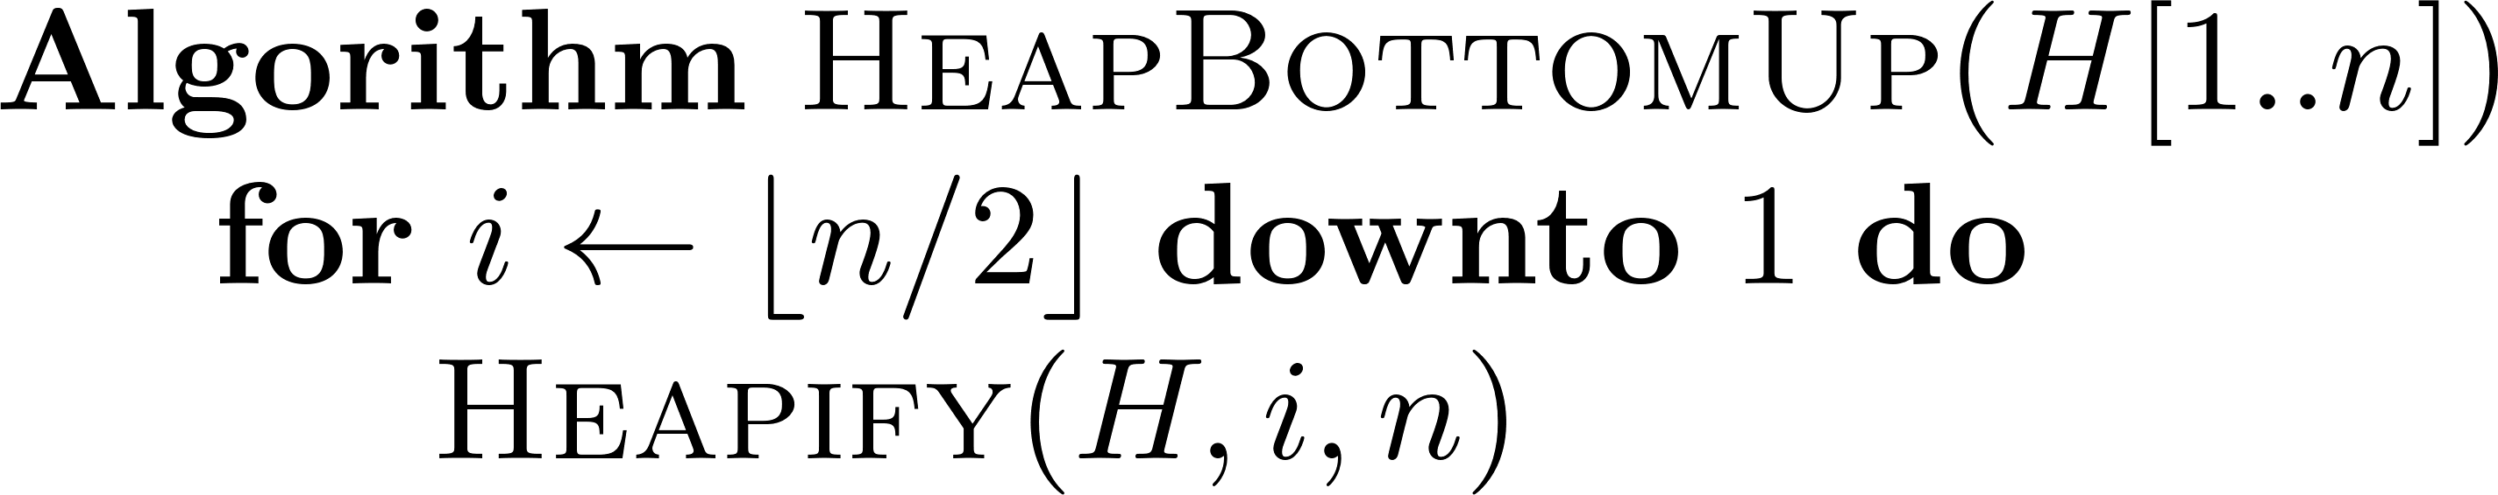
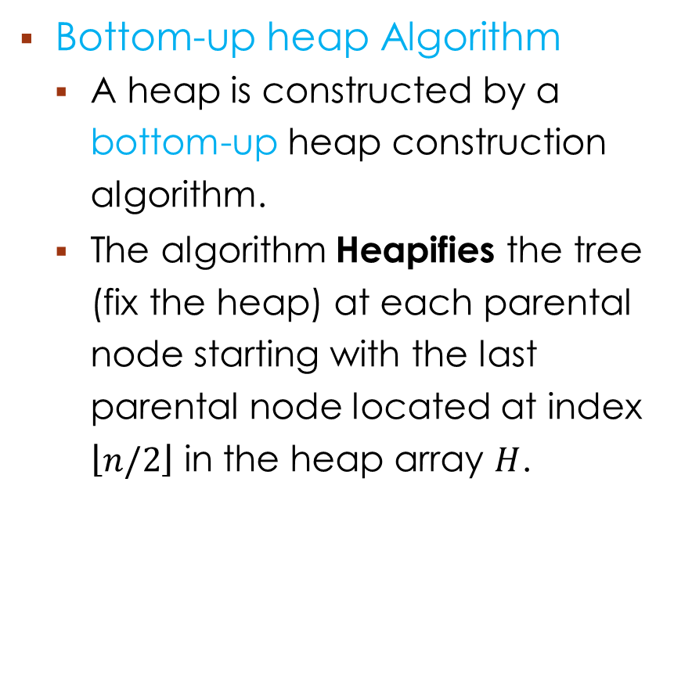
3. Constructing A Heap – the Algorithm
Bottom-up heap Algorithm
A heap is constructed by a bottom-up heap construction algorithm.
The algorithm Heapifies the tree (fix the heap) at each parental node starting with the last parental node located at index $\left\lfloor n/2\right\rfloor$ in the heap array $H$.
The Heapify Algorithm

Slide 13
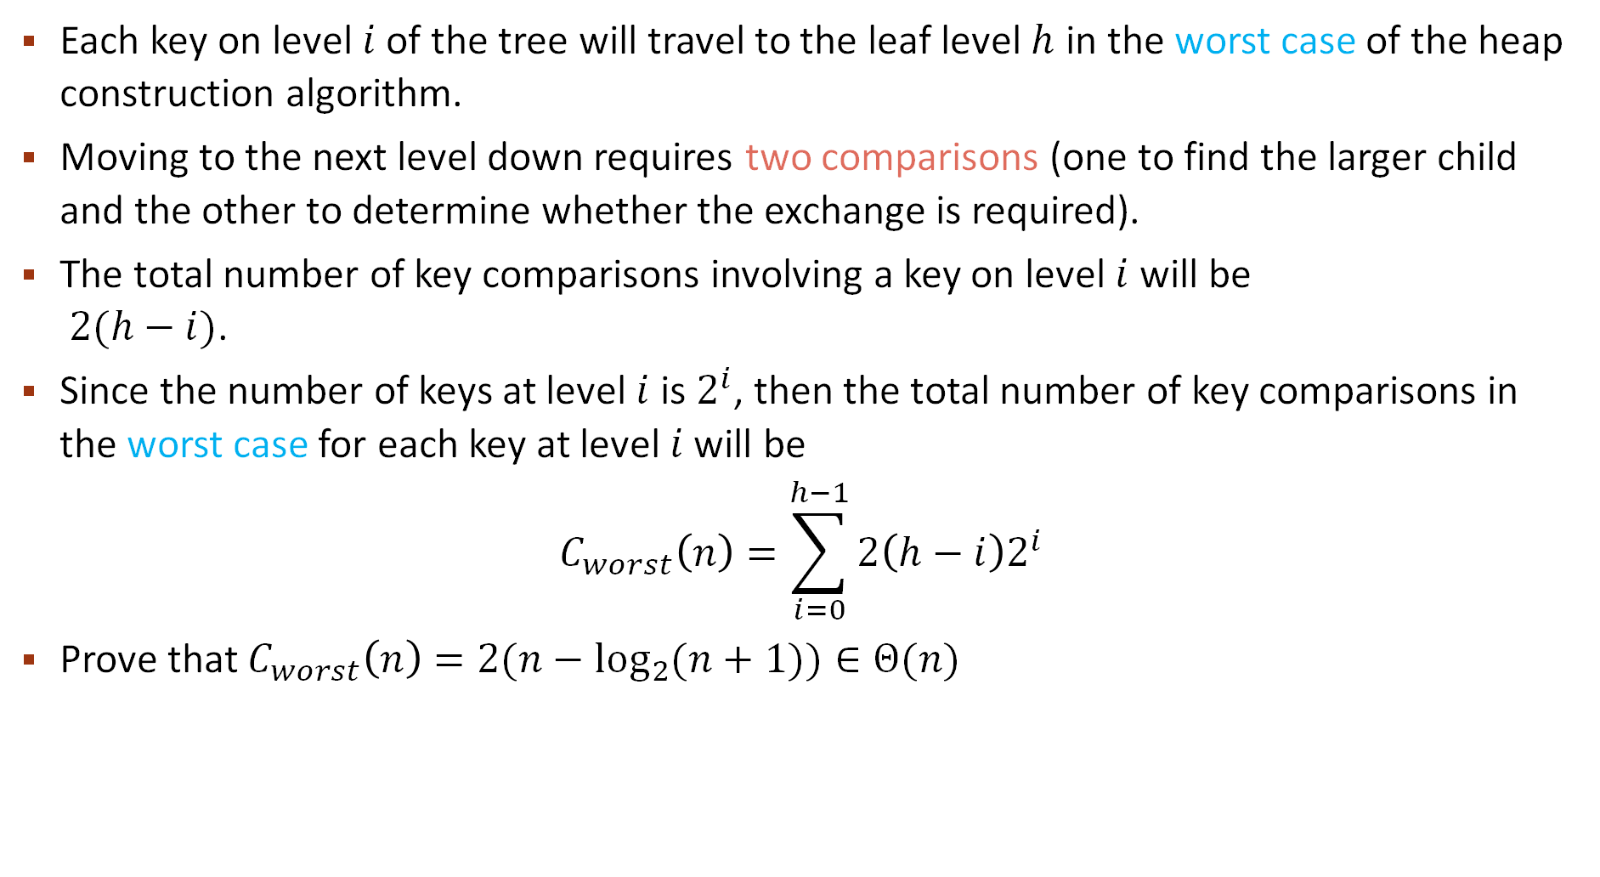
3. Constructing A Heap – the efficiency
Each key on level $i$ of the tree will travel to the leaf level $h$ in the worst case of the heap construction algorithm.
Moving to the next level down requires two comparisons (one to find the larger child and the other to determine whether the exchange is required).
The total number of key comparisons involving a key on level $i$ will be $2(h−i)$.
Since the number of keys at level $i$ is $2^{i}$, then the total number of key comparisons in the worst case for each key at level $i$ will be
$$C_{worst}\left(n\right)=\sum_{i=0}^{h−1}{2\left(h−i\right)2^{i}}$$
Prove that $C_{worst}\left(n\right)=2(n−\log_{2}{(n+1))}∈Θ(n)$

Slide 14


3. Constructing A Heap – example: {2, 9, 7, 6, 5, 8}
Index → | 0 | 1 | 2 | 3 | 4 | 5
 | 2 | 9 | 7 | 6 | 5 | 8
2
$$i$$
2
$$i$$
2
9
7
9
8
9
8
6
5
8
6
5
7
6
5
7
$$i$$
2
9
9
9
8
2
8
6
8
6
5
7
6
5
7
2
5
7

Slide 15
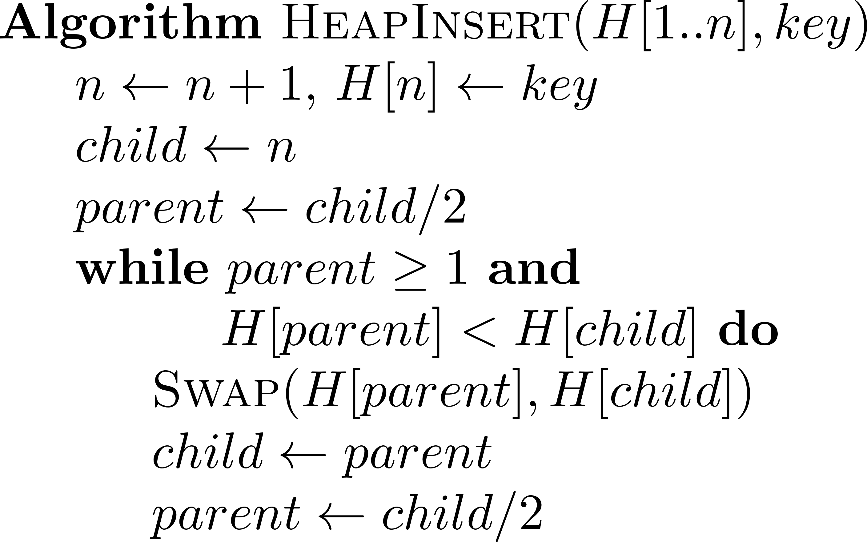

4. Heap Operations - Insertion
The insertion of a new key $k$ into a heap is done as follows:
Attach a new node with key $k$ after the last leaf of the existing heap.
Sift $k$ up to its appropriate place in the new heap:
Compare $k$ with its parent’s key. If the parent is ≥ $k$, stop. Otherwise swap them and compare $k$ with its new parent.
Continue swapping $k$ with its new parent until $k$ is not greater than its last parent or it reaches the root.
The complexity of insertion is $O(\log{n})$

Slide 16
4. Heap Operations - Insertion
Insert the key 10 to the below heap.
9
9
10
6
8
6
10
6
9
2
5
7
10
2
5
7
8
2
5
7
8

Slide 17
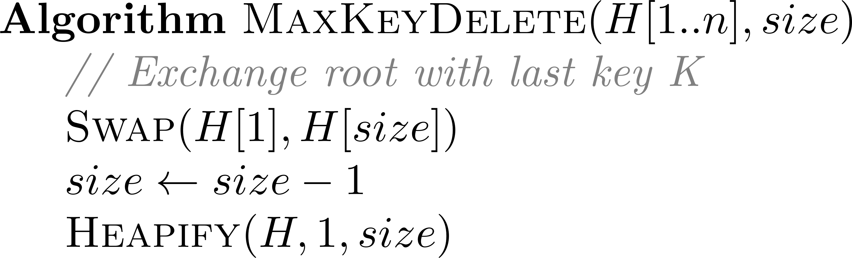

4. Heap Operations – maximum Key Deletion
Maximum Key
How can we delete the maximum key (the root) from a heap?
Exchange the root’s key with the last key $K$ of the heap.
Decrease the heap’s size by 1.
Heapify the smaller tree by sifting $K$ down the tree applying Heapify algorithm.
The complexity of Maximum Key Deletion is $O(\log{n})$
1
9
2
3
8
swap
6
4
5
6
2
5
1
Heapify
1
1
2
3
8
6
4
5
2
5

Slide 18
4. Heap Operations – maximum Key Deletion
9
8
6
2
5
1
1
1
8
8
6
8
6
5
6
2
5
9
2
5
2
1

Slide 19
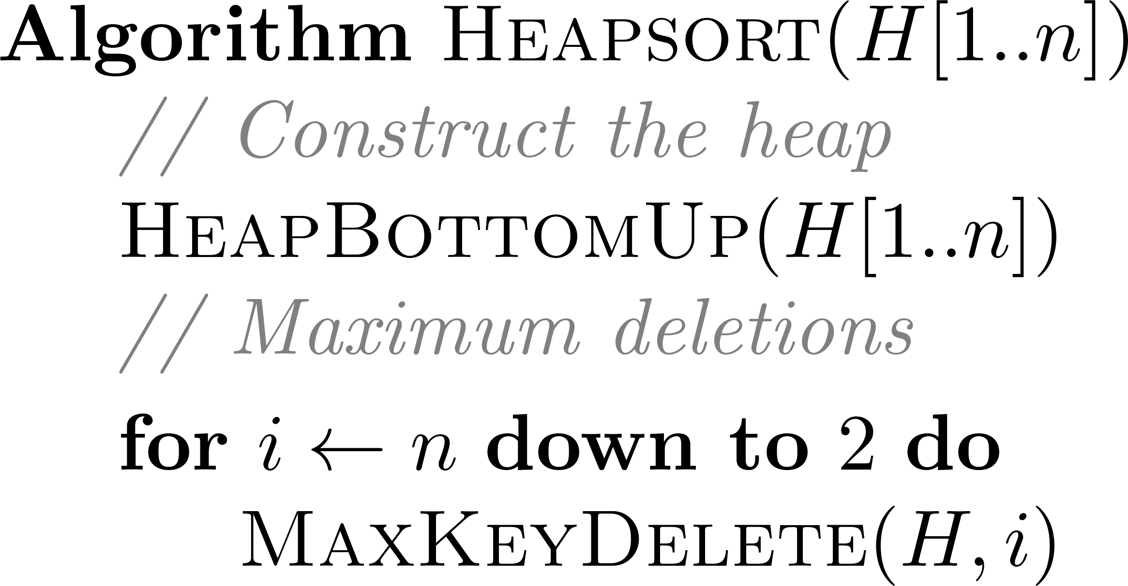
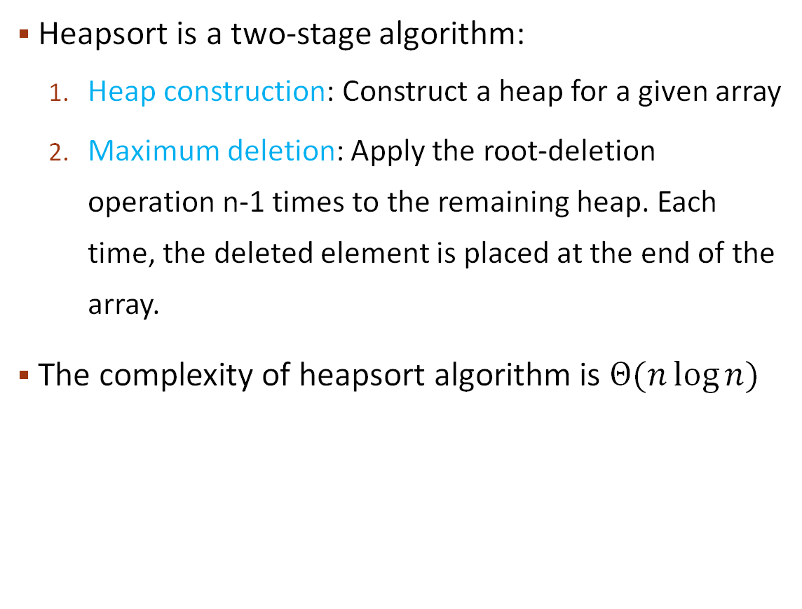
5. Heap sort
Heapsort is a two-stage algorithm:
Heap construction: Construct a heap for a given array
Maximum deletion: Apply the root-deletion operation n-1 times to the remaining heap. Each time, the deleted element is placed at the end of the array.
The complexity of heapsort algorithm is $Θ(n\log{n})$

Slide 20
4. Heap sort – Example (2, 9, 7, 6, 5, 8)
Stage 2: maximum deletions
9 6 8 2 5 7
6 8 2 5 9
8 6 7 2 5
5 6 7 2 8
7 6 5 2
2 6 5 7
6 2 5
5 2 6
5 2
2 5
2
Stage 1: heap construction
2 9 7 6 5 8
2 9 8 6 5 7
2 9 8 6 5 7
9 2 8 6 5 7
9 6 8 2 5 7

