Slide 1
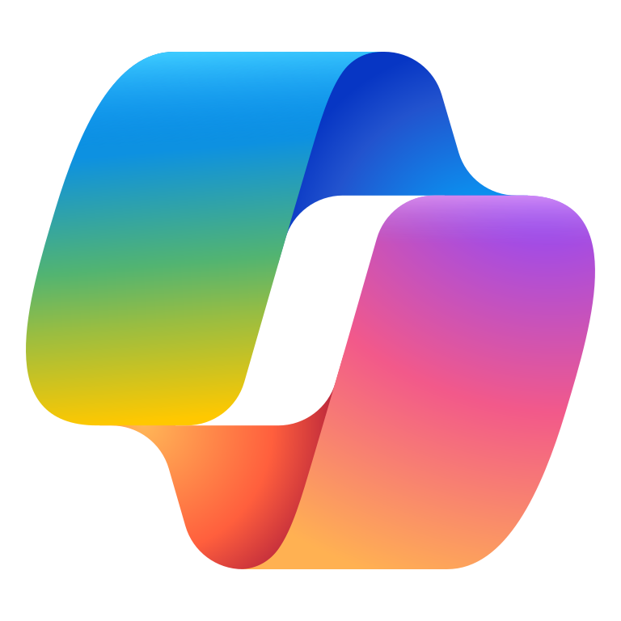




AI visual creation
NEW READY FOR REVIEW
Media & Entertainment
Microsoft 365 Copilot and Azure Foundry AI
Build
Enable teams to ideate campaign concepts, delivering faster, smarter, and more scalable visual creation for ad tech and on-the-fly video production.
Brainstorm campaign ideas, themes, arcs
Research creative trends
Connect creative inputs
In Copilot Chat, a creative team describes the target audience, tone, and desired emotional impact—Copilot helps refine these ideas into structured prompts, scripts, and visual concepts.
The team uses Researcher to explore previous campaign data to enrich the context of their next campaign. For example, they prompt it to pull performance insights and suggest trending visual styles based on recent engagement metrics.
Next, a custom agent quickly parses inputs—like campaign briefs, brand assets, and other reference materials—to extract key creative parameters prepares them for visual generation.
Copilot Chat¹
Researcher
AI Agent³
+ Connection to SharePoint
Benefit: Accelerate the creative process by transforming vague ideas into actionable content, reducing time spent on manual drafting and enabling faster iteration cycles.
Benefit: Ensure every visual generation request is grounded in current trends and past learnings.
Benefit: Transform fragmented creative inputs inputs into structured, actionable data to reduce rework and improve creative alignment.
KPIs impacted
Audience engagement rate
Analyze and optimize campaign feedback
Generate visuals via Sora + Azure Foundry AI
Creative cycle time
Once final assets are distributed via marketing channels, the creative team uses Copilot to actively analyze feedback collected from social media and other engagement platforms—helping teams make data-driven decisions that maximize engagement and campaign impact.
These refined prompts are then sent to Sora through Azure AI Foundry, which supports multimodal generation. Sora creates short-form videos, animated ads, or personalized highlight reels using advanced models.
Value benefit
Workflow efficiency
Copilot in Dynamics 365
AI Agent³
+ Connection to Sonora
Cross-team collaboration
Sample prompt: Summarize the audience feedback and engagement trends from our latest campaign across social media and other platforms.
Benefit: Azure AI Foundry orchestrates model selection, safety filters, and compliance checks to deliver high-quality, brand-safe visual content at scale—enabling rapid production of engaging video assets tailored to specific audiences or events.

