Slide 1
Quality
Software Architecture

Slide 2
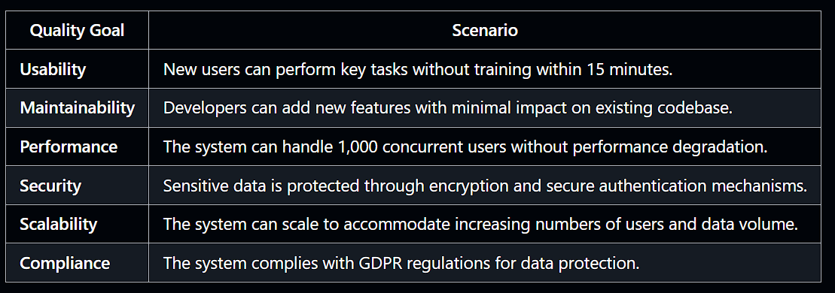
Quality Goals and Scenarios
Goal
Scenario …
Goal
Scenario …
Goal
Scenario …s
Since quality requirements will have a lot of influence on architectural decisions you should know for every stakeholder what is really important to them, concrete and measurable.
Define three Quality Goals and Scenarios.
Help: https://docs.arc42.org/section-10/ & https://biking.michael-simons.eu/docs/index.html#_evaluation_scenarios

Slide 3
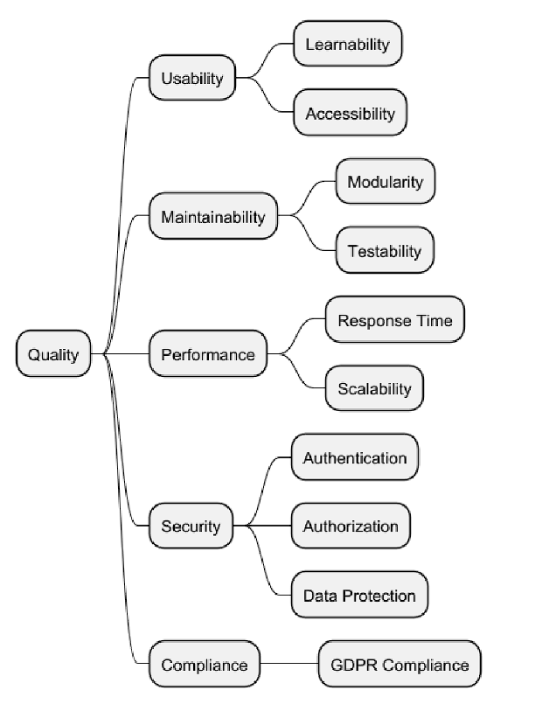
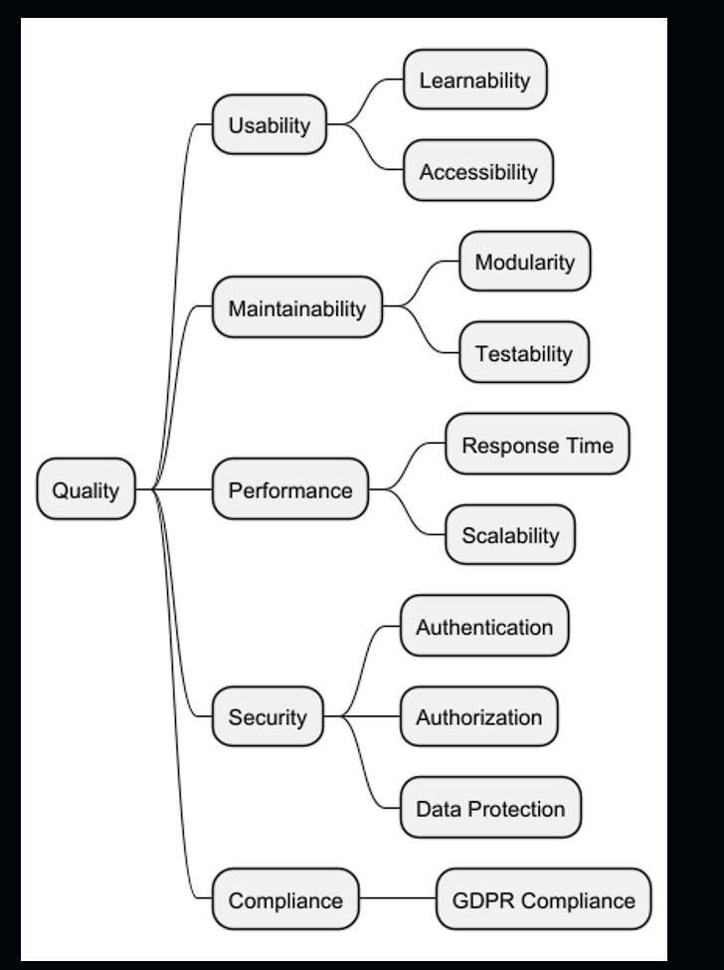
Quality Tree
Since quality requirements will have a lot of influence on architectural decisions you should know for every stakeholder what is really important to them, concrete and measurable.
Define a Quality Tree with at least 5 “arms”.
Help: https://docs.arc42.org/section-10/ & https://biking.michael-simons.eu/docs/index.html#_quality_tree

