Slide 1

HIKVISION-CCTV USER SETUP GUIDE
Guide to New User Setup, Basic Functionalities & Troubleshooting

Slide 2

DOWNLOAD(s) required
Open Google PlayStore(Android) or AppStore(iOS)
Download / Install the HiLookVision App

Slide 3
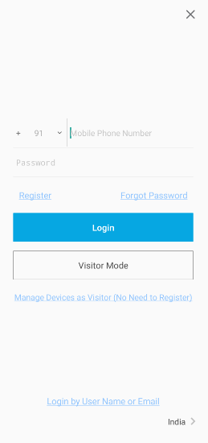
Login to HiLookVision
Enter registered mobile number
Enter password (case sensitive)
For registration number/ password recovery or
for further assistance, please call 9831442971

Slide 4
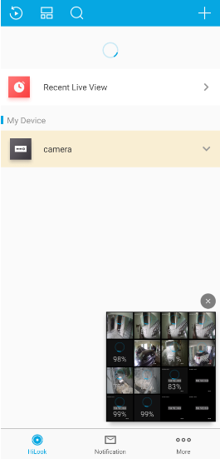
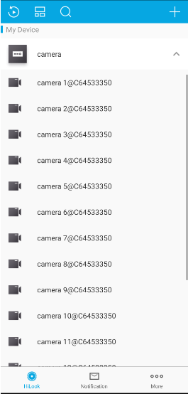

List view – ALL CCTVs
Tap on ‘camera’ option to get full live view of all associated cameras
Tap on the dropdown icon
next to ‘camera’ to get a list of all cameras

Slide 5
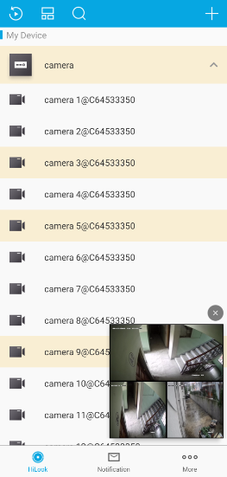
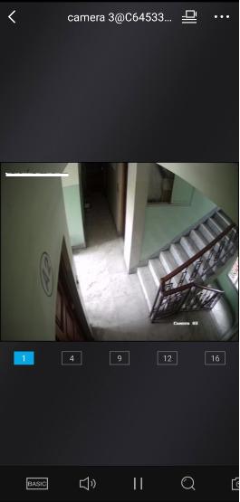
Live View- Single CCTV
Tap on camera(s) listed for pop-out live view
Tap on any live view to enter single camera view

Slide 6
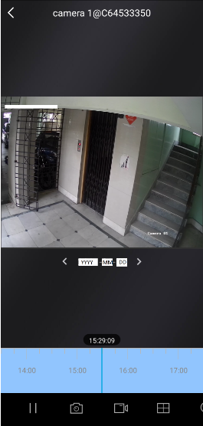




Playback
While in live view (single camera) tap the icon to access Playback (top right of screen while in LIVE VIEW)
Tap on date to change date of playback
Use slider at bottom of screen to adjust time
Pause playback using the pause icon
Take a screenshot by tapping the camera icon
Take a video by tapping on the video icon

Slide 7
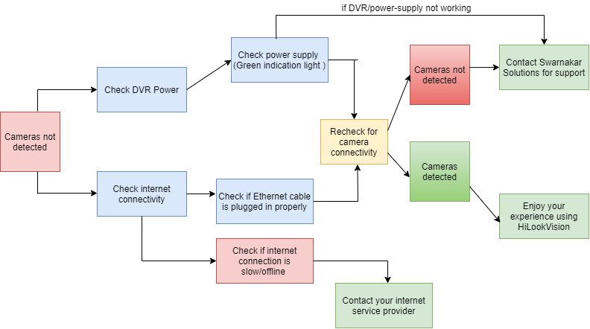
Basic Troubleshooting
for further assistance, please call 9831442971

Slide 8
Feel free to reach out to Swarnakar Solutions to resolve any query regarding operation and maintenance of CCTVs and other security systems.
samikswarnakar@gmail.com / +91-9831442971 / 12B, Kalibari Road, Kolkata-700075

Slide 9
THANK YOU

