Slide 1
Arizona State Retirement System Solvency Analysis
Prepared by: Pension Integrity Project at Reason Foundation. 2022—Preliminary Draft

Slide 2
About the Pension Integrity Project
We offer pro-bono technical assistance to public officials to help them design and implement pension reforms that improve plan solvency and promote retirement security, including:
Customized analysis of pension system design, trends
Independent actuarial modeling of reform scenarios
Consultation and modeling around custom policy designs
Latest pension reform research and case studies
Peer-to-peer mentoring from state and local officials who have successfully enacted pension reforms
Assistance with stakeholder outreach, engagement and relationship management
Design and execution of public education programs and media campaigns

Slide 3
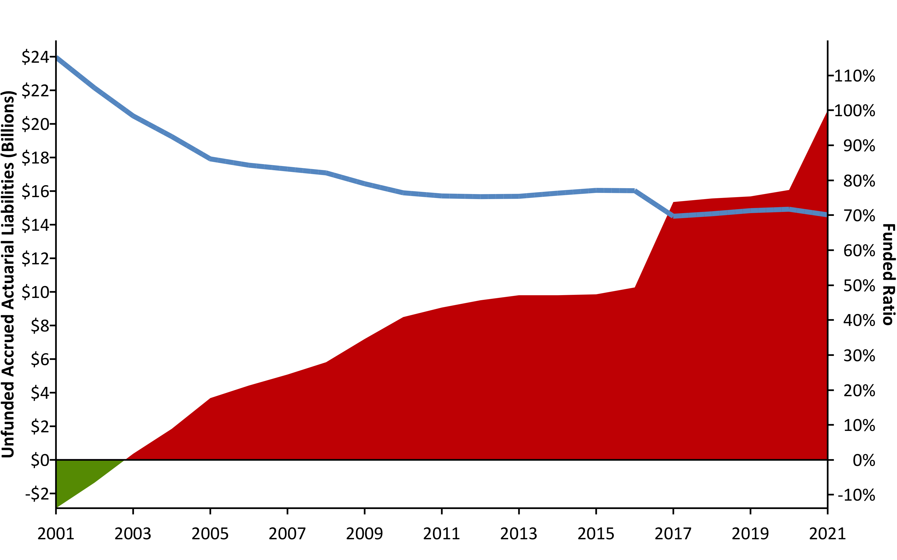
ASRS Unfunded Liabilities (2001-2021) w/ R (areaPlot())
Source: Pension Integrity Project analysis of ASRS actuarial valuation reports.

Slide 4
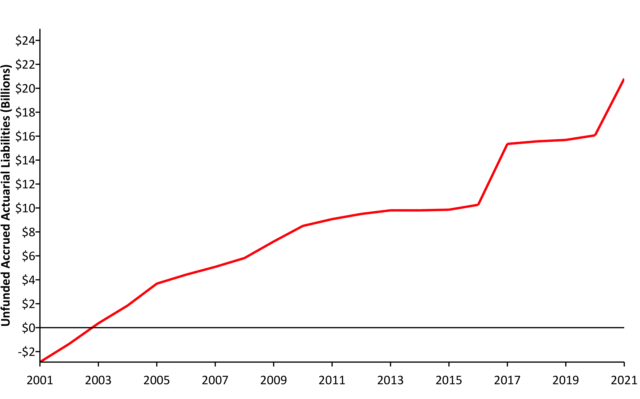
ASRS UAL #2 (2001-2021) w/ R (areaPlot())
Source: Pension Integrity Project analysis of ASRS actuarial valuation reports.

Slide 5
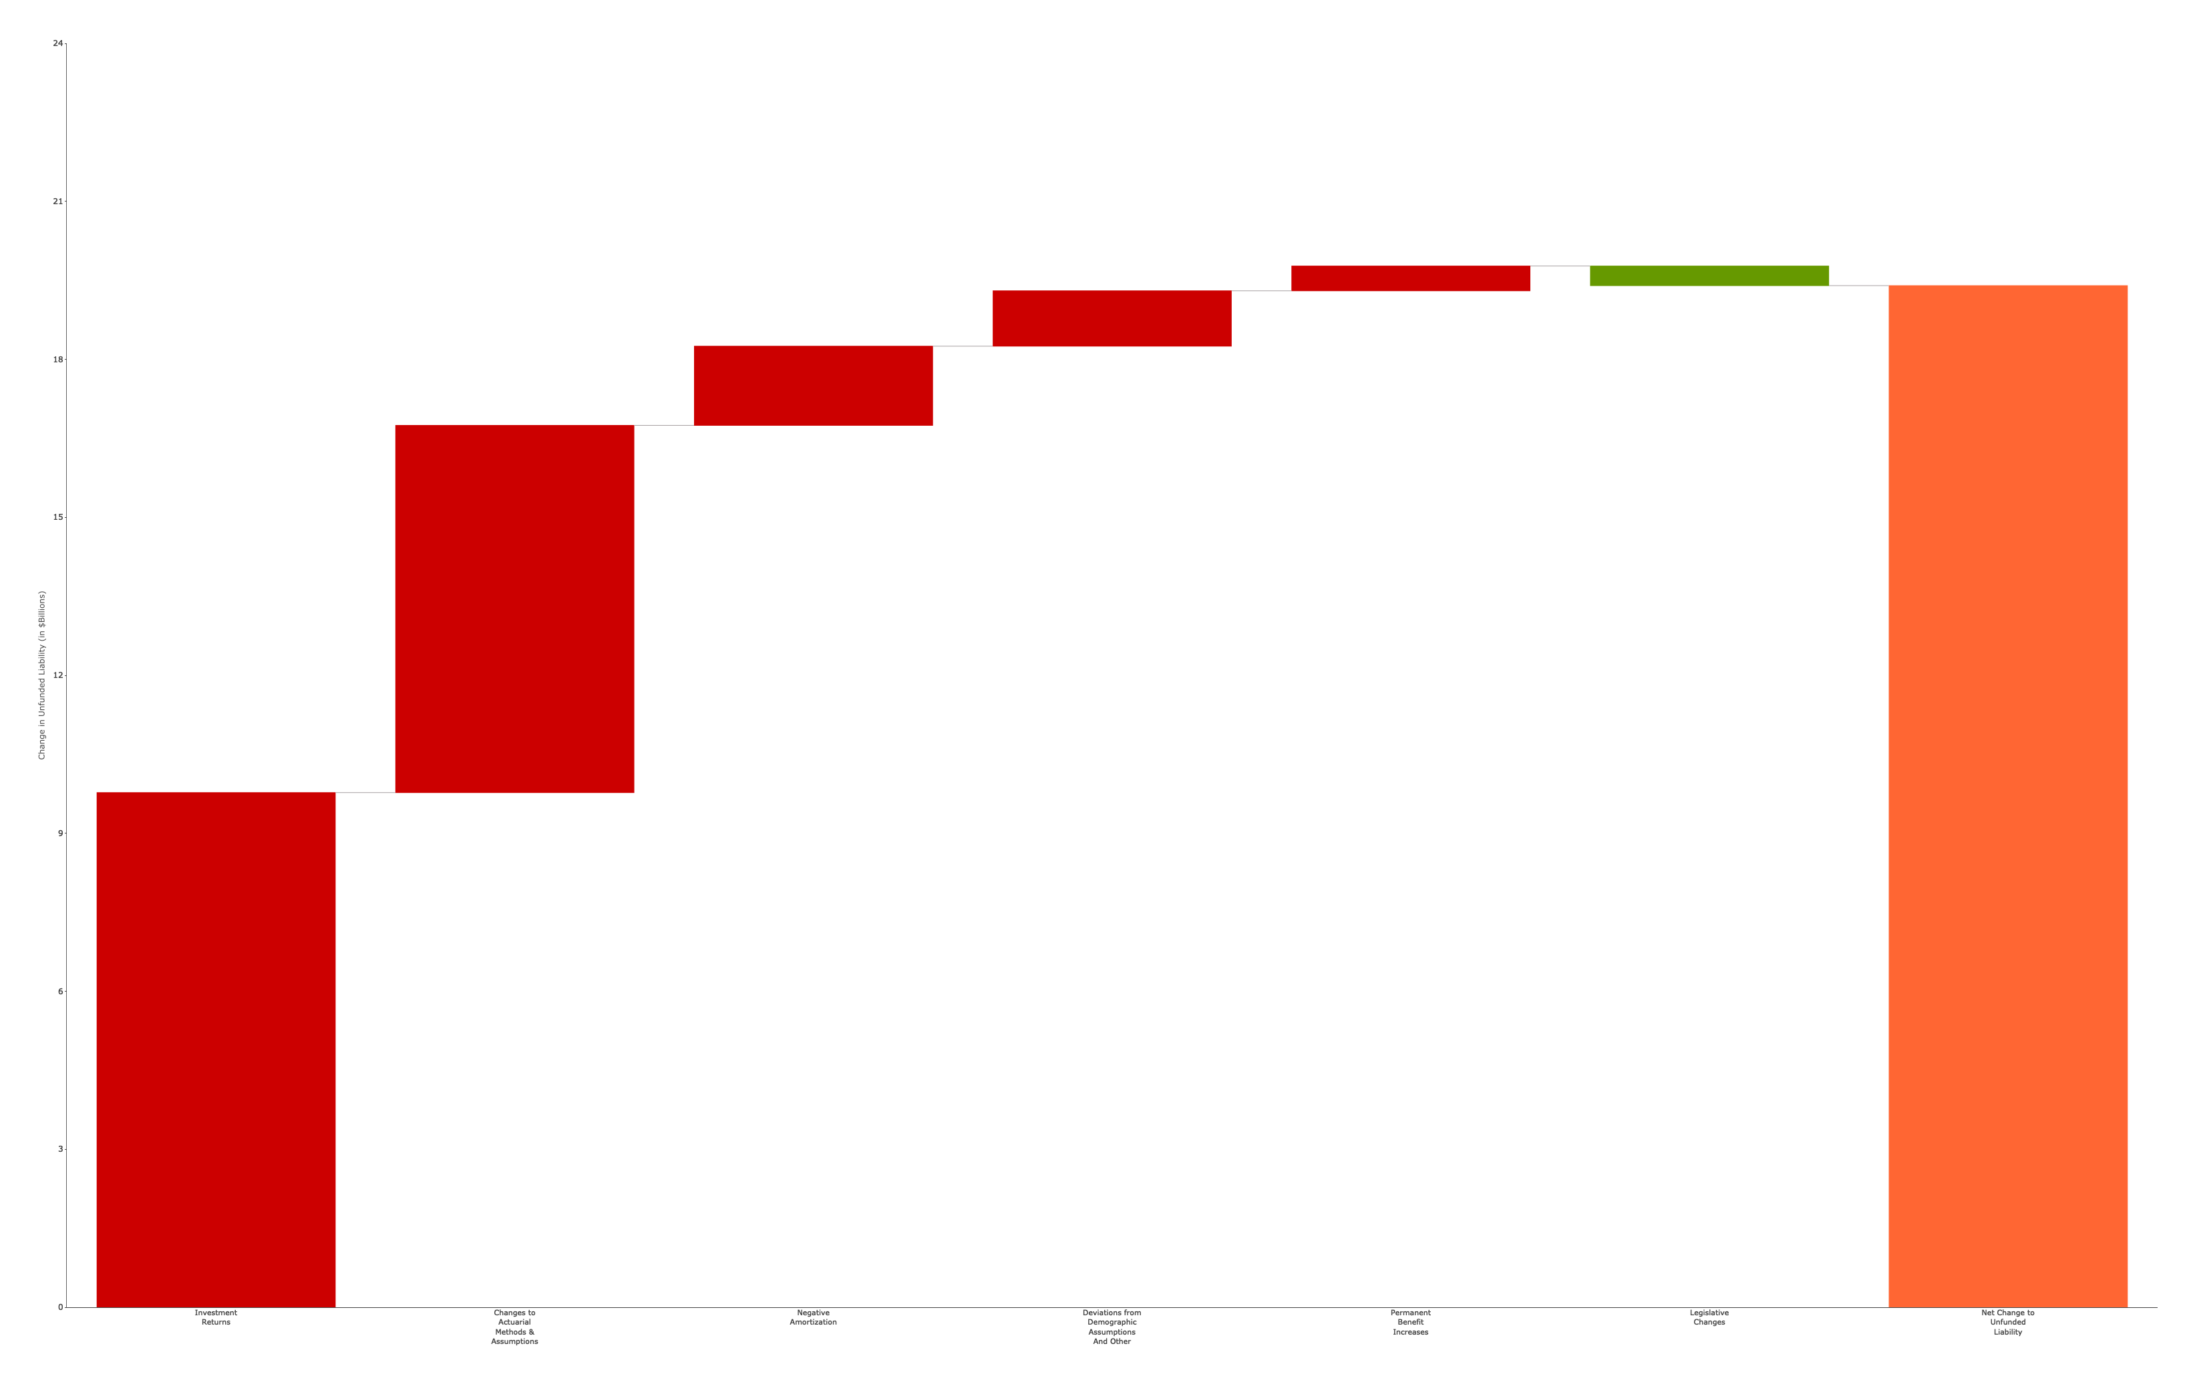
Causes of Pension Debt (2001-2021) w/ R (custom Plotly-Image)

Slide 7
Driving Factors Jeopardizing ASRS Resiliency
Deviations from Investment Return Assumptions have been the largest contributor to the unfunded liability growth, adding $9.77 billion from 2001 to 2021.
Changes to Actuarial Methods and Assumptions – including assumed rate of return - have revealed roughly $6.97 billion in additional unfunded liability since 2001.
Extended Amortization Timetables and low Statutory Contributions in the past have resulted in interest on ASRS debt exceeding the actual debt payments (negative amortization) since 2001, adding a net $1.5 billion to the unfunded liabilities.
Deviations from Demographic Assumptions – including deviations from assumed rates of withdrawal, retirement, and mortality — added $1.05 billion to the debt since 2001.
Permanent Benefit Increases (PBI) given added $47 million to unfunded liabilities since 2001.

Slide 8
A History of Weakening Solvency #2 (2001/2021) w/ R (table)
 | UAL | Funded Ratio
2001 | -$2,876,000,000 | 115.2%
2021 | $18,377,290,170 | 70.1%
Pension Integrity Project pension database.

Slide 9
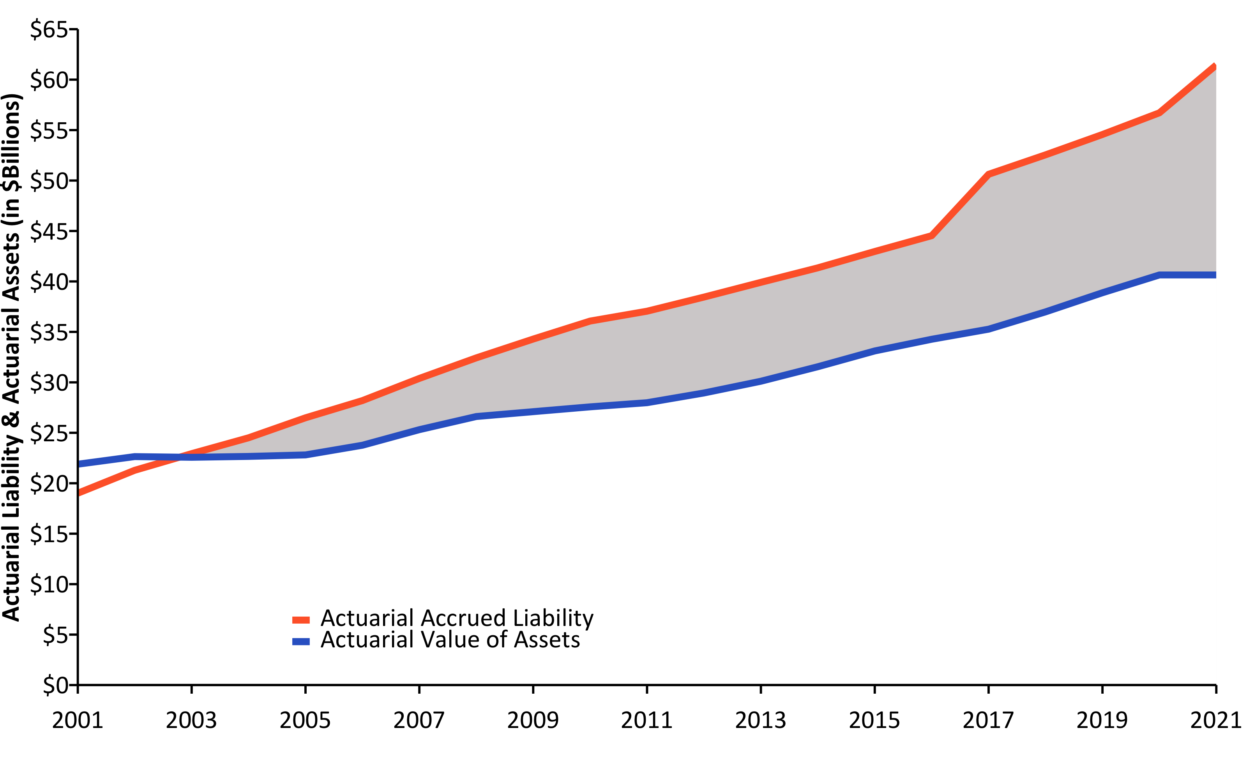
Liabilities Growing Faster than Assets (2001-2021) w/ R (linePlot())
Source: Pension Integrity Project analysis of ASRS actuarial valuation reports.

Slide 10
Make up of Pension Contributions w/ R (flextable())
FY2023 Contributions | FY2023 Contributions | FY2023 Contributions
Contribution Type | % of Payroll | $ Value
Total Employee | 12.0% | $1,321,694,000
Total Employer | 12.0% | $1,381,021,862
Employer (Debt Amortization) | 10.0% | $1,163,209,689
Employer (Normal Cost) | 1.8% | $217,812,173
Total ASRS Contributions | 24.0% | $2,774,788,052

Slide 11
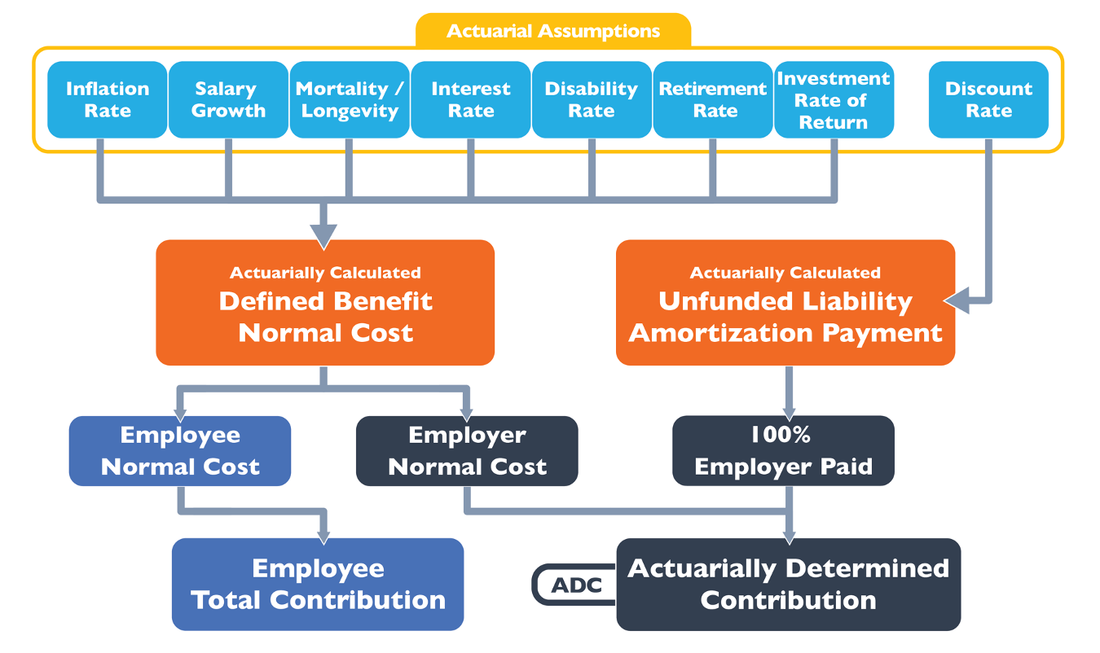
How a Pension Plan is Funded w/ Image

Slide 12
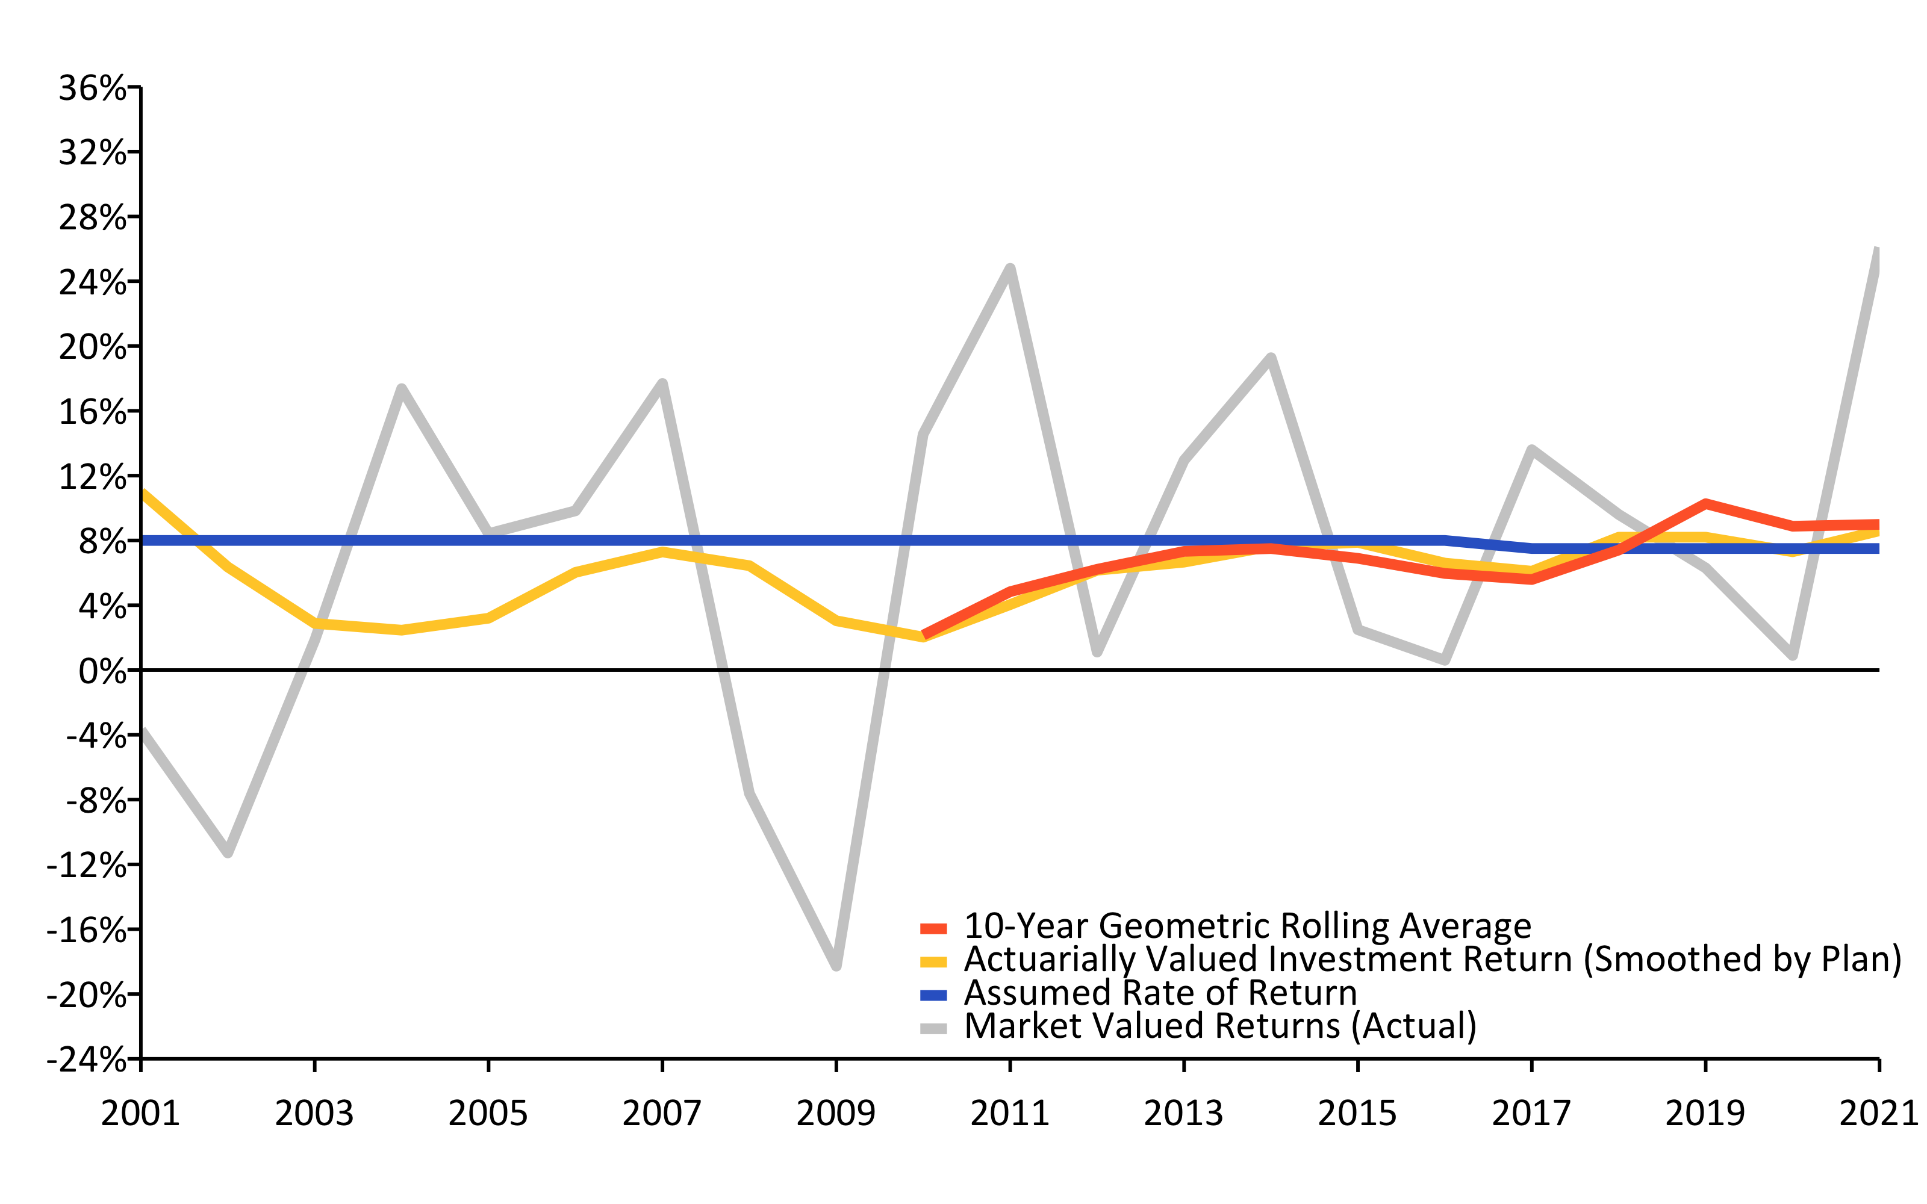
A History of Investment Returns (2001-2021) w/ R (linePlot())
Source: Pension Integrity Project analysis of ASRS actuarial valuation reports.

Slide 13
Investment Returns vs. Assumptions w/ R (flextable)
Year | Average Market Valued Returns | Average Actuarially Valued Returns
20-Years (2002-2021) | 6.90% | 5.80%
15-Years (2007-2021) | 7.60% | 6.40%
10-Years (2012-2021) | 9.00% | 7.30%
5-Years (2017-2021) | 11.00% | 7.70%

Slide 14
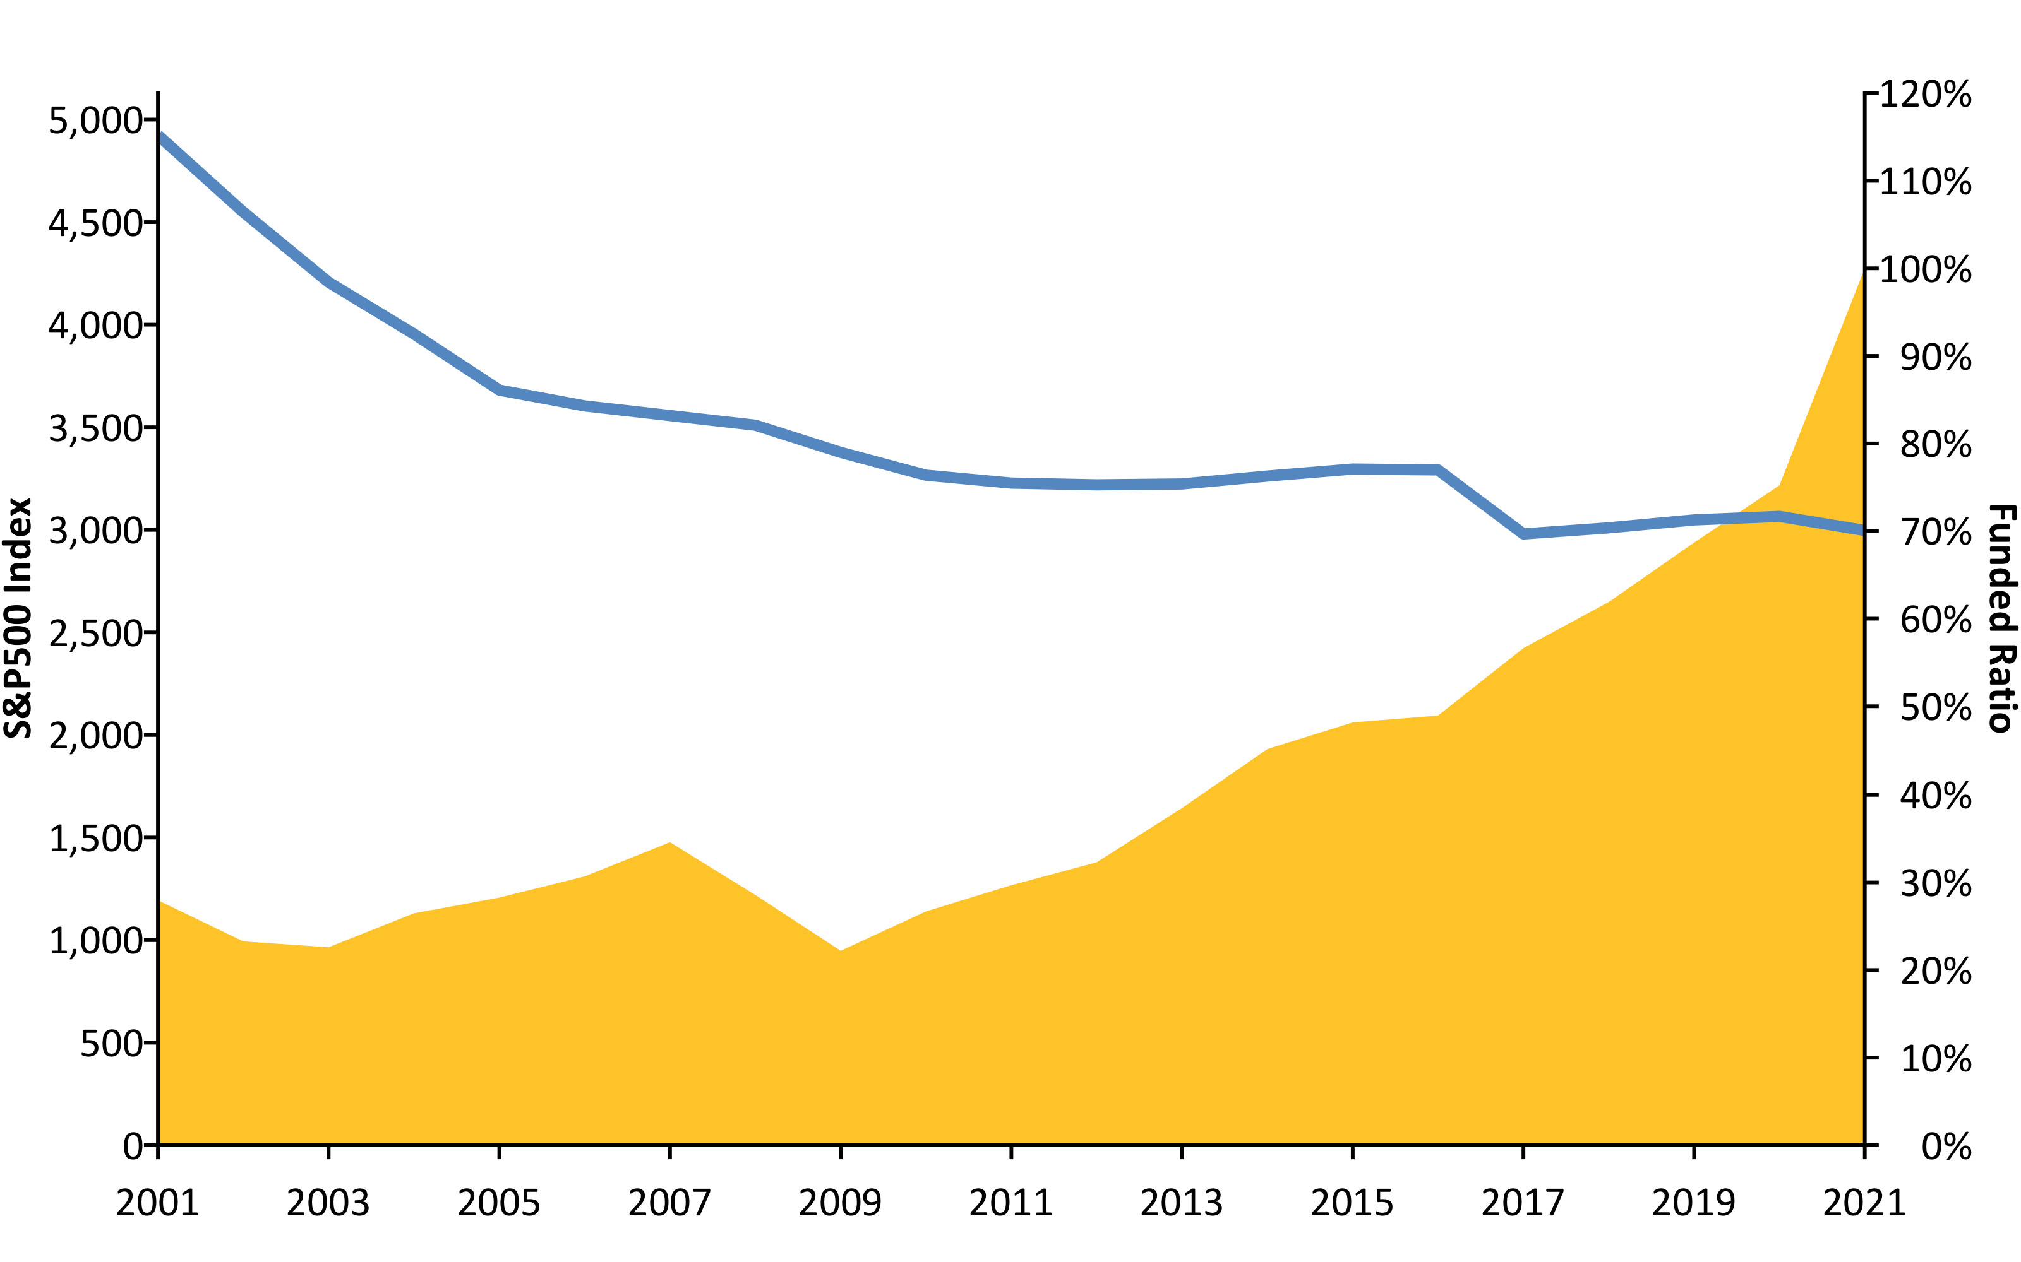
S&P500 vs. Funded Ratio (2001-2020) w/ R (areaPlot())
Source: Pension Integrity Project analysis of ASRS actuarial valuation reports.

Slide 15
New Normal: The Market Has Changed
The “new normal” for the institutional investing, despite the post-COVID rebound, suggests that achieving even a 6% average rate of return is optimistic.
Over the past two decades there has been a steady change in the nature of the institutional investment returns.
30-year Treasury yields have fallen from around 8% in the 1990s to consistently less or around 3% today.
Globally, interest rates are at the ultralow historic levels, while market liquidity continues to be restrained by financial regulations.
McKinsey & Co. forecast the returns to equities will be 20% to 50% lower over the next two decades compared to the previous three decades.
Using their forecast, the best-case scenario for a 60/40 portfolio of equities and bonds is likely to earn less than a 5% return.
As ASRS waits for the continual “rebound” its unfunded liabilities continue to grow.

Slide 16
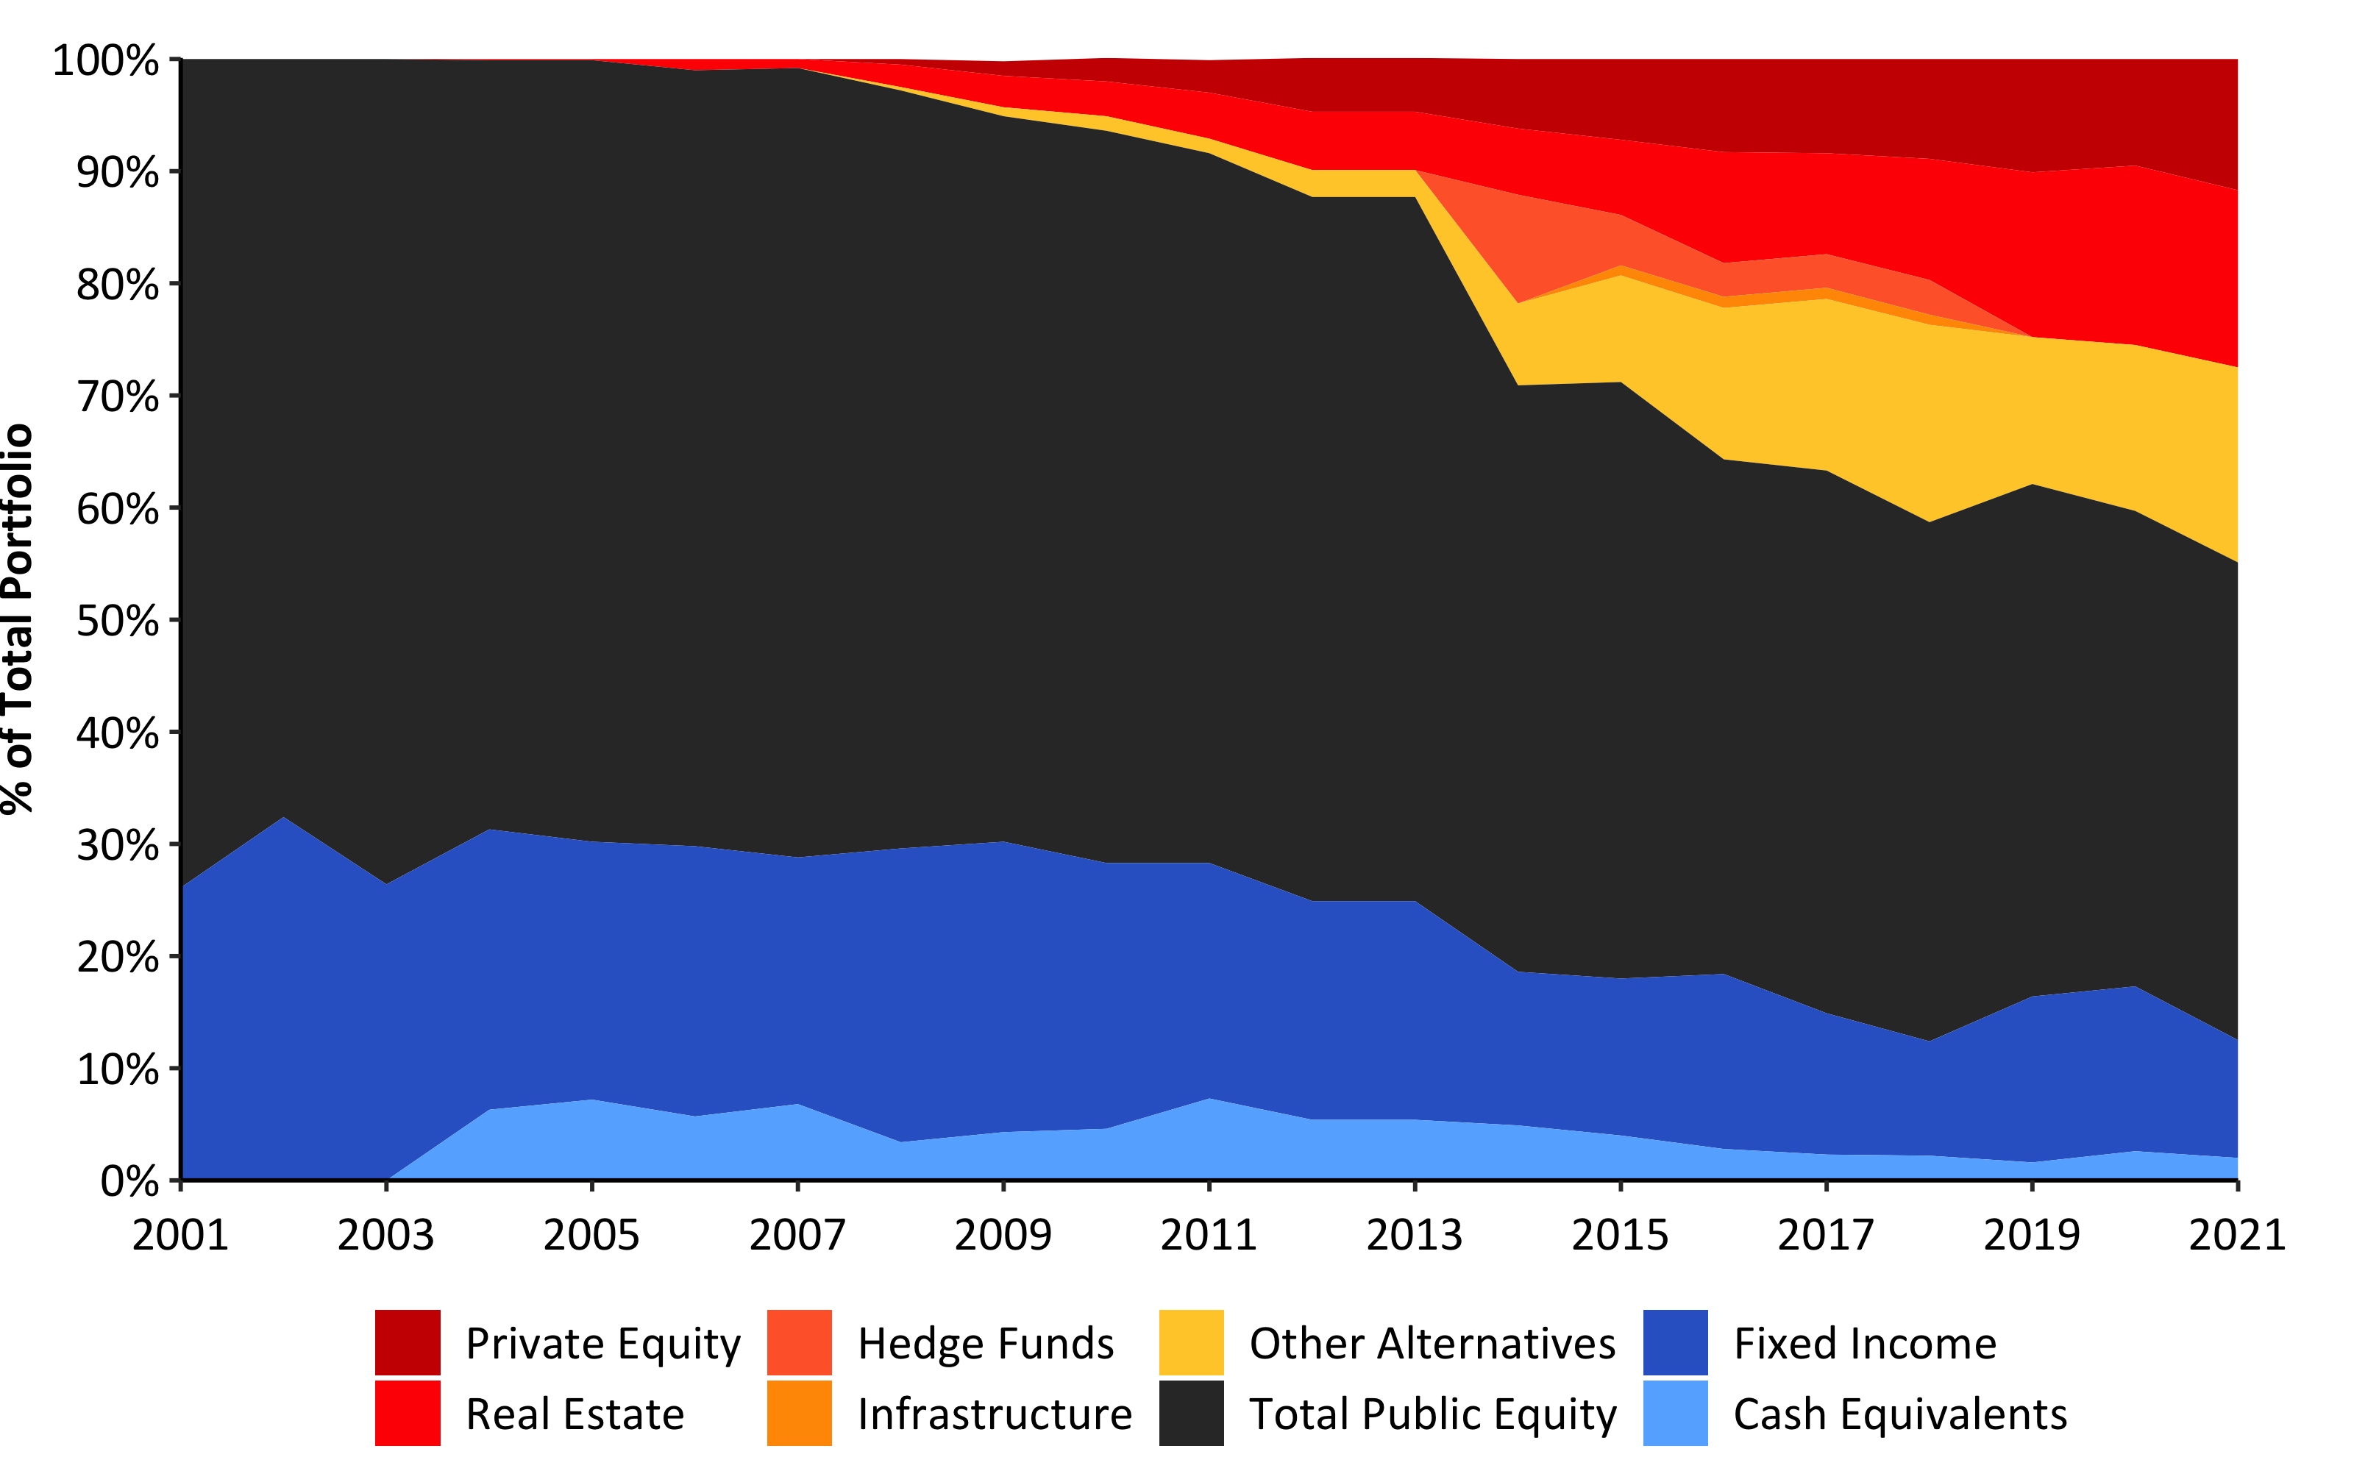
Asset Allocation (2001-2021) w/ R (Custom)

Slide 17
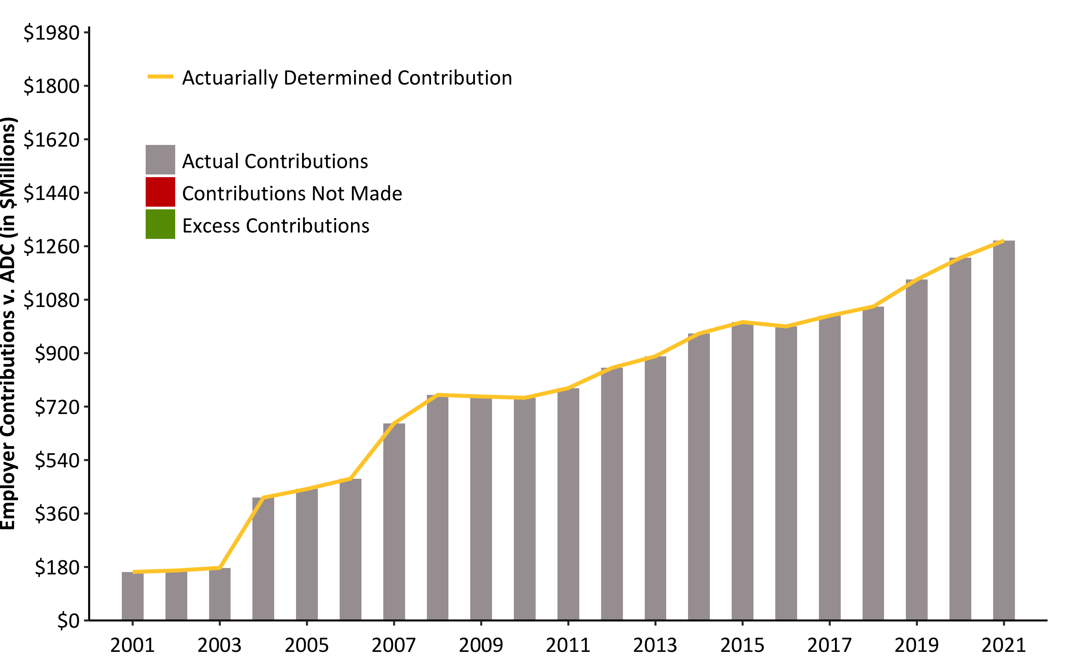
ADEC Contribution History (2001-2021) w/ R (barPlot())
Source: Pension Integrity Project analysis of ASRS actuarial valuation reports.

Slide 18
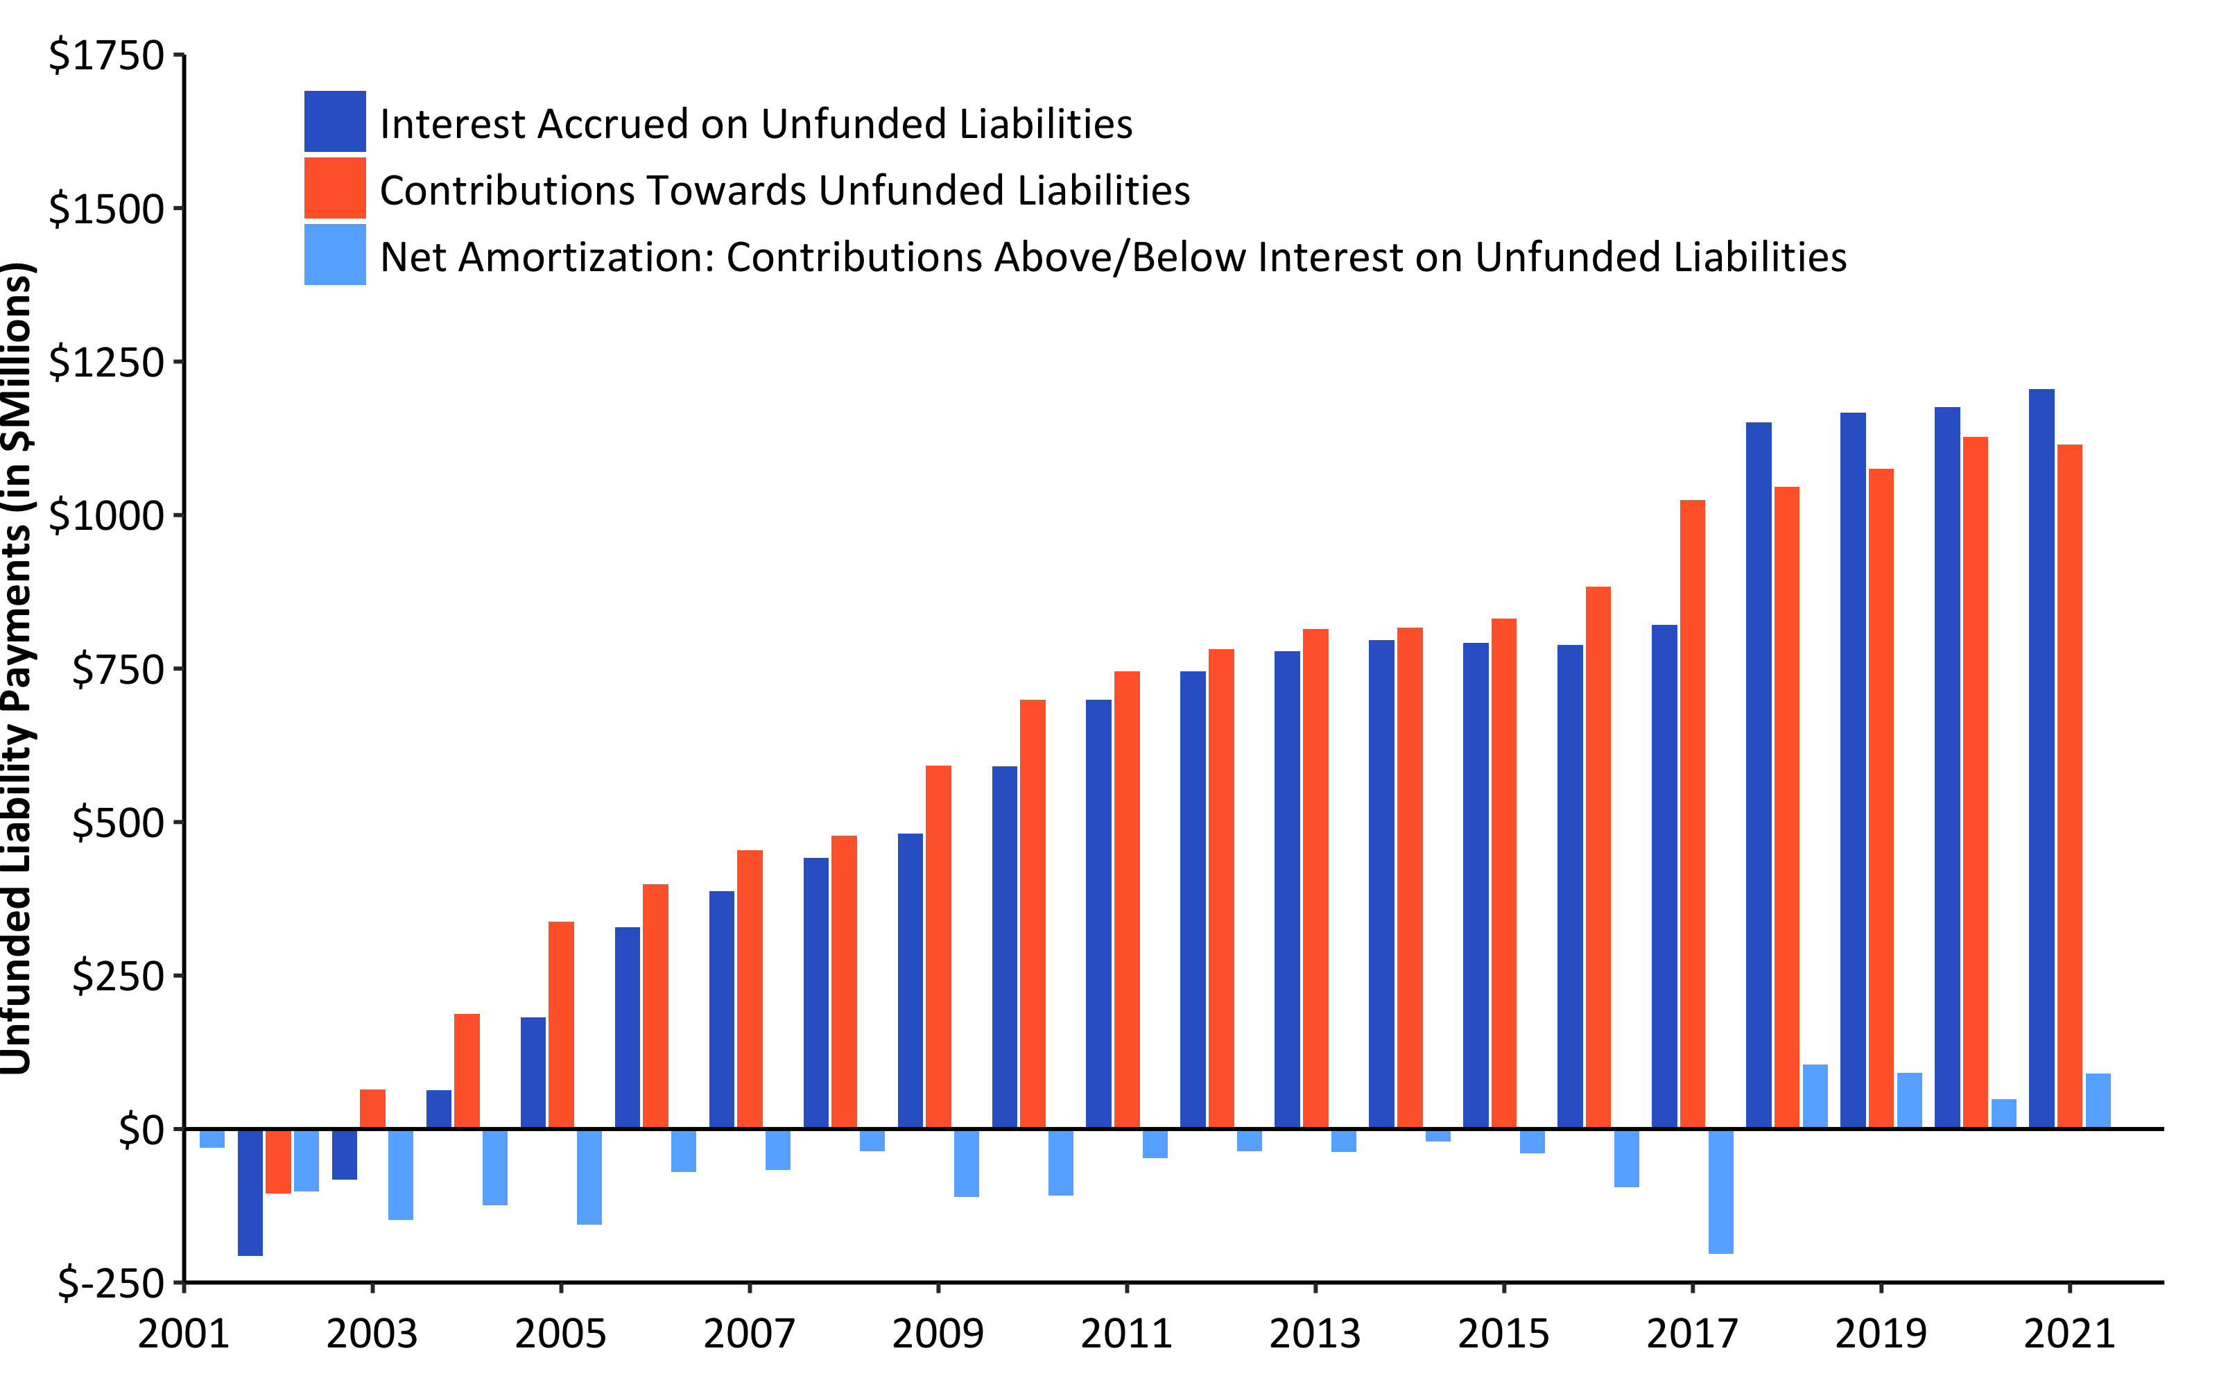
Debt Interest vs. Unfunded Liability Payments (2001-2021) w/ R (w/ barPlot())
Source: Pension Integrity Project analysis of SCRS actuarial valuation reports.

Slide 19
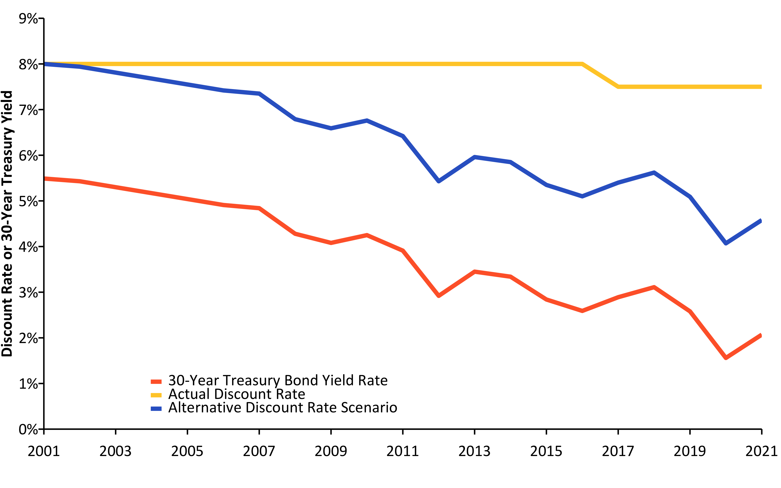
Change in Risk-Free Rate vs. Discount Rate (2001-2021) w/ R (linePlot())
Source: Pension Integrity Project analysis of ASRS actuarial valuation reports.

Slide 20
Actual Change in Payroll vs. Assumption (2001-2021) w/ R (linePlot())
## [1] 0.045

Slide 21
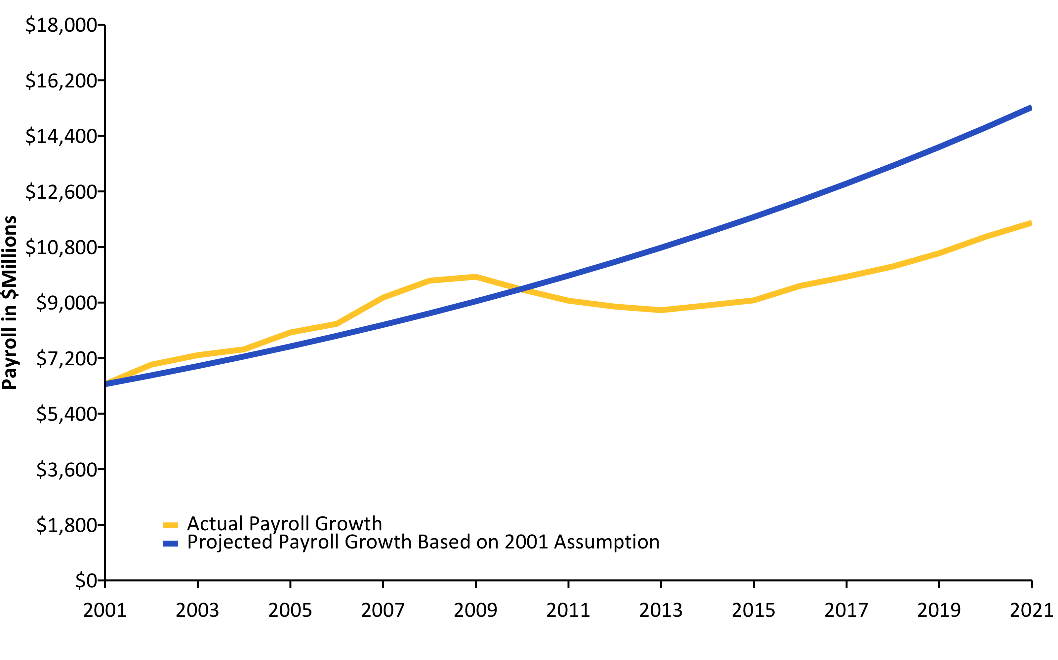
Source: Pension Integrity Project analysis of ASRS actuarial valuation reports.

Slide 22
Actual Inflation vs. Assumption (2001-2020) w/ R (linePlot())
## Response [https://raw.githubusercontent.com/ReasonFoundation/databaseR/master/files/CPI_by_Region_DOL.xlsx] ## Date: 2022-01-26 21:43 ## Status: 200 ## Content-Type: application/octet-stream ## Size: 13.8 kB ## <ON DISK> /var/folders/0z/p5zgjmbn6531bgclzwc383500000gn/T//Rtmp1Uo2vb/file233c2a6cfabc.xlsx

Slide 23
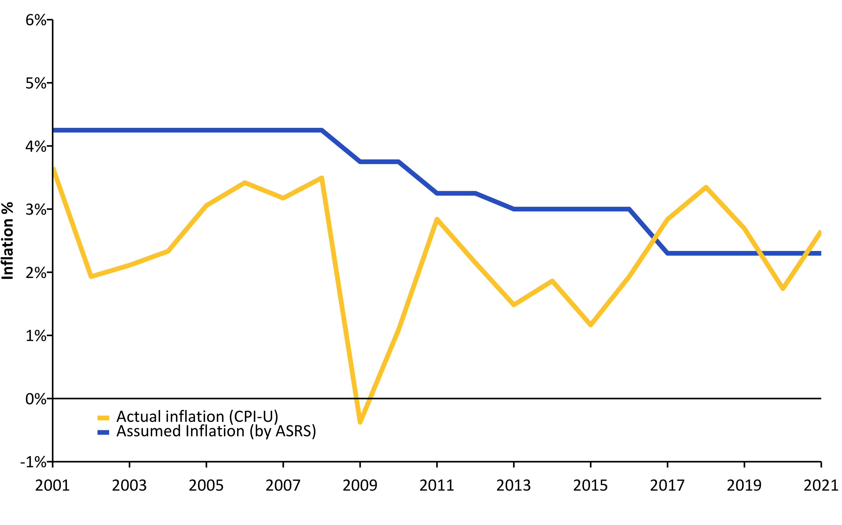
Source: Pension Integrity Project analysis of ASRS actuarial valuation reports.

