Slide 1
SamplePPT (PERSI graphs)
Anil, Swaroop & Jen

Slide 2
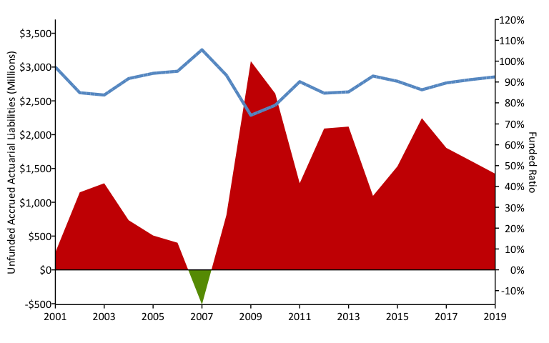
A History of Weakening Solvency (2001-2019) w/ R (debtPlot())

Slide 3
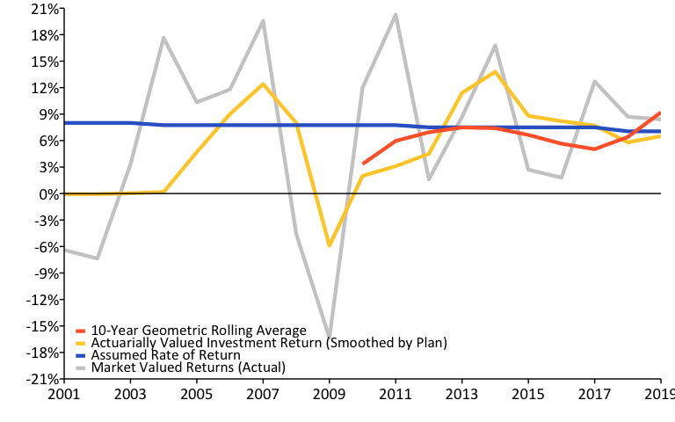
A History of Investment Returns (2001-2019) w/ R (linePlot())

Slide 4
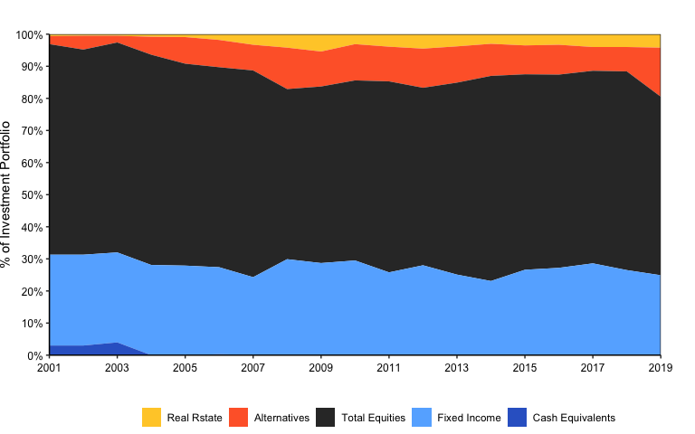
Asset Allocation w/ R (custom)

Slide 5
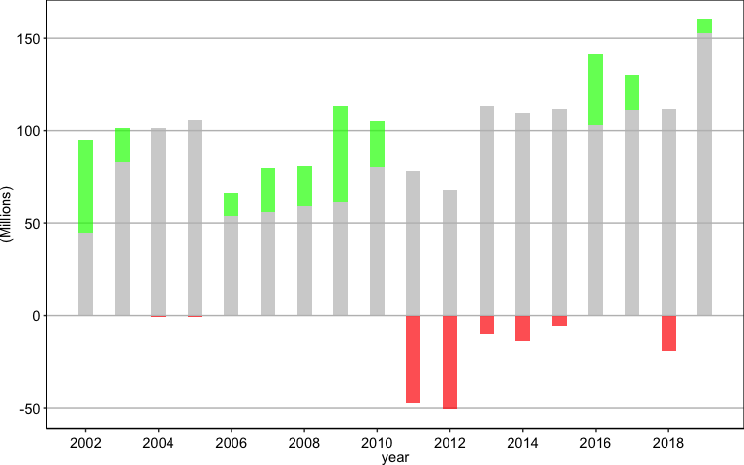
Negative Amortization Growth w/ R (custom)

Slide 6
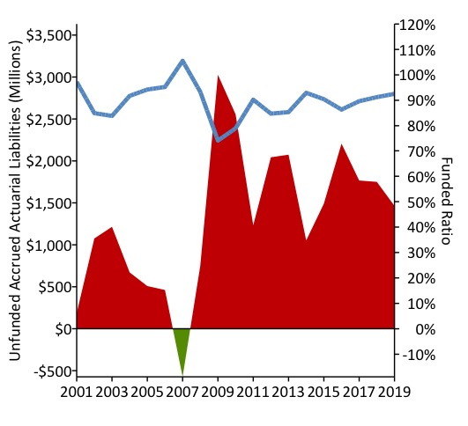
A Mountain fo Debt Plot w/ R (Saved Img)

Slide 7
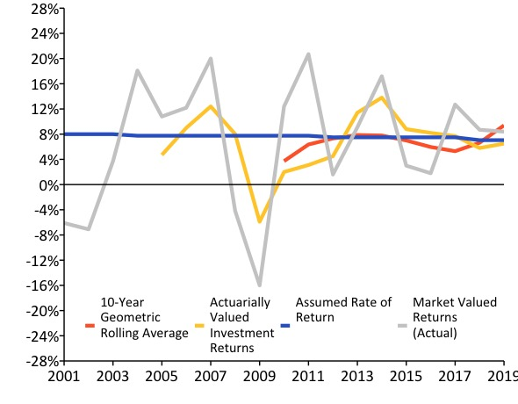
A History of Weakening Solvency (2001-2019) w/ R (Saved Img)

Slide 8
References
https://github.com/ReasonFoundation/GraphicsR
https://rstudio.com/wp-content/uploads/2015/03/rmarkdown-reference.pdf
https://bookdown.org/yihui/rmarkdown/

