Slide 1
SamplePPT (PERSI graphs)
Anil, Swaroop, Jen & Jordan

Slide 2
About the Pension Integrity Project
We offer pro-bono technical assistance to public officials to help them design and implement pension reforms that improve plan solvency and promote retirement security, including:
## [1] "Customized analysis "

Slide 3
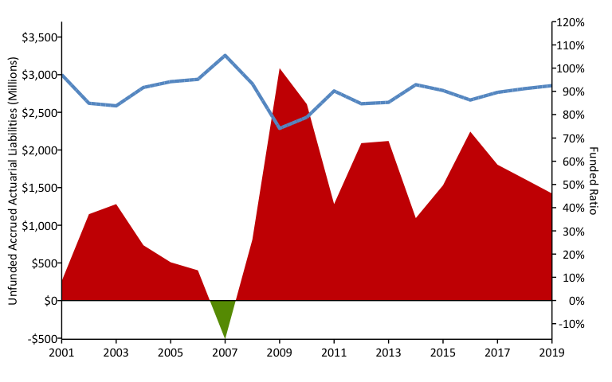
A History of Weakening Solvency (2001-2019) w/ R (areaPlot())

Slide 4
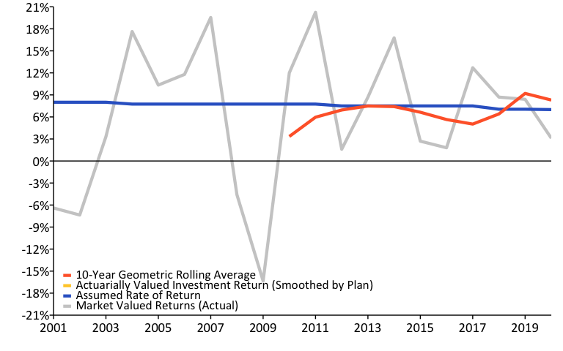
A History of Investment Returns (2001-2019) w/ R (linePlot())

Slide 5
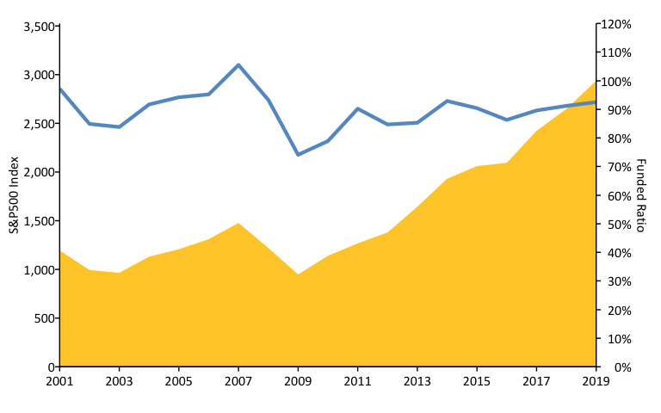
S&P500 vs. Funded Ratio (2001-2019) w/ R (areaPlot())

Slide 6
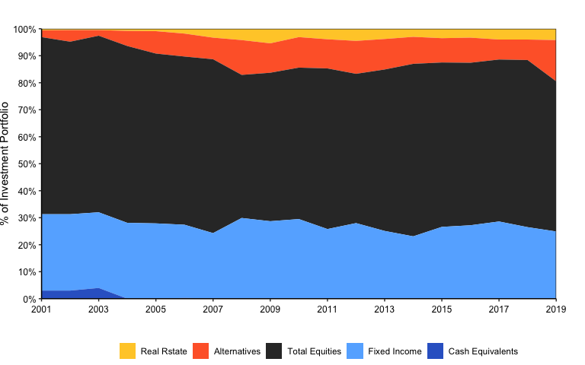
Asset Allocation w/ R (custom)

Slide 7
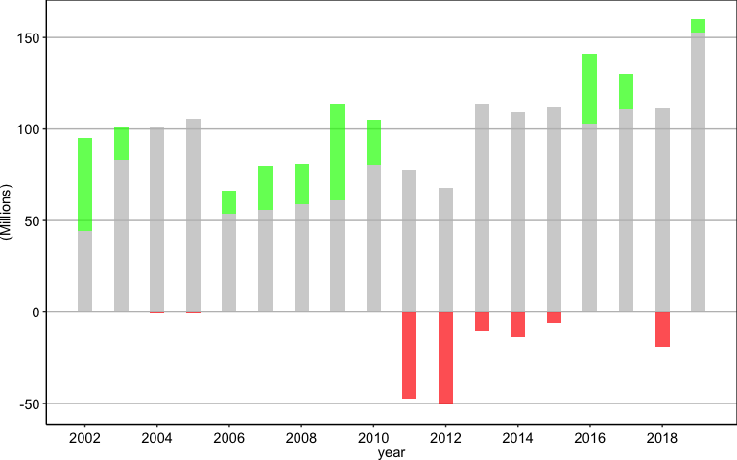
Negative Amortization Growth w/ R (custom)

Slide 8
References
https://github.com/ReasonFoundation/GraphicsR
https://rstudio.com/wp-content/uploads/2015/03/rmarkdown-reference.pdf
https://bookdown.org/yihui/rmarkdown/

