Slide 1
Dallas Police and Fire Pension System Pension Solvency Analysis
Prepared by: Pension Integrity Project at Reason Foundation February 18, 2020

Slide 2
About the Pension Integrity Project
We offer pro-bono technical assistance to public officials to help them design and implement pension reforms that improve plan solvency and promote retirement security, including:
Customized analysis of pension system design, trends
Independent actuarial modeling of reform scenarios
Consultation and modeling around custom policy designs
Latest pension reform research and case studies
Peer-to-peer mentoring from state and local officials who have successfully enacted pension reforms
Assistance with stakeholder outreach, engagement and relationship management
Design and execution of public education programs and media campaigns

Slide 3
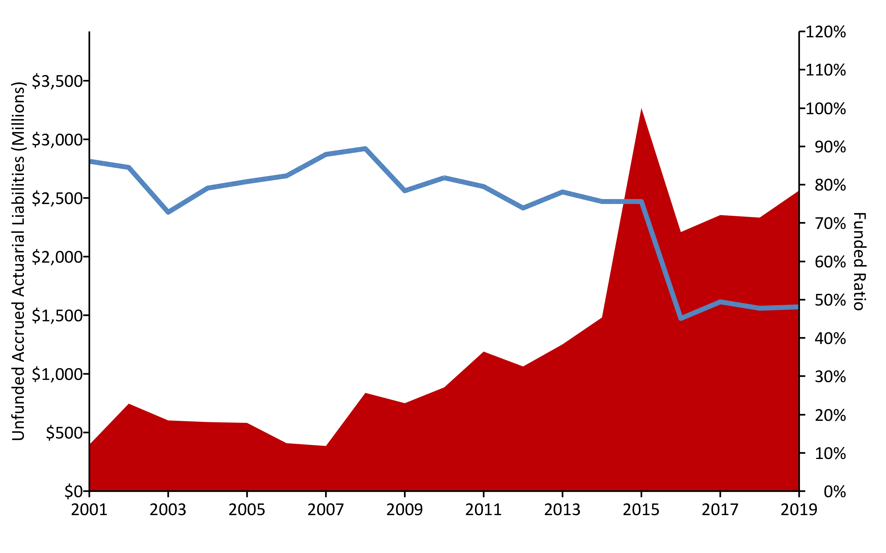
A History of Weakening Solvency (2001-2019) w/ R (areaPlot())
Notes:
Mountain of Debt Plot for Dallas PFPS

Slide 4
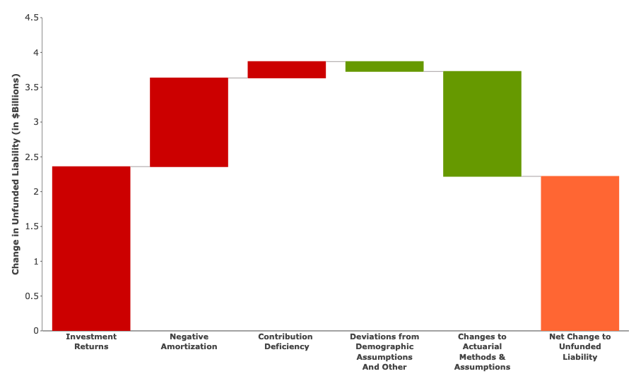
Causes of Pension Debt (2001-2019) w/ R (custom Plotly-Image)

Slide 5
Make up of Pension Contributions w/ R (custom)
 | % of Payroll | $ Value
Total Employee | 13.5% | $32,977,425
Employer (Normal Cost) | 3.2% | $11,038,570
Employer (Debt Amortization) | 38.7% | $133,881,595
Total Employer | 41.9% | $144,920,166
Total Dallas Police and Fire Pension System Contributions | 55.4% | $198,688,830
Pension Integrity Project pension database.

Slide 6
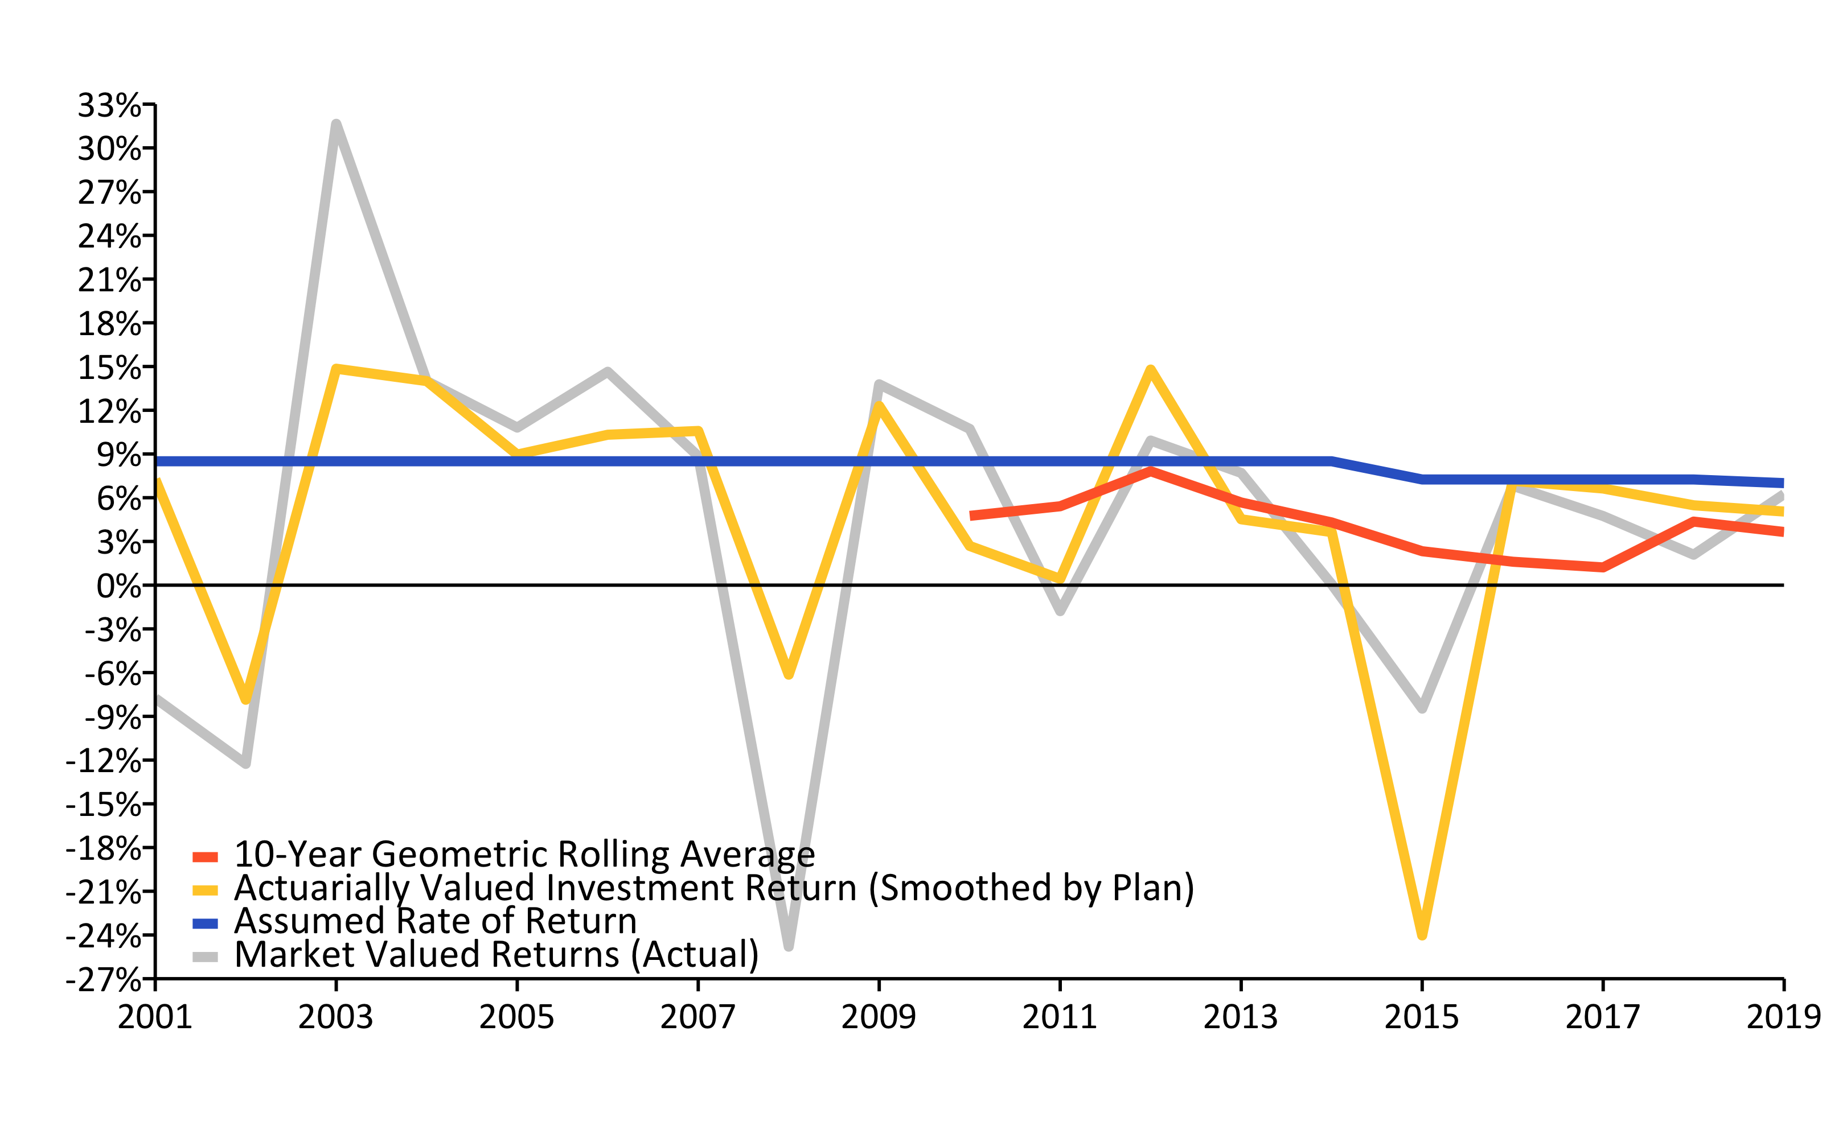
A History of Investment Returns (2001-2019) w/ R (linePlot())

Slide 7
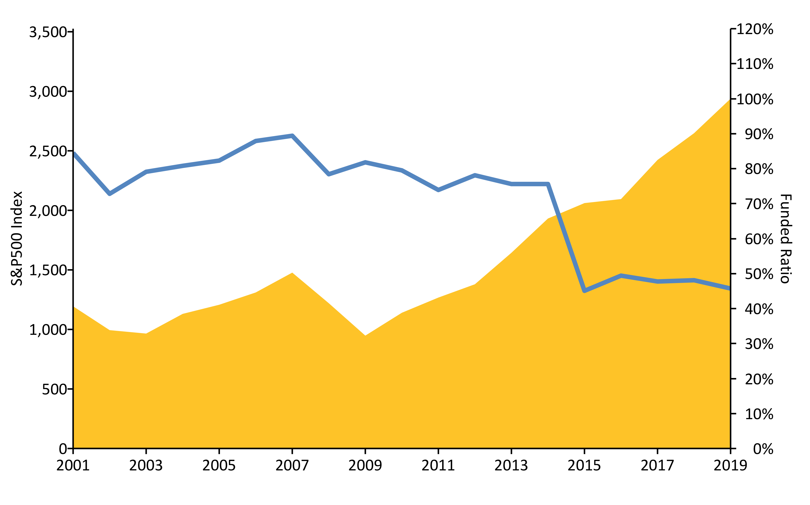
S&P500 vs. Funded Ratio (2001-2019) w/ R (areaPlot())

Slide 8
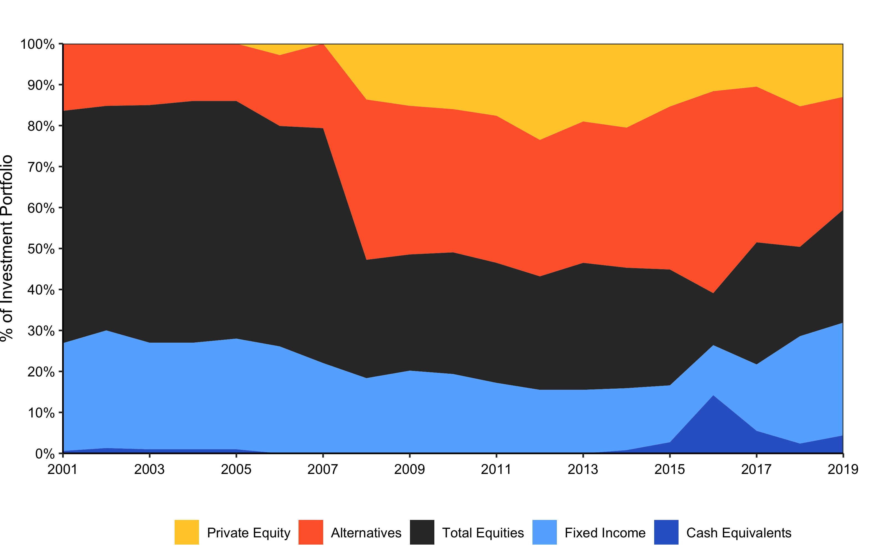
Asset Allocation (2001-2019) w/ R (custom)

Slide 9
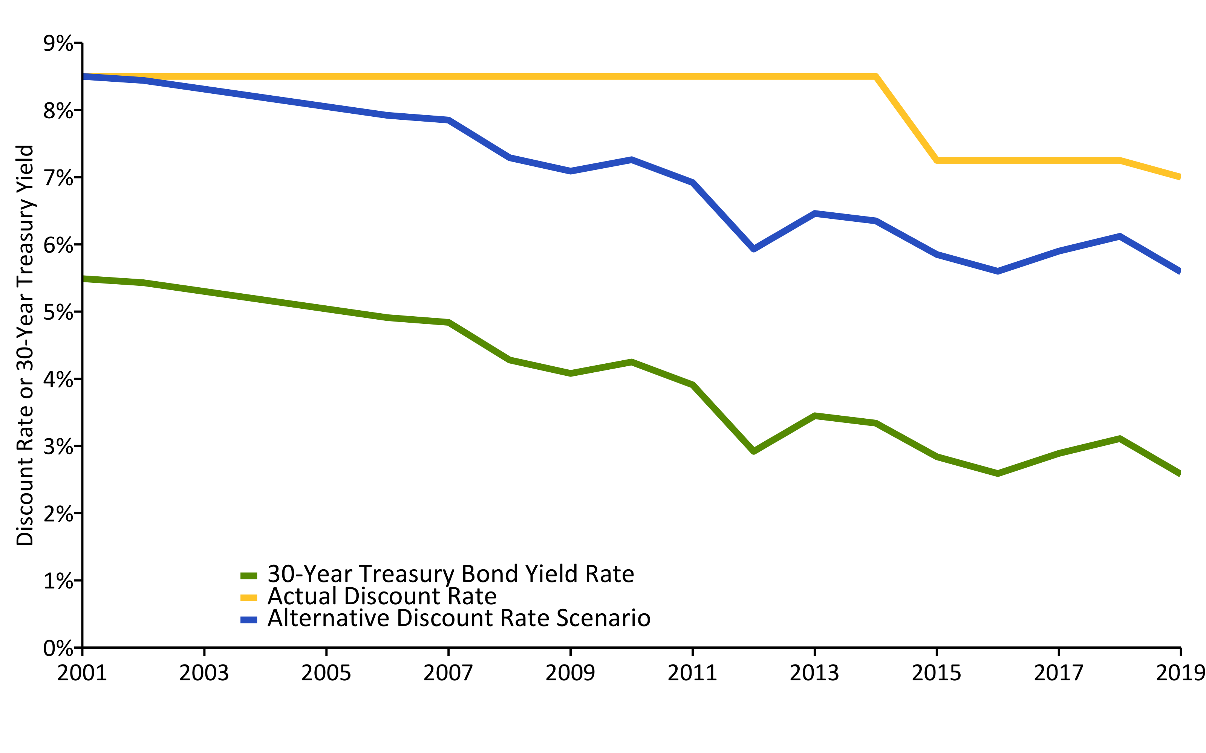
Change in Risk-Free Rate vs. Discount Rate (2001-2019) w/ R (linePlot())

Slide 10
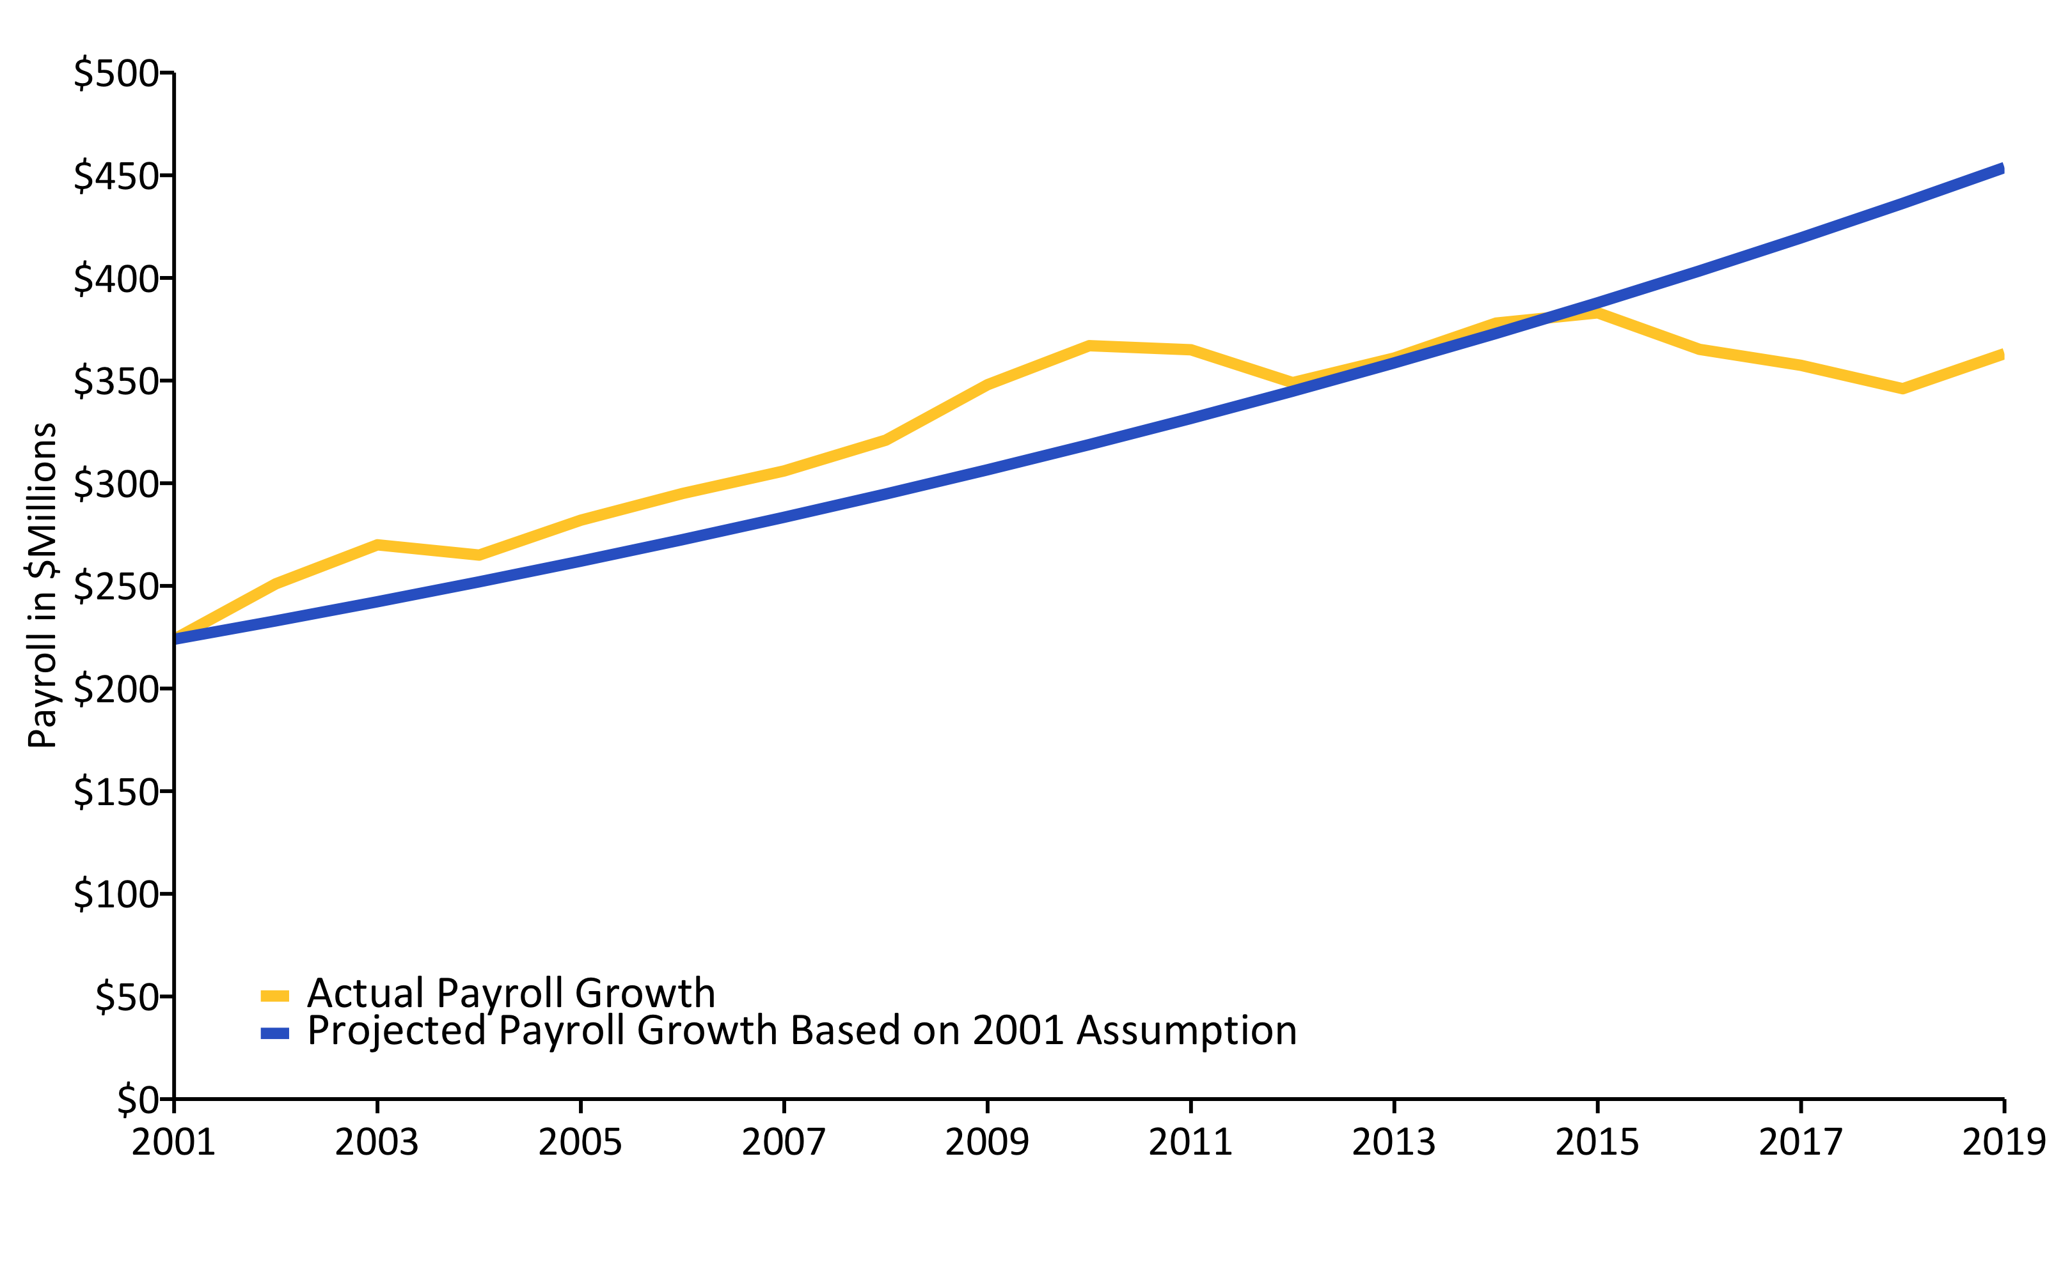
Actual Change in Payroll vs. Assumption (2001-2019) w/ R (linePlot())

Slide 11
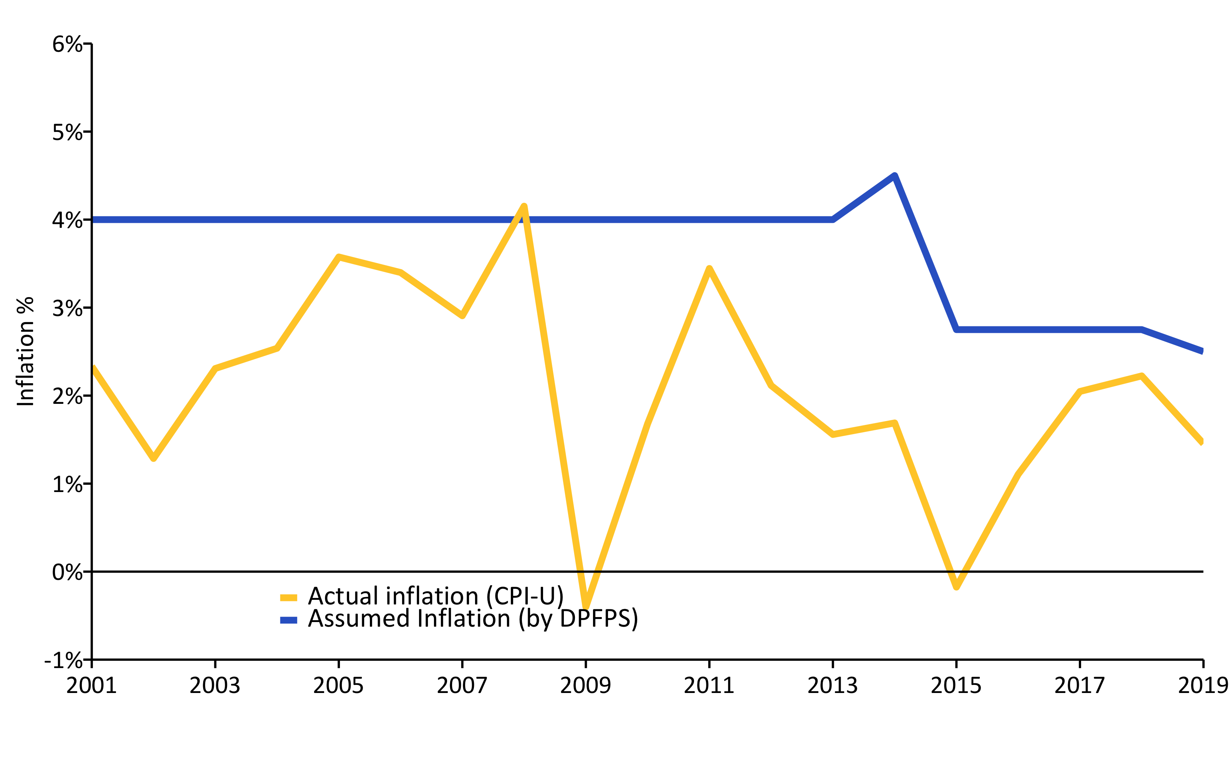
Actual Inflation vs. Assumption (2001-2019) w/ R (linePlot())

Slide 12
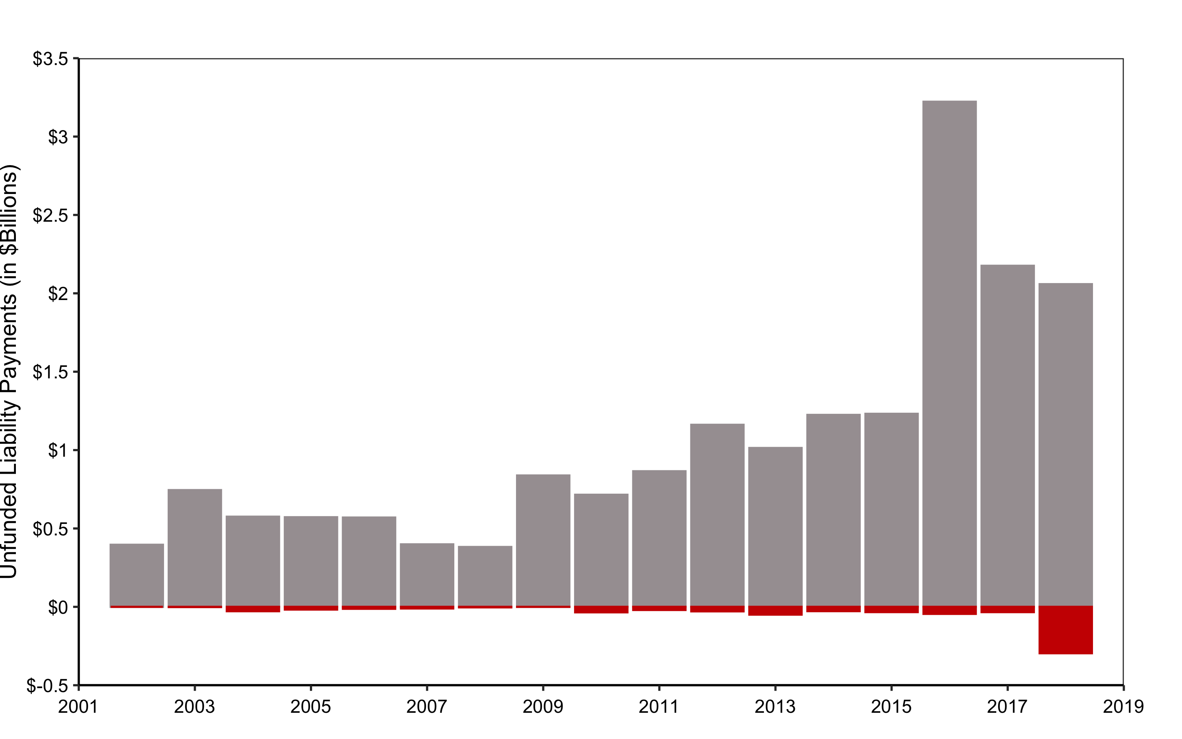
Debt Interest vs. Unfunded Liability Payments (2001-2019) w/ R (custom)

Slide 13
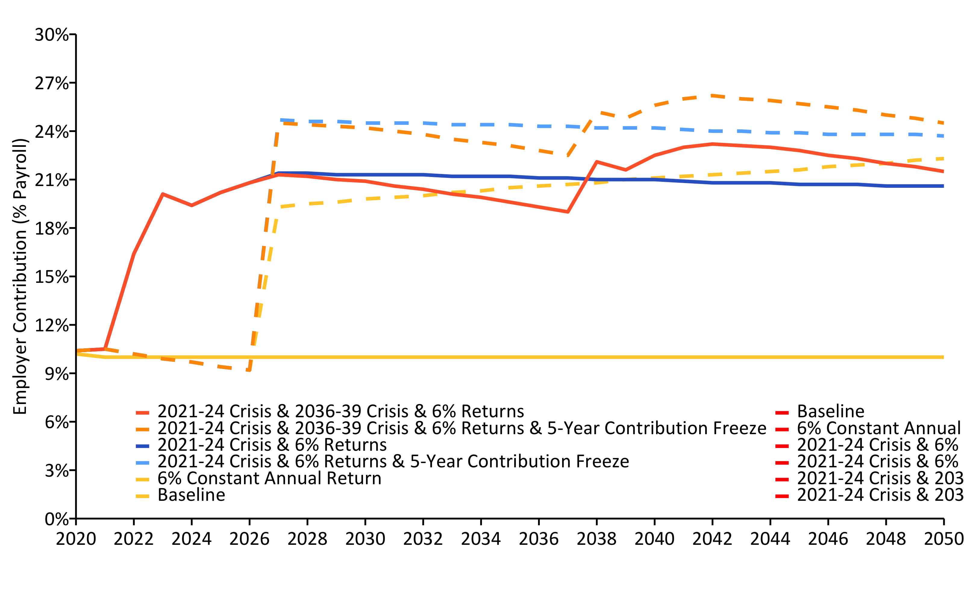
Current Contributions Are Actuarially Insufficient (2001-2019) w/ R (linePlot())

