Slide 1
SamplePPT (PERSI graphs)
Anil

Slide 2
Reference: https://rstudio.com/wp-content/uploads/2015/03/rmarkdown-reference.pdf https://bookdown.org/yihui/rmarkdown/

Slide 3
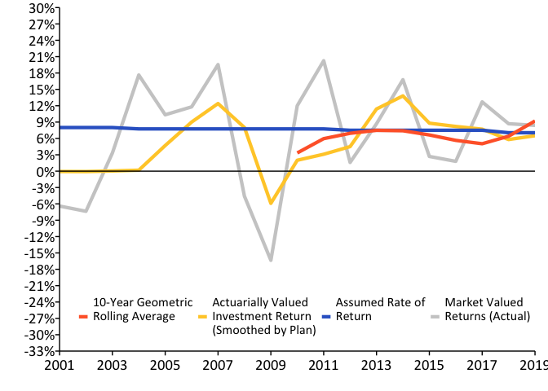
A History of Weakening Solvency (1995-2019) w/ R Code

Slide 4
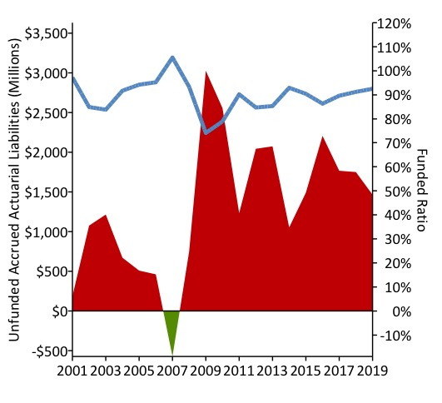
A History of Weakening Solvency (1995-2019) w/ Saved Img

Slide 5
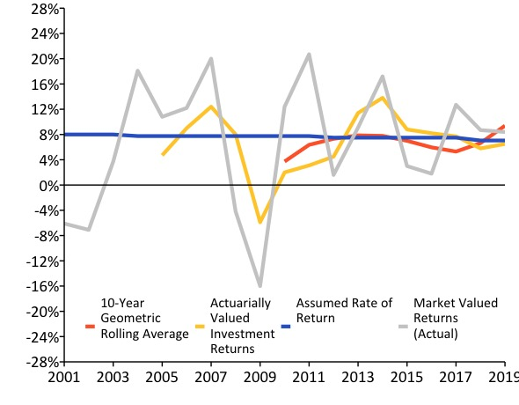
Two column

Slide 6
## Slide with Bullets
Bullet 1
Bullet 2
Bullet 3

