Slide 1
Sample_PPT (PERSI graphs)
Anil, Swaroop, Jen & Jordan

Slide 2
About the Pension Integrity Project
We offer pro-bono technical assistance to public officials to help them design and implement pension reforms that improve plan solvency and promote retirement security, including:
Customized analysis of pension system design, trends
Independent actuarial modeling of reform scenarios
Consultation and modeling around custom policy designs
Latest pension reform research and case studies
Peer-to-peer mentoring from state and local officials who have successfully enacted pension reforms
Assistance with stakeholder outreach, engagement and relationship management
Design and execution of public education programs and media campaigns

Slide 3
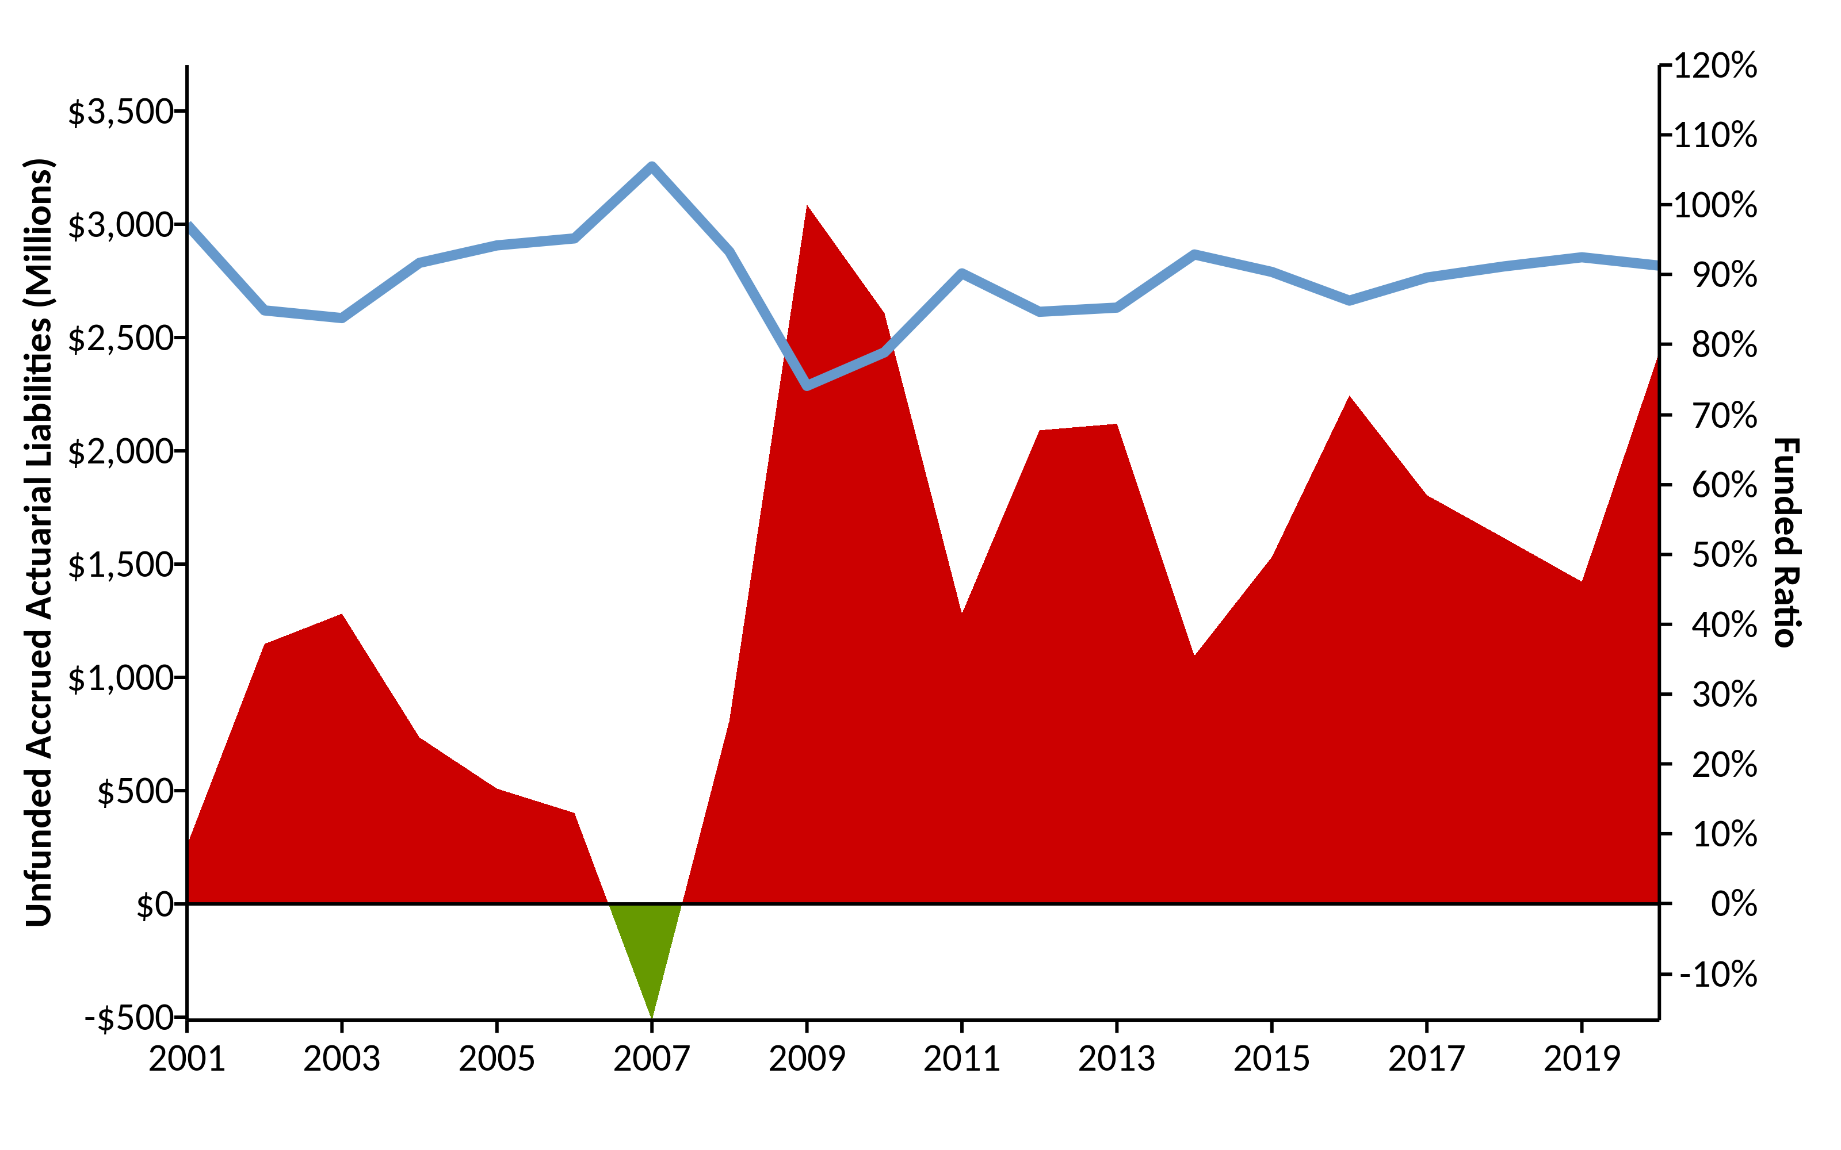
A History of Weakening Solvency (2001-2020) w/ R (areaPlot())

Slide 4
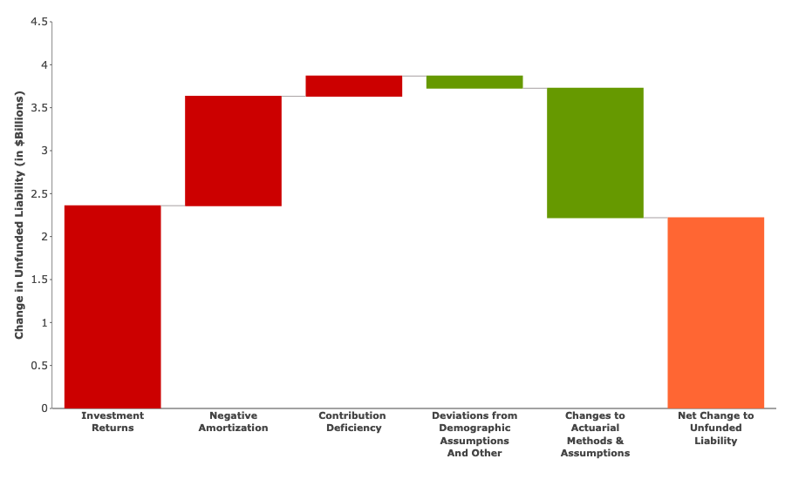
Causes of Pension Debt (2001-2019) w/ R (custom Plotly-Image)

Slide 5
Make up of Pension Contributions w/ R (custom)
 | % of Payroll | $ Value
Total Employee | 7.4% | $257,060,520
Employer (Normal Cost) | 7.5% | $252,981,080
Employer (Debt Amortization) | 4.5% | $152,532,710
Total Employer | 12.0% | $405,513,790
Total PERSI Contributions | 19.4% | $647,141,440
Pension Integrity Project pension database.

Slide 6
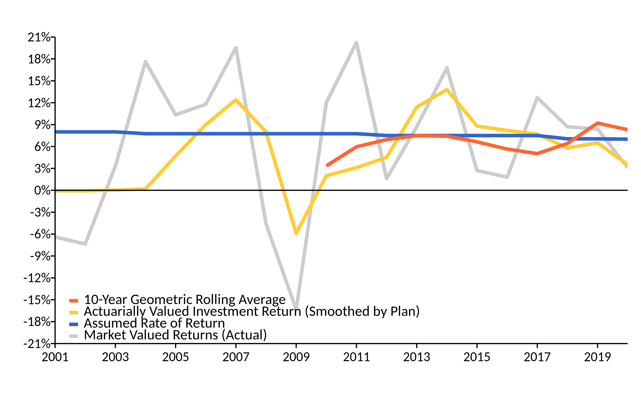
A History of Investment Returns (2001-2020) w/ R (linePlot())

Slide 7
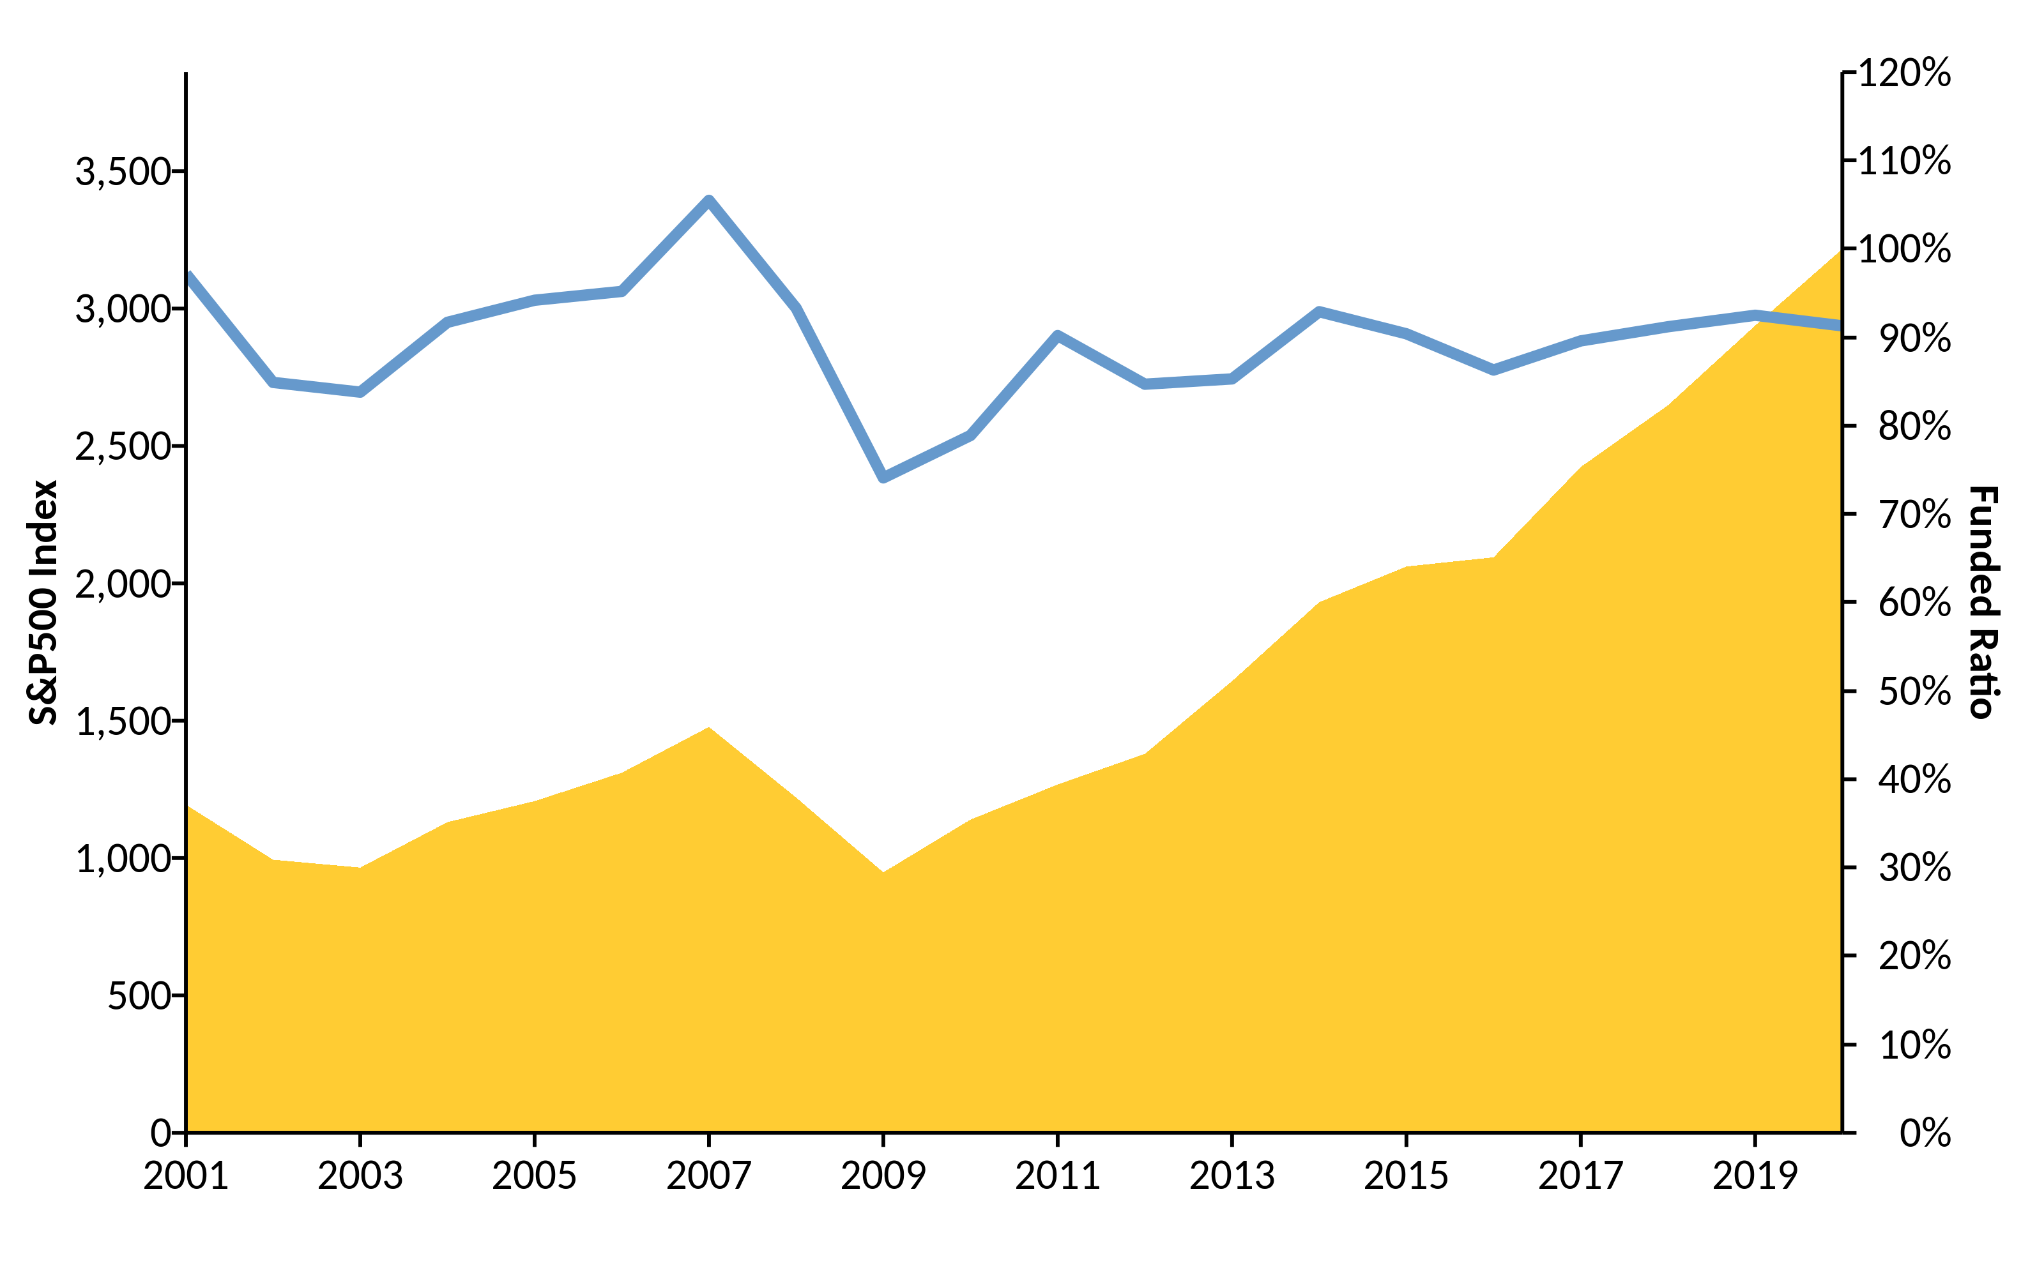
S&P500 vs. Funded Ratio (2001-2019) w/ R (areaPlot())

Slide 8
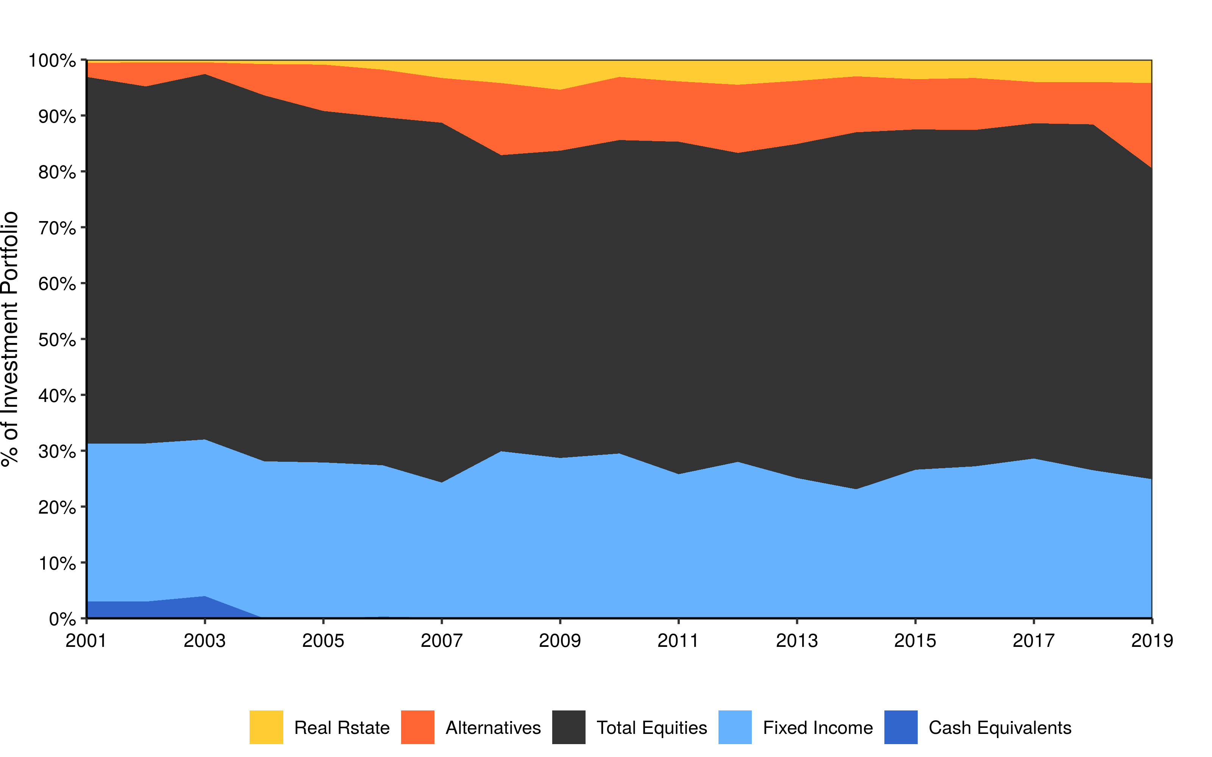
Asset Allocation (2001-2019) w/ R (custom)

Slide 9
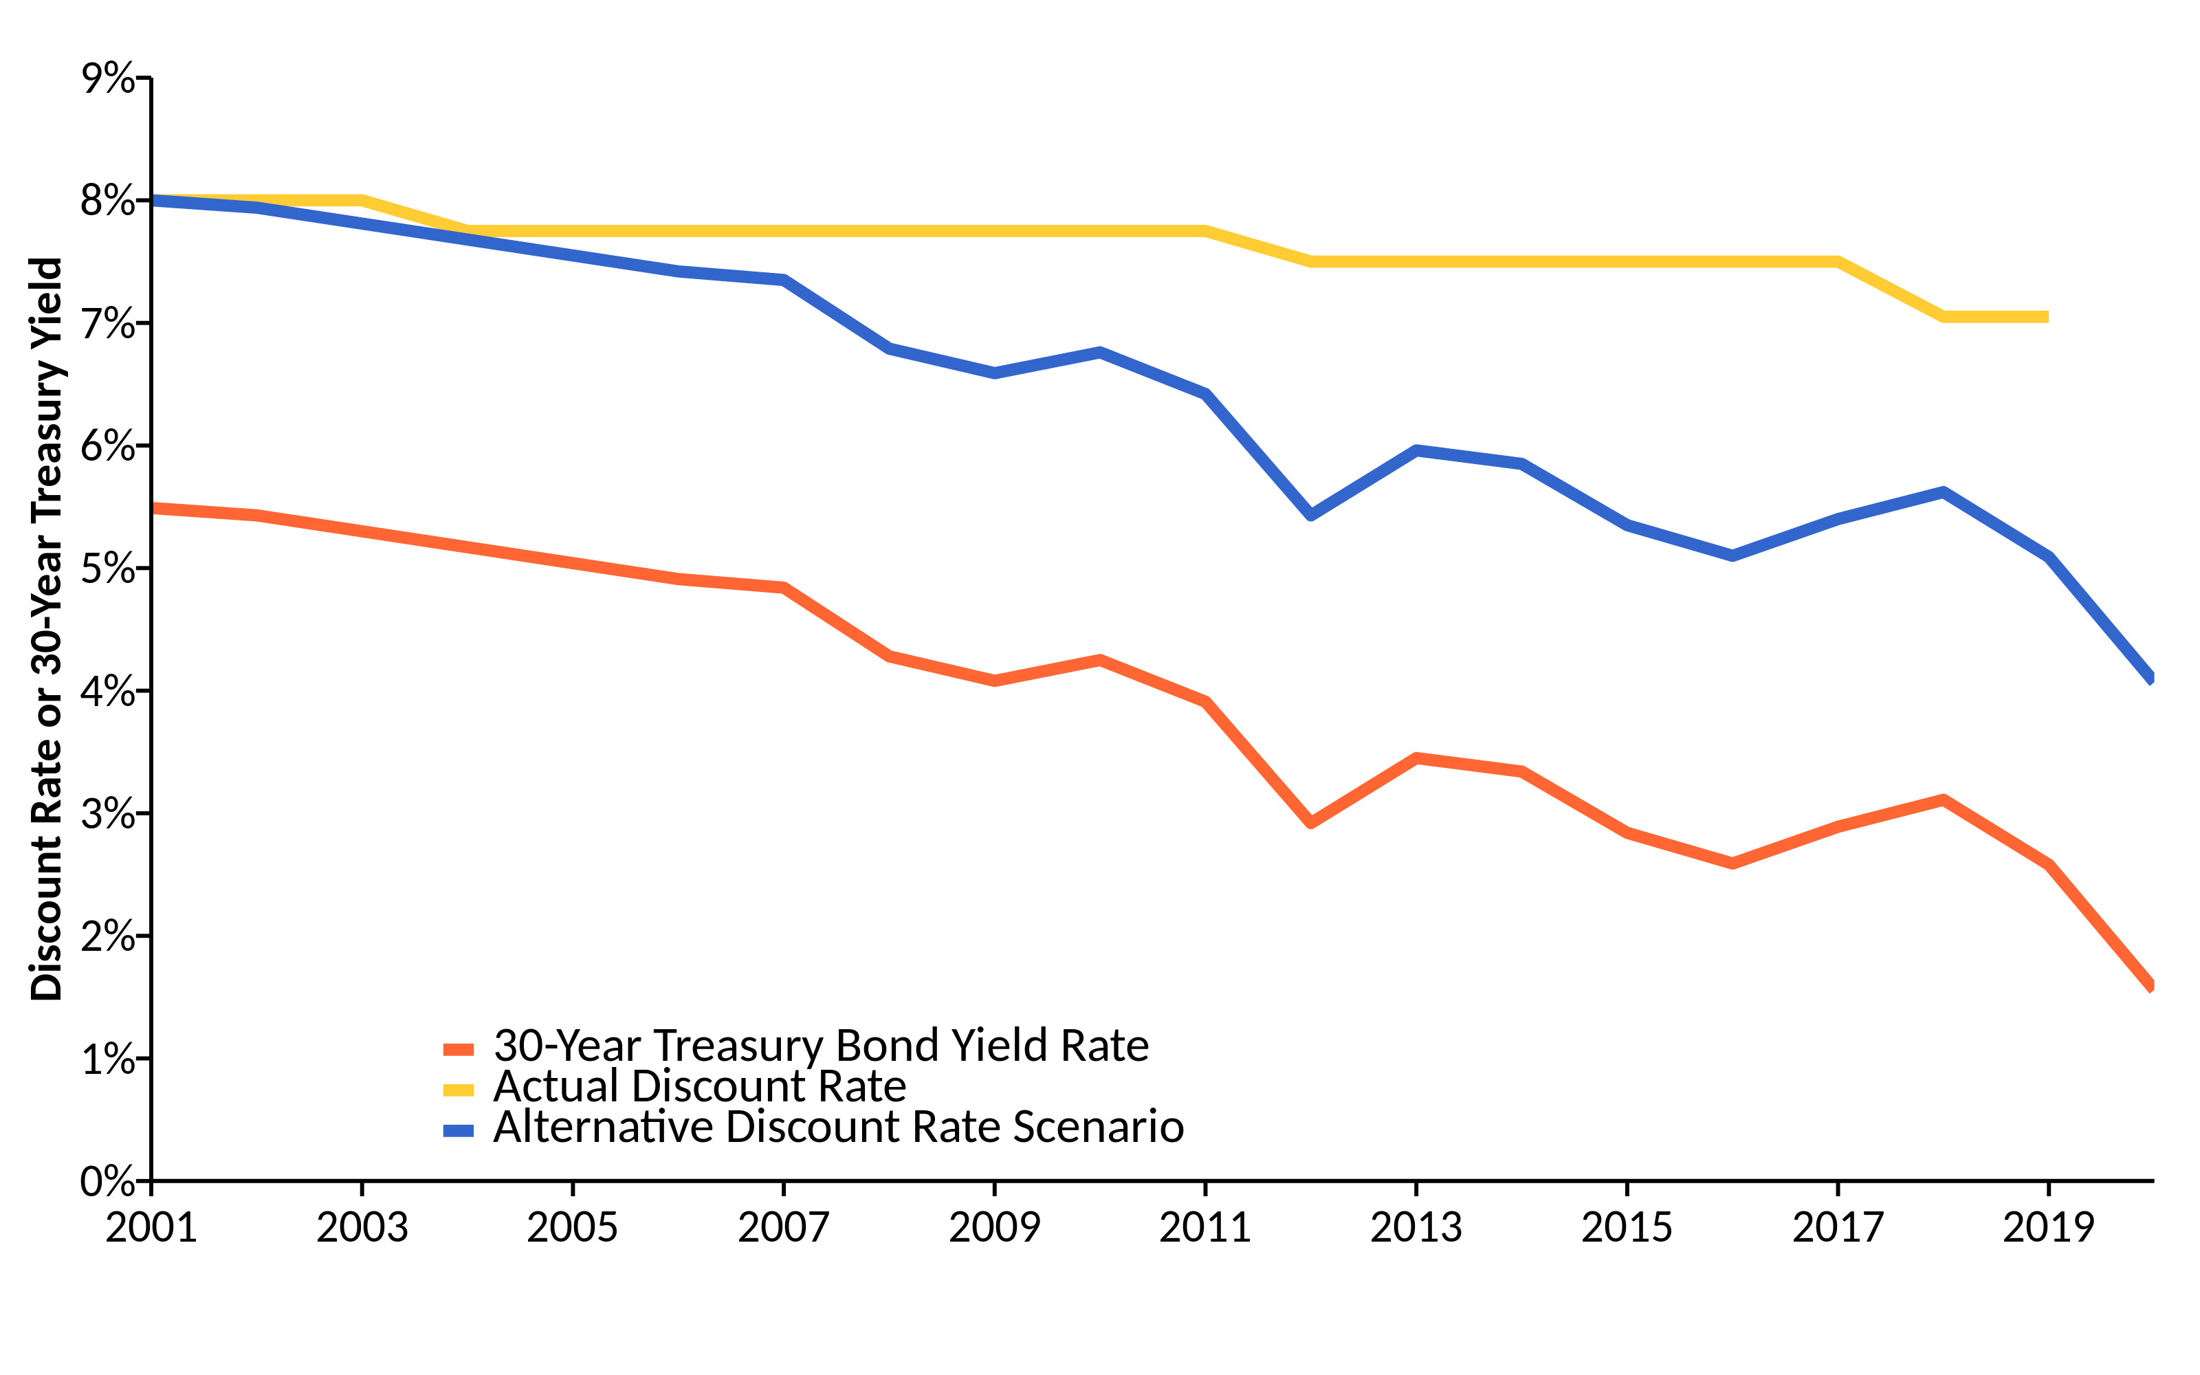
Change in Risk-Free Rate vs. Discount Rate (2001-2019) w/ R (linePlot())

Slide 10
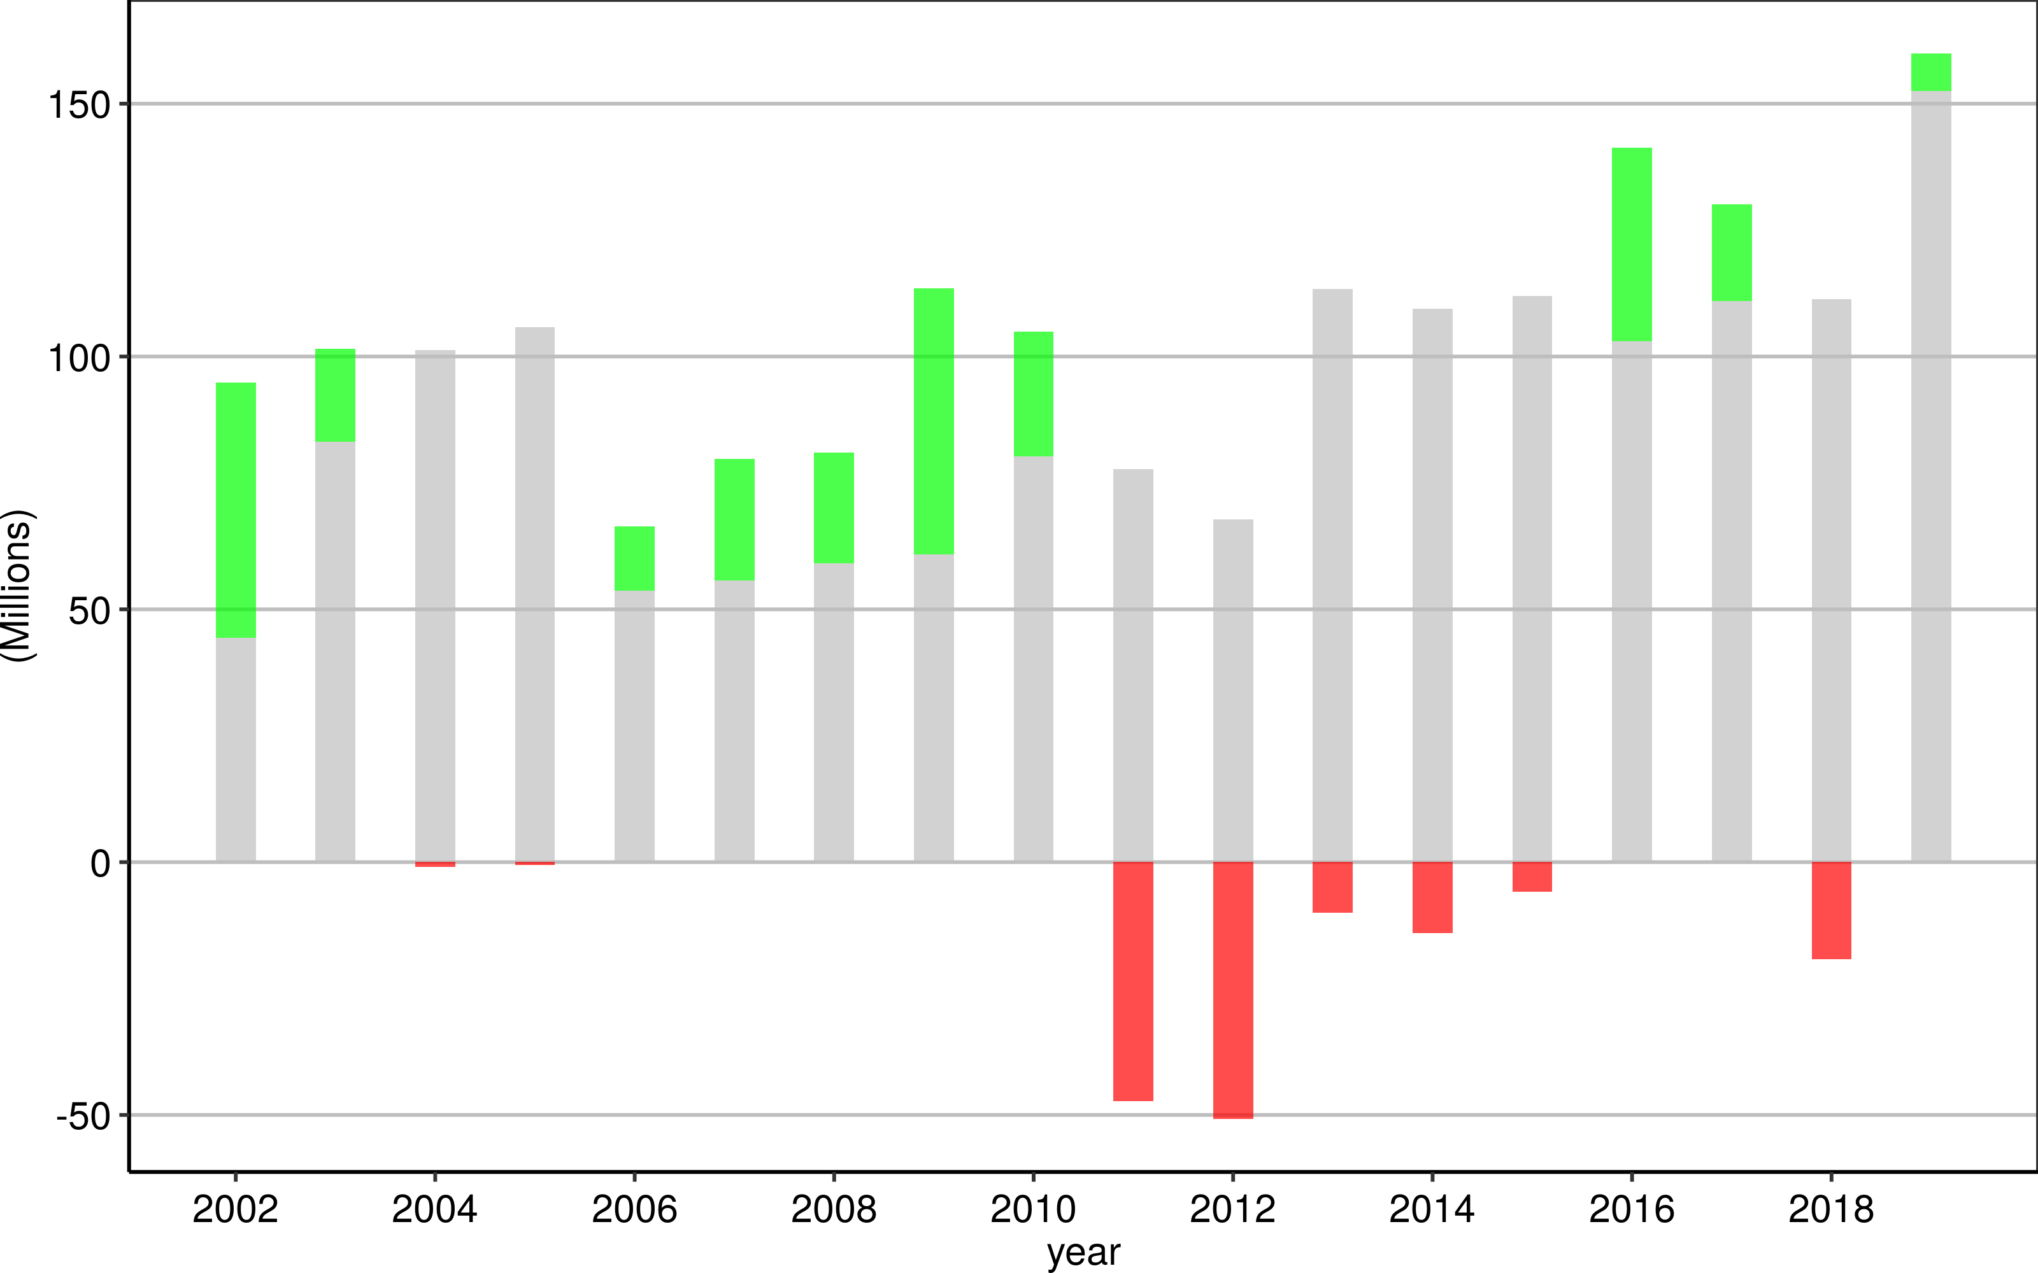
Negative Amortization Growth w/ R (custom)

Slide 11
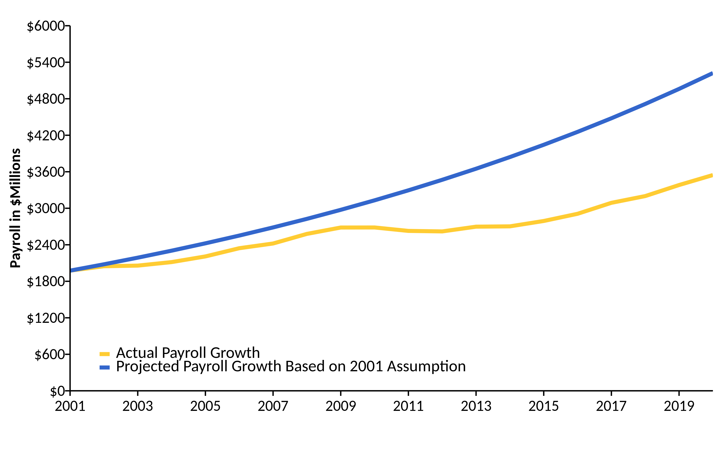
Actual Change in Payroll vs. Assumption (2001-2020) w/ R (linePlot())

Slide 12
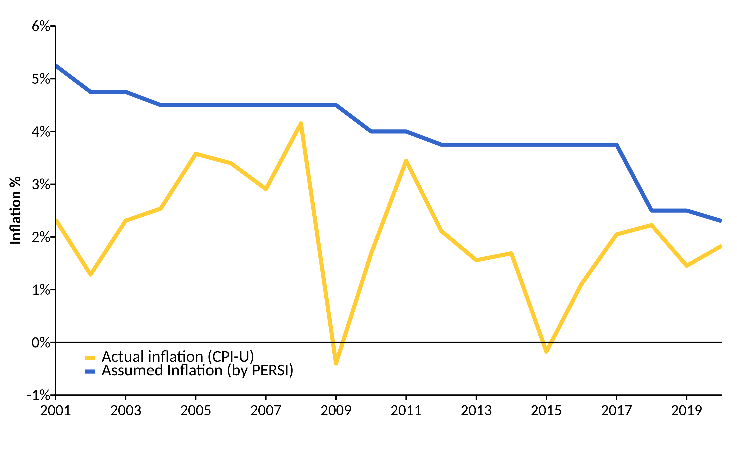
Actual Inflation vs. Assumption (2001-2020) w/ R (linePlot())

Slide 13
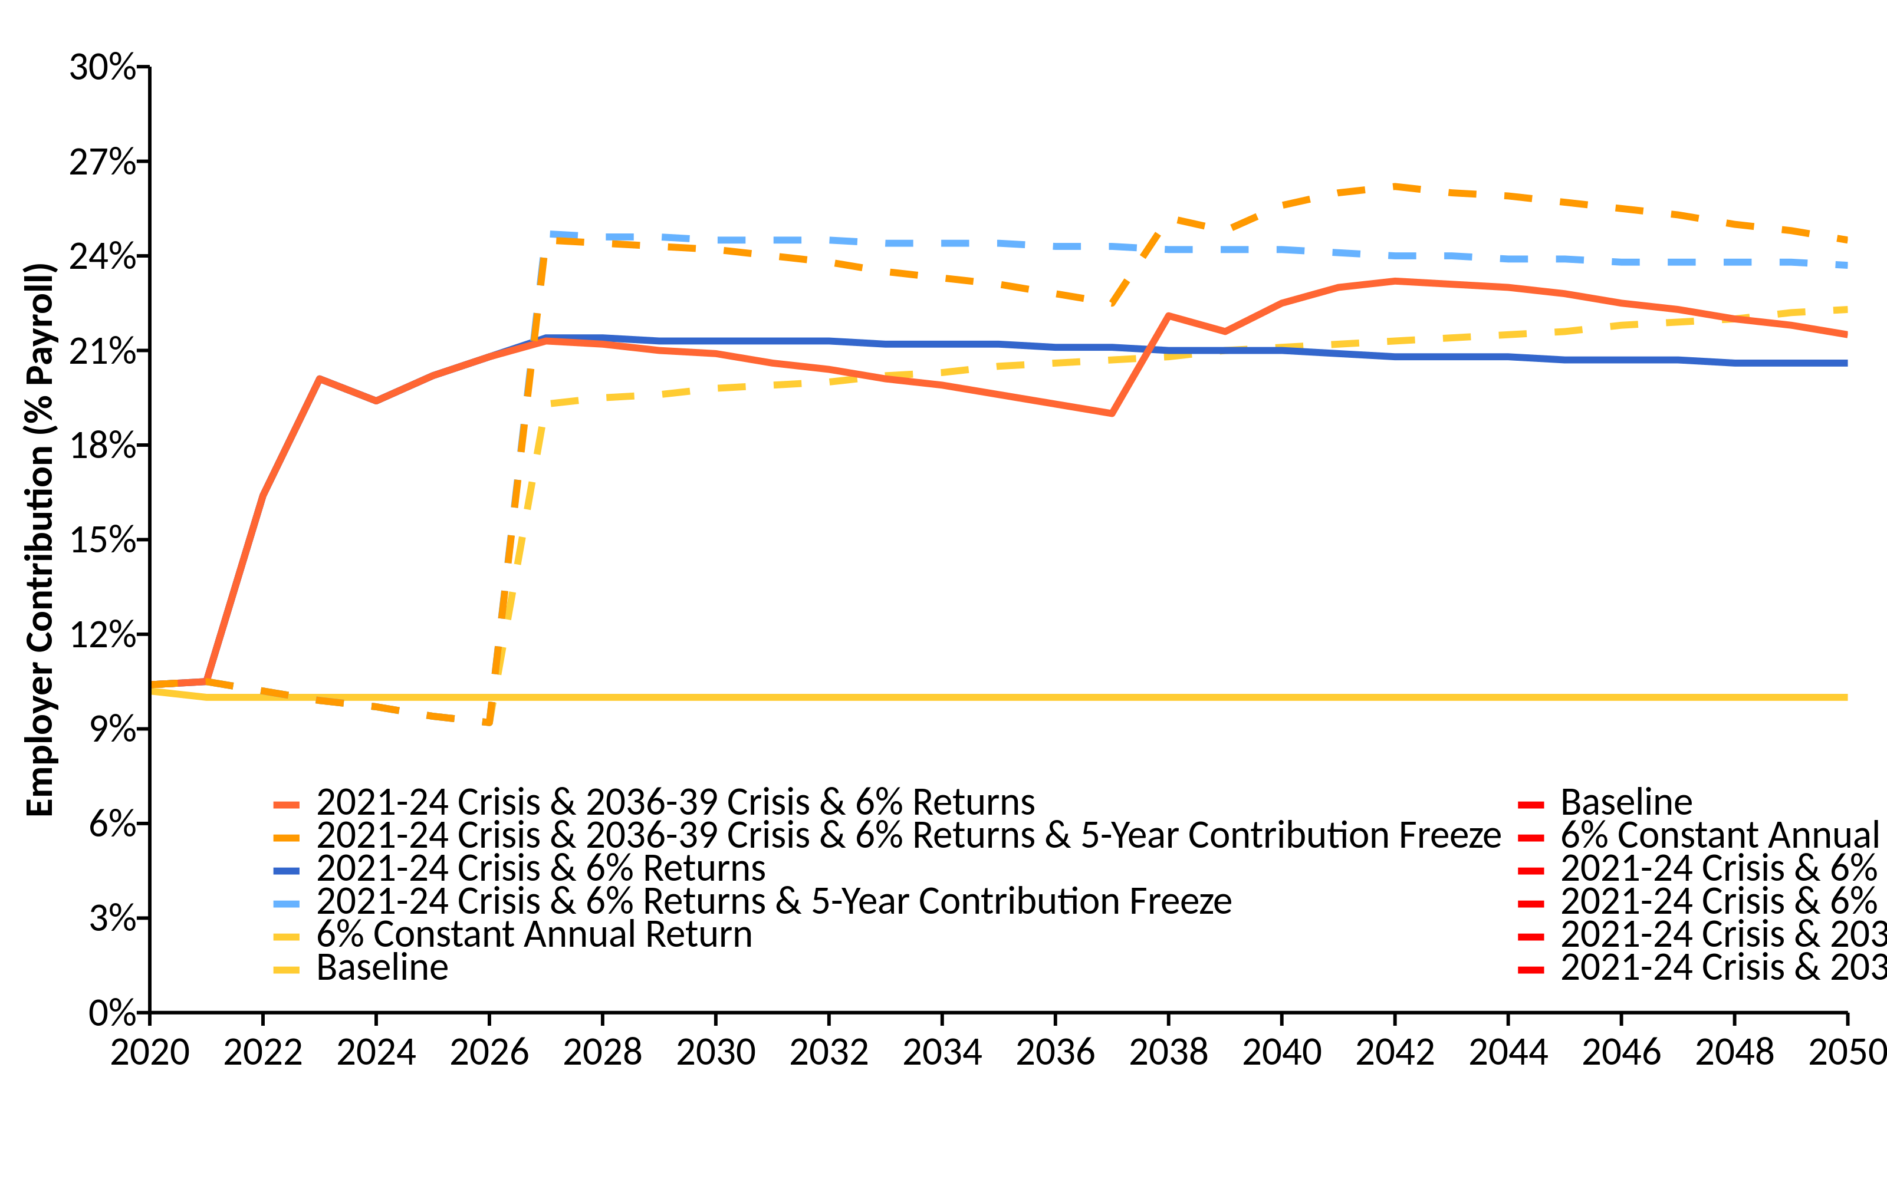
Current Contributions Are Actuarially Insufficient (2001-2019) w/ R (linePlot())

Slide 14
References
https://github.com/ReasonFoundation/GraphicsR
https://rstudio.com/wp-content/uploads/2015/03/rmarkdown-reference.pdf
https://bookdown.org/yihui/rmarkdown/

