Slide 1
SamplePPT (PERSI graphs)
Anil, Swaroop, Jen & Jordan

Slide 2
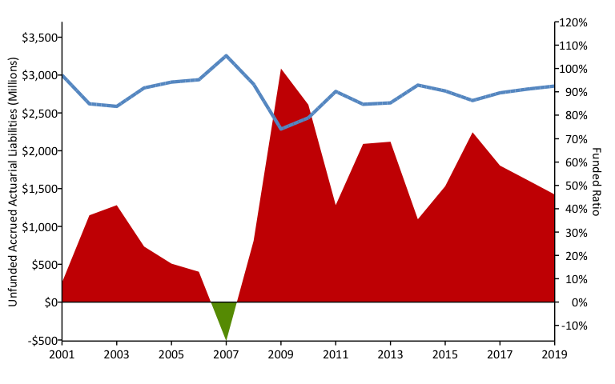
A History of Weakening Solvency (2001-2019) w/ R (areaPlot())

Slide 3
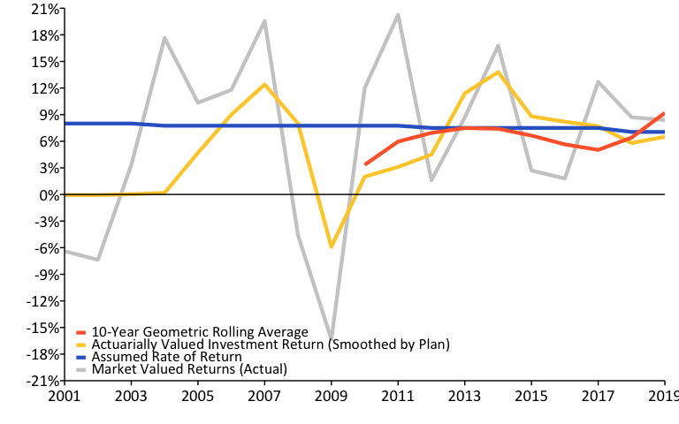
A History of Investment Returns (2001-2019) w/ R (linePlot())

Slide 4
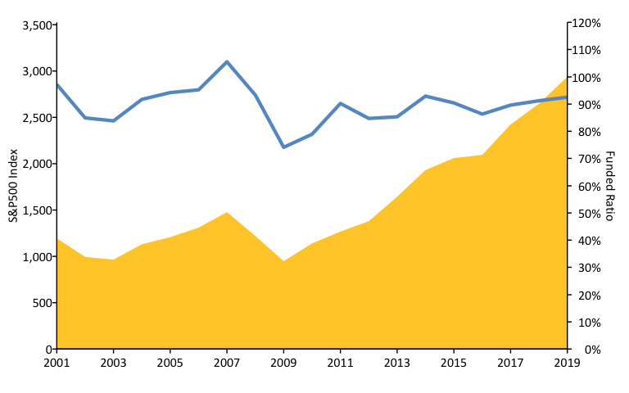
S&P500 vs. Funded Ratio (2001-2019) w/ R (areaPlot())

Slide 5
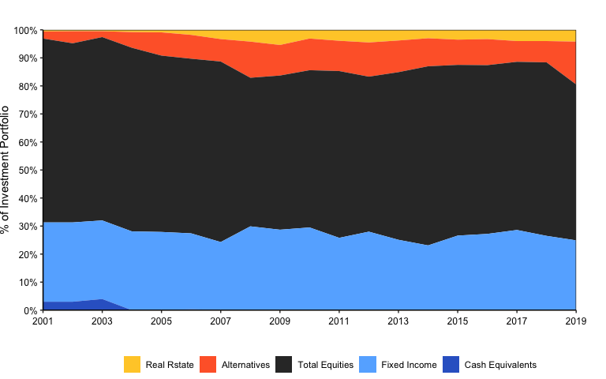
Asset Allocation w/ R (custom)

Slide 6
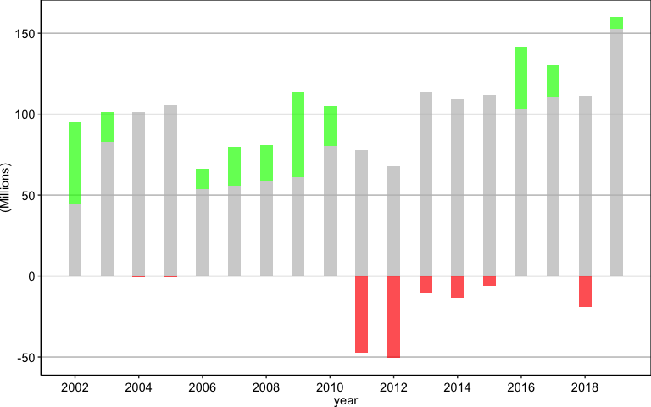
Negative Amortization Growth w/ R (custom)

Slide 7
References
https://github.com/ReasonFoundation/GraphicsR
https://rstudio.com/wp-content/uploads/2015/03/rmarkdown-reference.pdf
https://bookdown.org/yihui/rmarkdown/

