Slide 1
South Carolina Retirement System Solvency Analysis
Prepared by: Pension Integrity Project at Reason Foundation. 2022—Preliminary Draft

Slide 2
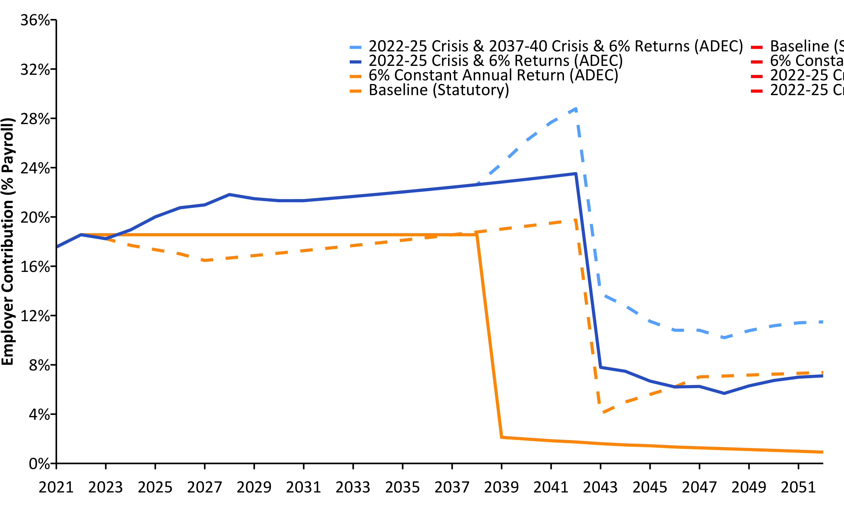
Current Contributions Are Actuarially Insufficient (2021-2052) w/ R (linePlot())
Source: Pension Integrity Project actuarial forecast of SCRS.

Slide 3
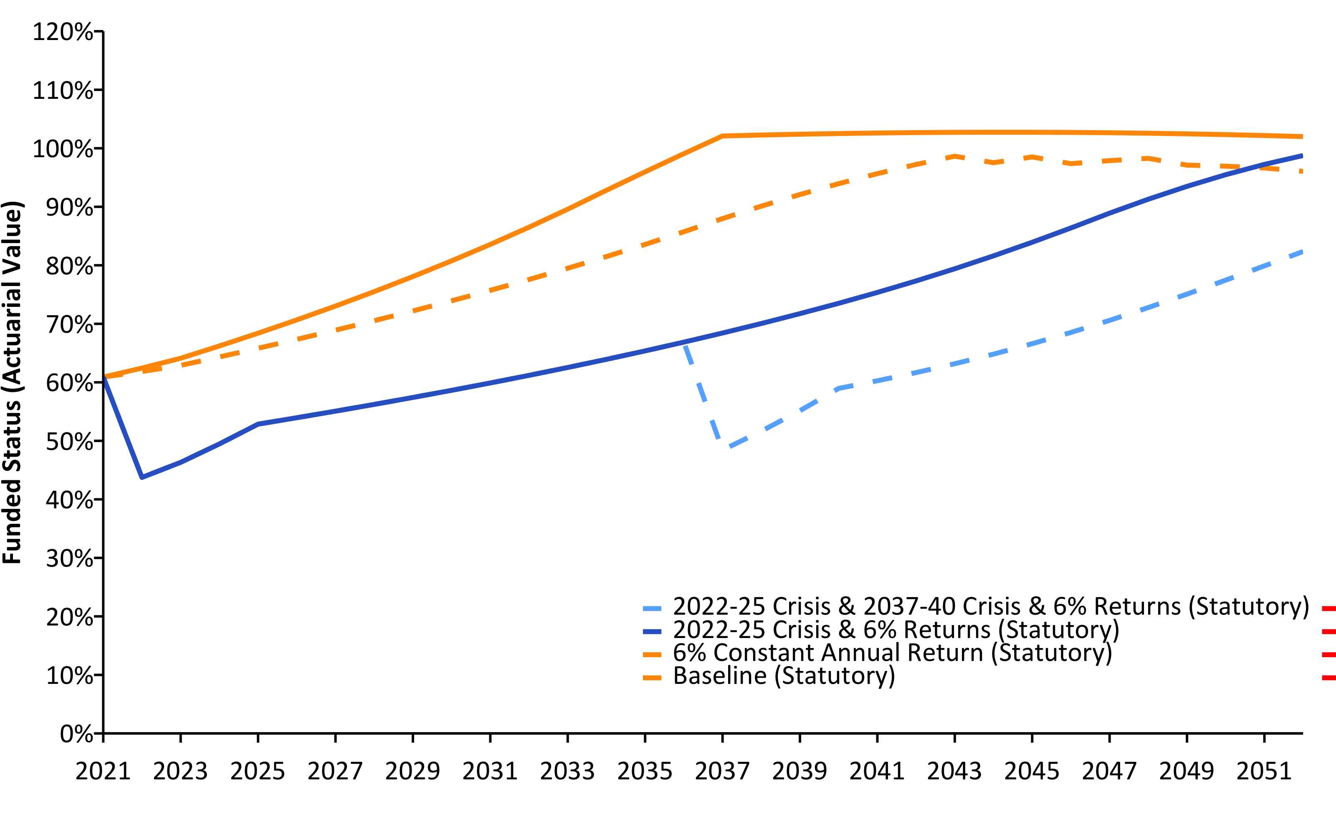
SCRS Solvency Degrades Under Crisis Scenarios (2021-2052) w/ R (linePlot())
Source: Pension Integrity Project actuarial forecast of SCRS.

Slide 4
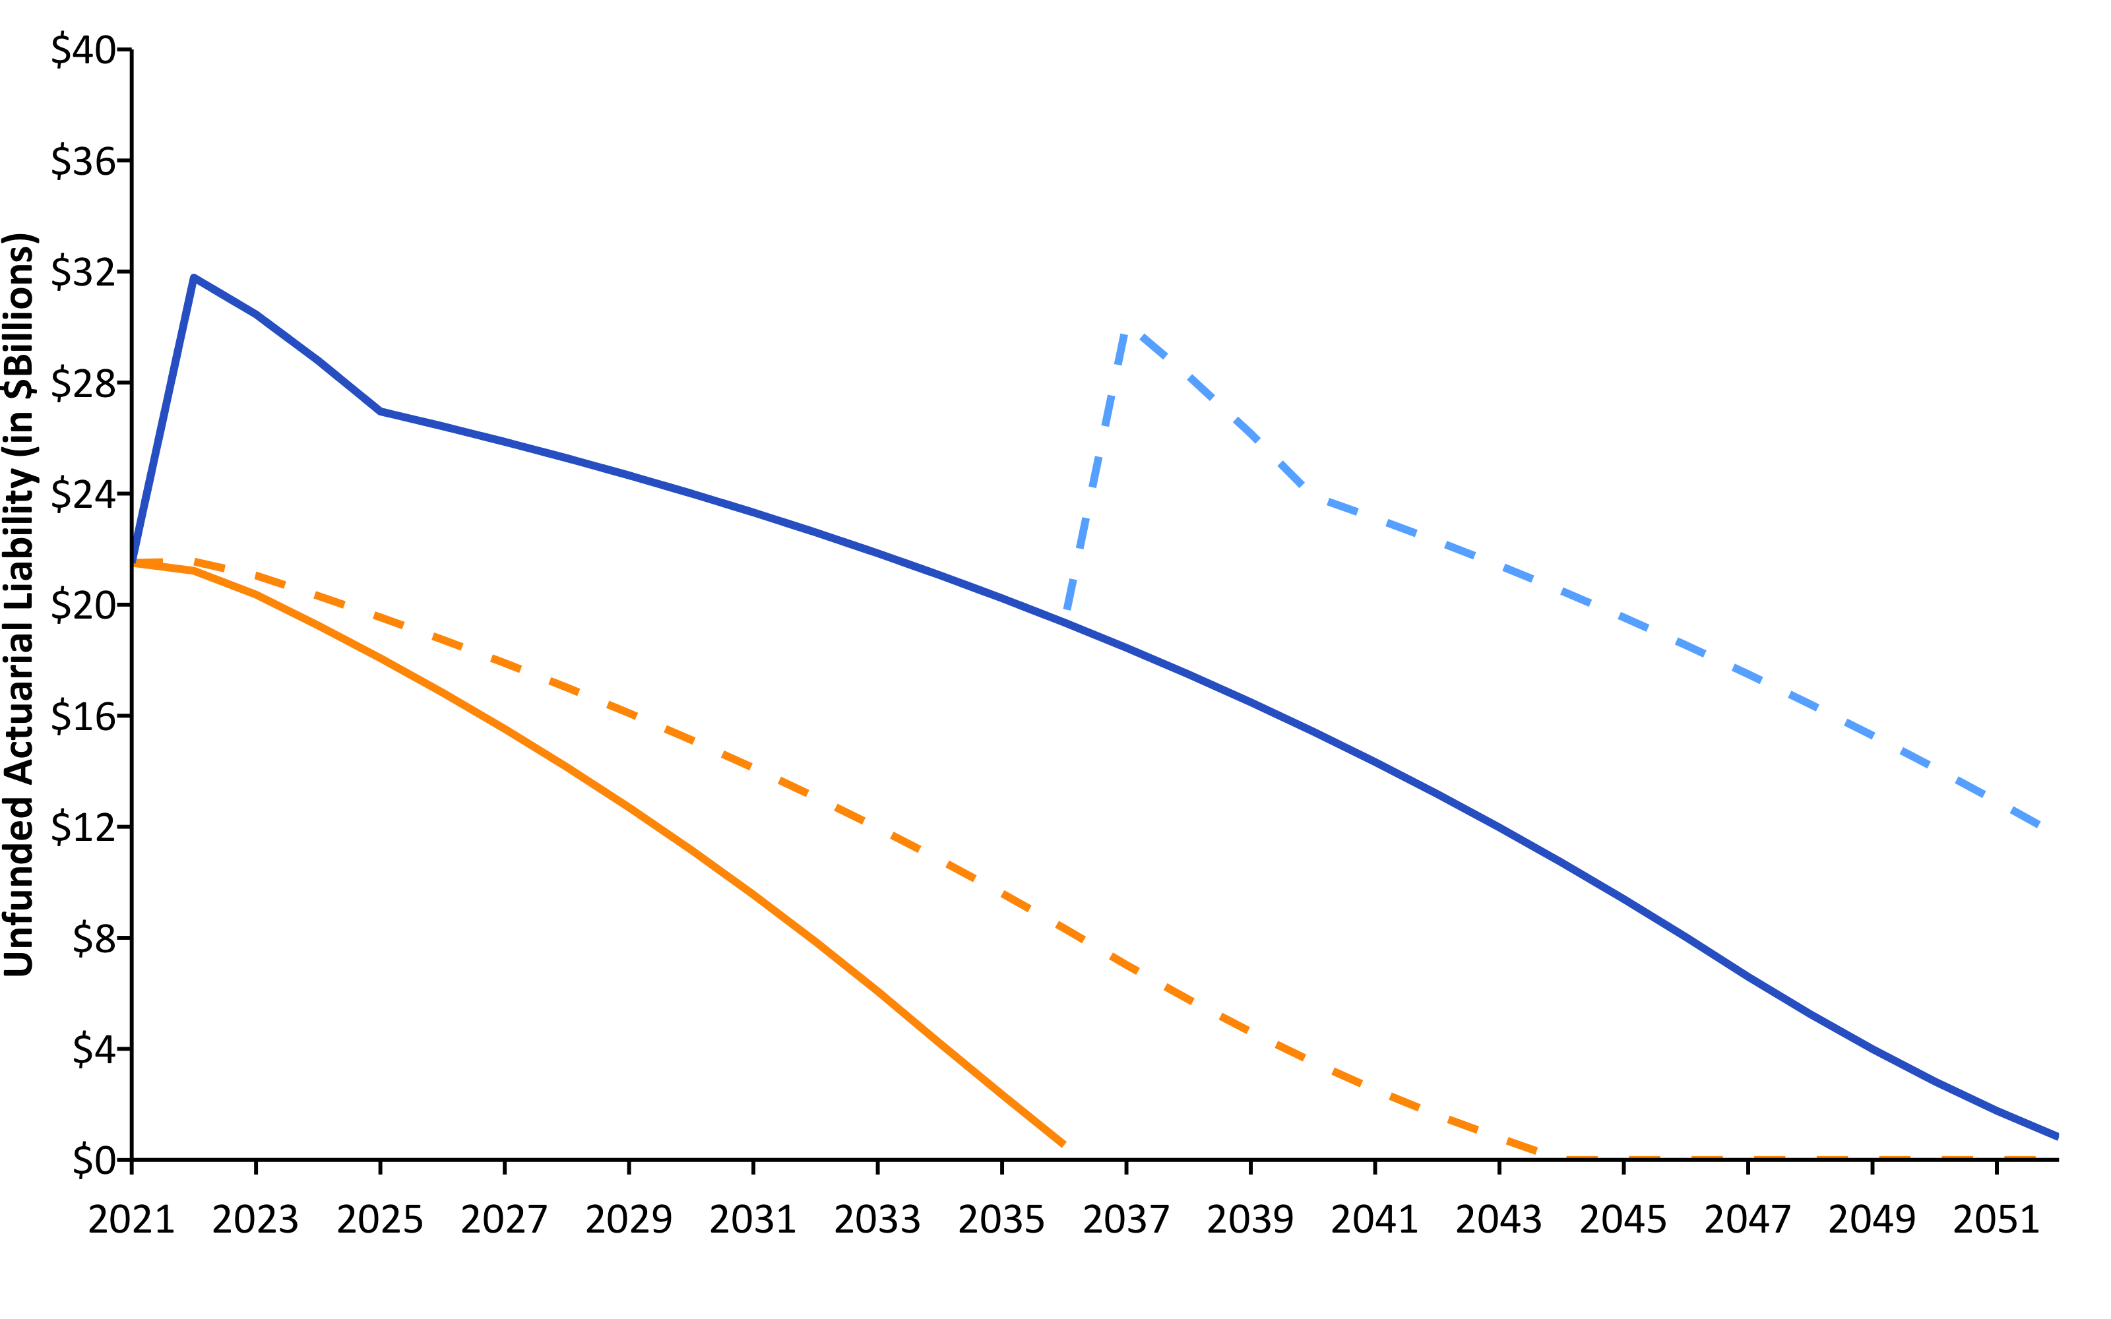
Pension Debt Will Likely Grow (2021-2052) w/ R (linePlot())
Source: Pension Integrity Project actuarial forecast of SCRS.

Slide 5
SCRS Unfunded Liability Sensitivity to DR Changes 2021 w/ R (flextable())
Discount Rate | Funded Ratio (MVA) | Unfunded Liability (MVA) | Actuarial Accrued Liability
7.0% | 60.9% | $21.50 | $55.00
6.0% | 54.3% | $28.20 | $61.70
5.0% | 48.0% | $36.30 | $69.80
4.0% | 42.1% | $46.10 | $79.50

Slide 6
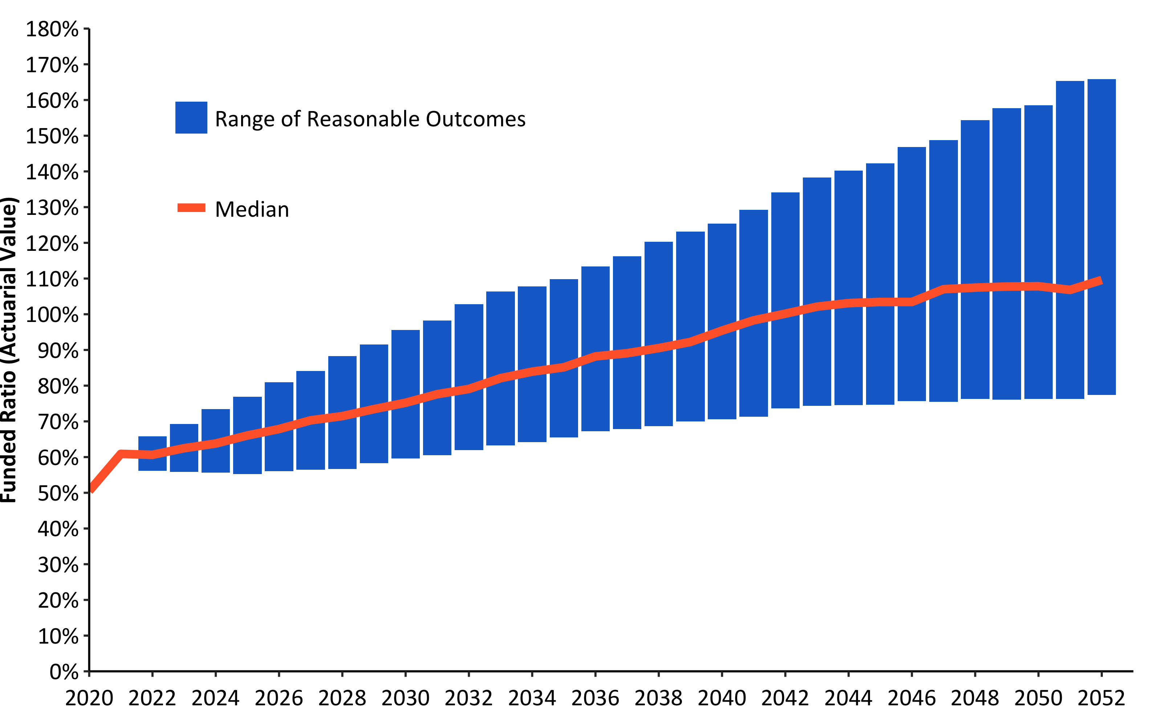
30-Year Funded Ratio Forecast - Statutory (Assumed) w/ R (barPlot())
Source: Pension Integrity Project actuarial forecast of SCRS.

