Slide 1
South Carolina Retirement System Solvency Analysis
Prepared by: Pension Integrity Project at Reason Foundation. 2022—Preliminary Draft

Slide 2
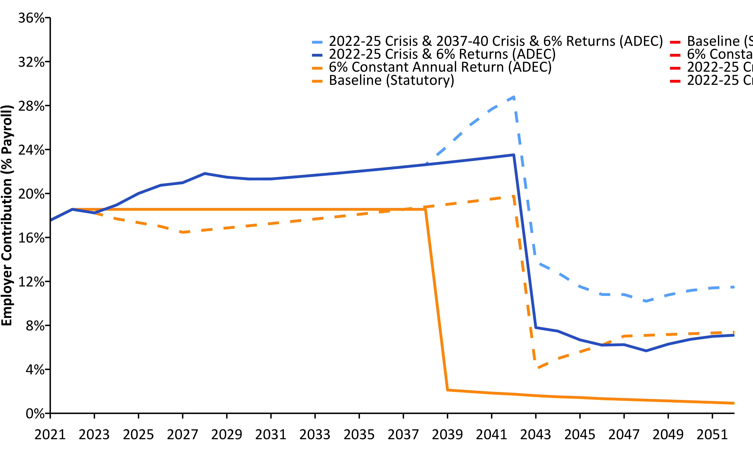
Current Contributions Are Actuarially Insufficient (2021-2052) w/ R (linePlot())
Source: Pension Integrity Project actuarial forecast of SCRS.

Slide 3
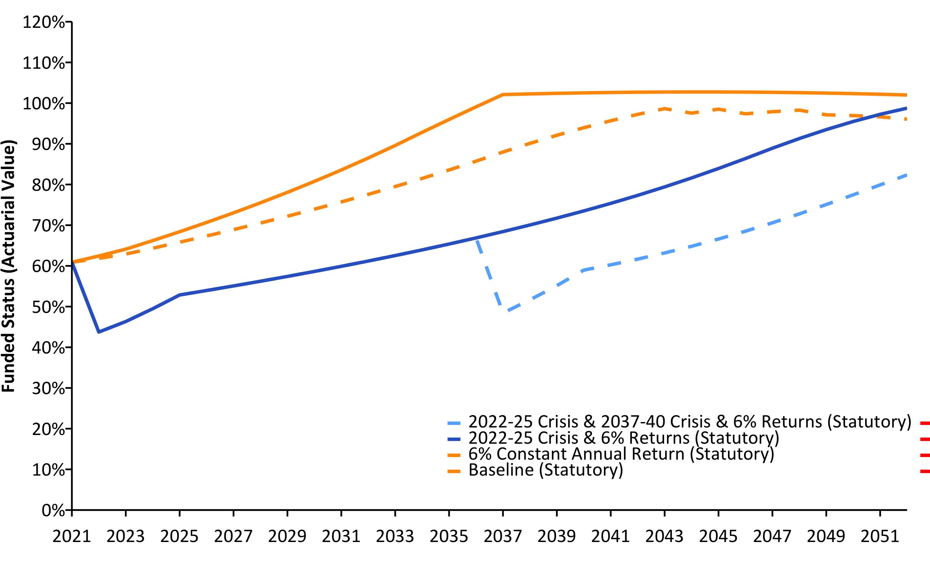
SCRS Solvency Degrades Under Crisis Scenarios (2021-2052) w/ R (linePlot())
Source: Pension Integrity Project actuarial forecast of SCRS.

Slide 4
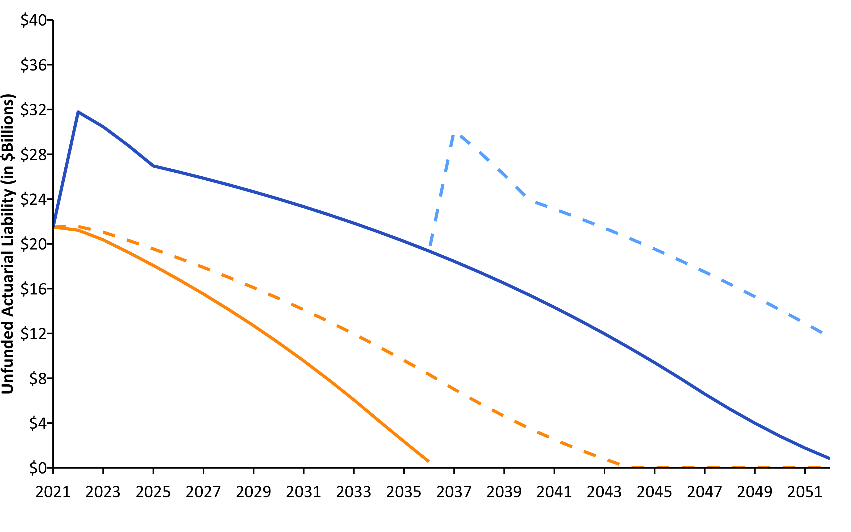
Pension Debt Will Likely Grow (2021-2052) w/ R (linePlot())
Source: Pension Integrity Project actuarial forecast of SCRS.

Slide 5
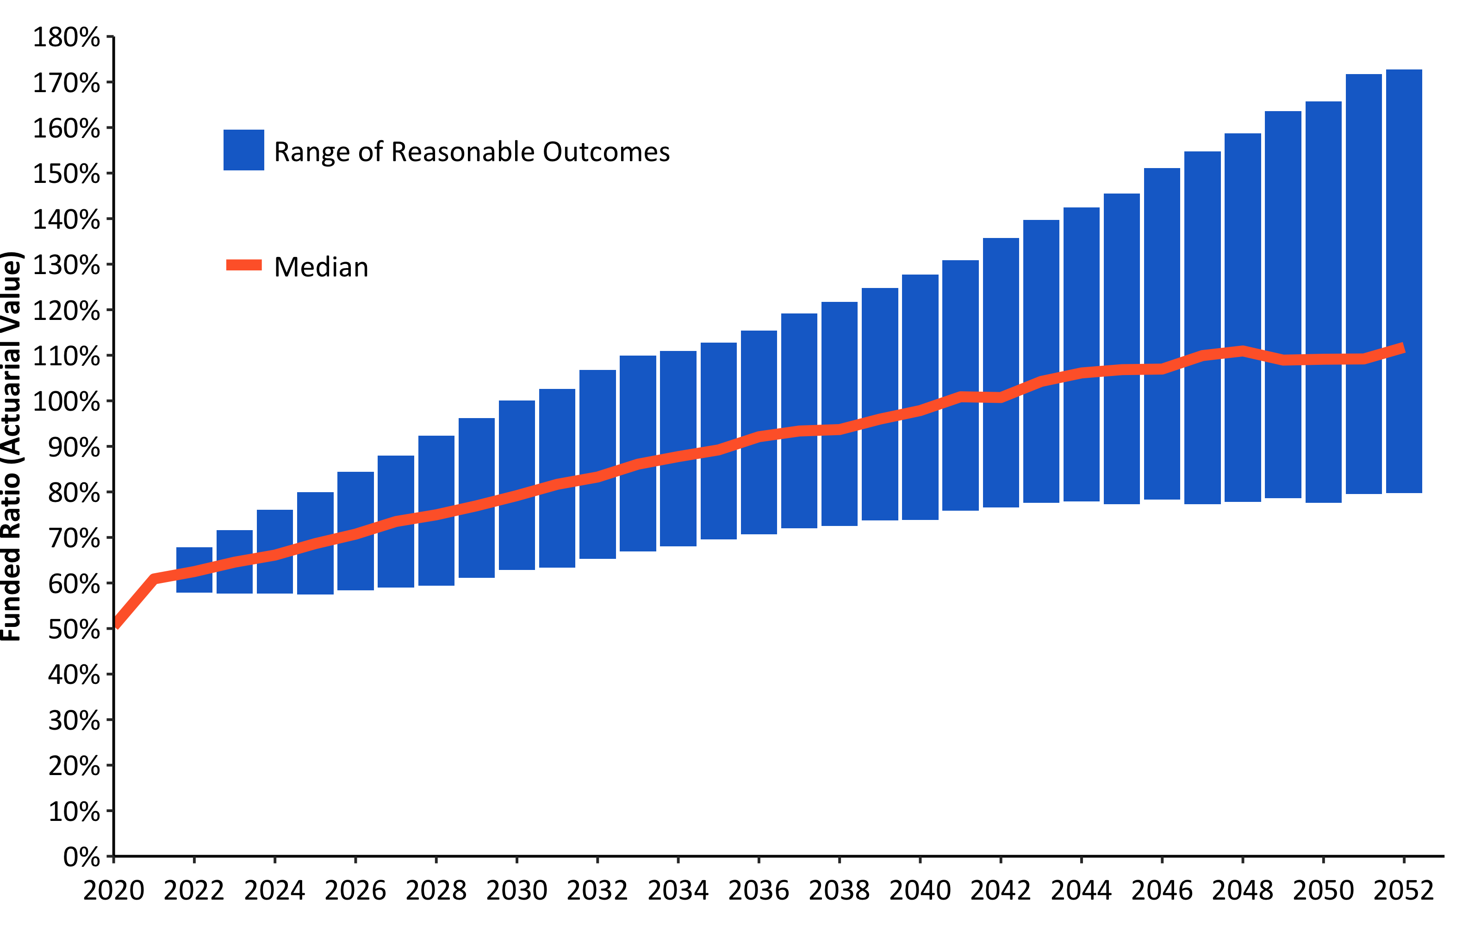
30-Year Funded Ratio Forecast - Statutory (Assumed) w/ R (barPlot())
Source: Pension Integrity Project actuarial forecast of SCRS.

Slide 6
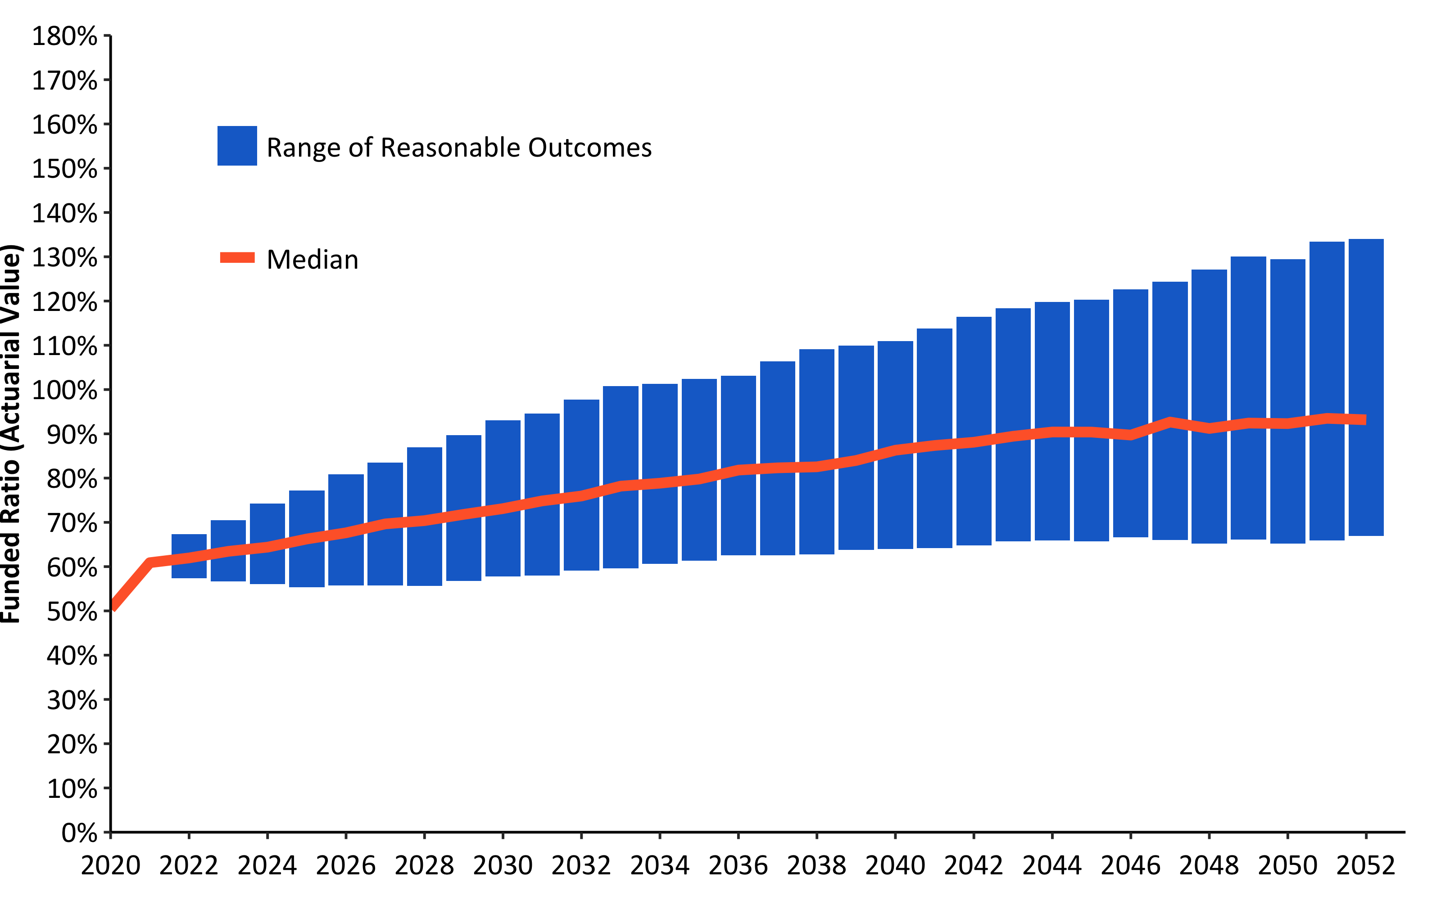
30-Year Funded Ratio Forecast - Statutory (Conservative) w/ R (barPlot())
Source: Pension Integrity Project actuarial forecast of SCRS.

Slide 7
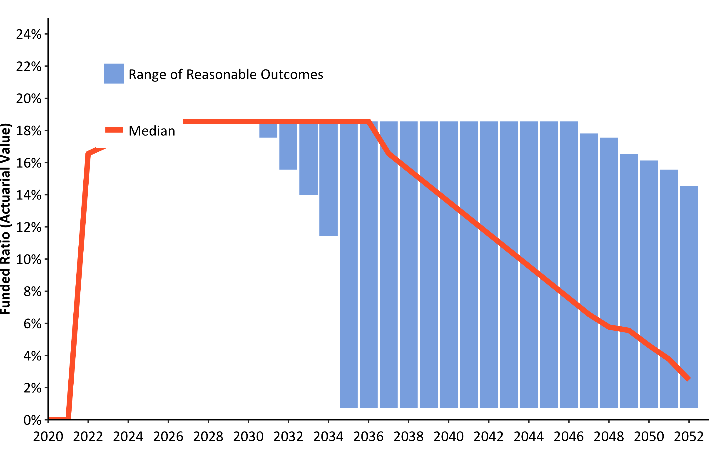
30-Year Employer Contribution Forecast - Statutory (Assumed) w/ R (barPlot())
Source: Pension Integrity Project actuarial forecast of SCRS.

