Slide 1

SVD and Clustering for Unsupervised POS Tagging
This presentation delves into the fascinating world of word embeddings and clustering, exploring how these techniques are used to analyze and understand language data. We'll examine the process of building context matrices, performing singular value decomposition (SVD), and applying clustering algorithms to uncover hidden relationships within text.
by Arnav Aditya,, Aditya Raghuram and Sanskar Sugandhi

Slide 2
Function build_context_matrices
Input Parameters
Context Matrices
Matrix Population
The function takes three inputs: tokens, vocab_size, and word_to_id. Tokens is a list of word IDs representing a corpus of text. vocab_size is the total number of unique words in the vocabulary. word_to_id is a dictionary mapping words to their corresponding IDs.
The function initializes two context matrices: left (L) and right (R). These matrices represent the relationships between a word and its surrounding words. The size of each matrix is (vocab_size, w1), where w1 is a parameter determining the number of most frequent words to consider.
The function iterates through each token in the corpus. For each token, it checks if the previous or next word is among the top w1 most frequent words. If so, it increments the corresponding entry in the left or right matrix, respectively.

Slide 3
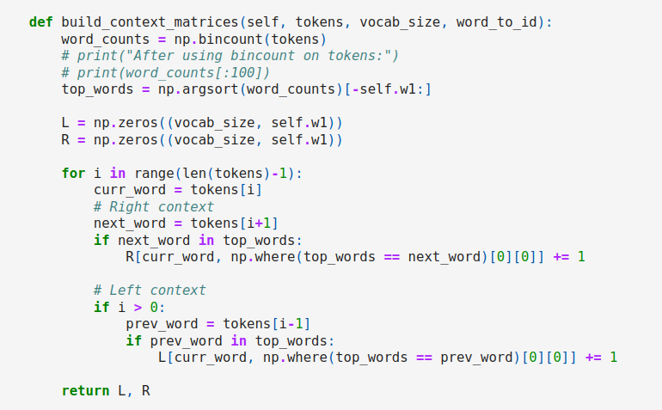

Slide 4




Function fit
Context Matrix Computation
SVD Reduction
K-Means Clustering
Refinement
SVD is applied to both the left and right context matrices to reduce their dimensionality and extract the most important features.
The reduced-rank descriptors from the left and right matrices are horizontally stacked and then clustered using the k-means algorithm.
The cluster assignments are used to refine the clustering process. The function repeats the SVD and clustering steps, but this time using the cluster descriptors instead of individual word indices.
The function first computes the left and right context matrices using the build_context_matrices function.

Slide 5
Function prepare_treebank_data
1
Lowercase Conversion
2
Word Frequency Calculation
All words in the input sentences are converted to lowercase.
The frequency of each word in the corpus is calculated and stored in a dictionary.
3
Word-to-ID Mapping
4
Tokenization
A dictionary is created to map words to unique IDs. Only words with a frequency greater than 1 are included in the mapping. An token is added to represent words that were not included.
The function iterates through the words in the corpus and appends the corresponding ID to the tokens array. If a word is not found in the word_to_id mapping, the ID of the token is appended.

Slide 6
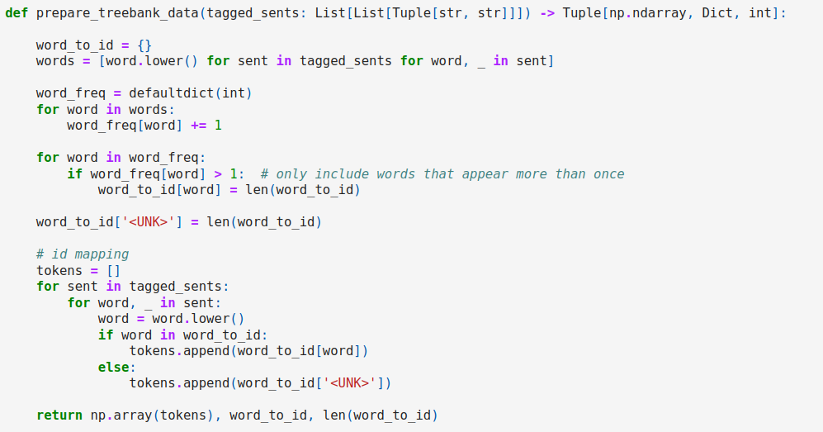

Slide 7
Return Values
tokens
word_to_id
A list of word IDs representing the entire corpus. Each word in the corpus is assigned a unique ID based on the word_to_id mapping.
A dictionary mapping words to their corresponding IDs. Only words with a frequency greater than 1 are included in the mapping.
vocab_size
The total number of unique word IDs in the vocabulary. This value is equal to the length of the word_to_id dictionary.

Slide 8
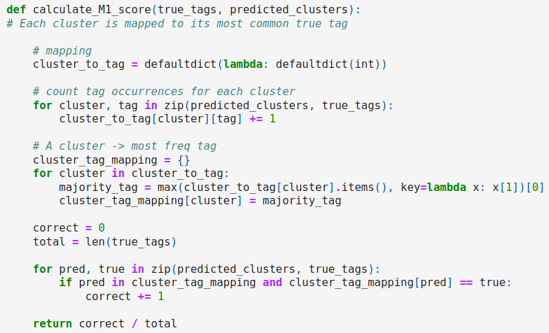
M-1 Mapping Method
true_tags
A list of the true labels for each token.
predicted_clusters
A list of the predicted clusters for each token.
cluster_to_tag
A dictionary that stores the count of each true tag within each predicted cluster.
cluster_tag_mapping
A dictionary that maps each cluster to its most frequent tag.
correct
A counter that keeps track of the number of correct assignments.
accuracy
The ratio of correct assignments to the total number of tokens.

Slide 9
1-1 Mapping Method
Initialization
Hungarian Algorithm
Cluster-to-Tag Mapping
The function initializes a confusion matrix with dimensions corresponding to the number of unique predicted clusters and true tags. The matrix is used to count the occurrences of each cluster-tag pair.
The Hungarian algorithm is applied to the negated confusion matrix to find the optimal assignment between clusters and tags. This algorithm minimizes the total cost of the assignment.
A dictionary is created to map each cluster to its assigned tag based on the optimal assignment found by the Hungarian algorithm.

Slide 10
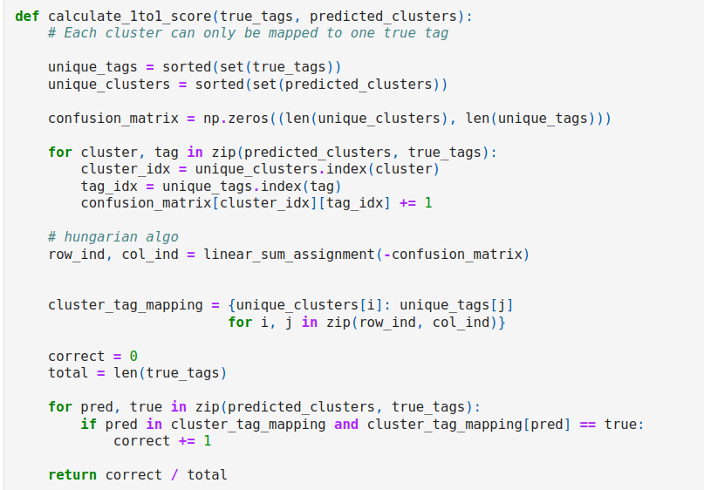

Slide 11
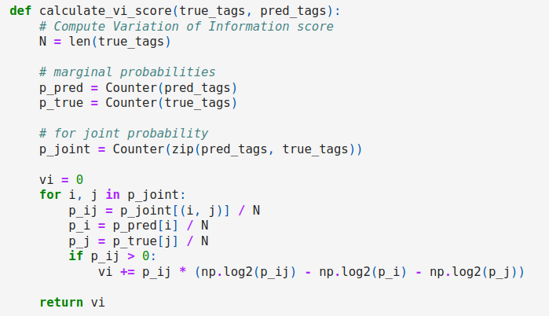




VI Score Calculation
Marginal Probabilities
Joint Probabilities
Mutual Information
Entropy
The probabilities of predicted and true labels occurring together.
Represents the amount of shared information between the predicted and true labels.
Measures the uncertainty associated with a random variable.
The probabilities of individual predicted and true labels occurring.

Slide 12
Variation of Information (VI)
The VI score quantifies the difference between the predicted labels and the true labels. A higher VI value indicates greater dissimilarity. In this example, a VI score of 1.0 suggests a moderate level of difference between the clusterings.

