Slide 1
Java Secure Native Interface
DSP-LAB 2016-17
By: Clindo Devassy and Subhadeep Manna
Guidance By: Marcel Blöcher and Malte Viering

Slide 2

Security and Computers

Slide 3


Slide 4

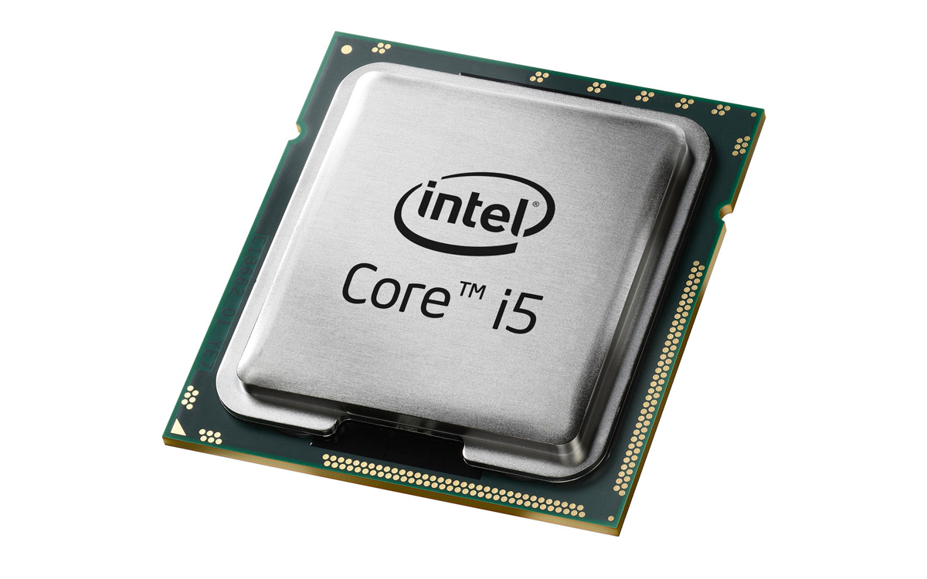
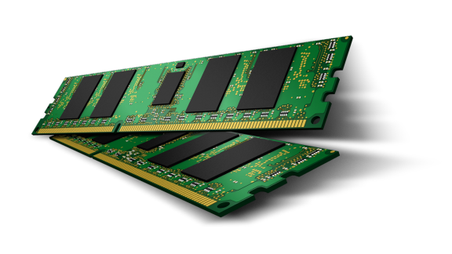
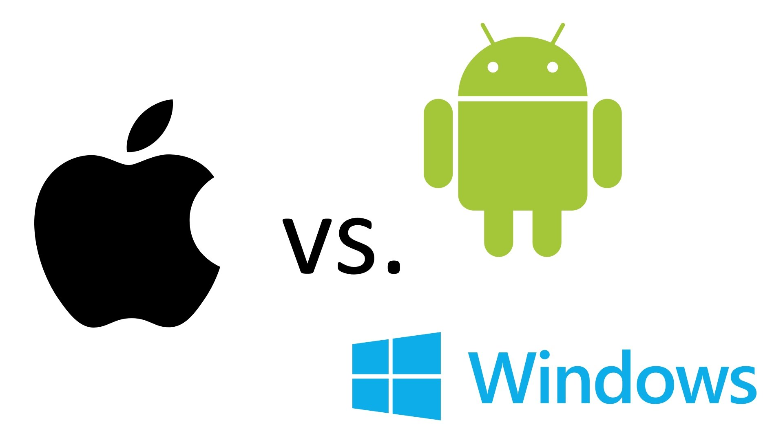


Security: Broad Classification
Web security
Web site attack and defences project
Browser policies, session mgmt, user authentication
HTTPS and web application security
Memory and OS security
Buffer overflow project
Vulnerabilities: control hijacking attacks, fuzzing
Prevention: System design, robust coding, isolation
Network security
Network traceroute and packet filtering project
Protocol designs, vulnerabilities, prevention
Malware, botnets, DDoS, network security testing
Notes:
Application and OS security
Buffer overflow project
Vulnerabilities: control hijacking attacks, fuzzing
Prevention: System design, robust coding, isolation
Web security
Web site attack and defences project
Browser policies, session mgmt, user authentication
HTTPS and web application security
Network security
Network traceroute and packet filtering project
Protocol designs, vulnerabilities, prevention
Malware, botnets, DDoS, network security testing

Slide 5
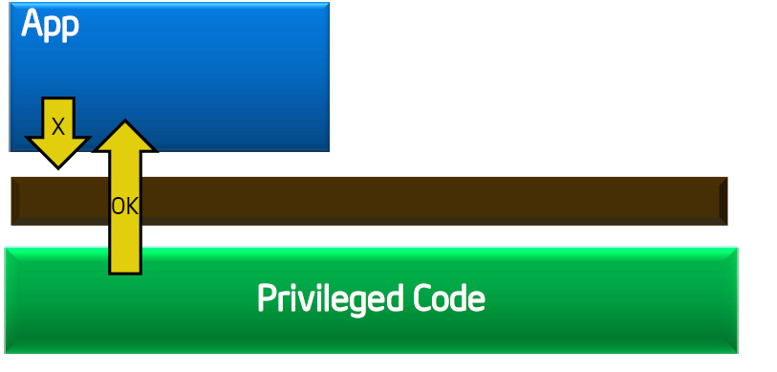
OS, Application Security and Memory and Permissions
Protected Mode protects OS from apps
Notes:
Privileges temporarily grant permission to code that would normally not have permission to run.
Normally, the entire execution stack (all callers) needs to have permission to do a sensitive operation.
With Privileged Code, you can specify in a fine-grained way that only the final class in the execution stack needs permission.

Slide 6
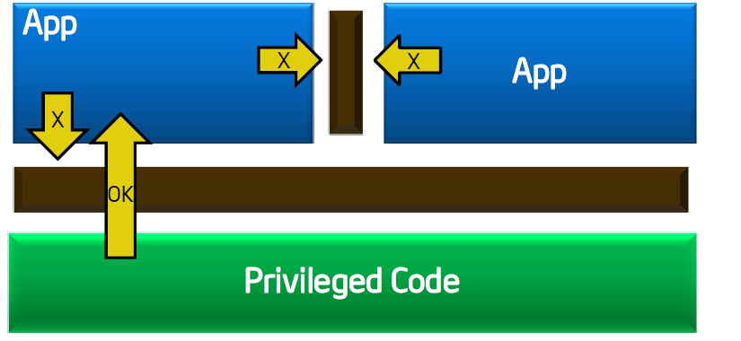
OS, Application Security and Memory and Permissions
Protected Mode protects apps from other apps

Slide 7
Example Privileged Code
Main.java:
public class Main
{
public static void main(String []args) {
LowLevel.executeLowLevelAction();
}
}
LowLevel.java:
public class LowLevel
{
public static void executeLowLevelAction() {
System.out.println(System.getProperty("test"));
}
}
Notes:
As you expected, the first run can just get the property test without needing any permissions (as no security manager is installed by default).
In the second run, we ask the VM to set up a default SecurityManager which results in an AccessControlException because reading System Property “test” is not allowed.
To grant permission to read this property, we need to write a policy security configuration file. But we really only want the class LowLevel to have permission to read the property. We do not want to grant the calling class Main that permission.

Slide 8
Example Privileged Code
C:> java -Dtest="Hello, World!" Main
Hello, World!
C:> java -Dtest="Hello, World!" -Djava.security.manager Main
Exception in thread "main" java.security.AccessControlException: access denied
java.util.PropertyPermission test read)
at java.security.AccessControlContext.checkPermission(AccessControlCont
xt.java:195)
at java.security.AccessController.checkPermission(AccessController.java
403)
at java.lang.SecurityManager.checkPermission(SecurityManager.java:549)
at java.lang.SecurityManager.checkPropertyAccess(SecurityManager.java:1
43)
at java.lang.System.getProperty(System.java:539)
at LowLevel.executeLowLevelAction(LowLevel.java:6)
at Main.main(Main.java:4)
Notes:
As you expected, the first run can just get the property test without needing any permissions (as no security manager is installed by default).
In the second run, we ask the VM to set up a default SecurityManager which results in an AccessControlException because reading System Property “test” is not allowed.
To grant permission to read this property, we need to write a policy security configuration file. But we really only want the class LowLevel to have permission to read the property. We do not want to grant the calling class Main that permission.

Slide 9
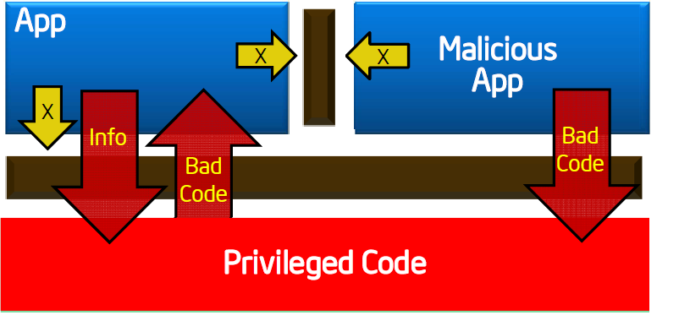
Well, we still cannot trust the Security
A malicious app exploits a flaw to gain full privileges and then tampers with the OS or other apps and memory.

Slide 10

Example: Hacking Asphalt 8 using CheatEngine v6.3
Notes:
Now Imagine if you could do the same to your Banking Client App.

Slide 11

So, how to Stop the Attacks on memory, OS and Apps ?

Slide 12
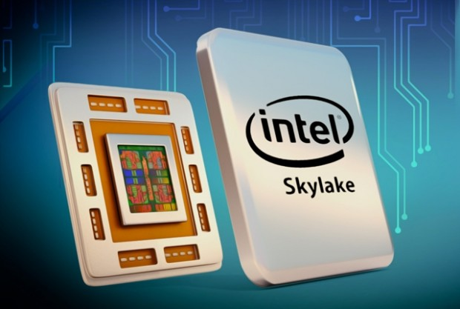
Intel SGX- Software Guard Extensions
Notes:
Intel SGX is a set of new instructions from Intel that allows user-level code to allocate private regions of memory, called enclaves, that unlike normal process memory is also protected from processes running at higher privilege levels.
Support for SGX in the CPU is indicated in CPUID "Structured Extended feature Leaf", EBX bit 02, but its availability to applications requires BIOS support and opt-in enabling which is not reflected in CPUID bits. This complicates the feature detection logic for applications.
Emulation of SGX was added to experimental version of QEMU system emulator in 2014.
In 2015, researchers at the Georgia Institute of Technology released an open-source simulator known as OpenSGX.
It was introduced in 2015 with the sixth generation Intel Core microprocessors based on the Skylake microarchitecture.
The introduction of SGX has a large impact on the security industry. It shifts how security is being achieved and lowers the attack surface area of projects. One example of SGX used in security was a demo application from wolfSSL using it for cryptography algorithms. An additional example is Numecent using SGX to protect the DRM that is used to authorize application execution with their Cloudpaging application delivery products.

Slide 13
A brief Introduction to Intel- SGX
Intel SGX is a set of new instructions from Intel that allows user-level code to allocate private regions of memory, called enclaves.
Emulation of SGX was added to experimental version of QEMU system emulator in 2014.
It was introduced in 2015 with the sixth generation Intel Core microprocessors based on the Skylake microarchitecture.
The introduction of SGX has a large impact on the security industry. It shifts how security is being achieved and lowers the attack surface area of projects
Notes:
Intel SGX is a set of new instructions from Intel that allows user-level code to allocate private regions of memory, called enclaves, that unlike normal process memory is also protected from processes running at higher privilege levels.
Support for SGX in the CPU is indicated in CPUID "Structured Extended feature Leaf", EBX bit 02, but its availability to applications requires BIOS support and opt-in enabling which is not reflected in CPUID bits. This complicates the feature detection logic for applications.
Emulation of SGX was added to experimental version of QEMU system emulator in 2014.
In 2015, researchers at the Georgia Institute of Technology released an open-source simulator known as OpenSGX.
It was introduced in 2015 with the sixth generation Intel Core microprocessors based on the Skylake microarchitecture.
The introduction of SGX has a large impact on the security industry. It shifts how security is being achieved and lowers the attack surface area of projects. One example of SGX used in security was a demo application from wolfSSL using it for cryptography algorithms. An additional example is Numecent using SGX to protect the DRM that is used to authorize application execution with their Cloudpaging application delivery products.

Slide 14
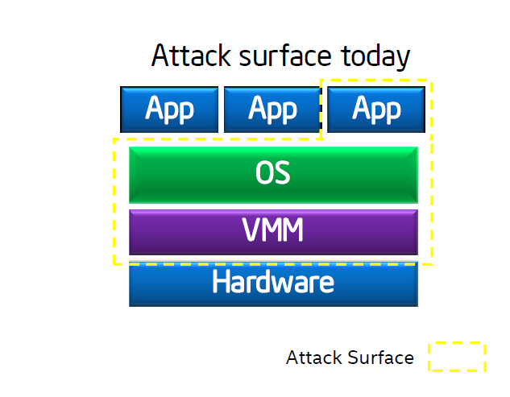
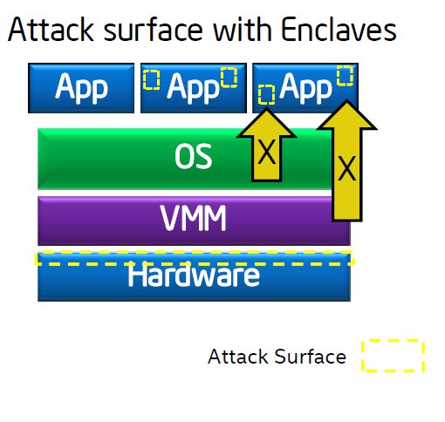
Developing a more secure App – using Intel SGX
Application gains ability to defend its own secrets.
Reduced Attack Surface.
Notes:
Application gains ability to defend
its own secrets
– Smallest attack surface (App + processor)
– Malware that subverts OS/VMM, BIOS, Drivers
etc. cannot steal app secrets

Slide 15
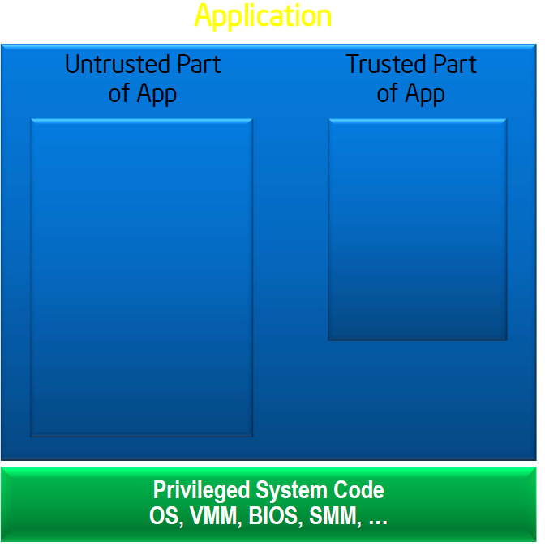
Intel - SGX : Concept of Enclaves
Notes:
1. App is built with trusted
and untrusted parts.

Slide 16
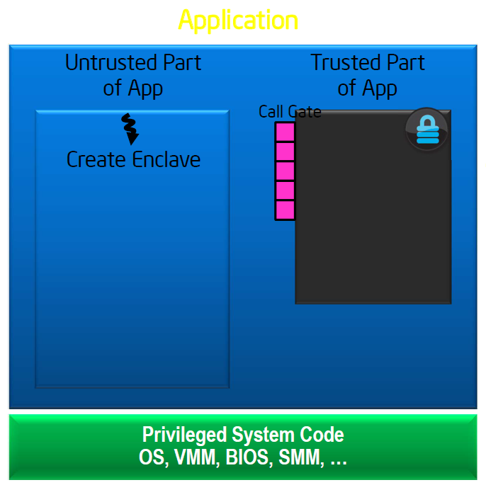
Intel - SGX : Concept of Enclaves
Notes:
2. App runs & creates
enclave which is placed
in trusted memory.

Slide 17
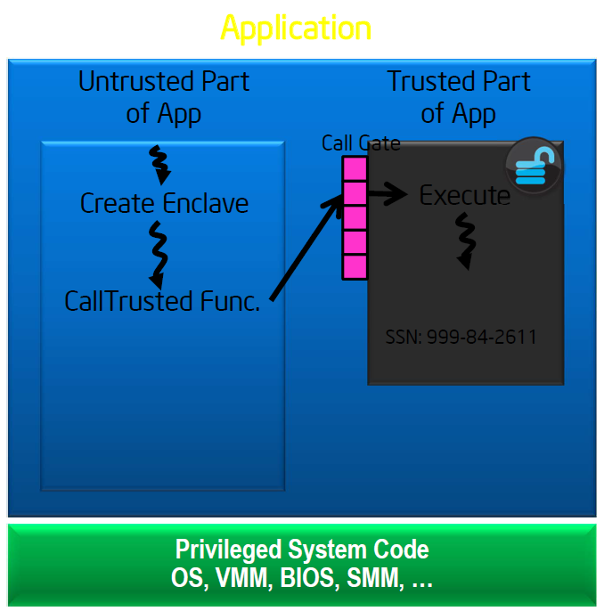
Intel - SGX : Concept of Enclaves
Notes:
3. Trusted function is
called; code running
inside enclave sees data
in clear; external access
to data is denied.

Slide 18
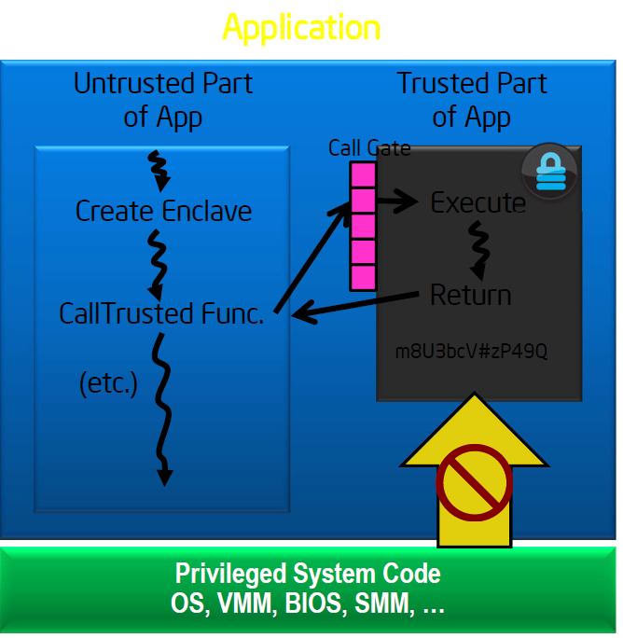
Intel - SGX : Concept of Enclaves
Notes:
4. Function returns; enclave
data remains in trusted
Memory.

Slide 19
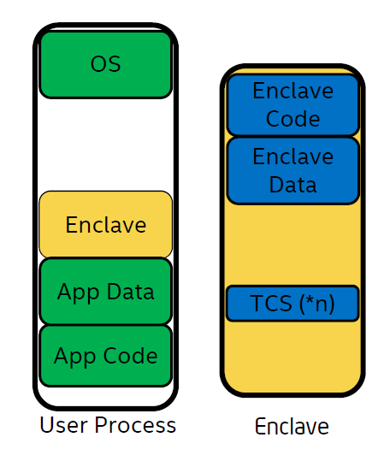
Intel - SGX : Feature of Enclaves
With its own code and data
Provide Confidentiality
Provide integrity
With controlled entry points
With full access to app memory
Notes:
With its own code and data
Provide Confidentiality
Provide integrity
With controlled entry points
With full access to app memory

Slide 20
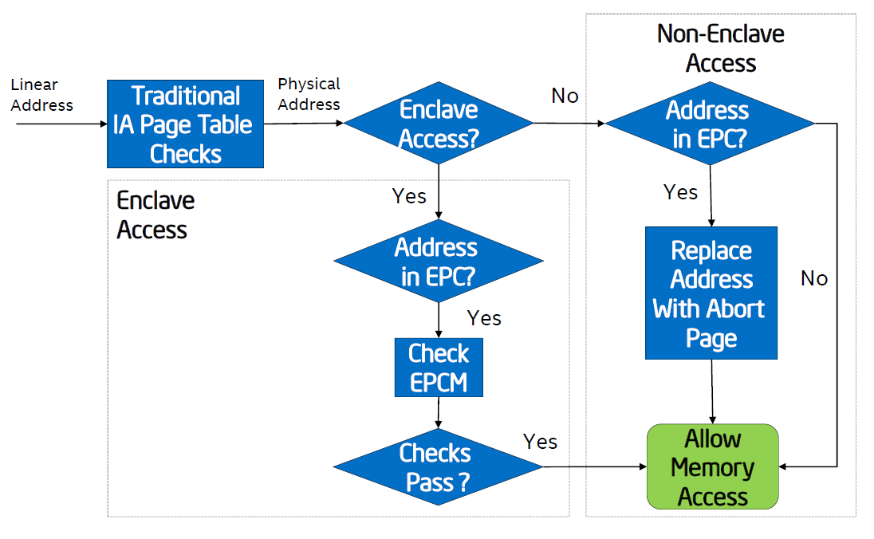
Intel - SGX : Access Control
Notes:
Non Enclave Access
• Security perimeter is the
CPU package boundary
• Data and code unencrypted
inside CPU package
• Data and code outside CPU
package is encrypted and/or
integrity checked
• External memory reads and
bus snoops see only
encrypted data
Cores

Slide 21
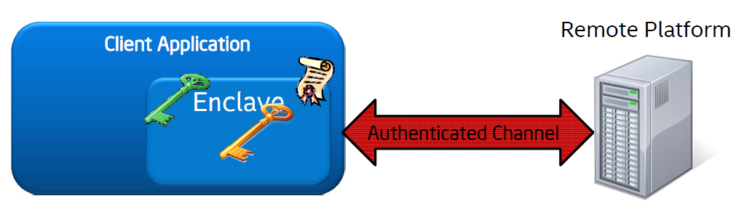

Intel - SGX : Attestation and Sealing
Notes:
Critical Feature: Attestation and Sealing
1. Enclave built & measured
2. Enclave requests REPORT (HW-signed blob that
includes enclave identity information)
3. REPORT sent to server & verified
4. Application Key sent to enclave, first secret
provisioned
5. Enclave-platform-specific Sealing Key generated
(EGETKEY)
6. Application Key encrypted via Sealing Key & stored
for later (offline) use

Slide 22
Currently libraries available for implementation in C/C++.
How do we implement it into our old friend Java ?

Slide 23
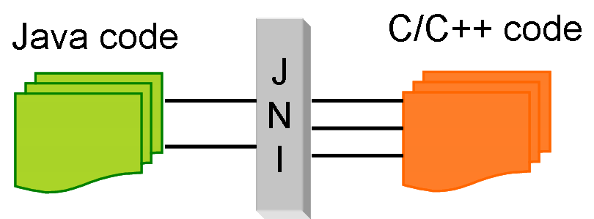

Java Native Interface (JNI)
Our Current Objective

Slide 24
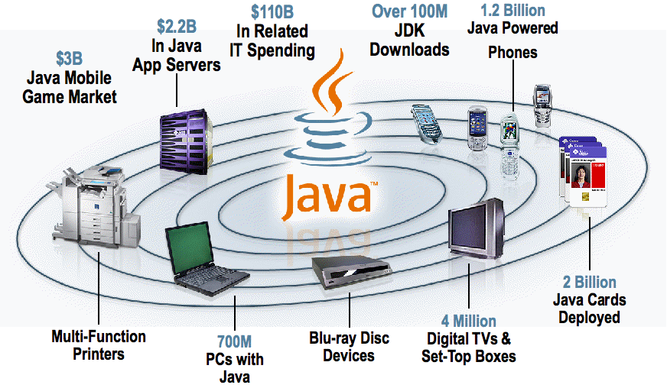
Java is widespread, needs no introduction

Slide 25
JNI in short
At times, it is necessary to use native codes (C/C++) to overcome the memory management and performance constraints in Java.
Java Native Interface (JNI) is a programming framework.
Notes:
Approach using JNI to make apps secure

Slide 26
Problem Statement: How to make Java App more secure ?
Java code running in a Java Virtual Machine (JVM) to call and be called by native applications .(programs specific to a hardware and operating system platform).
In the JNI framework, native functions are implemented in separate .c or .cpp files. (Intel SGX has native functions)
JVM invokes the function, it passes a JNIEnv pointer, a jobject pointer, and any Java arguments declared by the Java method.

Slide 27
Our Objective : Approach for creating secure Interpreter
Interpreter code written in Java must not be accessed by other applications.
Should not be prone to attack by malicious apps and users.(Using SGX native C/C++ libraries).
So we make the trusted code run in Enclave and not trusted code outside the enclave of the application.

Slide 28
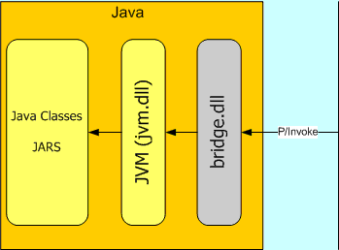
Our Objective : Creating a secure interpreter in Java
C/C++ classes and libraries
Intel SGX-C/C++ libraries
JNI.bridge.dll

Slide 29
Thank You!

