Slide 1
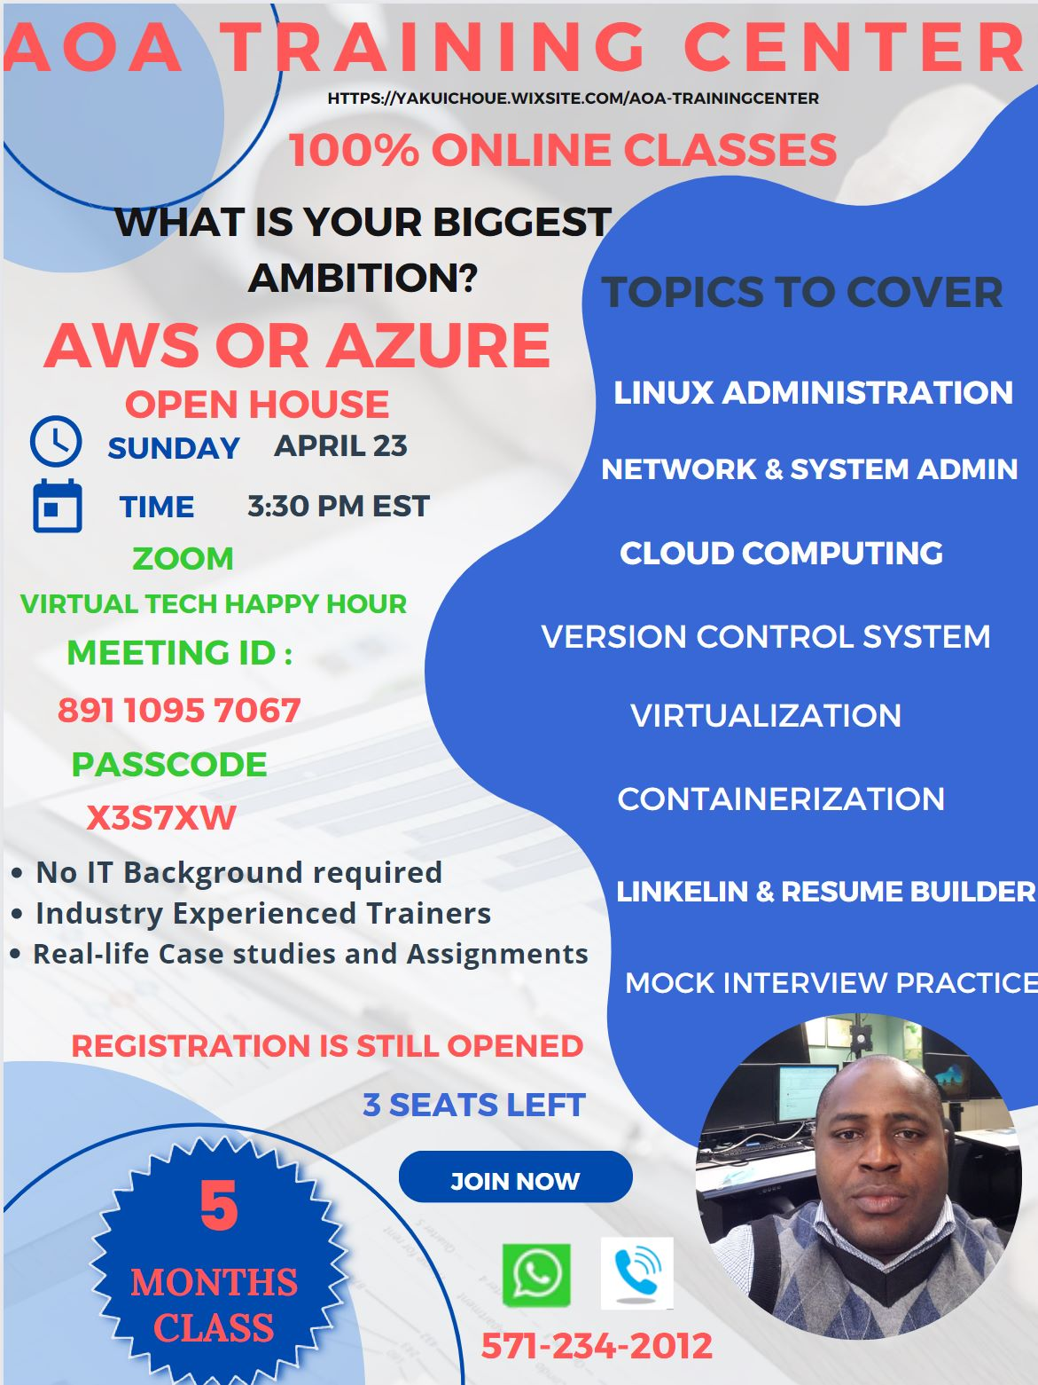

Slide 2

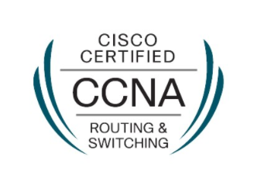




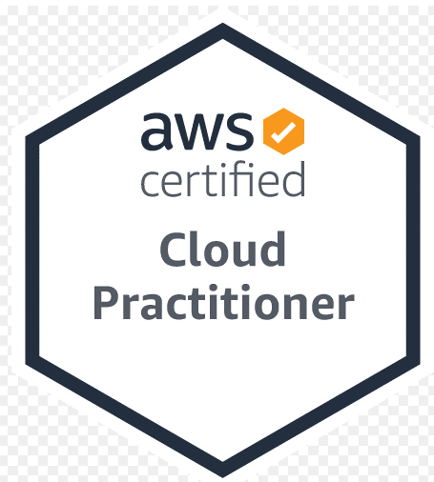

Armand Akuichoue
Trainer,
Co-Founder, AOA Training Center

Slide 3
Here's an overview of what you can expect from the training:
Training Title: AWS Duration: 5 months Training Objectives:
Introduction to AWS: You will learn about the basics of Amazon Web Services (AWS), including its history, architecture, and key services.
AWS Management Console: You will get hands-on experience with the AWS Management Console, which is the web-based interface for managing your AWS resources.
AWS Services: You will be introduced to some of the popular AWS services such as Amazon S3 (Simple Storage Service), Amazon EC2 (Elastic Compute Cloud), Amazon RDS (Relational Database Service), and Amazon SNS (Simple Notification Service), and learn how to use them for various use cases.

Slide 4
AWS Security: You will learn about the security measures provided by AWS, including identity and access management (IAM), virtual private cloud (VPC), and encryption options.
AWS Deployment: You will understand different methods of deploying applications on AWS, including using EC2 instances, container services like Amazon ECS (Elastic Container Service), and serverless computing with AWS Lambda.
AWS Best Practices: You will learn about best practices for designing, deploying, and managing applications on AWS, including cost optimization, performance optimization, and high availability.
AWS Well-Architected Framework: You will be introduced to the AWS Well-Architected Framework, which provides guidance on designing and building well-architected applications on AWS.

Slide 5
TRAINING METHODOLOGY:
This AWS training will be conducted using a combination of lectures, hands-on exercises, and discussions. Participants will have access to their own AWS accounts to practice the concepts learned during the training. The training will be facilitated by experienced AWS-certified trainers who will provide guidance and answer questions.
TARGET AUDIENCE:
The Open House on AWS training is suitable for beginners who are new to AWS and want to get started with the platform. It is also suitable for IT professionals, developers, architects, and decision-makers who want to gain a basic understanding of AWS and its services.
PREREQUISITES:
There are no specific prerequisites for the Open House on AWS training. However, basic knowledge of cloud computing concepts and general IT skills would be beneficial.

Slide 6
CONCLUSION:
The AWS training provides an overview of AWS and its services and offers hands-on experience with the AWS Management Console. It covers key topics such as AWS services, security, deployment, best practices, and the AWS Well-Architected Framework.
The training is suitable for beginners as well as IT professionals who want to gain a basic understanding of AWS. So, get ready to explore the world of AWS and unlock the potential of cloud computing!

Slide 7
WHAT DO YOU NEED
Laptop or Desktop ( with a large screen if possible)
AWS or Azure cloud account
A credit card
Github, Putty or Mobaxterm, Powershell
Telegram
Zoom

Slide 8


Slide 9
NEXT SESSION
Introduction to the cloud
AWS Global Infrastructure (Datacenters Availability zones. Regions, Edges locations, The AWS management console, etc.)
Lab
Shared responsibilities model
Homework

