Slide 1
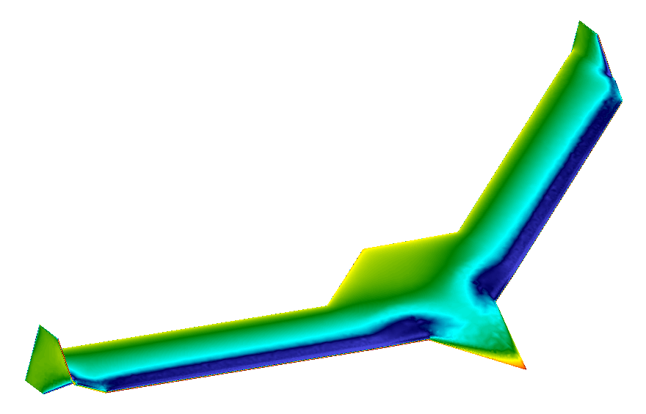
mAEWing1-Hati Updates
October 8, 2015
CMSoft Inc.
Alexandre Coderre-Chabot Thuan Lieu

Slide 2
Summary
Converted the Virginia Tech NASTRAN structural model of mAEwing1-Hati v3.3 to AERO-S.
Edited the control surface connector properties in the AERO-S structural model.
Performed an eigenvalue analysis to identify important dry structural modes.
Connected the structure stick model to an aerodynamic “dressing” shell model.
Ran unsteady aeroelastic simulations to compare models with different numbers of modes.
Ran unsteady aeroelastic simulations to find the critical flutter conditions.

Slide 3
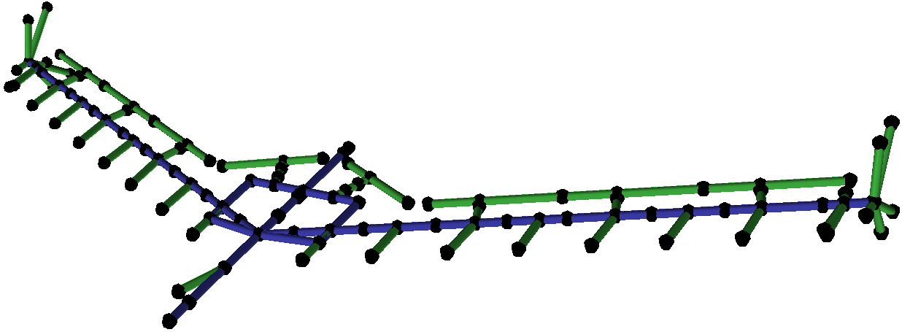
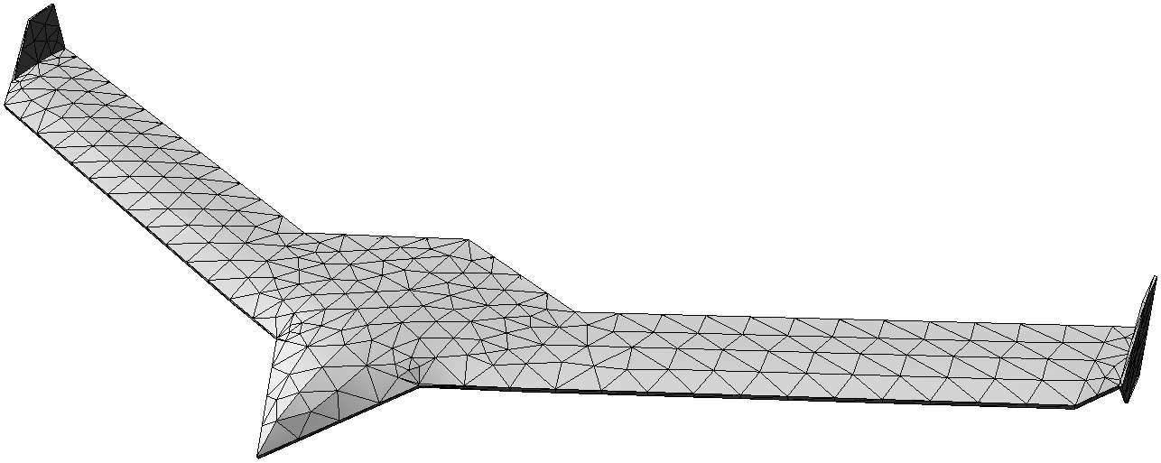
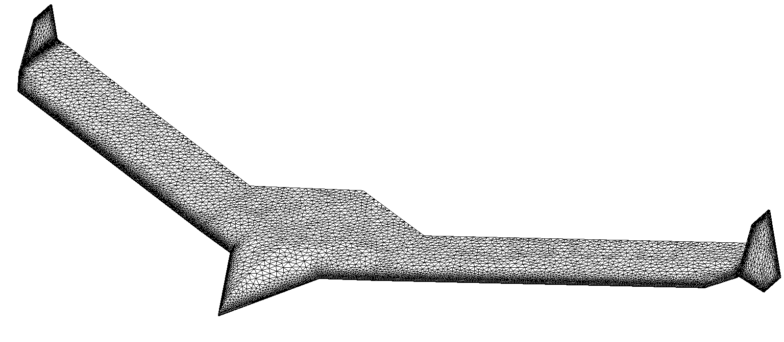
mAEWing1-Hati Meshes
Structure Model
Structure “Dressing” Mesh
Fluid Euler Mesh

Slide 4
mAEWing1-Hati Mass & Inertia Properties
Property | VirginiaTech NASTRAN Model | CMSoft AERO-S Model | Difference
Weight (lb.) | 14.059 | 14.049 | 0.07%
Center of Mass Position X (in) Center of Mass Position Y (in) Center of Mass Position Z (in) | 7.9475 0.0000 0.0000 | 8.0812 0.0000 0.0000 | 1.67%
Moment of Inertia Ixx (lb. in²) Moment of Inertia Iyy (lb. in²) Moment of Inertia Izz (lb. in²) | 9,577.9 1,633.1 9,602.9 | 9,580.6 1,600.0 9,604.6 | 0.03% 2.05% 0.02%
Product of Inertia Ixy (lb. in²) Product of Inertia Ixz (lb. in²) Product of Inertia Iyz (lb. in²) | 3.8 0.0 0.0 | 0.4 0.0 0.0 | −

Slide 5
mAEWing1-Hati Dry Structural Modes
Mode | VirginiaTech Model | CMSoft Model | Difference
7 | 5.38 Hz | 5.37 Hz | 0.08%
8 | 9.47 Hz | 9.55 Hz | 0.80%
9 | 12.78 Hz | 12.69 Hz | 0.70%
10 | 14.41 Hz | 14.47 Hz | 0.43%
11 | 19.35 Hz | 19.41 Hz | 0.35%
12 | 27.26 Hz | 27.42 Hz | 0.57%
13 | 30.66 Hz | 30.19 Hz | 1.56%
14 | 31.65 Hz | 31.78 Hz | 0.40%
15 | 38.33 Hz | 38.33 Hz | 0.01%
16 | 46.15 Hz | 45.89 Hz | 0.58%
17 | 63.37 Hz | 63.53 Hz | 0.25%
18 | 66.14 Hz | 66.42 Hz | 0.41%
19 | 67.17 Hz | 67.43 Hz | 0.39%
20 | 71.45 Hz | 70.82 Hz | 0.88%

Slide 6
mAEWing1-Hati Dry Structural Modes
Mode | CMSoft Original Model | CMSoft Model with Edited Control Surfaces | Difference
7 | 5.37 Hz | 5.37 Hz | 0.00%
8 | 9.55 Hz | 9.55 Hz | 0.00%
9 | 12.69 Hz | 12.69 Hz | 0.05%
10 | 14.47 Hz | 14.47 Hz | 0.04%
11 | 19.41 Hz | 19.41 Hz | 0.04%
12 | 27.42 Hz | 27.41 Hz | 0.01%
13 | 30.19 Hz | 30.16 Hz | 0.10%
14 | 31.78 Hz | 31.77 Hz | 0.05%
15 | 38.33 Hz | 38.30 Hz | 0.07%
16 | 45.89 Hz | 45.86 Hz | 0.06%
17 | 63.53 Hz | 63.38 Hz | 0.23%
18 | 66.42 Hz | 66.39 Hz | 0.05%
19 | 67.43 Hz | 67.40 Hz | 0.05%
20 | 70.82 Hz | 70.63 Hz | 0.26%

Slide 7
mAEWing1-Hati Dry Structural Modes
Mode | Freq. (Hz) | Description
1−6 | 0.00 | 6 Rigid-Body Modes
7 | 5.37 | Bending 1st Symmetric
8 | 9.55 | Bending 1st Anti-Sym.
9 | 12.69 | Torsion 1st Anti-Sym.
10 | 14.47 | Torsion 1st Symmetric
11 | 19.41 | Bending 2nd Symmetric
12 | 27.42 | Bending 2nd Anti-Sym.
13 | 30.19 | Torsion 2nd Anti-Sym.
14 | 31.78 | Torsion 2nd Symmetric
15 | 38.33 | Bending 3rd Symmetric
16 | 45.89 | Bending 3rd Anti-Sym.
18 | 66.42 | Torsion 3rd Anti-Sym.
19 | 67.43 | Torsion 3rd Symmetric
Mode | Freq. (Hz) | Description
27 | 109.21 | + 1*L3 – 4*L4
32 | 126.12 | + 1*R3 – 2*R4
36 | 136.03 | + 4*L3 + 1*L4
37 | 142.15 | + 1*R3 + 1*R4
43 | 174.95 | + 1*L2 – 8*R2
44 | 175.01 | + 8*L2 + 1*R2
48 | 193.24 | + 1*L1 – 1*R1
49 | 195.44 | + 1*L1 + 1*R1

Slide 8
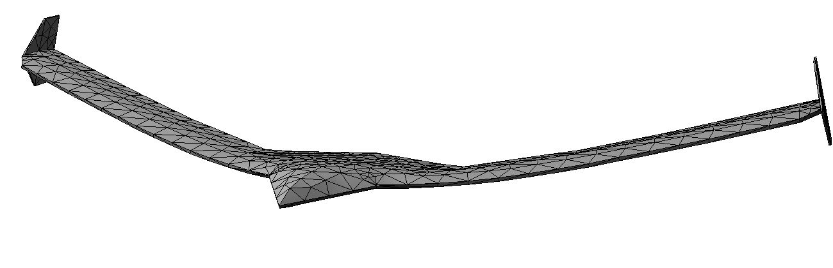
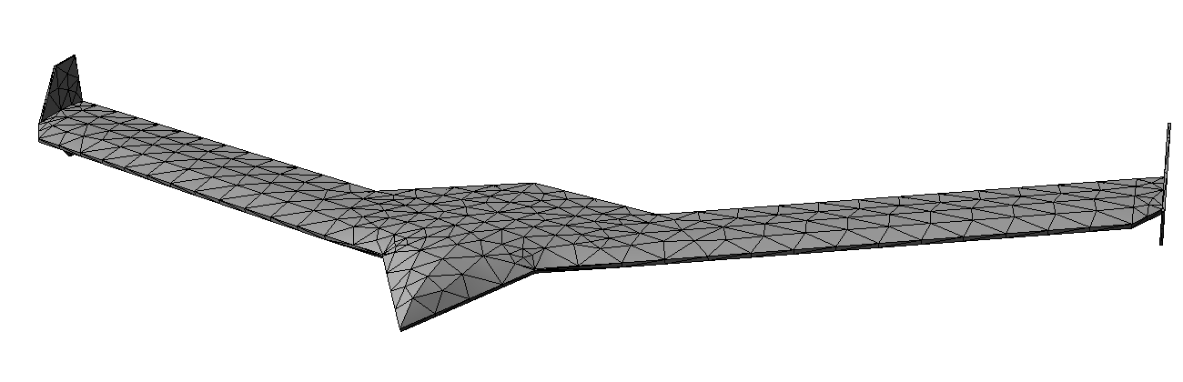
mAEWing1-Hati Dry Structural Modes
Mode 7
5.37 Hz
Bending 1st Symmetric

Slide 9
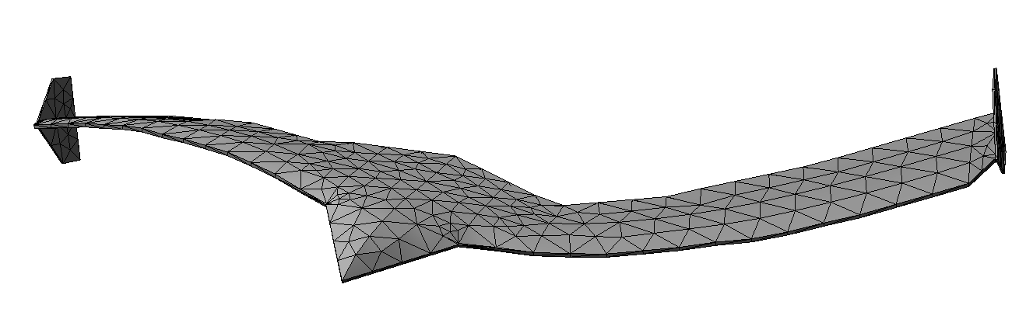
mAEWing1-Hati Dry Structural Modes
Mode 8
9.55 Hz
Bending 1st Anti-Sym.

Slide 10
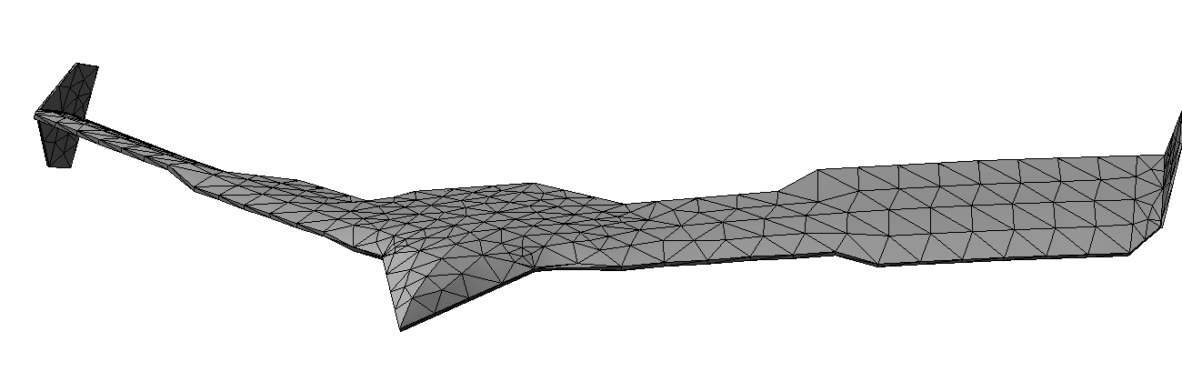
mAEWing1-Hati Dry Structural Modes
Mode 9
12.69 Hz
Torsion 1st Anti-Sym.

Slide 11
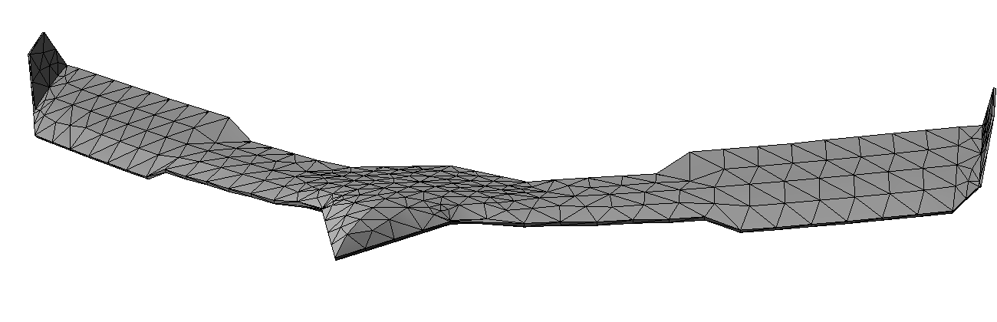
mAEWing1-Hati Dry Structural Modes
Mode 10
14.47 Hz
Torsion 1st Symmetric

Slide 12
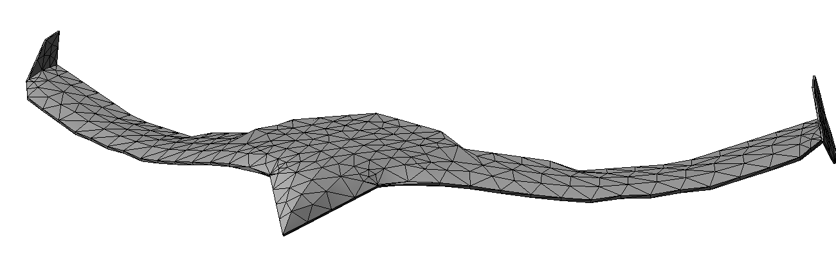
mAEWing1-Hati Dry Structural Modes
Mode 11
19.41 Hz
Bending 2nd Symmetric

Slide 13
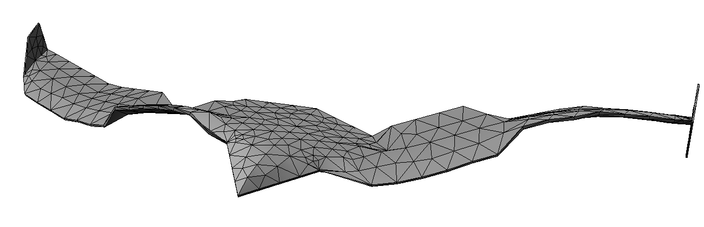
mAEWing1-Hati Dry Structural Modes
Mode 12
27.41 Hz
Bending 2nd Anti-Sym.

Slide 14
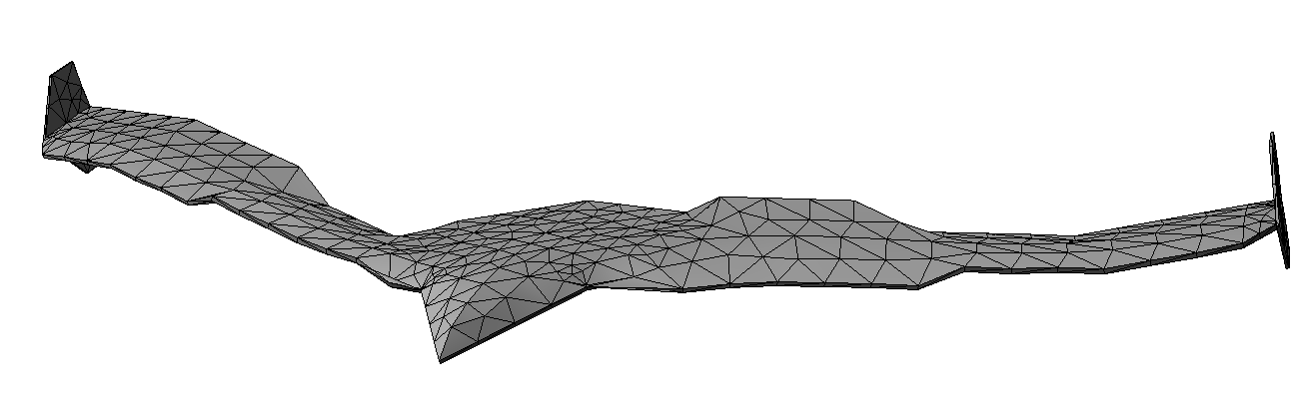
mAEWing1-Hati Dry Structural Modes
Mode 13
30.16 Hz
Torsion 2nd Anti-Sym.

Slide 15
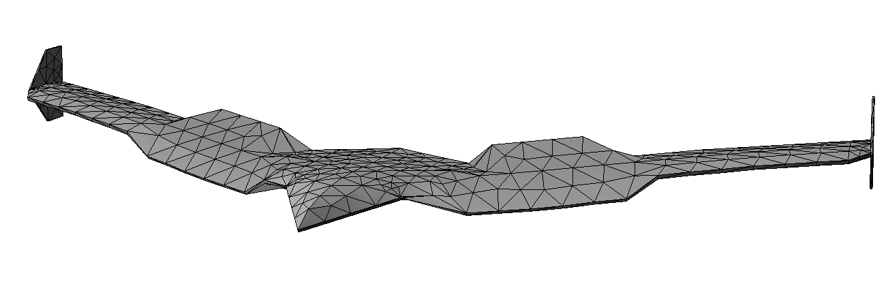
mAEWing1-Hati Dry Structural Modes
Mode 14
31.77 Hz
Torsion 2nd Symmetric

Slide 16
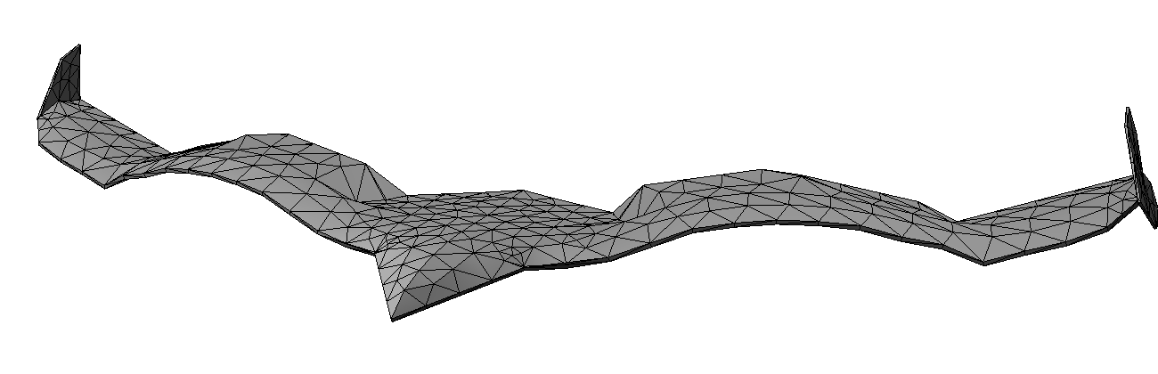
mAEWing1-Hati Dry Structural Modes
Mode 15
38.30 Hz
Bending 3rd Symmetric

Slide 17
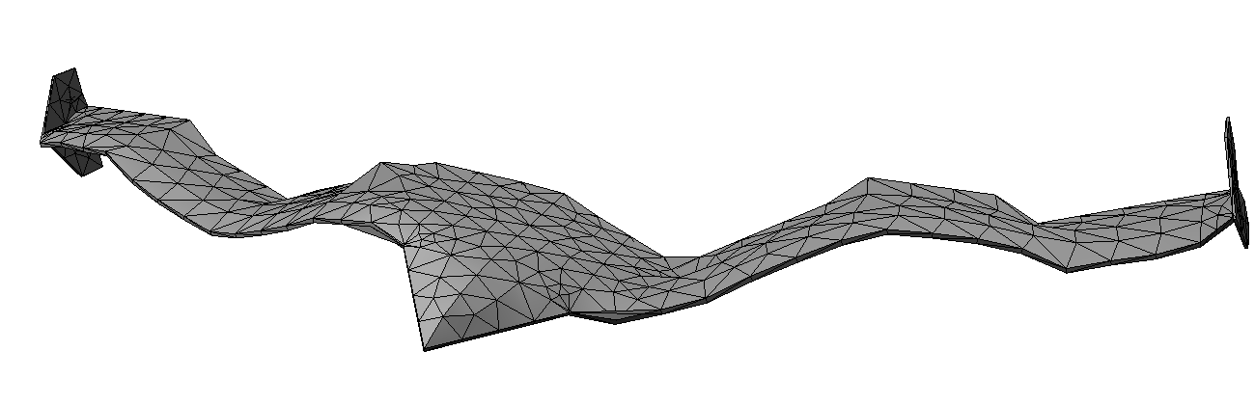
mAEWing1-Hati Dry Structural Modes
Mode 16
45.86 Hz
Bending 3rd Anti-Sym.

Slide 18
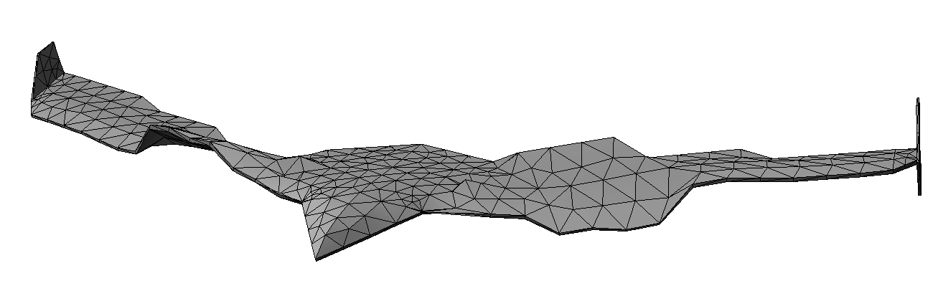
mAEWing1-Hati Dry Structural Modes
Mode 18
66.39 Hz
Torsion 3rd Anti-Sym.

Slide 19
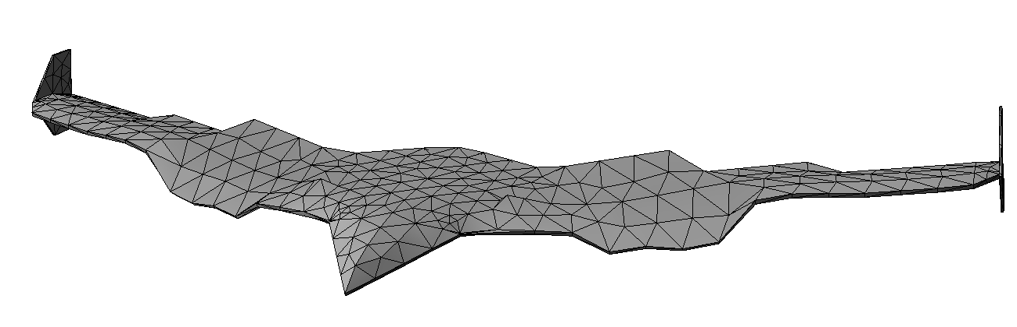
mAEWing1-Hati Dry Structural Modes
Mode 19
67.40 Hz
Torsion 3rd Symmetric

Slide 20
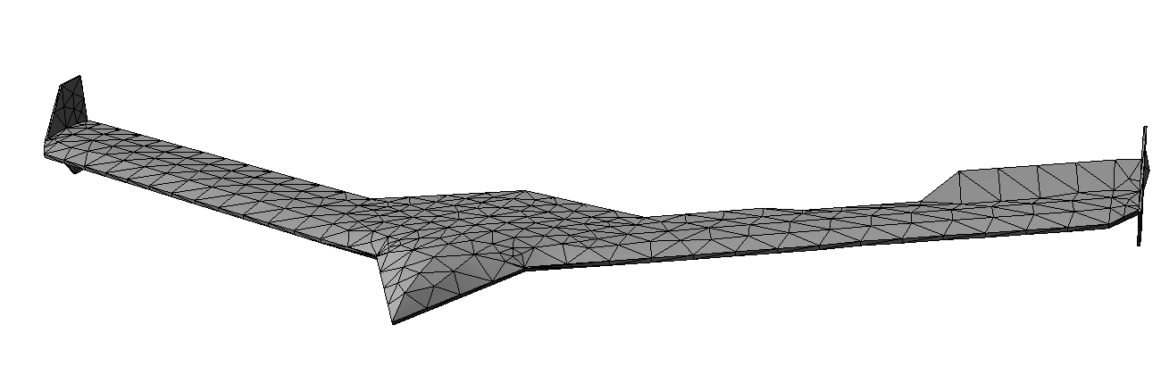
mAEWing1-Hati Dry Structural Modes
Mode 27
109.21 Hz
+ 1*L3 – 4*L4 Control Surfaces

Slide 21
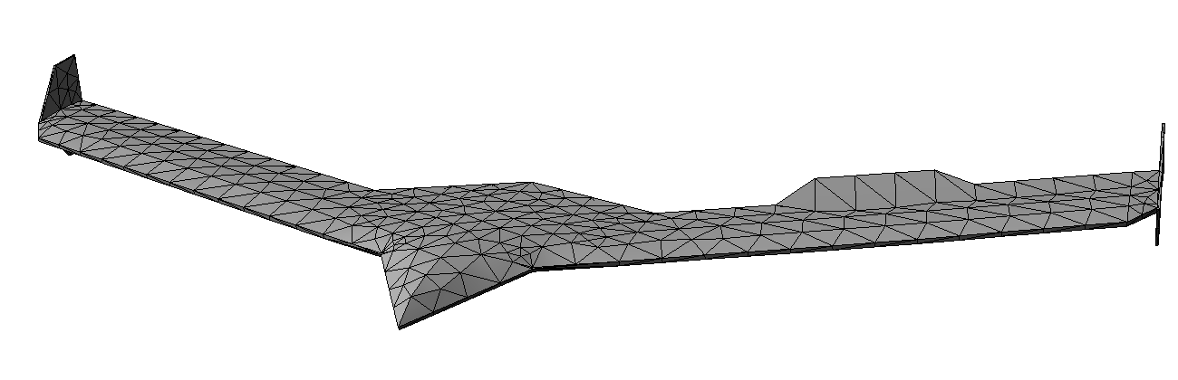
mAEWing1-Hati Dry Structural Modes
Mode 36
136.03 Hz
+ 4*L3 + 1*L4 Control Surfaces

Slide 22
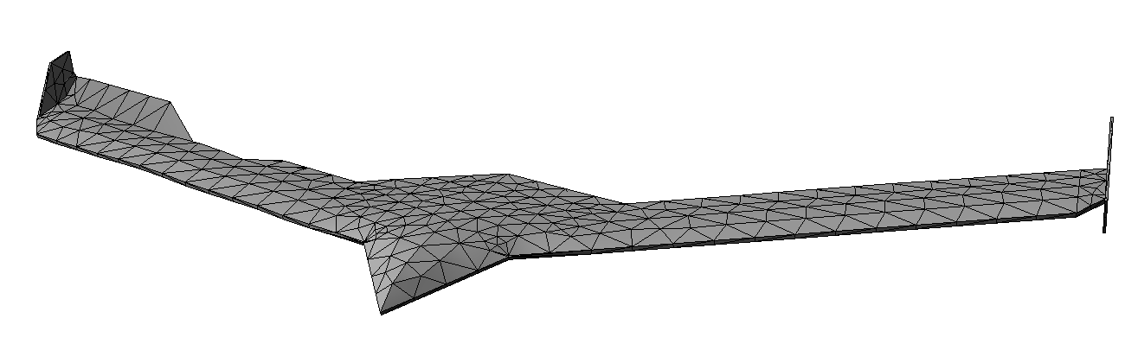
mAEWing1-Hati Dry Structural Modes
Mode 32
126.12 Hz
+ 1*R3 – 2*R4 Control Surfaces

Slide 23
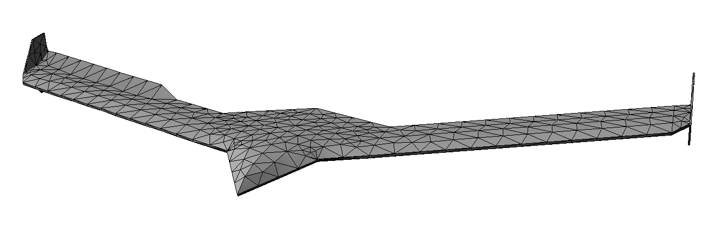
mAEWing1-Hati Dry Structural Modes
Mode 37
142.15 Hz
+ 1*R3 + 1*R4 Control Surfaces

Slide 24
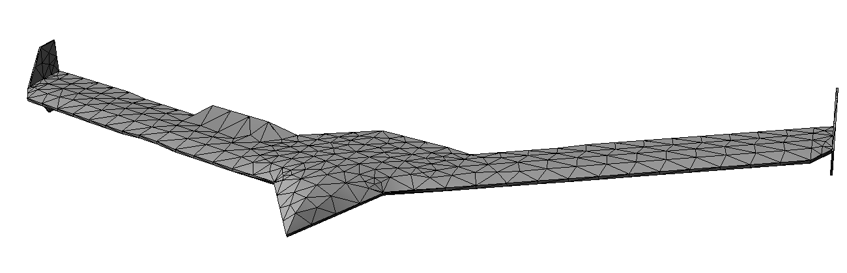
mAEWing1-Hati Dry Structural Modes
Mode 43
174.95 Hz
R2 Control Surface

Slide 25
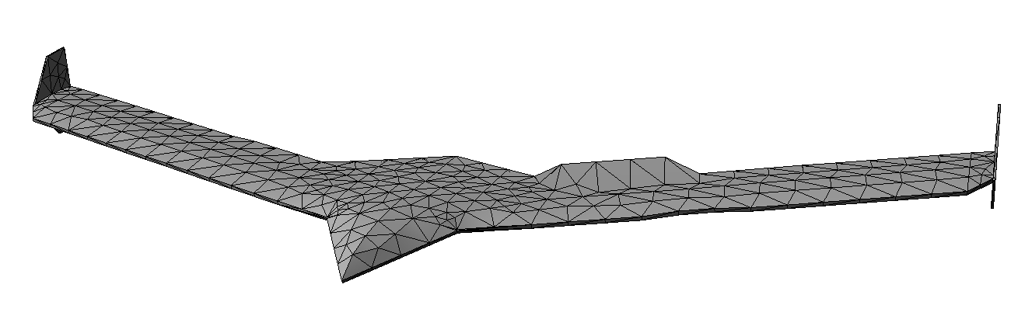
mAEWing1-Hati Dry Structural Modes
Mode 44
175.01 Hz
L2 Control Surface

Slide 26
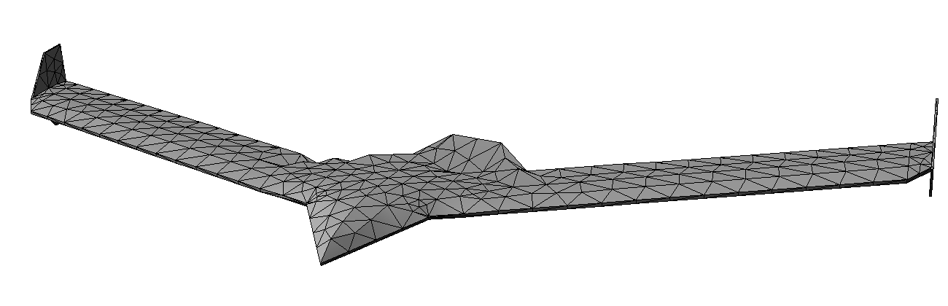
mAEWing1-Hati Dry Structural Modes
Mode 48
193.24 Hz
+ 1*L1 – 1*R1 Control Surfaces

Slide 27
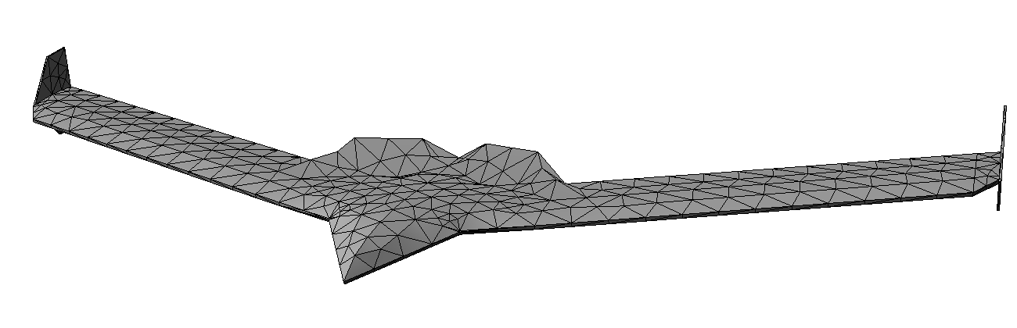
mAEWing1-Hati Dry Structural Modes
Mode 49
195.44 Hz
+ 1*L1 + 1*R1 Control Surfaces

Slide 28
mAEWing1-Hati Modalized Models
Parameter | Value
Equations | Inviscid (Euler) fluid equations; linear structure
Fluid Problem Size | 360,000 nodes in total, including 38,000 nodes on aircraft surface
Structure Problem Size | Full Model: 126 nodes Modalized Models: 6 rigid-body modes + 4, 8, and 12 flexible modes + 8 control surface deflection modes
Order | 2nd order in space, 2nd order in time
Time Step | Time Step: 0.0005 seconds Total Time: 0.5 seconds Number of Time Steps: 1,000
Flight Conditions | Mach 0.1 at sea-level, which gives: Speed: 34.03 m/s, 111.64 ft./s, 66.14 kt. Pressure: 14.696 psi Density: 1.376×10⁻⁶ slug/in^3
Initial Conditions | Structure deformed about its first flexible mode.
Solvers | Implicit for both structure (modal) and fluid

Slide 29
mAEWing1-Hati Modalized Models
The full structural model is compared to 3 modalized structural models:
Modalized Model 1:
6 rigid-body modes, 2 bending modes, 2 torsion modes, and 8 control surface modes, for a total of 18 modes.
Modalized Model 2:
6 rigid-body modes, 4 bending modes, 4 torsion modes, and 8 control surface modes, for a total of 22 modes.
Modalized Model 3:
6 rigid-body modes, 6 bending modes, 6 torsion modes, and 8 control surface modes, for a total of 26 modes.
These models are abbreviated as R6-B2-T2-C8, R6-B4-T4-C8 and R6-B6-T6-C8.

Slide 30
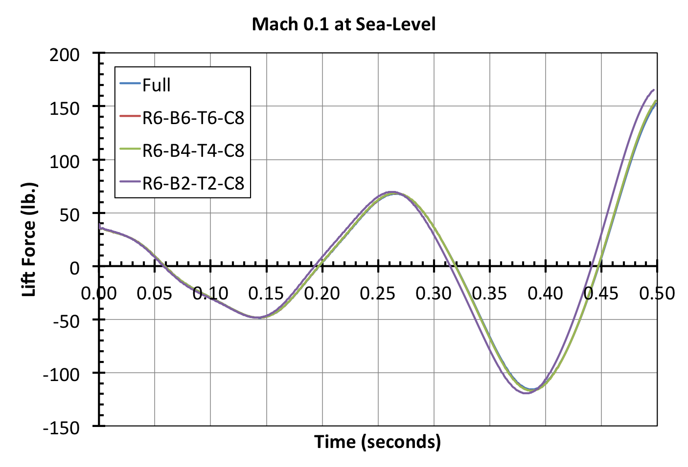
mAEWing1-Hati Modalized Models

Slide 31
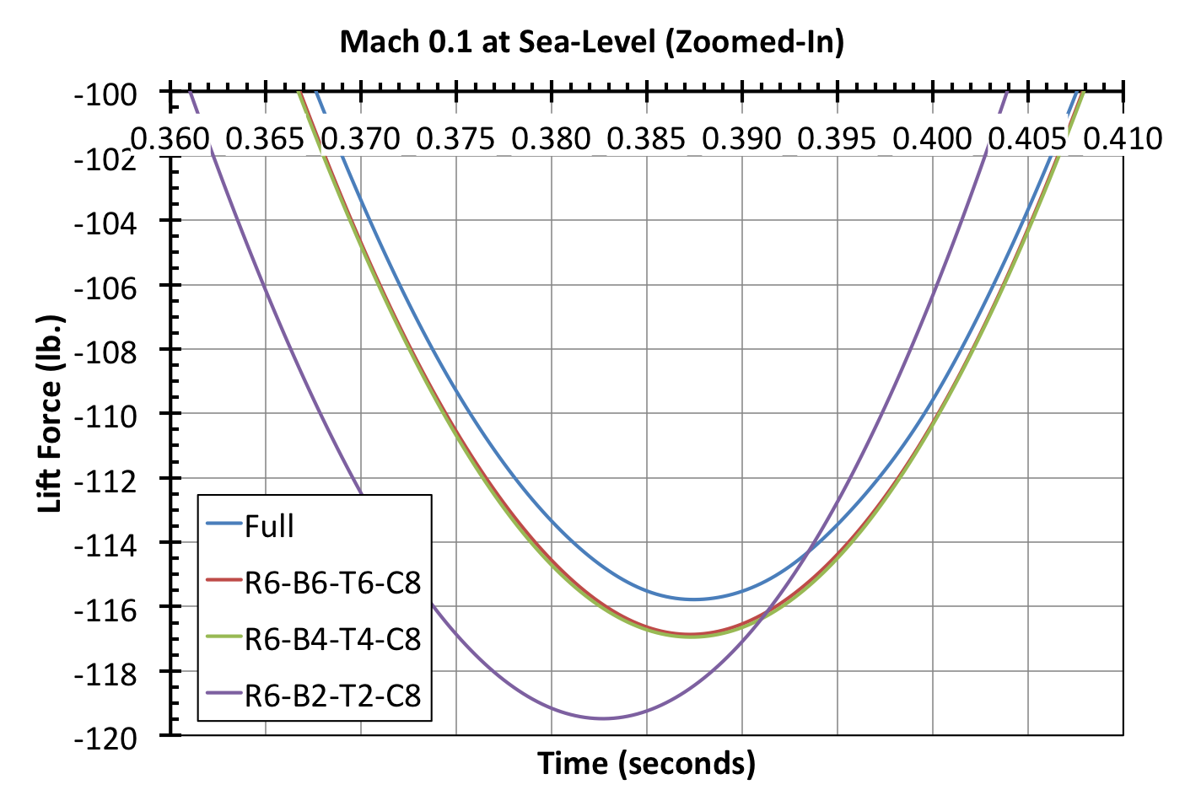
mAEWing1-Hati Modalized Models

Slide 32
mAEWing1-Hati Aeroelastic Frequency
Model | 1st Aeroelastic Mode Frequency (Hz) | 1st Aeroelastic Mode Damping Ratio | Frequency Difference with Full Model | Damping Ratio Difference with Full Model
Full | 4.3012 | −0.2921 | − | −
R6-B6-T6-C8 | 4.3091 | −0.3003 | 0.18% | 0.40%
R6-B4-T4-C8 | 4.2915 | −0.3020 | 0.22% | 0.97%
R6-B2-T2-C8 | 4.1901 | −0.3162 | 2.58% | 5.72%
The R6-B4-T4-C8 modalized structural model is a good compromise and is used to perform future unsteady aeroelastic simulations to determine the flutter conditions.

Slide 33
mAEWing1-Hati Flutter Conditions
Parameter | Value
Equations | Inviscid (Euler) fluid equations; linear structure
Fluid Problem Size | 360,000 nodes in total, including 38,000 nodes on aircraft surface
Structure Problem Size | Modalized Model: R6-B4-T4-C8 6 rigid-body modes + 8 flexible modes + 8 control surface deflection modes
Order | 2nd order in space, 2nd order in time
Time Step | Time Step: 0.001 seconds Total Time: 3 seconds Number of Time Steps: 3,000
Flight Conditions | Mach Numbers: { 0.08 , 0.09 , 0.10 , 0.11 } Altitudes: { 0 , 1,000 , 3,000 , 6,000 } ft.
Initial Conditions | Structure deformed about its first flexible mode
Solvers | Implicit for both structure (modal) and fluid

Slide 34
mAEWing1-Hati Aeroelastic Frequency
After running the lift-time history data through an eigensystem realization algorithm, the following aeroelastic damping ratios are obtained:
Aeroelastic Damping Ratios | Ma = 0.08 | Ma = 0.09 | Ma = 0.10 | Ma = 0.11
Altitude = 6,000 ft. | 0.142 | 0.030 | −0.119 | −0.148
Altitude = 3,000 ft. | 0.089 | 0.017 | −0.166 | −0.287
Altitude = 1,000 ft. | 0.056 | 0.015 | −0.302 | −0.350
Altitude = 0 ft. | 0.045 | 0.014 | −0.314 | −0.452
Linear interpolation is used between the Mach 0.09 and Mach 0.10 results to find the critical flutter points (where the damping ratio is 0).

Slide 35
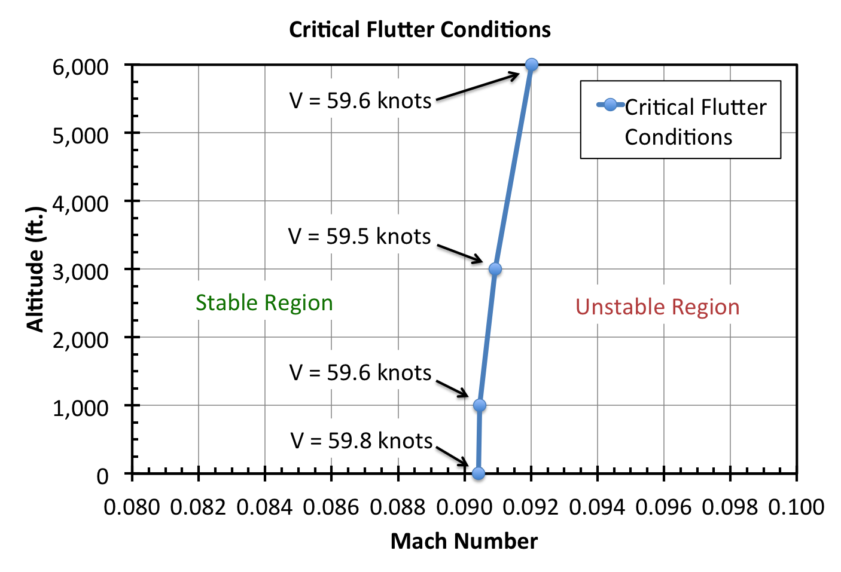
mAEWing1-Hati Modalized Models

Slide 36
Conclusions & Questions
Based on the results of the unsteady aeroelastic simulations with the inviscid full-order fluid model and the 22-mode modalized structural model, we can conclude:
mAEWing1-Hati becomes unstable at an airspeed of 59−60 knots.
This critical speed is essentially independent of altitude and corresponds to a Mach number of 0.0905 at altitudes of 0−1,000 ft.
Contact Information:
Alexandre Coderre-Chabot: acoderre@cmsoftinc.com
Thuan Lieu: tlieu@cmsoftinc.com

