Slide 1
TAI Pricing Handbook
NORAM - Oct 15, 2025
EMEA - Oct 17, 2025
Tom Callway, VP Product Marketing

Slide 2
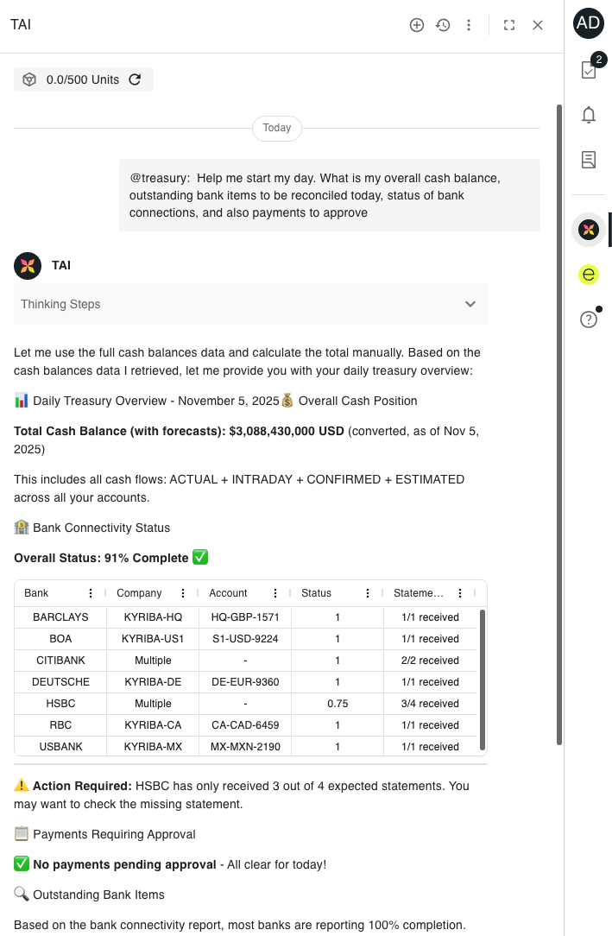
What is TAI?
TAI is an agentic AI because it will plan and execute governed, multi‑step treasury workflows on trusted Kyriba data—with explainability, role‑based controls, and full auditability—rather than merely a AI chatbot responding to prompts.
Production* starts with two agents and more agents are planned in the pipeline:
@treasury - run treasury actions and workflows.
@help - 24x7 support and online helper
TAI is part of our Trusted AI portfolio that includes Cash AI, Invoice AI, Fraud Detection AI
Understands treasury terms and context.
Gives recommendations with clear explanations you can review.
Delivers results
Faster insights
Fewer manual steps
Improved forecast accuracy
Faster onboarding
TAI works only on the new UI - encourage your customers to upgrade
*TAI is optimized for cash management queries at launch. For payments, the quality of the queries can vary for now. The team is working to bring it on par in the coming months.

Slide 3
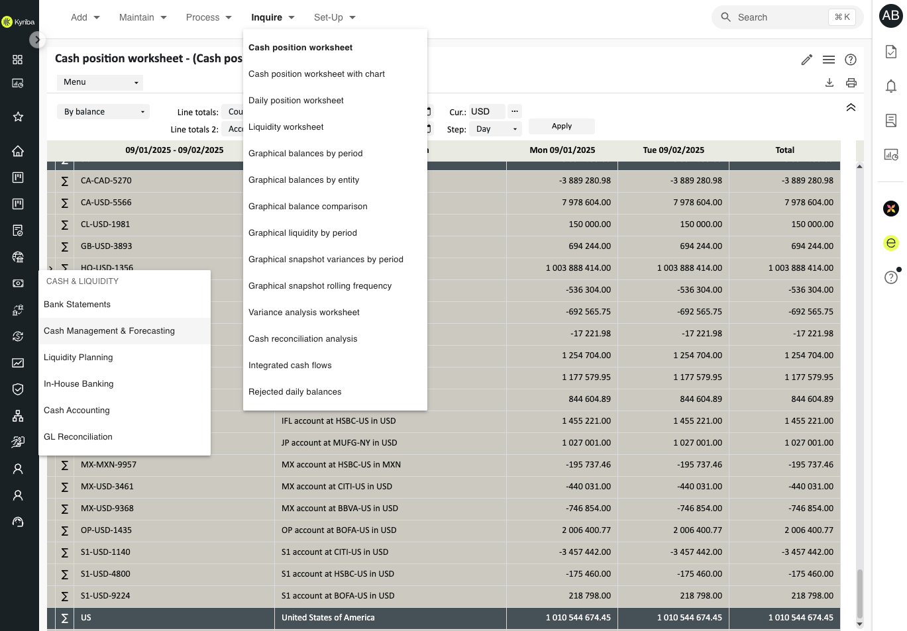
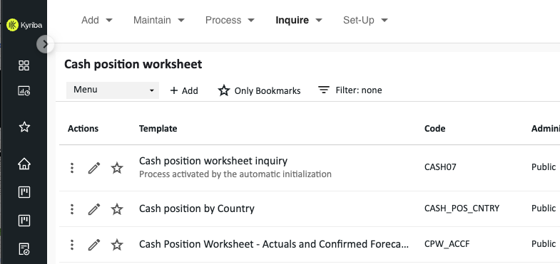
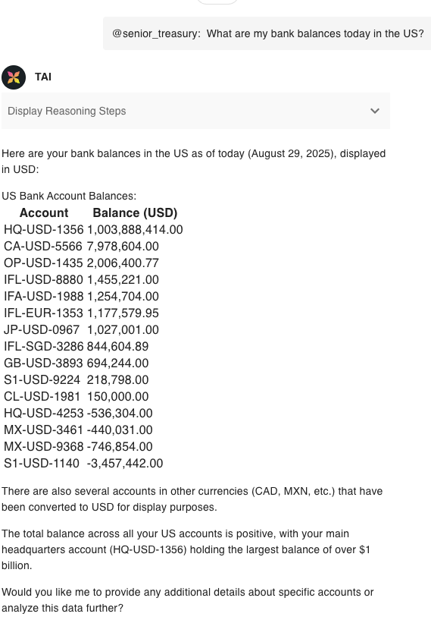
Optimized Workflows: Net New & Existing
Q: What are my bank balances today in the US?
3
With TAI (~5 secs)
1
4
1
2
2
5
Without TAI (Time varies by user)

Slide 4

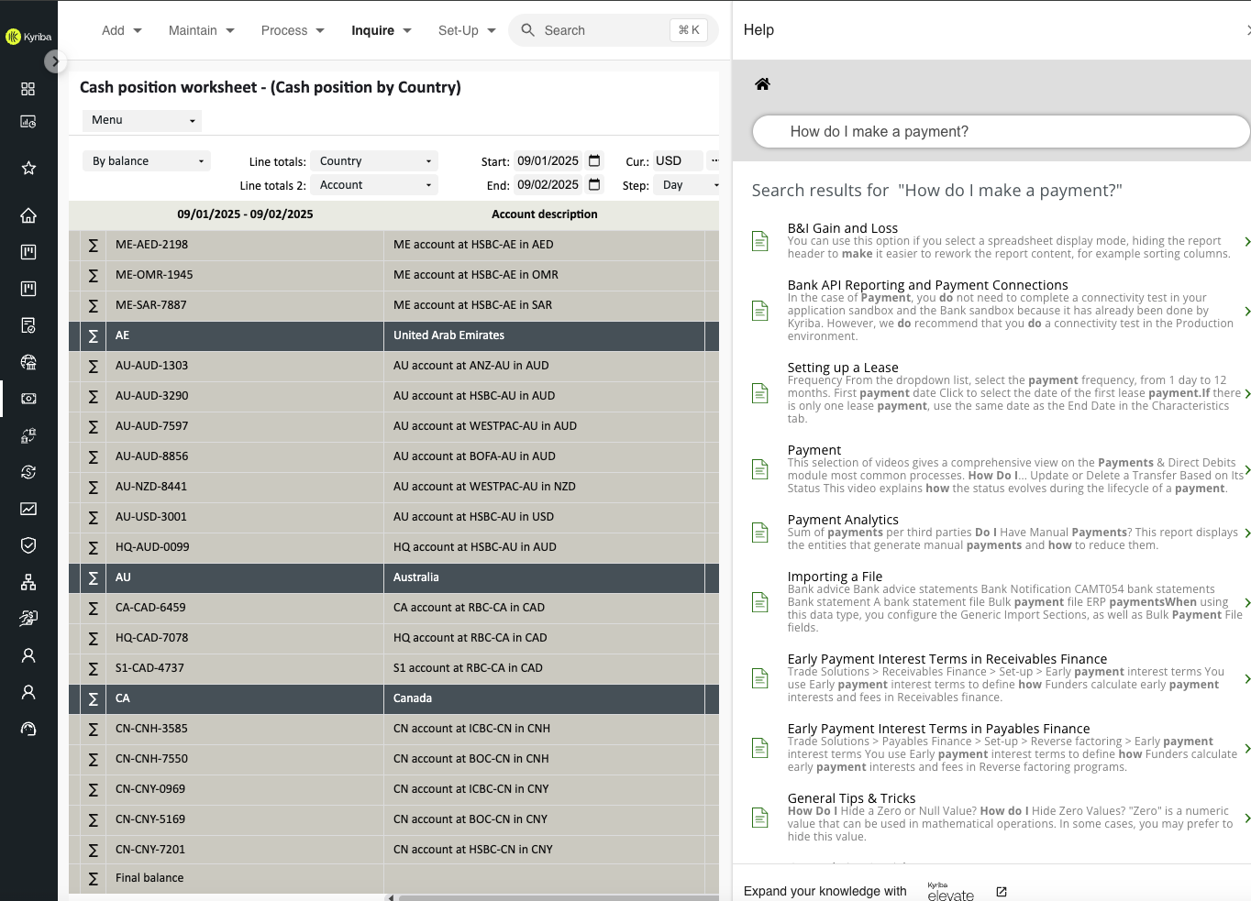
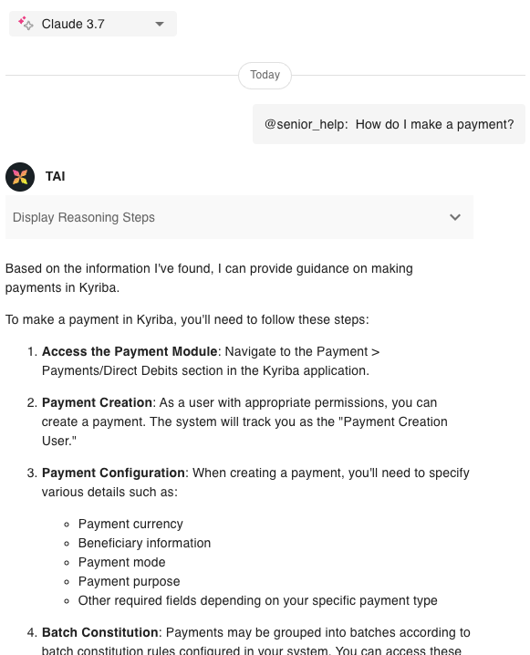
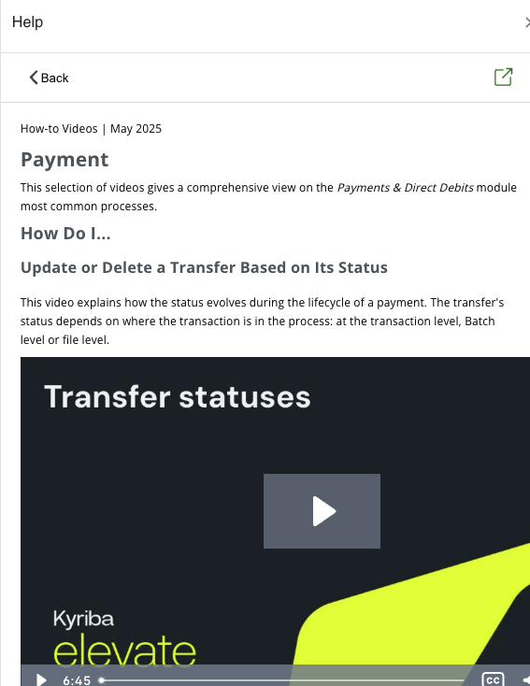
Accelerated Onboarding & Utilization
Q: How do I make a payment?
Roadmap: initiate payments from TAI
With TAI (~5sec)
2
1
1
4
3
2
Watch >1 video
Without TAI (+6 mins)

Slide 5

Gartner on AI Pricing for SaaS vendors
Consumption-led shift:
Usage-based models dominate as AI features scale; 42% of large SaaS deals used credit/token pricing in 2025, boosting flexibility but increasing cost unpredictability.
Credit and PAYG options:
Credits are the common AI monetization unit (vendor-controlled consumption rates); PAYG offers maximum flexibility.
Tiered and volumetric pricing:
Structured tiers tied to business outcomes provide predictability and align spend with value delivered.
Buyer sentiment and guidance:
Win trust with transparent meters, mix fixed + variable fees, add cost caps, and emphasize outcome-based pricing.

Slide 6


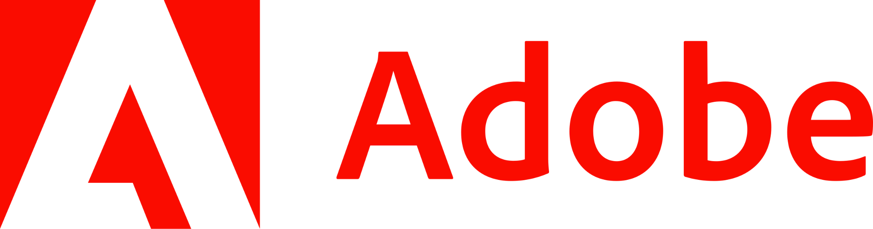


SaaS Vendors adopting consumption-based AI pricing
365 Copilot Chat
Agentforce - FlexCredits
Adobe Firefly
SAP AI Units - Joule Agents
SAP S/4HANA Cloud finance agents
SAP Ariba procurement agents
ServiceNow Enterprise - Now Assists

Slide 7


What is a Kyriba Unit?
Databricks (DBU)
Future Databricks Powered Features - e.g. DaaS
Kyriba Unit
Query
Simple Interaction
Complex Interaction
1-2 units
3-5 units
6-10 units

Slide 8
Example Queries vs Interactions
Disclaimer: these examples are illustrative only. Query returns & unit consumption will vary by customer.
Query
"What's my current global cash position?"
"Show me today's bank balances across all entities"
"List all our active bank accounts in Germany"
“How to create a user in Kyriba?”
Simple Interactions
"Show me next week's cash forecast" → "What are the main drivers of the variance?"
"What's our Q3 liquidity projection?" → "How does this compare to last quarter?"
"Display cash flow by entity" → "Which entity has the highest outflow?"
Complex Interactions
"Analyze our global cash position"
"Identify surplus cash by region"
"Recommend optimal investment opportunities"
"Prepare investment proposal for CFO review"

Slide 9

How is TAI priced?
Top-ups
If customers use up all their units, they can purchase Top-up packs to fine-tune their usage.
TAI is Bundled with Cash Management Module
Adds $1,200 uplift to list price - user receives enough Kyriba Units for ~1 user per month.
1
2
3
Upsell Kyriba Unit Pack
Customers buy Kyriba Unit packs aligned with their subscription.
NOTE: You can sell more than one pack based on customer need.

Slide 10
Units - Users - Queries
 | Bundled (+Top-up) | Standard | Premium | Elite
Price | $1,200 | $6,000 | $12,000 | $30,000
Units /month | 500 | 2,500 | 5,000 | 12,500
Expected Users | ~1 | ~5 | ~10 | ~25
Queries /month | 100 | 500 | 1,000 | 2,500
Unit allocation expires each month (use-it-or-lose-it)

Slide 11
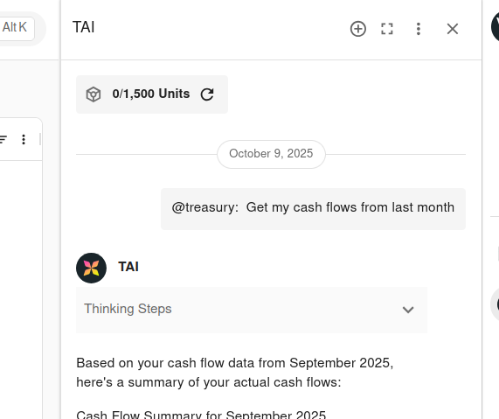

How Customers Use Kyriba Units
How will clients know when they run out of Kyriba Units?
Unit Counter
Alerts at 80% (yellow) & 95% (red)
More management features coming soon
Internal teams - unit tracking by customers
Will the agent just stop working?
YES!
Top-up required

Slide 12
Salesforce Timeline:
30th September: New TAI subscriptions were created in Salesforce
1st October: TAI Salesforce quotes were able to be created.
Quotes blocked from being approved
Expected 1st November: New legal wording for TAI
Quotes able to be approved
Expected 15th November: “TAI - agentic AI” to go-live on Quartz and Opal
Expected 31st December: “TAI - agentic AI” to go-live on all platforms except:
China, Saudi Arabia, Canada and UAE
2026 Q1 next year: Embed 1x PC21-0001 Kyriba Units - 500 & PC22-0002 TAI Agents
into cash management bundles/renewals by default but can be excluded. (Expected mid-January)
Salesforce How-to video will be sent out early next week

Slide 13
TAI: Available for Customers from Mid-November!
TAI in Production:
On track. Targeting November 15th for Quartz and Opal (mainly for customers in US & EMEA).
TAI Pricing (IMPORTANT):
Recording is distributed by Sales Enablement: TAI Pricing with Highspot link & non-Highspot link
NORAM & EMEA Live enablement sessions booked for Oct 15 and Oct 17 respectively.
TAI Content Highlights:
For easy-sharing, public accessible asset to show the customers quickly what TAI looks/can do, use the TAI landing page with a product tour embedded: https://www.kyriba.com/products/agentic-ai-tai/
Felix's recent blog on TAI is a great piece to share with customers on TAI differentiation.
If customers would like more details, there is an on-demand webinar where TomG presented TAI.
If customers still want more info such as future features, they can register for a follow-up TAI webinar that's upcoming and hosted by TomG on 21st of Oct.
Check out the internal AI FAQ if you have further questions
Review our Sales Crib Sheet
All content has been made available in HighSpot by Sales Enablement
Contact Tom Callway, Adam Bridgewater or Liang Fang if you have any further questions about TAI and TAI pricing.

Slide 14

TAI in Salesforce
FY25 Q4

Slide 15
Salesforce Timeline:
30th September: New TAI subscriptions were created in Salesforce
1st October: TAI Salesforce quotes were able to be created.
Quotes blocked from being approved
Expected 1st November: New legal wording for TAI
Quotes able to be approved
Expected 15th November: “TAI - agentic AI” to go-live on Quartz and Opal
Expected 31st December: “TAI - agentic AI” to go-live on all platforms except:
China, Saudi Arabia, Canada and UAE

Slide 16
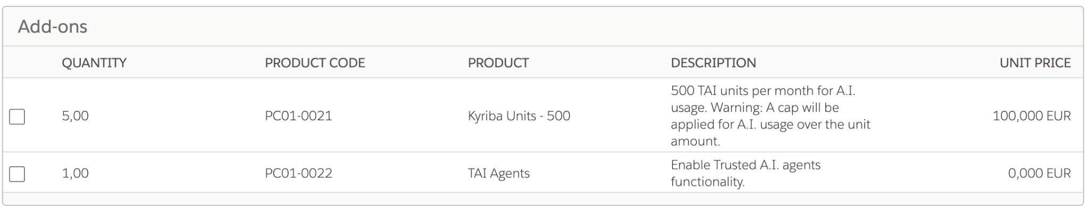
Quote: Two new SKUs
Kyriba Units - 500: Drives the number of queries the customer can perform
1x 500 units is roughly enough for 1 user, assuming roughly 100 average queries a month.
TAI agents: Zero cost and turns on TAI agents functionality/screens in Kyriba.

Slide 17
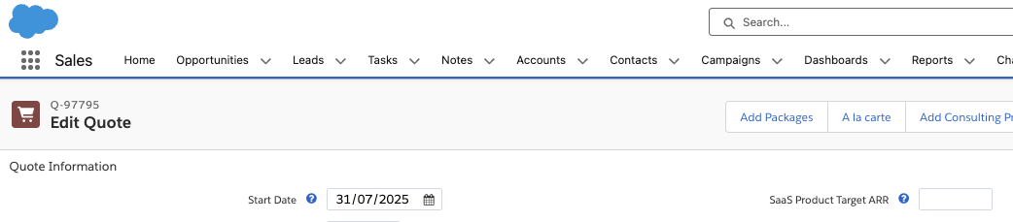
Quote: Sales add packages
A la carte is currently NOT in scope.
Please reach out if anyone sees this causing an issue for a customer.

Slide 18
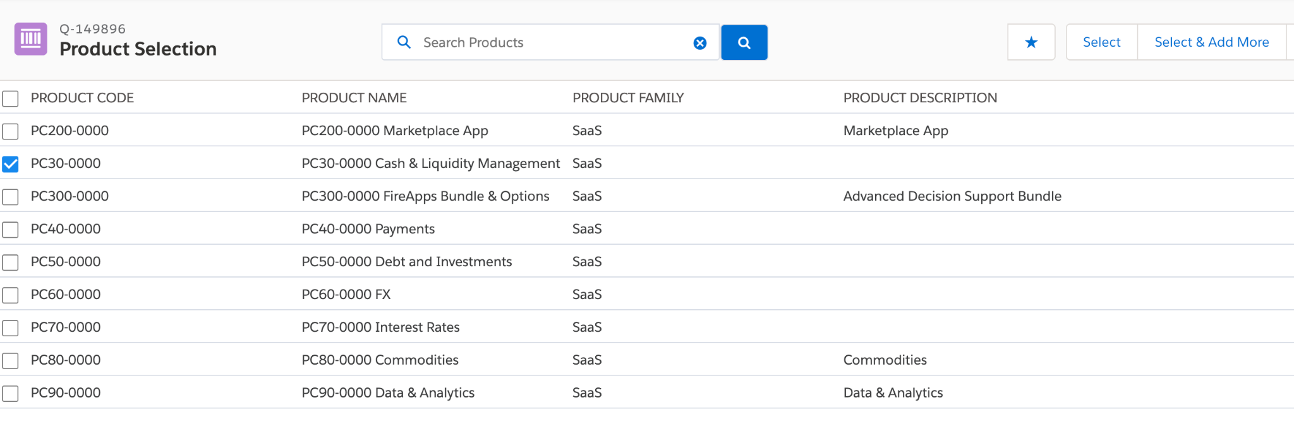
Quote: Select the cash product

Slide 19
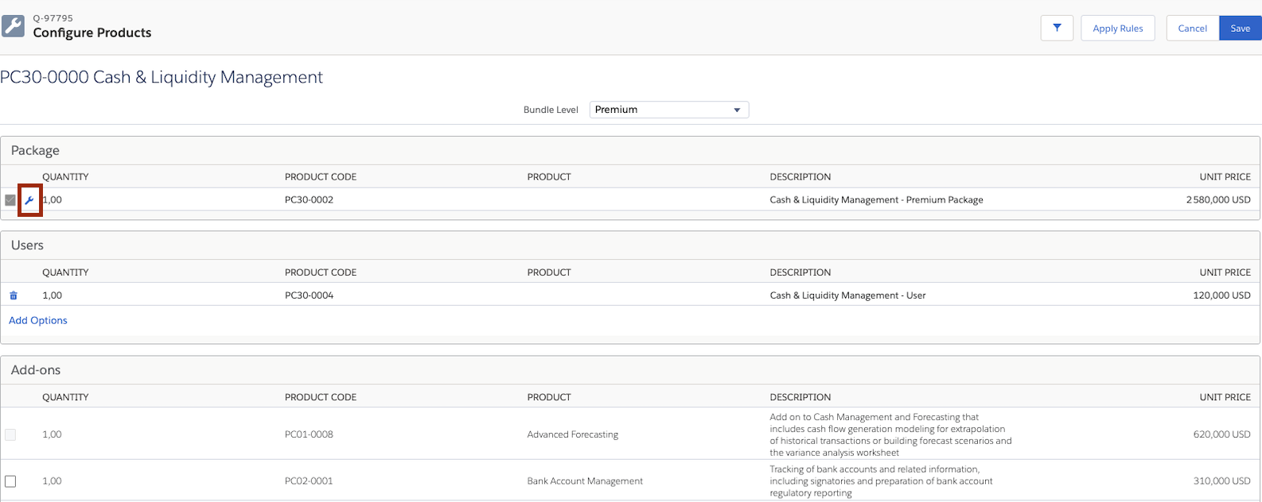
Quote: Open the package contents

Slide 20
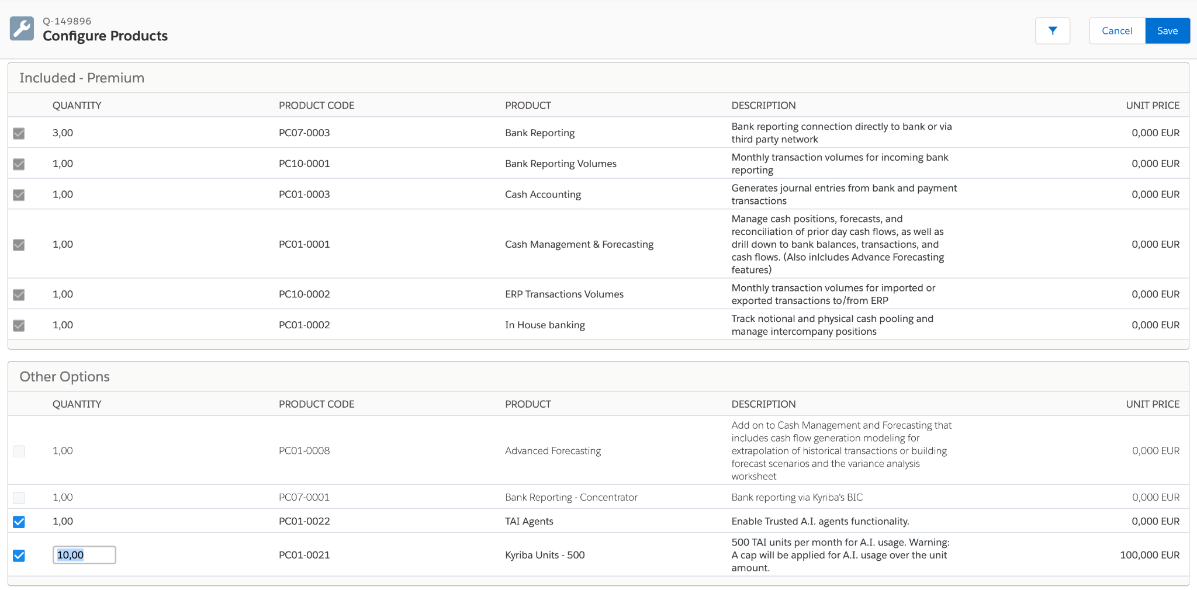
Quote: Select TAI add-ons
Each package has a minimum but more can be added

Slide 21
List of cash management modules with TAI
Package | Min add-on quantity PC01-0021 Kyriba Units - 500
PC30-0001 Cash Management - Standard Package | 5
PC30-0002 Cash Management - Premium Package | 10
PC30-0003 Cash Management - Elite Package | 25
PC01-0000 Cash And Liquidity Management | 5
PC2000-0000 Cash Bundle 1 | 5
PC2001-0000 Cash Bundle 2 | 5
PC31-0001 Cash & Liquidity Core | 5
PC31-0002 Cash & Liquidity Core Extensions | 5
PC31-0003 Cash & Liquidity Options | 5
PC32-0001 Cash & Liquidity Core | 5
PC33-0001 Cash & Liquidity Core | 5
PC34-0001 Cash & Liquidity Core | 5
PC35-0001 Cash & Liquidity Core | 5
PC36-0001 Cash & Liquidity Core | 5
PC37-0001 Cash & Liquidity Core | 5
PC1000-0001 DDA0130 - LQM Cash Pos Fore Std | 5
PC1100-0001 DDA0140 - LQM Cash Pos, Fore and ICL | 5

Slide 22
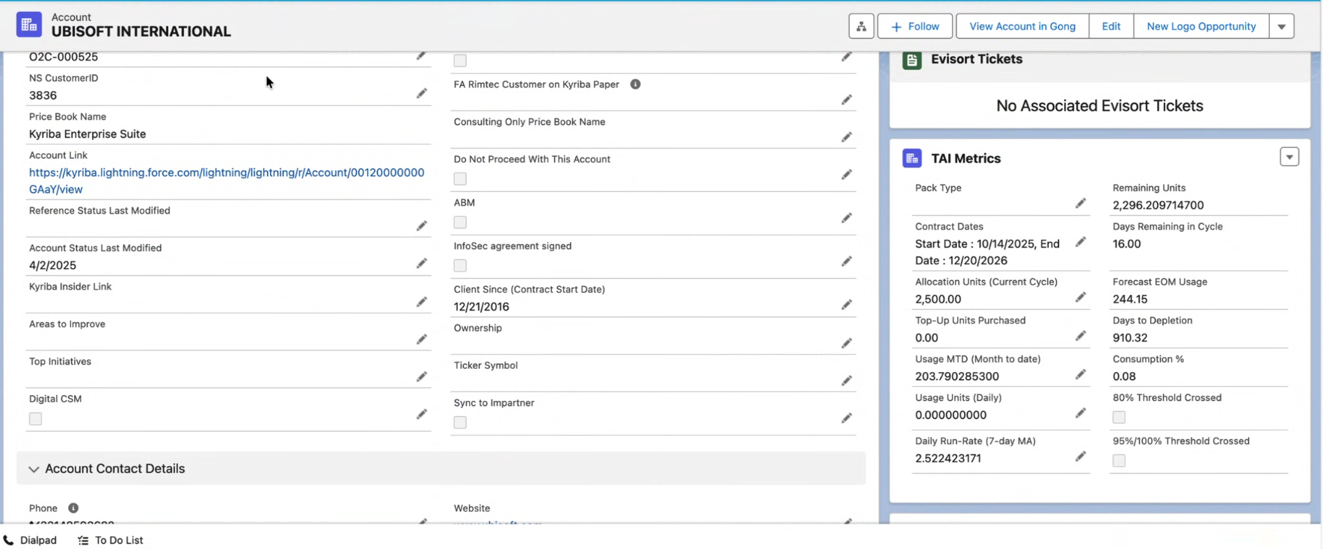
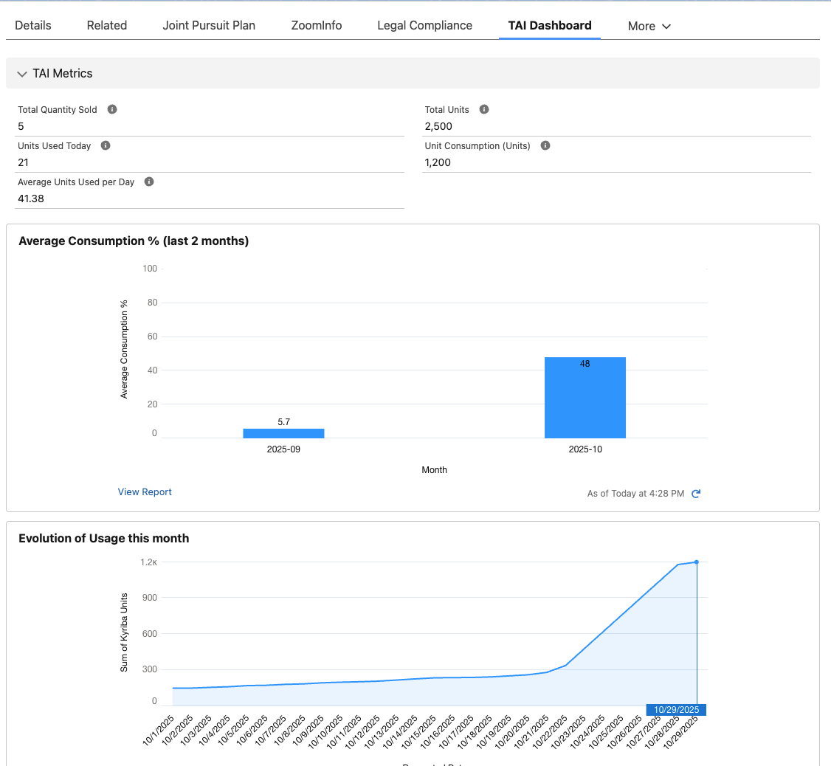
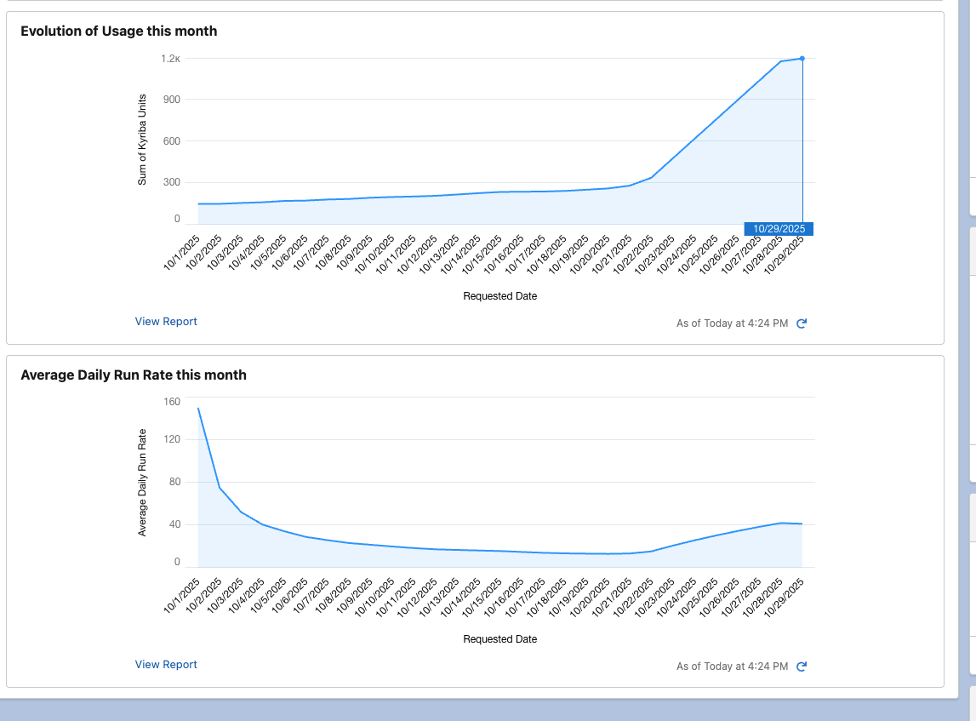
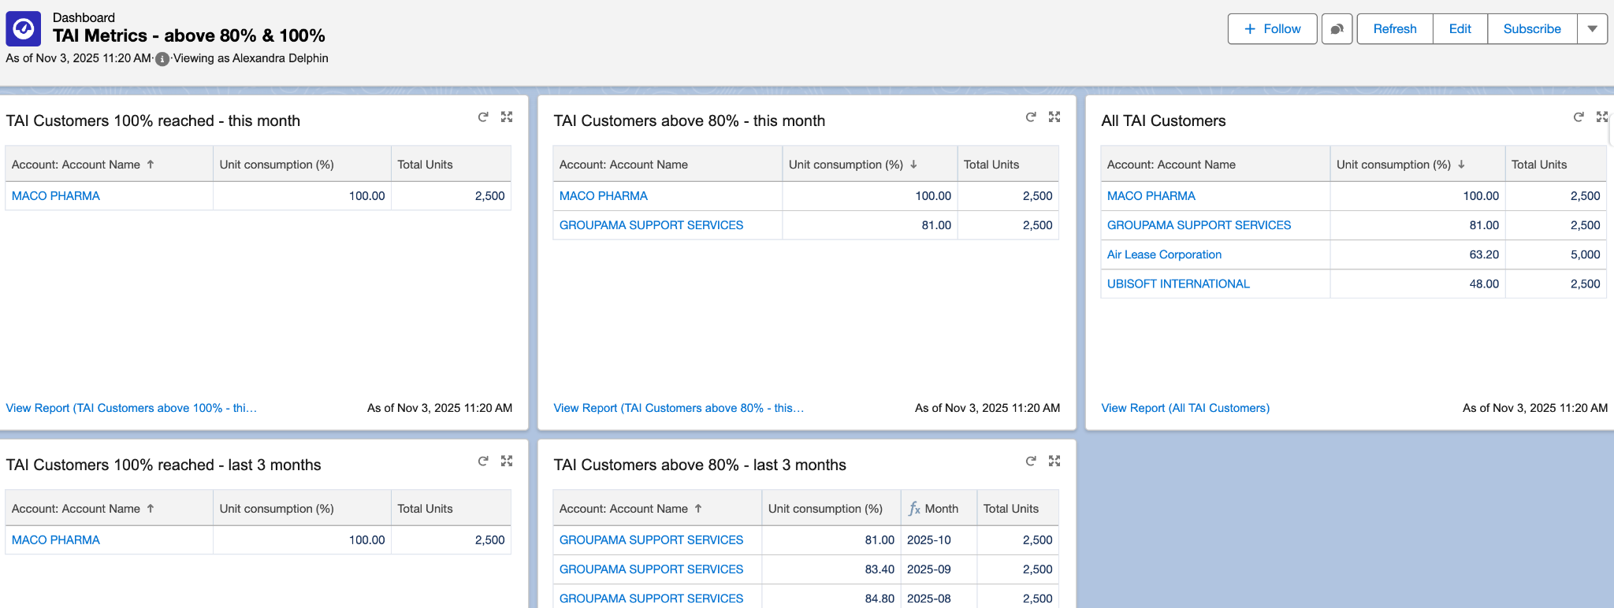
How We Monitor Kyriba Units
1
2
3

Slide 23
Thank you.
Questions?
Subtitle goes here

