Slide 1
Advanced Object Oriented Programming SCHEDULE ME
By
G.Haritha Maithreyee(2110030014)
G.Mahitha Christina(2110030147)
A.Bhavya Sri(2110030067)
G.Vaishnavi(2110030009)
Under the guidance of
Mrs.Figlu Mohanty

Slide 2
Data Set Collection
In today’s fast paced life, keeping track of all the events which has travel schedules is a tedious task.
Though there are number of event reminder and calendar applications available for android, none of them supports dynamic reminders based on user’s current location.
All the current available applications give an event reminder before a fixed amount of time from the event start time.
We are having many existing reminder apps like BZ Reminder, Ntask, Heynote, Wunder list, TickTick.

Slide 3
Tools Setups
MIT app Builder

Slide 4
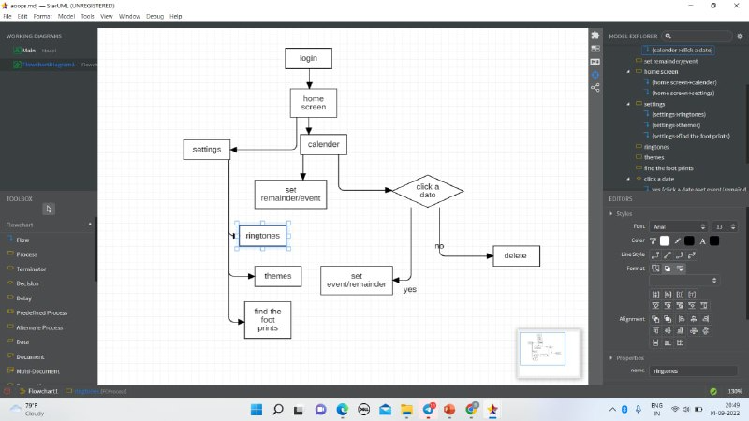
Flow Chart

Slide 5
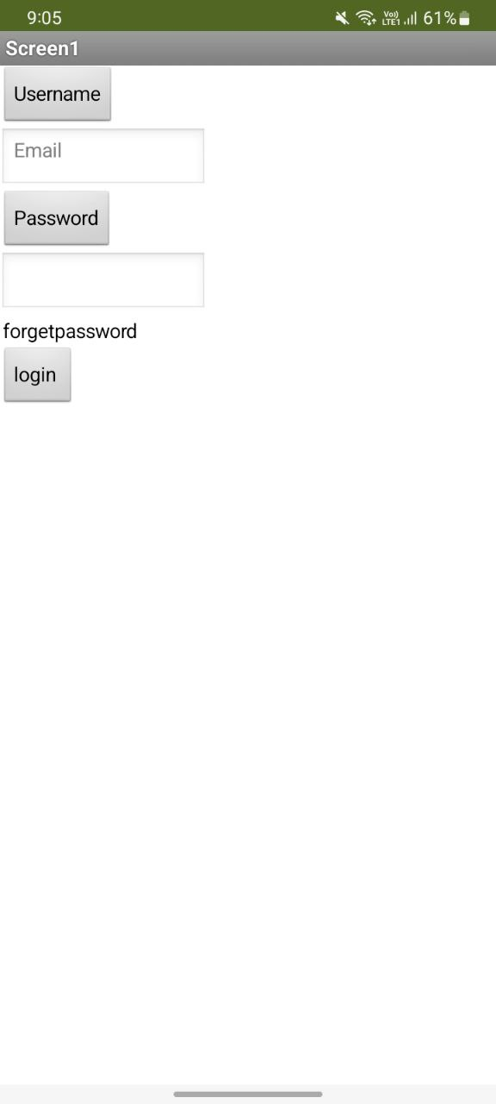
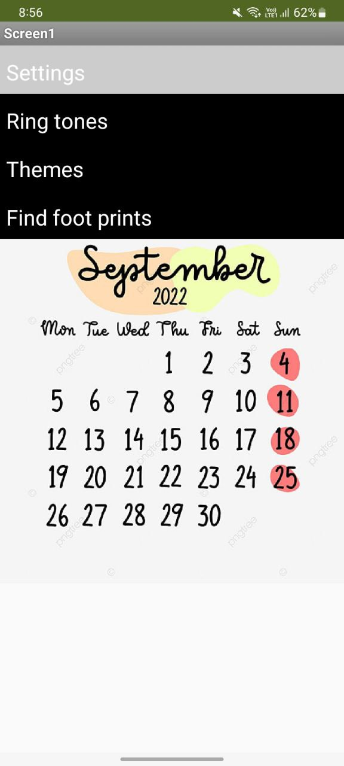
Front End

Slide 6
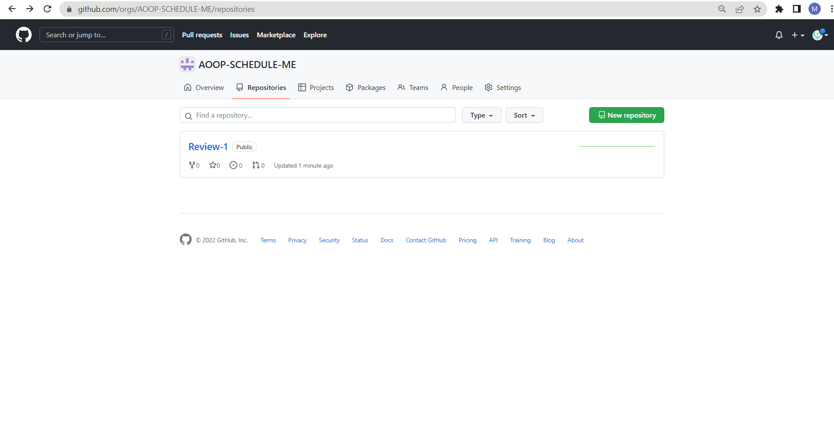
GitHub

Slide 7
Work process
To implement the project we need to undergo five phases: Communication, Planning, Modelling, Construction, Deployment.
We completed modelling phase and proceeding to construction phase.

Slide 8
THANK YOU

