Slide 1
Android Bluetooth-BSP part
Tungnt58

Slide 2



Content
Android Bluetooth Architecture
Bluetooth Workflow
HIDL and Vendor Implementation

Slide 3
Android Bluetooth Architecture
APPLICATION FRAMEWORK
Application Framework
At the application framework level is application code, which uses the android.bluetooth APIs to interact with the Bluetooth hardware. Internally, this code calls the Bluetooth process through the Binder IPC mechanism.
Apps
Android.bluetooth
Binder
APPLICATION FRAMEWORK
Bluetooth system service
Packages/apps/Bluetooth
The Bluetooth system service is package as an Android app and implements the Bluetooth services and profiles at the Android framework layer. This app calls into the native Bluetooth stack via JNI
Bluetooth Service
Bluetooth Profiles
JNI
JNI
The JNI code calls into the Bluetooth stack when certain Bluetooth operations occur, such as when devices are discovered.
Packages/apps/Bluetooth/jni
BLUETOOTH STACK
HIDL
HIDL INTERFACES
Bluetooth stack
system/bt
hardware/interfaces/Bluetooth
The stack implements the generic Bluetooth HAL and customizes it with extensions and configuration changes.
Bluetooth App layer
Vendor Implement
Vendor implementation
Bluetooth embedded system
Vendor devices interact with Bluetooth stack using the HIDL
Bluetooth Controller
Ref: https://source.android.com/docs/core/connect/bluetooth

Slide 4
Android Bluetooth Architecture
APPLICATION FRAMEWORK
BlueDroid Overview
Apps
Android.bluetooth
Binder
Bluetooth
AV(audio/video)
HF
PAN
…
APPLICATION FRAMEWORK
BTIF
Packages/apps/Bluetooth
Bluetooth Service
Bluetooth
AV(audio/video)
HF
PAN
…
Bluetooth Profiles
BlueDroid
BTA
JNI
BTM
BTU
L2CAP
HCI
…
Stack
Packages/apps/Bluetooth/jni
BLUETOOTH STACK
HIDL
HIDL INTERFACES
BTIF (Bluetooth Interface): Provide Blueroid external interface
system/bt
hardware/interfaces/Bluetooth
BTU (Bluetooth Upper Layer): undertake BTA and HCI
BTM (Bluetooth Manager): Bluetooth paring and link management
Bluetooth App layer
BTE (Bluetooth Embedded System):The internal processing of Bluedroid, subdivided into BTU, BTM and HCI
Vendor Implement
BTA (Bluetooth Application Layer): Logic implementation and processing of each profile
Bluetooth embedded system
HCI (Host controller interface: Read/Write data to Bluetooth HW
Bluetooth Controller

Slide 5
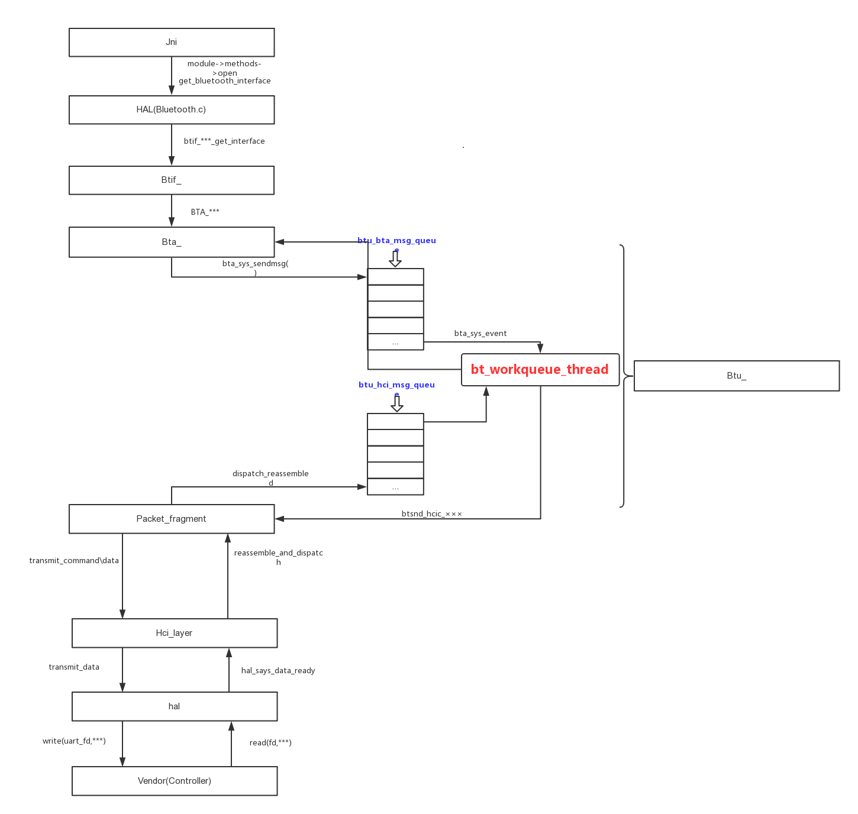
Bluetooth Workflow
BLUETOOTH STACK
system/bt
Bluetooth App layer
Bluetooth embedded system
HIDL
HIDL INTERFACES
hardware/interfaces/Bluetooth
Vendor Implement
Focus
Bluetooth Controller
Ref: https://blog.csdn.net/edmond999/article/details/115728286

Slide 6



Slide 7
HIDL and Vendor Implementation
Transmit data
Receive data
HCI Layer (system/bt/hci)
BLUETOOTH STACK
system/bt
Initialize {hci_initialize()}
Transmit data {hci_transmit()}
Bluetooth App layer
Send HCI command
Send ACL data
Send SCO data
HCI event receive
Receive ACL data
Receive SCO data
Bluetooth embedded system
HIDL Layer(hardware/interfaces/bluetooth/)
HIDL
Send HCI command
Send ACL data
Send SCO data
HCI event receive
Receive ACL data
Receive SCO data
HIDL INTERFACES
hardware/interfaces/Bluetooth
Initialize {initialize(callbacks)}
Callback funcs {IBluetoothHciCallbacks interface}
Vendor Implement
Vendor Implementation
Bluetooth Controller
Initialize {Initialize()}
write(fd…)
read(fd…)
Bluetooth Hardware

Slide 8
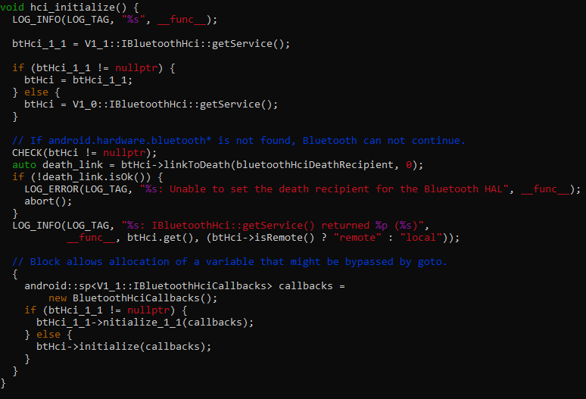
HCI Layer - Initialize
System/bt/hci/src/hci_layer_android.cc
Initialize {hci_initialize()}
Back

Slide 9
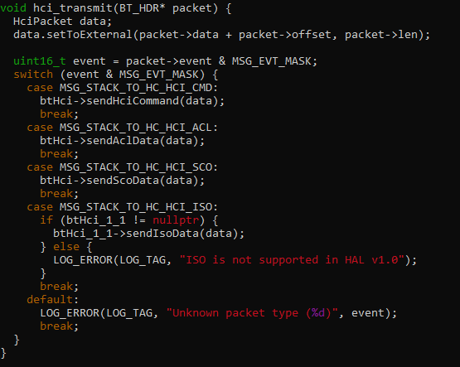
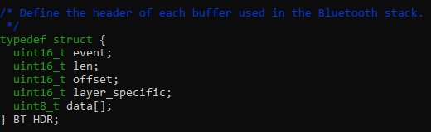
HCI Layer – Transmit data
System/bt/hci/src/hci_layer_android.cc
Transmit data {hci_transmit()}
ACL (Asynchronous Connection Less) for general data frame
SCO (Synchronous Connection Oriented) for synchronous audio frame
Back

Slide 10
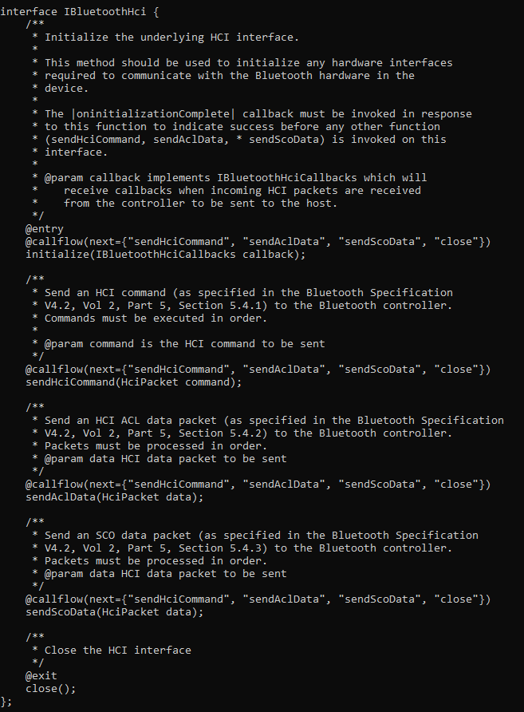
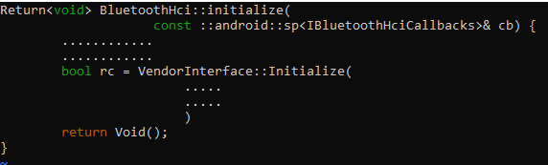
HIDL Layer– Initialize
hardware/interfaces/bluetooth/1.0/default/bluetooth_hci.cc
Initialize {initialize(callbacks)}
Back

Slide 11
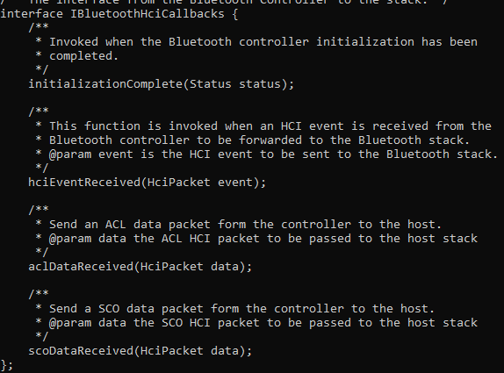
HIDL Layer – IBluetoothHciCallbacks
hardware/interfaces/bluetooth/1.0/IBluetoothHciCallbacks.hal
Callback funcs {IBluetoothHciCallbacks interface}
Back

Slide 12
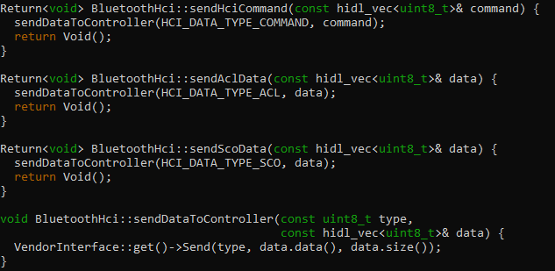
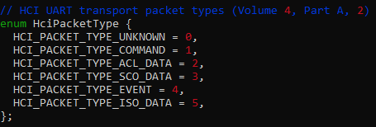
HIDL Layer– Send data
hardware/interfaces/bluetooth/1.0/default/bluetooth_hci.cc
Send data/command
hardware/interfaces/bluetooth/1.0/default/hci_internals.h
Back

Slide 13
Vendor Implementation
Vendor Implementation
User
space
Vendor_interface.cc
dlopen(libbt-vendor.so)
Initialize {Initialize()}
write(fd…)
read(fd…)
Libbt-vendor
Initialize {Initialize()}
/dev/rfkill
sysfs/rfkill
write(fd…)
read(fd…)
/dev/rfkill
sysfs/rfkill
System call (socket()- hci interface)
Devfs (dev/tty*)
Network
stack
Socket layer
net/Bluetooth/af_Bluetooth.c
Kernel space
transport layer
net/Bluetooth/hci_core.c
rfkill driver
UART driver
Socket buffer
(struct sk_buff)
rfkill driver
HCI driver
UART driver
Bluetooth Hardware
Send data via socket
Send data via UART device file
Back
Method 1
Method 2

Slide 14
Vendor Implementation-Send data via socket
Vendor Implementation
User
space
Initialize {Initialize()}
write(fd…)
read(fd…)
/dev/rfkill
sysfs/rfkill
System call (socket()- hci interface)
Network
stack
Socket layer
net/Bluetooth/af_Bluetooth.c
Kernel space
transport layer
net/Bluetooth/hci_core.c
Socket buffer
(struct sk_buff)
rfkill driver
HCI driver
UART driver
Bluetooth Hardware
Back
Send data via socket

Slide 15
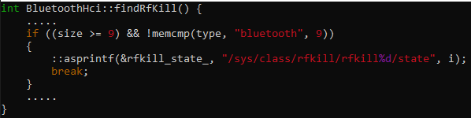
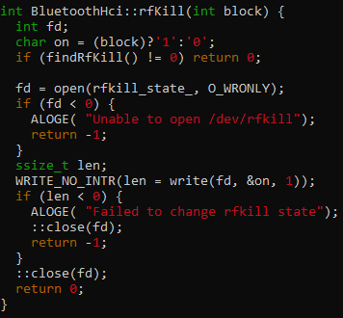
Vendor Implementation-Send data via socket
User space vendor implementation
Initialize
Power on Bluetooth device
Open socket
Initialize Callback
Send data
sendHciCommand
sendAclData
sendScoData
system/bt/vendor_libs/linux/interface/bluetooth_hci.cc

Slide 16
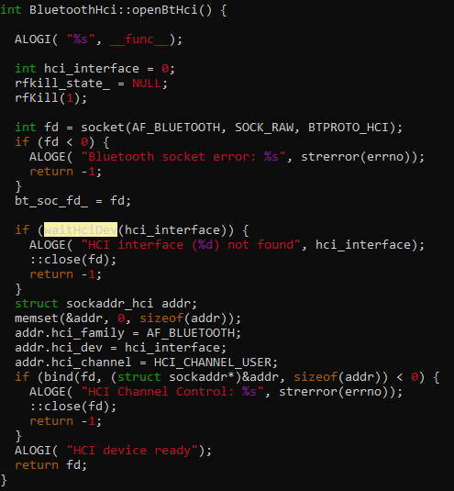
Vendor Implementation-Send data via socket
User space vendor implementation
Initialize
Power on Bluetooth device
Open socket
Initialize Callback
Send data
sendHciCommand
sendAclData
sendScoData
system/bt/vendor_libs/linux/interface/bluetooth_hci.cc

Slide 17
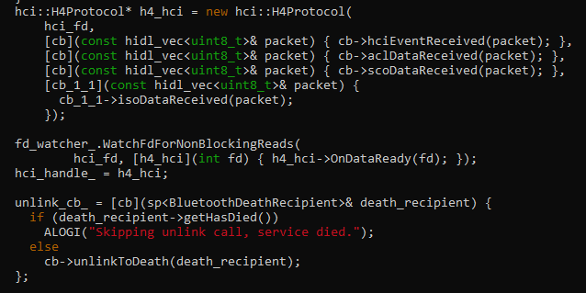

Vendor Implementation-Send data via socket
User space vendor implementation
system/bt/vendor_libs/linux/interface/bluetooth_hci.cc
Initialize
Power on Bluetooth device
Open socket
Initialize Callback
Send data
sendHciCommand
sendAclData
sendScoData
system/bt/vendor_libs/linux/interface/async_fd_watcher.cc

Slide 18
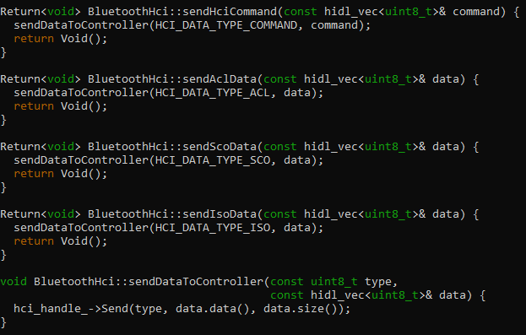
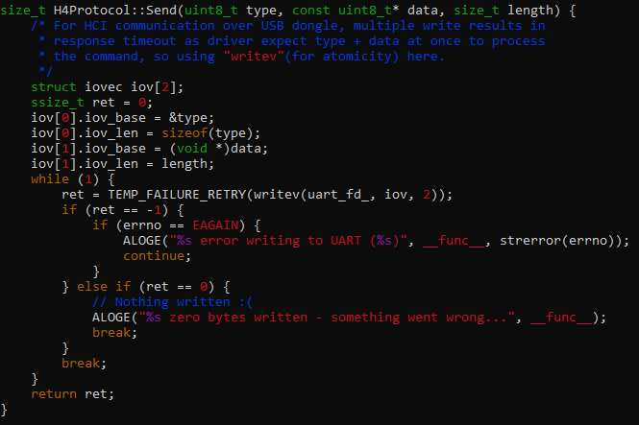
Vendor Implementation-Send data via socket
User space vendor implementation
system/bt/vendor_libs/linux/interface/bluetooth_hci.cc
Initialize
Power on Bluetooth device
Open socket
Initialize Callback
Send data
sendHciCommand
sendAclData
sendScoData
Back
system/bt/vendor_libs/linux/interface/h4_protocol.cc

Slide 19
Vendor Implementation-HCI Driver
Send data
receive data
HCI driver
Socket buffer
(struct sk_buff)
2. Register hci device
HCI device
hci_uart_send_frame
h4_recv_buf
hci_uart_open
hci_uart_close
hci_uart_receive_buf
hci_uart_write_work
hci_uart_setup
1. Register serial device driver
Serial device
serdev_device_write_buf
receive_buf
Serdev TX buffer
Serdev RX buffer
Bluetooth Hardware
Back

Slide 20
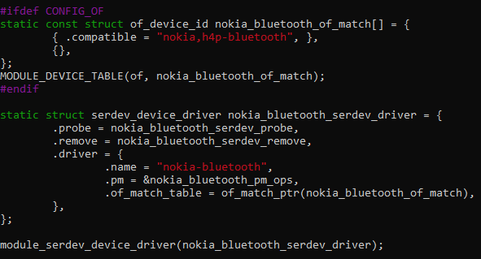
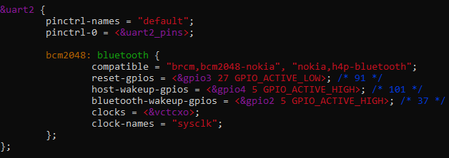
Vendor Implementation-HCI Driver
1. Register serial device driver
https://github.com/torvalds/linux/blob/master/drivers/bluetooth/hci_nokia.c
Back

Slide 21
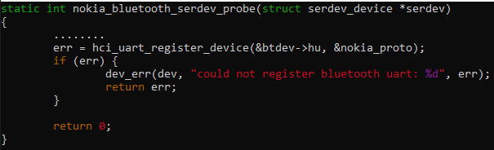
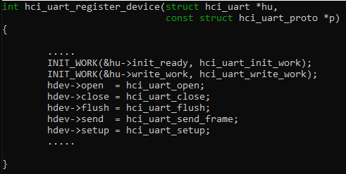
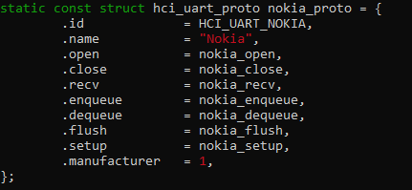
Vendor Implementation-HCI Driver
2. Register hci device
Back

Slide 22
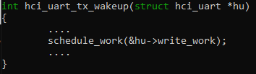
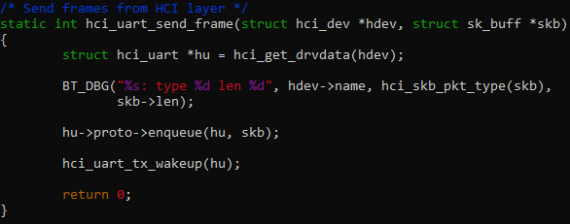
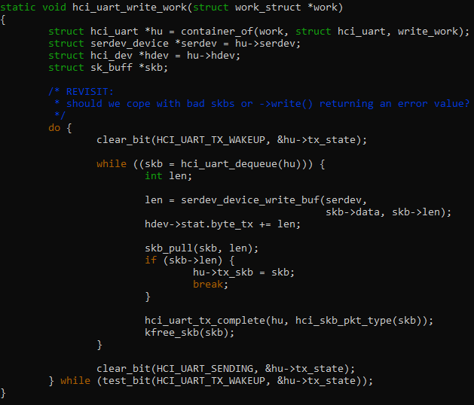
Vendor Implementation-HCI Driver
hci_uart_send_frame() workflow
Start write data
Back

Slide 23
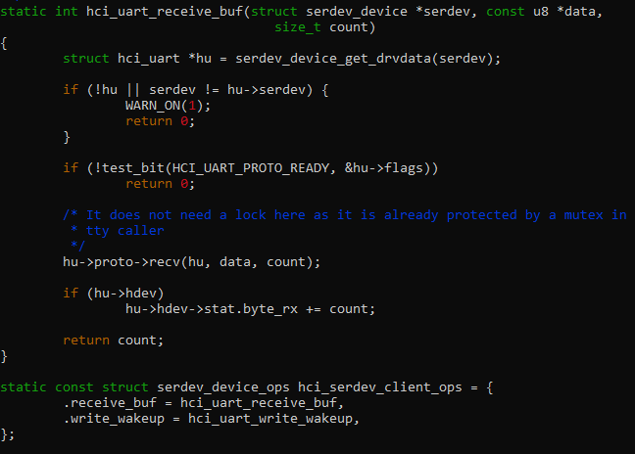
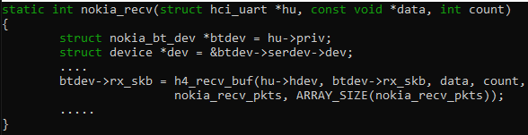
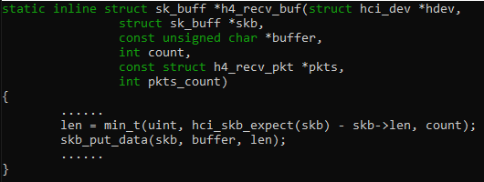
Vendor Implementation-HCI Driver
hci_uart_receive_buf() workflow
Back

Slide 24
Vendor Implementation-Send data via UART device file
Vendor Implementation
User
space
Vendor_interface.cc
dlopen(libbt-vendor.so)
Initialize {Initialize()}
Libbt-vendor
write(fd…)
read(fd…)
/dev/rfkill
sysfs/rfkill
Devfs (dev/tty*)
Kernel space
rfkill driver
UART driver
Bluetooth Hardware
Back
Send data via UART device file

Slide 25
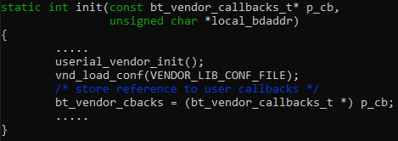
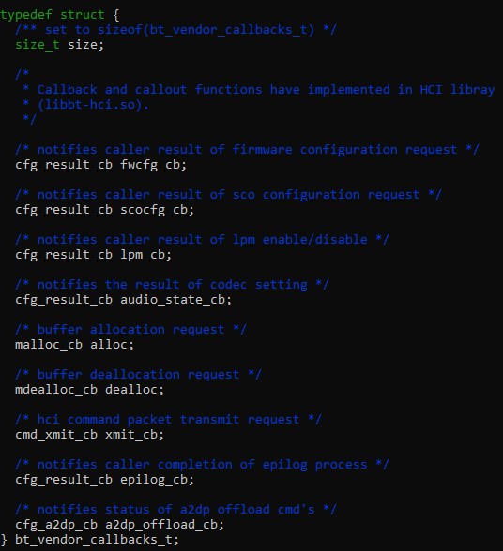
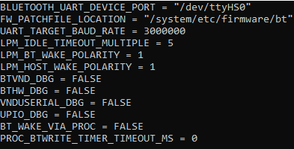
Vendor Implementation-Send data via UART device file
hardware/broadcom/libbt/src/bt_vendor_brcm.c
hardware/interfaces/bluetooth/1.0/default/bt_vendor_lib.h
Libbt-vendor
Initialize {init()}
Cleanup()
Create dynamic library entry point
hardware/broadcom/libbt/include/vnd_anthias.txt
Vendor specific operation {*op()}

Slide 26
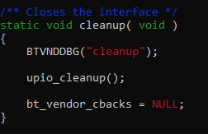
Vendor Implementation-Send data via UART device file
Libbt-vendor
hardware/broadcom/libbt/src/bt_vendor_brcm.c
Initialize {init()}
Cleanup()
Create dynamic library entry point
Vendor specific operation {*op()}

Slide 27
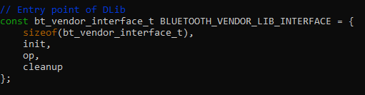
Vendor Implementation-Send data via UART device file
Libbt-vendor
hardware/broadcom/libbt/src/bt_vendor_brcm.c
Initialize {init()}
Cleanup()
Create dynamic library entry point
Vendor specific operation {*op()}

Slide 28
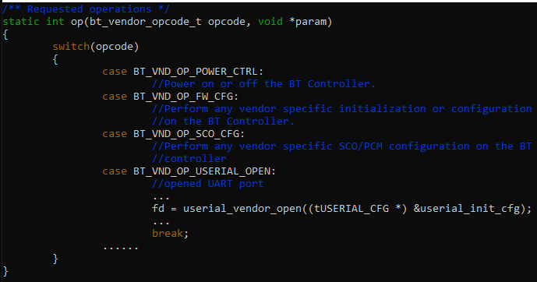
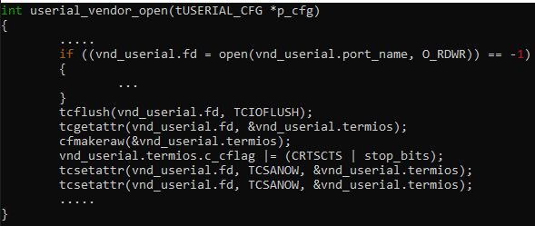
Vendor Implementation-Send data via UART device file
hardware/broadcom/libbt/src/bt_vendor_brcm.c
Libbt-vendor
Initialize {init()}
Cleanup()
Create dynamic library entry point
Vendor specific operation {*op()}
hardware/broadcom/libbt/src/userial_vendor.c

Slide 29
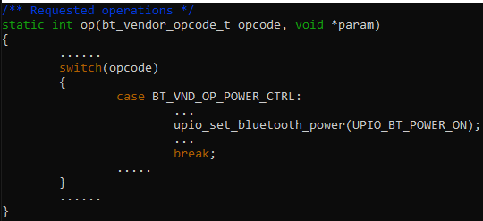
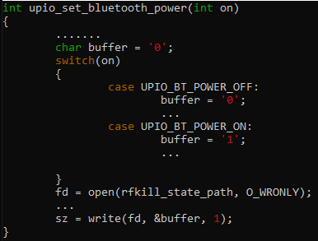
Vendor Implementation-Send data via UART device file
hardware/broadcom/libbt/src/bt_vendor_brcm.c
Libbt-vendor
Initialize {init()}
Cleanup()
Create dynamic library entry point
Vendor specific operation {*op()}
Back
hardware/broadcom/libbt/src/upio.c

Slide 30
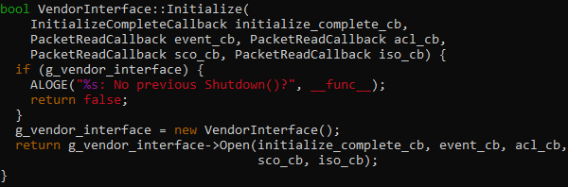
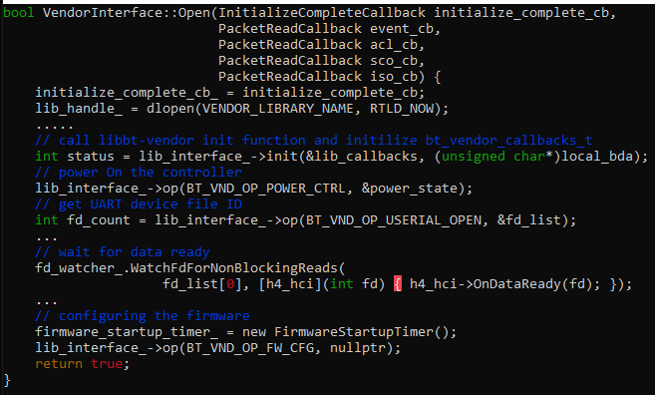
Vendor Implementation-Send data via UART device file
hardware/broadcom/libbt/src/bt_vendor_brcm.c
Vendor_interface.cc
Initialize {init()}
Send data functions
hardware/broadcom/libbt/src/userial_vendor.c

Slide 31
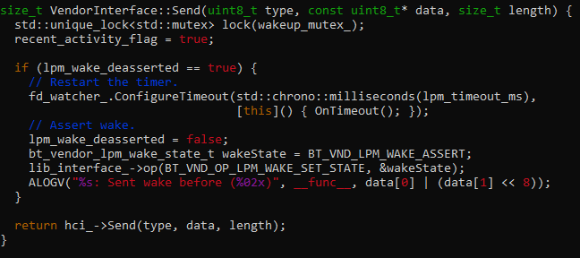
Vendor Implementation-Send data via UART device file
hardware/interfaces/bluetooth/1.0/default/vendor_interface.cc
Vendor_interface.cc
Initialize {init()}
Send data functions
Back
hardware/interfaces/bluetooth/1.0/default/h4_protocol.cc

Slide 32

THANKS

