Slide 1
Assessing Diabetes Readmission with Machine Learning
Prepared by Alexander Olden

Slide 2
QUESTION TO ANSWER
Which medical variables predict hospital readmission within 30 days among diabetes patients?
Of particular interest: measurement of HbA1c (glycated hemoglobin), which forms when red blood cells join with glucose in the body
Original researchers were interested in potential link between HbA1c and hyperglycemia.

Slide 3
Data attributes and limitations
102,000 observations and 50 variables to start
Binary dependent variable: readmitted (or not) within 30 days
Potential sources of bias addressed:
Multiple encounters per patient
Discharges to hospice or due to death

Slide 4
missing data
Weight, payer code, and attending-physician specialty dropped (> 50% missing)
ID variables also dropped (no predictive value)
Other variables with less than 3% missing
Removed only rows with relevant values missing

Slide 5
Variable adjustments
Grouping of diagnosis codes
HbA1c test as binary
Four categories initially
Number of patient visits
Created in removal of multiple patient visits

Slide 6
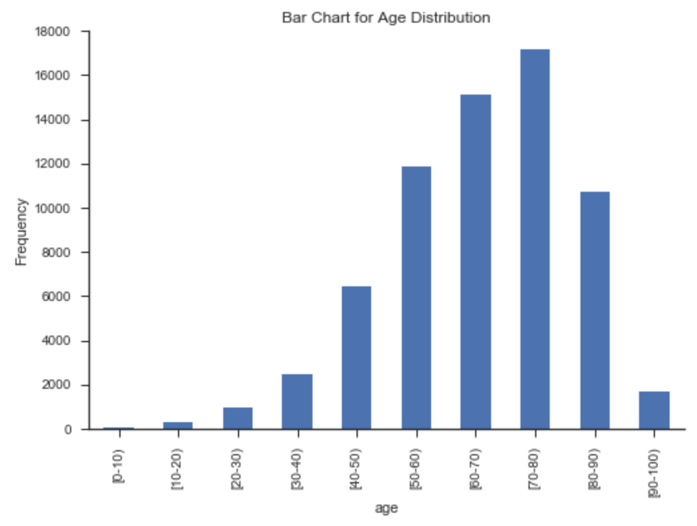
Exploratory analysis
Patient age skews older.

Slide 7
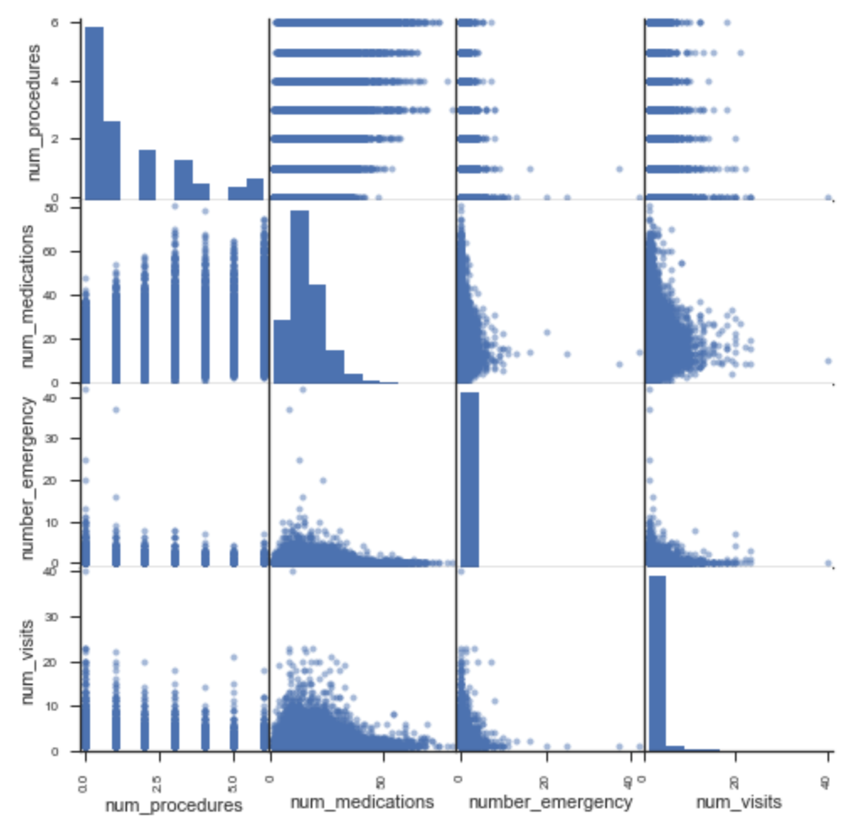
Exploratory analysis
Multicollinearity is likely not an issue for key predictor variables.

Slide 8
Exploratory analysis
Chi-square test for independence between HbA1c test and dependent variable.
HbAlc Test? | Readmission Within 30 Days No Yes All
No | 49718 | 5033 | 54751
Yes | 11052 | 1041 | 12093
All | 60770 | 6074 | 66844
Patients with HbA1c levels tested were less likely to be readmitted within 30 days than were untested patients, and the relationship is not due to chance.

Slide 9
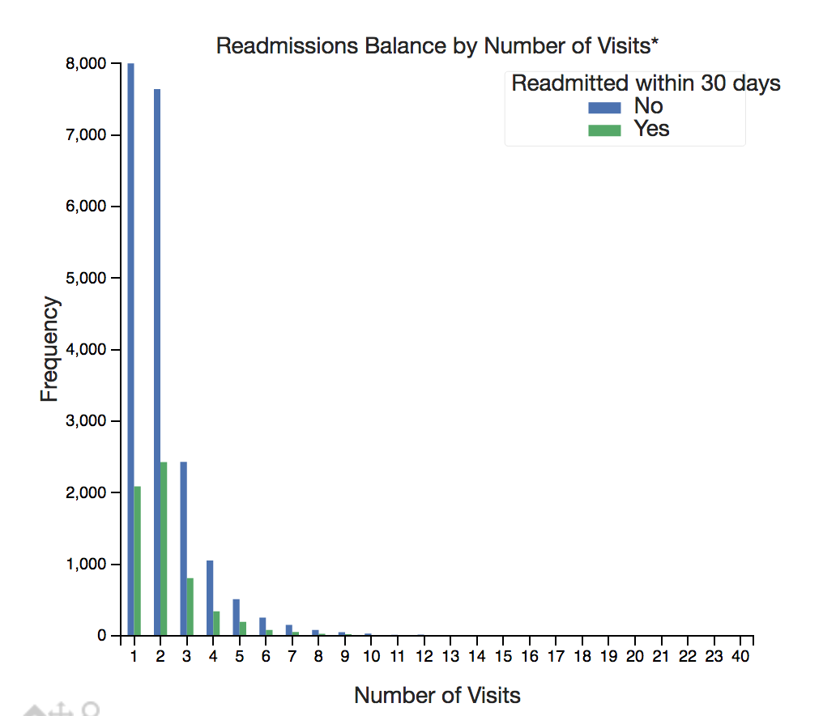
Exploratory analysis
Number of hospital visits may have predictive power.

Slide 10
preprocessing
Bin the number of lab procedures
range of 1-132 with heavy skew initially
Change potentially useful IDs (e.g., admission type) to categorical
One-hot encoding

Slide 11
Logistic regression
Good for predicting categorical outcomes
coefficients give log odds
Direct comparison with results from original research
80-20 split of training and test data

Slide 12
Logistic regression: Model building
Regularization parameter for non-linear splitting
variance-bias tradeoff
L2 penalty to control overfitting
Weighting of positive and negative cases (.9 and .1)
Initial results
Accuracy scores of 80.85 percent and 82.44 percent for the training and test data, respectively
For positive class, precision was .26 and recall was .5 in training data.
Performance metrics for test data were equally discouraging.

Slide 13
Logistic regression: imbalanced data
Ratio of non-readmitted to readmitted about 11:1
not fixed by weights in model
Correction through random undersampling and SMOTE oversampling methods
Tradeoff: reduced global accuracy (72.8% for training and 72.5% for test) for improved precision and recall

Slide 14
Logistic regression: imbalanced data
 | Training Data | Test Data
Precision | 75.2 | 75.5
Recall | 67.5 | 67.5
Precision is slightly higher for test data.
Although the difference is small, minor underfitting may have ensued in correcting the imbalance in the dependent variable.

Slide 15
Logistic regression: important predictors
Variable | Coefficient
num_visits | 0.589403
number_inpatient | 0.284375
discharge_disposition_id_3 | 0.180511
discharge_disposition_id_22 | 0.138675
first_diag_injury | 0.082984

Slide 16
Logistic regression: comparisons
The original researchers found medical specialty of “none” to have the highest coefficient.
They also found discharge disposition ID of “other” as second highest.
aligns with some combination of my third and fourth coefficients
They also categorized discharge IDs into “home” and “other” but did not offer more information on categorizing ID numbers from the original data.
HbA1c was associated with not being readmitted within 30 days, but it was not a top predictor in my model.

Slide 17
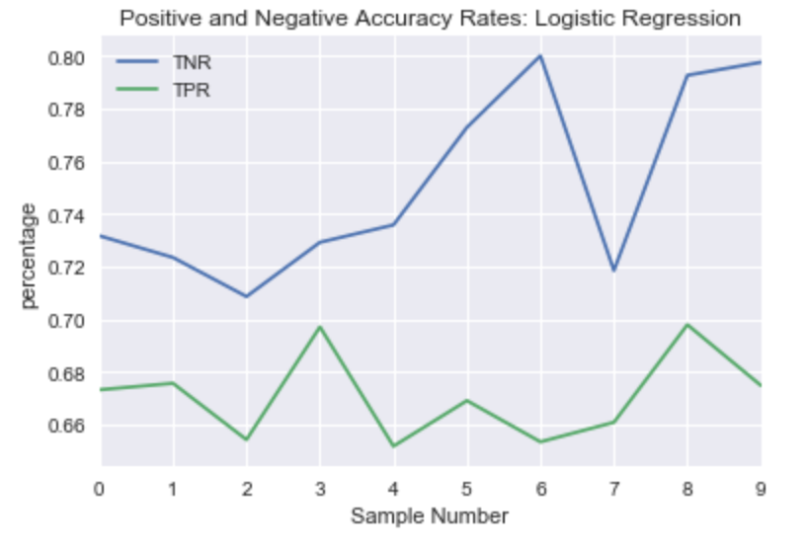
Checking imbalance corrections
Random undersampling and SMOTE on loops of 10 samples
Finding true positive and true negative rates each time

Slide 18
Tree-based methods: random forests
Initial model used weights for classes of dependent variable
Results were poor, similar to logistic regression
Global accuracy of 90.84%, but precision and recall were 25.3% and 1.6%, respectively.
Used random undersampling and SMOTE again

Slide 19
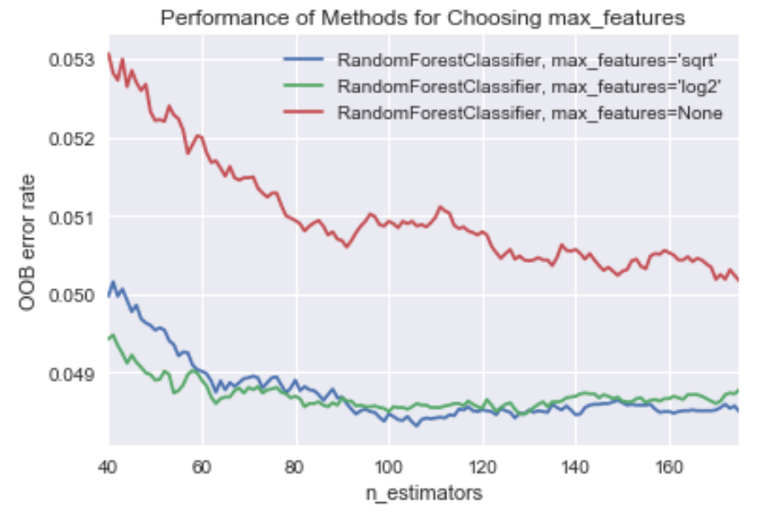
random forests: tuning parameters
Examine number of estimators (65), maximum number of variables (log2), and maximum tree depth (7)
Out-of-bag (OOB) error as metric

Slide 20
random forests: results
Random forest measures importance with Gini importance.
Variable | Importance
num_visits | 0.2438
race_Caucasian | 0.0452
admission_source_id_7 | 0.0444
number_inpatient | 0.0378
third_diag_other | 0.0339

Slide 21
Logistic regressi0n vs. random forest
Mutually important variables:
number of visits
number of inpatient visits
discharge disposition IDs 3 and 22
age bracket 70-80
Neither chose HbA1c as a top predictor.
Random forest is likely the better model.
better performance metrics
may handle continuous variables better
benefits of ensemble approach

Slide 22
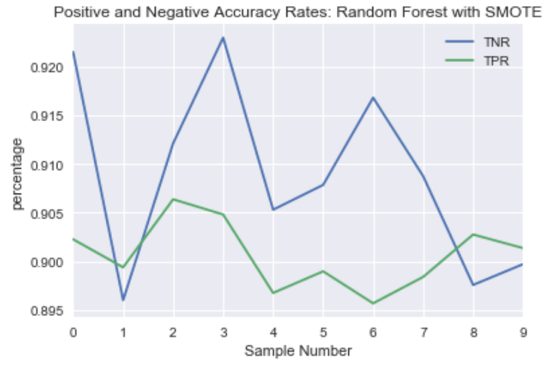
Checking imbalance corrections for random forest

Slide 23
Summary and future work
Logistic regression
Transform continuous variables for more normal distributions
Ensemble model
Combine logistic regression and random forest using predicted probabilities from each
Interaction terms used by original researchers
Especially with HbA1c and primary diagnosis

Slide 24
recommendations
HbA1c is a predictor of not being readmitted within 30 days, but it does not have as much predictive value as other variables do.
Closely monitor previous number of patient visits and inpatient visits.
Learn more about discharge disposition IDs (what the numbers indicate).

Slide 25
references
1. Beata Strack, Jonathan P. DeShazo, Chris Gennings, Juan L. Olmo, Sebastian Ventura, Krzysztof J. Cios, and John N. Clore, “Impact of HbA1c Measurement on Hospital Readmission Rates: Analysis of 70,000 Clinical Database Patient Records,” BioMed Research International, vol. 2014, Article ID 781670, 11 pages, 2014.
2. This data set was obtained from a previous study done to explore a similar problem. It included about 102,000 observations and 50 variables. More information is available here: http://archive.ics.uci.edu/ml/datasets/Diabetes+130-US+hospitals+for+years+1999-2008.
3. @article{JMLR:v18:16-365, author = {Guillaume Lema{{\^i}}tre and Fernando Nogueira and Christos K. Aridas}, title = {Imbalanced-learn: A Python Toolbox to Tackle the Curse of Imbalanced Datasets in Machine Learning}, journal = {Journal of Machine Learning Research}, year = {2017}, volume = {18}, number = {17}, pages = {1-5}, url = {http://jmlr.org/papers/v18/16-365.html} }
4. @article{scikit-learn, title={Scikit-learn: Machine Learning in {P}ython}, author={Pedregosa, F. and Varoquaux, G. and Gramfort, A. and Michel, V. and Thirion, B. and Grisel, O. and Blondel, M. and Prettenhofer, P. and Weiss, R. and Dubourg, V. and Vanderplas, J. and Passos, A. and Cournapeau, D. and Brucher, M. and Perrot, M. and Duchesnay, E.}, journal={Journal of Machine Learning Research}, volume={12}, pages={2825--2830}, year={2011} }

