Slide 1
Assessing Diabetes Readmission with Machine Learning
Prepared by Alexander Olden

Slide 2
QUESTION TO ANSWER
Which medical variables predict hospital readmission within 30 days among diabetes patients?
Of particular interest: measurement of HbA1c (glycated hemoglobin), which forms when red blood cells join with glucose in the body
Original researchers were interested in potential link between HbA1c and hyperglycemia.

Slide 3
Data attributes and limitations
102,000 observations and 50 variables to start
Binary dependent variable: readmitted (or not) within 30 days
Potential sources of bias addressed:
Multiple encounters per patient
Discharges to hospice or due to death

Slide 4
missing data
Weight, payer code, and attending-physician specialty dropped (> 50% missing)
ID variables (no predictive value)
Other variables with less than 3% missing
Removed only rows with relevant values missing

Slide 5
Variable adjustments
Group diagnosis codes
HbA1c test as binary
Four categories initially
Number of patient visits
Created in removal of multiple patient visits

Slide 6
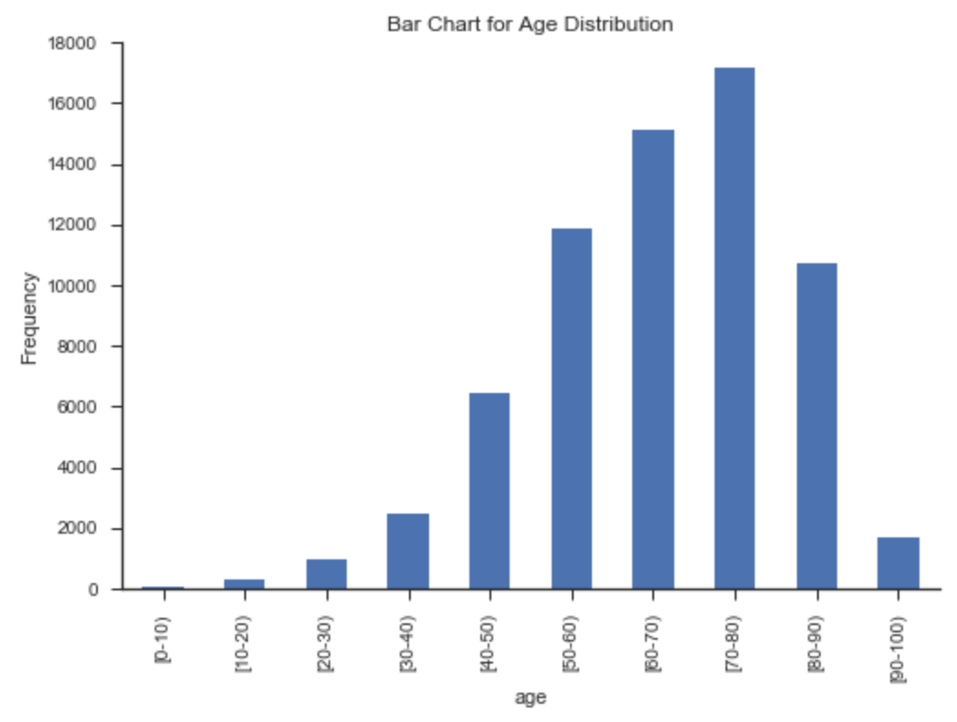
Exploratory analysis
Patient age skews older.

Slide 7
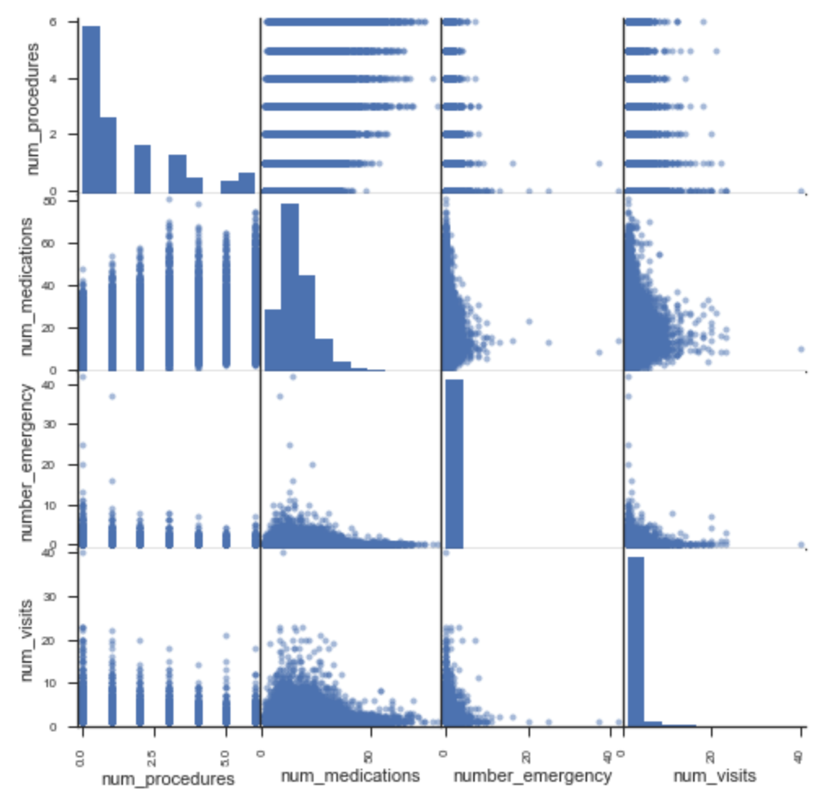
Exploratory analysis
Multicollinearity likely not an issue for key predictor variables.

Slide 8
Exploratory analysis
Chi-square test for independence
HbAlc Test? | Readmission Within 30 Days No Yes All
No | 49718 | 5033 | 54751
Yes | 11052 | 1041 | 12093
All | 60770 | 6074 | 66844
Patients with HbA1c levels tested were less likely to be readmitted within 30 days than were untested patients, and the relationship is not due to chance.

Slide 9
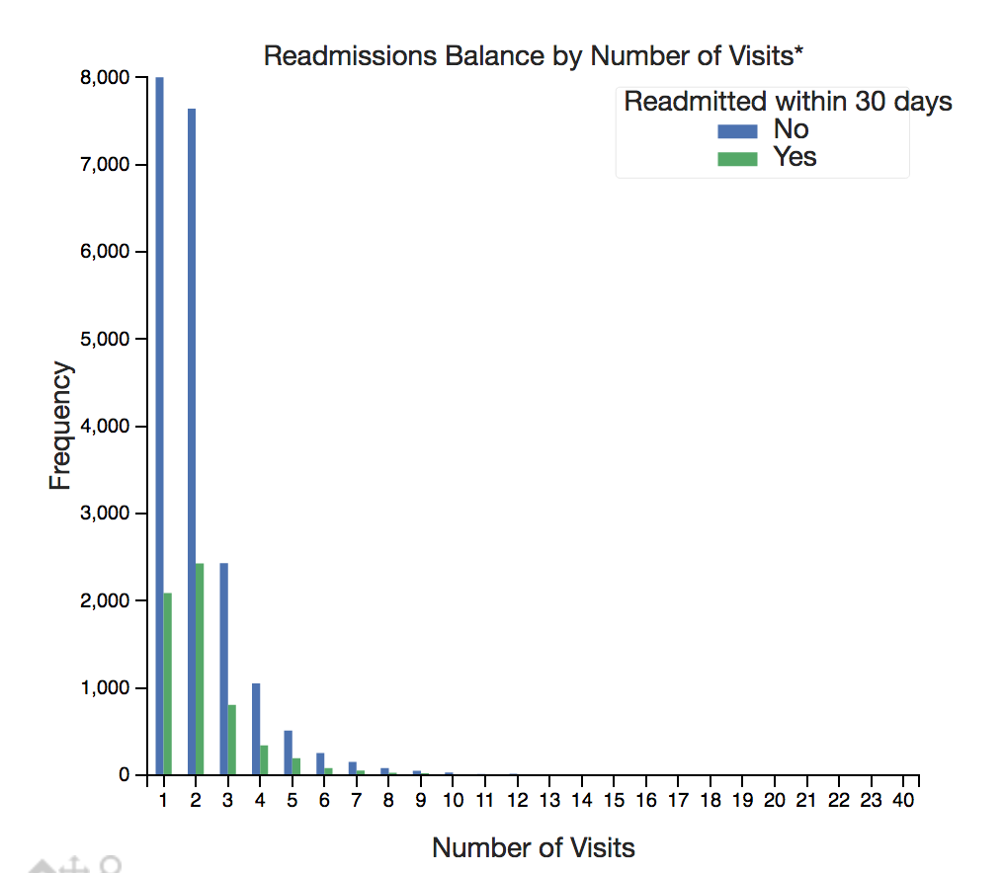
Exploratory analysis
Number of hospital visits may have predictive power.

Slide 10
preprocessing
Bin number of lab procedures
range of 1-132 with heavy skew initially
Change potentially useful IDs (e.g., admission type) to categorical
One-hot encoding

Slide 11
Logistic regression: Choices
Good for predicting categorical outcomes
coefficients give log odds
Direct comparison with results from original research
80-20 split of training and test data

Slide 12
Logistic regression: Model building
Regularization parameter for non-linear splitting
variance-bias tradeoff
L2 penalty to control overfitting
Weighting of positive and negative cases (.9 and .1)
Initial results
Accuracy scores of 80.85 percent and 82.44 percent for the training and test data, respectively
For positive class, precision was .26 and recall was .5 in training data.
Performance metrics for test data were equally discouraging.

Slide 13
Resume p.11 of report

