Slide 1
HANDWRITTEN CHARACTER RECOGNITION USING MACHINE LEARNING
Springboard DSC Capstone Project II
Prepared by Alexander Olden
November 2017

Slide 2
QUESTION TO ANSWER
Which algorithm best classifies handwritten digits: logistic regression, random forests, or neural networks?
Of particular interest: learning more about the implementation of neural networks
Image analysis presents different challenges than more conventional numerical datasets do.

Slide 3
Data attributes
MNIST dataset (70,000 observations)
Accessed through fetch_mldata in sklearn.datasets library in Python
2 components: handwritten digit (flattened) and image label
Vector of 70,000 integer values (0-9) as dependent variable
No missing data, and no preprocessing needed

Slide 4
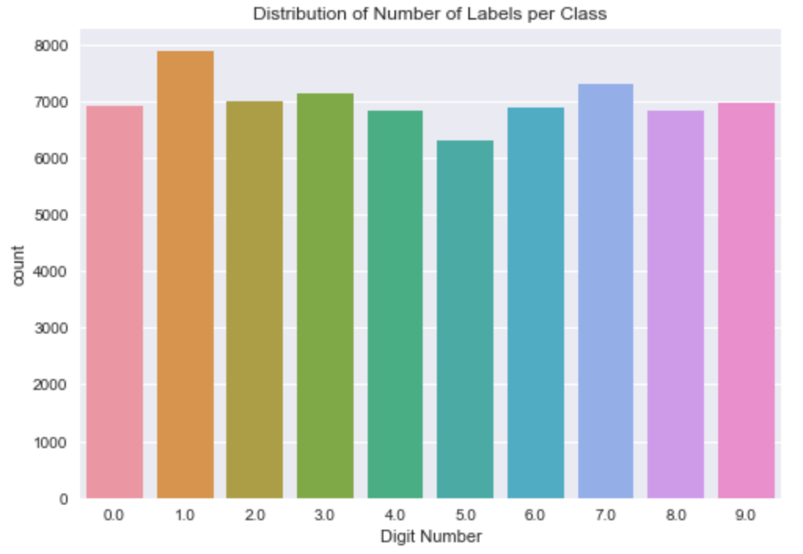
Balance of integer classes
The frequencies of each label (0-9) are reasonably balanced.

Slide 5
Logistic regression
Baseline algorithm for comparisons in solving multinomial classification problems
Created base model, then tuned regularization parameters to control overfitting
L1 parameter with SAGA solver to balance bias-variance trade-off
Tolerance adjusted to expedite computation
80-20 split of training and test data

Slide 6
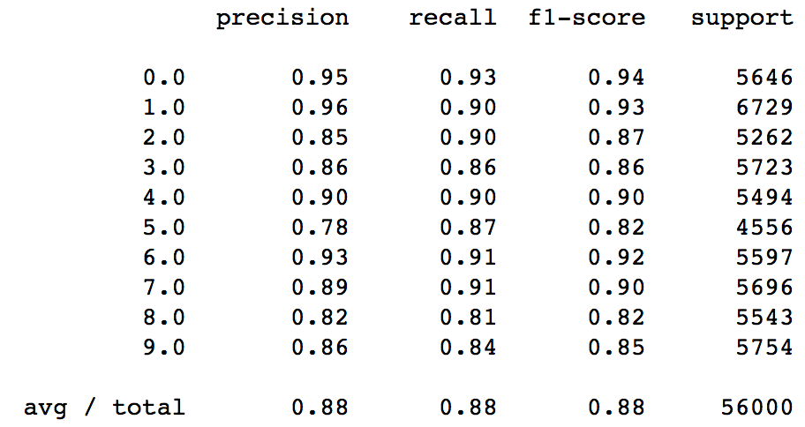
Logistic regression
Classification report for training data

Slide 7
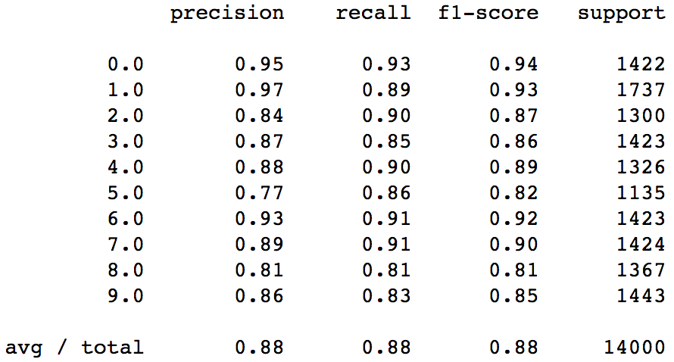
Logistic regression
Classification report for test data

Slide 8
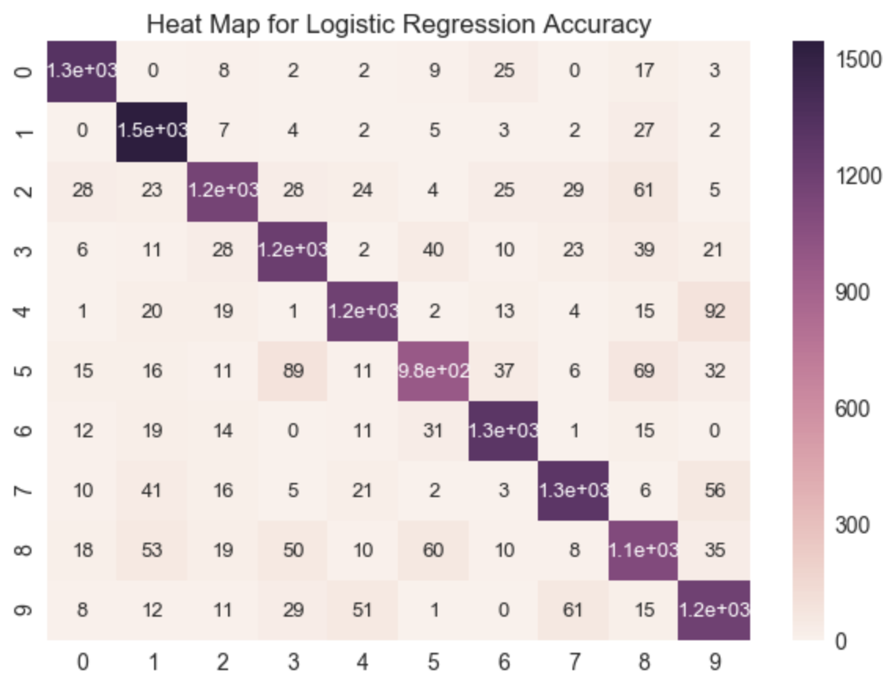
Logistic regression: heat map

Slide 9
Random forest
Classifications using split points (nodes in trees)
Benefits of ensemble model
Parameter tuning – drop in accuracy to improve generalization
Maximum number of features, maximum depth, maximum number of trees

Slide 10
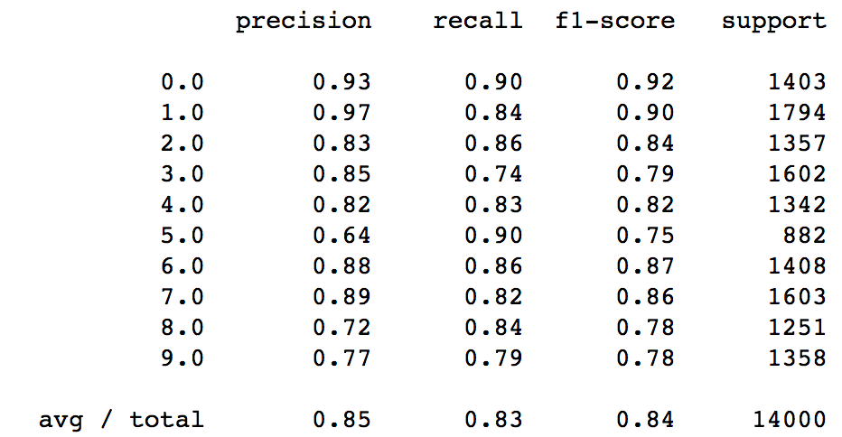
Random forest: Classification report

Slide 11
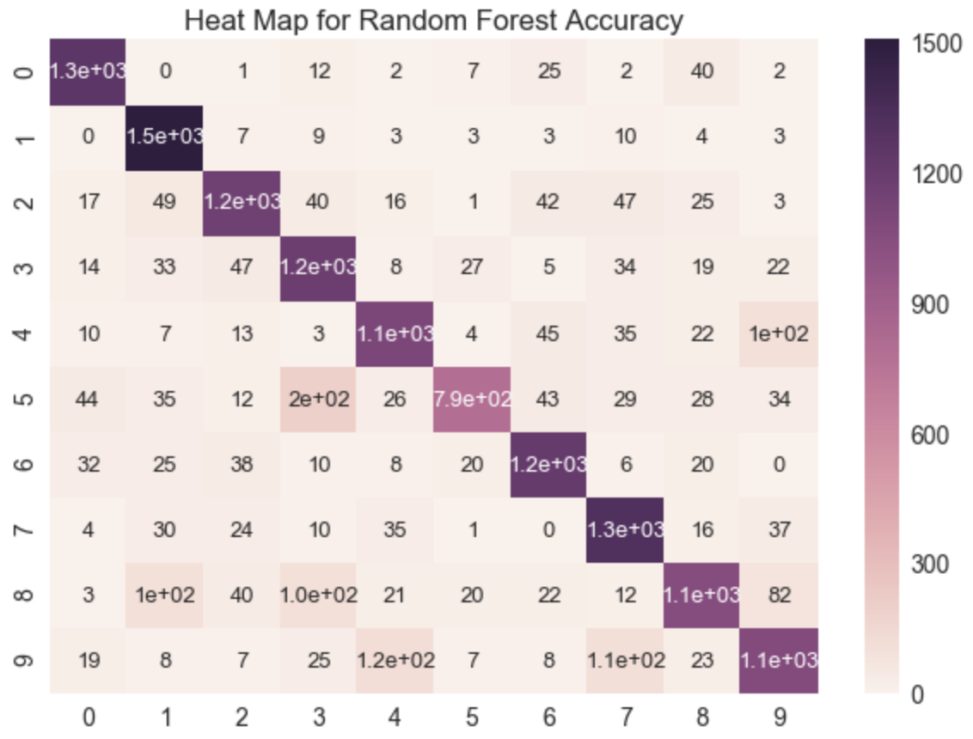
Random forest: heat map

Slide 12
Neural network
“adam” solver to balance computational demand and advanced weighting
Logistic activation function
Alpha value of .01 for regularization
3-layer multi-layer perceptron network
Input layer (784 units), hidden layer (default 100 units), output layer (10 units)
Linear combinations of prior layers

Slide 13
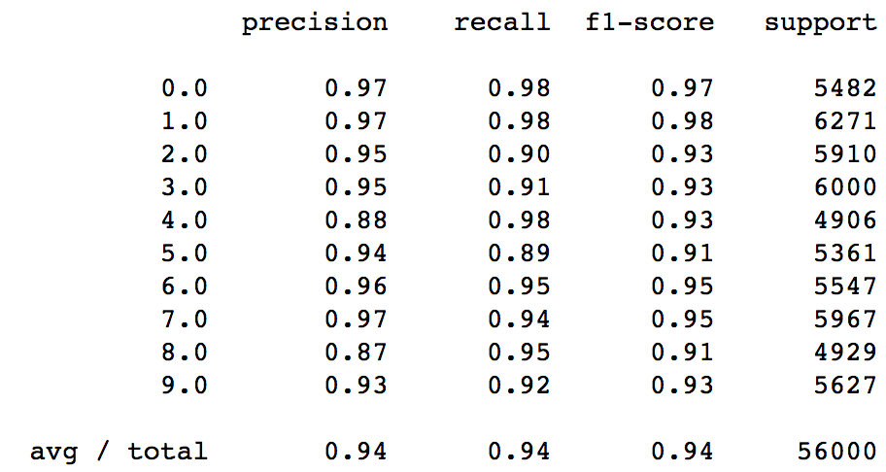
Neural network
Classification report for training data

Slide 14
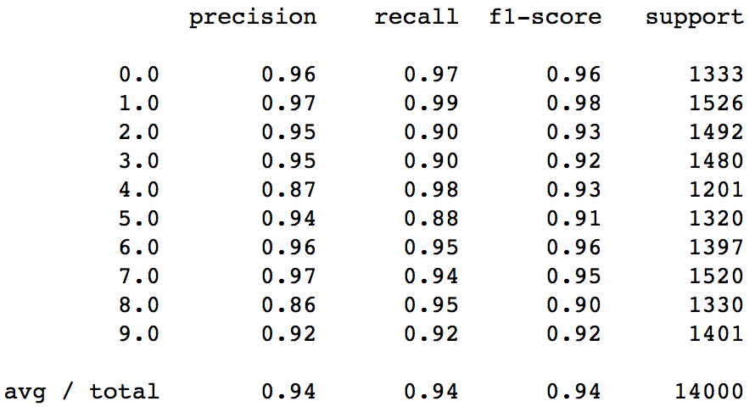
Neural network
Classification report for test data

Slide 15

Neural network: heat map

Slide 16
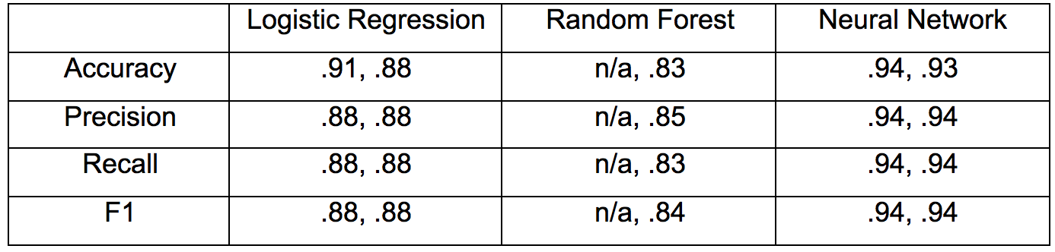
summary
Neural network performs best among the three models. (The first digit in each cell represents training performance; the second captures test performance.)

Slide 17
Recommendations and Future work
Range of potential clients, including banks and medical facilities
Use neural networks for image detection
Best accuracy in stable model
Less computationally intensive than logistic regression was
Future work: deep learning (more hidden layers)

Slide 18
references
1. F. Pedregosa, G. Varoquaux, A. Gramfort, V. Michel, B. Thirion, O. Grisel, M. Blondel, P. Prettenhofer, R. Weiss, V. Dubourg, J. Vanderplas, A. Passos, D. Cournapeau, M. Brucher, M. Perrot, and E. Duchesnay. “Scikit-learn: Machine Learning in Python.” Journal of Machine Learning Research, vol. 12, pages 2825-2830, 2011.
“MNIST for ML Beginners,” Tensorflow.org. <https://www.tensorflow.org/get_started/mnist/beginners#about_this_tutorial>. Last updated August 17, 2017.

