Slide 1
Sig • Mal
Meeting 8

Slide 2
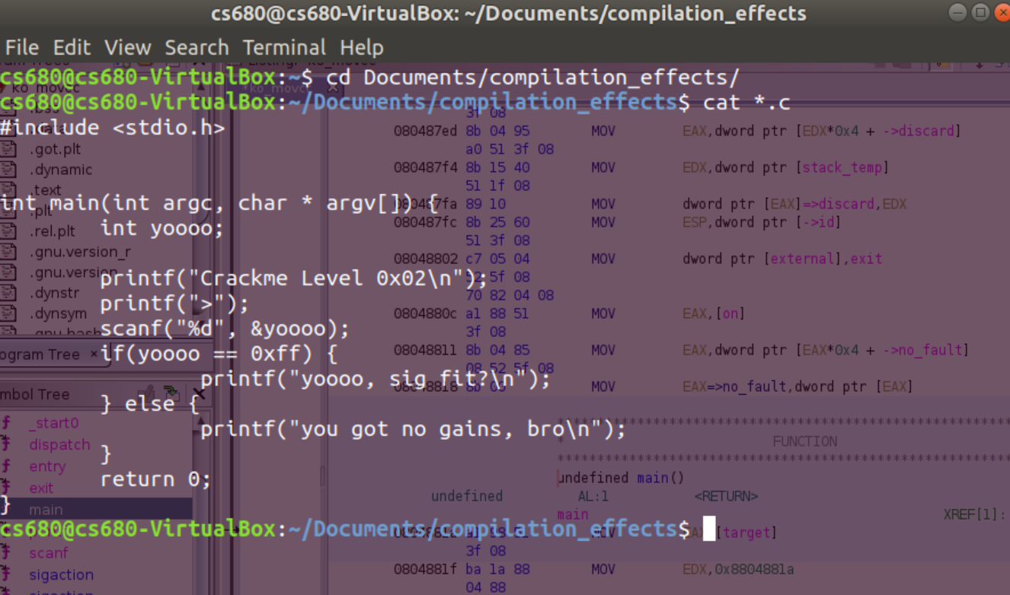
crackme0x02

Slide 3
Different Decompilation Methods
GCC / G++ → GNU C Compiler
Clang → is a compiler front end for the C, C++, Objective-C and Objective-C++ programming languages, as well as the OpenMP, OpenCL, RenderScript, CUDA and HIP frameworks. It uses the LLVM compiler infrastructure as its back end and has been part of the LLVM release cycle since LLVM 2.6
MOVCC → movfuscator for reversing
Distcc → tool for speeding up compilation of source code by using distributed computing over a computer network. With the right configuration, distcc can dramatically reduce a project's compilation time

Slide 4
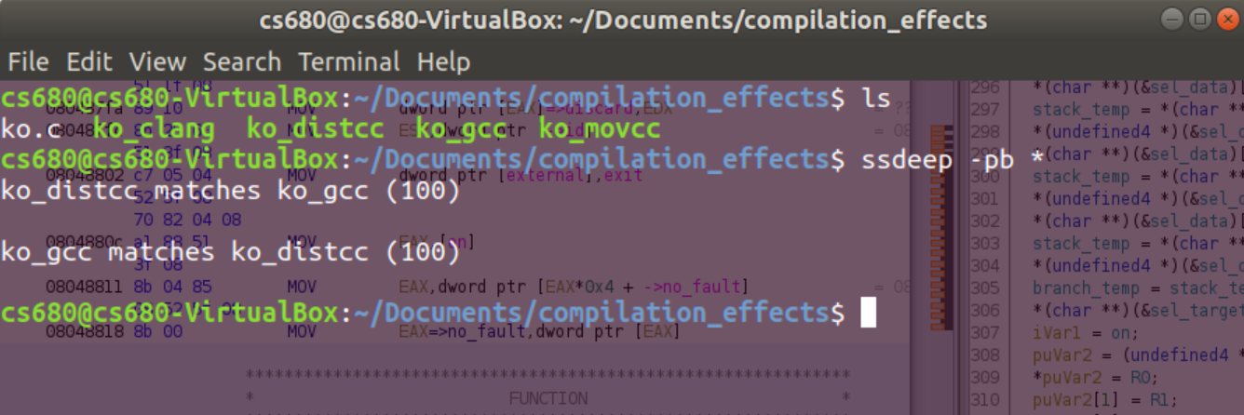
Application for Fuzzy Hashing
Let’s use our boy, ssdeep
>> ssdeep -pb *

Slide 5
Compilation Methods (CLICK ME)
GCC
CLANG
MOVCC
DISTCC

Slide 6
Hypotheticals Hacks
ServiceMain
In software, normally you write functions names that provide useful information
So your ‘program’ doesn’t run so then Hypothetically...
→ Check Microsoft Documentation → Learn that in order to run a program as a service, define a ‘ServiceMain’ function → The presence of an exported function function called ‘ServiceMain’ tells you that your software runs as part of a service

Slide 7
LIVE DEMO TIME

