Slide 1
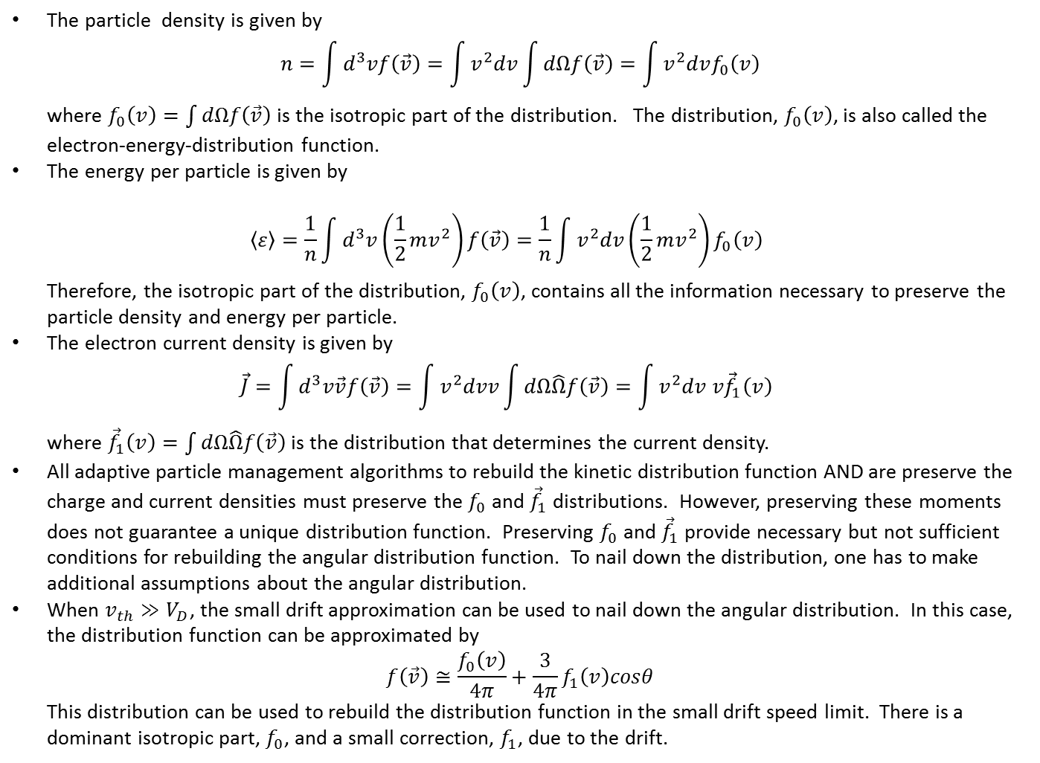
The particle density is given by
$$n=\int{d^{3}vf\left(\vec{v}\right)}=\int{v^{2}dv\int{dΩf\left(\vec{v}\right)}}=\int{v^{2}dvf_{0}\left(v\right)}$$
where $f_{0}\left(v\right)=\int{dΩf\left(\vec{v}\right)}$ is the isotropic part of the distribution. The distribution, $f_{0}\left(v\right)$, is also called the electron-energy-distribution function.
The energy per particle is given by
$$\left\langle ε\right\rangle =\frac{1}{n}\int{d^{3}v\left(\frac{1}{2}mv^{2}\right)f\left(\vec{v}\right)=\frac{1}{n}\int{v^{2}dv\left(\frac{1}{2}mv^{2}\right)f_{0}\left(v\right)}}$$
Therefore, the isotropic part of the distribution, $f_{0}\left(v\right)$, contains all the information necessary to preserve the particle density and energy per particle.
The electron current density is given by
$$\vec{J}=\int{d^{3}v\vec{v}f\left(\vec{v}\right)}=\int{v^{2}dvv\int{dΩ\hat{Ω}f\left(\vec{v}\right)}}=\int{v^{2}dv v{\vec{f}}_{1}\left(v\right)}$$
where ${\vec{f}}_{1}\left(v\right)=\int{dΩ\hat{Ω}f\left(\vec{v}\right)}$ is the distribution that determines the current density.
All adaptive particle management algorithms to rebuild the kinetic distribution function AND are preserve the charge and current densities must preserve the $f_{0}$ and ${\vec{f}}_{1}$ distributions. However, preserving these moments does not guarantee a unique distribution function. Preserving $f_{0}$ and ${\vec{f}}_{1}$ provide necessary but not sufficient conditions for rebuilding the angular distribution function. To nail down the distribution, one has to make additional assumptions about the angular distribution.
When $v_{th}≫V_{D}$, the small drift approximation can be used to nail down the angular distribution. In this case, the distribution function can be approximated by
$$f\left(\vec{v}\right)≅\frac{f_{0}\left(v\right)}{4π}+\frac{3}{4π}f_{1}\left(v\right)cosθ$$
This distribution can be used to rebuild the distribution function in the small drift speed limit. There is a dominant isotropic part, $f_{0}$, and a small correction, $f_{1}$, due to the drift.

