Slide 3
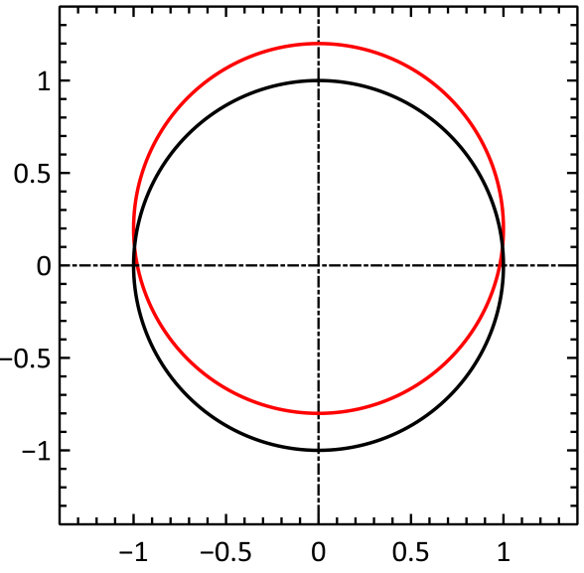
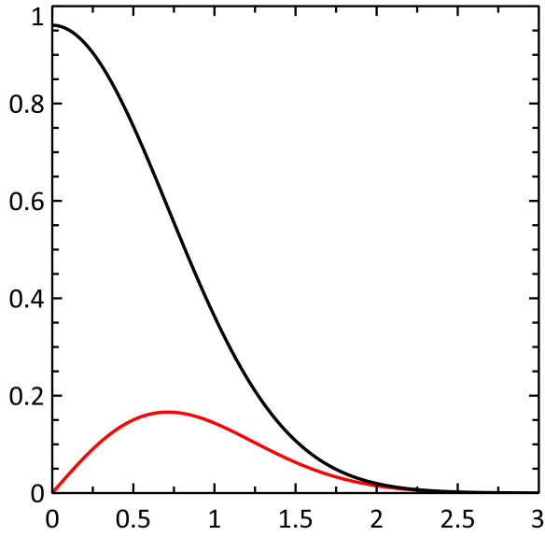
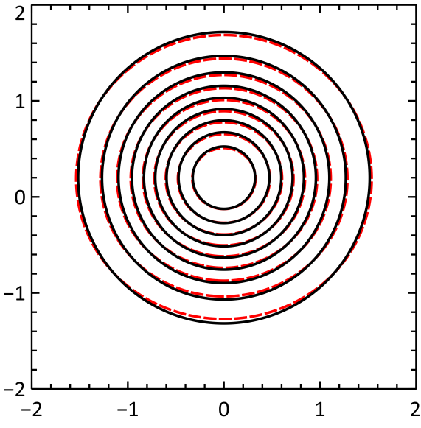












a)
$$\frac{f_{0}}{4πA}$$
$$\vec{v}/v_{0}$$
$${\vec{v}}_{D}/v_{0}$$
$$α$$
$${\vec{v}}_{0}/v_{0}$$
$$f\left(v\right)$$
$$v_{z}/v_{0}$$
$$\frac{3f_{1}}{4πA}$$
$$v_{x}/v_{0}$$
$$v/v_{th}$$
b)
$$v_{z}/v_{th}$$
$$v_{x}/v_{th}$$

Slide 4
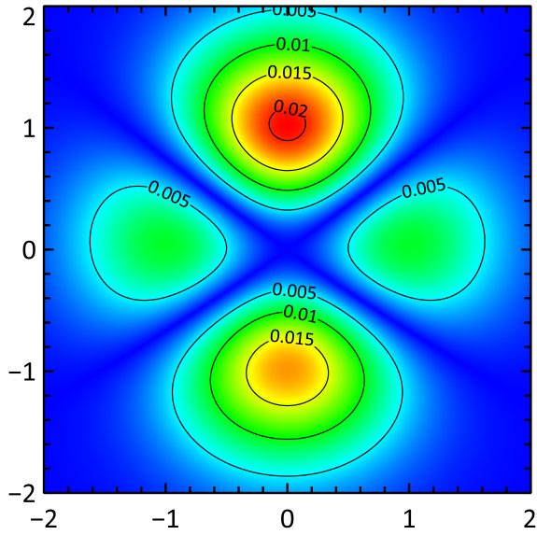
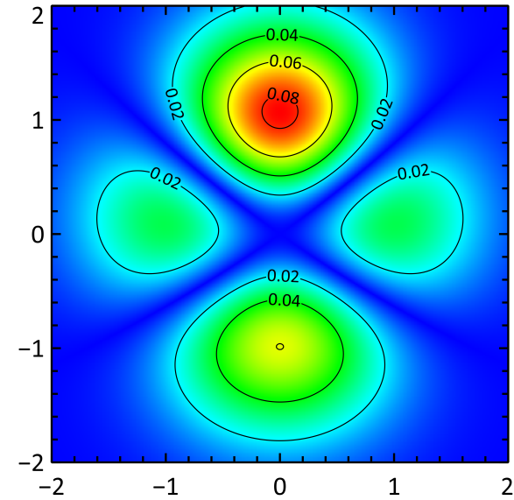



a)
$$v_{z}/v_{th}$$
b)
$$v_{z}/v_{th}$$
$$v_{x}/v_{th}$$

Slide 5
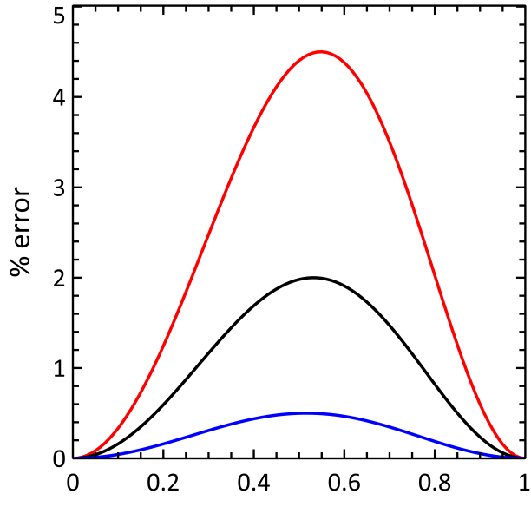






$\left|\vec{v}\right|$/$v_{0}$
a)
$\left|{\vec{v}}_{0} \right|$/$v_{0}$
$v_{D}\text{/}v_{0}$=0.3
b)
$v_{D}\text{/}v_{0}$=0.2
$v_{D}\text{/}v_{0}$=0.1
$$α/π$$

Slide 6
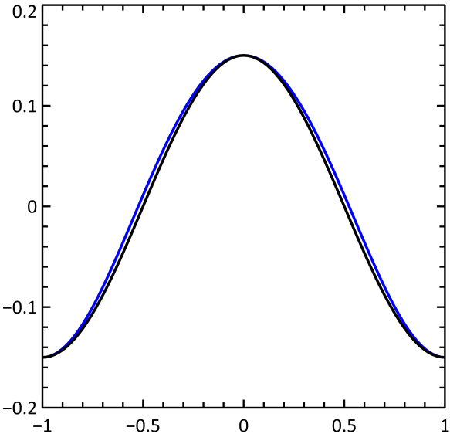
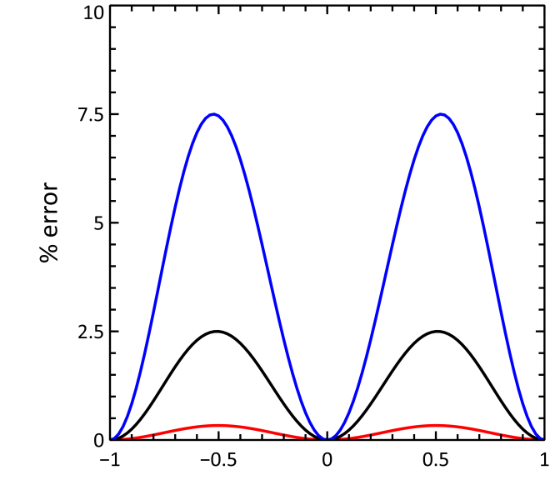


$\left|Δ\vec{v}\right|$/$v_{0}$
0.15
0.05
0.01
$$α/π$$

