Slide 1
ARealm

Slide 2


Slide 3
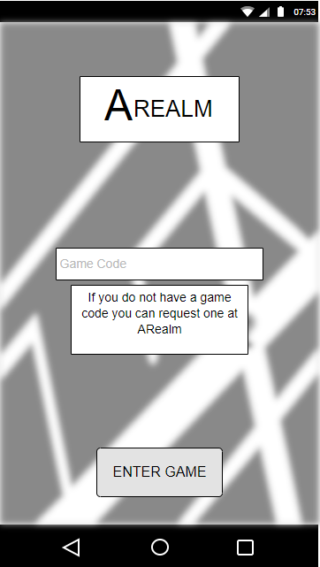
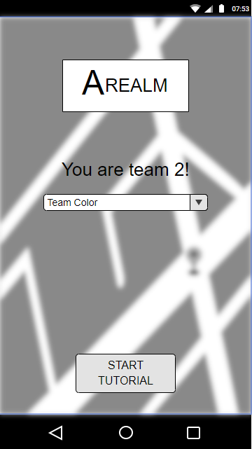
Start scherm
Setup scherm

Slide 4
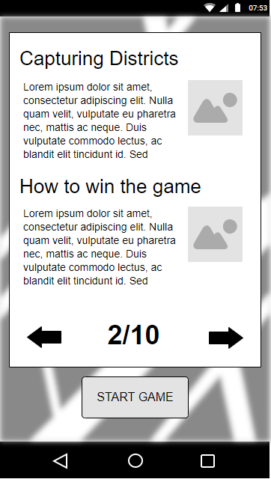
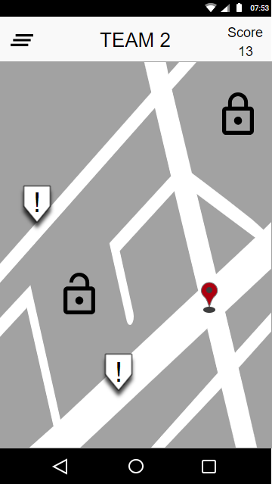
Tutorial
Spelmap

Slide 5
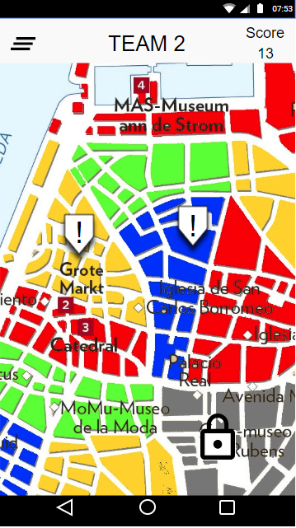
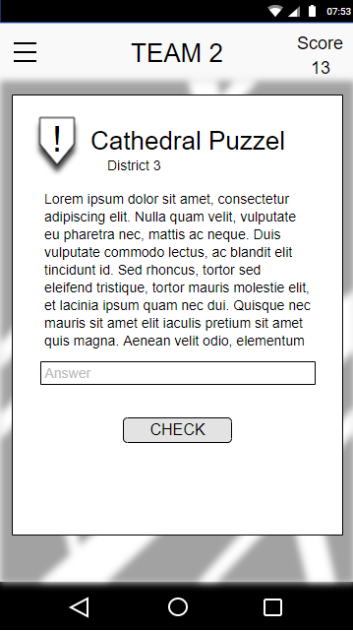
Map overview
Opdrachten

Slide 6
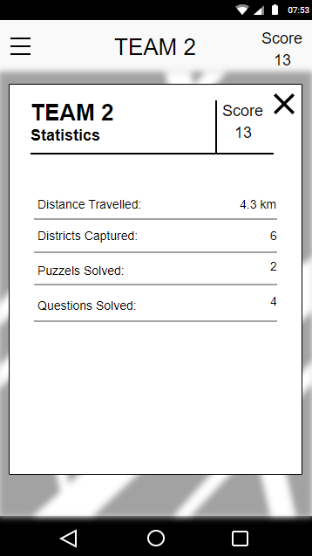
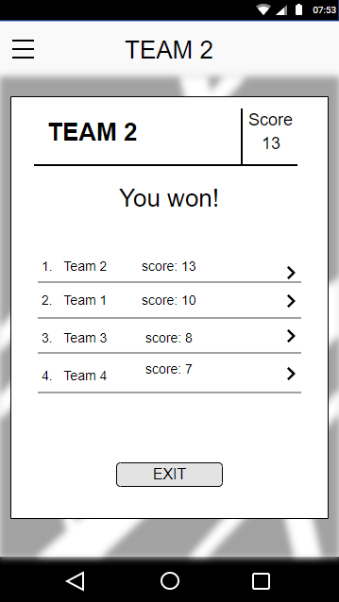
Statistieken
Eind scherm

Slide 7



Analyse
Websocket/HTTP
ASP NET MVC core + EF
Ionic
Azure

Slide 8
JIRA
https://jira.ap.be/secure/RapidBoard.jspa?rapidView=234&projectKey=CA18AR&view=planning&selectedIssue=CA18AR-42&epics=visible

Slide 9
Bedankt

