Slide 1

Methoden overloaden

Slide 2
Method overloading
static void Main(string[] args)
{
Console.WriteLine(ComputeArea(5, 6));
}
static int ComputeArea(int h, int w)
{
int sq = h*w;
return sq;
}
What if you want to compute area of a circle?

Slide 3
Overloading Methods
When you overload a C# method:
You write multiple methods with a shared name
Compiler understands your meaning based on the arguments you use with the method
Methods are overloaded correctly when:
They have the same identifier (=methodname) and returntime but parameter lists are different

Slide 4
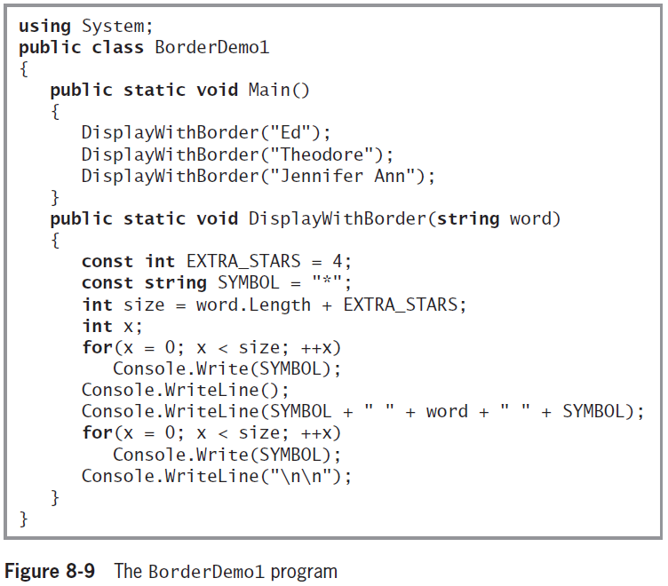
Overloading Methods (cont'd.)

Slide 5
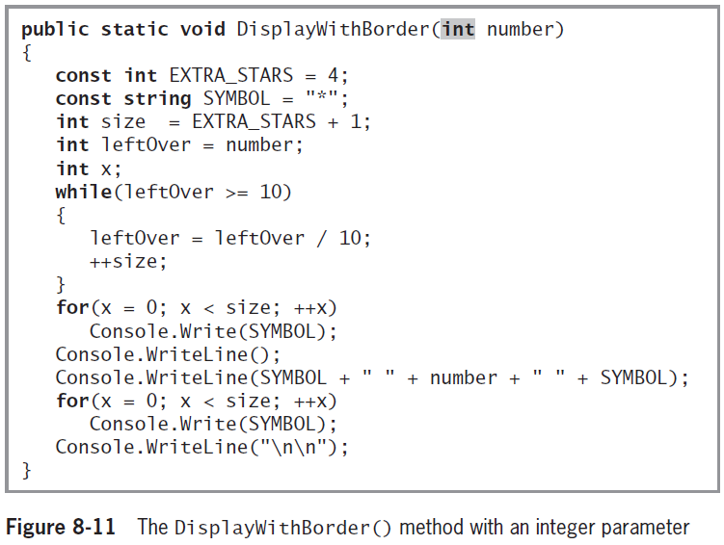
Overloading Methods (cont'd.)

Slide 6
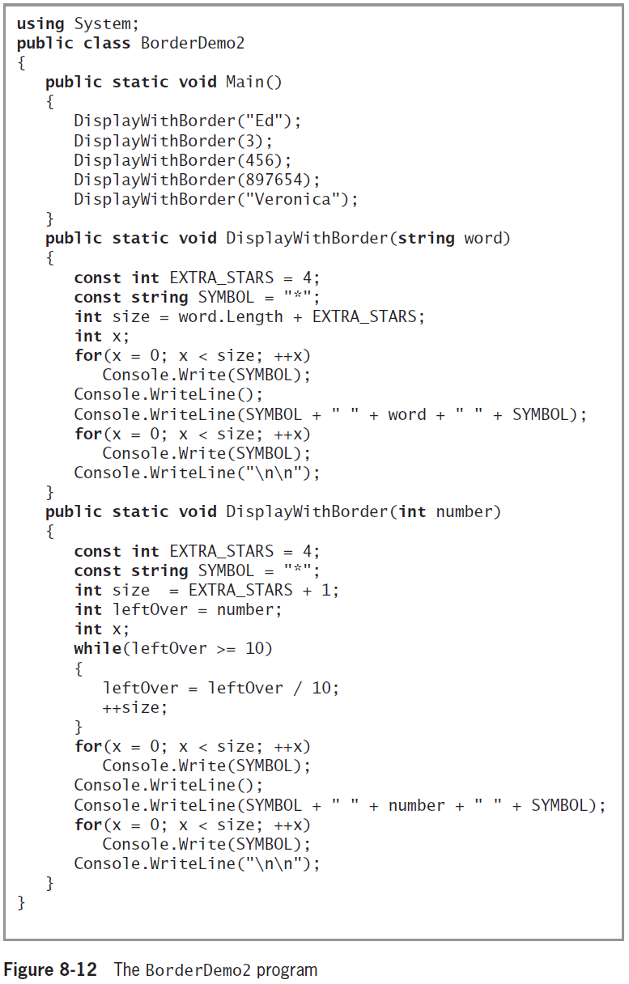

Slide 7
Method overloading
static void Main(string[] args)
{
Console.WriteLine($"Rechthoek: {ComputeArea(5, 6)}");
Console.WriteLine($"Circle: {ComputeArea(7)}");
}
static int ComputeArea(int h, int w)
{
int sq = h*w;
return sq;
}
static int ComputeArea(int radius)
{
int sq =(int) (Math.PI*radius*radius);
return sq;
}

Slide 8

Method overloading
static void Main(string[] args)
{
Console.WriteLine($"Rechthoek: {ComputeArea(5, 6)}");
Console.WriteLine($"Circle: {ComputeArea(7)}");
}
static int ComputeArea(int h, int w)
{
int sq = h*w;
return sq;
}
static int ComputeArea(int radius)
{
int sq =(int) (Math.PI*radius*radius);
return sq;
}

Slide 9
Understanding Overload Resolution
Overload resolution
Used by C# to determine which method to execute when a method call could execute multiple overloaded method
Applicable methods
Set of methods that can accept a call with a specific list of arguments
Betterness rules
Rules that determine which method version to call
Similar to the implicit data type conversion rules

Slide 10

Betterness rule
static void Main(string[] args)
{
Console.WriteLine($"Circle 1: {ComputeArea(7)}");
Console.WriteLine($"Circle 2: {ComputeArea(7.5)}");
Console.WriteLine($"Circle 3: {ComputeArea(7.3f)}");
}
static int ComputeArea(int radius)
{
int sq =(int) (Math.PI*radius*radius);
return sq;
}
static int ComputeArea(double radius)
{
int sq = (int)(Math.PI * radius * radius);
return sq;
}

Slide 11
Betterness rule
static void Main(string[] args)
{
Console.WriteLine($"Circle 1: {ComputeArea(7)}");
Console.WriteLine($"Circle 2: {ComputeArea(7.5)}");
Console.WriteLine($"Circle 3: {ComputeArea(7.3f)}");
}
static int ComputeArea(int radius)
{
int sq =(int) (Math.PI*radius*radius);
return sq;
}
static int ComputeArea(double radius)
{
int sq = (int)(Math.PI * radius * radius);
return sq;
}

Slide 12
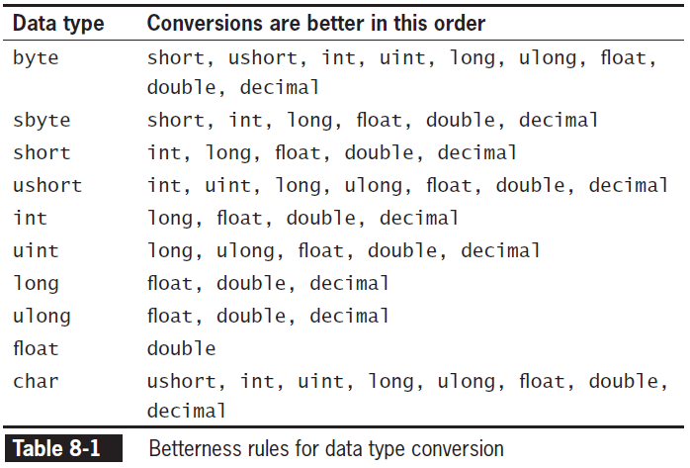
Understanding Overload Resolution (cont'd.)
Example: if you pass an int to a method. The method that allows a long will be prefered to float, etc.

Slide 13
But…
static void Main(string[] args)
{
Toonverhouding(5, 3.4);
Toonverhouding(6.2, 3);
}
static void Toonverhouding(int a, double b)
{
Console.WriteLine($"{a}/{b}");
}
static void Toonverhouding(double a, int b)
{
Console.WriteLine($"{a}/{b}");
}

Slide 14

But…
static void Main(string[] args)
{
Toonverhouding(5, 3.4);
Toonverhouding(6.2, 3);
}
static void Toonverhouding(int a, double b)
{
Console.WriteLine($"{a}/{b}");
}
static void Toonverhouding(double a, int b)
{
Console.WriteLine($"{a}/{b}");
}
The first parameter that fits and so on…

Slide 15

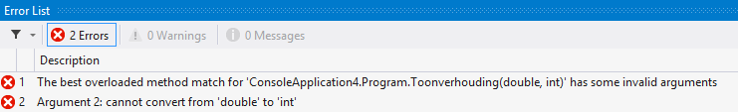
Ambigious overload
static void Main(string[] args)
{
Toonverhouding(5.6, 3.4);
}
static void Toonverhouding(int a, double b)
{
Console.WriteLine("{0}/{1}", a, b);
}
static void Toonverhouding(double a, int b)
{
Console.WriteLine("{0}/{1}", a, b);
}
Ambiguous method
Compiler cannot determine which method to use
Occurs when you overload methods

Slide 16

Different Return times
Methods with identical names that have identical parameter lists but different return types
Are not overloaded

